Slide 1

Airbnb Data Science Project
For CSC 6740

Slide 2
AIRBNB- PREDICT PRICE FOR EXISTING LISTINGS
Manjusha Roy CHOUDHURY

Slide 3
PREPROCESSING DATA BEFORE USE
dropped certain columns that HAD NO VALUES ATALL
"neighbourhood_group_cleansed", "bathrooms", "calendar_updated", "license", "neighbourhood"
DROPPED COLUMNS WHICH WERE Completely EMPTY or MORE THAN 9000(1/3) VALUES MISSING.
"host_response_time", "host_response_rate", "host_acceptance_rate", "host_neighbourhood"

Slide 4
Handling Missing Values

Slide 5
REPLACING MISSING VALUES WITH MEAN AND MODE.
SUBSTITUED THE VALUES OF CERTAIN COLUMN VALUES WITH THE MODE
host_since', 'host_is_superhost', 'host_location', 'host_listings_count', 'host_total_listings_count', 'host_identity_verified', 'bedrooms', 'beds', 'bathrooms_text'
SUBSTITUED THE VALUES OF CERTAIN COLUMN VALUES WITH THE MEAN.
'review_scores_accuracy','review_scores_cleanliness', 'review_scores_checkin','review_scores_communication','review_scores_location', 'review_scores_value'

Slide 6
GETTING RID OF CERTAIN RECORDS
Records with missing RATING
VALUES WERE DELETED SINCE
RATING CAN BE AN IMPORTANT FACTOR IN DETERMING PRICE

Slide 7
CERTAIN DERIVED COLUMNS
HOST_SINC_DERIVED = PRESENT DATE-HOST_SINCE
FIRST_REVIEW_DERIVED= PRESENT DATE-FIRST_REVIEW
LAST_REVIEW_DERIVED= PRESENT DATE-FIRST_LAST
CALENDAR_LAST_SCRAPED_
DERIVED= PRESENT DATE-CALENDAR_LAST_SCRAPED

Slide 8
CERTAIN DERIVED COLUMNS
converting certain columns to label encoders – 0 FOR MiSSING VALUE, 1 IF VALUE IS PRESENT
'description','neighborhood_overview' , 'host_about', 'host_name', 'host_has_profile_pic', 'host_thumbnail_url', 'host_picture_url’
convert ‘HOST_LOCATION’ To 0 IN CASE HOST RESIDES OUTSIDE AMSTERDAM OTHERWISE 1.

Slide 9
CERTAIN DERIVED COLUMNS
converting LATITUDE AND LONGITUDE TO DISTANCE FROM BERLIN BY FINDING HAVERSINE DISTANCE'
Convert CERTAIN COLUMNS CONTAINING MORE THAN 2 CATEGORIES TO NUMERIC COLUMNS USING BACKWARD DIFFERENCE ENCODER FOR NOMINAL VALUES
‘ROOM_TYPE’. ‘PROPERTY_TYPE’, ‘BATHROOM_TEXT’

Slide 10
FINAL LIST OF FEATURES
'description', 'neighborhood_overview', 'host_name', 'host_about’,
'host_is_superhost', 'host_thumbnail_url', 'host_picture_url’,
'host_listings_count', 'host_has_profile_pic', 'host_identity_verified’,
'property_type(0-60)', 'room_type(0-2)', 'accommodates', 'bathrooms_text(0-23)', 'bedrooms’,
'beds', 'price', 'minimum_nights', 'maximum_nights', 'has_availability’,
'availability_30', 'availability_60', 'availability_90', 'availability_365’,
'number_of_reviews', 'number_of_reviews_ltm', 'number_of_reviews_l30d’,
'review_scores_rating', 'review_scores_accuracy', 'review_scores_cleanliness’,
'review_scores_checkin', 'review_scores_communication', 'review_scores_location’,
'review_scores_value', 'instant_bookable', 'calculated_host_listings_count’,
'calculated_host_listings_count_entire_homes’,
'calculated_host_listings_count_private_rooms’,
'calculated_host_listings_count_shared_rooms', 'reviews_per_month’,
'host_since_derived', 'calendar_last_scraped_derived', 'first_review_derived’,
'last_review_derived', 'host_location_derived', 'distancefromberlin']

Slide 11
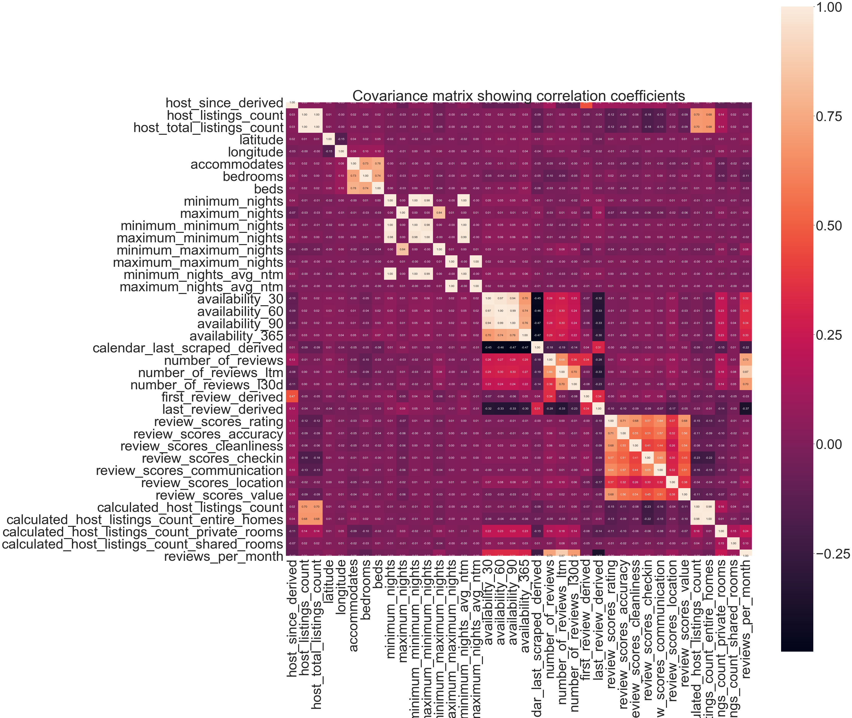
CORRELATION PLOT-HIGHLY CORRELATED (>75%) WERE replaced by one of the features

Slide 12
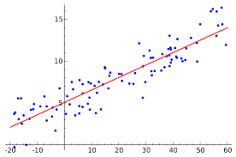
Part A: LINEAR REGRESSION (PREDICTING PRICE FOR NEW AIRBNB LISTINGS)
STANDARDIZED ALL INDEPENDENT VARIABLES.
CHECKED THE INPUT SPREAD Using SEABORN PAIR PLOTS.

Slide 13
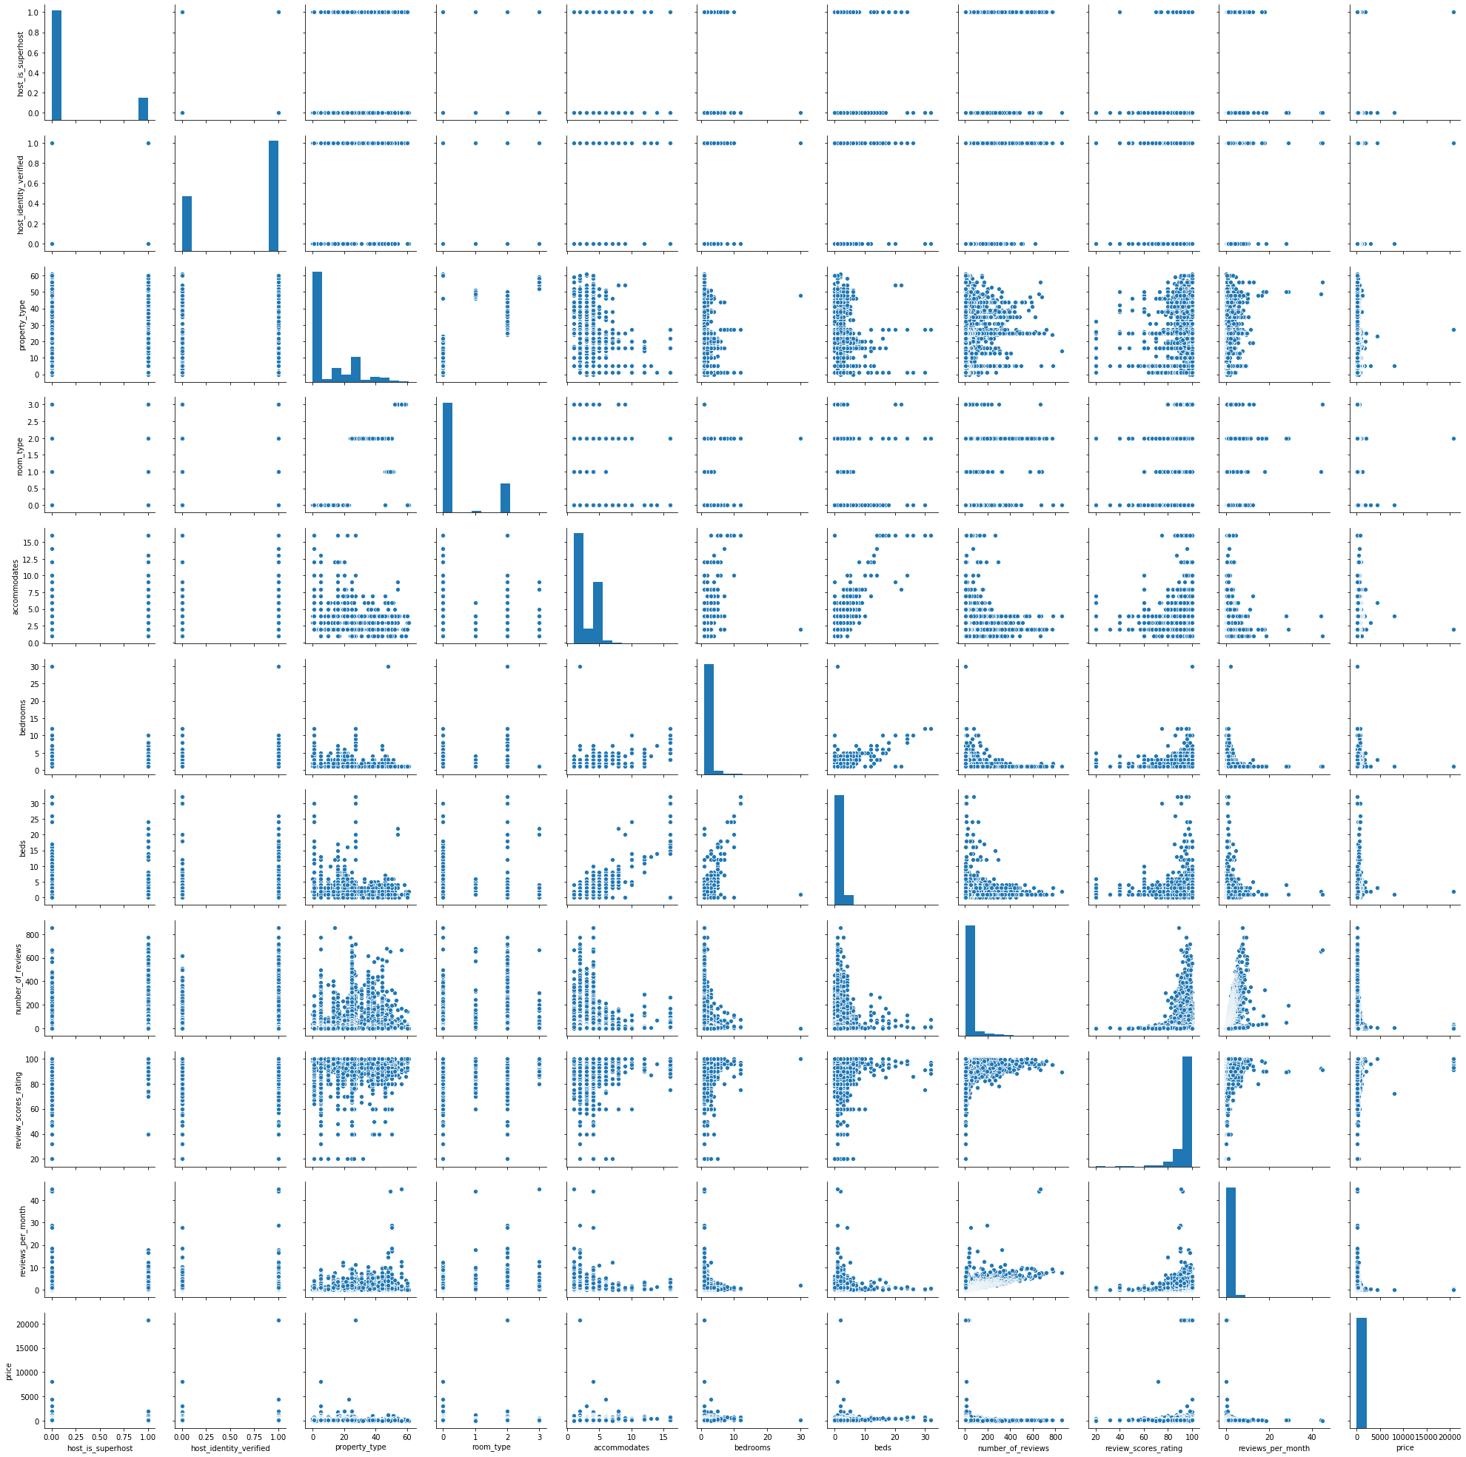
PAIR PLOTS TO UNDERSTAND THE RELATIONSHIP BETWEEN
THE FEATURES

Slide 14
PERFORMANCE OF THE MODEL IN PREDICTING PRICE
OLS Regression Results
==============================================================================
Dep. Variable: y R-squared: 0.543
Model: OLS Adj. R-squared: 0.540
Method: Least Squares F-statistic: 153.1
Date: Sat, 12 Dec 2020 Prob (F-statistic): 0.00
Time: 05:49:59 Log-Likelihood: -1.1917e+05
No. Observations: 16351 AIC: 2.386e+05
Df Residuals: 16224 BIC: 2.396e+05
Df Model: 126
Covariance Type: nonrobust
This model is not suitable

Slide 15
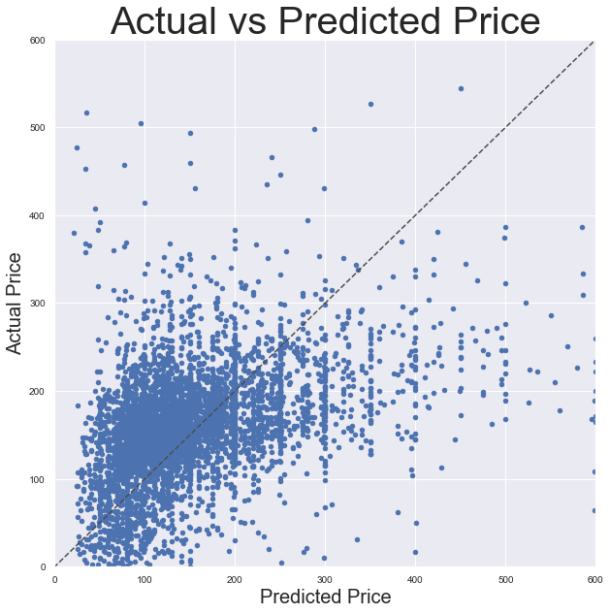
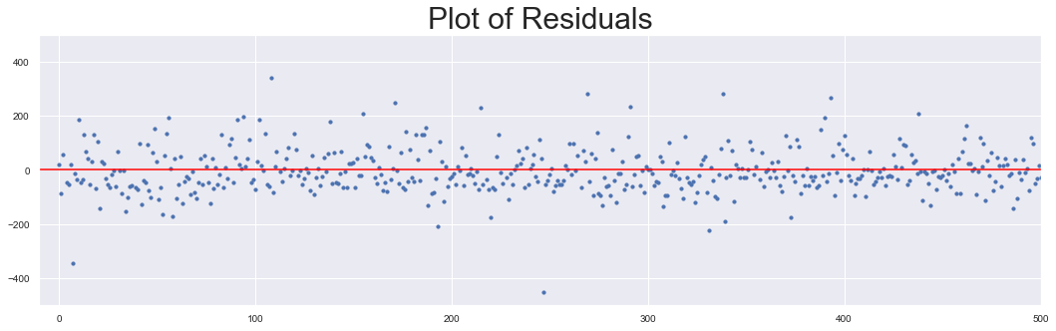
NOT A GOOD CHOICE FOR PRICE
PREDICTION IN THIS CASE
Mean absolute error: 106.53
Mean squared error: 106.53
Root Mean Squared error: 10.32

Slide 16
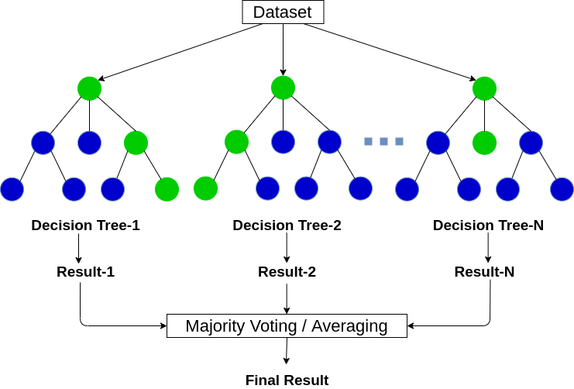
Part A: RANDOM FOREST (PREDICTING PRICE FOR NEW AIRBNB LISTINGS)
STANDARDIZED ALL INDEPENDENT VARIABLES.
CHECKED THE INPUT SPREAD Using SEABORN PAIR PLOTS.

Slide 17
RANDOM FOREST MODEL -1 USING THE 132 FEATURES FROM THE LINEAR REGRESSION MODEL

Slide 18
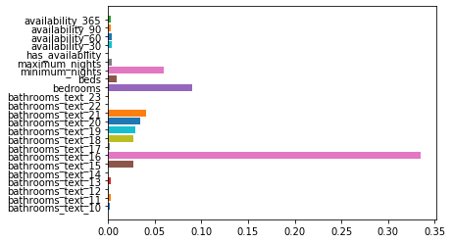
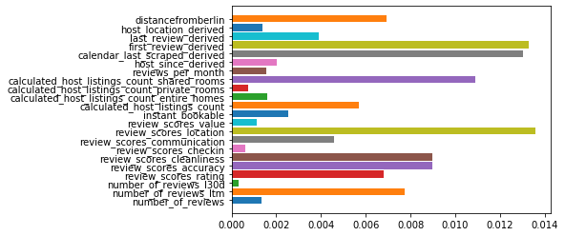
Feature IMPORTANCE

Slide 19
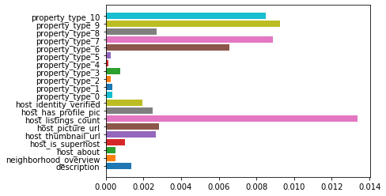
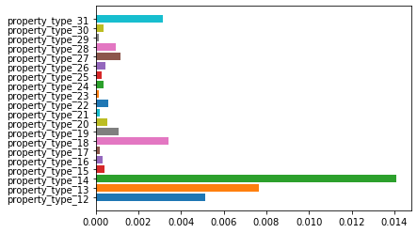
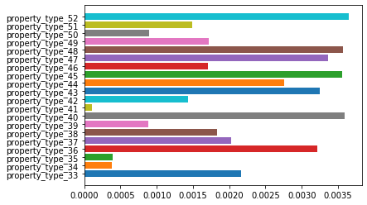
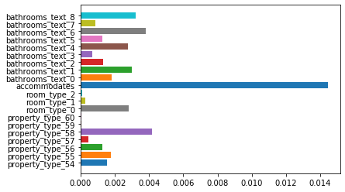

Slide 20
RandomForestRegressor(bootstrap=True, ccp_alpha=0.0, criterion='mse',
max_depth=None, max_features='auto', max_leaf_nodes=None,
max_samples=None, min_impurity_decrease=0.0,
min_impurity_split=None, min_samples_leaf=1,
min_samples_split=2, min_weight_fraction_leaf=0.0,
n_estimators=300, n_jobs=None, oob_score=False,
random_state=0, verbose=0, warm_start=False)
Mean Squared Error 73556.46
Root Mean Squared Error 272.21
Mean Absolute Error 56.98
R^2 Training Score: 0.96
R^2 Validation Score: 0.70

Slide 21
RANDOM FOREST MODEL -2 USING THE 137 FEATURES ADDED BACK FEATURES lIKE 'host name, 'minimum minimum nights','maximum minimum nights','minimum maximum nights','maximum maximum nights'

Slide 22
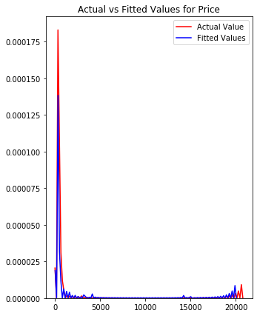
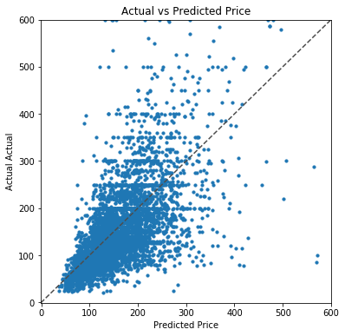

Slide 23
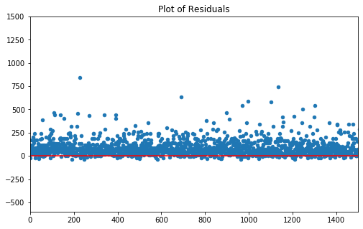

Slide 24
RANDOM FOREST PARAMETERS USED
RandomForestRegressor(bootstrap=True, ccp_alpha=0.0, criterion='mse',
max_depth=None, max_features='auto', max_leaf_nodes=None,
max_samples=None, min_impurity_decrease=0.0,
min_impurity_split=None, min_samples_leaf=1,
min_samples_split=2, min_weight_fraction_leaf=0.0,
n_estimators=300, n_jobs=None, oob_score=False,
random_state=0, verbose=0, warm_start=False)
Mean Squared Error 32039.61
Root Mean Squared Error 178.96
Mean Absolute Error 54.3
R^2 Training Score: 0.97
R^2 Validation Score: 0.87

Slide 25
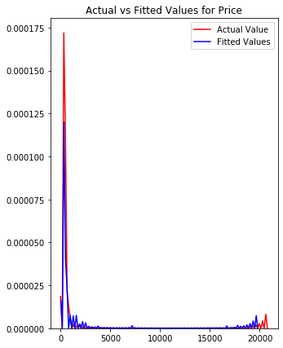
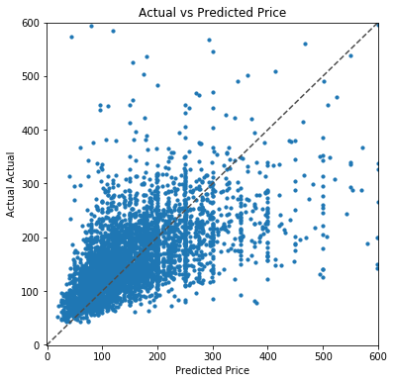

Slide 26
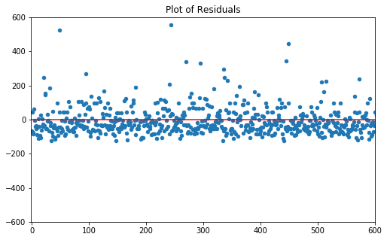

Slide 27
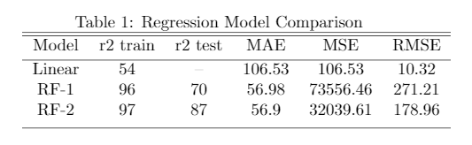
TABLE OF COMPARISON OF THE DIFFERENT REGRESSION METHODS

Slide 28
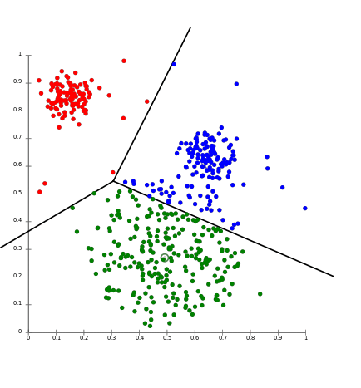
PaRT b: classifying the listings into GOOD, Average and Poor Deals
Using k-Means clustering technique

Slide 29
LABEL THE CLUSTERS AS GOOD DEALS, AVERAGE AND poor DeaLS

Slide 30
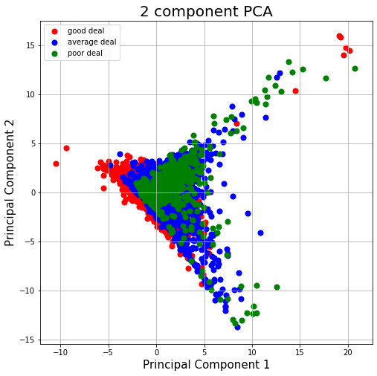
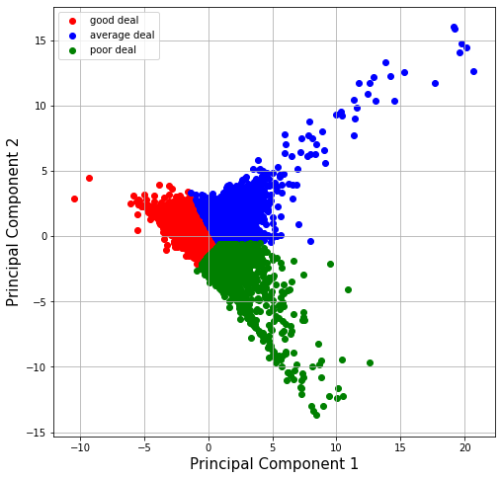
PCA clustering color encoded by deal score
(price/review_score_rating)
K-means clustering color encoded by understanding
And going through dataset

Slide 31
COLOR CODING K-MEANS PLOT BASED ON CAREFUL
EVALUATION OF THE LISTINGS
host_since_derived | host_location_derived | host_is_superhost | host_listings_count | host_has_profile_pic | host_identity_verified | distancefromberlin | accommodates | ... | minimum_nights | has_availability | calendar_last_scraped_derived | number_of_reviews | review_scores_rating | review_scores_accuracy | review_scores_cleanliness | reviews_per_month | price | K-mean
4461.573215 | 1 | 1 | 1 | 1 | 1 | 573.58 | 2 | ... | 3 | 0 | 92.573215 | 278 | 98 | 10.0 | 10.0 | 1.99 | 59.0 | 0
4027.573215 | 1 | 0 | 2 | 1 | 1 | 576.82 | 2 | ... | 1 | 0 | 93.573215 | 340 | 89 | 10.0 | 10.0 | 2.65 | 216.0 | 0
4039.573215 | 0 | 1 | 2 | 1 | 0 | 577.43 | 3 | ... | 14 | 0 | 93.573215 | 5 | 100 | 10.0 | 10.0 | 0.16 | 125.0 | 0
3916.573215 | 1 | 1 | 1 | 1 | 1 | 576.72 | 2 | ... | 2 | 0 | 92.573215 | 219 | 99 | 10.0 | 10.0 | 2.07 | 141.0 | 0
3865.573215 | 1 | 1 | 2 | 1 | 1 | 576.98 | 2 | ... | 2 | 0 | 92.573215 | 334 | 97 | 10.0 | 10.0 | 2.73 | 75.0 | 0
3865.573215 | 1 | 1 | 2 | 1 | 1 | 576.93 | 1 | ... | 2 | 0 | 92.573215 | 481 | 95 | 10.0 | 10.0 | 4.16 | 55.0 | 0
3851.573215 | 1 | 0 | 1 | 1 | 1 | 580.02 | 4 | ... | 3 | 0 | 92.573215 | 32 | 95 | 9.0 | 10.0 | 0.29 | 219.0 | 1
3794.573215 | 1 | 1 | 1 | 1 | 1 | 577.39 | 3 | ... | 4 | 0 | 93.573215 | 89 | 96 | 10.0 | 10.0 | 0.75 | 160.0 | 0
3785.573215 | 1 | 0 | 0 | 1 | 1 | 577.01 | 4 | ... | 3 | 0 | 91.573215 | 60 | 98 | 10.0 | 7.0 | 5.54 | 211.0 | 1
4007.573215 | 1 | 0 | 1 | 1 | 0 | 579.08 | 2 | ... | 30 | 0 | 92.573215 | 61 | 80 | 8.0 | 7.0 | 0.51 | 79.0 | 2
10 rows × 22 columns
Good
Deal
Average
Deal
Poor
Deal

Slide 32
How to make it useful for CUSTOMERS-PLOT ON THE MAP!

Slide 33
THANK YOU!

