Slide 1
SLIDE 1 OF 3
Test Prompt without plan
Generated from prompt
Generated from prompt

Slide 2
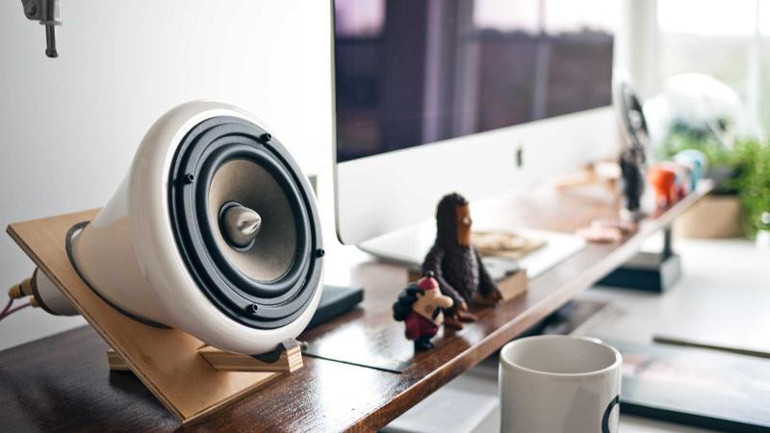
SLIDE 2 OF 3
Key Points
Key Points

Slide 3
SLIDE 3 OF 3
Introduction
Introduction

