Slide 1

Portfolio Overview and Stock Recommendations
By: Partha Sarathi Sahoo

Slide 2
Problem background
1. To provide consultation to two different investors, Mr Patrick Jyenger and Mr Peter Jyenger based on their requirements and financial objectives.
2. Analyze 24 different stocks compare different metrics with the metrics of SnP500 and suggest two different portfolios for the two investors.
3. Estimate the prices of the of the portfolio in future and validate if they have the potential to fulfil the financial goals set by the investor.

Slide 3
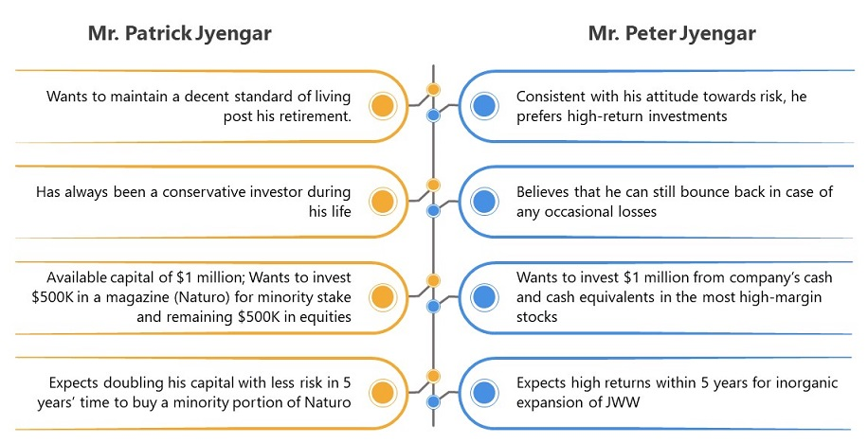
Investor Profile - I

Slide 4
Investor Profile - I
After looking at the profile of Mr Partick Jyenger, we can jot down the below points
the priority of the portfolio should be lowering the risk
we can select a portfolio, for which risk should be in the zone of lower-mid 20s
we should select a portfolio with stocks at least from 2 different sectors to limit the industry risk
2. After looking at the profile of Mr Peter Jyenger, we can jot down the below points
the priority of the portfolio should be the profit
we can select a portfolio, for which the return should be maximum possible

Slide 5
Interactive Dashboard

Slide 6
Introduction to the dashboard
I have created a tableau interactive dashboard which helps in understanding different trends and other details about different stocks and industries.
Any single/multiple stock can be selected from the dashboard and the trends can be observed
We have 6 different charts in the dashboard
Stock Trend-wo Normalization – A simple plot of stock’s close prices against dates which shows a trend of companies progress over time
Stock Trend-w Normalization – A plot of stock’s normalized close prices against dates. This is very helpful when comparing 2 different stocks. Normalized price give clearer picture.
Monthly Return – This is a line graph which shows the monthly return of different stocks over the years
Dispersion From Mean – This is a histogram plot which shows the dispersion from mean price of the stock.
A chart where the chart is skewed towards the positive numbers or negative will imply that the stooks have high dispersion most of the time, thus implying high volatility
A inverted U-shaped chart with the middle nearing 0 will mean that the stock remains flat most of the time.
Cumulative Returns – This column chart shows all the stocks and their cumulative returns
Relative Strength – This column chart shows all the stocks and strength compared to SnP500 benchmark index.
We also have side widget in the dashboard which provide a simple summary of any single stock.

Slide 7
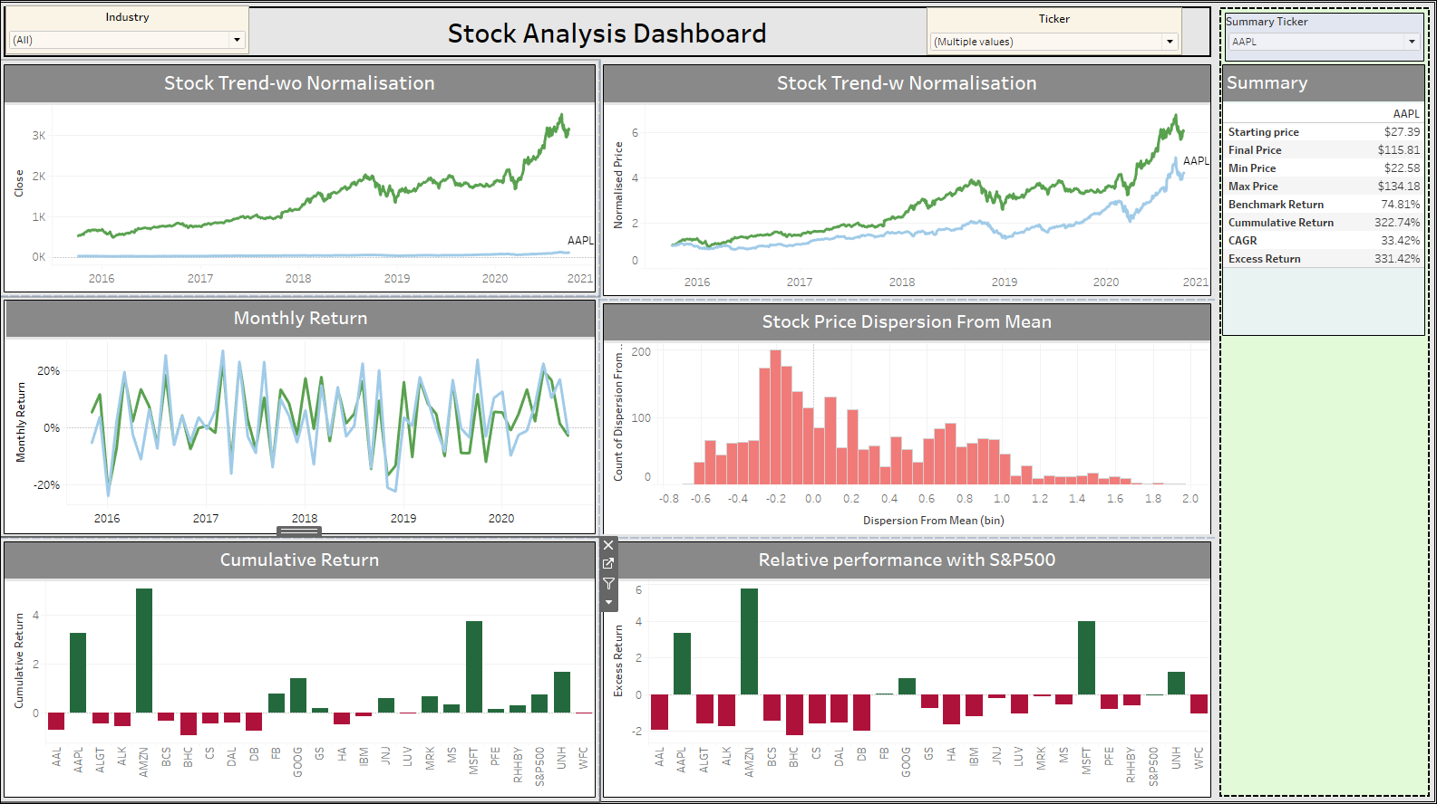
Interactive Dashboard

Slide 8
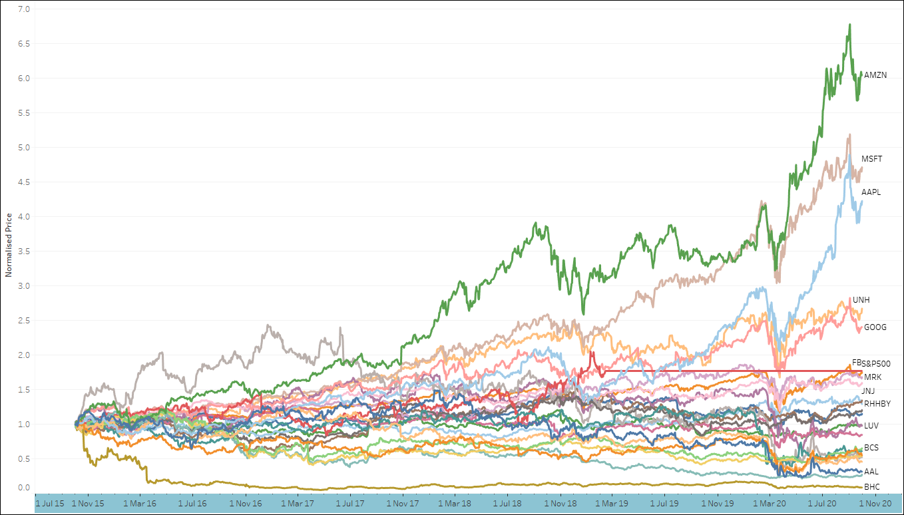
Trend Of Stock’s Normalized Price
We see that while most of the stocks have remained flat over the course of the last 5 years, a lot of technology stocks are booming.
Amazon, although volatile, has seen amazing growth in the last 5 years.
Other stocks like Microsoft, Apple and Google,UNH etc are booming as well

Slide 9
STOCK METRIC OBSERVATIONS

Slide 10
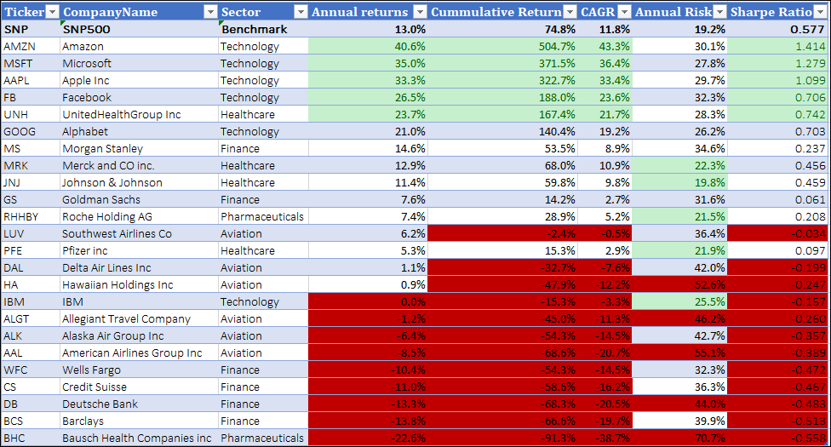
Different Metrics For Stocks - I

Slide 11
Different Metrics For Stocks - II
Just by looking at the metrics we can eliminate a lot of the stocks from consideration for our portfolio.
The Technology stocks perform well, but they come with higher risk as well
Amazon gives the highest returns and Johnson and Johnson comes with the least risk after the SnP500 benchmark index.
With the exception of Morgan Stanley and Goldman Sachs, Finance and Aviation sectors are performing poorly.

Slide 12
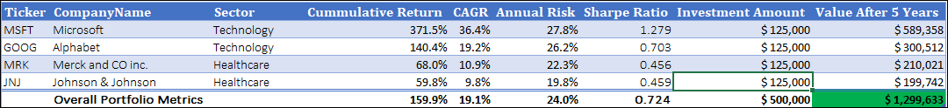
Suggested Portfolio for Mr. Partick Jyenger
I have selected 4 stocks here with a cumulative risk of 24.0% and cumulative return of 159.9%
The Sharpe ratio is a tad bit low with 0.724, but the risk is lowered at the same time.
Since the stocks are distributed across 4 different stocks with 2 stocks each from two different sectors, the industrial and
At the end of 5 years, we have the potential to generate 1.2 million dollars which meets Mr Patrick Jyenger’s requirement to double his money.

Slide 13
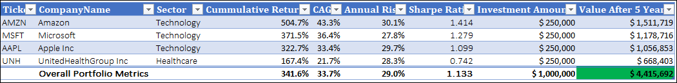
Suggested Portfolio for
Mr. Peter Jyenger
I selected the 4 of the top 5 best performing stocks for Mr Peter Jyenger and naturally we have 3 stocks from Technology sector
The risk of this portfolio is pretty high at 29.0%. But we get a handsome return of 341.6% on our investment at an CAGR of 33.7%.
At the end of 5 years, we have the potential to generate 4.4 million dollars which can be used for expansion of JWW
We could have simply gone with 3, 2 or even only 1 technology stocks and generated a higher return, but its recommended to go with at least one stock from other sector to offset the high sectoral risk.

Slide 14
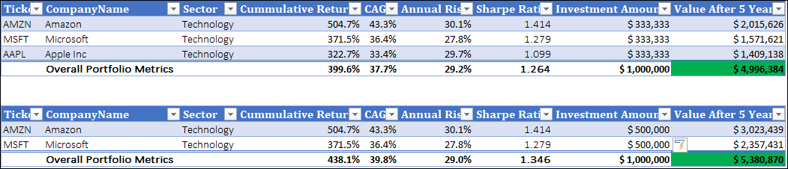
Alternative Portfolio for
Mr. Peter Jyenger and why they are not recommended
These alternative portfolios provide higher returns potential.
But while the annual risk look to be close, the industrial risk is very high in these cases as they are all technology stocks.
Naturally, you get even more returns if you invest in only AMZN. But the risk will be tremendous.

Slide 15
Appendix
We used Python to do all the numerical analysis on the 25 stock data
Then we used Tableau to create the interactive dashboard which can be used to change different options to view what other stock that can be suitable
There is a second dashboard in Tableau which shows the selected stocks. The numbers can be changed using the interactive slider in case you want to select more or less stocks.

Slide 16
THANK YOU

