Slide 1
Artificial Creativity
Movie Recommendation system
Devam Shah AU1841044
Parth Sarkhelia AU1841045
Nancy Radadia AU1841070
Varshil Shah AU1841095

Slide 2
Introduction
Our project aims around building a movie recommendation system based on Collaborative filtering.
Recommender systems can be loosely broken down into: content based systems, collaborative filtering systems and hybrid systems, out of which we are going for item based collaborative filtering systems.
In particular we look at implementing two algorithms of item based collaborative filtering which are K-Nearest Neighbours (KNN) and Alternating Least Squares (ALS).
This project uses movie-lens dataset or training the recommendation models which contains two files: movies.csv and rating.csv.
This dataset contain 9000 unique movies and 600 unique user . Total ratings in this dataset is around 300,000.

Slide 3
Problem Statement
Can we recommend a movie based on the users previous preference and rating ?
Can we recommend the movies based on given movie from the user ?
Can we perform accuracy and performance analysis for the implemented algorithms ?
Given similar type of users can we recommend the movies rated by one user to the other similar users?
Can we recommend a movie, given there’s not enough data about the movie such as cast, release year, genres etc. ?

Slide 4
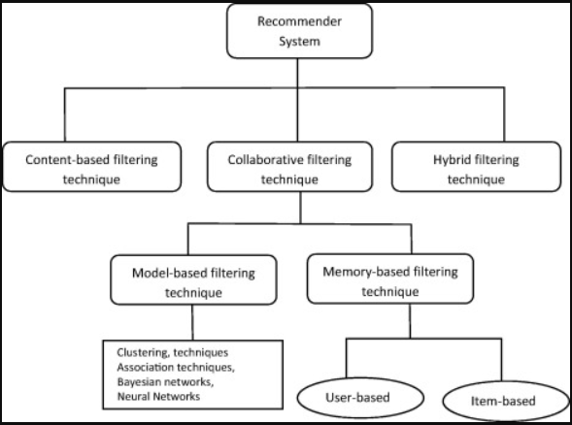
Existing body of Work
Recommendation system are mostly based on descriptors: ”Collaborative filtering”, ”Contents filtering” and ”Hybrid Recommendation Systems”.
Content-based filtering needs a lot of information about the item to recommend it, on the other hand, collaborative filtering doesn’t need anything else except users historical preference on a set of items.
Hence mostly, collaborative filtering algorithms are used in recommendation system.

Slide 5
Approach - 1
Since we are interested in recommending only top k items/movies to user, our first approach is to implement K Nearest Neighbours algorithm.
The first step is to clean and reshape the dataset by reducing number of unwanted users and movies to decrease sparsity, cause KNN doesn’t work properly in case of large number of dimension.
When a movie name is given as input, KNN model selects movies from dataset which have a fuzz ratio of more than 50 for the given input.
It then calculates Euclidean distance for each selected movie with respect to the input movie and selects K nearest movies with the smallest Euclidean distance as per calculation.
These K nearest movies are the recommended movies for the user.

Slide 6
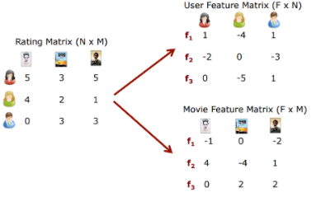
Approach - 2
Scalability issues, popularity bias and cold start problem are some of the limitations of KNN which can be overcome by matrix factorization.
Matrix factorization divides the Ratings matrix into two lower dimension matrix which are User matrix and Item matrix.
Multiplying each feature of the user by the corresponding feature of the movie and adding it together gives reasonable estimate of user’s rating.
Alternating least Square (ALS) is a matrix factorization algorithm which minimizes two loss functions alternatively obtained from matrix factorization by holding one set of latent vectors
as constant and tune the other set of latent vectors in order to minimise loss.

Slide 7
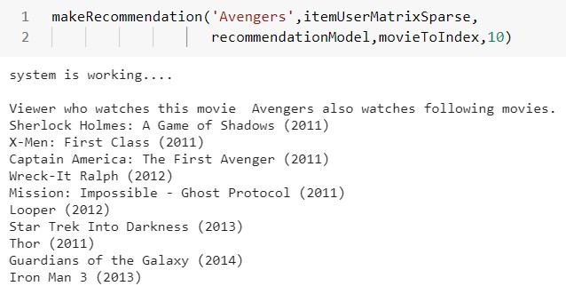
Initial results for KNN

Slide 8
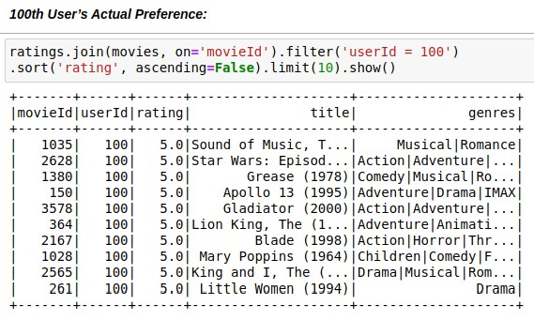
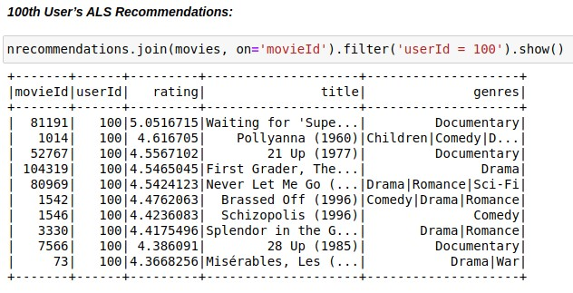
Initial results
for ALS

Slide 9
Future Work
References
After implementing the ALS algorithm we are planning to implement Singular value decomposition(SVD) algorithm on the dataset.
SVD is another method of matrix factorization which is generally used as dimensionality reduction technique. In other words it is matrix decomposition method for reducing a matrix to its constituent parts in order to make certain subsequent matrix calculations simpler.
We will also compare the performance of the two algorithms.
Harrison, Onel. “Machine Learning Basics with the K-Nearest Neighbors Algorithm.” Medium, Towards Data Science, 14 July 2019, towardsdatascience.com/machine-learning-basics-with-the-k-nearest-neighbors-algorithm-6a6e71d01761.
Gupta, Meenu, et al. "Movie Recommender System Using Collaborative Filtering." 2020 International Conference on Electronics and Sustainable Communication Systems (ICESC). IEEE, 2020.
Li, Jung-Bin, et al. "Implementation of an Alternating Least Square Model Based Collaborative Filtering Movie Recommendation System on Hadoop and Spark Platforms." International Conference on Broadband and Wireless Computing, Communication and Applications. Springer, Cham, 2018.

Slide 10
Role of each group member
Work People | Data Exploration | Algorithm research | Coding and Results | Report and Presentation
Devam | ✓ | ✓ |  | ✓
Parth | ✓ |  | ✓ | ✓
Nancy | ✓ | ✓ |  | ✓
Varshil | ✓ | ✓ | ✓

