Slide 1

ORACLE 8.0

Slide 2
ORACLE 8.0
CONTENTS
INTRODUCTION
SQL QUERIES and SQL FUNCTIONS
OPERATORS, JOINS and SUB-QUERIES
CONSTRAINTS
LOCKS and TABLE PARTITIONS
DATABASE OBJECTS
OBJECTS IN ORACLE 8.0
PL/SQL INTRODUCTION
EXCEPTIONS
CURSOR MANAGEMENT
DATABASE TRIGGERS
SUBPROGRAMS AND PACKAGES

Slide 3
ORACLE 8.0
INTRODUCTION

Slide 4
ORACLE 8.0
An introduction to the features and the various data types supported by Oracle is given. This chapter also discusses the- Data Definition Language (DDL), Data Manipulation Language (DML) and Transaction Control Language (TCL). These commands are required to create objects, view and manipulate data in these objects and to manage changes made by the DML commands.
Oracle Datatypes
Data Definition Language
Data Manipulation Language
Transaction Control
Data Control Language

Slide 5
ORACLE 8.0
What is Database Management System?
A Database Management System is essentially a collection of interrelated data and a set of programs to access this data. This collection of data is called as Database. DBMS is to provide a convenient environment to retrieve and store database information.

Slide 6
ORACLE 8.0
A Database consists of two parts namely,
Database Management System and
Database Application.
Database Management maintains the information.
Database Application is the program that is used to
view, retrieve and up-date information stored in the DBMS.

Slide 7
ORACLE 8.0
Data Definition: It is a method of data definition and storage.
Data Maintenance: It checks whether each record has fields containing all information about one particular item. For example in an employee table, all information about the employee like name, address, designation, salary, dept-name are recorded.
Data Manipulation: Allows data in the Database to be inserted, updated, deleted and sorted.
Data Display: This method helps in viewing data.
Data Integrity: This ensures the accuracy of the data.

Slide 8
ORACLE 8.0
Entity: It is an object name, place, thing which is used to store the data. For example student, course etc., and Entity is represented with rectangle.
Attributes: An attribute is the characteristic property of the entity for example student is the entity and student name, address are the characteristic property of an entity. An ellipse always represents the attribute. Student's address, Roll No., name are the attribute types

Slide 9
ORACLE 8.0
Relationship among data:
A relationship is defined as association of entity types, while a relationship instance is an association of entity
The different types of Relationship are:
One to One Relationship
One to Many Relationship
Many to Many Relationship

Slide 10
ORACLE 8.0
One - to – One:
Consider for example a set of Students in a class. One student will be having a unique roll no and the same will not be repeated to other student.
Many - to – One:
One Student can register for only one Particular course and many students could register for the same course.
Many – to- Many:
A vendor can sell a number of items and the same item can be sold by any number of vendors

Slide 11
ORACLE 8.0
Database Models
Database models are broadly classified into two categories, they are:
Object-based logical models
Record-based logical models
The object-based logical model can be defined as a collection of ideal tools for describing data, data relationships and data constraints.
The record-based logical model can be defined as data structures and access techniques of a DBMS.
The different record based logical models are,
File Management system
Hierarchical Database System
Network Database system and
Relational database System.

Slide 12
ORACLE 8.0
File Management Systems (FMS)
The File Management System was the first method used to store data in a computerized database. The data item is stored in sequential order. If the data has to be retrieved, then it checks sequentially till the required item is found.
Disadvantages
In this method, locating and retrieving a record is a very tedious process because of its sequential access method. Altering the file structure such as updating a record is also cumbersome. To add the item as a last field of each record, deleting the original file and renaming the temporary file has to be done each and every time.

Slide 13
ORACLE 8.0
Hierarchical Database Systems (HDS)
This was storing the data in the form of parent to child relationship. The origin of a data is called as tree and Data located at different levels along the root is called the node. The last node in the series is called the leaf. This model supports One-to-Many relationship.
Disadvantages
It is not possible to enter a new level into the system. As and when such a need arises the entire transaction has to be revamped.
Another disadvantage is that this Model supports, many-to-many relationship In case this sort of a relation is required then multiple copies of the same data have to made which results in redundancy. TO Overcome this drawback, the Network Database Model was introduced.

Slide 14
ORACLE 8.0
Network Database Systems (NDS)
The main idea behind the NDS model is to bring about Many-to-Many relationship.
Disadvantages
The use of pointers leads to complexity in the structure. As a result of the increased complexity, mapping the data becomes very difficult.

Slide 15
ORACLE 8.0
Relational Database System
Relational Database Model introduced in 1970. Each data field is considered as a column and each record is considered as a row of a table. Consider a set of raw data, which has to be organized in a particular fashion. Initially the entities and corresponding attributes are recognized and defined. Then the data that have the same attributes are put into tables and these are then related.
Object Relational Model
As the name implies the Object relational model supports both object oriented and relational concepts. In this model it is possible to Provide well defined interfaces for the application. A structure once created can be reused this is the fundamental property of the OOPS concepts. By combining the object oriented and relational concepts Oracle now offers the best of both worlds.

Slide 16
ORACLE 8.0
Codd's Rules
The Information rule:
All information is explicitly and logically represented in
tables as data values.
The rule of Guaranteed access:
Every item of data must be logically addressable with the
help of a table name. Primary key value and column name.
The systematic Treatment of Null values:
The RDBMS must be able to support null values (Null values
are different from Zeros and spaces) to represented missing
or inapplicable information.

Slide 17
ORACLE 8.0
Codd's Rules
The database description rule:
A description of database is maintained using the same
structures with which data was defined by the RDBMS.
These are accessible to users with appropriate.
Comprehensive Data sub language: According to this rule, the system supports the following.
a). Data definition.
b). View definition.
c). Data manipulation.
d). Integrity constraints.
f). Authorization.
g). Transaction management operations.

Slide 18
ORACLE 8.0
Codd's Rules
The view updating rule:
All views that are theoretically updateable must also be
updateable by the system.
The insert and update rule:
A single operand must hold well for all retrieval, update,
delete and insert activities. This rule implies that all the data
manipulation commands must be operational on sets of rows
having a relation rather than a single row.
The physical independent rule:
Application program must remain unaltered when any
changes are made in storage representation or in the
accessing method.

Slide 19
ORACLE 8.0
Codd's Rules
The logical data independence rule:
The changes that are made should not effect the user ability
to work with the data. The changed can be splitting the table
into many more tables.
The distribution rule:
The system must be able to access or manipulate the data
that is distributed in other systems.
The integrity independence rule:
The integrity constraints should be stored in the system
catalog or in the database as a table.
The non-subversion rule:
States that different levels of the language cannot
subvert or by pass the integrity rules and
constraints.

Slide 20
ORACLE 8.0
Tools Of Oracle
SQL*Plus
PL/SQL
Forms
Reports
SQL*Plus
SQL*Plus is a Structured Query Language which is
supported by Oracle. Through SQL*Plus we can store,
retrieve, edit, enter and run SQL commands and PL/SQL
blocks. Using SQL*Plus we can perform calculations, list
column definitions for any table and can also format query
results in the form of a report.

Slide 21
ORACLE 8.0
PL/SQL
PL/SQL is an extension of SQL. PL/SQL block can contain
any number of SQL statements integrated with flow of
contro1 statements Thus PL/SQL combines the data
manipulating power of SQL with data processing power of
procedural languages.
Forms
This is a graphical tool used for generating and executing
Forms based applications. A form basically comprises
blocks and fields. Multiple tables can be accessed over a
single form.

Slide 22
ORACLE 8.0
Reports
It is an application development tool of Oracle for
developing, executing, displaying and printing reports. We
can create a wide variety of reports, which have various
modes that are explained in later chapters. Oracle Reports
are powerful, yet easy to use.

Slide 23
ORACLE 8.0
In order to communicate with the database, SQL supports
the following categories of commands
Data Definition Language - create, alter, drop commands.
Data Manipulation Language - insert, select, delete and
update commands.
Transaction Control Language - Commit save point and
rollback commands.
Data Control Language - grant and revoke commands

Slide 24
ORACLE 8.0
Oracle Datatypes
In order to create a table we need to specify a datatype for
individual columns in the create table command. Oracle
supports the following datatypes, to achieve the above
requirements.
Character
Number
Date
Long
Raw
Long Raw
LOB
Clob, Blob, BFile

Slide 25
ORACLE 8.0
Char datatype
The Char datatype is used when a fixed length character
string is required. It can store alphanumeric data length of
such a datatype can vary between 1-2000 bytes. If the user
enters a value shorter than the specified length then the
database blank-pads to the fixed length. In case, if the user
enters a value larger than the specified length then the
database would return an error.
Ex : CHAR(6)

Slide 26
ORACLE 8.0
Varchar2 datatype
The Varchar2 ( ) datatype supports a variable length
character string. It also stores alphanumeric values. The
size for this datatype ranges from I - 4000 bytes. While
defining this datatype we should specify the size. Using
varchar2 saves is space when compared to char. This
statement can be justified with the help of an example.
Considering a column assigned with varchar2 datatype of
size 30 bytes, if the user enters 10 bytes of character, then
the column length in that row would only be 10 bytes and not
30 bytes. In the case of char, it would still occupy 30 bytes
because the remaining would be blank padded by Oracle.
Currently varchar datatype is equivalent to varchar2
datatype.
Ex : VARCHAR2(20)

Slide 27
ORACLE 8.0
Long datatype
This datatype is used to store variable character length. Maximum size is 2 GB Long datatype has several characters similar to varchar2 datatype. Its length would be restricted based on the memory space available in the computer. The following restriction needs to be fulfilled when a long datatype attribute is cast on a column in a table.
Ex: LONG

Slide 28
ORACLE 8.0
Number datatype
The Number datatype can store Positive numbers, negative
numbers, zero, fixed point , and floating Point numbers with
a precision of 38.
Column-name number
Column-name number (p) p = 38, s = 0
Column-name number (p, s)

Slide 29
ORACLE 8.0
Date datatype
Date datatype is used to store date and time in a table.
Oracle database makes Use Of its own format to store date in
a fixed length of 7 bytes each for century, month, day, Year,
hour, minute and second. Default date datatype is
"dd-mon-YY".
To view system's date and time we can use the SQL function
called sysdate (). Valid date is from Jan 1, 4712 BC to Dec
31, 4712 AD.
Ex : DATE

Slide 30
ORACLE 8.0
Oracle Datatypes
In order to create a table we need to specify a datatype for
individual columns in the create table command. Oracle
supports the following datatypes, to achieve the above
requirements.
Character
Number
Date
Long
Raw
Long Raw

Slide 31
ORACLE 8.0
DATA DEFINITION LANGUAGE
CREATE
ALTER
DROP
TRUNCATE

Slide 32
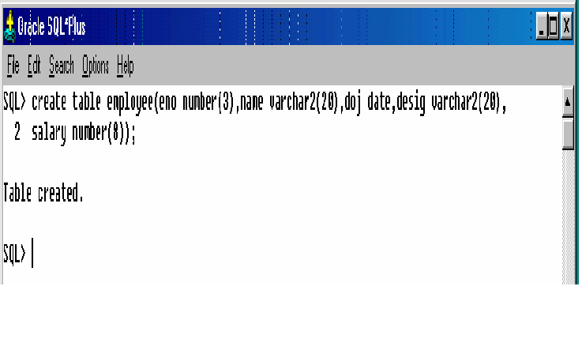
ORACLE 8.0
TRY OUTS: CREATE STATEMENT

Slide 33
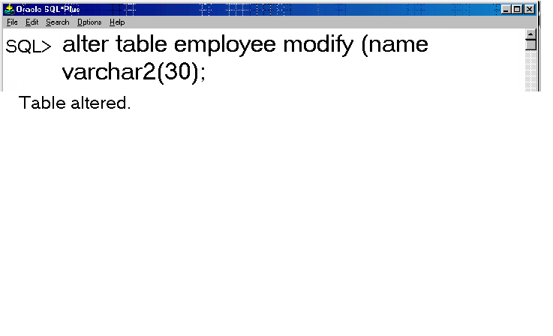
ORACLE 8.0
TRY OUT ALTER COMMAND MODIFY

Slide 34
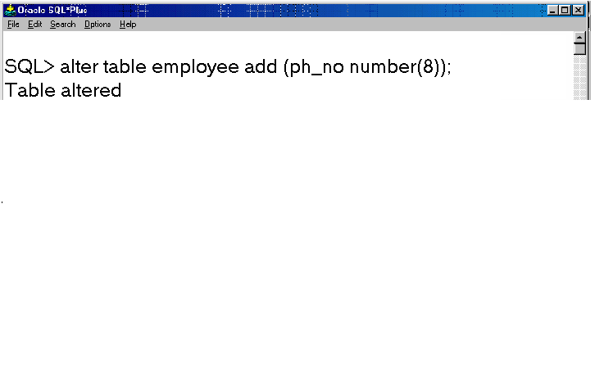
ORACLE 8.0
TRY OUT ALTER COMMAND TO ADD COLUMN

Slide 35
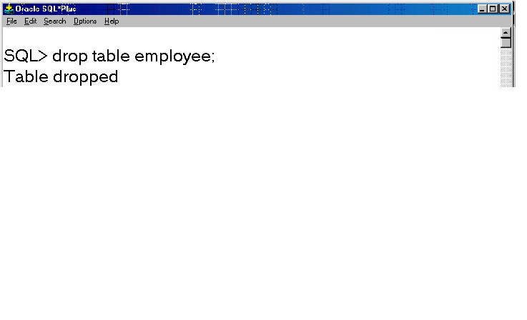
ORACLE 8.0
TRY OUT DROP COMMAND

Slide 36
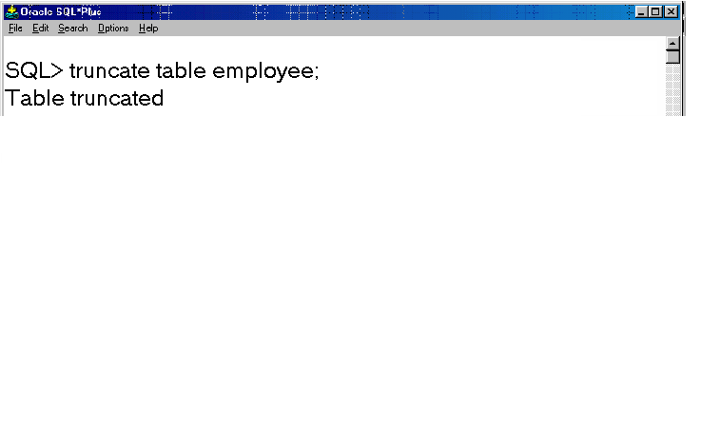
ORACLE 8.0
COMMAND TO TRUNCATE THE TABLE

Slide 37
ORACLE 8.0
DML COMMANDS
INSERT
SELECT
UPDATE
DELETE

Slide 38
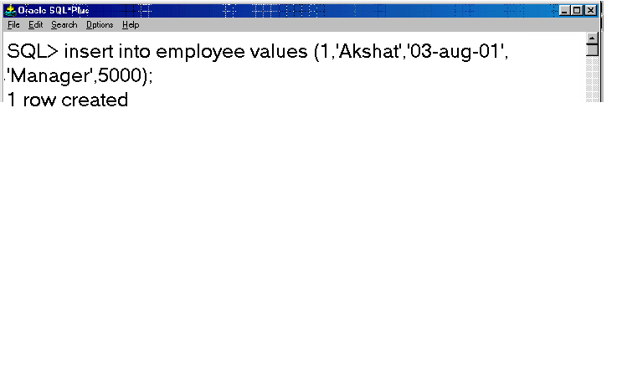
ORACLE 8.0
INSERT COMMAND

Slide 39
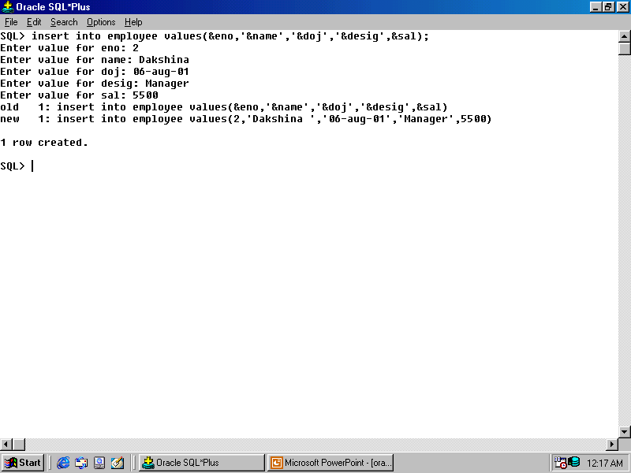
ORACLE 8.0
INSERT COMMAND

Slide 40
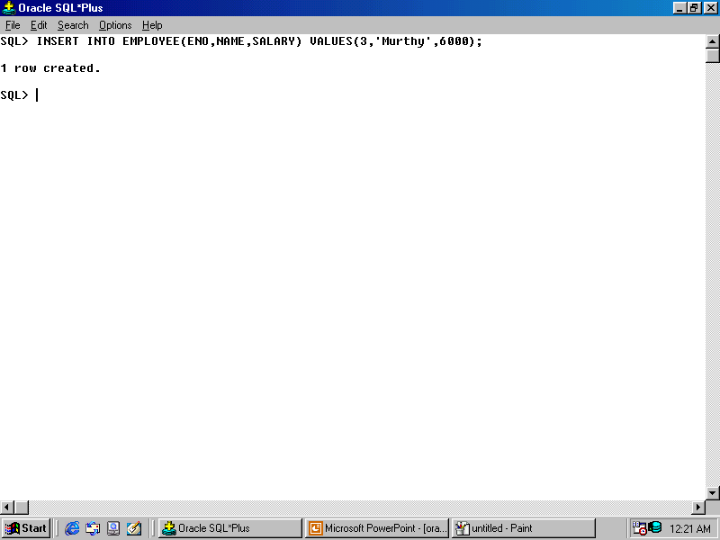
ORACLE 8.0
INSERT COMMAND

Slide 41
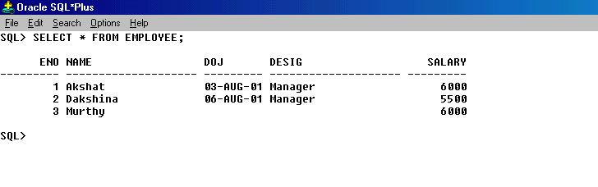
ORACLE 8.0
SELECT COMMAND

Slide 42
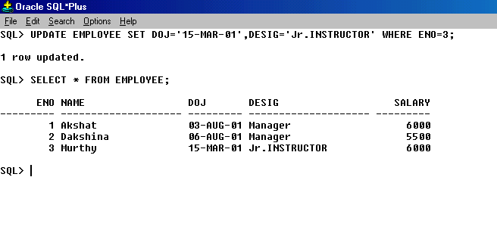
ORACLE 8.0
UPDATE COMMAND

Slide 43
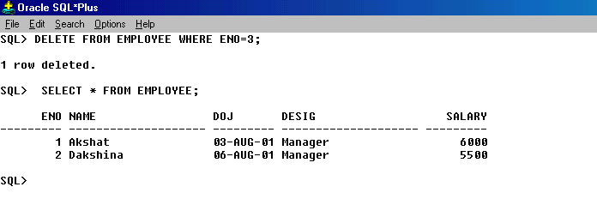
ORACLE 8.0
DELETE COMMAND

Slide 44
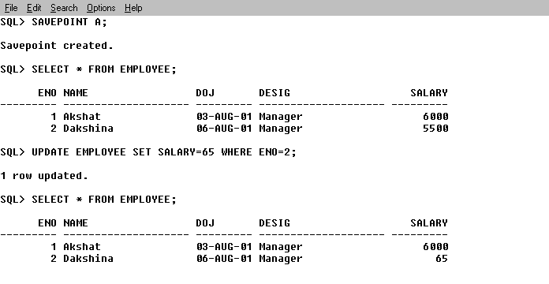
ORACLE 8.0
SAVEPOINT

Slide 45
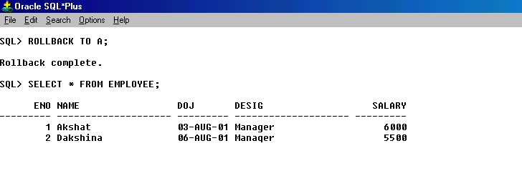
ORACLE 8.0
ROLLBACK

Slide 46
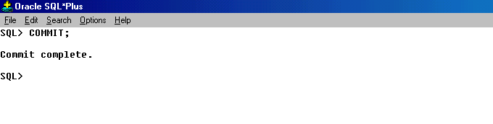
ORACLE 8.0
COMMIT

Slide 47
ORACLE 8.0
TRANSACTION CONTROL LANGUAGE
GRANT
REVOKE

Slide 48
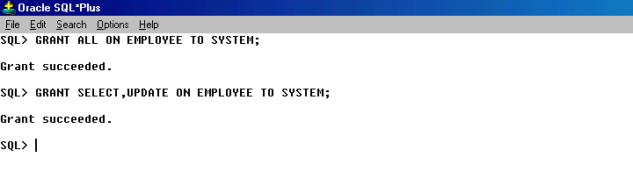
ORACLE 8.0
GRANT

Slide 49
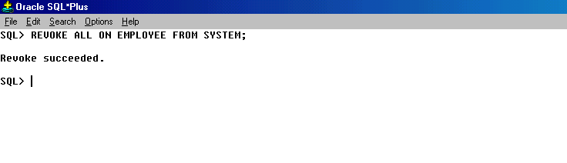
ORACLE 8.0
REVOKE

Slide 50
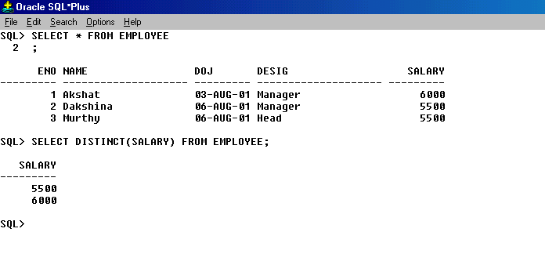
ORACLE 8.0
SELECT DISTINCT VALUES

Slide 51
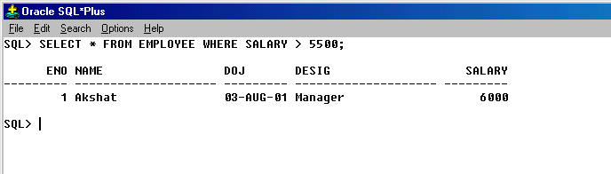
ORACLE 8.0
SELECT COMMAND USING WHERE CONDITION

Slide 52
ORACLE 8.0
SQL QUERIES
AND
SQL FUNCTIONS

Slide 53
ORACLE 8.0
DIFFERENT SELECT STATEMENTS
SQL OPERATORS
SQL FUNCTIONS

Slide 54
ORACLE 8.0
DIFFERENT SELECT STATEMENTS
We know that to perform a query, the select command is used. Apart from just providing information this command can be clubbed with some DDL and DML statements to perform relational operations.

Slide 55
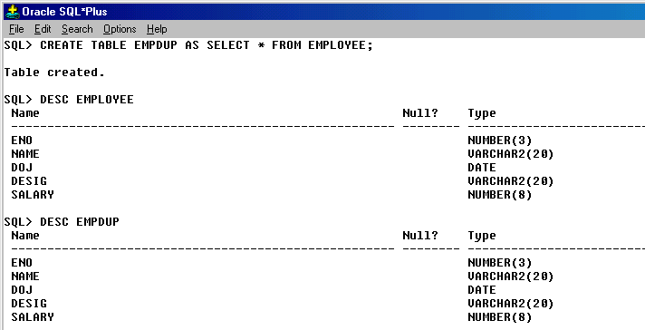
ORACLE 8.0
Select command to create a table

Slide 56
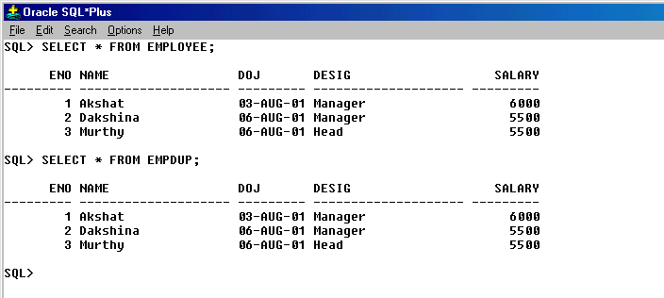
ORACLE 8.0
SELECT COMMAND TO VIEW THE DUPLICATE TABLE

Slide 57
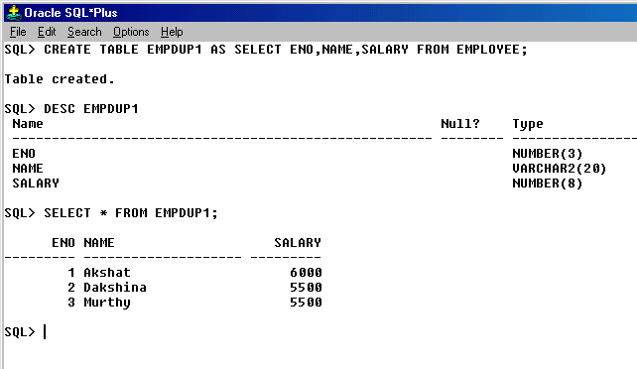
ORACLE 8.0
SELECT COMMAND TO CREATE TABLE WITH SELECTIVE COLUMNS

Slide 58
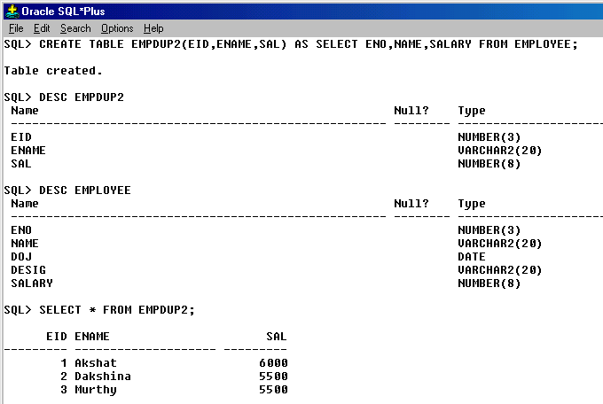
ORACLE 8.0
SELECT COMMAND TO CREATE TABLE WITH DIFFERENT FIELD NAMES IN THE DUPLICATE TABLE

Slide 59
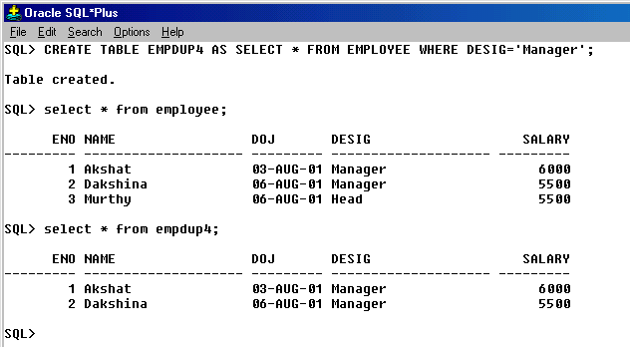
ORACLE 8.0
SELECT STATEMENT TO CREATE A TABLE USING WHERE CONDITION

Slide 60
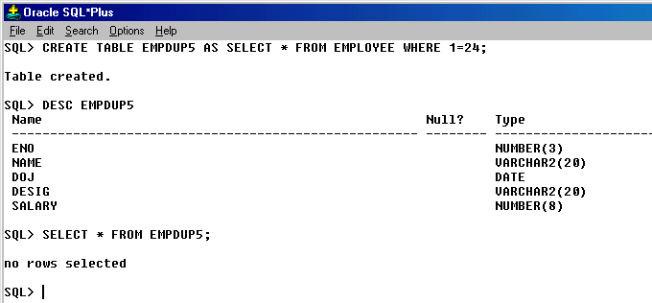
ORACLE 8.0
SELECT COMMAND TO CREATE AN EMPTY TABLE

Slide 61
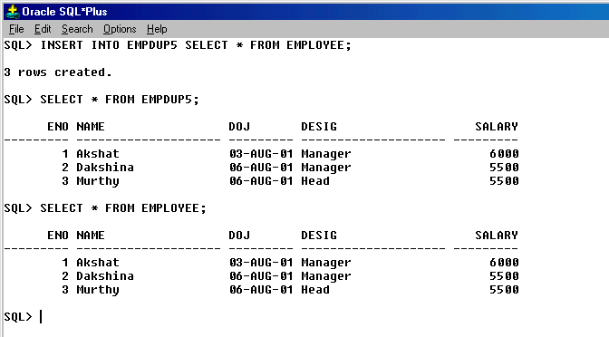
ORACLE 8.0
SELECT COMMAND TO INSERT RECORDS

Slide 62
ORACLE 8.0
SQL OPERATORS
COMPARISON OPERATORS
ARITHMETIC OPERATORS
LOGICAL OPERATORS

Slide 63
ORACLE 8.0
COMPARISON OPERATOR
The comparison operators are:
>=, <=, = , !=,
between (to check between any two values),
in (to match with any of the values in the list), like( to match a character pattern)
and is Null (to check whether it is Null).
The last four operators mentioned above can also be used for checking the NOT conditions like NOT BETWEEN, NOT LIKE and so on.

Slide 64
ORACLE 8.0
ARITHMETIC OPERATOR
ADDITION (+)
SUBTRACTION (-)
MULTIPLICATION (*)
DIVISION (/)
MODULUS (%)

Slide 65
ORACLE 8.0
LOGICAL OPERATOR
A logical operator is used to combine the results of two conditions to produce a single result.
The logical operators are :
AND
NOT and
OR.

Slide 66
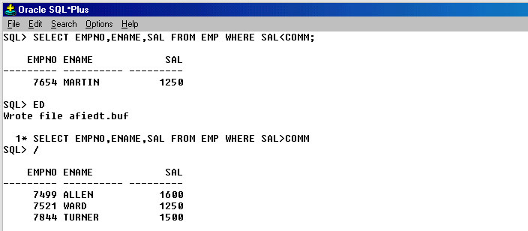
ORACLE 8.0
SELECT STATEMENT USING COMPARISON OPERATOR

Slide 67
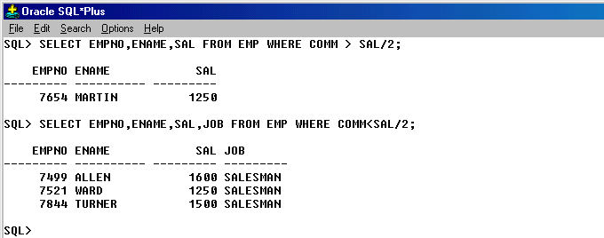
ORACLE 8.0
SELECT STATEMENT USING COMPARISON OPERATOR

Slide 68
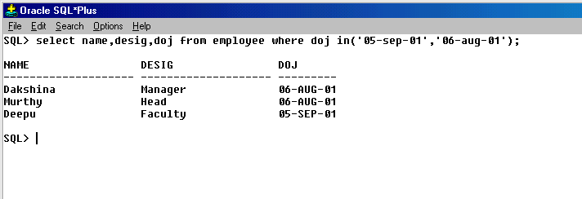
ORACLE 8.0
SELECT STATEMENT USING COMPARISON OPERATOR

Slide 69
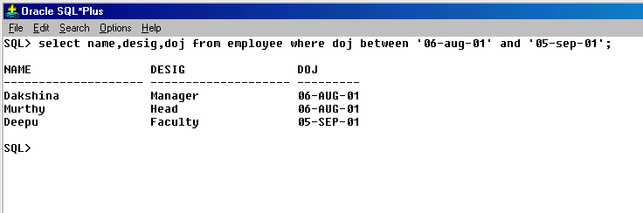
ORACLE 8.0
SELECT STATEMENT USING COMPARISON OPERATOR

Slide 70
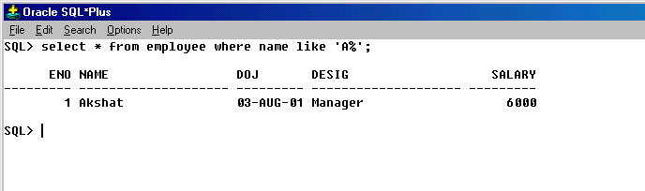
ORACLE 8.0
SELECT STATEMENT USING LIKE OPERATOR

Slide 71
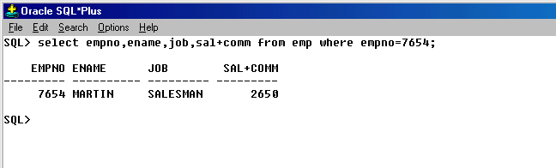
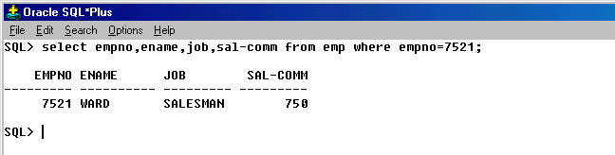
ORACLE 8.0
SELECT COMMAND USING ARITHMETIC OPERATOR

Slide 72
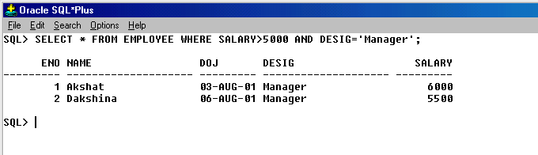

ORACLE 8.0
SELECT COMMAND USING LOGICAL OPERATOR

Slide 73
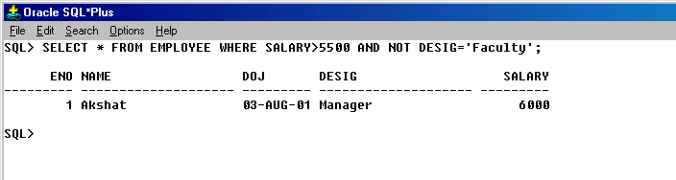
ORACLE 8.0
SELECT COMMAND USING LOGICAL OPERATOR
Operator precedence
The precedence of the operators discussed above are given below:-
Arithmetic operators -------- highest precedence
Comparison operators
NOT logic operator
AND logic operator
OR logic operator -------- lowest precedence

Slide 74
ORACLE 8.0
SQL*Plus Functions
SQL* PLUS provides specialized functions to Perform operations using the Data Manipulation Commands.
A function takes one or more arguments and returns a value. One can broadly classify functions into single row function, group functions.

Slide 75
ORACLE 8.0
Single ROW Functions
A single row function or a scalar function return only one value for every row queried in the table. Single row functions can appear in a select command and can also be included in a where' clause.
The single row functions can be broadly classified as:
Date functions
Numeric functions
Character functions
Conversion functions
Miscellaneous functions

Slide 76
ORACLE 8.0
DATE FUNCTIONS
ADD_MONTHS
MONTHS_BETWEEN
LAST_DAY
NEXT_DAY
ROUND
TRUNC
GREATEST

Slide 77
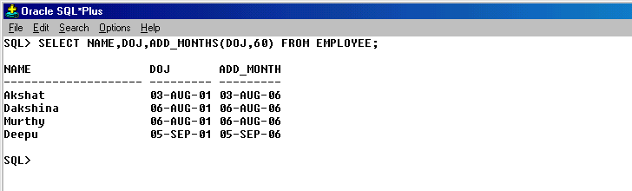
ORACLE 8.0
ADD_MONTHS
The add_months date function returns a date after adding a specified date with the specified number of months, add_months(d,n) Where d is the date and n represents the number of months.

Slide 78
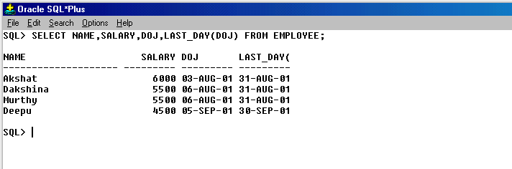
ORACLE 8.0
LAST_DAY
The format is last_day(d), which returns the date corresponding to the last day of the month.

Slide 79
ORACLE 8.0
MONTHS_BETWEEN
To find out the number of months between two dates, we use the months-between function. Its format is Months_between(d1, d2) where d1, d2 are dates. The output will be a number. If d1 is larger than d2, result is positive; if earlier, negative. If d1 and d2 are the same days of the month or both last days of months, the result is always an integer otherwise Oracle calculates the fractional partition of the result based on a 31-day month and considers the difference in time components of d1 and d2.

Slide 80
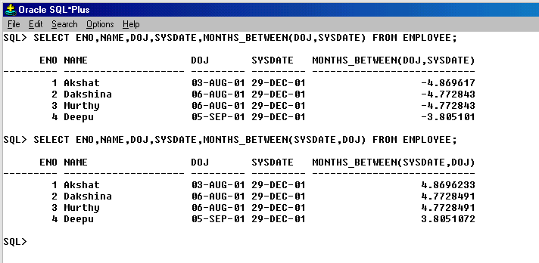
ORACLE 8.0

Slide 81
ORACLE 8.0
ROUND
This function returns the date which is rounded to the unit specified by the format model. Its format is Round(d,fmt)
It can be rounded in terms of
YEAR
MONTH
DAY

Slide 82
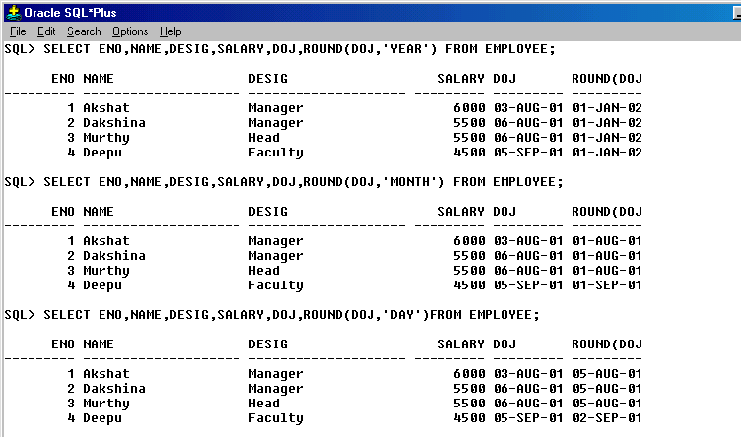
ORACLE 8.0

Slide 83
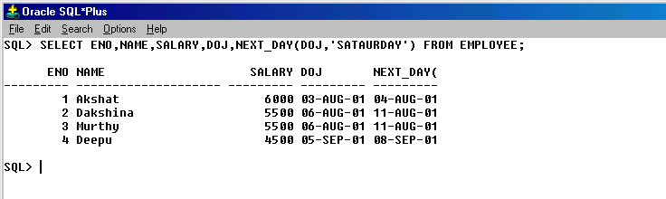
ORACLE 8.0
NEXT_DAY(DATE, ‘DAY’)
Where date is the date column and day is the concerned day

Slide 84
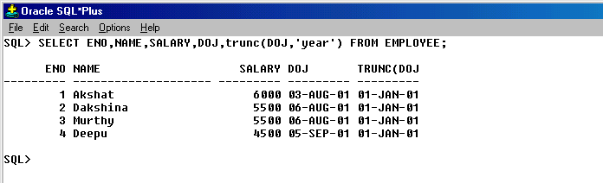
ORACLE 8.0
Truncate
Truncate function returns the date with the time portion of the day truncated to the unit specified by format model. The syntax is trunc(d, fmt). If fmt is neglected, then date is converted to the nearest day. It has fmt like year, month, day.

Slide 85

ORACLE 8.0
GREATEST
This Function returns the greatest date from the two dates which is given as input.
The format is greatest(d1, d2), where d1 is date1 and d2 is date.

Slide 86
ORACLE 8.0
CHARACTER FUNCTIONS
Character functions accept character input and return either character or number values.
The character functions supported by Oracle are listed below:
INITCAP(CHAR)
UPPER(CHAR)
LOWER(CHAR)
LTRIM(CHAR,SET)
RTRIM(CHAR,SET)
TRANSLATE(CHAR, FROM, TO)
REPLACE(CHAR, SEARCHSTRING , [REP STRING] )

Slide 87
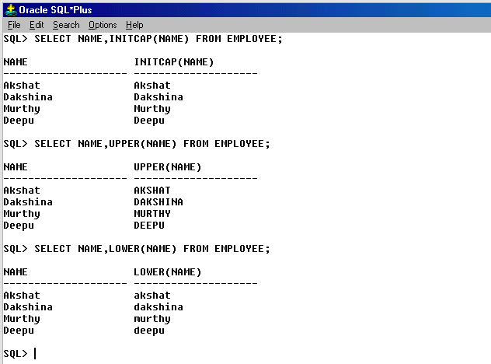
ORACLE 8.0

Slide 88
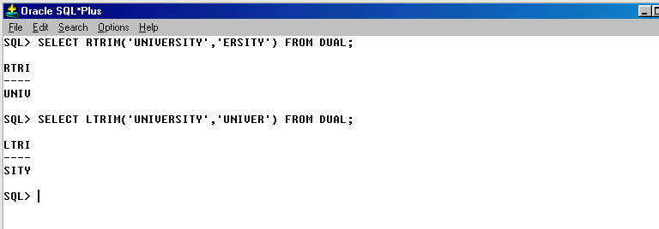
ORACLE 8.0

Slide 89
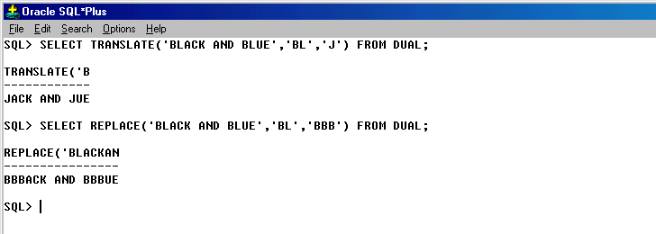
ORACLE 8.0

Slide 90
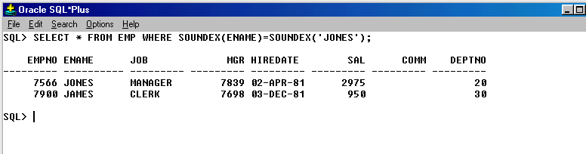
ORACLE 8.0
SOUNDEX
Soundex, which is also a character function compares words that are spelled differently, but sound alike. Consider the following example.

Slide 91
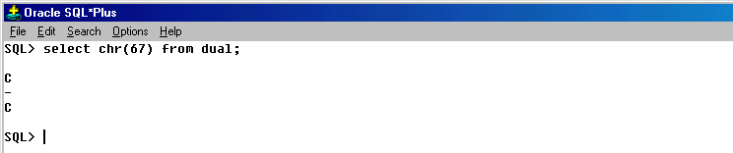
ORACLE 8.0
CHAR
Character functions accept character input and return either character or number values. The first among the character functions is ‘CHR'. This returns the character value for the number given within braces.

Slide 92
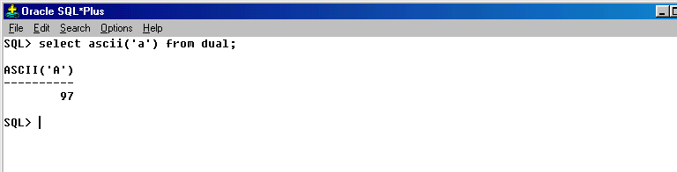
ORACLE 8.0
ASCII
ASCII functions accept character input and return either number values. This returns the number value for the character given within braces.

Slide 93
ORACLE 8.0
LPAD
The next function is the Ipad. This takes three arguments. The first argument is the character string, which has to be displayed with the left padding. The second is the number, which indicates the total length of the return value. The third is the string, with which the left padding has to be done when required.
RPAD
The function ‘RPAD' does the exact opposite of the LPAD function. The number of arguments it takes is the same as the LPAD function.

Slide 94
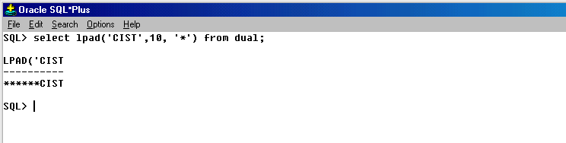

ORACLE 8.0

Slide 95
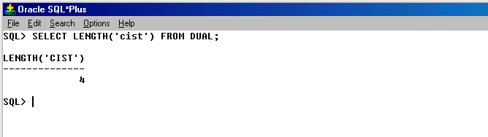
ORACLE 8.0
Length
When the length function is used in a query it returns the length of a string.

Slide 96
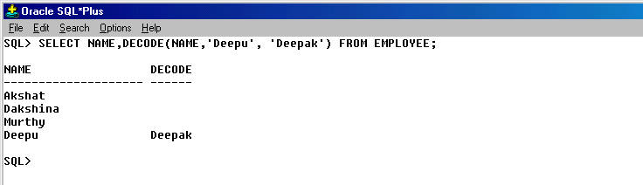
ORACLE 8.0
Decode
Unlike the translate function which performs a character by character replacement the DECODE function does a value by value replacement.

Slide 97
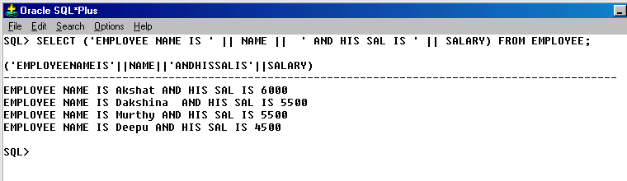
ORACLE 8.0
Concatenation ( || ) Operator
The concatenation operator is used to merge two or more strings , or a string and a data value together.

Slide 98
ORACLE 8.0
Numeric Functions
Numeric function accepts numeric input and returns numeric values as the output. The values that the numeric functions return an accurate number, In addition to the functions that are already present a few new functions have been introduced. One among them is the LN. This function returns the logarithmic value of the given number.

Slide 99

ORACLE 8.0
LN, SIGN, MOD FUNCTIONS

Slide 100
ORACLE 8.0
Conversion Functions
Conversion functions convert a value from one data type to another.
The conversion functions are
To_Char( )
To_date( )
To_number()

Slide 101

ORACLE 8.0
TO_CHAR (d,fmt)
This function is to convert from date data type to a varchar2 data type. Here d is the date and fmt is the format model which specifies the format of date.

Slide 102

ORACLE 8.0
TO_DATE
The format is to_date(char fmt).This converts char or varchar2 data type to date data type. Format model, fmt specifies the form of character. Consider the following example which returns date for the string 'January 27 1999'.

Slide 103
ORACLE 8.0
Miscellaneous Functions
The following are some of the miscellaneous functions supported by Oracle.
Uid
User
Vsize

Slide 104
ORACLE 8.0
Uid
This function returns the integer value corresponding to the user currently logged in.
User
This function returns the login's user name, which is in varchar2 data type.
Vsize
This function returns the size of the expression, which is passed through the arguments.

Slide 105

ORACLE 8.0
DUAL IS THE SYSTEM TABLE

Slide 106
ORACLE 8.0
Group Functions
A group function returns the result based on a group of rows. Some of these are mathematical functions. The Avg function will return the average of values of the column specified in the argument.
Some of the Group functions are:
SUM ( )
AVG ( )
MIN ( )
MAX ( )
COUNT ( )

Slide 107

ORACLE 8.0
SUM FUNCTION
The sum function can be used to obtain the sum of a range of values of a record set.

Slide 108

ORACLE 8.0
AVG FUNCTION
The Avg function will return the average of values of the column specified in the argument.

Slide 109

ORACLE 8.0
MIN FUNCTION
This function will give the least of all values of the column present in the argument.

Slide 110

ORACLE 8.0
MAX FUNCTION
To perform an operation which gives the maximum of a set of values the max function can be made use of.

Slide 111
ORACLE 8.0
COUNT FUNCTION
In order to count the number of rows, count function is used. It can take three different arguments and is discussed below :
COUNT (*)
COUNT(COL_NAME)
COUNT(DISTINCT (COL_NAME))

Slide 112

ORACLE 8.0

Slide 113
ORACLE 8.0
OPERATORS, JOINS
AND
SUB QUERIES

Slide 114
ORACLE 8.0
SET OPERATORS
Set operators combine the results of two queries into a single one. The following set operations aid joining queries to retrieve rows.
Union
Union all
Intersect
Minus

Slide 115
ORACLE 8.0
SET OPERATORS
The columns in the select statements joined using the set operators should adhere strictly to the rules mentioned below.
The queries, which are related by a set operator should have the same number of columns and the corresponding columns, must be of the same data type.
Such a query should not contain any column of type long.
The label under which the rows are displayed are those from the first select statement.

Slide 116
ORACLE 8.0
Union
The union operator returns all distinct rows selected by both queries. The following example combines the result of two queries with the union operator, which eliminates duplicate rows.
Assuming that there are two different tables namely,
EMP and EMPLOYEE which has some common fields which data types matches each other.

Slide 117

ORACLE 8.0

Slide 118
ORACLE 8.0
UNION ALL
The union all operator returns all rows selected by either query including duplicates.
INTERSECT
Intersect operator returns only rows that are common to both the queries.
MINUS
Minus operator returns all distinct rows selected only by the first query and not by the second.

Slide 119

ORACLE 8.0
UNION ALL

Slide 120


ORACLE 8.0
INTERSECT
MINUS

Slide 121
ORACLE 8.0
JOIN CONCEPT
The purpose of a joins is to combine the data spread across the table. A join is actually performed by the ‘where’ clause which combines the specified rows of tables. If a join involves over row tables then oracle joins the first two based on the condition and then compares the result with the next table and so on. For combining data where a common column will provide the join condition.

Slide 122
ORACLE 8.0
Basically there are three different types of Joins:
SIMPLE JOIN
SELF JOIN
OUTER JOIN

Slide 123
ORACLE 8.0
SIMPLE JOIN: It is further classified into two different Types,
EQUI-JOIN and NON EQUI-JOIN
SIMPLE JOIN:: It is the most common type of join. It retrieves rows from two tables having a common column and is further classified into: EQUI-JOIN and NON EQUI-JOIN.
EQUI-JOIN: A join which is based on equalities, is called an Equi-join. The Equi-join combines rows that have equivalent values for the specified columns.
NON EQUI-JOIN: A non Equi-join specifies the relationship between columns belonging to different tables by making use of the relational operators(>,<.<=,>=,=,<>)

Slide 124

ORACLE 8.0
EQUI-JOIN In the example column name is prefixed by the table name because both the tables have the same column name i.e.., deptno. Therefore to distinguish between them we use table names. If the column names are unique, then we need not prefix it with the table name. Suppose deptno was given some other name say dno, in one of the tables then the join condition need not be prefixed with the table names.

Slide 125

ORACLE 8.0
NON EQUI-JOIN

Slide 126
ORACLE 8.0
Table aliases: To prevent confusion in a query we include table names in the select statements. Table aliases is used to make multiple table queries shorter and more readable.
Self Join: Joining the table to itself is known as a self join. It joins one row in a table to another. The joins is performed by mirroring the table using the where clause. It can compare each row of the table to itself and also with other rows of the same table.
Outer Join: The outer join extends the result of a simple join. An outer join returns all the rows returned by simple join as well as those rows from one table that do not match any row from the outer table. The symbol (+) represents outer join.

Slide 127

ORACLE 8.0
SELF JOIN

Slide 128

ORACLE 8.0
OUTER JOIN

Slide 129

ORACLE 8.0
SUB QUERIES: Nesting of queries, one within the other is termed as a sub query. Sub queries are used to retrieve data from tables that depend on the values in the table itself. A statement containing a sub query is called a parent statement.

Slide 130

ORACLE 8.0
Sub queries returning several values: sub queries can also return more than one value. In such cases we should include operators like any, all, in or not in.

Slide 131

ORACLE 8.0
MULTIPLE QUERIES: Oracle places no limit on the number of queries included in a where condition. It allows nesting of a query within a sub query.

Slide 132
ORACLE 8.0
CONSTRAINTS

Slide 133
ORACLE 8.0
CONSTRAINTS: An Integrity constraint is a mechanism used by oracle to prevent invalid data entry into the table. Maintaining security and integrity of a database is the most important factor in judging the system.
The various types of constraints are:
Domain Integrity Constraints,
Entity integrity constraints,
Referential Integrity Constraints.

Slide 134
ORACLE 8.0
DOMAIN INTEGRITY CONSTRAINTS: These constraints set a range, and any violations that take place.
It is of two different types,
not null constraint, check constraint.
Oracle allows null values without returning an error. When a not null constraint is enforced, it will not allow null values. Zero and null are not equivalent. One null is not equal to another null.

Slide 135

ORACLE 8.0
CHECK CONSTRAINTS: it specifies the conditions that each row must satisfy. These are rules governed by logical expressions or biological expressions. Check constraint cannot contain sub queries.

Slide 136
ORACLE 8.0
ENTITY INTEGRITY CONSTRAINT: An entity is any data recorded in a database. Each entity represents a table. Each row in a table can be uniquely identified using the entity constraint.
Different types of Entity Integrity constraints are:
Unique key
Primary key

Slide 137
ORACLE 8.0
Unique constraint: It is to prevent the duplication of values
within the rows of a specified column or a set of columns in
a table. It will allow null values but not repeated value. If
unique constraint key is defined in more than one column,
then it is said to be as composite unique key.
Primary key constraint: The primary key constraint avoids duplication of rows and does not allow null values, a table can have only one primary key. It cannot be defined in alter table command when the table contains rows having null values.

Slide 138

ORACLE 8.0
EXAMPLE FOR UNIQUE AND PRIMARY KEY
Where ORPK is the constraint name for the primary key constraint and unq is the name given for the constraint unique key.

Slide 139
ORACLE 8.0
Referential integrity constraints: To establish a master-detail or parent-child relationship between two tables having a common column, we make use of referential integrity constraints.
To implement this the parent table as a primary key and the same column in the child table as a foreign key referring to the corresponding parent query.
Foreign key: A column is included in the definition of referential integrity which would refer to a referenced key.

Slide 140
ORACLE 8.0
Referenced key It is a unique or a primary key which is defined on a column belonging to the parent table.
Child table: This table depends upon the values present in the referenced key of the parent table, which I referred by a foreign key.
Parent table: This table determines whether insertion or updation of data can be done in child table.

Slide 141

ORACLE 8.0
In the above example, we have created two different tables and given constraint to both the tables by using alter command and then we have used reference key to make them refer each other.

Slide 142

ORACLE 8.0
TRY OUTS ON CONSTRAINTS WHILE CREATING TABLE

Slide 143

ORACLE 8.0
TRY OUT CONSTRAINTS USING ALTER COMMAND

Slide 144

ORACLE 8.0

Slide 145

ORACLE 8.0

Slide 146

ORACLE 8.0
On delete cascade: The on delete cascade clause specifies that oracle maintains referential integrity by automatically removing dependent foreign key values if a referenced primary key value is removed.

Slide 147

ORACLE 8.0

Slide 148
ORACLE 8.0
LOCKS
AND
TABLE PARTITIONS

Slide 149
ORACLE 8.0
LCOK CONCEPTS
TABLE PARTITIONS
Oracle automatically uses different types of locks to control concurrent access to data and to prevent destructive interaction between users. Oracle automatically locks a resource on behalf of a transaction.
Oracle automatically acquires different types of locks at different levels of restrictiveness depending on the resource being locked and the operation being performed. The lock is released automatically when an event occurs so that the transaction no longer requires the resource.

Slide 150
ORACLE 8.0
Consider users from two different departments in CIST ENTERPRISES - sales and accounts, wish to access the same table i.e., EMP. In such a case, the following situation may arise. Since both the users are accessing the same row on the same table at the same time it may end up in a situation where user in accounts will delete the row that user in sales has updated.
To overcome this situation Oracle incorporates a locking facility which permits or denies access to other users on a table or to certain rows in a table, when a user is still is in the process of operating on them.

Slide 151

ORACLE 8.0
There are two different types of Locks:
ROW LEVEL LOCK (For specific rows)
TABLE LEVEL LOCK (For entire table)
ROW LEVEL LOCK: In the row level lock, a row is locked exclusively so that other users cannot modify the row until the transaction is committed or rollbacked.

Slide 152
ORACLE 8.0
TABLE LEVEL LOCK: A table level lock will protect table data thereby guaranteeing data when data is accessed by multiple users.
There are three different types of Table Level Locks, they are:
Share lock
Share update lock
Exclusive lock

Slide 153
ORACLE 8.0
Share lock:
A share lock locks the table allowing other users to only query but not insert, update or delete rows in a table. Multiple users can place share locks on the same table at the same time, i.e., it allows resources to be shared, and hence the name share lock.
Share update lock:
It locks rows that are to be updated in a table. It permits other users to concurrently query, insert, update. It prevents the other users from altering the structure of the table.

Slide 154

ORACLE 8.0
Exclusive lock:
Exclusive lock is the most restrictive of table locks. When issued by one user, it allows the other user to only query but not insert, delete or update rows in a table. It is almost similar to a share lock but only one user can place an exclusive lock on a table at a time whereas many users can place a share lock on the same table at the same time.

Slide 155
ORACLE 8.0
Table Partitions:
The additional feature in Oracle 8 is that the tables can be partitioned and stored in different locations as per requirement. A single logical table can b into a number of physically separate pieces based on ranges of key values. Each of the parts of the table is called a partition. Although the partitions are held and managed independently, they can be queried and updated by reference to the name of the logical table. Oracle 8 provides partition transparency. The application could be unaware of the fact that the table has been partitioned. A non partitioned table cannot be partitioned later.

Slide 156
ORACLE 8.0
Storing the partitions in different table spaces has its advantages :
It reduces the possibility of data corruption in multiple partitions
Back up and recovery of each partition can be done independently Controlling the mapping of partitions to disk drives is possible.
Partitioned tables cannot contain any columns with long or long raw datatypes, LOB datatypes (BLOB, CLOB, NCLOB, or BFILE), or object types.

Slide 157

ORACLE 8.0
Creating a table with Partitions

Slide 158

ORACLE 8.0
Inserting records into a partitioned table

Slide 159

ORACLE 8.0
Selecting values from partition

Slide 160
ORACLE 8.0
A non partitioned table cannot be partitioned later.
Partition can be done to single column or more than one column. The updation done to the table will be affected to the table.
Maintaining Partitions:
adding partitions
dropping partitions
splitting partitions
exchanging table partitions

Slide 161

ORACLE 8.0
Adding partitions: The alter table add partition statement is used to add a new partition after the existing last partition.

Slide 162

ORACLE 8.0
Splitting partitions: the split partition clause can be used to split a partition into two. This is useful when a partition becomes too large ad causes backup, recovery or maintenance operation to consume a lot of long time.
The partition par3 in the table employee is split into partitions par4 and par5. Now par4 contains values from 5000 and 6000 and par5 contains from 6000 to 7500.

Slide 163

ORACLE 8.0
Dropping a partition: to drop a partition the drop partition clause can be made use of in the alter table statement. If a partitioned is dropped then the information inside the table as well as partition will be not there. Any manipulation we do to either for table or for partition it will be affected to both.

Slide 164

ORACLE 8.0
Exchanging partitions: Exchanging table partitions is used to convert a partition into a non-partitioned table, and a table into a partition of a partitioned table by exchanging their data segments.

Slide 165
ORACLE 8.0
DATABASE
OBJECTS

Slide 166
ORACLE 8.0
Different types of Database objects are:
SYNONYM
SEQUENCES
VIEWS
INDEX

Slide 167
ORACLE 8.0
Synonym:
A Synonym is a database object, which is used as am alias name for a table, view or sequence. They are used to:
Simplify SQL Statements
Hide the name and owner of an object
Provide public access to an object
Synonym can either be private or public. Public synonyms are created by a Database Administrator to hide the identity of a base table and reduce the complexity of SQL statements.
All synonyms in user can be viewed by using a query as follows:
Select * from user_synonyms;

Slide 168

ORACLE 8.0

Slide 169
ORACLE 8.0
SEQUENCES:
A sequence is a database object, which can generate unique, sequential integer values. It can be either in ascending order or descending order.
While creating a sequence we can define the following terms:
Increment by n: ‘n’ is an integer which specifies the interval between sequence numbers. The default is 1. if n is positive, then the sequence is in ascending order and if it is negative sequence descends.
Start with n: Specifies the first sequence numbers to be generated

Slide 170
ORACLE 8.0
Minvalue n: Specifies the minimum value of the sequence. By default, it is 1 for an ascending sequence.
Maxvalue n: Specifies the maximum value that the sequence can generate.
Cycle: Specifies that the sequence continues to generate values from the beginning after reaching either its max or min value.

Slide 171
ORACLE 8.0
No cycle: Specifies that the sequence cannot generate more values after reaching minimum or maximum value.
Cache: The CACHE option pre-allocates a set of sequence numbers and retains them in memory so that sequence numbers can be accessed faster.
No cache: The default value ‘nocache’, does not preallocate sequence numbers for faster access.

Slide 172

ORACLE 8.0

Slide 173
ORACLE 8.0
Nextval: Nextval returns initial value of the sequence, when referred to, for the first time, later references to nextval will increment the sequence using the increment y clause and return the new value.
Currval: Currval returns the current value of the sequence which is the value returned by the last reference to nextval.

Slide 174

ORACLE 8.0
Alter Sequence:
The Sequence can be altered when we want to perform the following:
Set or eliminate minvalue or maxvalue
Change the increment value
Change the number of cached sequence numbers

Slide 175
ORACLE 8.0
View: A view is a tailored partition of the data contained in one or more tables. We can use views in most places where a table can be used. The Advantages of views are as follows:
They provide an additional level of table security by restricting access to a predetermined set of rows or columns of a table.
They hide data complexity, the view hides the fact that this information actually originates from several tables.
They simplify commands for the user because they allow them to select information from multiple tables without actually knowing how to perform a join.

Slide 176

ORACLE 8.0

Slide 177

ORACLE 8.0
The above command will create a view which will display rows with job=‘MANAGER’

Slide 178

ORACLE 8.0

Slide 179

ORACLE 8.0

Slide 180

ORACLE 8.0

Slide 181

ORACLE 8.0

Slide 182

ORACLE 8.0
Creating view with errors
In the above example table abc does not exist and the view v11 is created with errors. When a view is created with errors, oracle returns a message indicating that the view was created with errors.

Slide 183

ORACLE 8.0
After creating the table which was taken to create view with compilation errors then, after creating the table compile the view.

Slide 184

ORACLE 8.0
Joining of tables is also possible in a view. Any update, insert or delete statement on a join view can modify only one underlying base table.

Slide 185
ORACLE 8.0
Key Preserved Tables: A table is a Key preserved if every key of the table can also be a key of the result of the join.
It is not necessary that the key or keys of a table has to be selected for it to be key preserved. It is sufficient, if the key or keys were selected, then they would also be key (s) of the result of the join.
We will come to know the updatable columns by querying user_updatable_columns.
Select * from user_updatable_columns from viewname;
In the above command, viewname means the name we have given to the view.

Slide 186

ORACLE 8.0
Functions in View: Single row functions comprising of number, character, date, group functions and expressions can be used in views.

Slide 187
ORACLE 8.0
There are two pseudo columns, they are:
Nextval
Currval
Views query cannot select pseudo columns like Currval and Nextval.
If a view’s query contains joins, set operators, group functions and distinct clause then deletion, updation, insertion cannot be performed.
The changes performed in a view will affect the base table and vice versa.
Group by clause and group functions can also be included in views.

Slide 188
ORACLE 8.0
General syntax for creating a view with relational operators like union, union all, intersect and minus.
Create view viewname as select * from table1 union select * from table2;
In the above example, if and only if both table1 and table2 has equal number of columns and both in the same hierarchy then only we can create otherwise it will return an error.
To drop a view the syntax is as follows:
Drop view viewname;
To view all the views in the system:
Select * from user_views;

Slide 189

ORACLE 8.0
Index: index are optional structures associated with tables. We can create indexes explicitly to speed up SQL statements execution on a table. Similar to the indexes in books that helps us to locate information faster. Oracle index provides a faster access path to table data.
The index points directly to the location of the rows containing the value. Indexes are the primary means of reducing disk i/o when properly used. An index is merely a fast access path to the data.

Slide 190
ORACLE 8.0
Indexes can be unique or non-unique. Unique indexes guarantee that no two rows of a table have duplicate values in the columns that define the index. Non-unique indexes do not impose this restriction on the column values. A unique index is created by using create unique index command.
Create unique index ind2 on tablename (col_name);
A unique index is created automatically when we create a primary key or unique constraint.

Slide 191
ORACLE 8.0
Reverse key indexes: creating a reverse index, when compared to a standard index, reverses each byte of the column being indexed while keeping the column order. Such an arrangement can help avoid performance degradation in indexes where modifications to the index are concentrated on a small set of blocks.
Create index ind2 on tablename (col_name) reverse;
A reverse index can be made normal by using the following command:
Alter index ind2 rebuild noreverse;

Slide 192
ORACLE 8.0
OBJECTS IN ORACLE 8
Concepts of Object Oriented Programming

Slide 193
ORACLE 8.0
Object-oriented programming is a way to organize data and code within program. While speaking about object oriented programming we need to know about a class, object, attribute and methods.
Objects: An Object is a reusable application component that developers need to be aware of, rather than how it works. Objects are the basic entities in a system. They may be a person, place on any item that is handled by the program. Every object consists of an attribute and one or more methods. An attribute could be any property of the object.

Slide 194
ORACLE 8.0
Class: Class refers to the definition of an object. Class helps in making the entire set of data and code into a single user defined data type. Once the class has been defined, a number of objects that belong to the same class can be created.
Attributes: Every object consists of methods and attributes. Attributes help in identifying an object. Example includes name, phone number etc.,
Methods: Methods are function and procedures that are used to perform actions related to the object.

Slide 195
ORACLE 8.0
Features of Object-Oriented Programming
The three main features of object oriented programming include:
Encapsulation
Inheritance
Polymorphism

Slide 196
ORACLE 8.0
Encapsulation: The wrapping of data and functions into a single unit is known as Encapsulation. Data is not accessable externally and is accessable to only those functions. Encapsulation of data from direct access by the program is called ‘Data Hiding’.
Inheritance: Inheritance allows designing of new objects that inherit the functionality of objects that are already created. This is a process by which objects of one class acquire the properties of objects of another.

Slide 197
ORACLE 8.0
Polymorphism: The ability of an object to take more than one form is known as polymorphism. It enables different objects to have methods of the same name that accomplish similar tasks, but in different ways. A single function name can be used to handle different number and different types of arguments.

Slide 198
ORACLE 8.0
Oracle 8 supports different types of objects:
The major object types include:
Abstract data types
Object views
Varying array
Nested tables
Object tables
Object views with REF’s

Slide 199
ORACLE 8.0
Abstract Data Types: Abstract data types are data types that consist of one or more subtypes. These are not constrained to the standard oracle data types. An abstract data type for address may contain the following columns.
Column name data type
Dno number(4)
Street varchar2(20)
City varchar2(20)
Area varchar2(20)
State varchar2(20)

Slide 200

ORACLE 8.0
To create an Abstract Data type:

Slide 201
ORACLE 8.0
Insertion of values into abstract data types:
Values cannot be inserted directly into the abstract data type. The reason being that a data type describes data and does not store data. Data cannot be stored in a number data type. Similarly, data cannot be stored in a user defined data type. In order to store data we have to create a tale that uses the data type. The data can then be stored in the table in he format specified. Hence values cannot be directly inserted into the abstract data type. The abstract data type has to be used in a table and only then values can be stored in it.

Slide 202

ORACLE 8.0
Implementing an object type as a column object:
let us use the abstract data type has to create a table and use the abstract data type to create a table and there by insert values into it.

Slide 203

ORACLE 8.0
Now the table is created and we can insert values into the table. To view the structure of the table before any values are inserted into the table.

Slide 204

ORACLE 8.0
When the user wants to view all the user defined types then the following query can be used.

Slide 205

ORACLE 8.0
Inserting values into abstract data type: when abstract data types
are created, oracle creates methods, called constructor methods, for
data management.

Slide 206

ORACLE 8.0
Selecting from abstract data types:

Slide 207

ORACLE 8.0
If user wants to query only the city or area name from customer then normal query is not possible, error will occur.

Slide 208

ORACLE 8.0
The abstract data type cannot be queried directly because it is a data type and not a table. The dot notation has to be used for the purpose of querying i.e., column.attribute. The main difference between selecting and inserting values is that in the case of insertion the default constructor method is used, while selecting column.attribute notation is used to select values.

Slide 209

ORACLE 8.0
Updating records in abstract data types:
Updating is done in a similar manner to that of select statement. The dot notation and an alias of the table is used.

Slide 210

ORACLE 8.0
Deleting Record from abstract data types: To Delete records that contain abstract data types use the dot notation and the table alias. This is similar to updating and selecting values from rows abstract data types.

Slide 211

ORACLE 8.0
Dropping object types: Dropping of types can be done in the same manner as other data base objects. But there should be no dependencies on the object type.

Slide 212

ORACLE 8.0
The compiler informs that the object cannot be dropped without dropping the other objects dependent on it. But FORCE clause can be used to forcefully drop an object type.

Slide 213

ORACLE 8.0
Indexing Abstract Data Type attributes:
When tables are created using the types, then certain columns are commonly used as part of limiting conditions in queries then there is the need for it to be indexed. An index is separate from the data.

Slide 214

ORACLE 8.0
Object views: The ability to overlay the object oriented structures such as abstract data types in existing tables is required. This can be done with the help of object views.
Once the abstract data type created then decided to create one more which could probably have all the columns of the tables.

Slide 215

ORACLE 8.0
Creating an object view based on the type and the table. The object view can be created with the create view command. They would like to restrict the access to a few columns

Slide 216
ORACLE 8.0
The benefits of creating an object view are:
Allows creation of abstract data types within tables that already exist. These can be used in other tables to maintain standard representations of data.
Allows different ways to enter data into the base tables. The flexibility of data manipulation for object views is that the base table can be either a relational or an object table.

Slide 217

ORACLE 8.0
Manipulating data through object views: data in the table can be manipulated via the object view and also the table directly. We are assuming that we have created the table called item already and then insert some rows into that.

Slide 218
ORACLE 8.0
The object view is created on the table, values can be inserted into the view with the help of constructor methods within the insert command. When the user queries the table we can see the values which we have inserted to object view.
The values can be inserted into table as well as to object view.

Slide 219

ORACLE 8.0

Slide 220
ORACLE 8.0
Varying Arrays:
Varray help in storing repeating attributes of a record in a single row. Varying Arrays have a fixed lower value 0 and a flexible upper value, could be any valid number. Varray cannot be extended beyond the limit that was defined when the varray was created.

Slide 221

ORACLE 8.0
Creating a Varying Array: A varying array can be based on an abstract data type or on one of oracle’s standard data types. A single telno can contain many telephone numbers.

Slide 222

ORACLE 8.0
Inserting Records into Varying Arrays:
When a data type is created the database automatically creates a method called a constructor method for the data type. The constructor method should be used while inserting records into columns that use abstract data types.

Slide 223

ORACLE 8.0
Selecting Data from Varying Arrays:
When values are inserted into the varying arrays care should be taken such that the maximum limit is not exceeded. The varying array cannot be queried directly using the select command. All rows that belong to the table that uses the varray can be selected.

Slide 224

ORACLE 8.0
Selecting the columns from the Varray :
The constraint comes only when the user wants to select individual attributes of the varying array implemented as a column in the table.

Slide 225

ORACLE 8.0
Updating the columns from the varray:

Slide 226
ORACLE 8.0
Nested Tables:
Varying arrays are used to create collectors within the tables and data types. Varying arrays have a limited number of entries. Whereas nested tables have no limit on the number of entries per row. A nested table is a table within a table. A table is represented as a column within another table. Multiple rows can be present in the nested table for each row in the main table.

Slide 227
ORACLE 8.0
Let us assume that the table contains a structure as shown
Column Type
Orno number(3)
Odate date
Cusno number(3)
Itno number(3)
Qord number(3)
Qdeld number(3)

Slide 228


ORACLE 8.0
There are number of itno for each orno. Each itno could contain a unique qord, qdeld. The exact number of itno is not known and hence let us create a type that is based on itno, qord, qdeld.

Slide 229

ORACLE 8.0
Creating a table using nested table

Slide 230

ORACLE 8.0
Inserting Records into Nested Tables:
Constructor methods are used to insert records into nested tables.

Slide 231

ORACLE 8.0
Querying Nested Tables:
Nested Tables support a greater variety of querying than varying arrays. The nature of the table must be taken into consideration while querying. A nested table is a column inside a table. To support queries of columns and rows of a nested table, oracle provides a new keyword i.e., THE. Its usage will be explained throughout this section. Assume that nested table is a normal relational table then, it could be queried using the normal select command.

Slide 232

ORACLE 8.0
A nested table is merely a data type and cannot be queried. A nested table does not exist until it is used in a normal relational table and hence cannot be queried like a relational table. This is the place where the THE function is used.

Slide 233

ORACLE 8.0
Uses of THE Function: THE Function can be used o perform inserts or updates directly against the nested table without necessarily requiring inserts into the main table.

Slide 234

ORACLE 8.0

Slide 235
ORACLE 8.0
When storing data that is related to a table it can be done in different ways and they are varray, nested tables and a normal table.
When number of rows increases in the varying array performance becomes a problem. Nested tables in comparison to varying array it supports multiple columns. Neither varray or nested table can be indexed. Nested tables are abstract data types.

Slide 236
ORACLE 8.0
Object Tables: The two characteristics shared by Object oriented concepts are: embedded object. A column object is one that is represented as a column in a table. Every row is a row object in an object table. There are several difference between an object table and a relational table. Each row within the object table has an OID – an object identifier value. This is assigned when the row is created. The OID is an identifier for a object for a row object. The object table can be created with the create table command.

Slide 237


ORACLE 8.0
The above type can be used to create a table as shown.

Slide 238

ORACLE 8.0
Inserting Rows into Object Tables: Customer1 is an object table, and hence the data type’s constructor method can be used when the data is inserted into the table. The cust_ty constructor method can be used to insert values into customer1.

Slide 239

ORACLE 8.0
Selecting values from Object Tables: The object table has been created, it is based entirely on an abstract data type. This table can be queried just like any other relational table. If the table is based on an abstract data type which is further based on another abstract data type, then the dot notation has to be used along with an alias name for a table.

Slide 240

ORACLE 8.0
REF Operator: The REF Operator allows referencing of existing row objects. Each of the row objects has an OID value assigned to it. The OID assigned can be seen by using the ref operator.

Slide 241
ORACLE 8.0
DEREF Operator: The REF operator takes a row object s its argument and returns a reference value. The DEREF operator performs the opposite function – it takes a reference value and return the value of the row objects. The DEREF operator takes as its argument the OID generated for a reference.
We have created an object table with the idea that it could be used in other database objects. If we have to use this object table in another table.

Slide 242

ORACLE 8.0

Slide 243

ORACLE 8.0
To insert values into the orders1 table the ref operator has to be used. We have an object tables existing and this table has values. They want to take in new orders but only from customers who already have an existing account.

Slide 244
ORACLE 8.0
The value for the orderno is selected from the customer1 table. The data type for the custdet column is cust_ty and hence, the reference is selected from customer1 table. The query is as shown below.
In order to view the referenced value the deref operator has to be used. The parameter for deref operator is the column name of the ref column

Slide 245

ORACLE 8.0
The query highlights the difference between object tables and relational tables. The query uses a reference from one table to another. There is a join that is performed by oracle in the referenced table need not be known in order to deref its value.
Use of Value Operator: When the deref operator is applied to the relational table, it returns the value of the reference that goes from the relational table to the object table. An object table can be queried in the same fashion as a normal table.

Slide 246
ORACLE 8.0
Object Views with REF’s: Object views allow superimposing of object oriented structures on existing relational tables. An abstract data type can be created and can be used within the object view of an existing table. Object views providing an important technological bridge from existing relational applications to object relational applications.
Assuming that we have two tables like, shop and odetail and the two have related to each other. Assume that these two tables have relationship, then object views can create a reference to simulate OIDs for use by refs between the tables. These tables can be accessed either as relational or object tables. When these tables are treated as objects then refs can be used to automatically perform joins on the tables.

Slide 247


ORACLE 8.0
Create table called shop and set the relationship
Create another table named details and set the foreign key relationship with the shop table.

Slide 248


ORACLE 8.0
Inserting values to both shop and details table

Slide 249

ORACLE 8.0
Generating OID: Use an object view to assign OIDs to the records in shop. OIDs are assigned to records in an object table and the object table is based on an abstract data type. Hence an abstract data type with the same structure as the shop table has to be created.

Slide 250

ORACLE 8.0
Create an object view based on the shop_ty type.
The OID values generated for the object view rows are called pkOIDs because they are based on the primary key values. Any of the relational tables can be accessed as row objects if object views are created for the tables.

Slide 251

ORACLE 8.0
This Query returns a reference to the object. MAKE_REF merely applies an internal Oracle algorithm to the supplied arguments to derive a REF.

Slide 252
ORACLE 8.0
To Create references use the MAKE_REF operator. The MAKE_REF operator. The MAKE_REF operator takes the name of the object view being referenced and the name of the column that forms the foreign key in the table as arguments. The two tables can be referenced as if they were object tables.

Slide 253
ORACLE 8.0
PL / SQL

Slide 254
ORACLE 8.0
PL/SQL
PL / SQL Stands for Procedural Language / SQL.
PL / SQL extends SQL by adding control structure found in other procedural language. PL/SQL is unique as it combines the flexibility of SQL with the power and configurability of a third generation language. PL/SQL is a completely portable, high performance transaction processing language. PL/SQL has been upgraded to support directly most of the new features of the DBMS.

Slide 255
ORACLE 8.0
Advantages of PL/SQL:
PL/SQL Supports the declaration and manipulation of object types and collections.
Allows the calling of external functions and procedures.
Contains new liberties of built-in packages.
It supports higher productivity
Better Performance
Portability

Slide 256
ORACLE 8.0
Introduction to PL/SQL Block:
A PL/SQL block can be divided into three parts, namely, a declaring part, an executable part and exception handling part. The order is as follows:
DECLARE
declarations
BEGIN
executable statements
EXCEPTION
handlers
END;

Slide 257
ORACLE 8.0
Objects can be declared in the declarative part, which can be used, in the executable part for further manipulations. All procedural statements are included between the BEGIN and END statements. Exception Part handles the Error handling part. The PL/SQL engine executes PL/SQL blocks. The PL/SQL engine executes only the procedural statements and sends the SQL statements to the SQL executor in the Oracle Server.

Slide 258
ORACLE 8.0
Attributes: Attributes allow us to refer to data types and objects from the database. PL/SQL variables and constants can have attributes.
Types of attributes supported by PL/SQL are:
%type
%rowtype

Slide 259
ORACLE 8.0
%type: %type attributes is used when declaring variables that refer to the database columns.
Declare
Eno emp.empno%type;
The advantages of using %type is:
We need not know the exact data type of the column empno
If the database definition of empno is changed, then, the data type of eno changes accordingly at run time.

Slide 260
ORACLE 8.0
%rowtype: %rowtype attribute provides a record type that represents a row in a table. The record can store an entire row of data selected from the table or fetched by a cursor.
Declare
Enoinfo emp%rowtype;

Slide 261
ORACLE 8.0
Logical Comparisons: PL/SQL supports the comparison of variables and constants in SQL and PL/SQL statements. These comparison are often connected by logical operators AND, OR and NOT. The following are the three kinds of Boolean Expressions:
Numeric
Character
Date

Slide 262
ORACLE 8.0
Control Structure: PL/SQL can also process data using flow of control statements. The flow of control statements can be classified under the following categories:
Conditional control
Iterative control
Sequential control

Slide 263
ORACLE 8.0
Conditional Control:
Sequence of Statements can be executed based on a certain condition using the if statement. There are three forms of if statements, namely,
If then
If then else
If then elsif
The simplest form of an if statements is the if then statement.

Slide 264

ORACLE 8.0
Before Working on PL/SQL make serveroutput on. A simple example is as follows.
Set serveroutput on;

Slide 265

ORACLE 8.0
A simple Example of PL/SQL.

Slide 266
ORACLE 8.0
A sequence of statements can be executed any number of times using loop constructs. Loops can be broadly classified as:
Simple Loop
For Loop
While Loop

Slide 267
ORACLE 8.0
Simple Loop: The Keyword loop should be placed before the first statement in the sequence and the keyword end loop after the last statement in the sequence.
Syntax:
Loop
-------- sequence of statements;
End loop;

Slide 268


ORACLE 8.0
Example for Simple Loop:

Slide 269
ORACLE 8.0
While loop: The While Loop statement includes a condition associated with a sequence of statement. If the condition evaluates to true, then the sequence of statements will be executed, and the control resumes at the beginning of the loop. If the condition is false, then the loop is bypassed and control passes to the next statement.
Syntax:
While <condition>
Loop
Sequence of statements
End loop;

Slide 270

ORACLE 8.0
Example for while loop:

Slide 271
ORACLE 8.0
For Loop: The number of iterations for a while loop is unknown until the loop terminates. The for loop statement specifies a range of integers, to execute the sequence of statements once for each integer.
Syntax:
For I in lower value . . Upper value
Loop
Sequence of statements;
End loop;

Slide 272

ORACLE 8.0
Example for FOR LOOP:

Slide 273

ORACLE 8.0
Sequential Control: The Goto statement allows us to branch to a label unconditionally. The label, which is enclosed within double angle brackets must precede an executable SQL statement or a PL/SQL block.

Slide 274
ORACLE 8.0
EXCEPTIONS

Slide 275
ORACLE 8.0
Error condition in PL/SQL is termed as an Exception. There are two types of exceptions, they are:
Predefined Exceptions
User-defined Exceptions
An Exception is raised when an error occurs. In case of an error, normal exception stops and the control is immediately transferred to the exception handling part of the PL/SQL block.
Predefined Exceptions must be raised explicitly using RAISE statements. An Exception is raised implicitly when a PL/SQL program violates oracle rule.

Slide 276
ORACLE 8.0
Exceptions are designed for run time error handling, rather than compile time error handling. Exceptions and Exception handlers are the method by which the program reacts and deals with the run time errors. When an error occurs, an exception is raised. Error handling is separate from the rest of the program.
User-Defined Exception: A user-defined exception is an error that is defined by the program. User-defined exceptions are declared in the declarative part of the PL/SQL block.

Slide 277

ORACLE 8.0
Example for User-defined Exception:

Slide 278

ORACLE 8.0
Pre-defined Exception: A Pre-defined-Exception is already defined by Oracle. An exception is raised explicitly when a PL/SQL program violates Oracle Rule.
Example for Pre-Defined-Exception:

Slide 279
ORACLE 8.0
The EXCEPTION_INIT Pragma: A named exception can be associated with a particular Oracle error. The association can be done via the EXCEPTION_INIT pragma. The EXCEPTION_INIT Pragma can be used as shown:
Pragma exception_init (exception name, oracle error number’);
Where exception name is the name of the exception declared. Oracle error number is the desired code to be associated with the name exception. A pragma is a compiler directive.

Slide 280

ORACLE 8.0
Example for the EXCEPTION_INIT Pragma:

Slide 281
ORACLE 8.0
Raise_application_error: This can be used to create user defined error messages, which can be more descriptive than name exceptions.
Syntax is as follows:
Raise_application_error (error number, error msg);
Where error number is any parameter between -20,000 and -20,999. Error message is the text that is associated with this error. The error msg parameter must be fewer than 512 characters.

Slide 282

ORACLE 8.0
Example for Raise_applicatio_error:

Slide 283
ORACLE 8.0
Cursor Management

Slide 284
ORACLE 8.0
A cursor is a handle or pointer to the context area. Through the cursor, a PL/SQL program can control the context area and what happens to it as the statement is processed. There are three types of cursors, they are:
Static Cursors
Dynamic Cursors
REF Cursor

Slide 285
ORACLE 8.0
Static Cursor definitions are those whose, select statements are known at compile time.
These are further classified into
Explicit cursor
Implicit cursor
An explicit cursor is one in which the cursor name is explicitly assigned to the select statement. An explicit cursor is used for all other SQL statements. Processing an explicit cursor involves four steps. Processing of an implicit cursor is taken care of by PL/SQL. The declaration of the cursor is done in the declarative part of the block.

Slide 286
ORACLE 8.0
Dynamic Cursor is made possible in PL/SQL only through the use of DBMS_SQL built – in package.
A cursor variable is a reference type. A reference type is similar to a pointer. It can name different storage locations as the program runs. In order to use the reference type, the variable has to be declared and the storage has to be allocated. REF cursors are further classified based on the return type.
Strong Cursor
Weak Cursor

Slide 287
ORACLE 8.0
Strong Cursor: A Strong Cursor is a cursor whose return type is specified.
Weak Cursor: A weak cursor is a cursor whose return type is not specified.
Static Cursor: Static Cursors are classified into
Implicit cursor
Explicit cursors.

Slide 288
ORACLE 8.0
Explicit Cursors: The set of rows returned by a query can contain zero or multiple rows depending upon the query defined. The cursor will point to the current row in the active set.
After declaring a cursor, we can use the following commands to control the cursor.
Open
Fetch
Close

Slide 289
ORACLE 8.0
Open: The open statement executes the query, identifies the active set and positions the cursor before the first row.
Syntax
Open <curname>;
Fetch: The fetch statement retrieves the current row and advances the cursor to the next row to fetch the remaining rows.
Syntax
fetch <curname>;
Close: After processing the last row in the active set, the cursor is disabled with the help of the ‘close’ command.
Syntax
close <curname>;

Slide 290

ORACLE 8.0
Example for Explicit Cursor:

Slide 291
ORACLE 8.0
Explicit Cursor attributes when appended to the cursor name allow us to access useful information from the retrieved rows. The are:
%notfound
%found
%rowcount
%isopen

Slide 292
ORACLE 8.0
%Notfound:
After opening a Cursor, a ‘fetch’ statement is used to fetch rows from the active set, one at a time. The attribute %notfound indicates whether fetch statement returns row from the active set. If the last ‘fetch’ fails to return a row, then %notfound evaluates to true, else, it evaluates to false.
%Found:
The %found attribute is the logical opposite of %notfound. It evaluates to true f the last fetch statement succeeds in returning a row. It is evaluated false if the last fetch command failed because no more rows were available.

Slide 293

ORACLE 8.0
An Example of %Notfound

Slide 294

ORACLE 8.0
%Rowcount:
The %Rowcount attribute is used to return the number of rows fetched. Before the first fetch, %Rowcount is zero. When the fetch statement returns a row, then the number is incremented.

Slide 295

ORACLE 8.0
%Isopen:
If the cursor is already open, then, the attribute %isopen evaluates to true, else it evaluates false.

Slide 296
ORACLE 8.0
Implicit Cursor: PL/SQL implicitly declares cursors for all SQL data manipulation statements, including queries that return one row. For queries that return more than one row, we should use explicit cursors to access the rows individually. It can be used to access the information which was recently executed. The implicit cursor attributes are:
%notfound
%found
%rowcount
%isopen

Slide 297

ORACLE 8.0
%Notfound: The %notfound attribute evaluates to true if DML statements do not return any row, else it evaluates to false.

Slide 298
ORACLE 8.0
%Found: The %Found attribute is the logical opposite of the %notfound attribute. The %found attribute is evaluated to true if the SQL DML statement affects one or more rows, else it is evaluated to false.
%Rowcount: The %Rowcount attribute counts the number of rows returned by an SQL DML statement. The %Rowcount will return zero if the DML statement does not effect any row.

Slide 299

ORACLE 8.0
Example on Rowcount:

Slide 300

ORACLE 8.0
Cursor For Loop: A ‘Cursor for’ loop can be used instead of explicit cursors to simplify coding. A ‘cursor for’ loop implicitly opens a cursor, repeatedly fetches rows from the active set, and then, closes the cursor when all rows have been processed.

Slide 301
ORACLE 8.0
REF Cursor: A cursor variable can be associated with different statements at run time. Cursor variables are similar to PL/SQL variables, which can hold different values at run time. Static cursors are similar to PL/SQL constants, as they can be associated with only one run time.
A cursor variable is a reference type. A reference type is the same as a pointer. It can name different storage locations as the program runs.

Slide 302
ORACLE 8.0
Opening a cursor variable for a Query: A cursor variable must be associated with a particular select statement. This is achieved by the open syntax, which is extended to allow the query to be specified. Using the ‘open for’ syntax.
Open for behaves the same way as open – any bind variables in the query examined and the active set is determined. The cursor variable is fetched using the fetch statement.

Slide 303

ORACLE 8.0

Slide 304

ORACLE 8.0

Slide 305
ORACLE 8.0
The previous two examples have various select statements that are given and depending on the value of the input variable, either of the select statements is executed and the output is displayed on the console. The usage of the cursor variable, opening, fetching of the same should be made note of.

Slide 306
ORACLE 8.0
Restrictions using cursor variables: Cursor variables are powerful feature and they can simplify processing, as they allow different kinds of data to be returned into the same variable. The Restrictions are:
Remote subprograms cannot return the value of a cursor variable.
PL/SQL tables cannot store cursor variables.
The query associated with a cursor variable in the OPEN…FOR statement cannot be FOR UPDATE.

Slide 307
ORACLE 8.0
DATABASE
TRIGGERS

Slide 308
ORACLE 8.0
Database Triggers: A database trigger is a stored procedure that is fired when an insert, update or delete statement is issued against the associated table. Database triggers can be used for the following purposes.
To generate data automatically.
To enforce complex integrity constraints.
Security authorizations.
To audit data modifications.

Slide 309
ORACLE 8.0
Parts of Triggers: A database trigger has three parts, namely,
A trigger statement
A trigger body
A trigger restriction

Slide 310
ORACLE 8.0
Trigger Statement: The Trigger Statement specifies the DML statements like update, delete and insert and it fires the trigger body. It also specifies the table to which the trigger is associated.
Trigger body: Trigger body is a PL/SQL block that is executed when a triggering statement is issued.
Trigger Restriction: Restrictions on a trigger can be achieved using the when clause. WHEN CLAUSE is evaluated for each row that is affected by the trigger.

Slide 311
ORACLE 8.0
Types of Triggers: Triggers are classified as follows,
Before
After
For each row
For each statement

Slide 312
ORACLE 8.0
Before/After Options:
The before / after options can be used to specify when the trigger body should be fired with the respect to the triggering statement. If the user includes a before option, then, Oracle fires the trigger before executing the triggering statement. On the other hand, if after is used, then oracle fires the trigger after executing the trigger statement.
For Each Row / Statement: When the for each row / statement option when included in the create trigger syntax specifies that the trigger fires once per row.

Slide 313
ORACLE 8.0
Syntax for Creating Triggers:
Create trigger (tigname) [before / after] [insert / update / delete] on table_name [for each statement / for each row] when condition

Slide 314


ORACLE 8.0
Example of Trigger:

Slide 315


ORACLE 8.0
There are two variables namely, :old and :new which retain the old and new values of the column updated in the database. The values in these variables can be used in database triggers for manipulation.

Slide 316
ORACLE 8.0
INSTEAD OF TRIGGERS: These are triggers that are defined on a view rather than on a table. Such triggers can be used to overcome the restrictions placed by Oracle on any view, which is deemed to be non-updatable.
There are few restrictions on INSTEAD OF TRIGGERS:
They are available only at the row level and not at the statement level.
They can be applied only to views and not to tables.

Slide 317
ORACLE 8.0
Enabling and Disabling Triggers: A trigger can be either enabled or disabled. An enabled trigger executes the trigger body if the triggering statement is issued. By default triggers are enabled. A disabled trigger can be enabled further.
Syntax:
Alter trigger trigname disable;
Alter table tablename disable trigname enable;
Alter table tablename disable all triggers;
Alter table tablename enable triggername;
Alter table tablename enable all triggername;

Slide 318
ORACLE 8.0
SUBPROGRAMS
AND
PACKAGES

Slide 319
ORACLE 8.0
Subprograms: Subprograms are named PL/SQL blocks that can accept parameters and can be invoked whenever required. Similar to a PL/SQL block, a subprogram can also have a declarative part, an executable part and an exception handling part. Some of the important features offered by subprograms are given below:
Modularity: subprograms allow us to break a program into manageable, well defined logical modules.
Reusability: subprograms once executed can be used in any number of applications.
Maintainability: subprograms can simplify maintenance, because if a subprogram is affected, only its definition changes.

Slide 320
ORACLE 8.0
PL/SQL supports two types of subprograms. They are:
Procedures
Functions
Procedures are usually used to perform any specific task and functions are used to compute a value.

Slide 321
ORACLE 8.0
Procedure: A Procedure is a subprogram that performs a specific action. The syntax is as follows:
Create or replace procedure procname [parameter list] is [local declaration];
Begin
Executable statements
Exception
Handlers
End;

Slide 322


ORACLE 8.0

Slide 323
ORACLE 8.0
The Parameter list can hold any of the models namely,
In (by default), out and inout. These can be used in any subprogram.
In Parameter: The In Parameter mode is used to pass values to the subprogram when invoked. It acts like a constant and therefore it cannot be assigned a value.
Out Parameter: The OUT Parameter mode is used to return values to the caller of a subprogram. Since the value for an out parameter is undefined. Its value is assigned to the other variable.

Slide 324

ORACLE 8.0
Procedure creation with in Parameter:

Slide 325

ORACLE 8.0

Slide 326
ORACLE 8.0
Functions: A Function is a subprogram that computes a value. The syntax for creating function is as follows:
Create function funname [argument] return datatype is (local declaration)
Begin
Executable statements
Exception
Exception handlers
End;

Slide 327

ORACLE 8.0
Creating a Function:

Slide 328

ORACLE 8.0

Slide 329
ORACLE 8.0
PACKAGES: A Package is a database object, which is an encapsulation of related PL/SQL types, subprograms, cursors, exceptions, variables and constants. It consists of two parts, a specification and a body. In the package specification we can declare types, variables, constants, exceptions, cursors and subprograms. A package body implements cursors, subprograms defined in the package specification.
Packages cannot be called, hence, we cannot pass parameters as we do in subprograms. Nesting of package is also not possible.

Slide 330
ORACLE 8.0
Packages can be created using the commands below:
Create package command.
Create package body command.
The syntax for creating package is as follows:
Create package packname is declarations
Begin
Executable statements
End packname;

Slide 331
ORACLE 8.0
The Procedures and cursors declared in the create package command is fully demand and implemented by the package body, which can be achieved by using the syntax:
Create package body packname as declarations
Begin
Executable statements
End body name;

Slide 332
ORACLE 8.0
The package specification: The Package Specification contains public objects and types. It can also include subprograms. If a package specification declares only types, constants, variables and exceptions, then we need not include package body. Only subprograms and cursors have an underlying implementation or definition and hence have to include package body.
Package Body: The Package Body contains the definition of every cursor and subprogram declared in the package specification and implements them. The initialization part of the package body is optional. It may consist of statements that initialize some of the variables previously declared in the package.

Slide 333

ORACLE 8.0
Creating a Package:

Slide 334

ORACLE 8.0

Slide 335

ORACLE 8.0
Calling a Packaged Subprograms: To reference the types, objects and subprograms declared in a package specification the following notation is used.
Exec Packagename.procedurename(args);

Slide 336
ORACLE 8.0
Overloading of Procedures and Functions: PL/SQL permits two or more packaged subprograms to have the same name. This option is used when we want to subprogram to accept parameters that belong to different datatypes.
Overloading as some restrictions:
Two subprograms cannot be overloaded if their parameters differ only in name or mode.
Two functions cannot be overloaded based on their return type.
The parameters of overloaded functions must differ on the basis type family.

Slide 337
ORACLE 8.0
Advantages of Packages:
Modularity
Easier application design
Information hiding
Added functionality
Better performance

Slide 338
ORACLE 8.0
THANK YOU

Slide 339
ORACLE 8.0
COMPILED & DEVELOPED
BY
B.V. DAKSHINA MURTHY
Faculty, Centre for Information Science and Technology (CIST)

