Slide 1
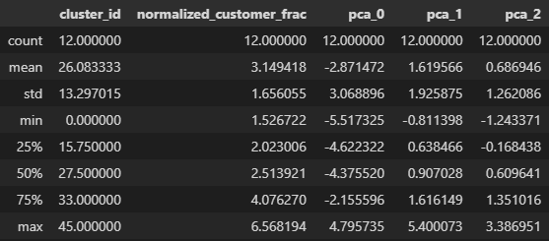
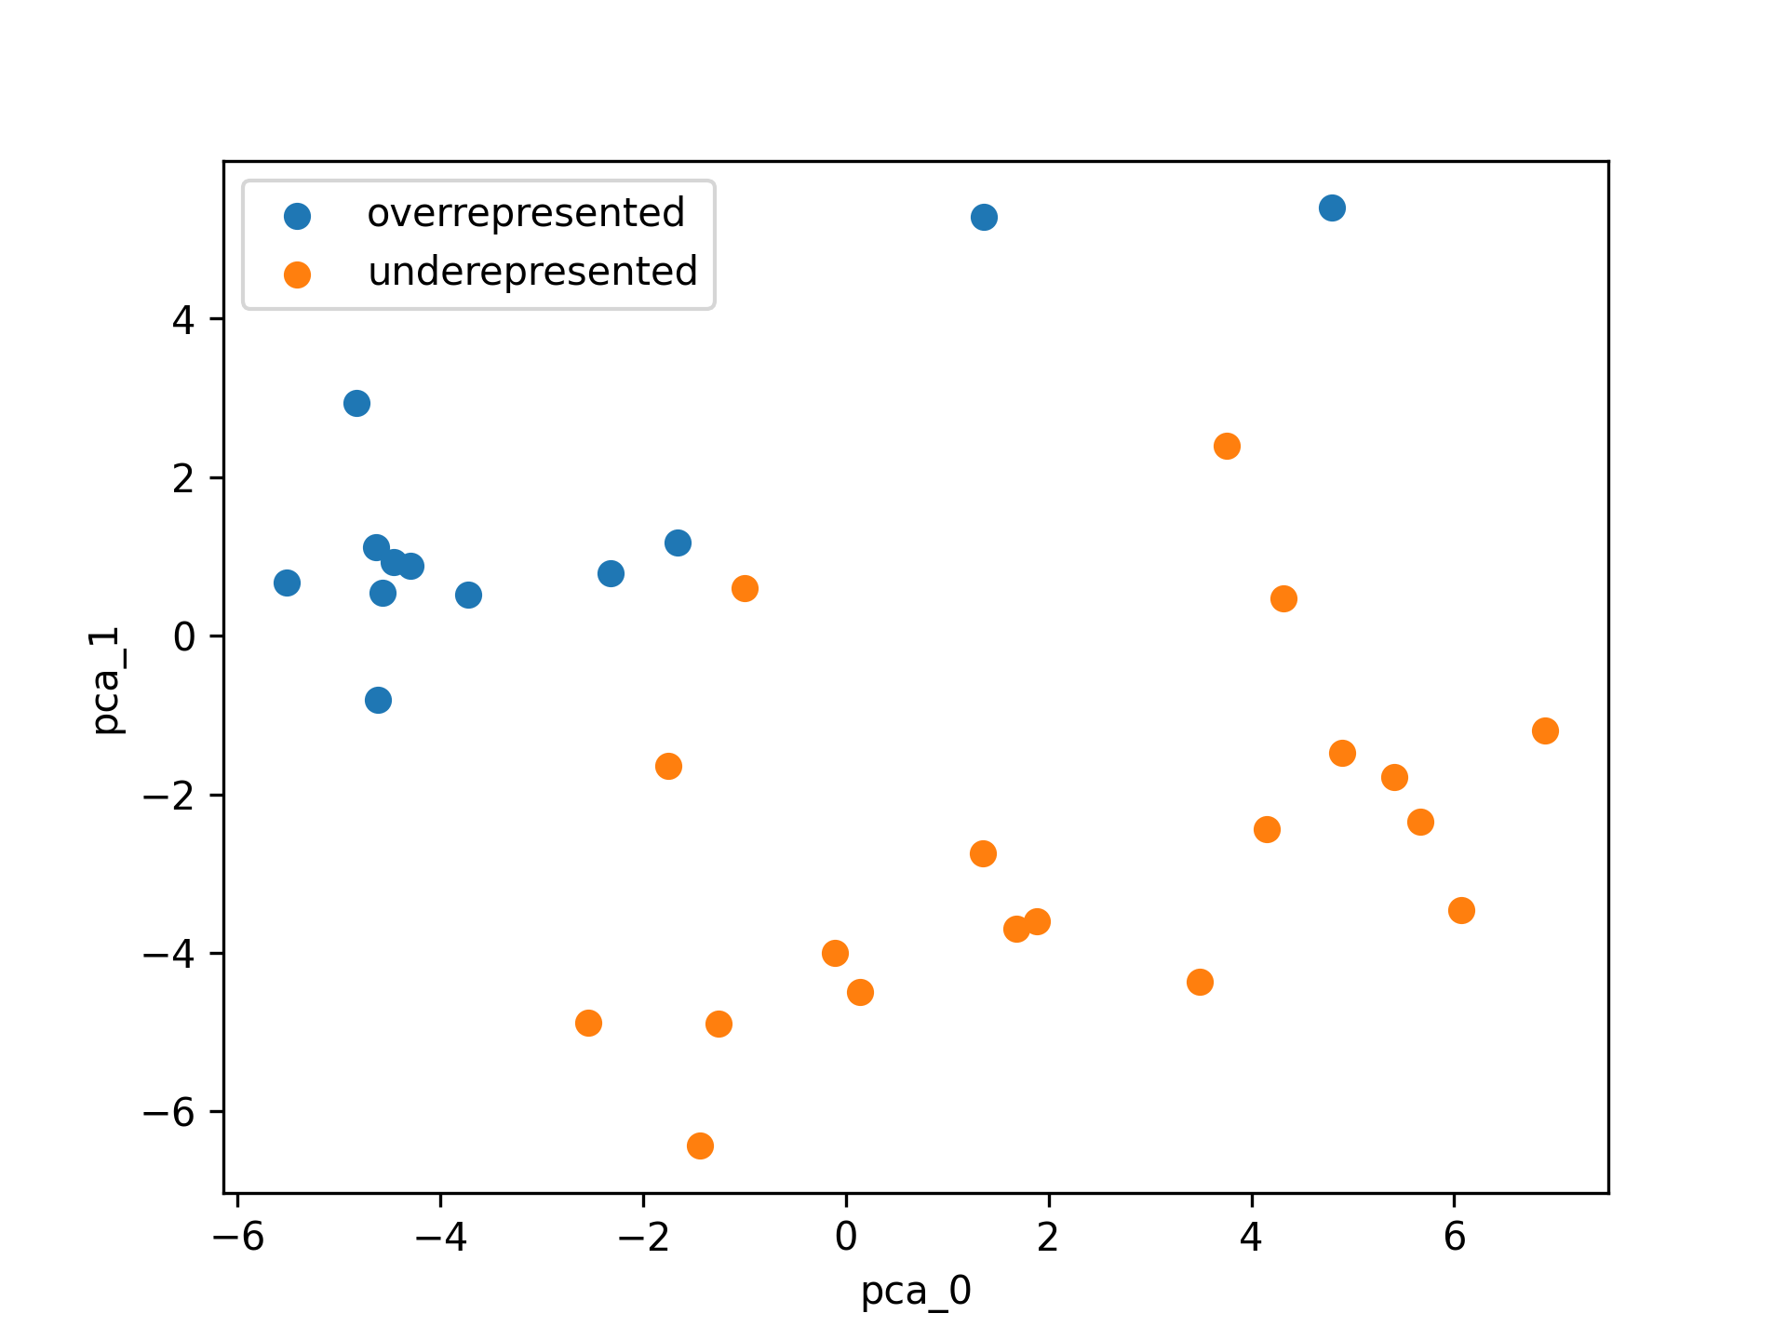
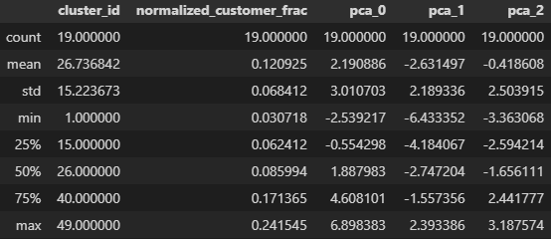
Overrepresented stats
Cluster centroids for greatest customer over- and under- representation relative to the general population
Older “money saver”
Underrepresented stats
Younger “be prepared”
High income
Low income

Slide 2
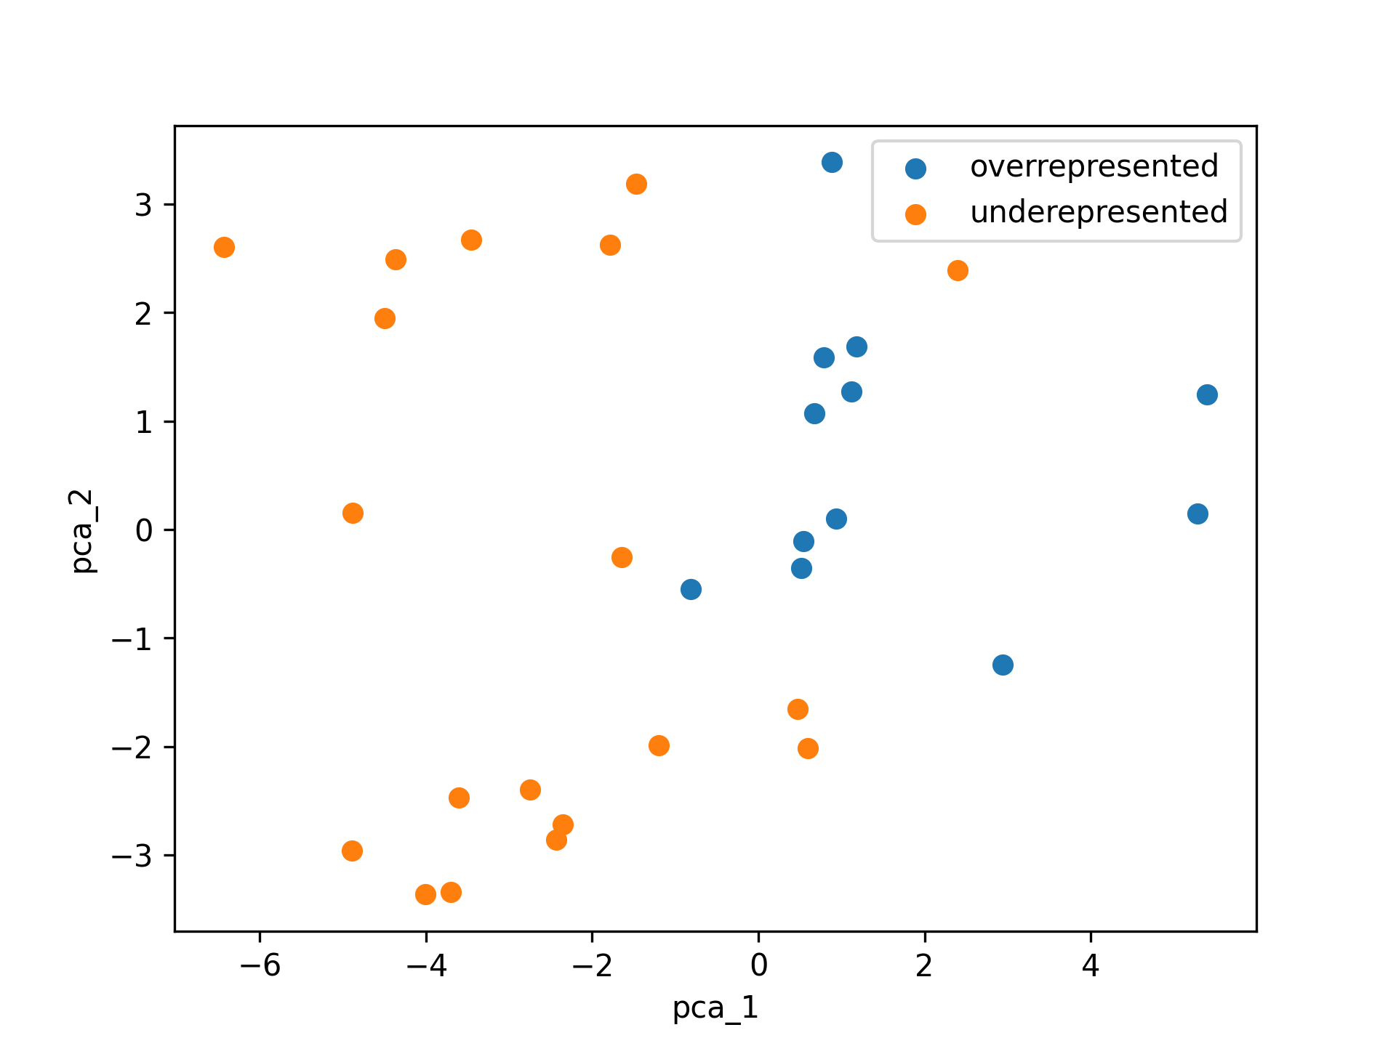
Cluster centroids for greatest customer over- and under- representation relative to the general population
Critical-minded investors
Family-oriented non-investors
Younger “be prepared”
Older “money saver”

Slide 3
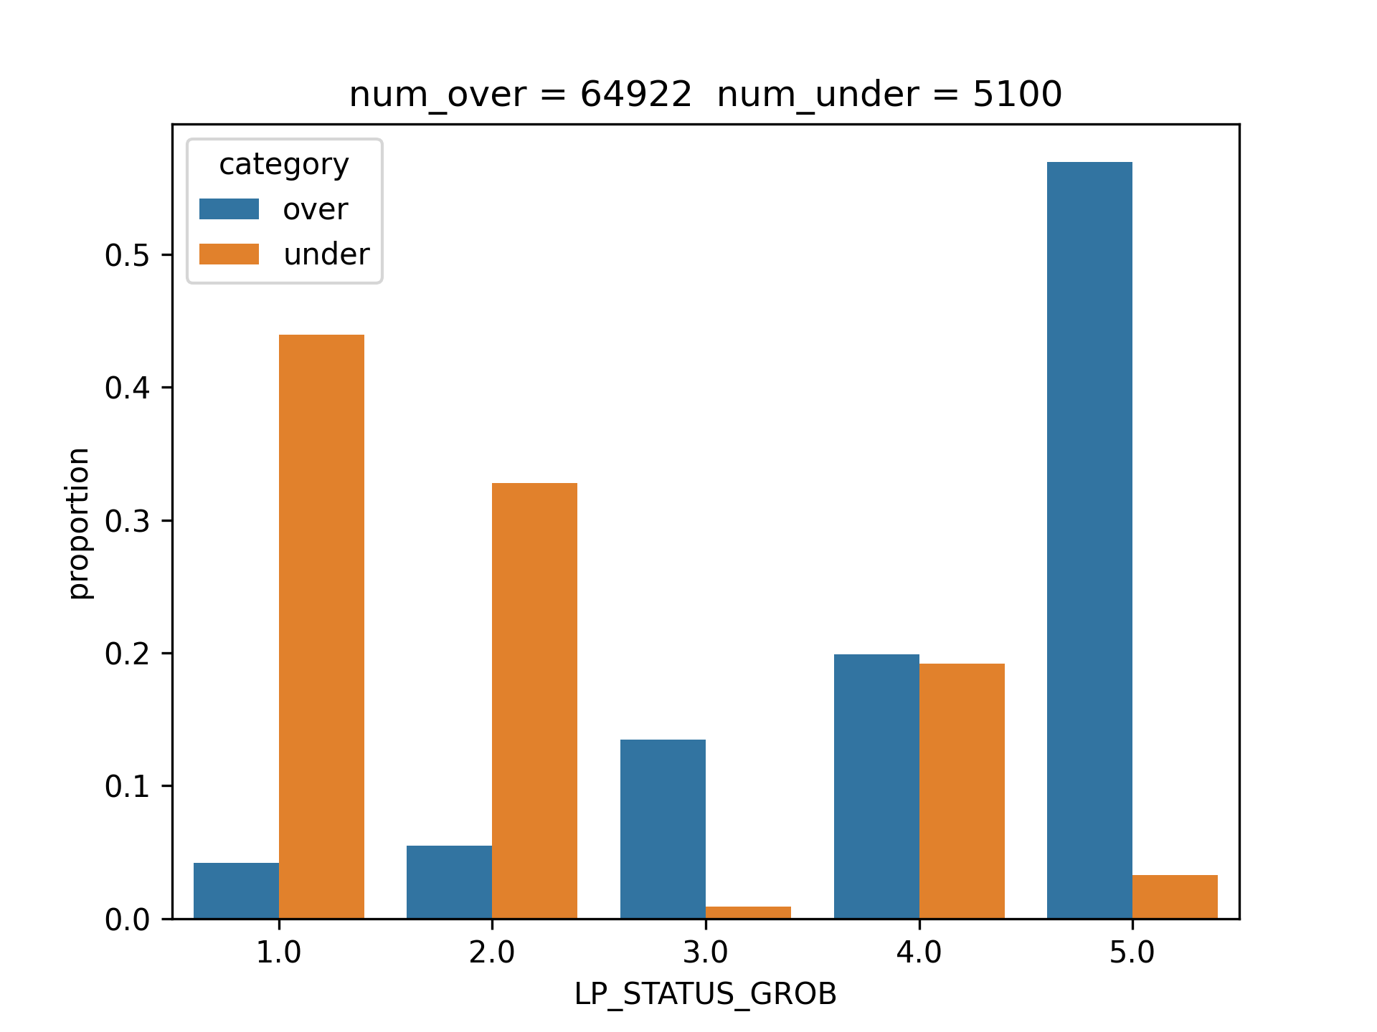
PCA 0 anecdote
### 1.16. LP_STATUS_GROB
Social status, rough scale
- 1: low-income earners (maps to 1-2 in fine scale)
- 2: average earners (maps to 3-5 in fine scale)
- 3: independents (maps to 6-7 in fine scale)
- 4: houseowners (maps to 8-9 in fine scale)
- 5: top earners (maps to 10 in fine scale)
low-income earners
independents
houseowners
top earners
average earners
social status

Slide 4
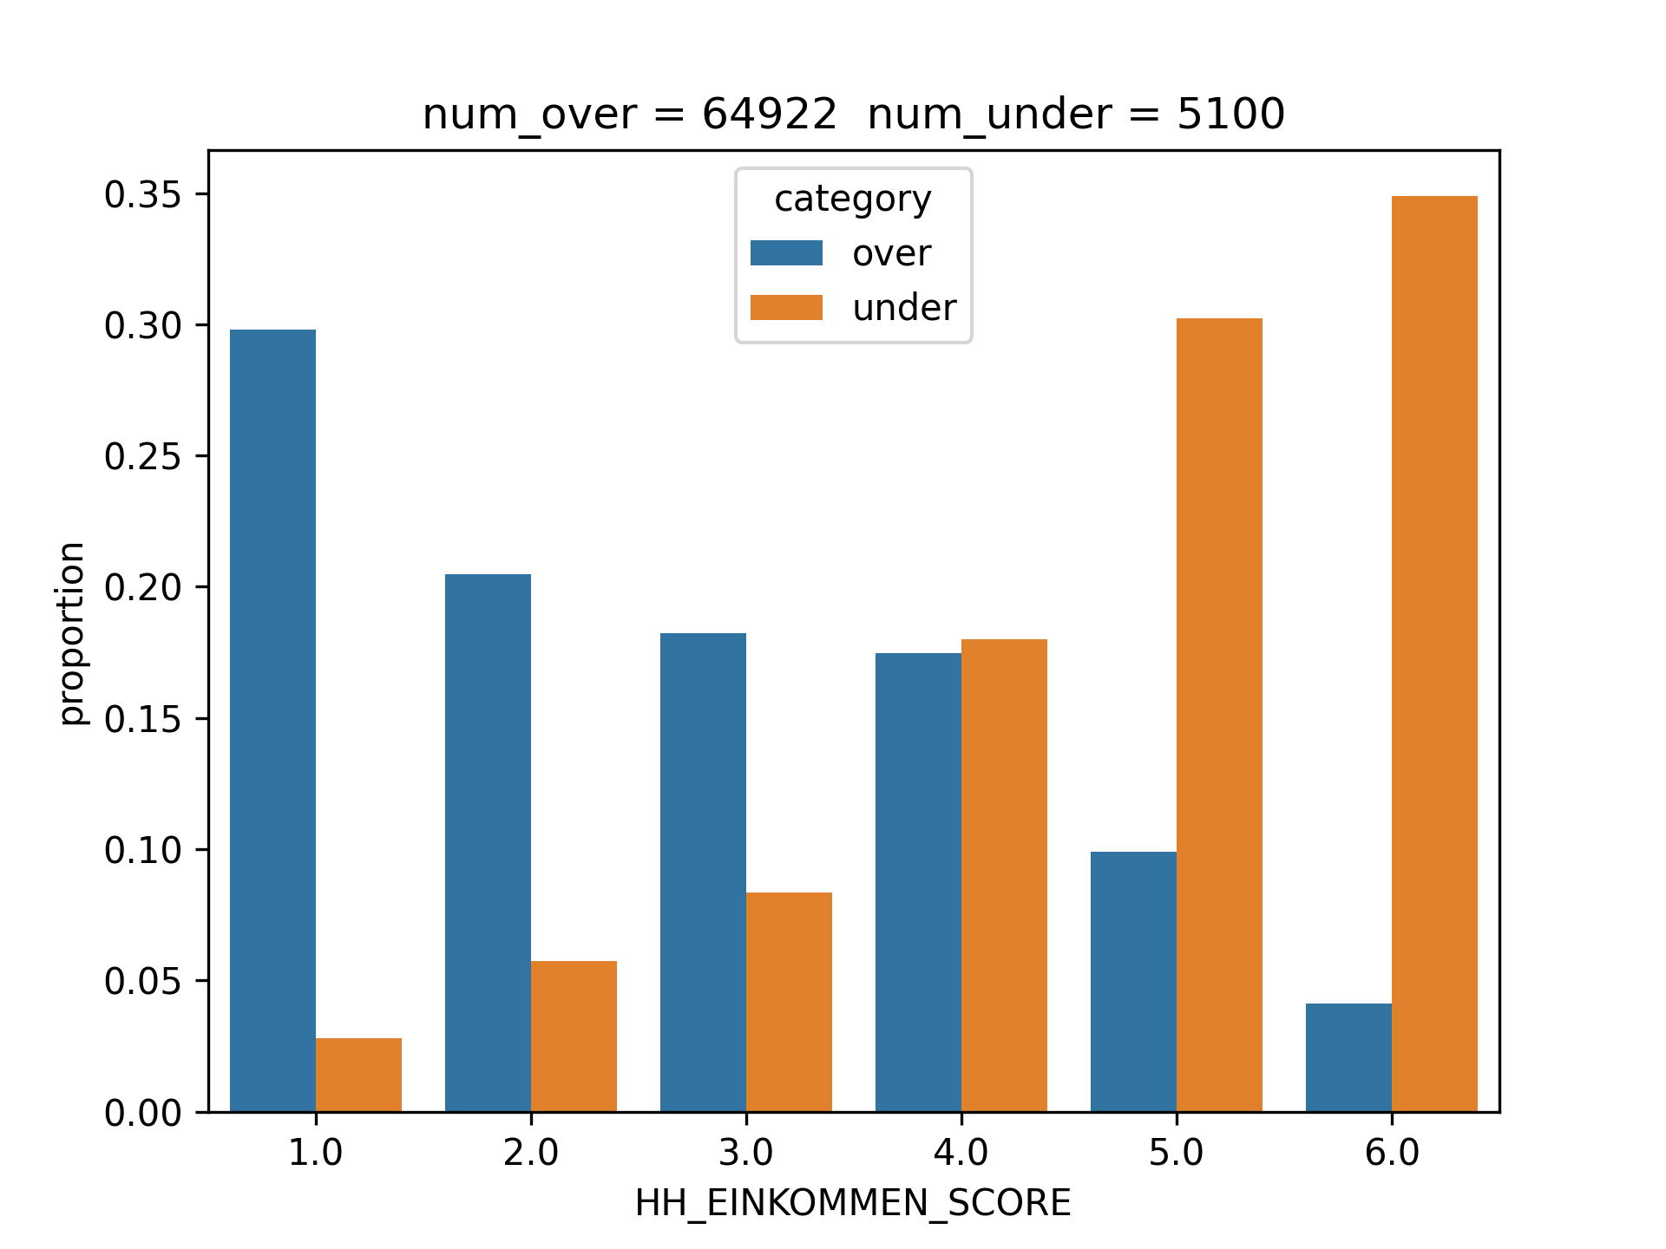
PCA 0 anecdote
### 2.4. HH_EINKOMMEN_SCORE
Estimated household net income
- -1: unknown
- 0: unknown
- 1: highest income
- 2: very high income
- 3: high income
- 4: average income
- 5: lower income
- 6: very low income
highest
very high
high
average
lower
very low
estimated household net income

Slide 5
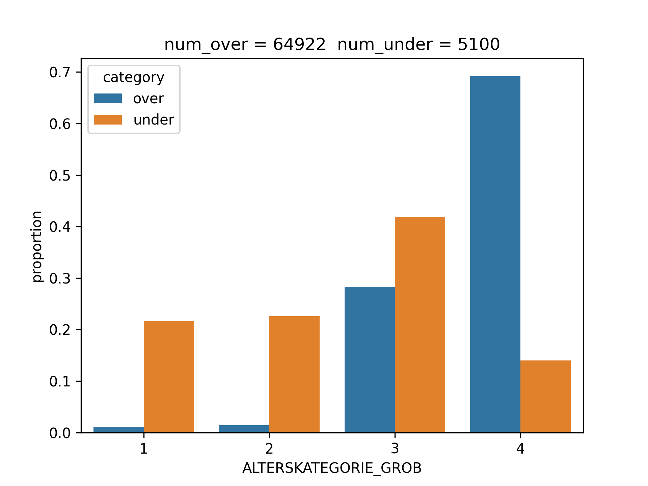
PCA 1 anecdote
### 1.2. ALTERSKATEGORIE_GROB
Estimated age based on given name analysis
- -1: unknown (missing)
- 0: unknown (cannot be determined)
- 1: < 30 years old
- 2: 30 - 45 years old
- 3: 46 - 60 years old
- 4: > 60 years old
- 9: uniformly distributed
<30
30-45
46-60
>60
Age (years)

Slide 6
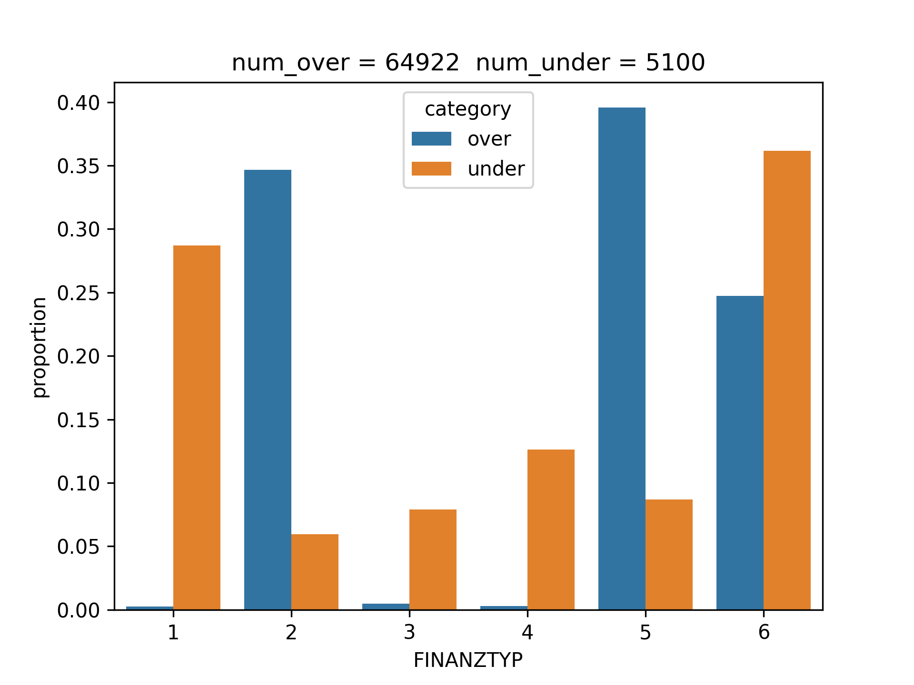
PCA 1 anecdote
### 1.6. FINANZTYP
Most descriptive financial type for individual
- -1: unknown
- 1: low financial interest (MINIMALIST)
- 2: money-saver (SPARER)
- 3: home ownership (HAUSBAUER)
- 4: be prepared (VORSORGER)
- 5: investor (ANLEGER)
- 6: inconspicuous (UNAUFFAELLIGER)
low interest
be prepared
investor
money-saver
inconspicuous
home ownership
Financial Type

Slide 7
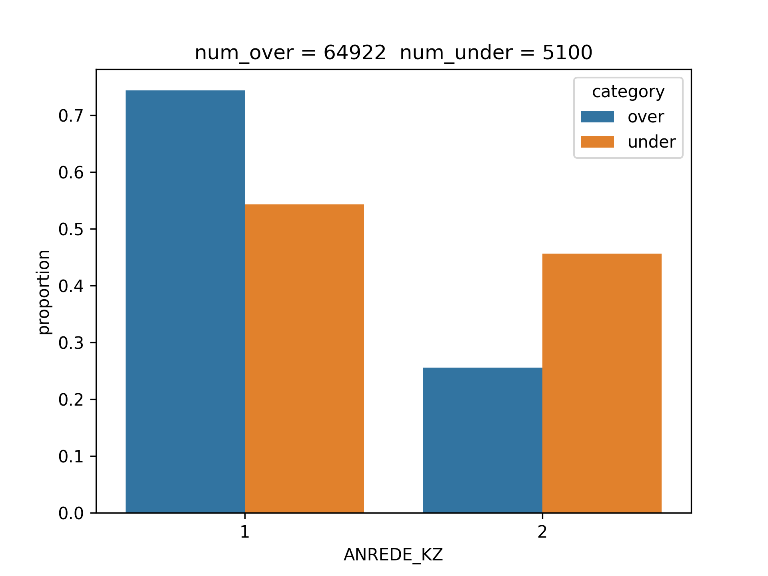
PCA 2 anecdote
### 1.3. ANREDE_KZ
Gender
- -1: unknown (missing)
- 0: unknown (cannot be determined)
- 1: male
- 2: female
Male
Female

Slide 8
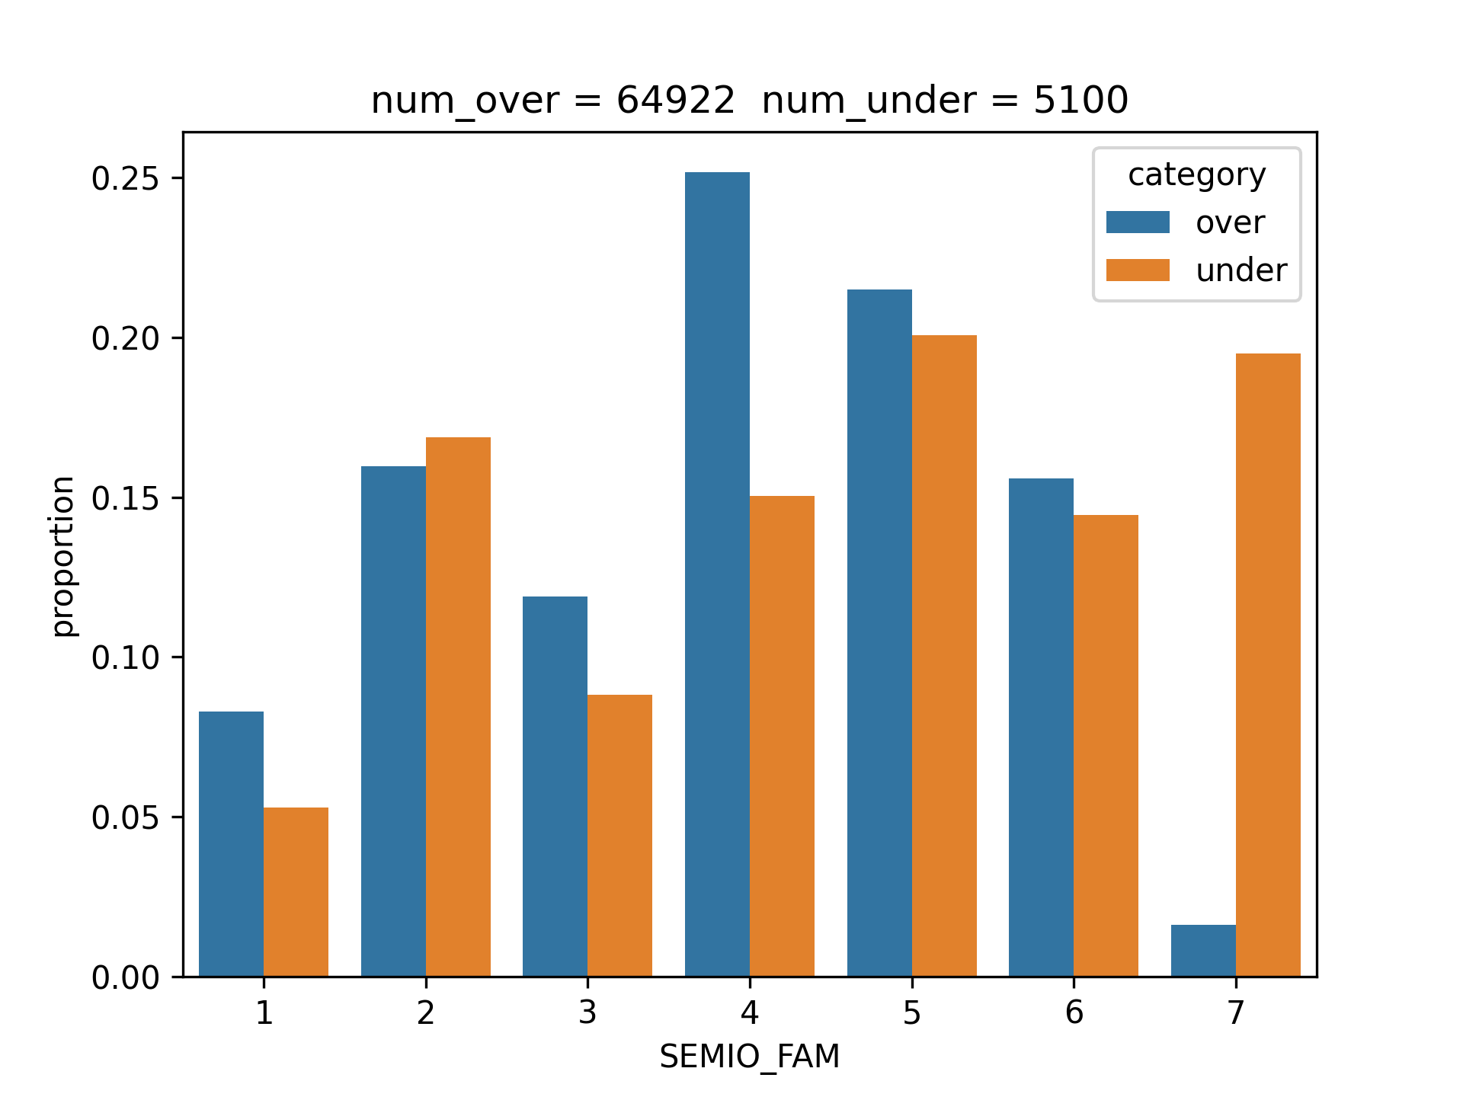
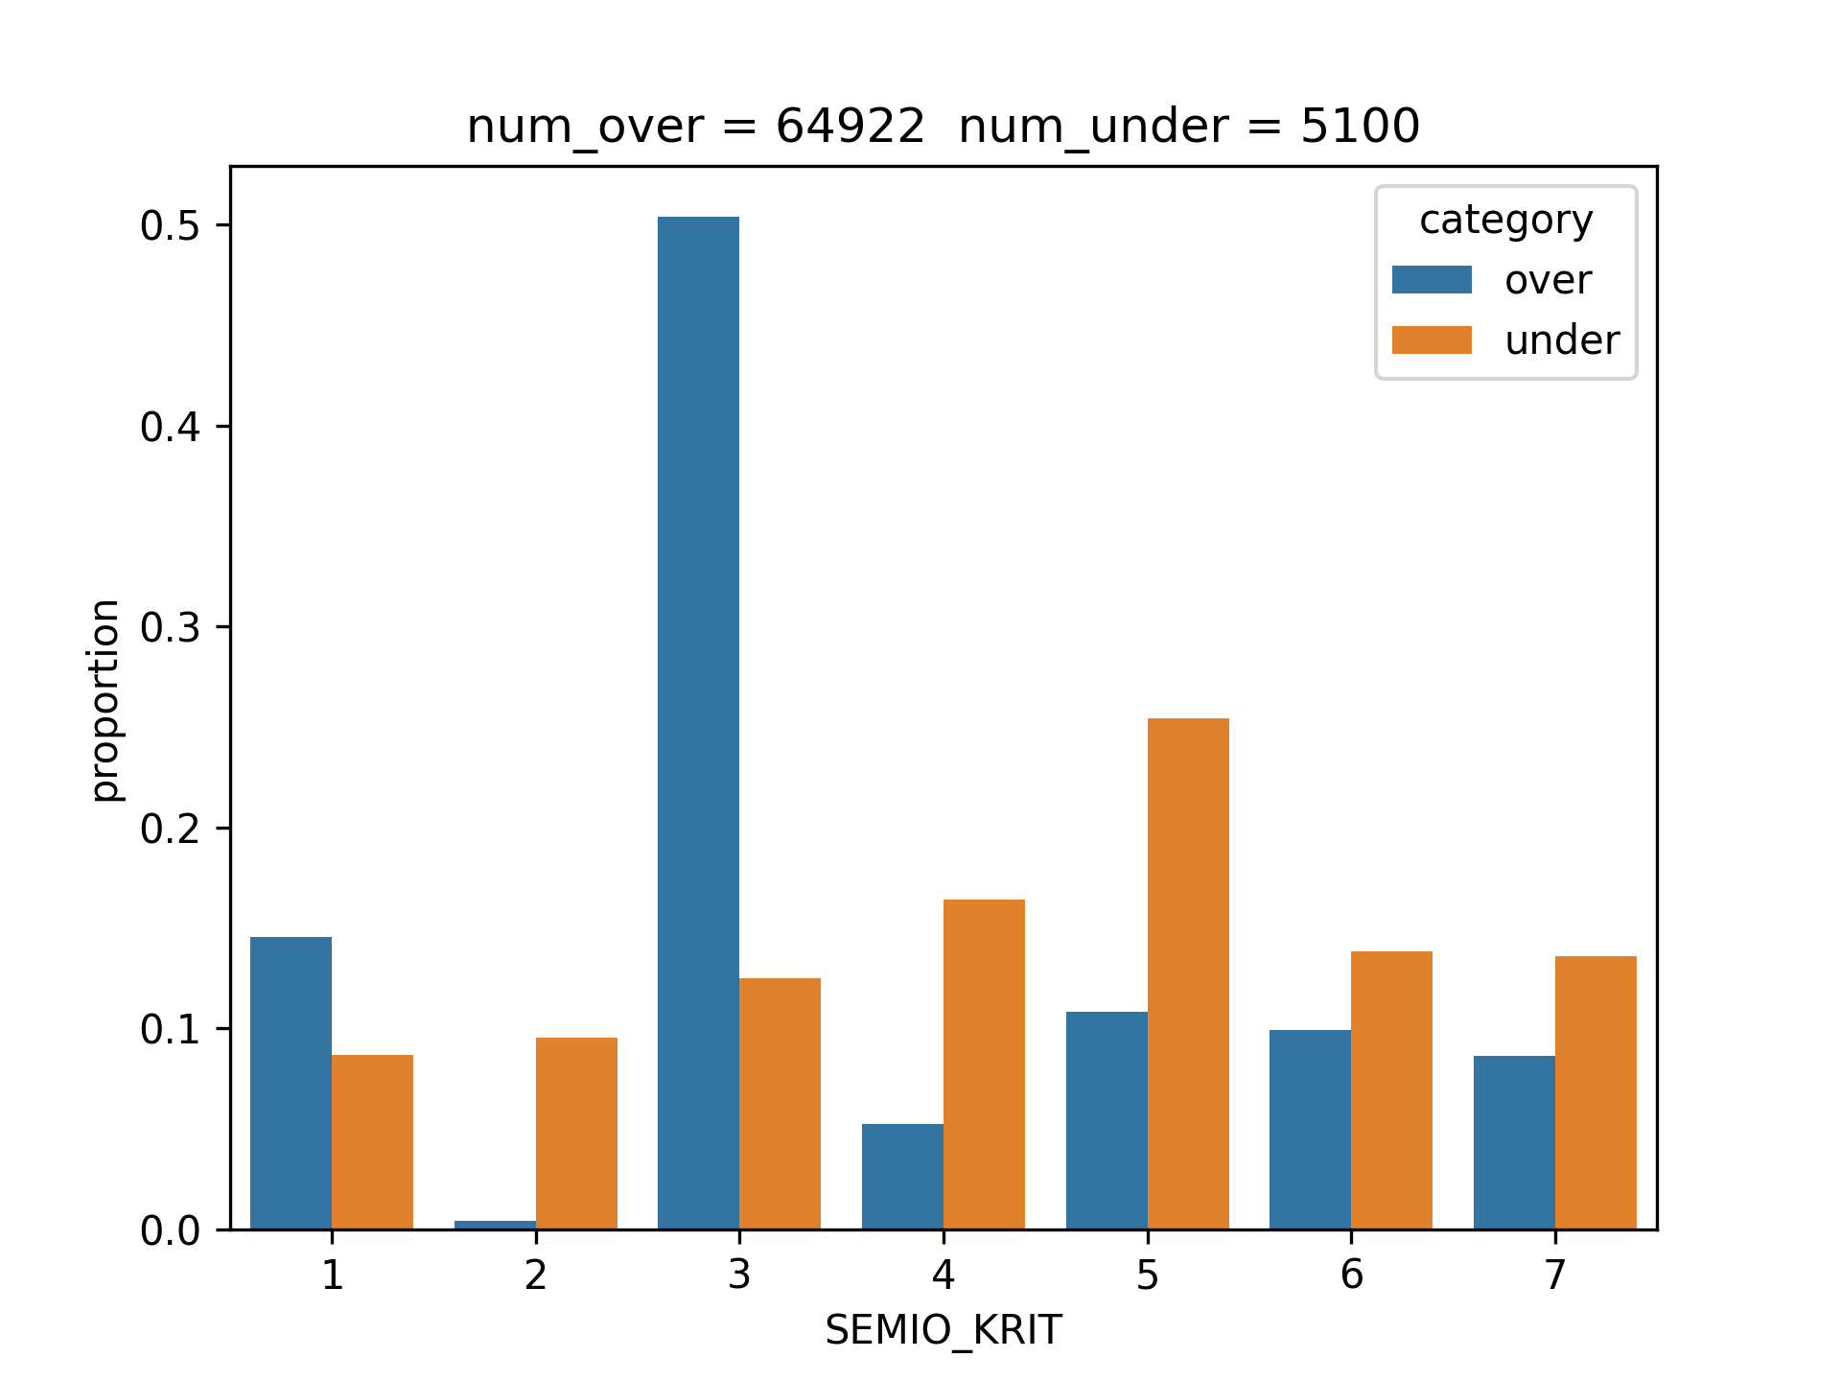
PCA 2 anecdote

Slide 9
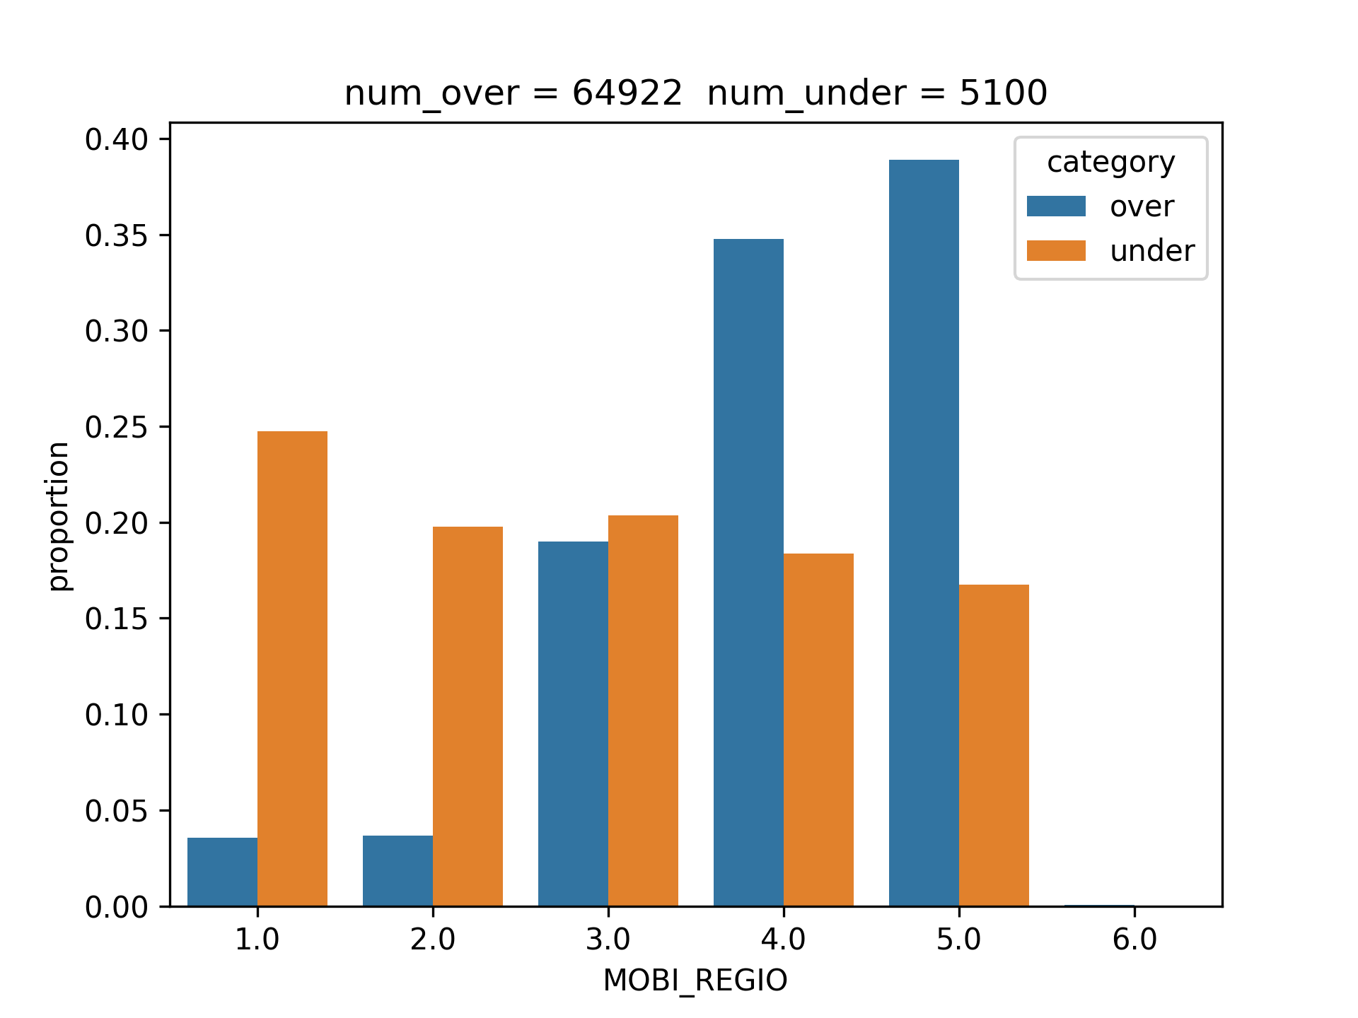
### 7.3. MOBI_REGIO
Movement patterns
- 1: very high movement
- 2: high movement
- 3: middle movement
- 4: low movement
- 5: very low movement
- 6: none
very high
high
middle
low
very low
none
Movement Patterns

