Slide 1
Detecting known and novel mutations in a host's SARS-CoV-2 population by ultra-deep sequencing with unique molecular barcodes
Presented by:
Prof. Dr. Stephan Ossowski
Institute for Medical Genetics and Applied Genomics at the University of Tübingen

Slide 2

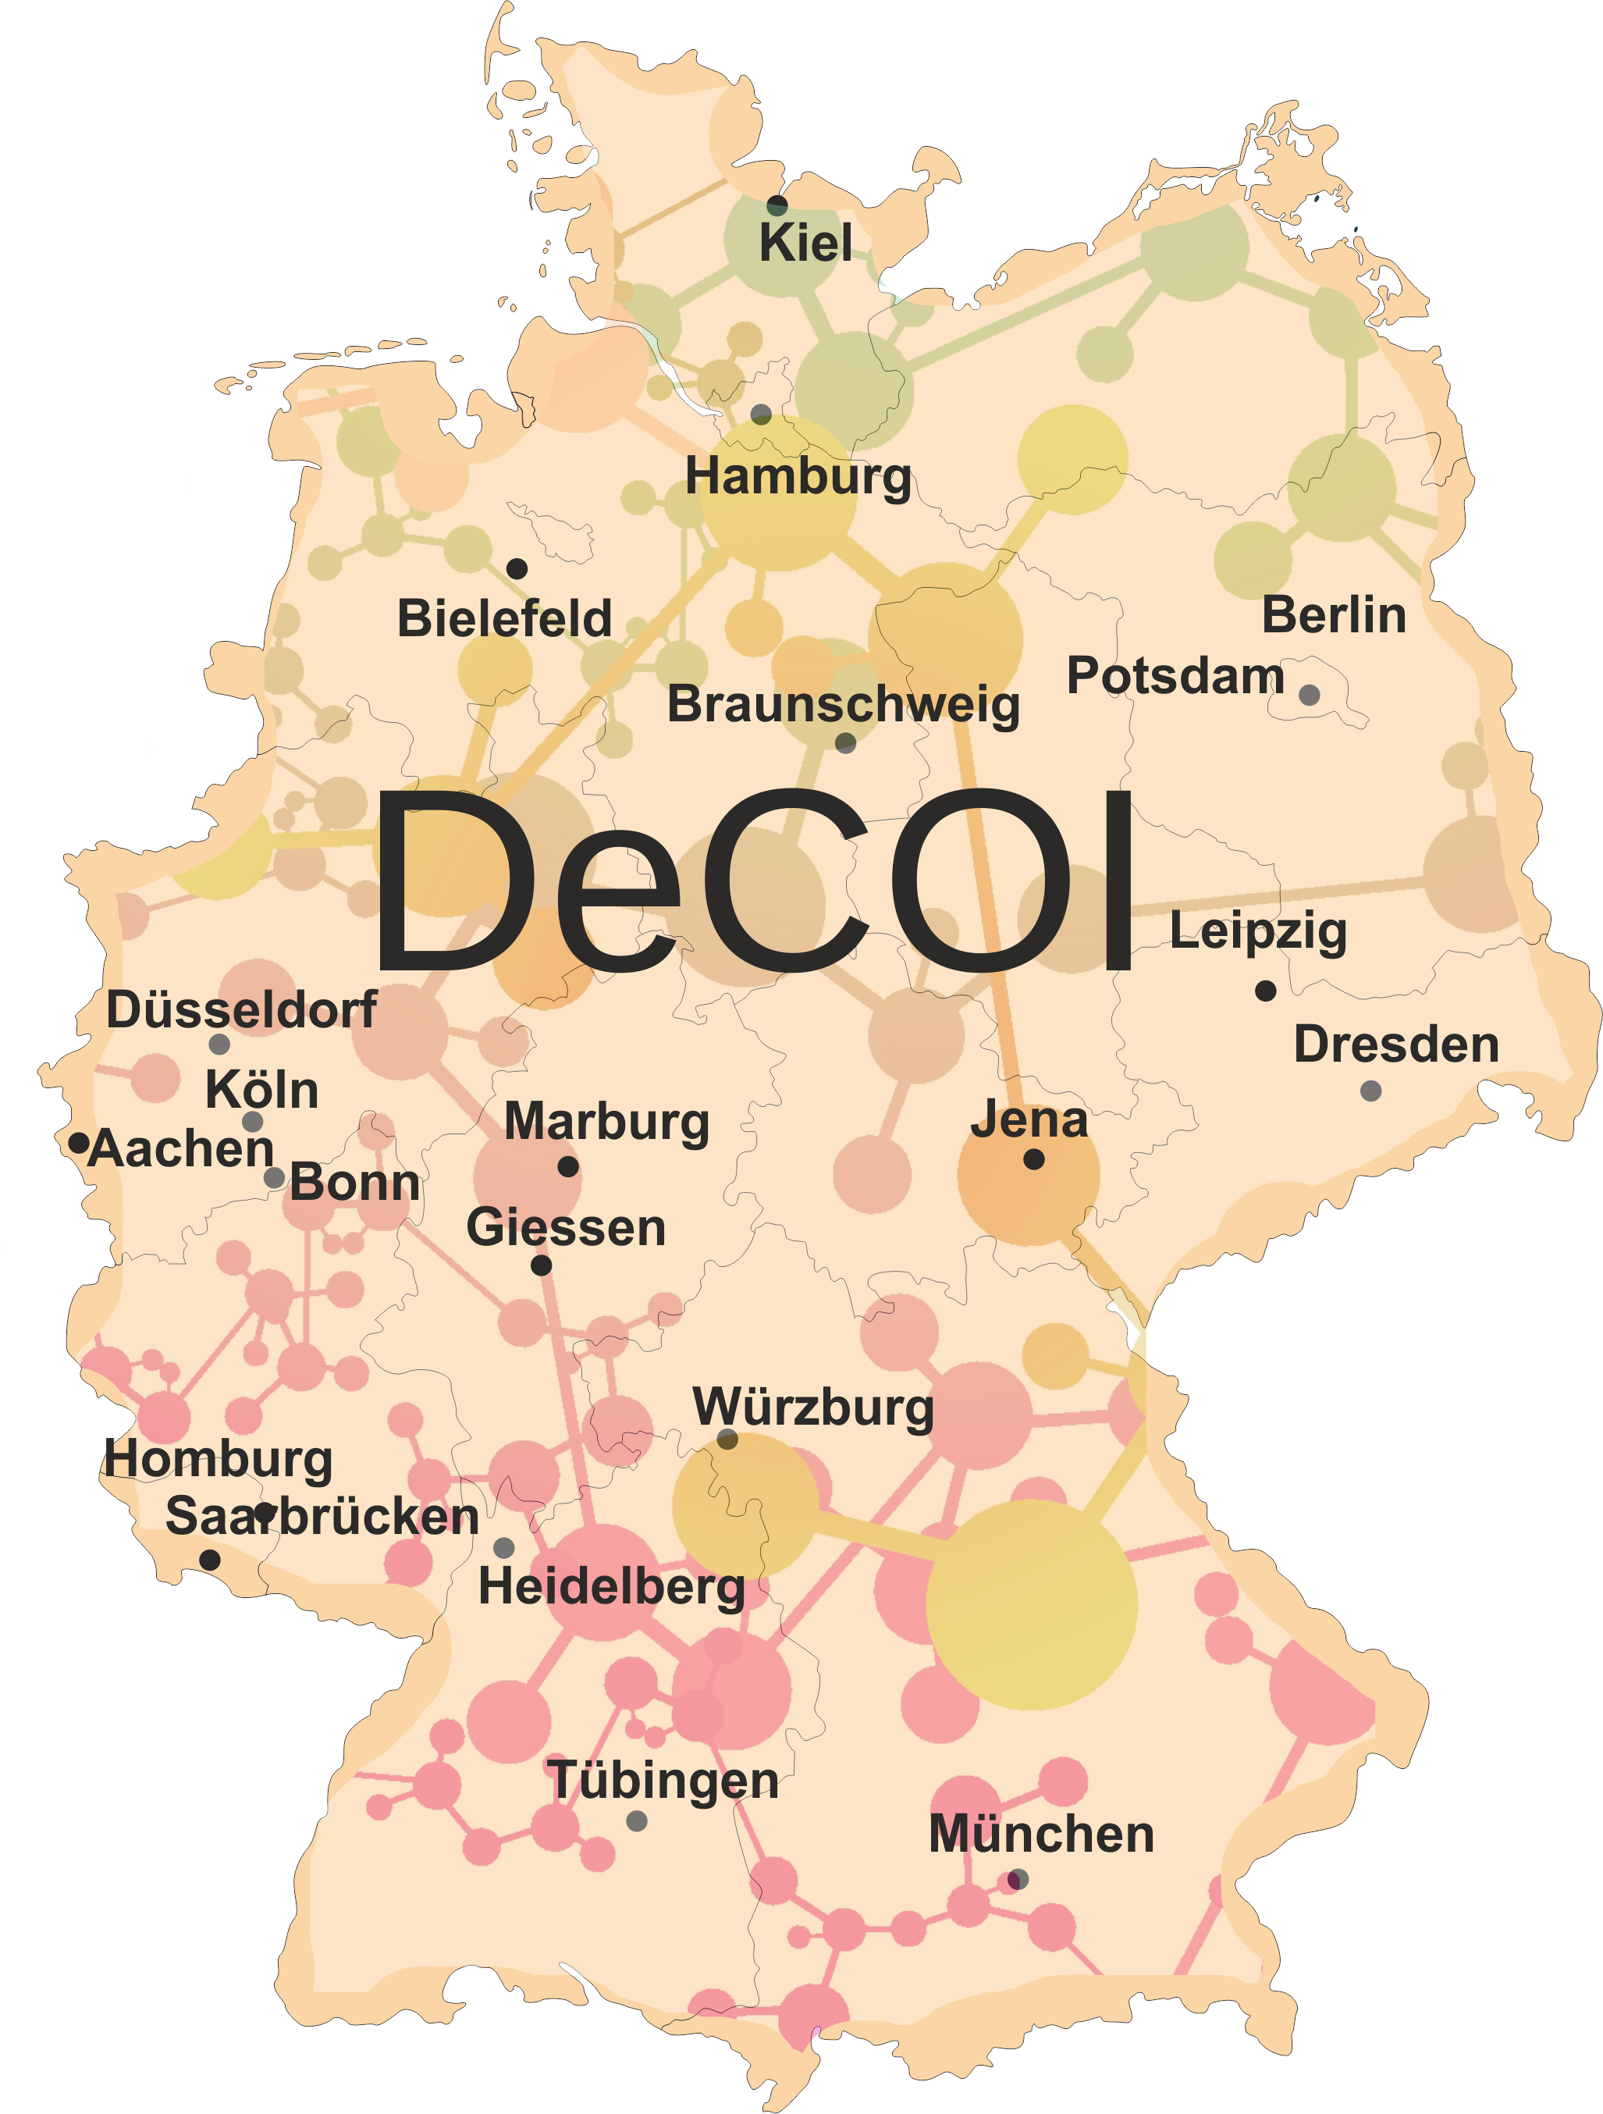










- Viral Genome Sequencing Group
Decentralized / federated
Since March 2020
Heterogeneous sequencing landscape
Various established protocols
Exchange of protocols, best practices, QC materials and tools
Open
Fast data sharing with community
Genomes and metadata submission: GISAID & RKI DESH
Funding sources:
DFG
NUM
Illumina
Central government & states
Lead: Alexander Dilthey (Düsseldorf)

Slide 3
SARS-CoV-2 genome sequencing in Germany: end of last year
GISAID: 753 viral genomes from Germany – 473 from DeCOI members (14 Nov 2020)
DeCOI current numbers:
 | Total | On GISAID
Bielefeld | 135 | 50
Dresden | 30 | 0
Düsseldorf | 477 | 322
Munich | 260 | 1
RKI | NA | 23
Saarbrücken | 65 | 25
Tübingen | 76 | 52
 | 1043 | 473
0.52% | 0.29% | 16.60% | 0.09% | 0.11% | 11.87% | 0.10% | 0.86% | 0.02% | 0.05% | 1.75% | 7.67% | 0.43%
Proportion cases sequenced (WHO/ GISAID)

Slide 4
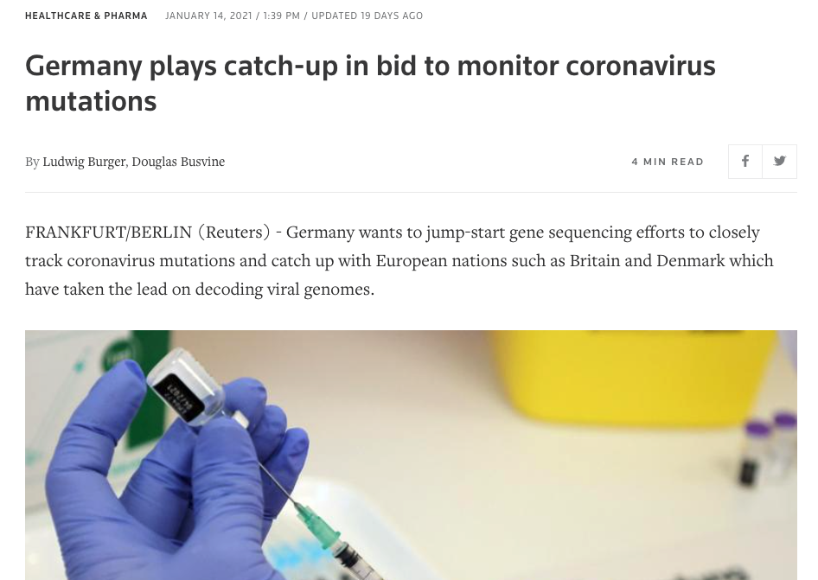
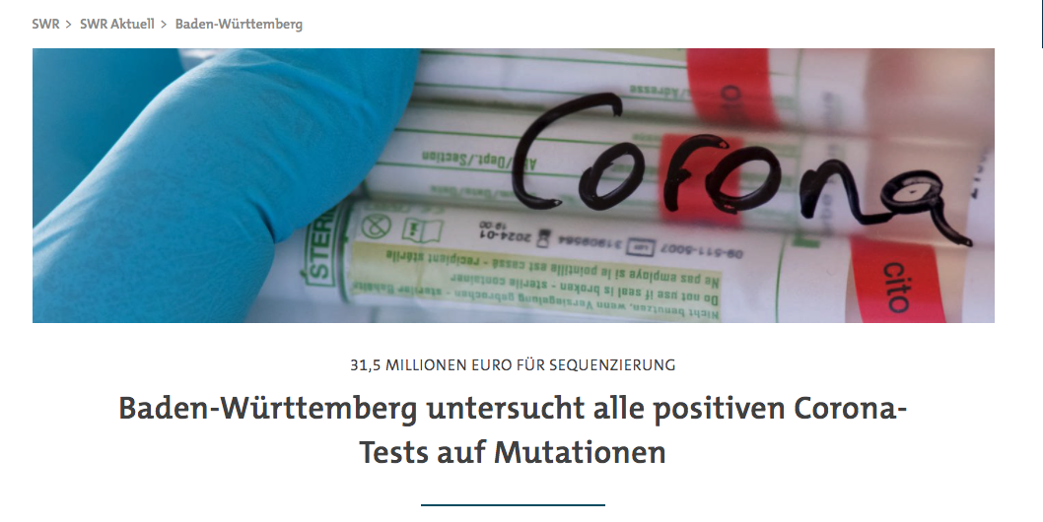
SARS-CoV-2 genome sequencing in Germany: January 2021
Sequencing of viral genomes for 5-10% of positive cases:
State of Baden-Württemberg:
Sequencing of all positive cases

Slide 5
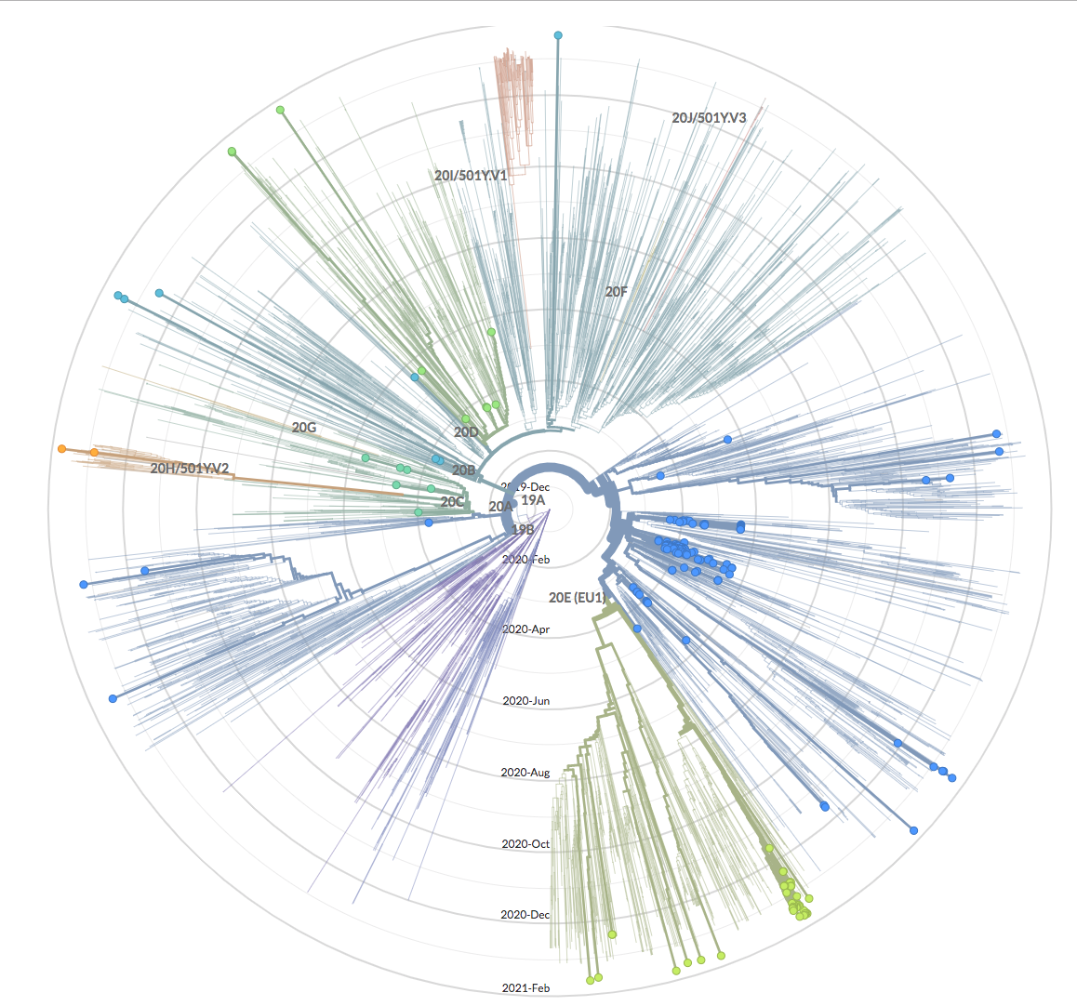
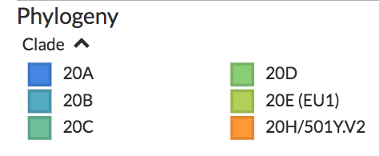
NextStrain: European Clades

Slide 6
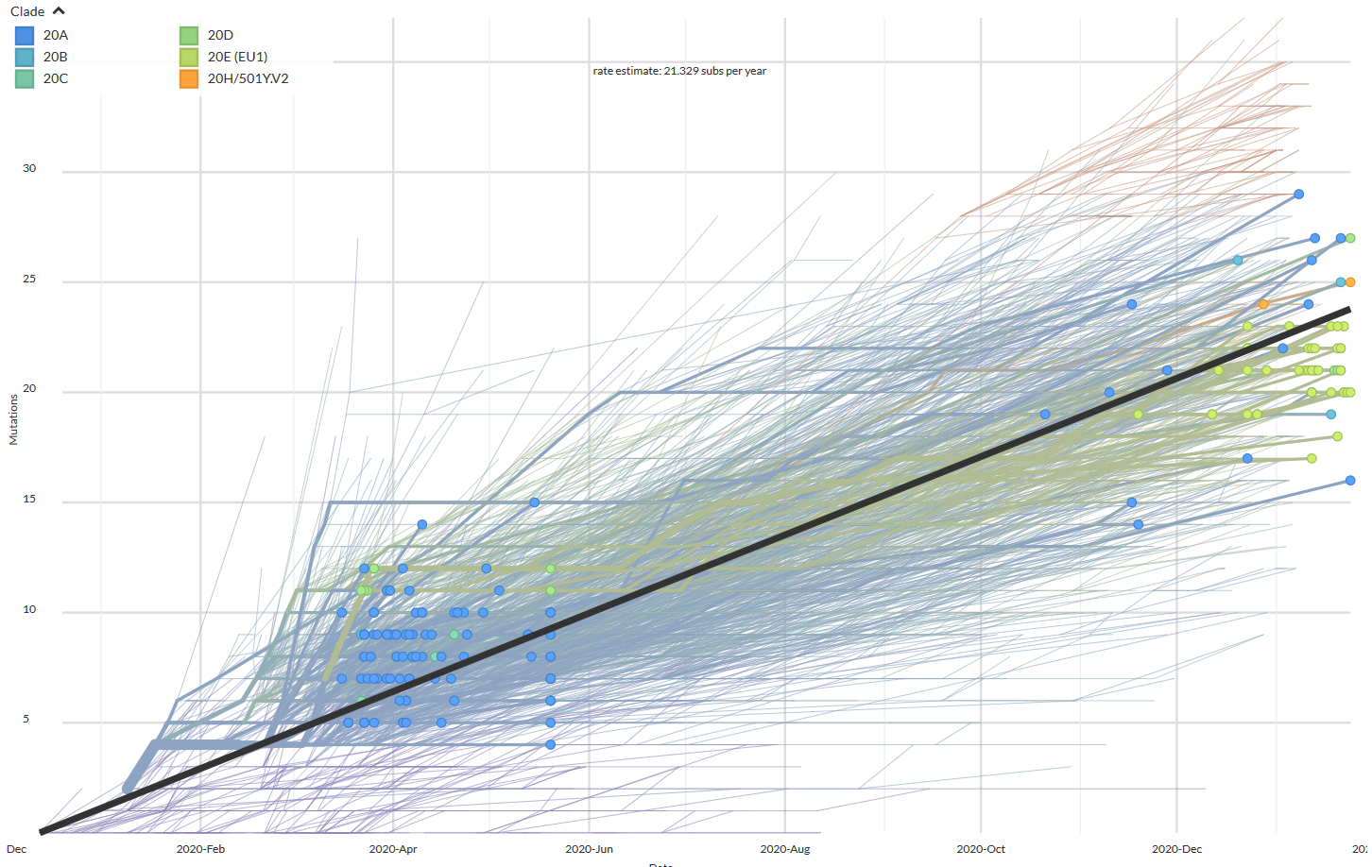
NextStrain: Linearly Increasing Divergence of Strains

Slide 7
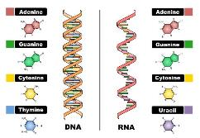
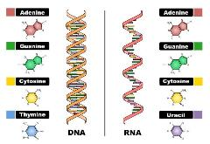
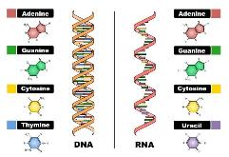
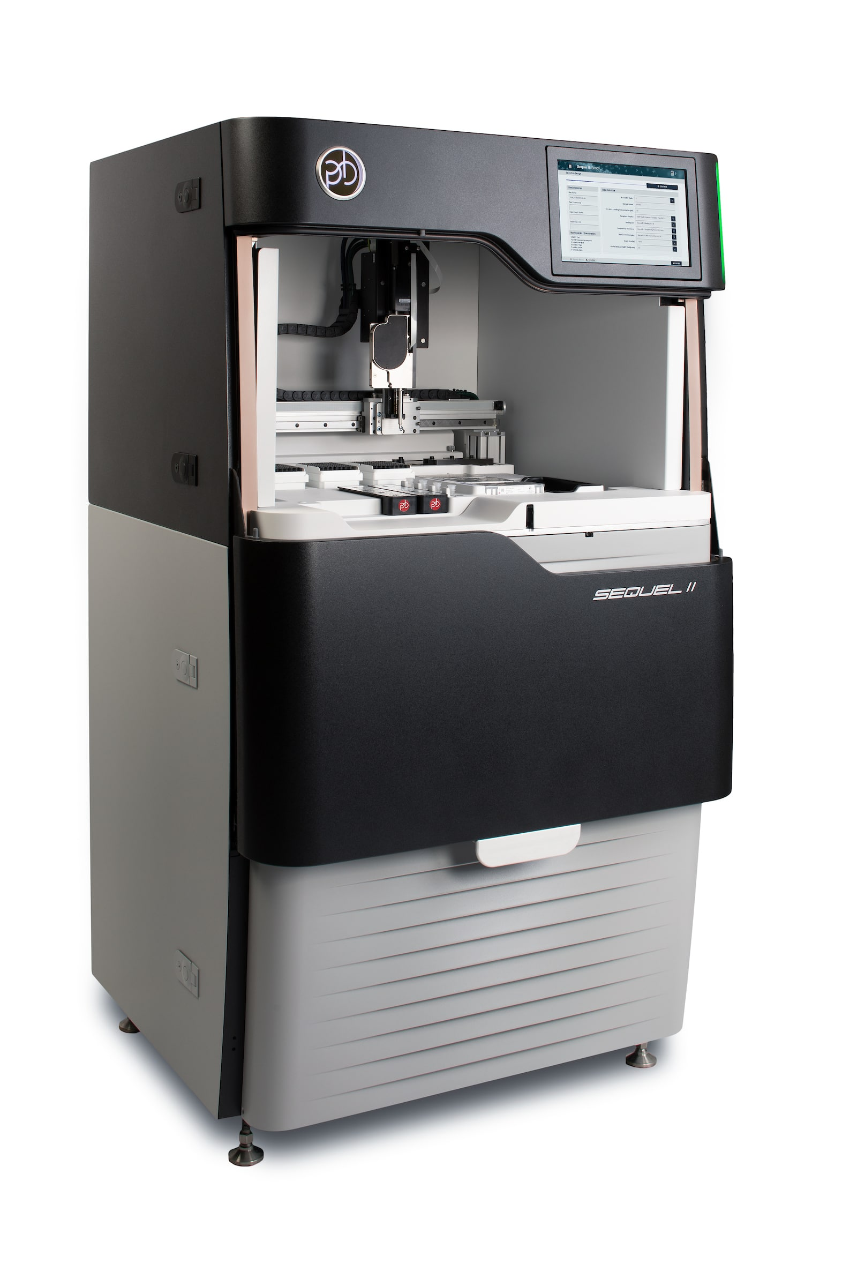
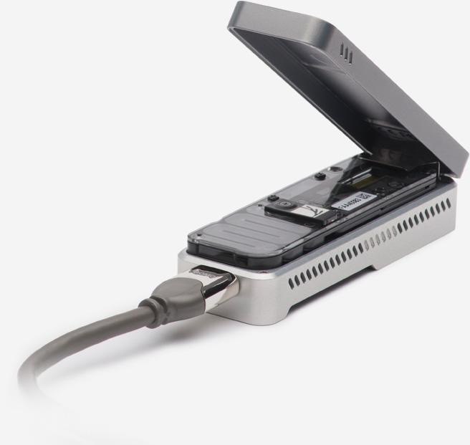
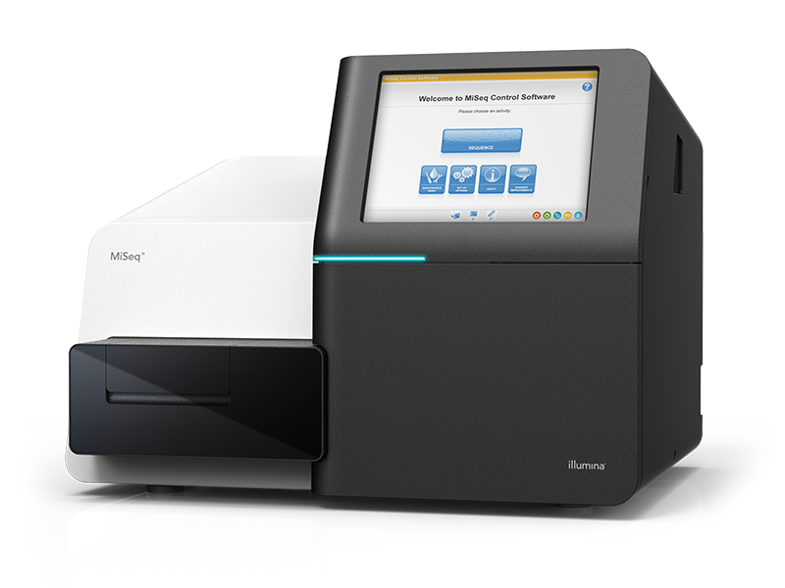
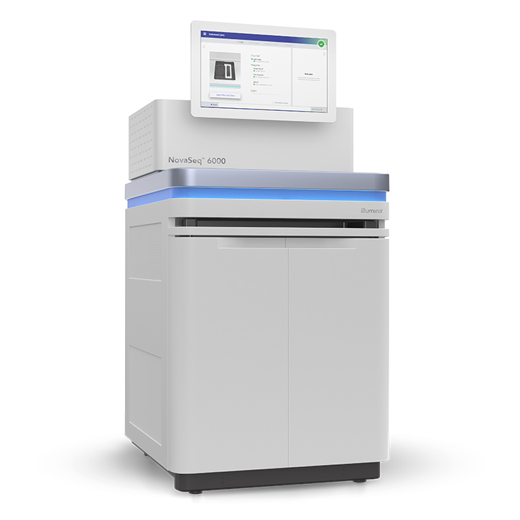
Sequencing Strategies for SARS-CoV2 Genomes
SARS-CoV-2 RNA: 29,882 nt
Reverse transcription of the complete SARS-CoV-2 RNA
PCR amplification
Short and long amplicon panels
Hybridization based enrichment
Twist SARS-CoV2 panel
Short amplicon = ARTIC panel
Read out: MinION or MiSeq
Short amplicon = EDEN panel
Read out: SEQUEL or MiSeq
Twist enrichment panel
Read out: MiSeq or NovaSeq

Slide 8


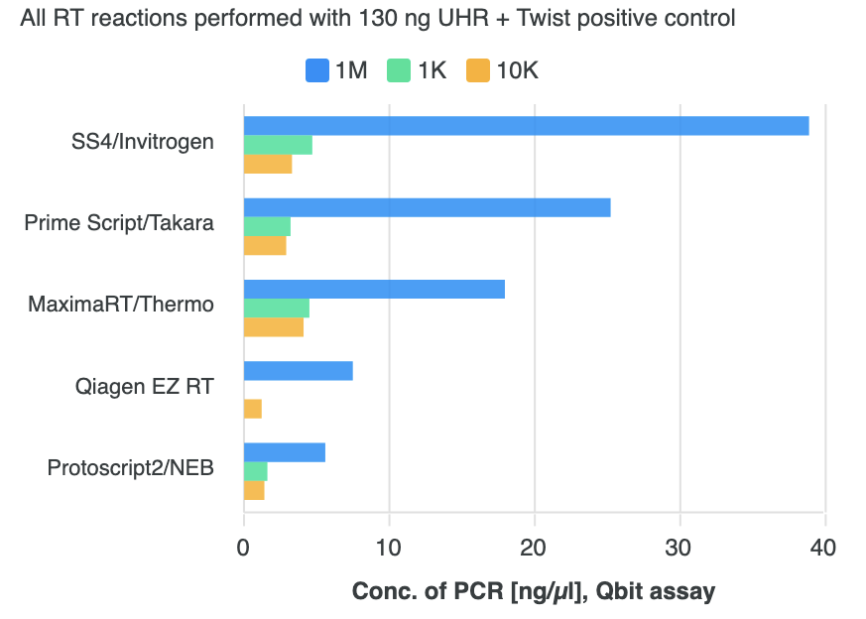
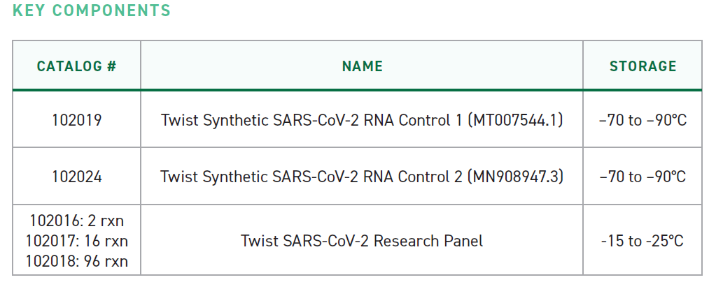
PCR Yield with Reverse Transcriptases
*
1M
10K
1K
*
Angel Angelov, Michael Sonnabend, Silke Peter

Slide 9
Michaela Pogoda (UKT), Tina Han, Ulrike Harms, Oliver Stephan (Twist Bioscience)
Twist SARS-CoV2 Panel
Prepped Library
Fragments
Blocked Library
Fragments
Hybridized Library
Fragments
Bead-Bound
Target Sequences
Universal Blockers and COT-1
TWIST DNA Probes
Streptavidin Beads
Sense Strand
Anti-Sense Strand
Dual Adapters
Biotin
https://www.twistbioscience.com/resources/product-sheet/twist-sars-cov-2-research-panel
Tina Han, Ulrike Harms, Oliver Stephan (Twist Bioscience)

Slide 10
Michaela Pogoda (UKT), Tina Han, Ulrike Harms, Oliver Stephan (Twist Bioscience)
Twist SARS-CoV2 Panel
Prepped Library
Fragments
Blocked Library
Fragments
Hybridized Library
Fragments
Bead-Bound
Target Sequences
Universal Blockers and COT-1
TWIST DNA Probes
Streptavidin Beads
Sense Strand
Anti-Sense Strand
Dual Adapters
Biotin
https://www.twistbioscience.com/resources/product-sheet/twist-sars-cov-2-research-panel
Tina Han, Ulrike Harms, Oliver Stephan (Twist Bioscience)

Slide 11
Prepped Library
Fragments
Blocked Library
Fragments
Hybridized Library
Fragments
Bead-Bound
Target Sequences
Universal Blockers and COT-1
TWIST DNA Probes
Streptavidin Beads
Sense Strand
Anti-Sense Strand
Dual Adapters
Biotin

Slide 12
CT value vs. Viral Copies vs. Seq-Depth
Patient Samples
Synthetic Samples
Coverage
CT 15
CT 22.5
CT 24.2
CT 26.1
CT 26.3
CT 27.8
CT 28.4
CT 28.8
1.000.000 copies
100.000 copies
10.000 copies
1.000 copies
Experiments: Michaela Pogoda
Clinical samples collected & processed by:
Michael Bitzer, Siri Göpel, Tina Ganzenmüller,
Michael Sonnabend, Angel Angelov, Silke Peter, Daniela Bezdan, Angelika Iftner, Thomas Iftner

Slide 13
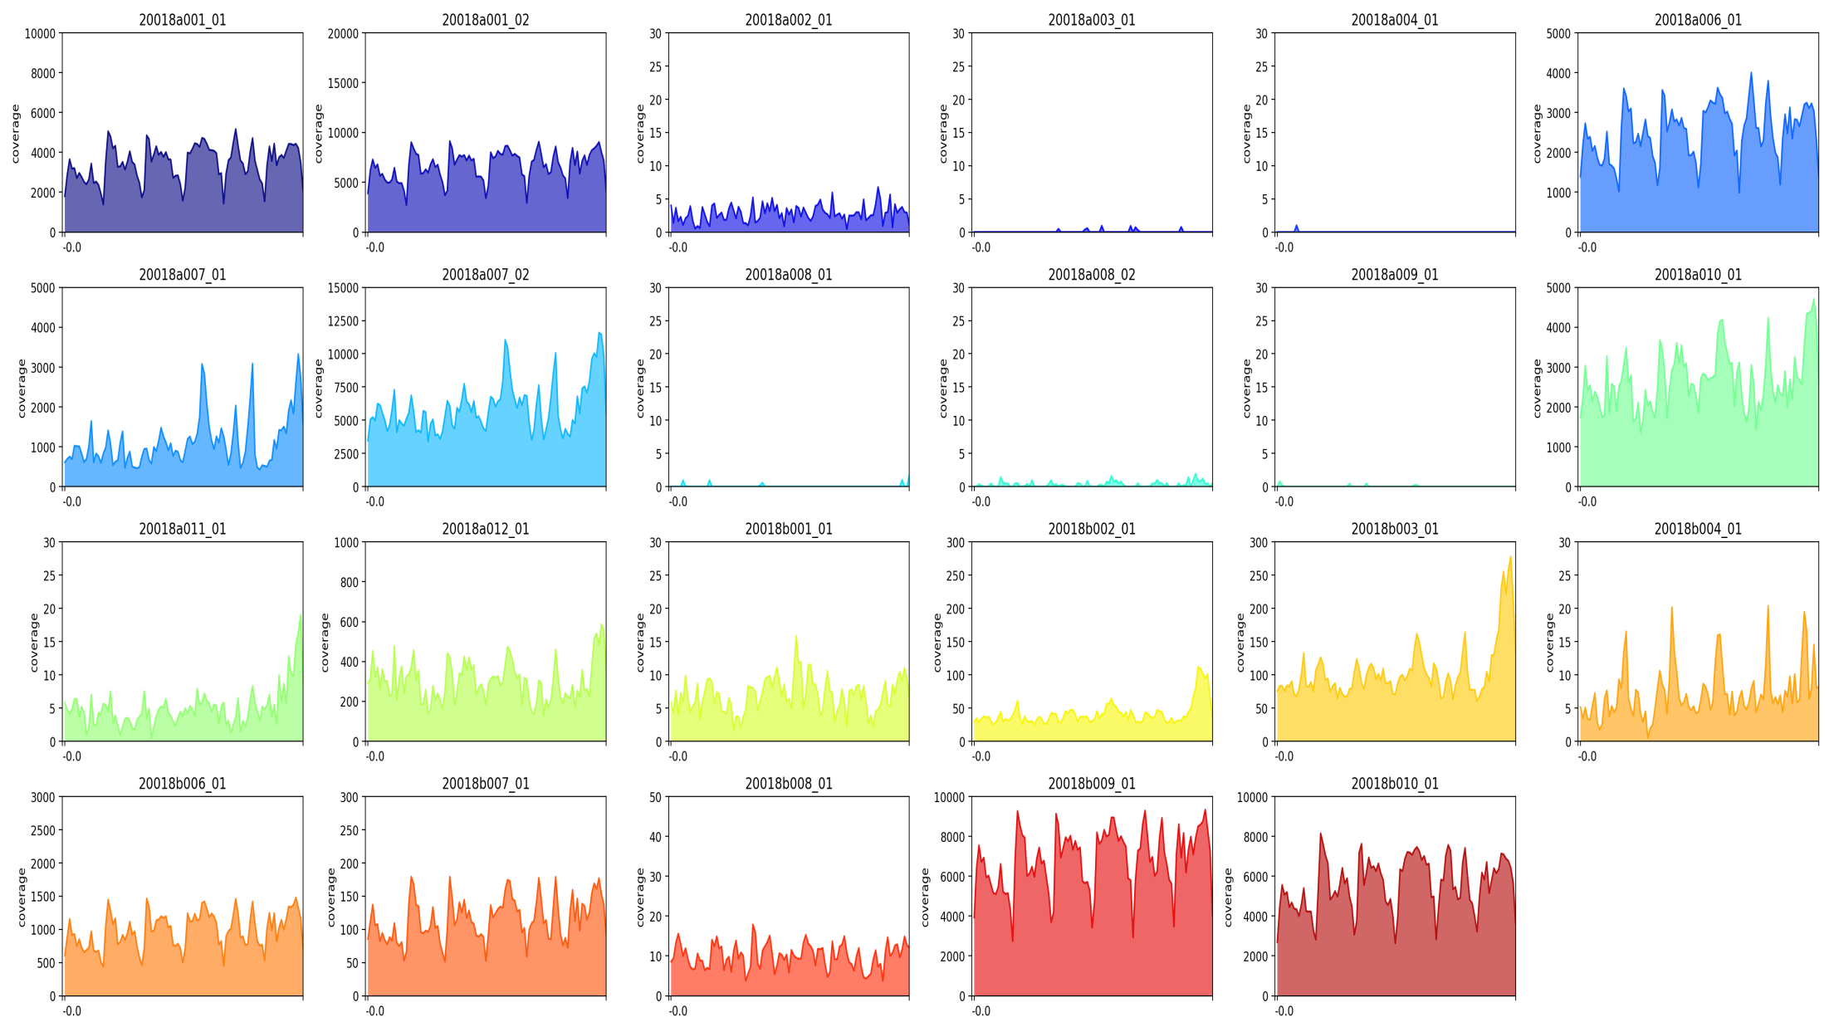

Coverage Profiles & Sequencing Yield
* Dilution: Synthetic SARS-CoV2 copies per ul
1 Mio *
100.000 *
10.000 *
Coverage
1.000 *
100 *
10 *
Genomic position

Slide 14

Coverage Profiles for Clinical Samples
CT 15,0
CT 22,5
CT 24,2
Coverage
CT 26,02
CT 27,8
CT 28,4
Genomic position
CT >30
We do not get continuous coverage for samples with Ct > 28
We get hardly any reads with Ct > 30

Slide 15
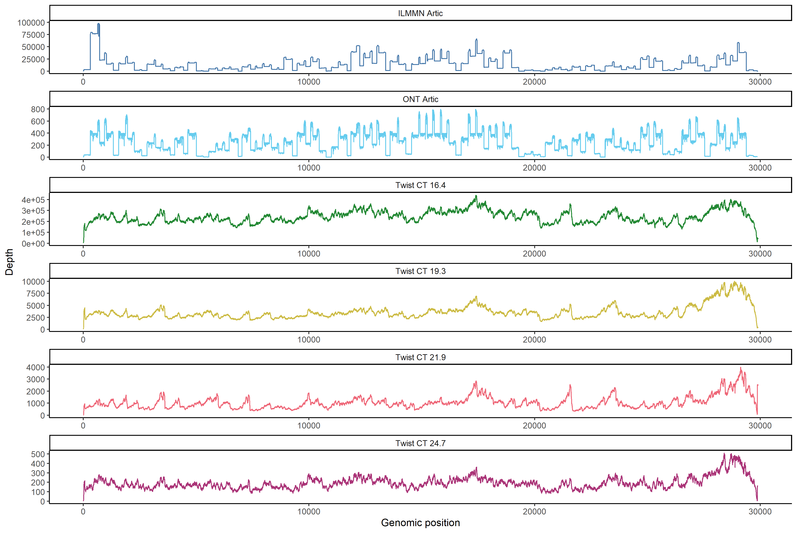
Coverage ARTIC vs. Twist
ILMN Artic
ONT Artic
Twist CT 16.4
Twist CT 19.3
Twist CT 21.9
Twist CT 24.7

Slide 16

Generating Consensus Genome
Remove Human Reads: KRAKEN2
Alignment to Reference: bwa mem
Variant Calling: iVar
Post-processing
Clade Assignment: Pangolin
Consensus Generation: iVar
Phylogeny: NextStrain
Viral Genome
Amino-Acid Anno: NextClade
GISAID
umiVar: https://github.com/imgag/umiVar
Caspar Gross, Ersoy Kocak, Leon Schütz, Jakob Admard

Slide 17
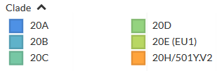
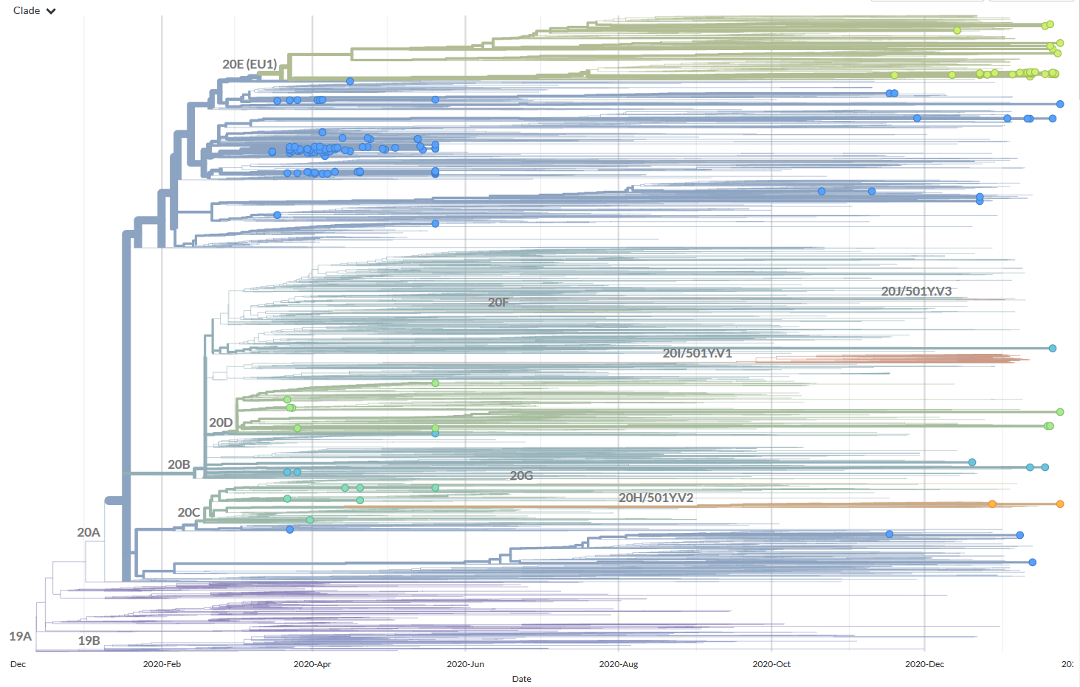
Clades of Samples from Tübingen
xxx

Slide 18
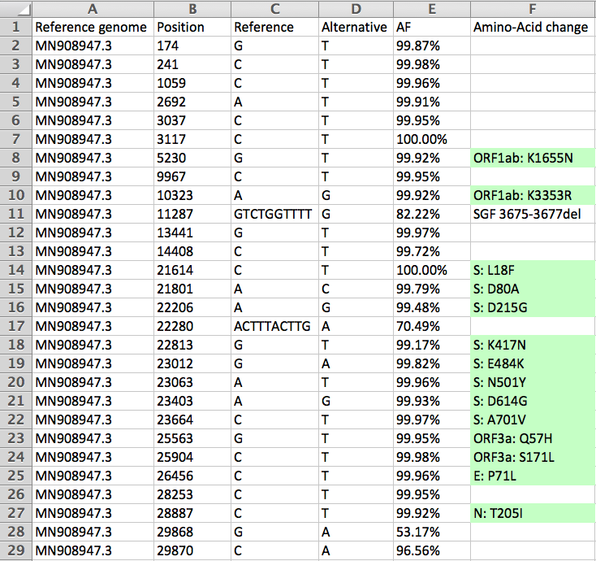
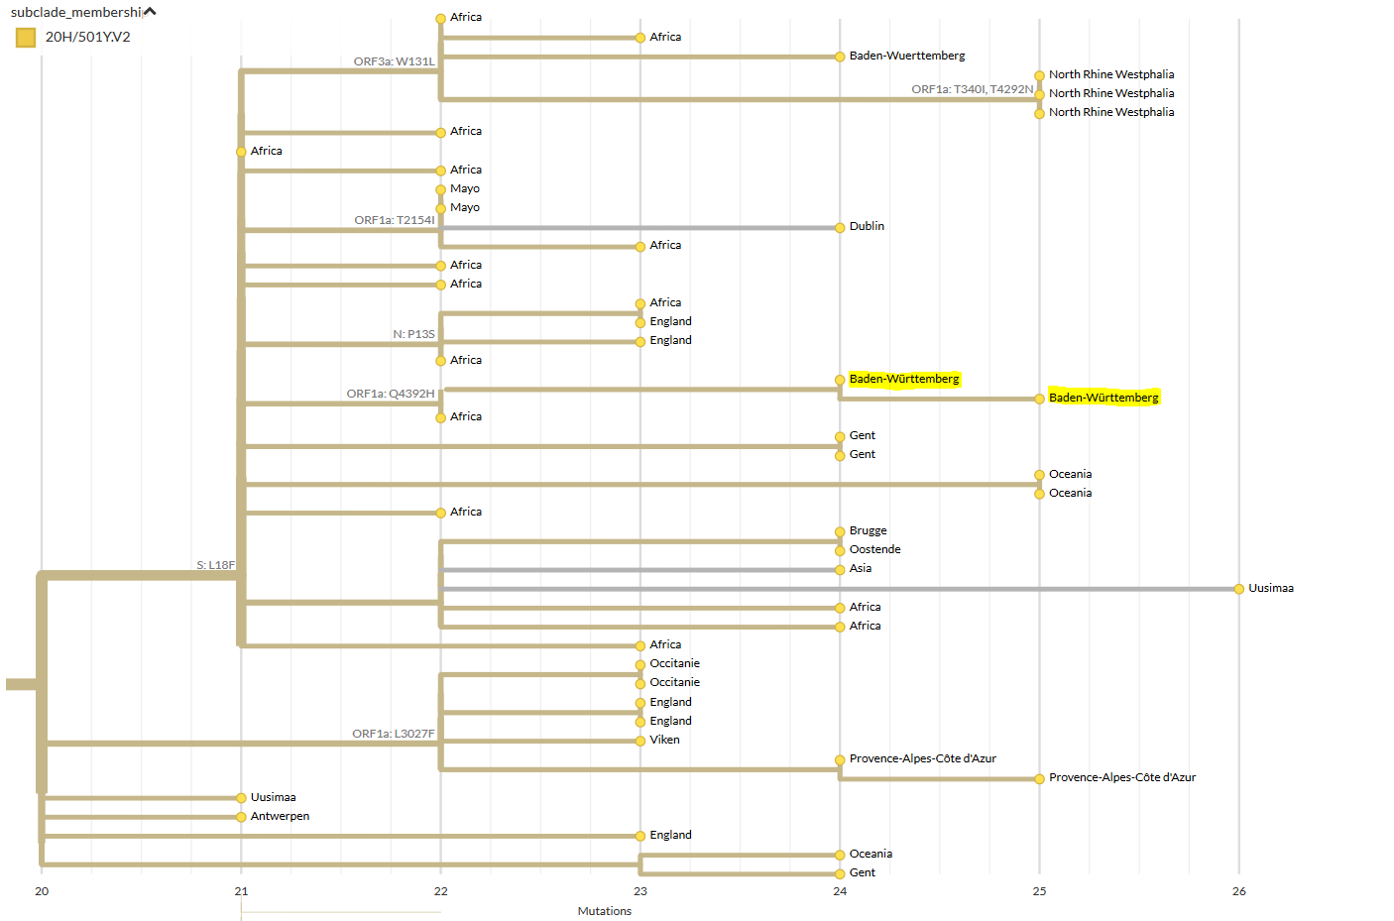
South African B1.351 in Tübingen
Tina Ganzenmüller, Virology, UKT

Slide 19
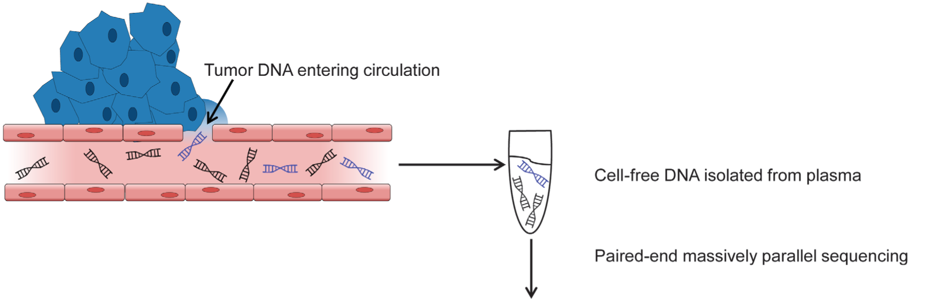
Brainstorming: Liquid Biopsy
Circulating cell-free DNA
Tiny fraction of circulating tumor DNA detected as biomarker of cancer
Identify true somatic mutation

Slide 20
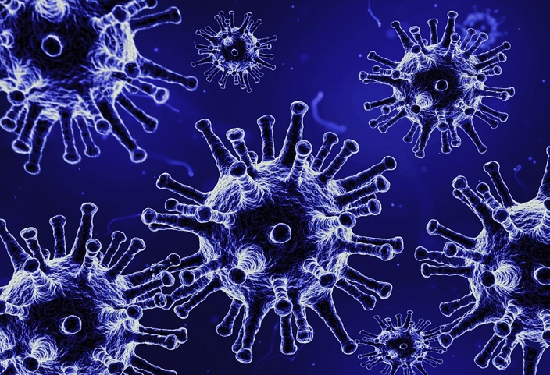
Ultradeep-Sequencing
Virus population in the host
cDNA
RNA extraction &
Reverse Transcription
Tiny fraction of the SARS-CoV-2 viruses in a sample carry a novel mutation
Ultra-Deep Sequencing: 1,000,000x Coverage

Slide 21
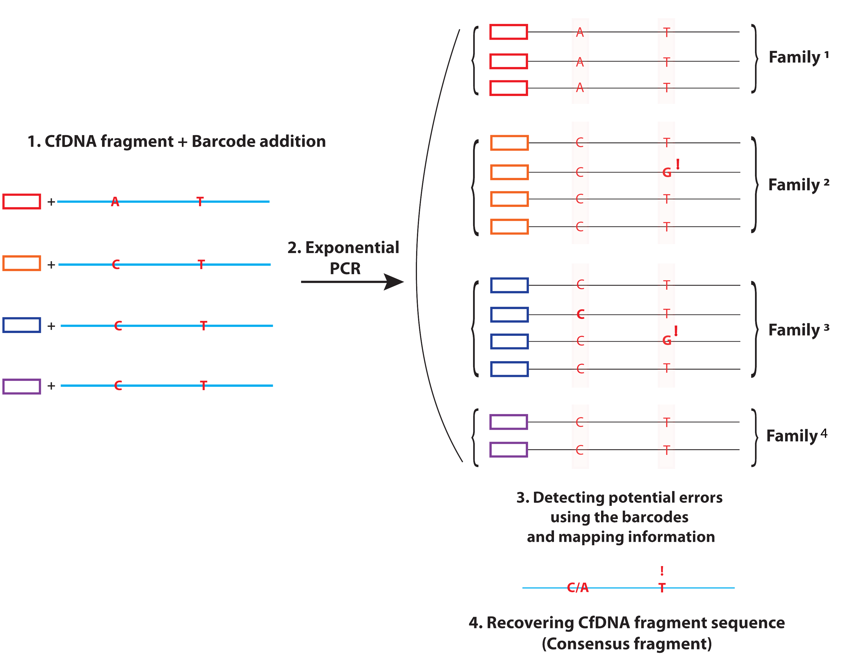
Ultradeep-Sequencing with UMIs
Virus population in the host
cDNA
RNA extraction &
Reverse Transcription
Unique Molecular
Barcodes (UMI)

Slide 22
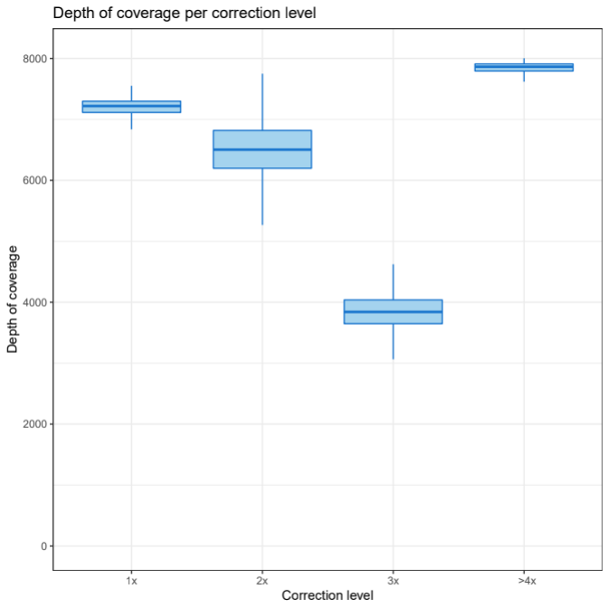
More Duplicates = Better Correction
Error correction level:
Depth of coverage per correction level:
3x
Error correction level
4x
4x
2x
1x
2x
3x
>4x
Error correction level

Slide 23
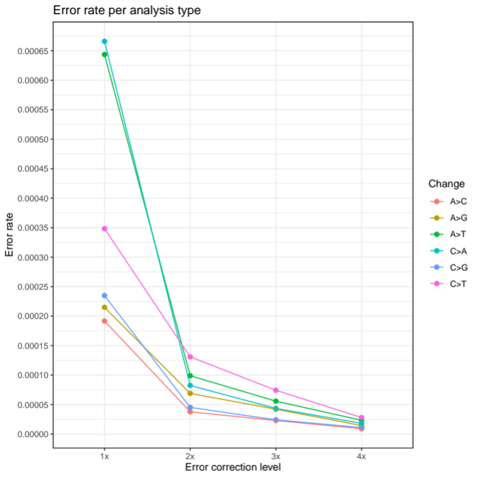
Error Rates per Nucleotide
1 error / 1400
sequenced nucleotides
1 error / 40,000
sequenced nucleotides
1x
2x
3x
>4x
Error correction level

Slide 24
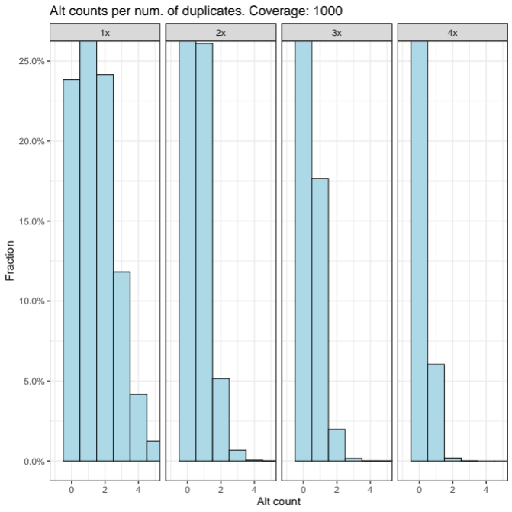
Seq-Errors per Genomic Position
Uncorrected reads
.
.
.
C
Fraction of Positions in %
C
C
T
Ref
n Errors per genomic position

Slide 25
Seq-Errors per Genomic Position
2-Copy
Correction
.
.
.
C
Fraction of Positions in %
C
C
T
Ref
n Errors per genomic position

Slide 26
Seq-Errors per Genomic Position
Errors per 1000x coverage
.
.
.
C
C
C
T
n Errors per genomic position
Statistical model in umiVar: https://github.com/imgag/umiVar

Slide 27
Variant Detection Pipeline umiVar
De-Duplication
Error-Correction
Alignment
Low-Frequency Variant Detection (SNV, InDels)
umiVar
VarScan
LoFreq
iVar
Statistical Analysis
umiVar: https://github.com/imgag/umiVar
Caspar Gross, Ersoy Kocak, Leon Schütz, Jakob Admard

Slide 28
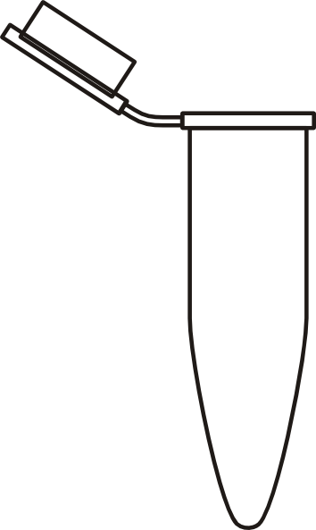
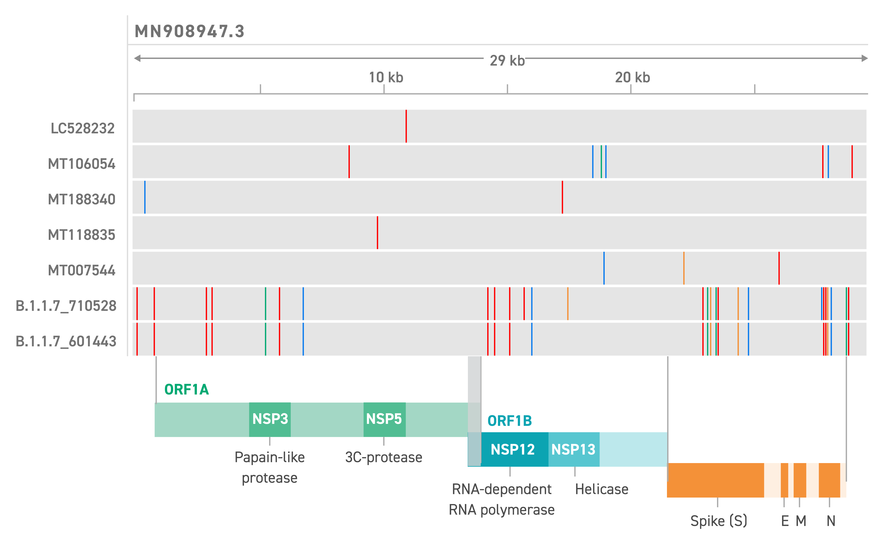
Generating Synthetic Mixed Populations
1%
99%
Seq

Slide 29
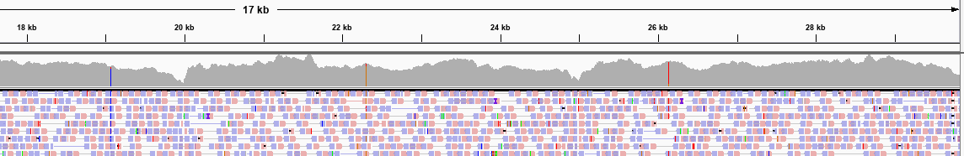
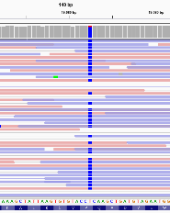
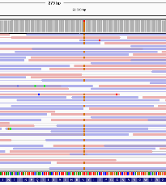
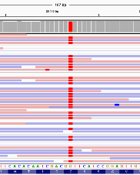
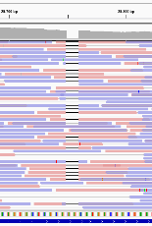
SNV-calling in Synthetic 99:1 Mix
Position | 19065 | 22303 | 26144 | 29754
Reads | 6087 | 6566 | 7025 | 38
A | 11 | 3 | 2 | 0
C | 5994 (99%) | 1 | 1 | 38 (1%)
G | 2 | 6462 (98.5%) | 120 (2%) | 0
T | 77 (1%) | 98 (1.5%) | 6901 (98%) | 0
Dels |  |  |  | 3769 (99%)

Slide 30
SNV-calling in up to Synthetic 1:999 Mix
Position | Change | %1 Mix (reads / AF) | %0.5 Mix (reads / AF) | %0.1 Mix (reads / AF)
19065 | T -> C | 348/38498 (0.9%) | 204/41687 (0.49%) | 78/40984 (0.19%)
22303 | T -> G | 385/45576 (0.85%) | 229/50939 (0.45%) | 64/49169 (0.13%)
26144 | G -> T | 507/47843 (1.05%) | 349/51955 (0.67%) | 113/49886 (0.23%)
29754 | C -> DEL | 180/20379 (0.89%) | 66/22176 (0.30%) | 19/21622 (0.09%)
SNVs and indels can be detected even at 0.1% fraction
About 50% drop in coverage around the indel, but still detectable
Test with synthetic SARS-CoV-2 strains with more SNVs and indels would be helpful to better estimate sensitivity

Slide 31
Outlook: Benchmark with synthetic British strain B.1.1.7
Twist Synthetic Viral Controls:
https://www.twistbioscience.com/products/ngs/synthetic-viral-controls?tab=sars-cov-2-controls

Slide 32
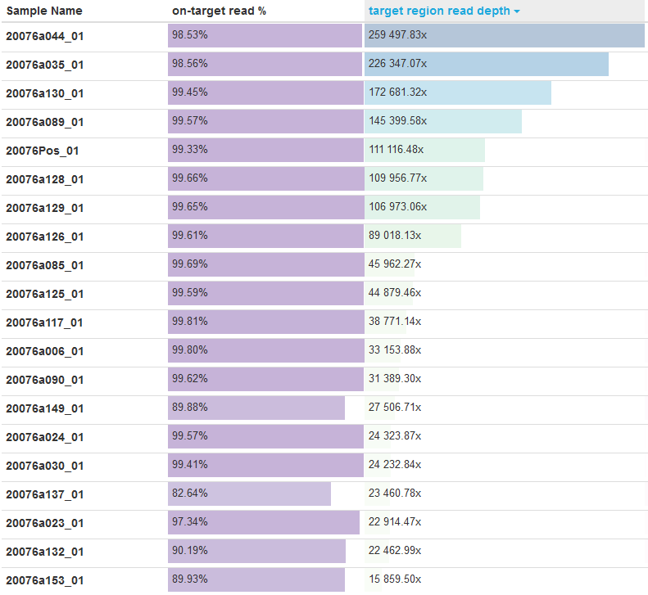
Ultra-deep Sequencing of Clinical Samples
… total of 80 clinical samples sequenced ultra-deep with UMI
Michaela Pogoda

Slide 33
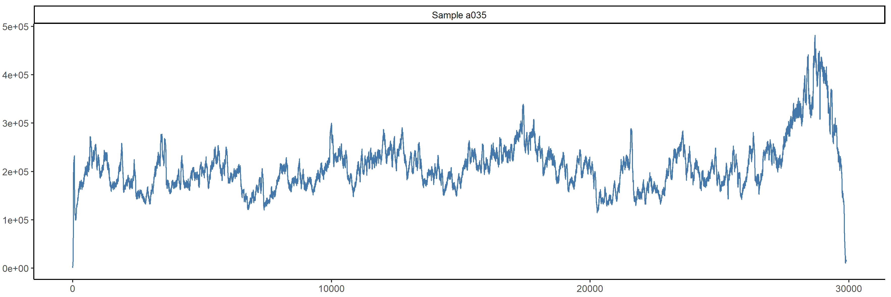
De-Duplicated Coverage Distribution
De-duplication = merging of PCR duplicates using UMIs
Leads to ‘true coverage’ representing unique RNA molecules
Errors are corrected during de-duplication
Sample 35: 226,000x => 25,000x coverage

Slide 34
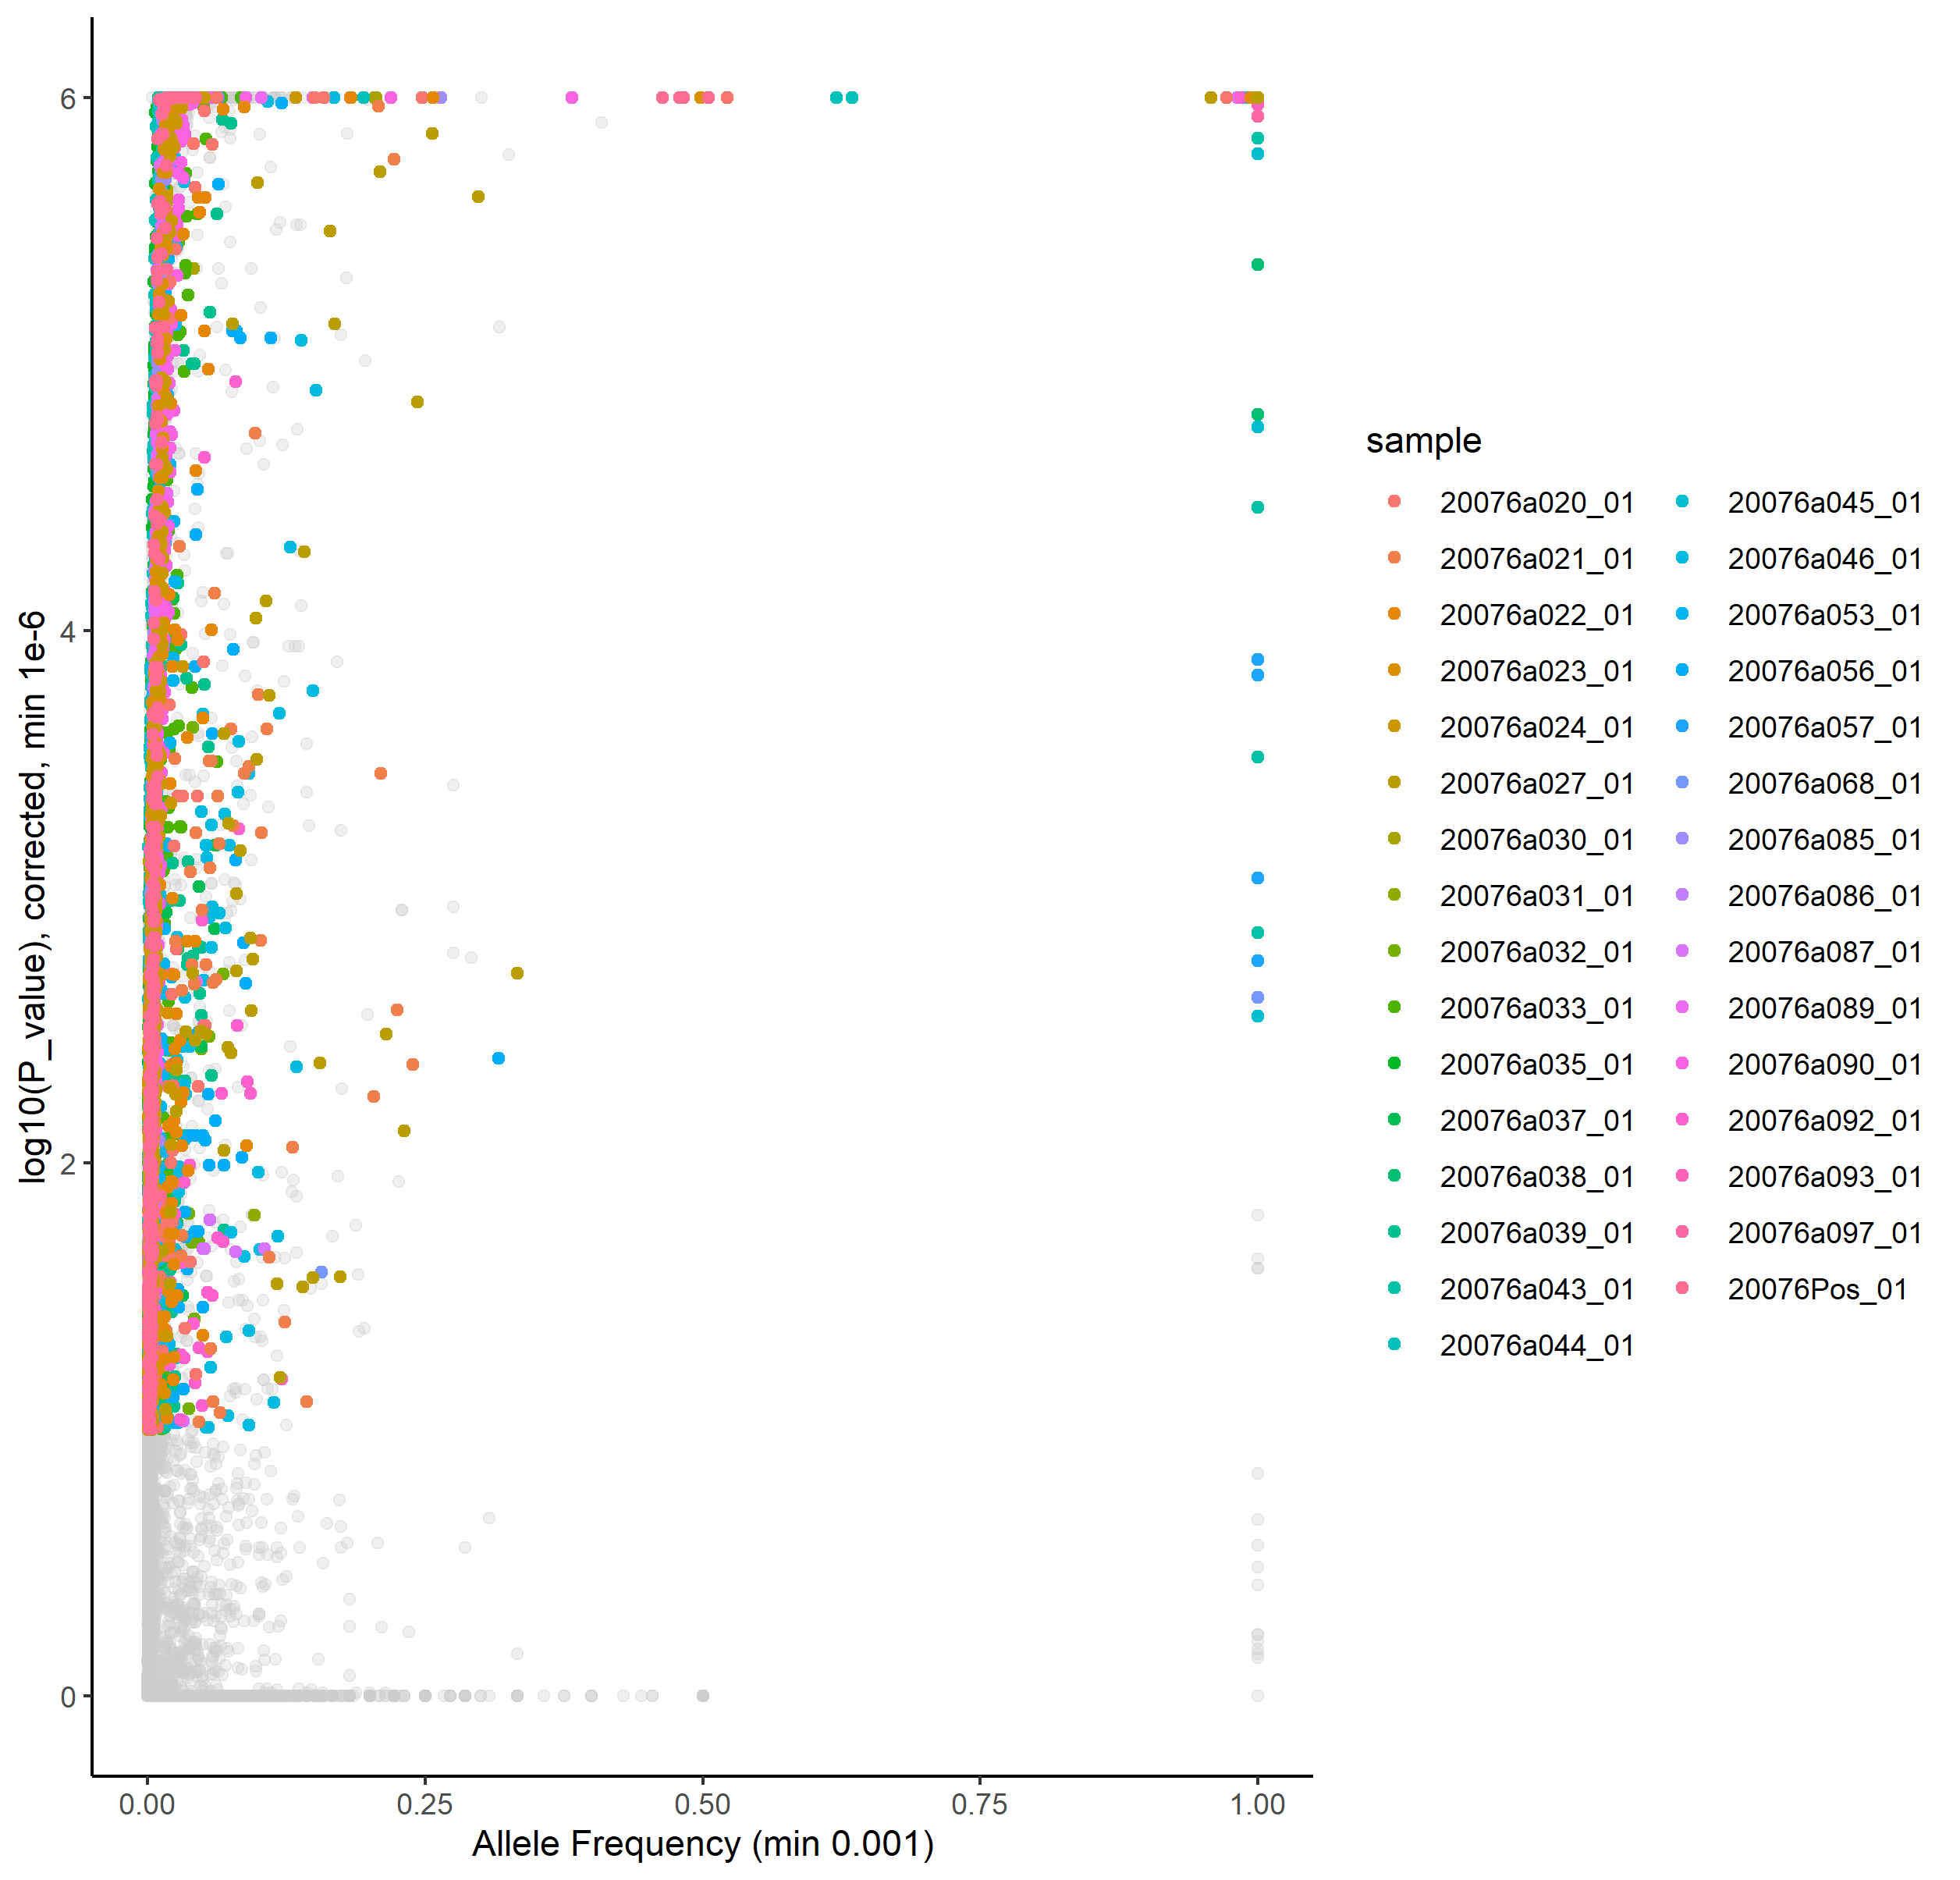
Variants Detected by umiVar
Caspar Gross, Ersoy Kocak

Slide 35
Variants Detected by umiVar
Clonal SNVs

Slide 36
Variants Detected by umiVar
Mixed Populations?

Slide 37
Variants Detected by umiVar
AF 2% - 25%

Slide 38
Variants Detected by umiVar
Very low-frequency variants: <2%

Slide 39
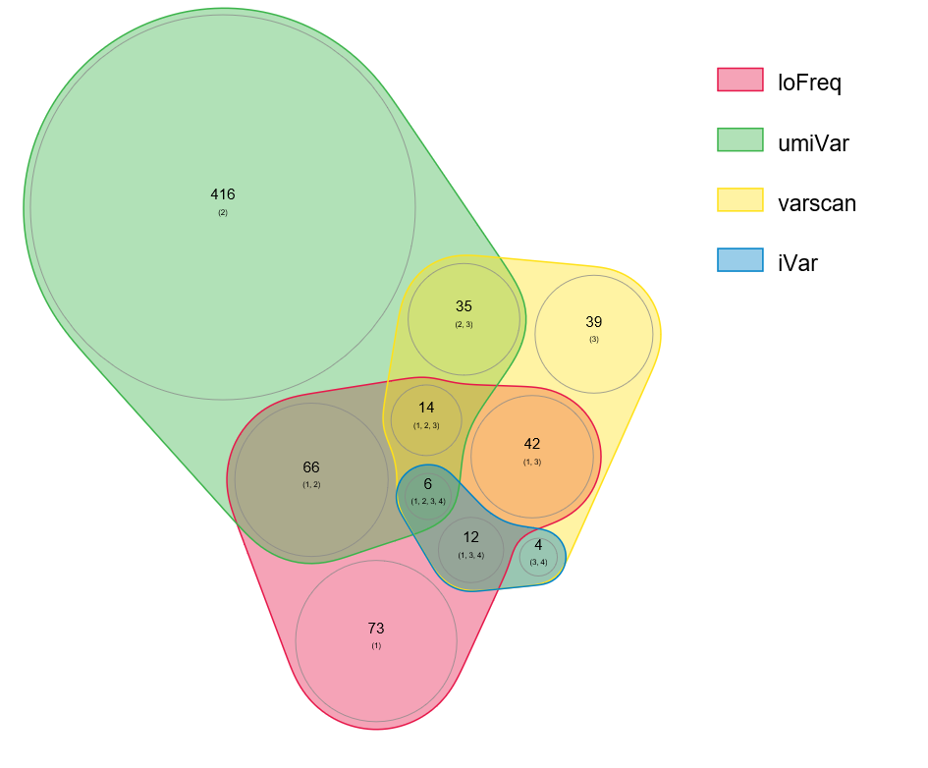
Comparison of 4 Variant Callers
Sample 35
Allele Fraction < 1%
Caspar Gross, Ersoy Kocak

Slide 40
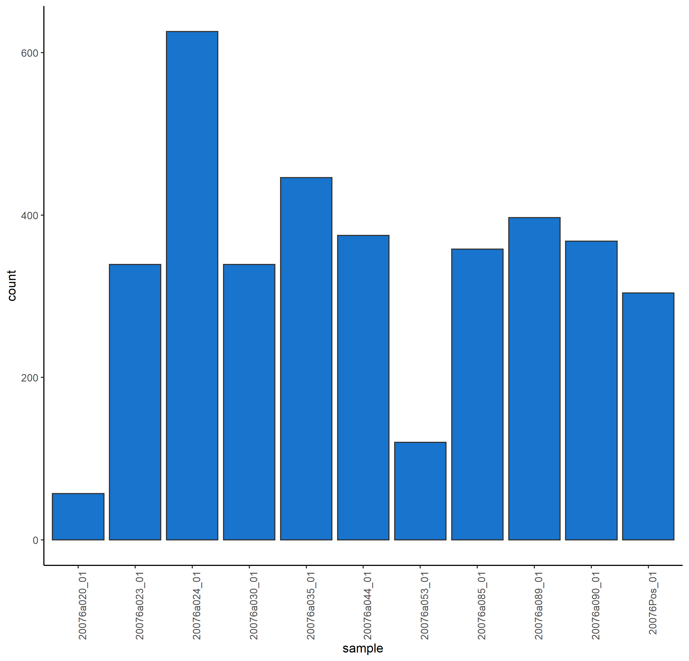
SNVs per Sample with >1000x Coverage

Slide 41
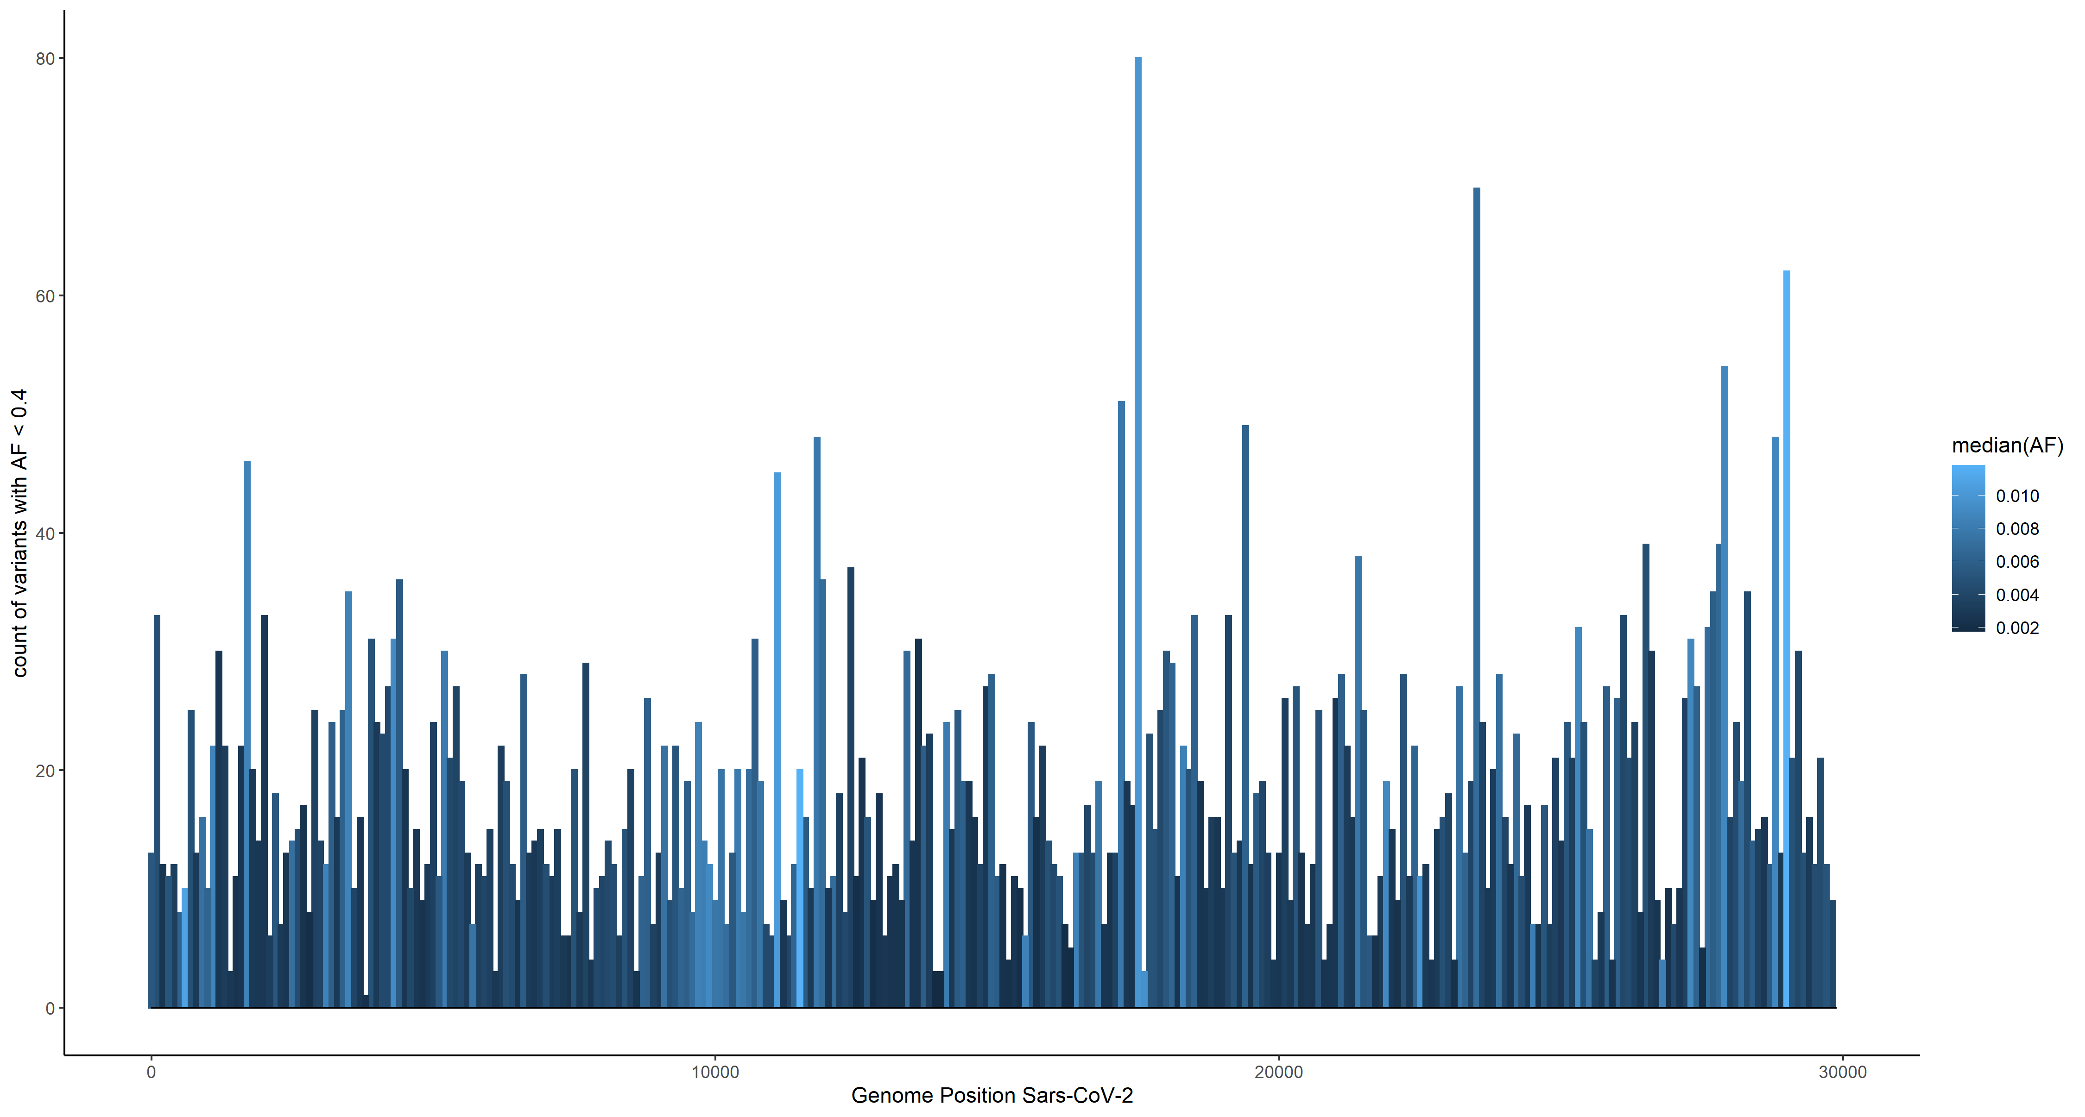
Distribution of low-AF variants across 32 Samples
Number of detected variants per bin
Genomic Position in 100bp bins

Slide 42
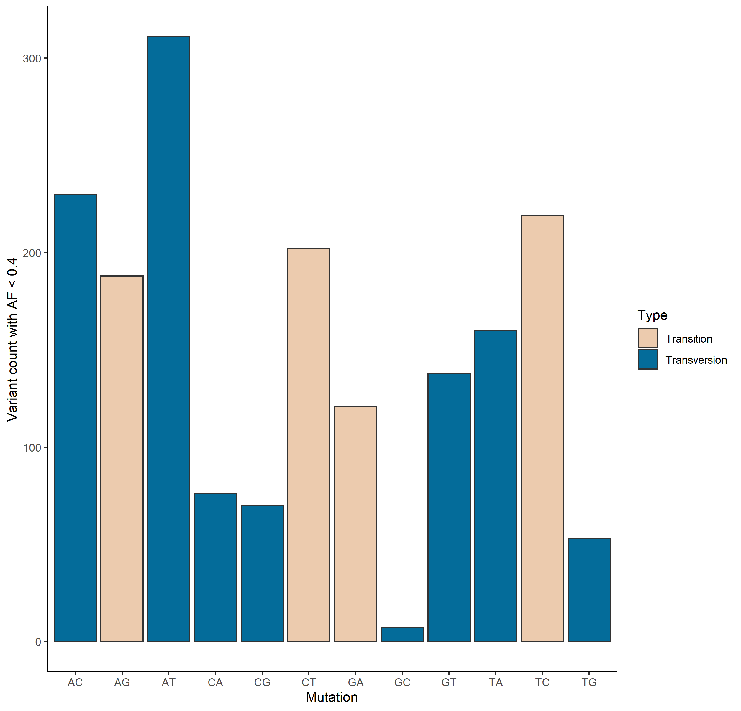
Mutational Signature of Low-AF Variants

Slide 43
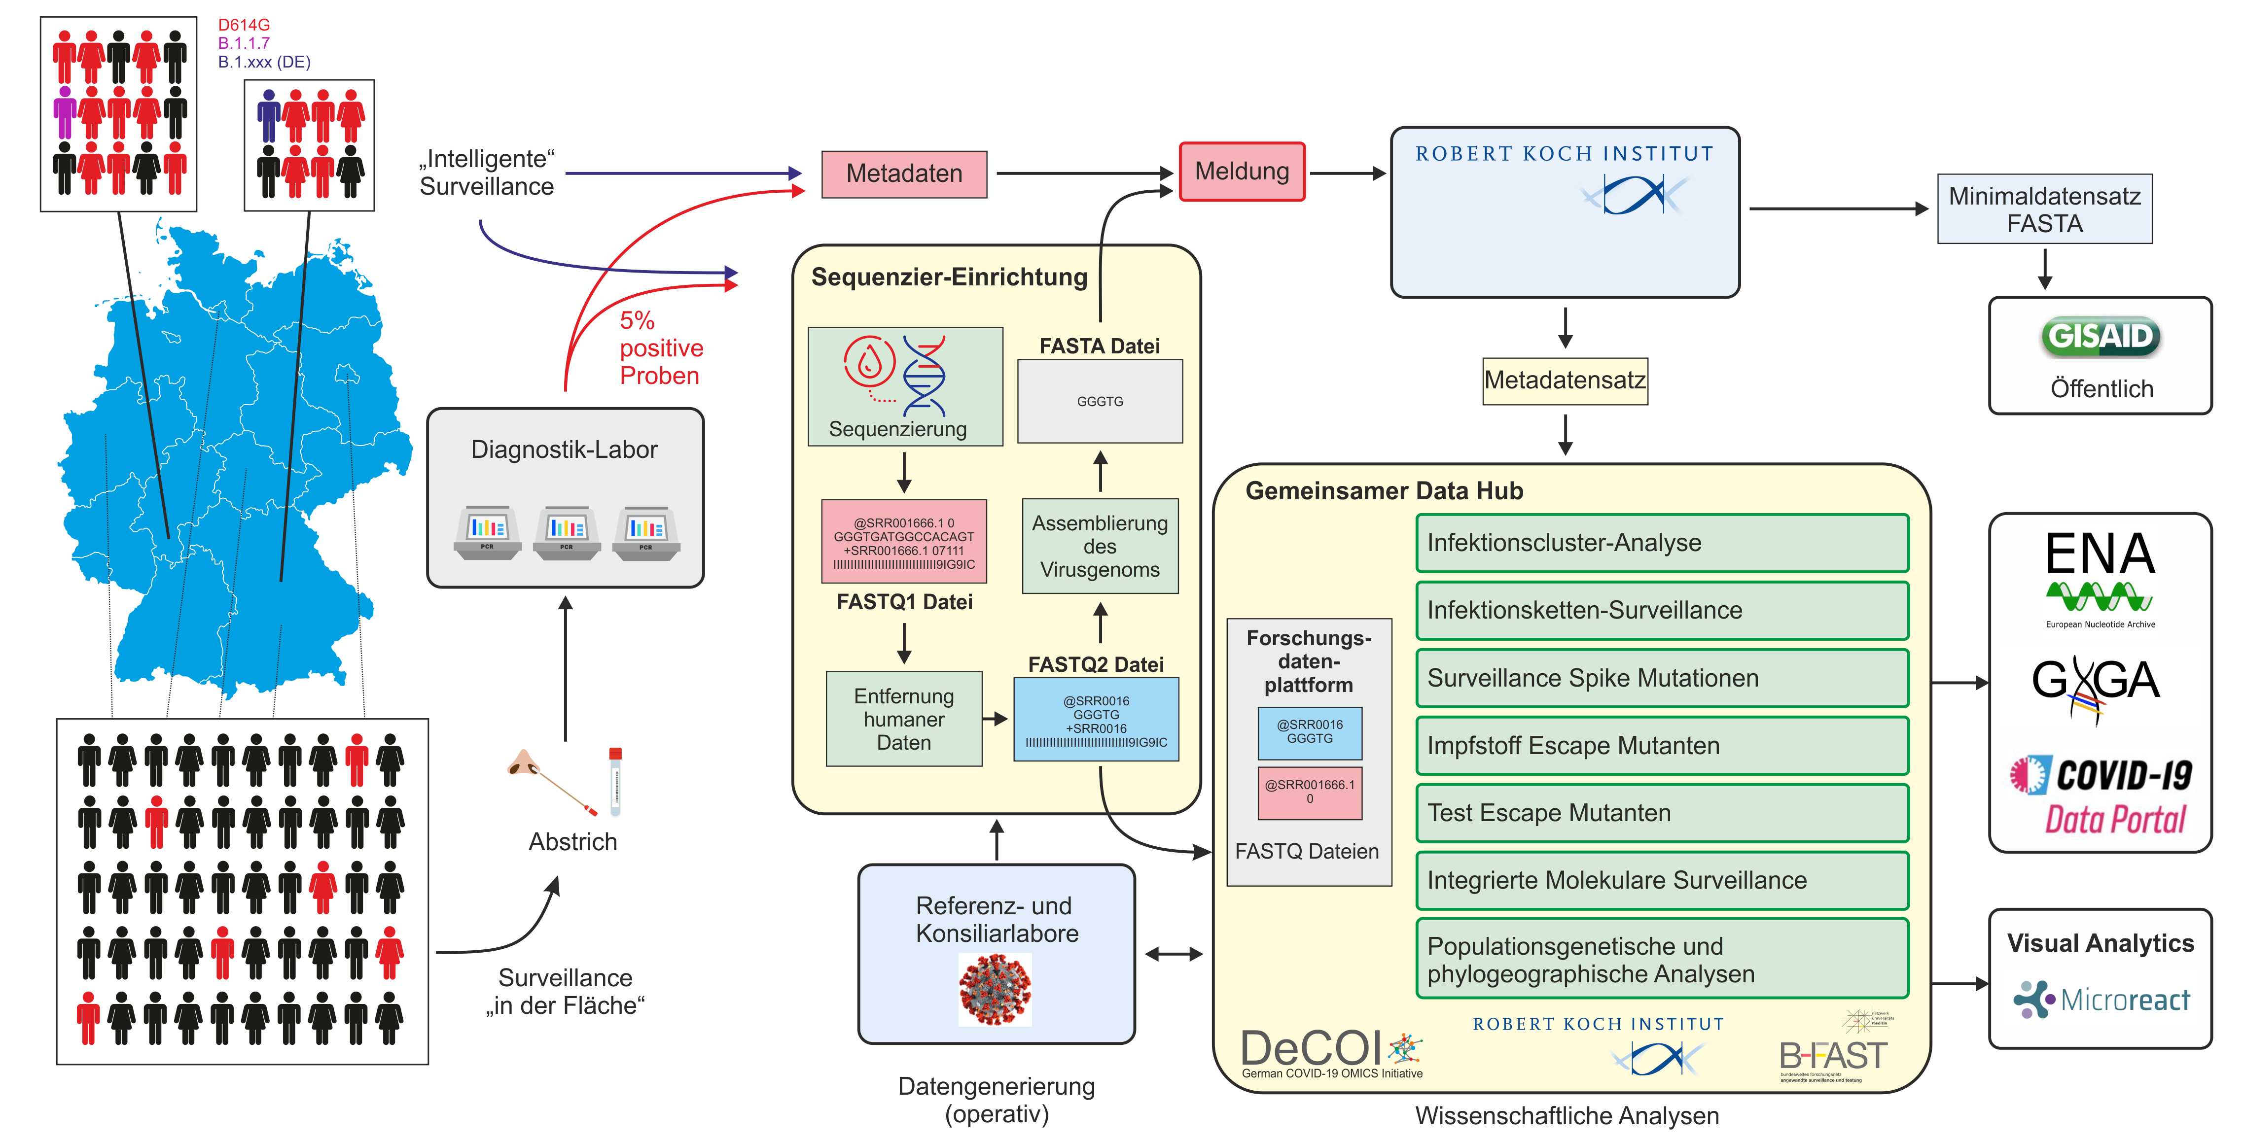


Outlook: Federated Molecular Surveillance in Germany
Joachim Schultze, Uni Bonn

Slide 44


Thanks!
Tübingen (NCCT, Microbiology,
Human Genetics, QBiC):
Michaela Pogoda
Angel Angelov
Michael Sonnabend
Marie Gauder
Silke Peter
Daniela Bezdan
Nicolas Casadei
Olaf Riess
Tübingen Bioinfo:
Caspar Gross
Leon Schütz
Jakob Admard
Ersoy Kocak
CeBiTec Bielefeld:
David Brandt
Tobias Busche
Markus Haak
Jörn Kalinowski
Levin-Joe Klages
Alexander Sczyrba
Marina Simunovic
Svenja Vinke
Ev. Klinikum Bethel, Bielefeld:
Dr. Christiane Scherer
MVZ Diamedis, Sennestadt:
Dr. Thomas Diedrich
MVZ Eberhard und Partner, Dortmund:
Dr. Frank-Jörg Vorhölter
Saarland University:
Kathrin Kattler
Jörn Walter
RKI:
Oliver Drechsel
Stephan Fuchs
Max von Kleist
Djin Ye Oh
Aleksandar Radonic
Maureen Smith
Andrea Theumer
Wiep van der Toorn
Maria Trofimova
Max Planck Institute SHH:
Denise Kühnert
Ariane Weber
DRESDEN-concept
Genome Center:
Andreas Dahl
Katrin Sameith-Lauber
Sylke Winkler
HZI:
Adrian Fritz
Alice McHardy
Cologne:
Konrad Förstner
Tübingen Virology:
Tina Ganzenmüller
Angelika Iftner
Thomas Iftner
Twist:
Tina Han
Ulrike Harms
Oliver Stephan
Tübingen ICU:
Siri Göpel
Michael Bitzer
Düsseldorf:
Alexander Dilthey
Maximilian Damagnez
Ashley-Jane Duplessis
Torsten Feldt
Torsten Houwaart
Lisanna Hülse
Björn Jensen
Malte Kohns Vasconcelos
Susanne Kolbe-Busch
Jessica Nicolai
Klaus Pfeffer
Daniel Strelow
Jörg Timm
Andreas Walker
Tobias Wienemann
TU Munich
(Virology, Computer Science):
Elisabeth Esser
Julien Gagneur
Dieter Hoffmann
Alexander Karollus
Christian Mertes
Thomas Michler
Ulrike Protzer
Eva-Christina Schulte
Charité:
Michael Hummel
DeCOI & NGS-CN:*

Slide 45
“Detecting known and novel mutations in a host's SARS-CoV-2 population by ultra-deep sequencing with unique molecular barcodes”
Questions?

