Slide 1
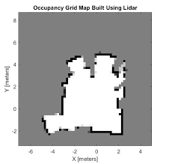
mp2p_icp::metric_map_t
layers[“raw”]
layers[“decimated”]
layers[“grid”]
Type: CPointsMap
Type: CPointsMap
Type: COccupancyGrid2D
layers[]
...
planes
lines
Optional attributes: “id”, “label”

