Slide 1
Quality Control Analysis Report
TST Jurisprudence Pipeline - CSDS-352 Capstone
Gustavo Henrique de Jesus da Silva

Slide 2
Quality Control Analysis Report

Slide 3
1. Scope and objective
This report documents the quality control (QC) module of the TST jurisprudence pipeline. It describes how candidate quality problems are detected, presents the distributions and scores produced over the full corpus of 1058 verbetes, and discusses the concrete anomalies that the module flags for manual review.
The module answers two complementary questions:
Is this record structurally complete? (heuristic rules + supervised classifier)
Is this record unusual with respect to the rest of the corpus? (unsupervised anomaly detection)

Slide 4
2. Method
Label | Rule
cancelado | the text contains a cancellation marker (e.g. “cancelada”)
curto | text length below VERBETE_CURTO (120 characters)
ruido | text length below VERBETE_RUIDO (30 characters)
duplicado | the body is repeated under more than one code
completo | none of the above
2.1 Heuristic labelling
During ingestion each verbete receives a heuristic quality_label:

Slide 5
2.2 Supervised re-labelling
A TF-IDF vectoriser (5000 features, 1-2 grams) feeds a Logistic Regression (class_weight="balanced") trained on the heuristic labels with an 80/20 stratified split. The fitted classifier then predicts the quality label for every verbete, and the trained vectoriser and classifier are persisted to models/quality_classifier.joblib.
2.3 Anomaly detection
An IsolationForest (200 trees, 5% contamination) is fitted on the 384-dimensional sentence embeddings. Its decision function is rescaled to a 0-1 anomaly_score (higher is more anomalous) and stored with each verbete.
2.4 How to read the metrics
Precision - of the records the classifier predicted as a given class, the fraction that truly belong to it; it measures the trustworthiness of a positive prediction.
Recall - of the records that actually belong to a class, the fraction the classifier found; it measures coverage.
F1 - the harmonic mean of precision and recall, a single balanced number.
Accuracy - the fraction of all predictions that are correct; it can be misleading when classes are imbalanced, which is why F1 is also reported.
Macro F1 - the average F1 over classes, weighting every class equally, so a tiny class counts as much as a large one; it is low here because curto scores zero.
Weighted F1 - the average F1 weighted by class size, so it is dominated by the large classes. The gap between macro and weighted F1 quantifies how much the tiny classes hurt the average.
Anomaly score - the IsolationForest output rescaled to 0-1, where higher means more unusual relative to the rest of the corpus. It is a review cue, not a judgment about legal validity.
2.5 Why these methods
TF-IDF + logistic regression was chosen because it is fast, interpretable (you can inspect the learned word weights) and strong on this scale of data; a heavier model would be harder to justify with heuristic labels.
IsolationForest is unsupervised, so it can flag novelty without any labels, complementing the supervised classifier.
UMAP + HDBSCAN were chosen over PCA + k-means because UMAP preserves local neighbourhoods for visualisation, and HDBSCAN needs no preset number of clusters and marks outliers as noise.

Slide 6
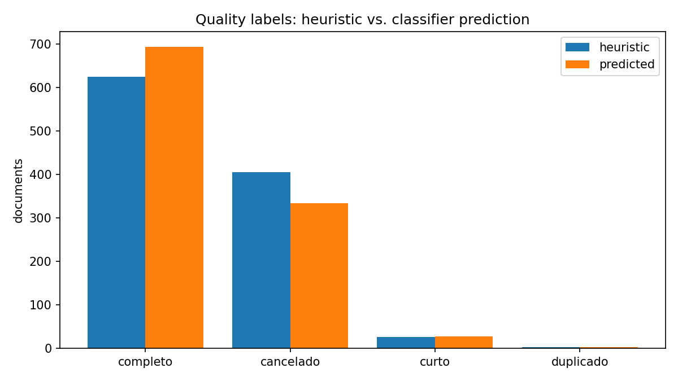
3. Quality label distribution
Label | Heuristic | Predicted
completo | 625 | 694
cancelado | 405 | 334
curto | 26 | 27
duplicado | 2 | 3
Total | 1058 | 1058
Heuristic versus predicted quality labels

Slide 7
The classifier moves 71 documents from cancelado to completo and reassigns a handful of short entries, reflecting the fact that the lexical cancellation marker is not always a reliable indicator of an actually cancelled record.

Slide 8
4. Classifier evaluation
Metric | Value
Accuracy | 0.906
F1 (macro) | 0.708
F1 (weighted) | 0.896
Held-out test split: 212 documents (846 for training).

Slide 9
Class | Precision | Recall | F1 | Support
cancelado | 0.99 | 0.84 | 0.91 | 81
completo | 0.87 | 0.98 | 0.92 | 125
curto | 0.00 | 0.00 | 0.00 | 5
duplicado | 1.00 | 1.00 | 1.00 | 1
Per-class results:

Slide 10
The two dominant classes (completo, cancelado) are classified reliably. The curto class is too small to be learned and is always missed, which drags the macro F1 down; in practice short records are still surfaced by the length rule at ingestion and by the anomaly score.

Slide 11
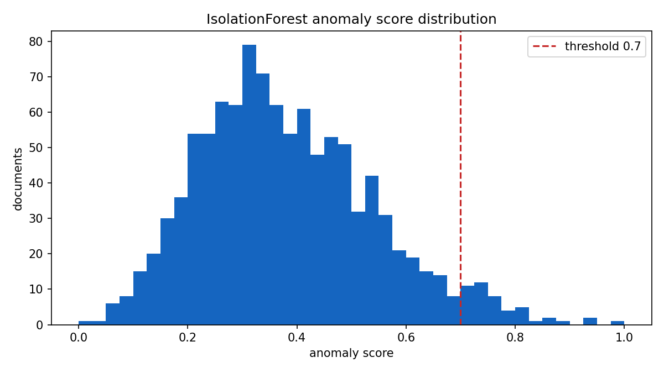
5. Anomaly detection
doc_id | tipo | orgao | quality | score
precedente_106 | precedente | SDC | completo | 1.000
precedente_63 | precedente | SDC | completo | 0.949
precedente_107 | precedente | SDC | completo | 0.936
precedente_60 | precedente | SDC | completo | 0.896
oj_sbdi-1_252 | oj | SBDI-1 | cancelado | 0.864
precedente_115 | precedente | SDC | completo | 0.852
sumula_83 | sumula | TST | cancelado | 0.829
precedente_22 | precedente | SDC | completo | 0.824
precedente_62 | precedente | SDC | completo | 0.822
precedente_65 | precedente | SDC | curto | 0.816
Mean anomaly score: 0.382.
Documents above the 0.7 review threshold: 47 (4.4% of the corpus).
The top flagged records concentrate on historical Precedentes Normativos about rural work, whose vocabulary differs sharply from the modern Súmulas and OJs. The ten highest-scoring documents are:
IsolationForest anomaly score distribution

Slide 12
Two representative flagged texts:
precedente_106 (score 1.000): “Os empregadores que se dedicarem à pecuária leiteira fornecerão, diariamente, 1 (um) litro de leite aos trabalhadores que exerçam atividades insalubres.”
oj_sbdi-1_252 (score 0.864, cancelado): “DJ 20, 22 e 25.04.2005 O conceito de mesmo localidade de que trata o art. 461 da CLT…”
The module therefore satisfies the requirement of flagging at least one anomalous or low-quality document, and in fact surfaces a coherent set of them.

Slide 13
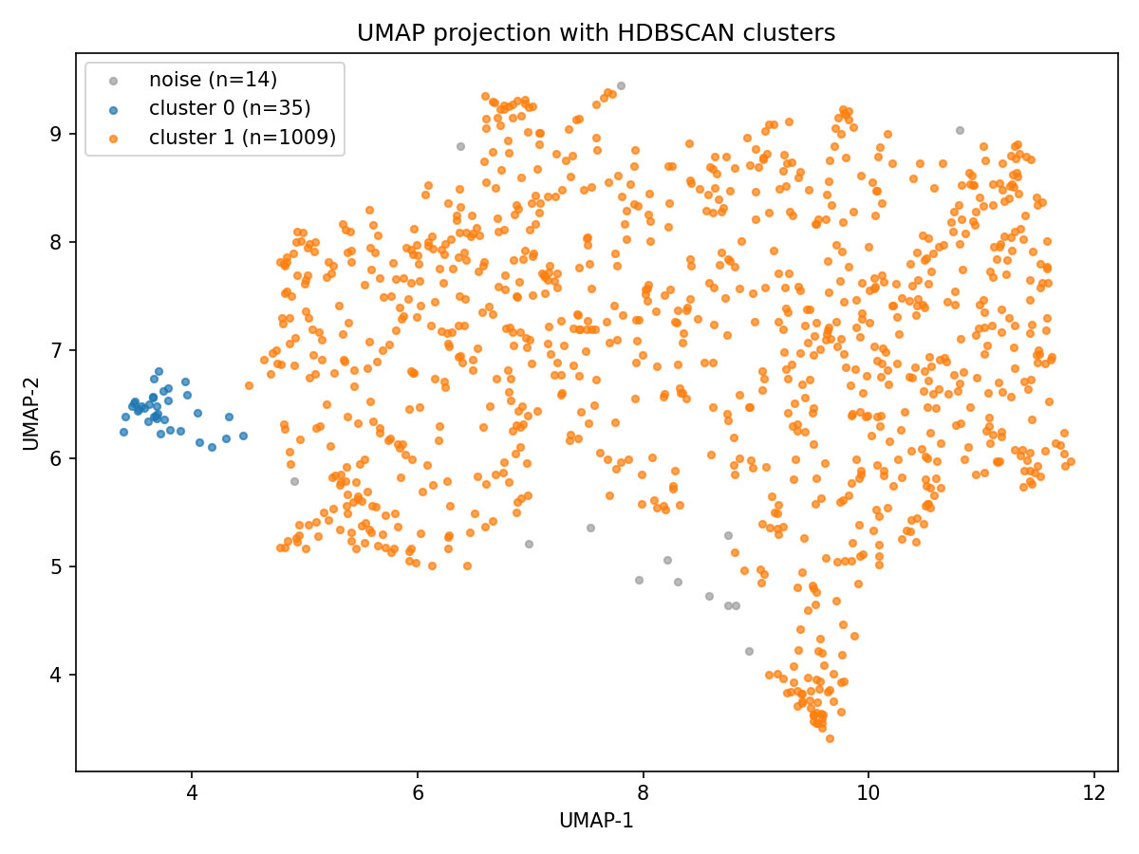
6. Clustering quality
Cluster | Size | Top terms
1 | 1009 | art., res., para, decorrência, súmula
0 | 35 | concede, homologação, res., sessão
noise | 14 | -
The corpus splits into two dense clusters plus a small noise band:
UMAP projection with HDBSCAN clusters

Slide 14
Cluster 0 captures the historical rural-work precedentes, which is consistent with the anomaly findings in section 5: the same records are both spatially isolated and statistically unusual.

Slide 15
7. Findings and recommendations
Cancelled records are the largest quality issue (334 predicted, about 32% of the corpus). They should be filtered from any downstream legal search unless the user explicitly requests them.
The curto class needs either more examples or a rule-based fallback; the supervised classifier cannot learn it from five samples.
Anomalies are mostly genuine and interpretable, not noise: they are historical precedentes with a distinct legal vocabulary. They are good candidates for a dedicated “historical” collection rather than deletion.
The noise band (14 points) should be inspected manually; it may contain parsing artefacts.

Slide 16
8. Reproduction
cd capstone
make pipeline # produces the labels and scores
python scripts/make_report_figures.py # regenerates the figures and summary.json
All numbers in this report are derived from docs/figures/summary.json, which the figure script writes from the pipeline artifacts.

Slide 17
9. Key methods and their sources (in one line each)
Sentence-BERT (Reimers & Gurevych, 2019) - how to train transformer networks to produce high-quality sentence embeddings; the model family behind our 384-D vectors.
UMAP (McInnes et al., 2018) - the dimensionality-reduction method used for the 2D projection.
HDBSCAN (Campello et al., 2013) - the density-based clustering method used to group the corpus and mark noise.
Isolation Forest (Liu, Ting & Zhou, 2008) - the anomaly-detection method used to score unusual verbetes.
You do not need to read these papers to follow this report; each is summarised above. Full citations appear in the technical report (report.md).

