Slide 1
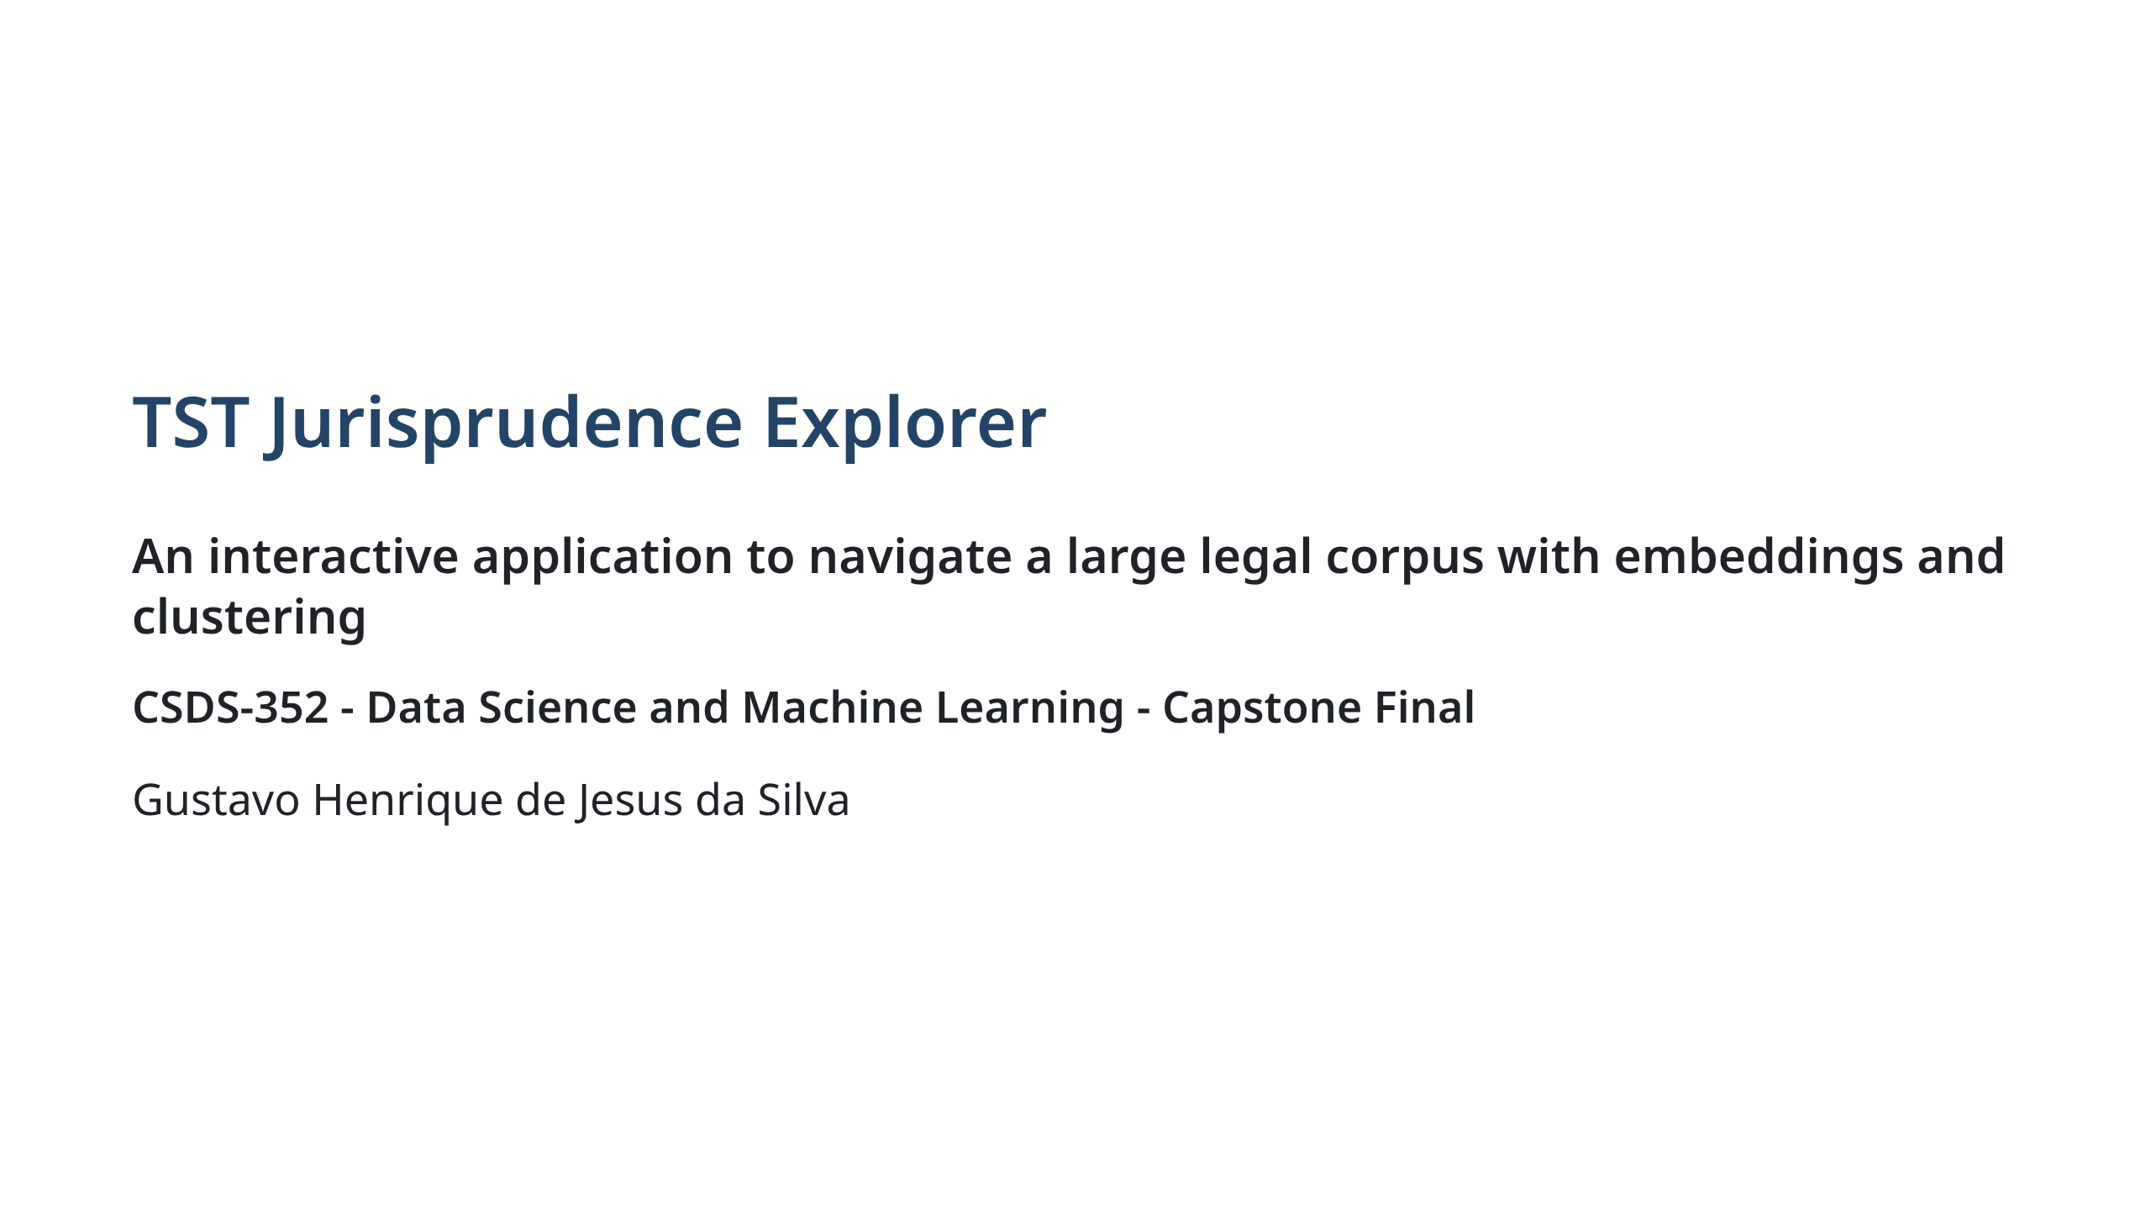
Notes:
Presenter: greet the audience and give the one-sentence pitch.

Slide 2
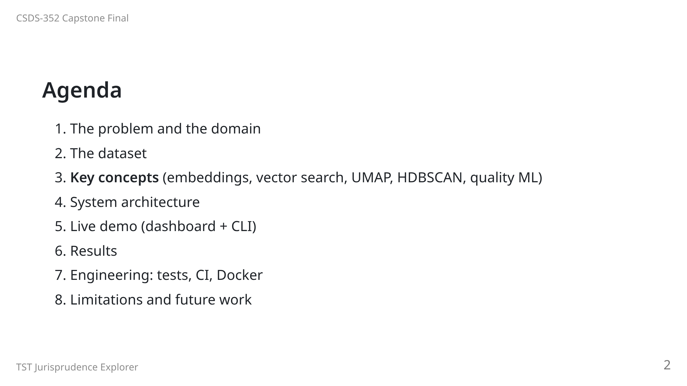
Notes:
Plan: ~28 min. The live demo is the centerpiece (~8 min). Concept slides
are short and can be skimmed if you are running late.

Slide 3
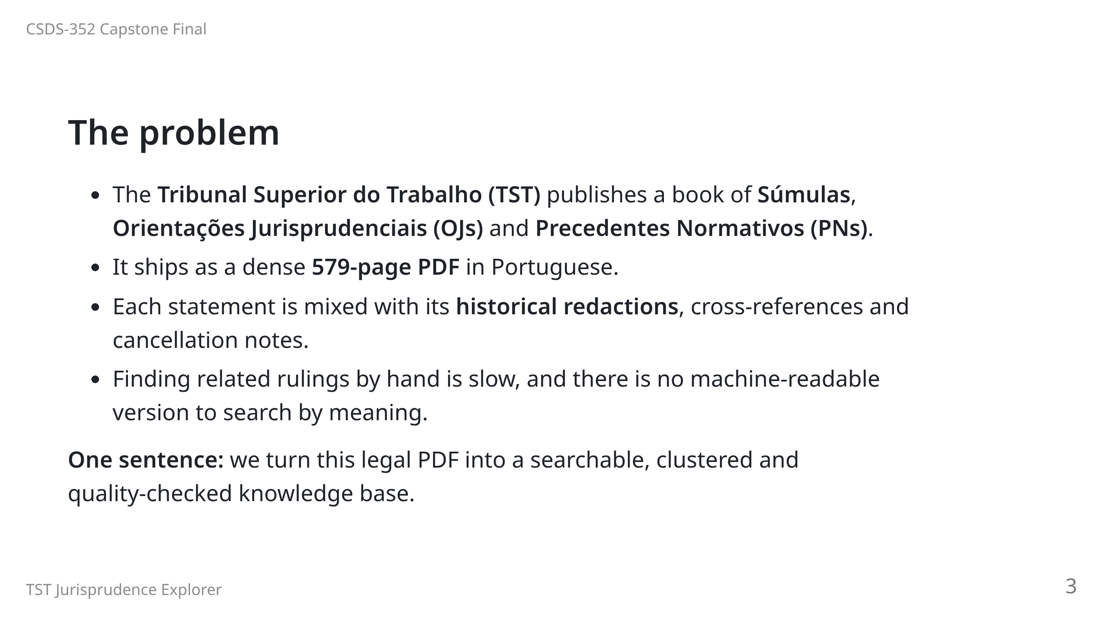

Slide 4
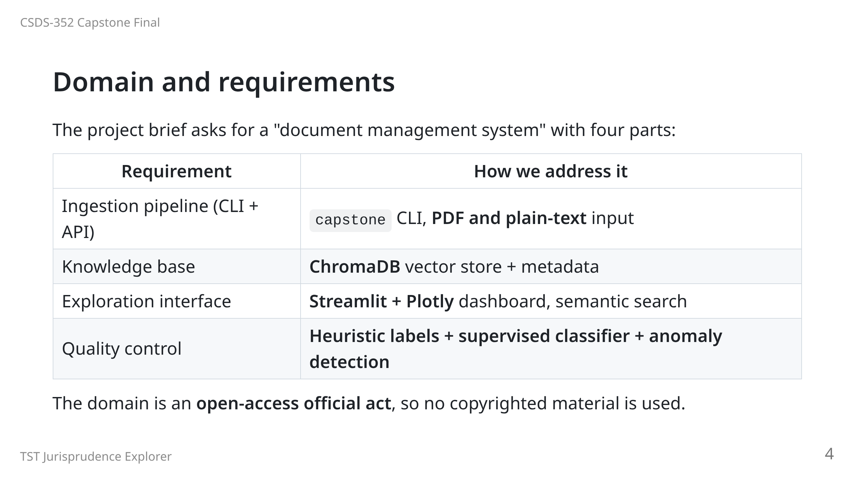

Slide 5
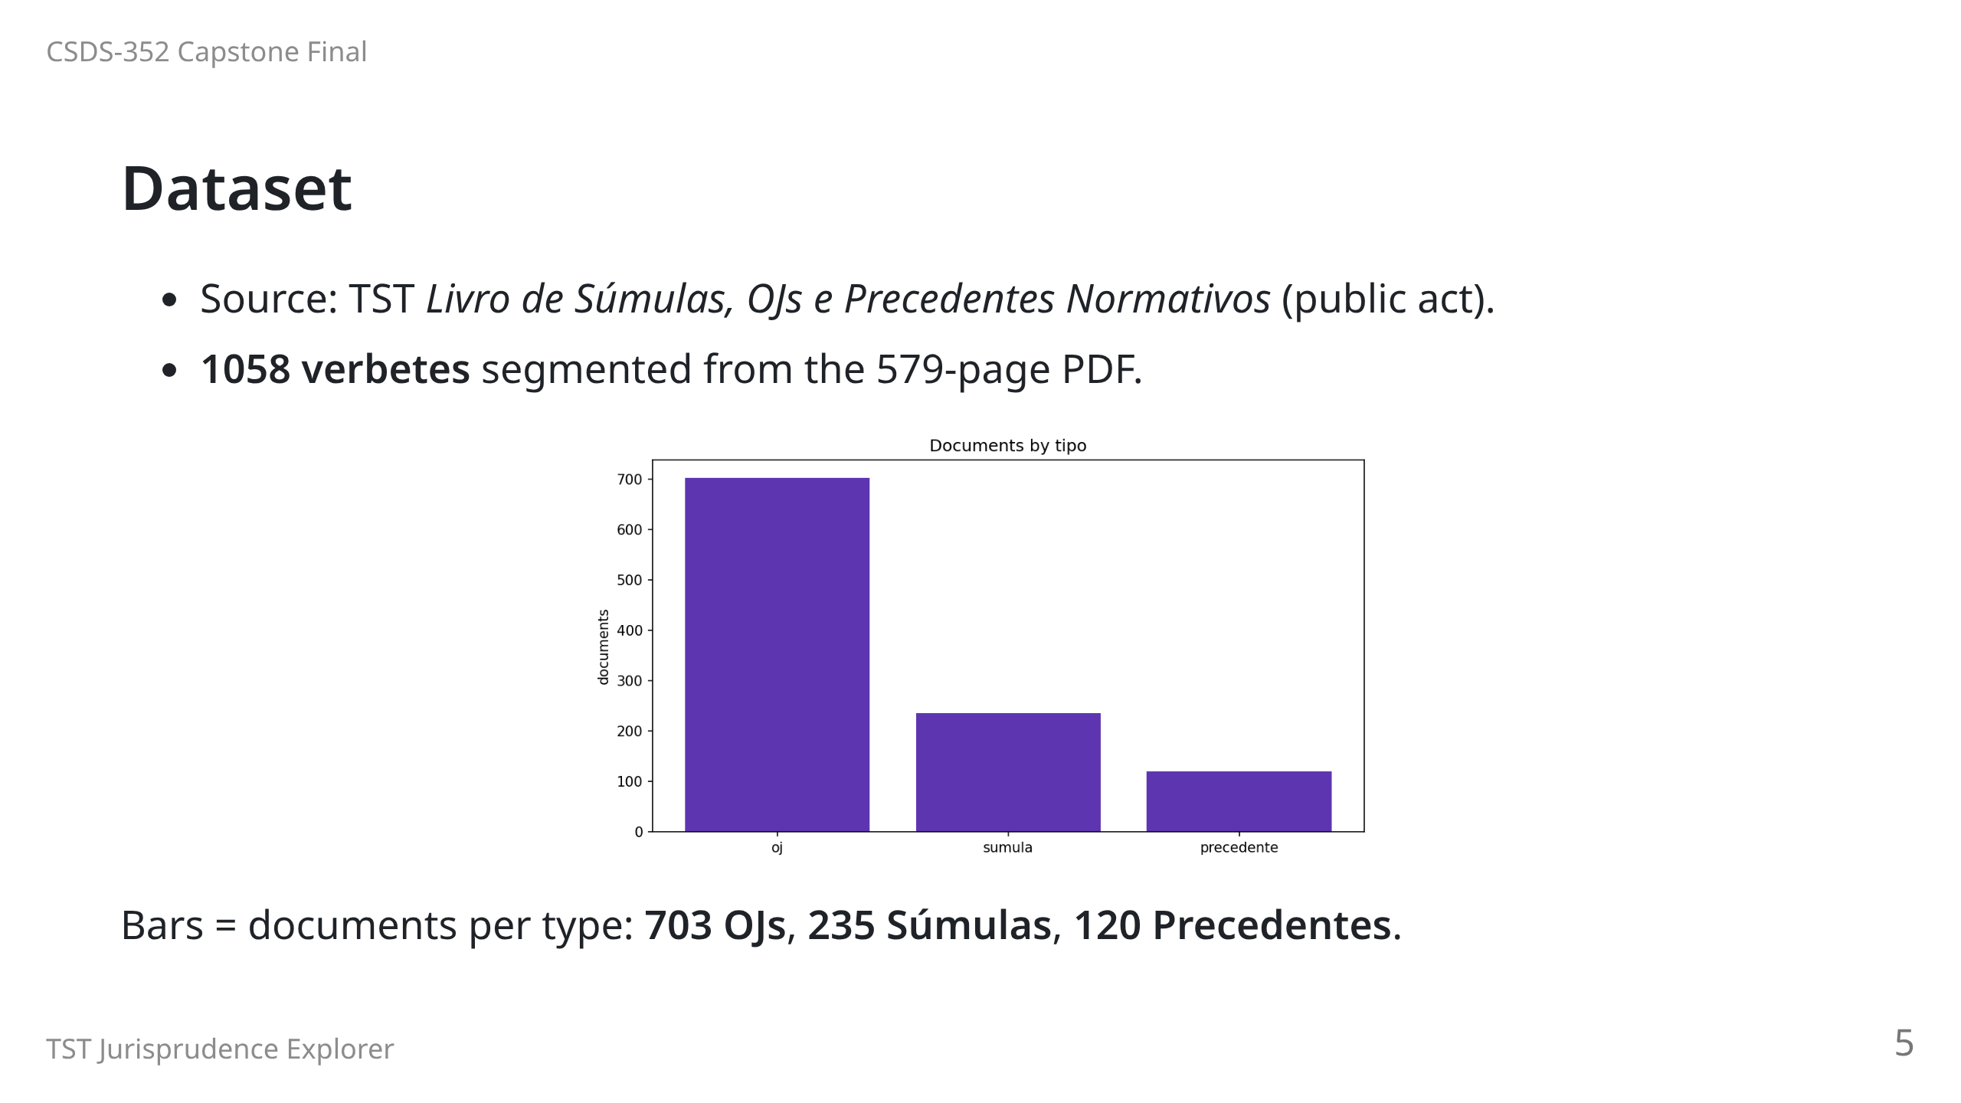
Notes:
"Verbere" = one numbered normative statement with type, body, theme.

Slide 6
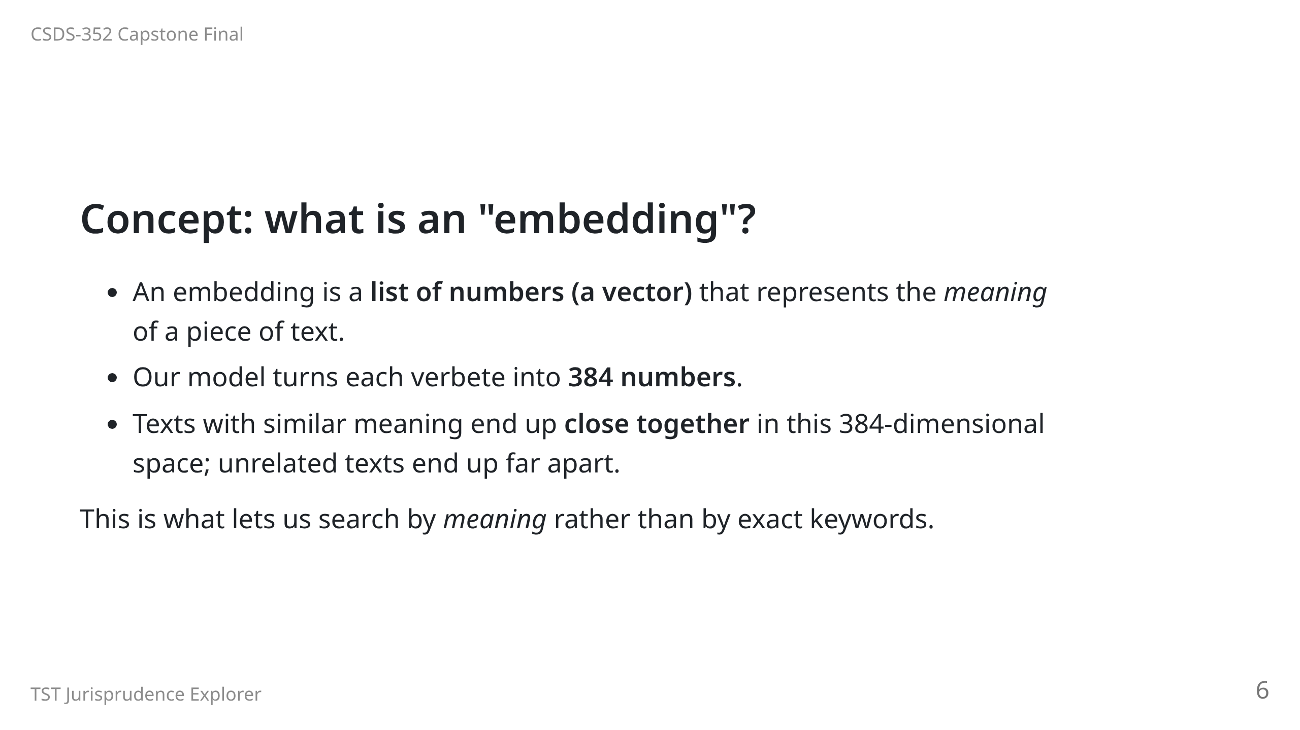
Notes:
The numbers are learned from data, not designed by hand.

Slide 7
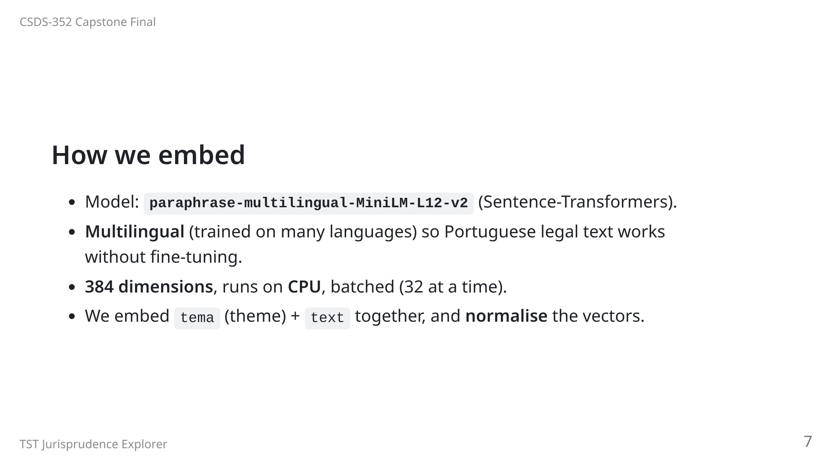
Notes:
Transfer learning: we reuse a model pre-trained on a huge general corpus
instead of training our own from scratch. That is why 1058 documents are enough.

Slide 8
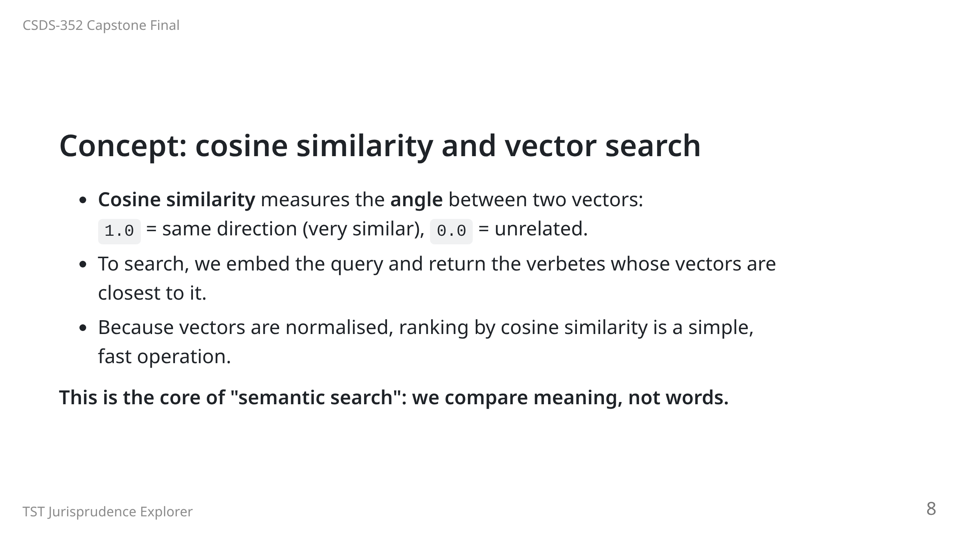

Slide 9
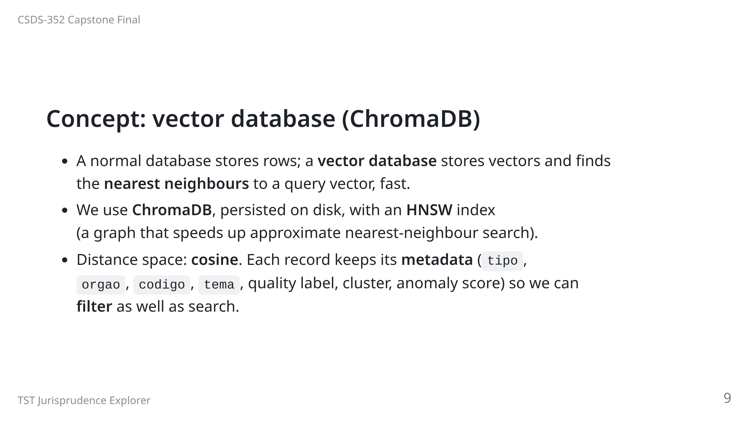
Notes:
HNSW = Hierarchical Navigable Small World. It trades a tiny bit of accuracy
for a huge speed-up, which is standard for large vector collections.

Slide 10
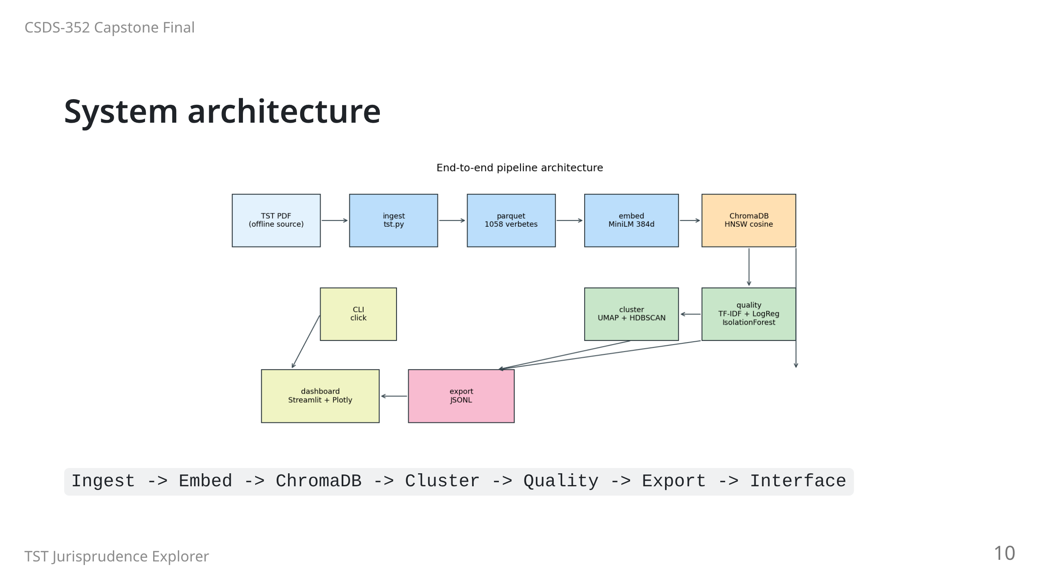

Slide 11
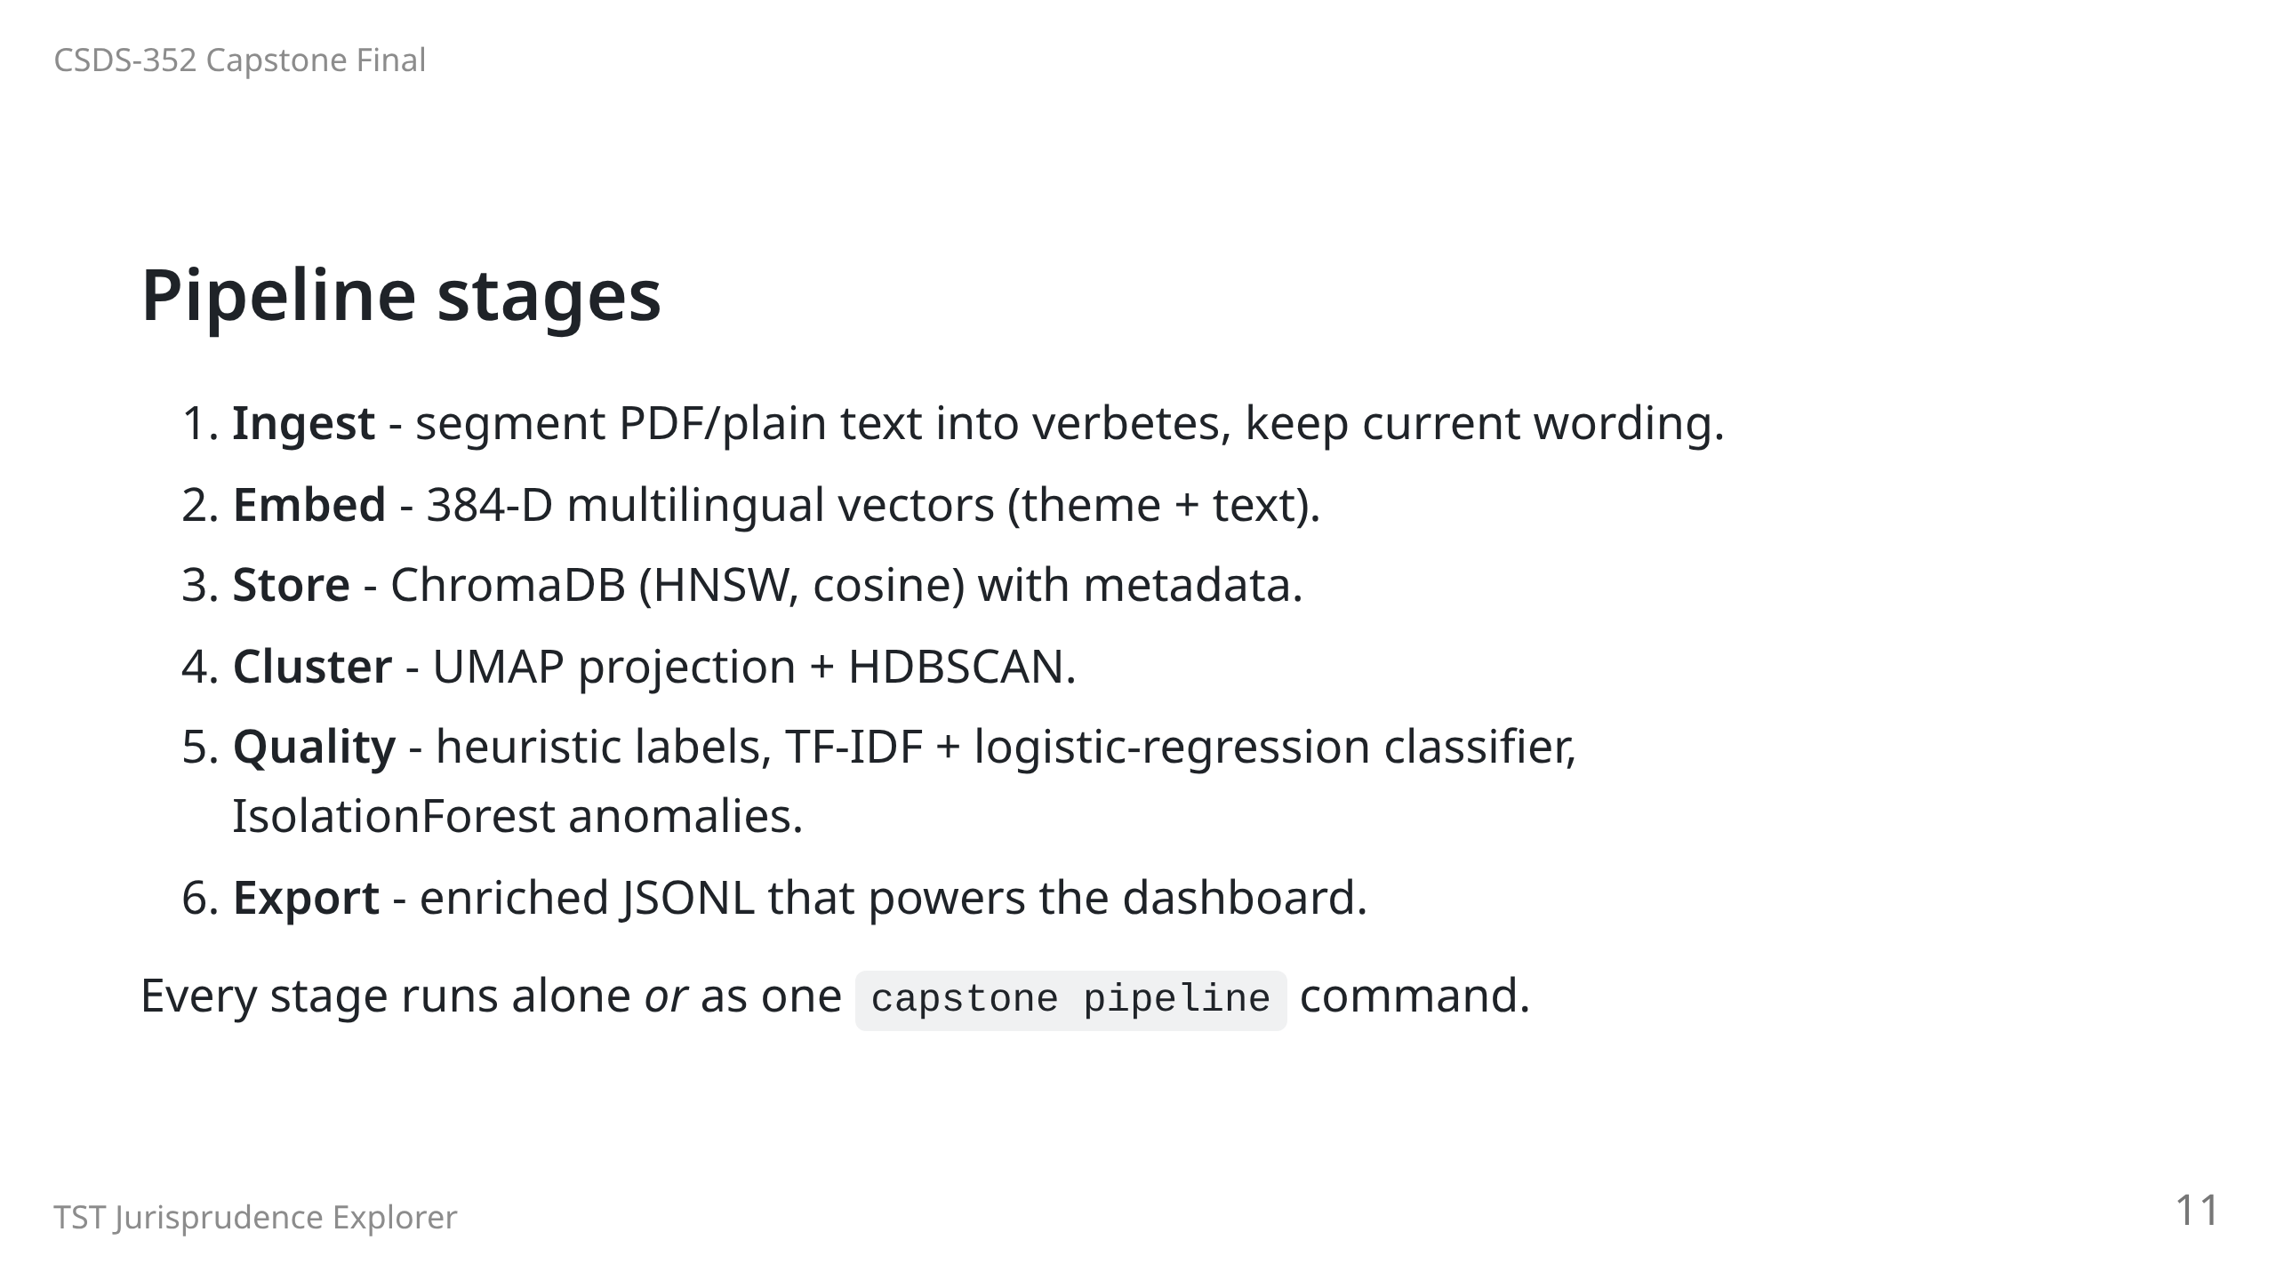

Slide 12
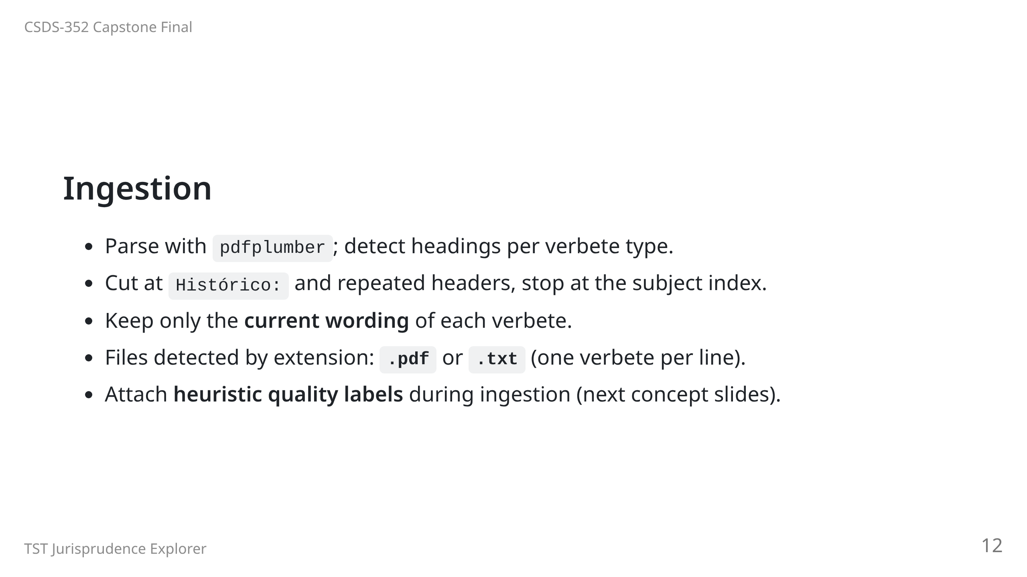

Slide 13
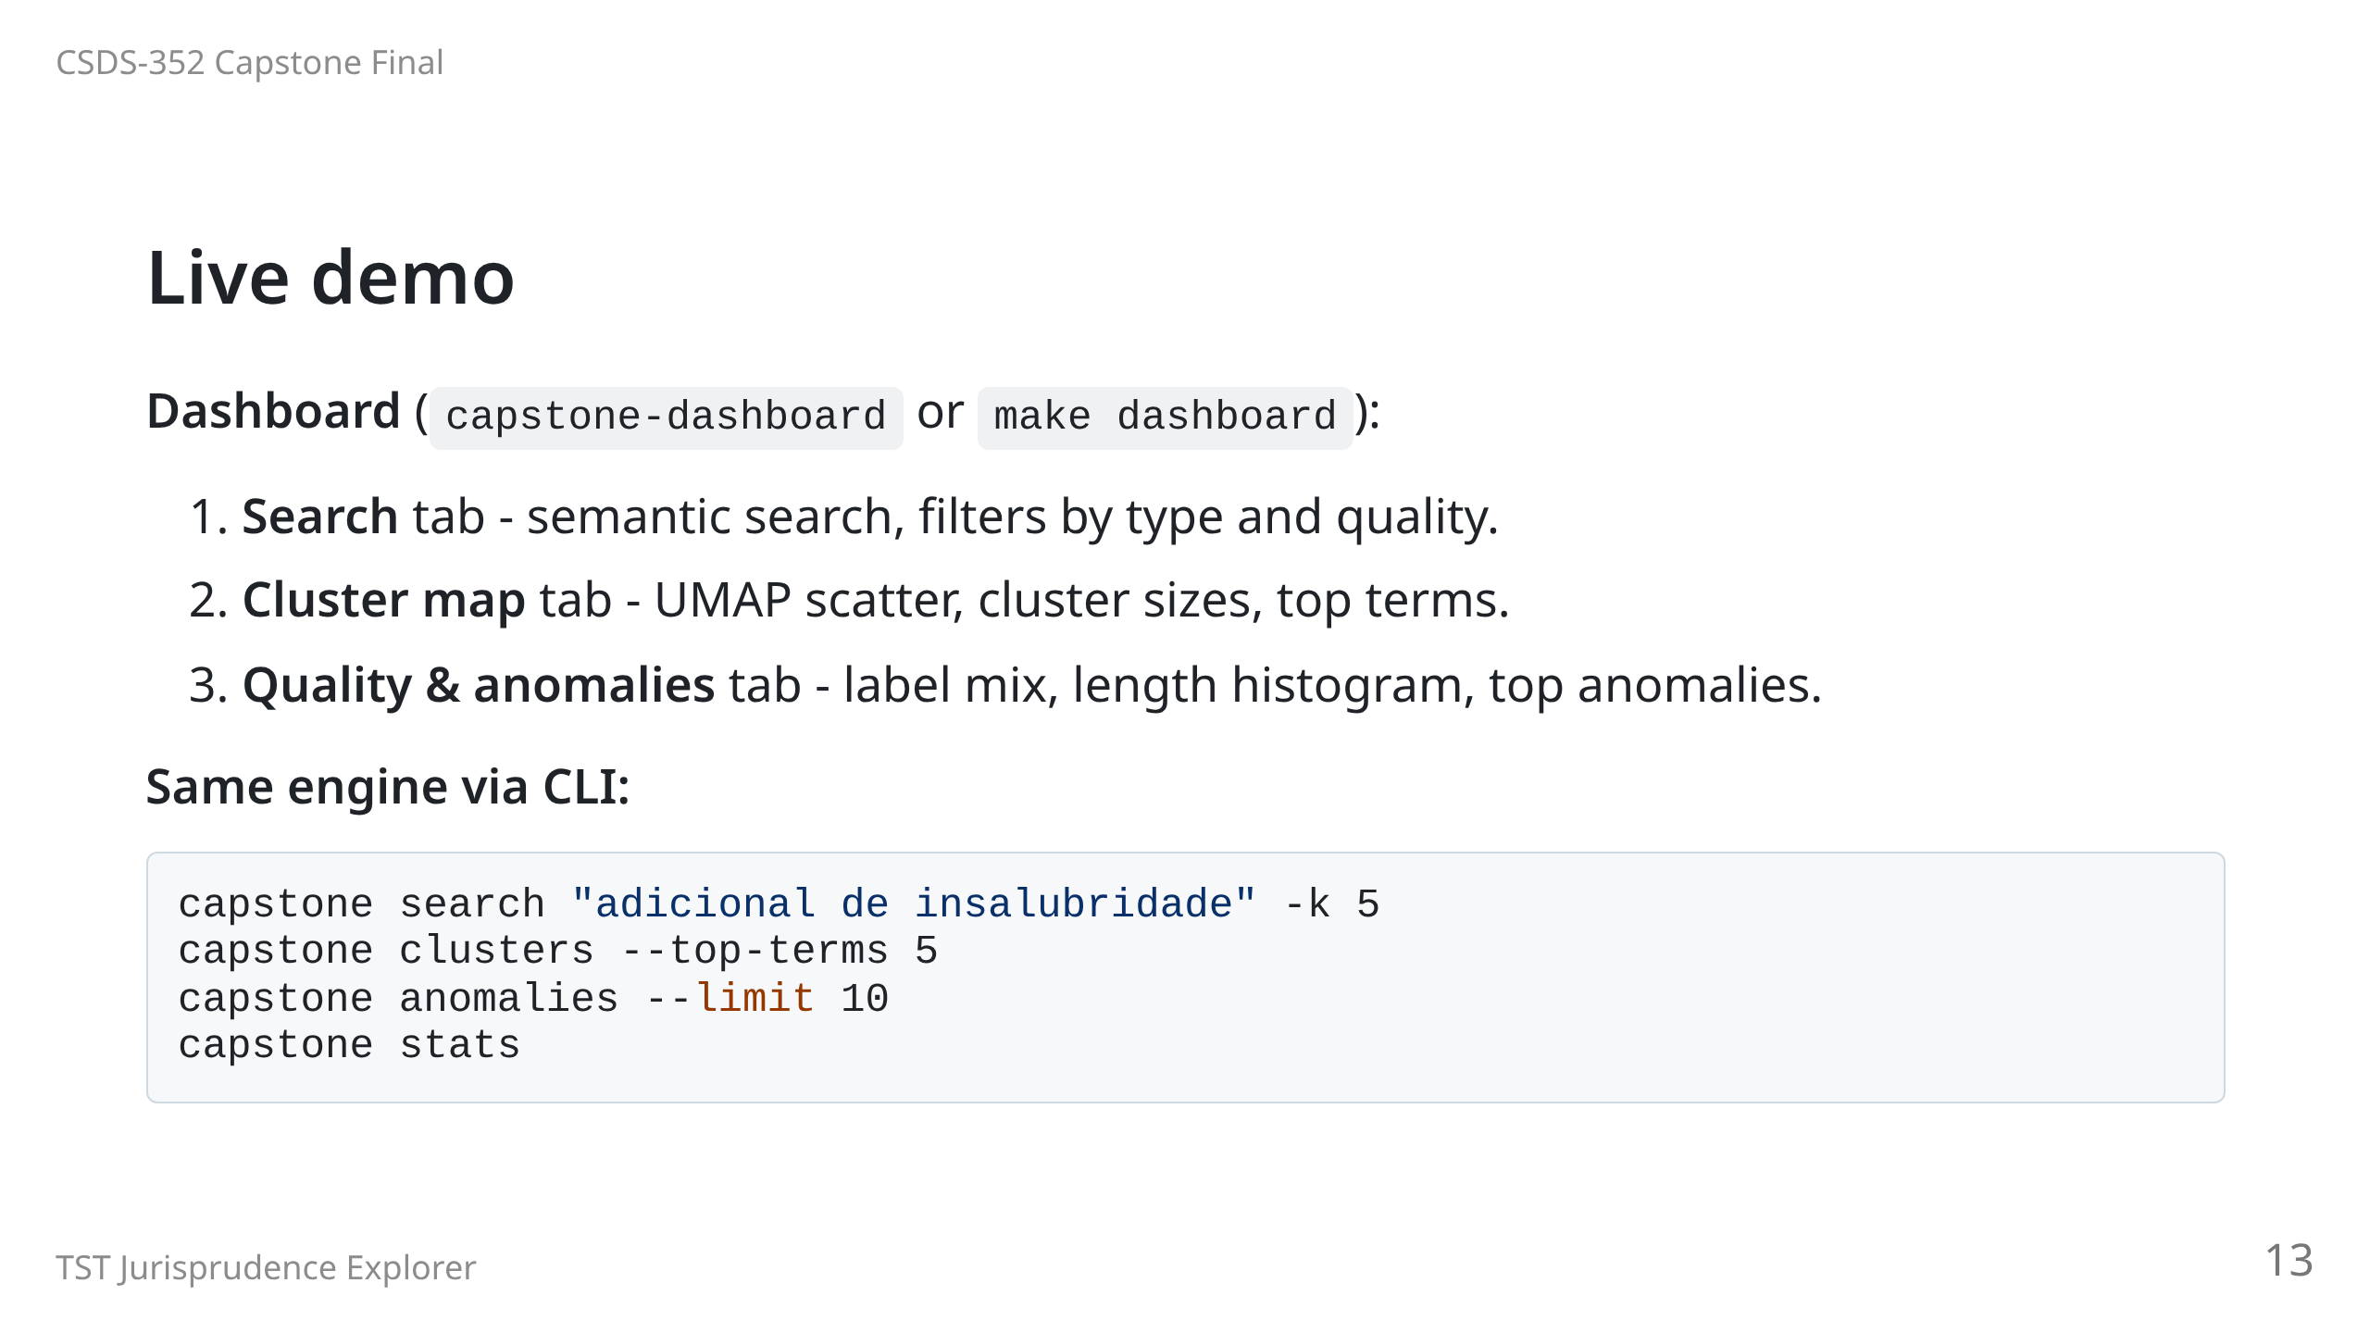
Notes:
Switch to the dashboard. Keep talking while it runs.

Slide 14
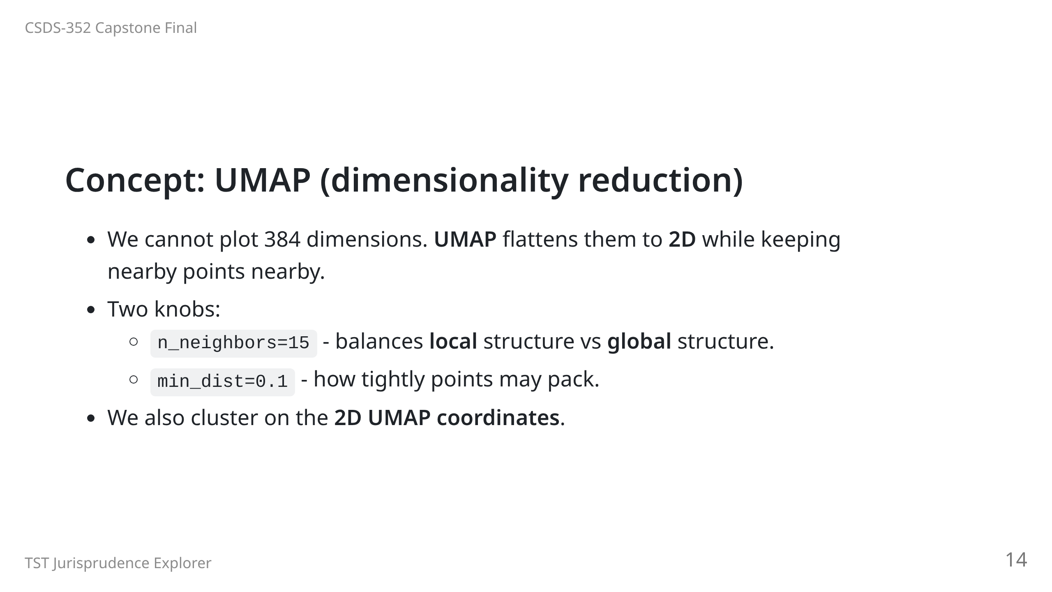
Notes:
Caveat: the 2D picture is a lossy projection; distances are approximate.

Slide 15
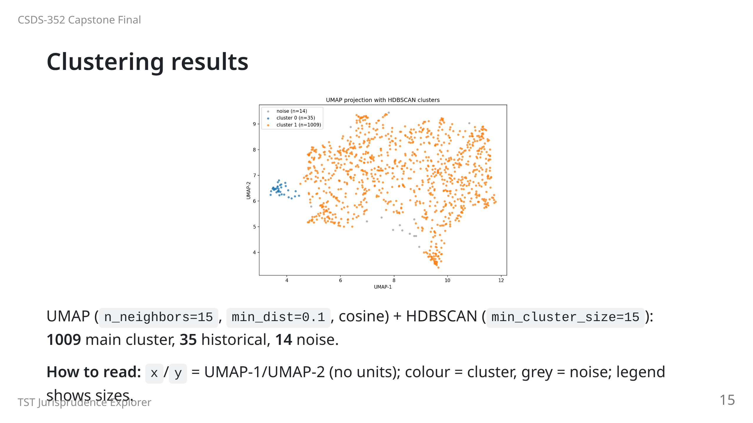

Slide 16
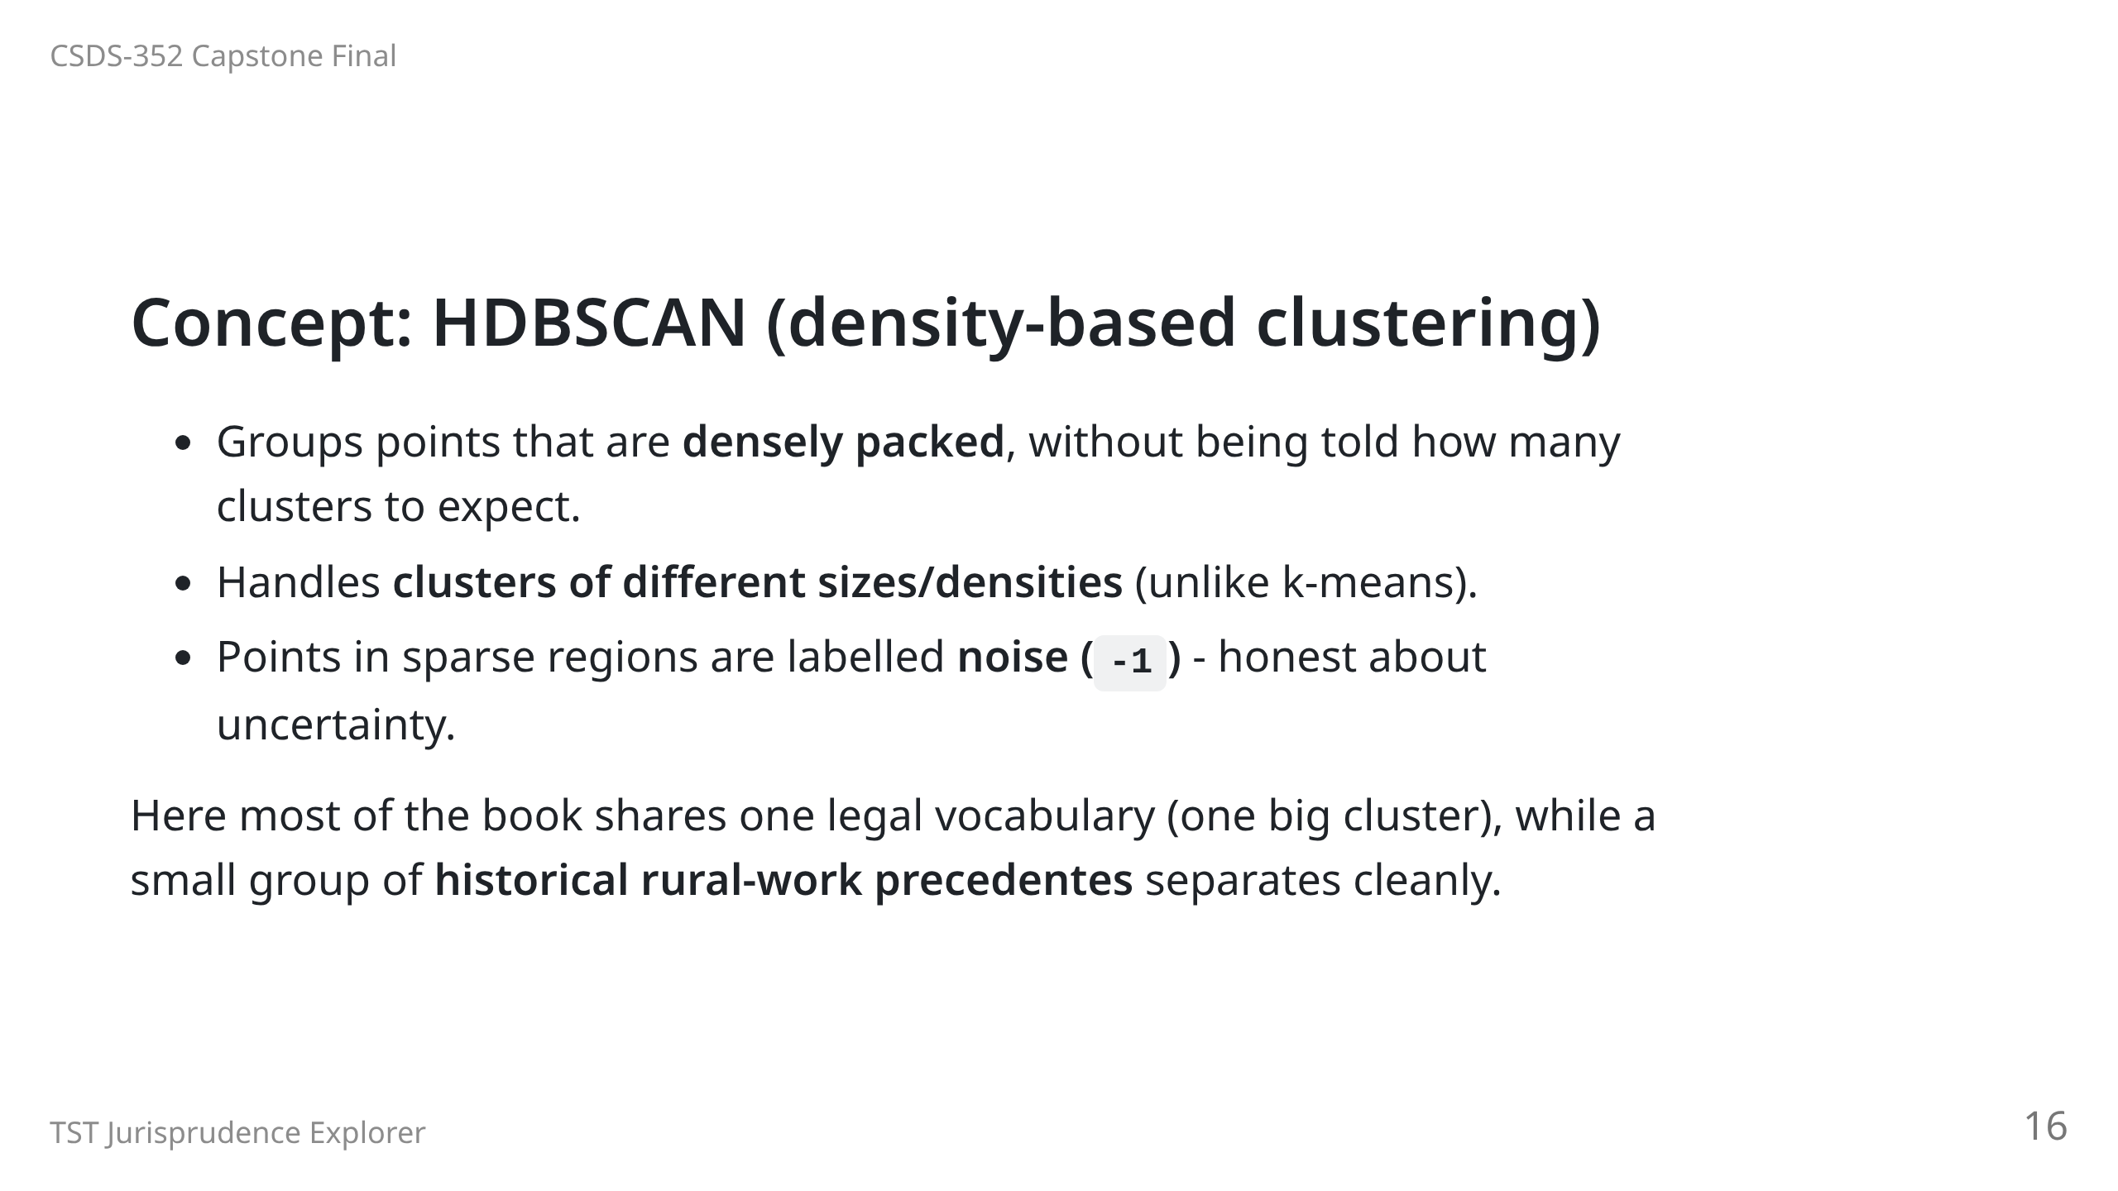

Slide 17
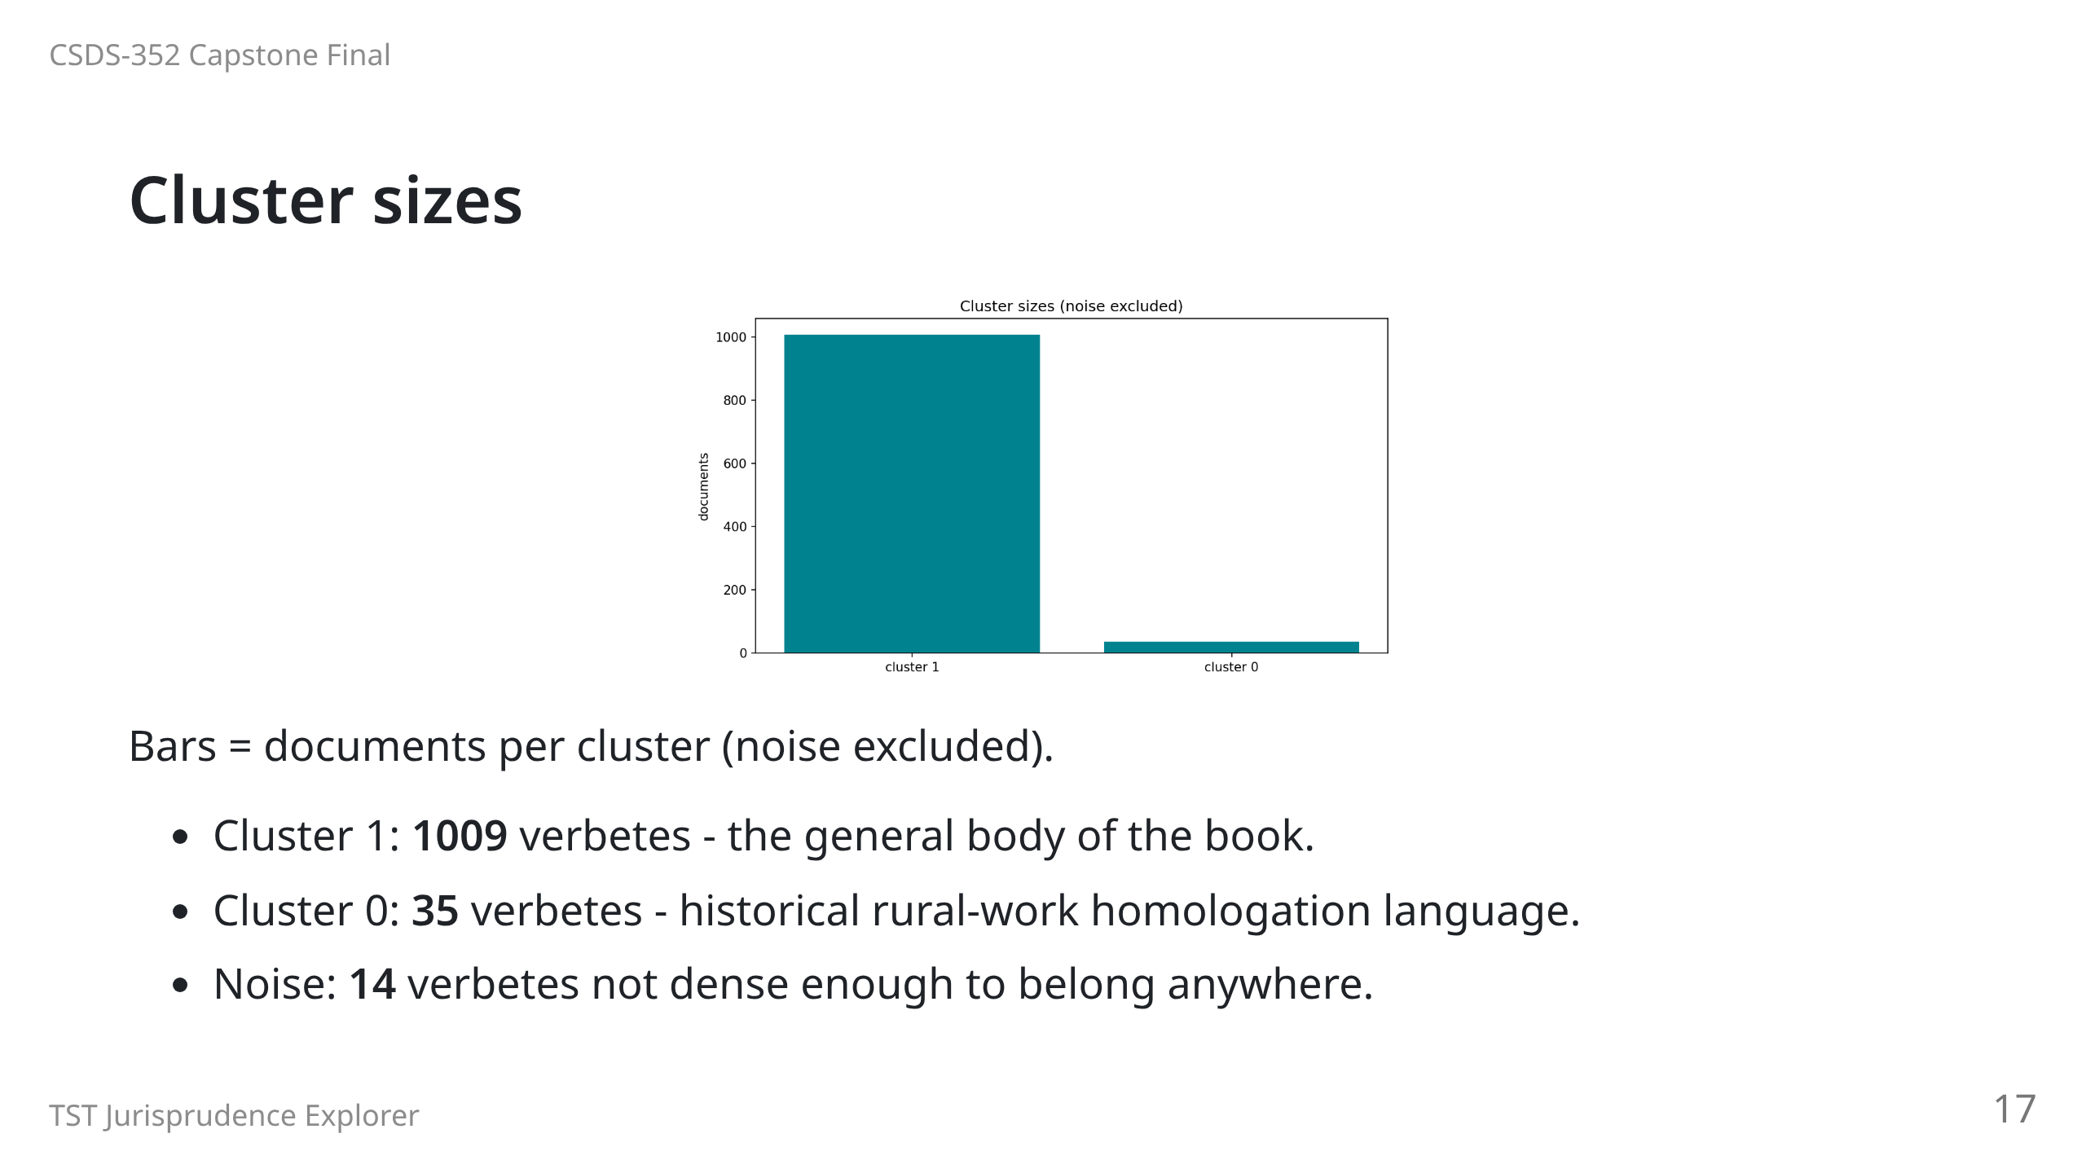

Slide 18
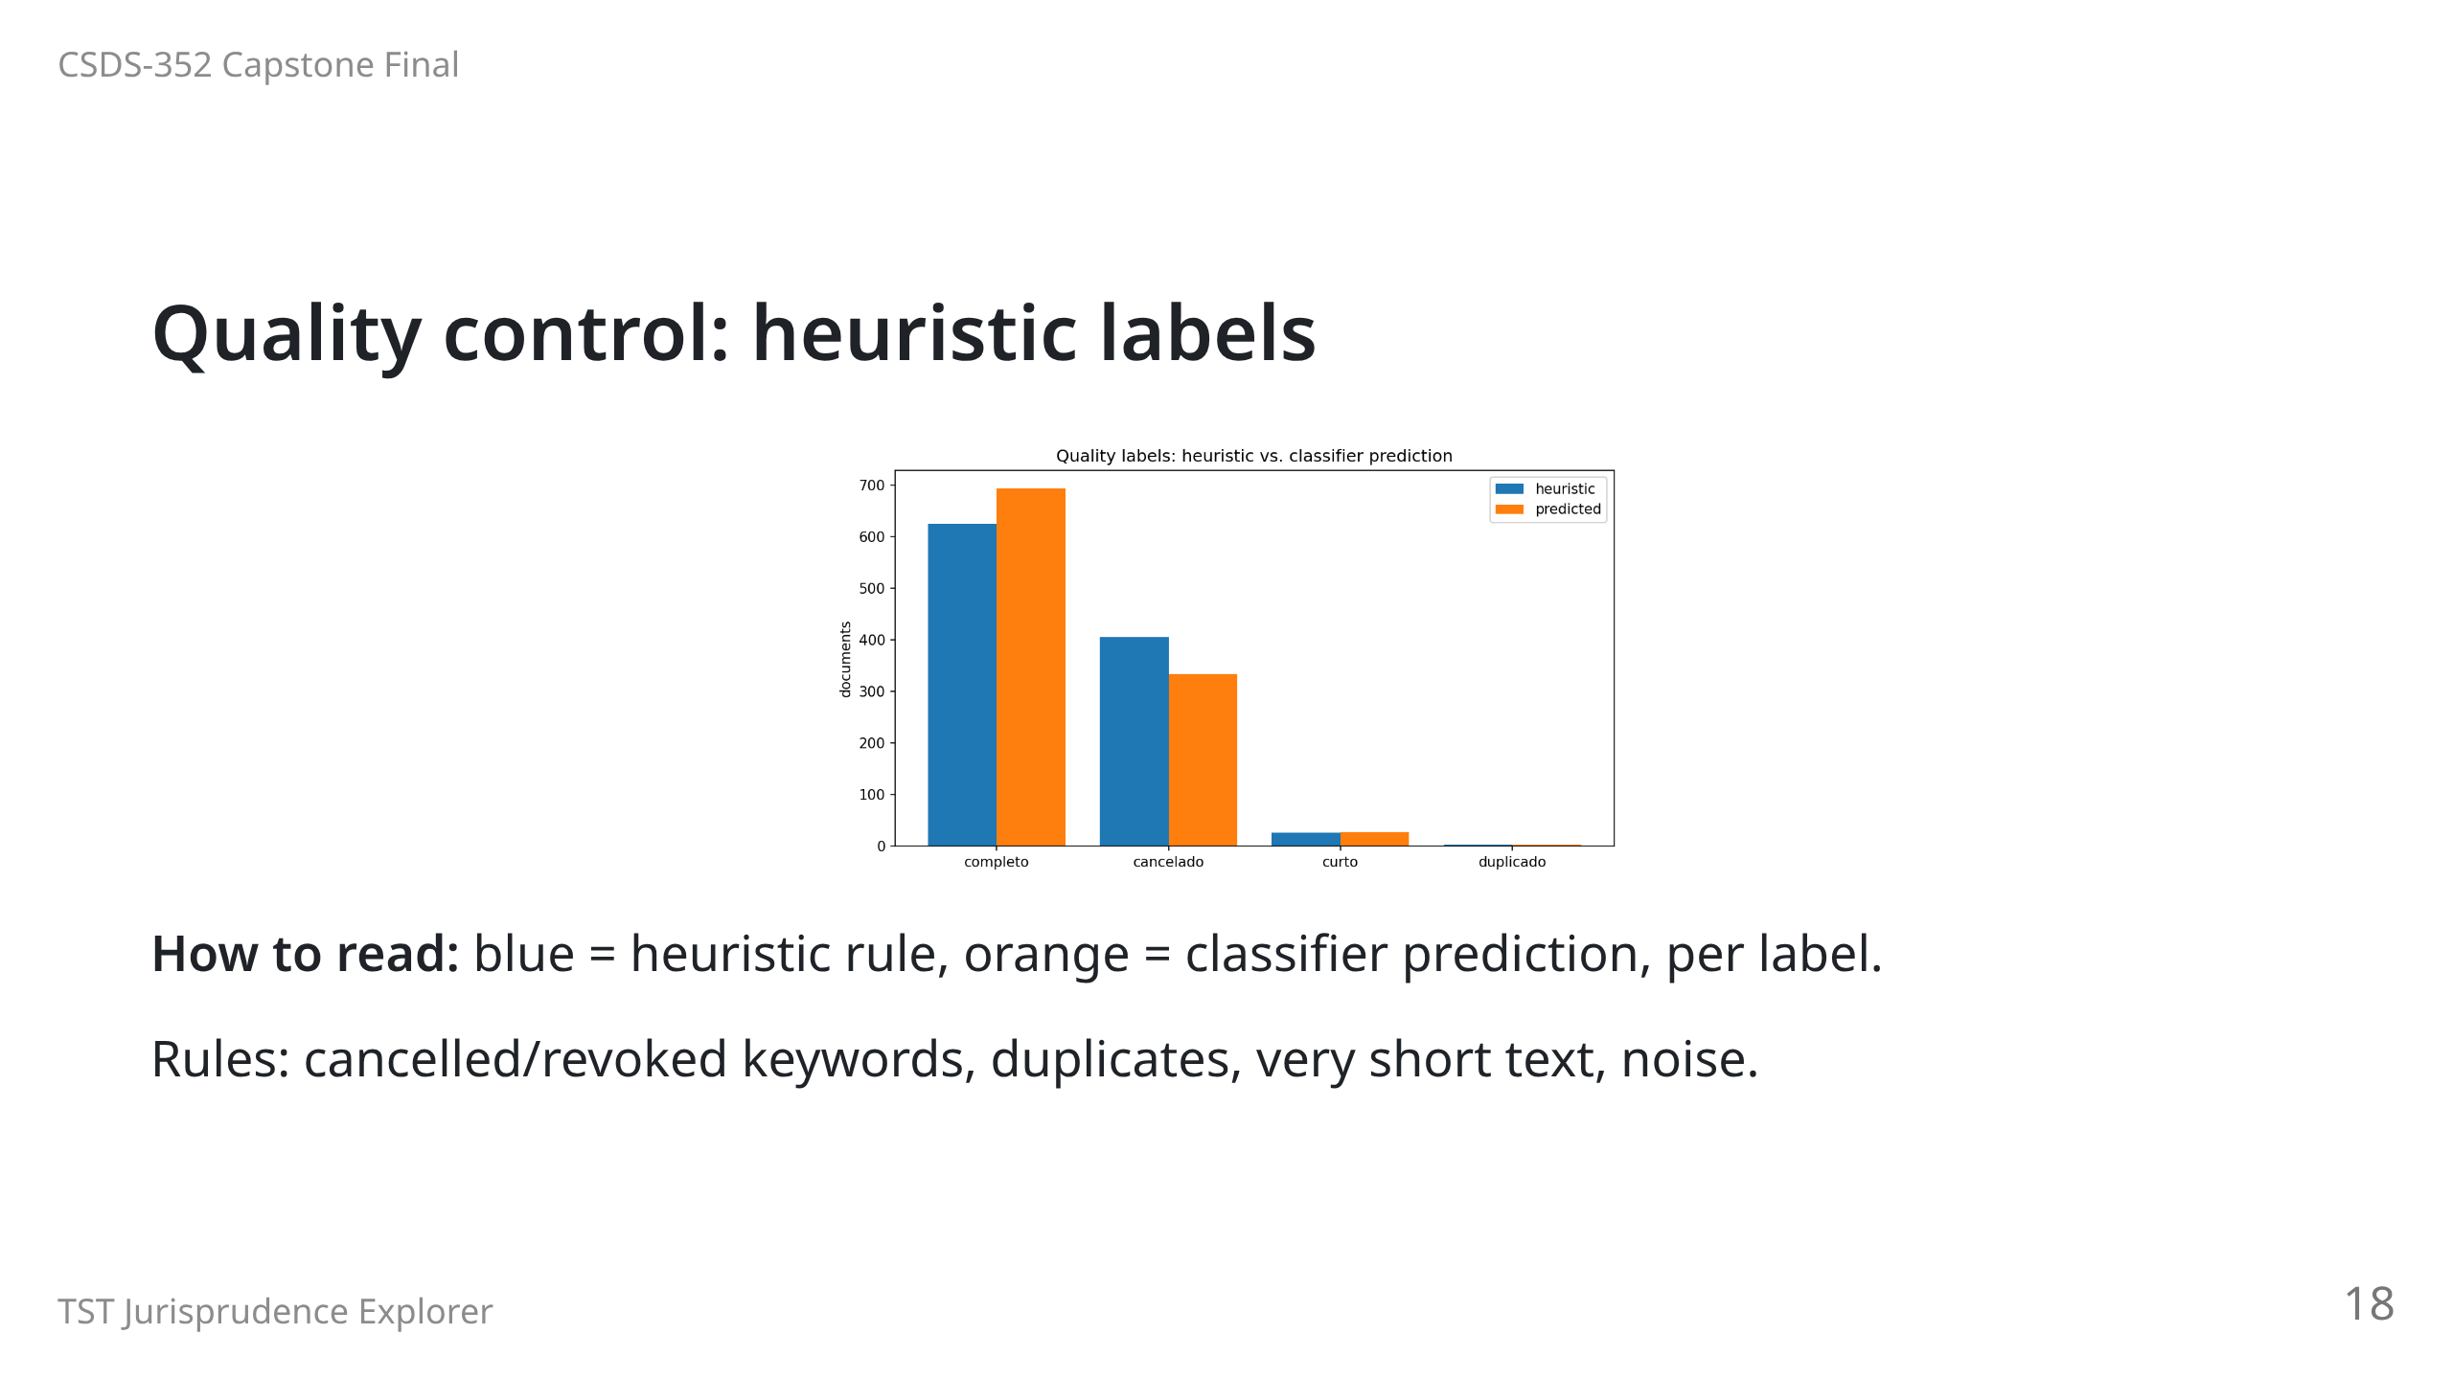
Notes:
Heuristic: 625 completo, 405 cancelado, 26 curto, 2 duplicado.

Slide 19
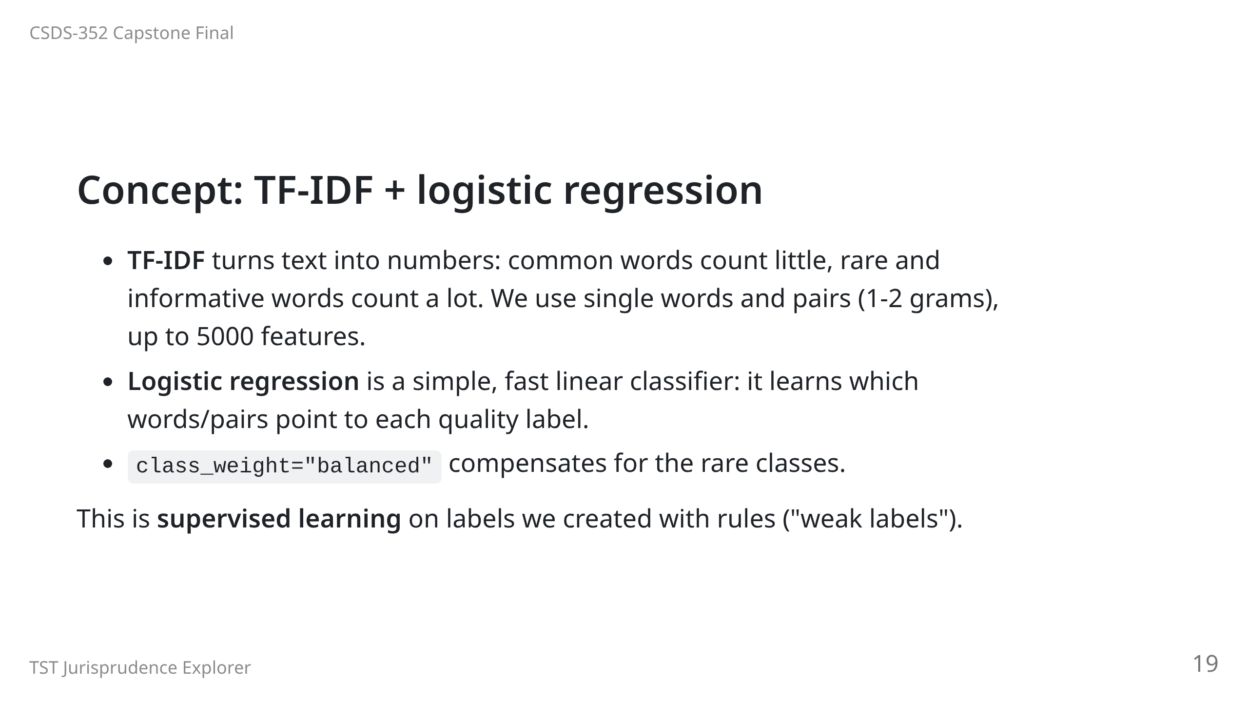

Slide 20
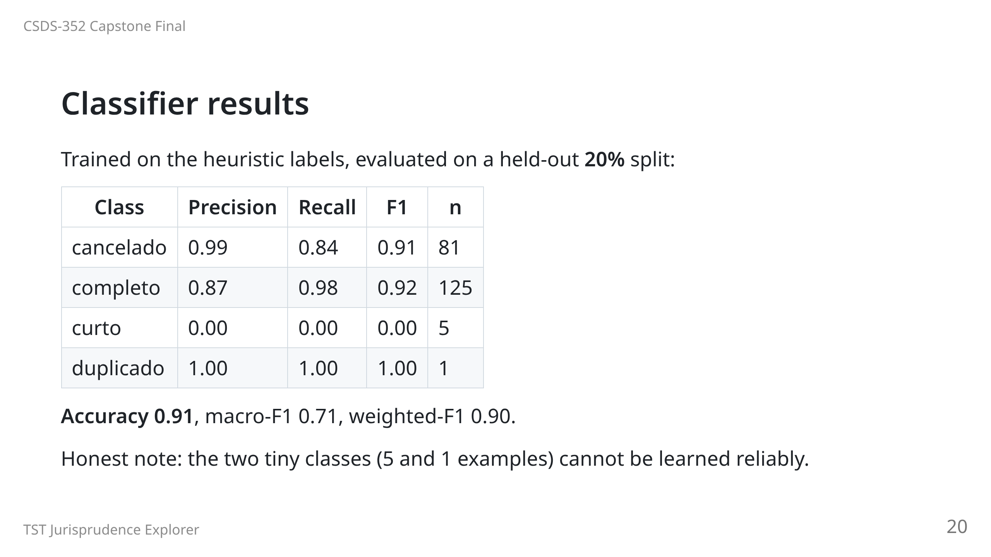

Slide 21
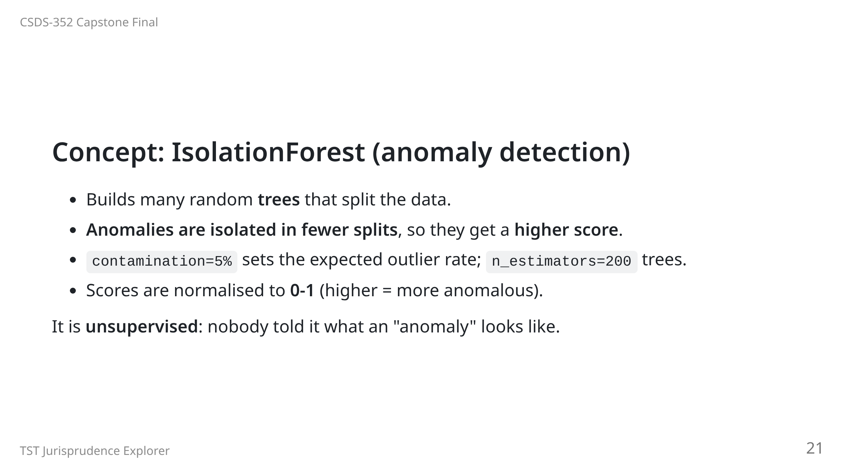

Slide 22
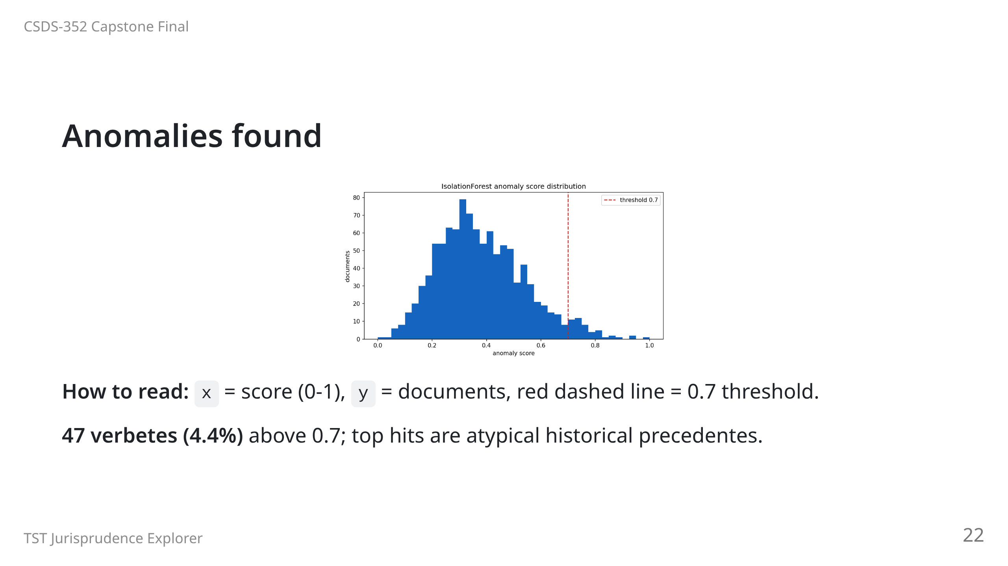
Notes:
Top hits: precedente_106 (1.00), precedente_63 (0.95), precedente_107 (0.94).

Slide 23
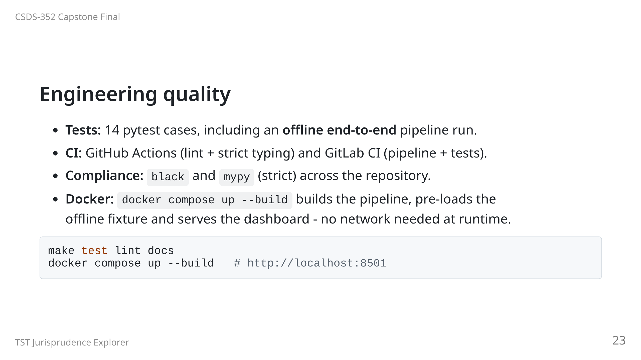

Slide 24
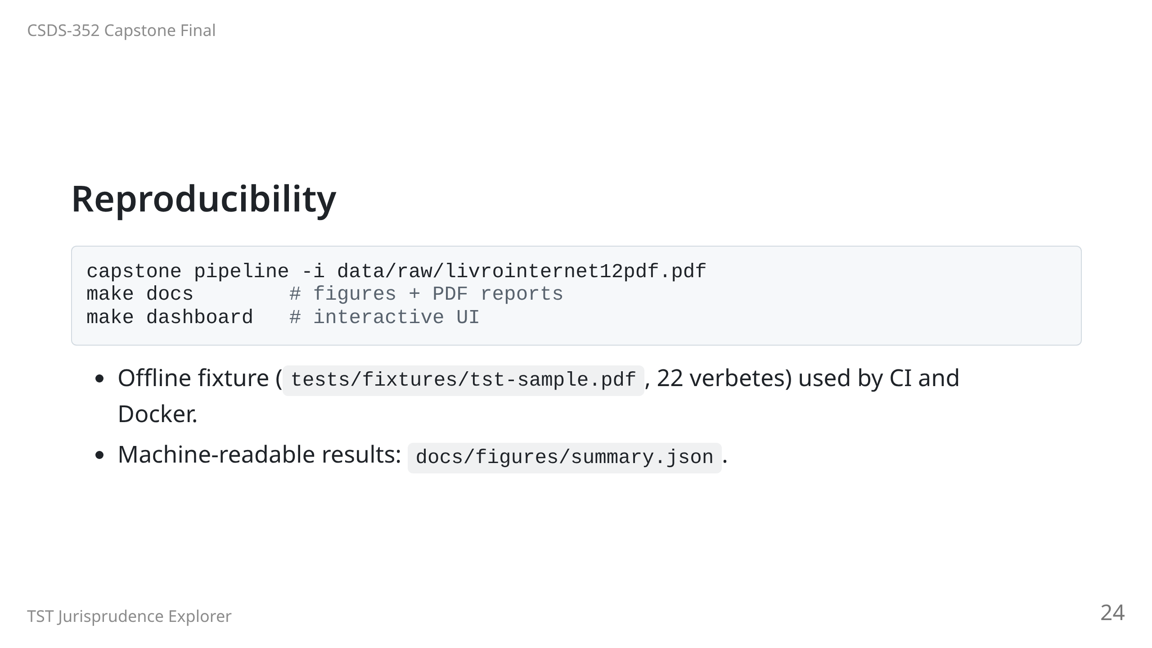

Slide 25
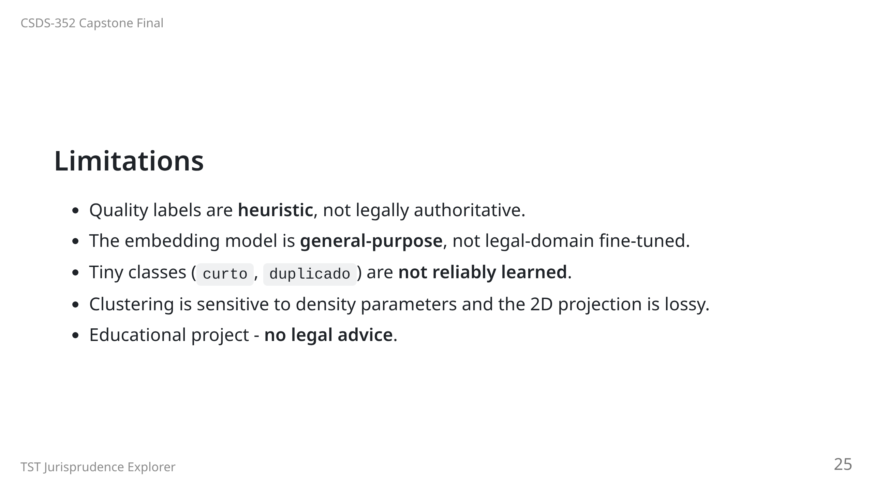

Slide 26
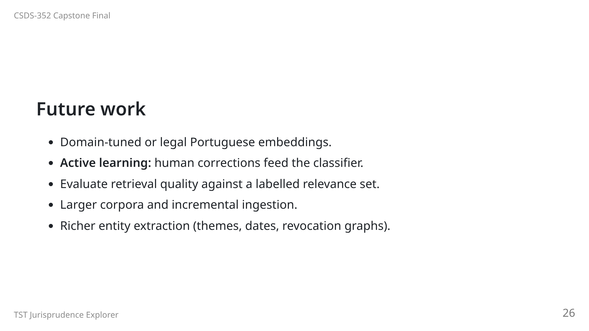

Slide 27
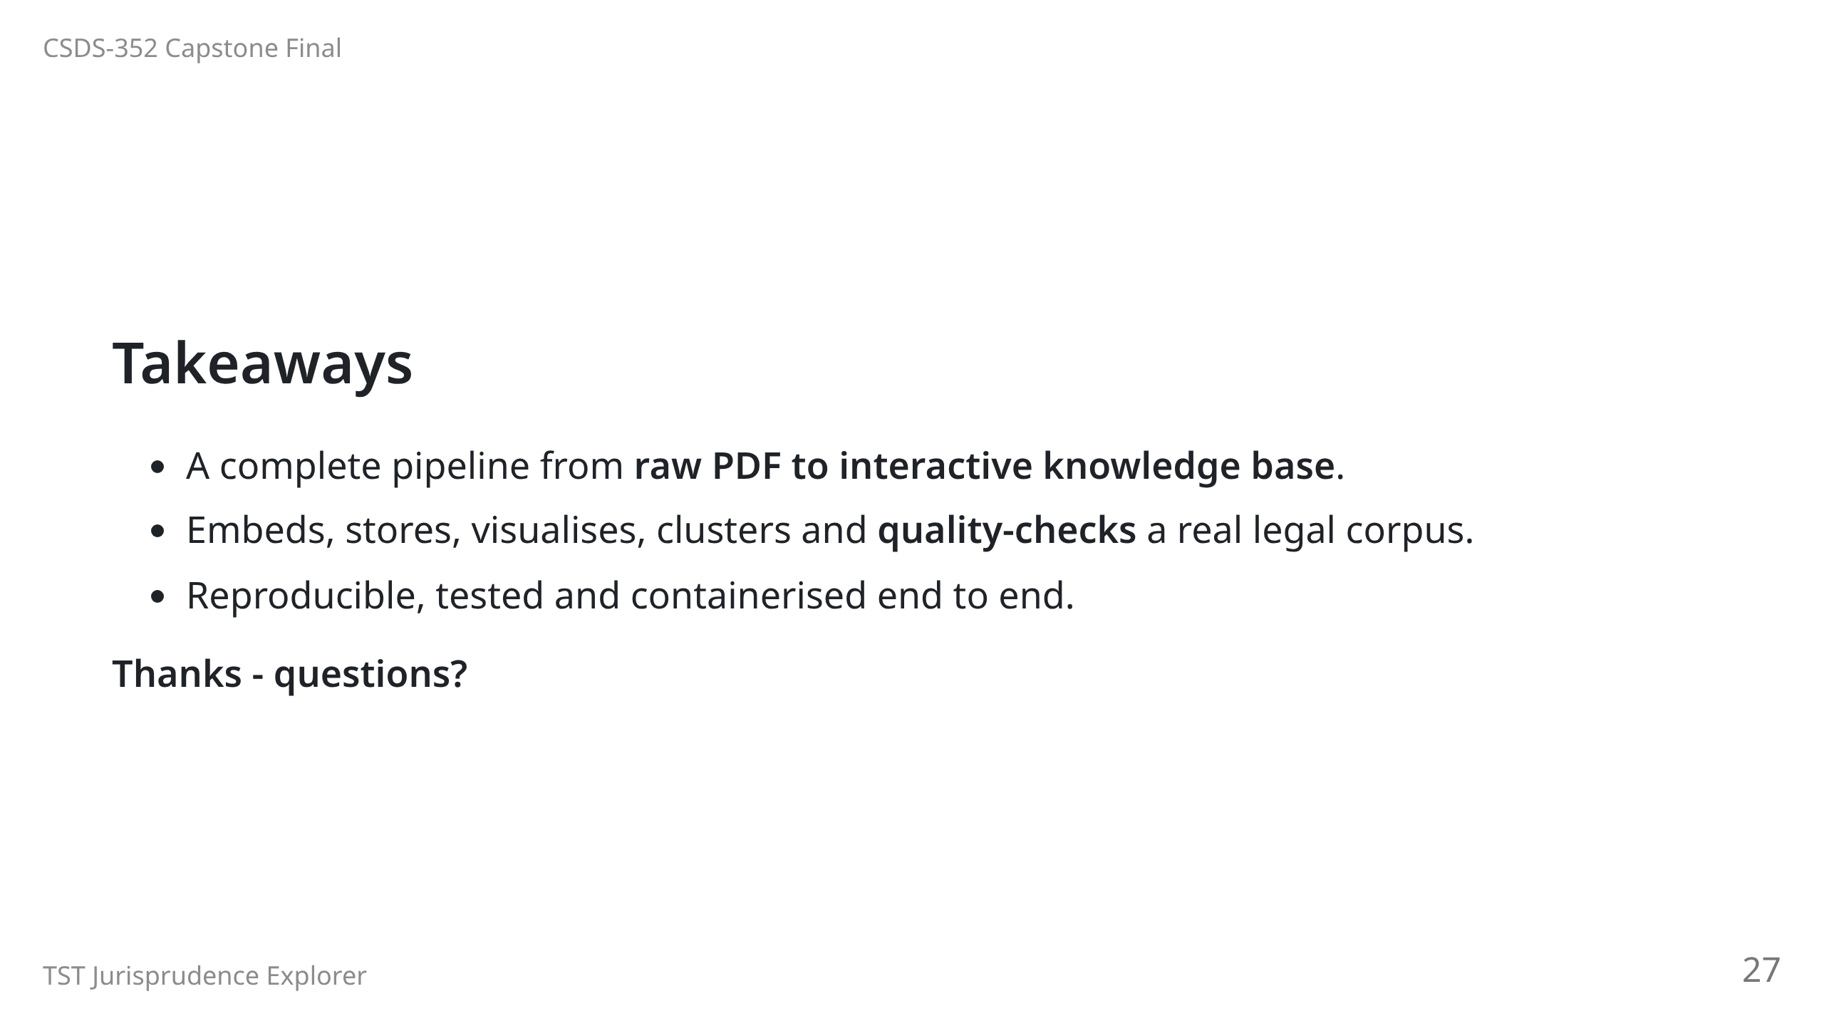
Notes:
Backup slides follow; use only if asked.

Slide 28
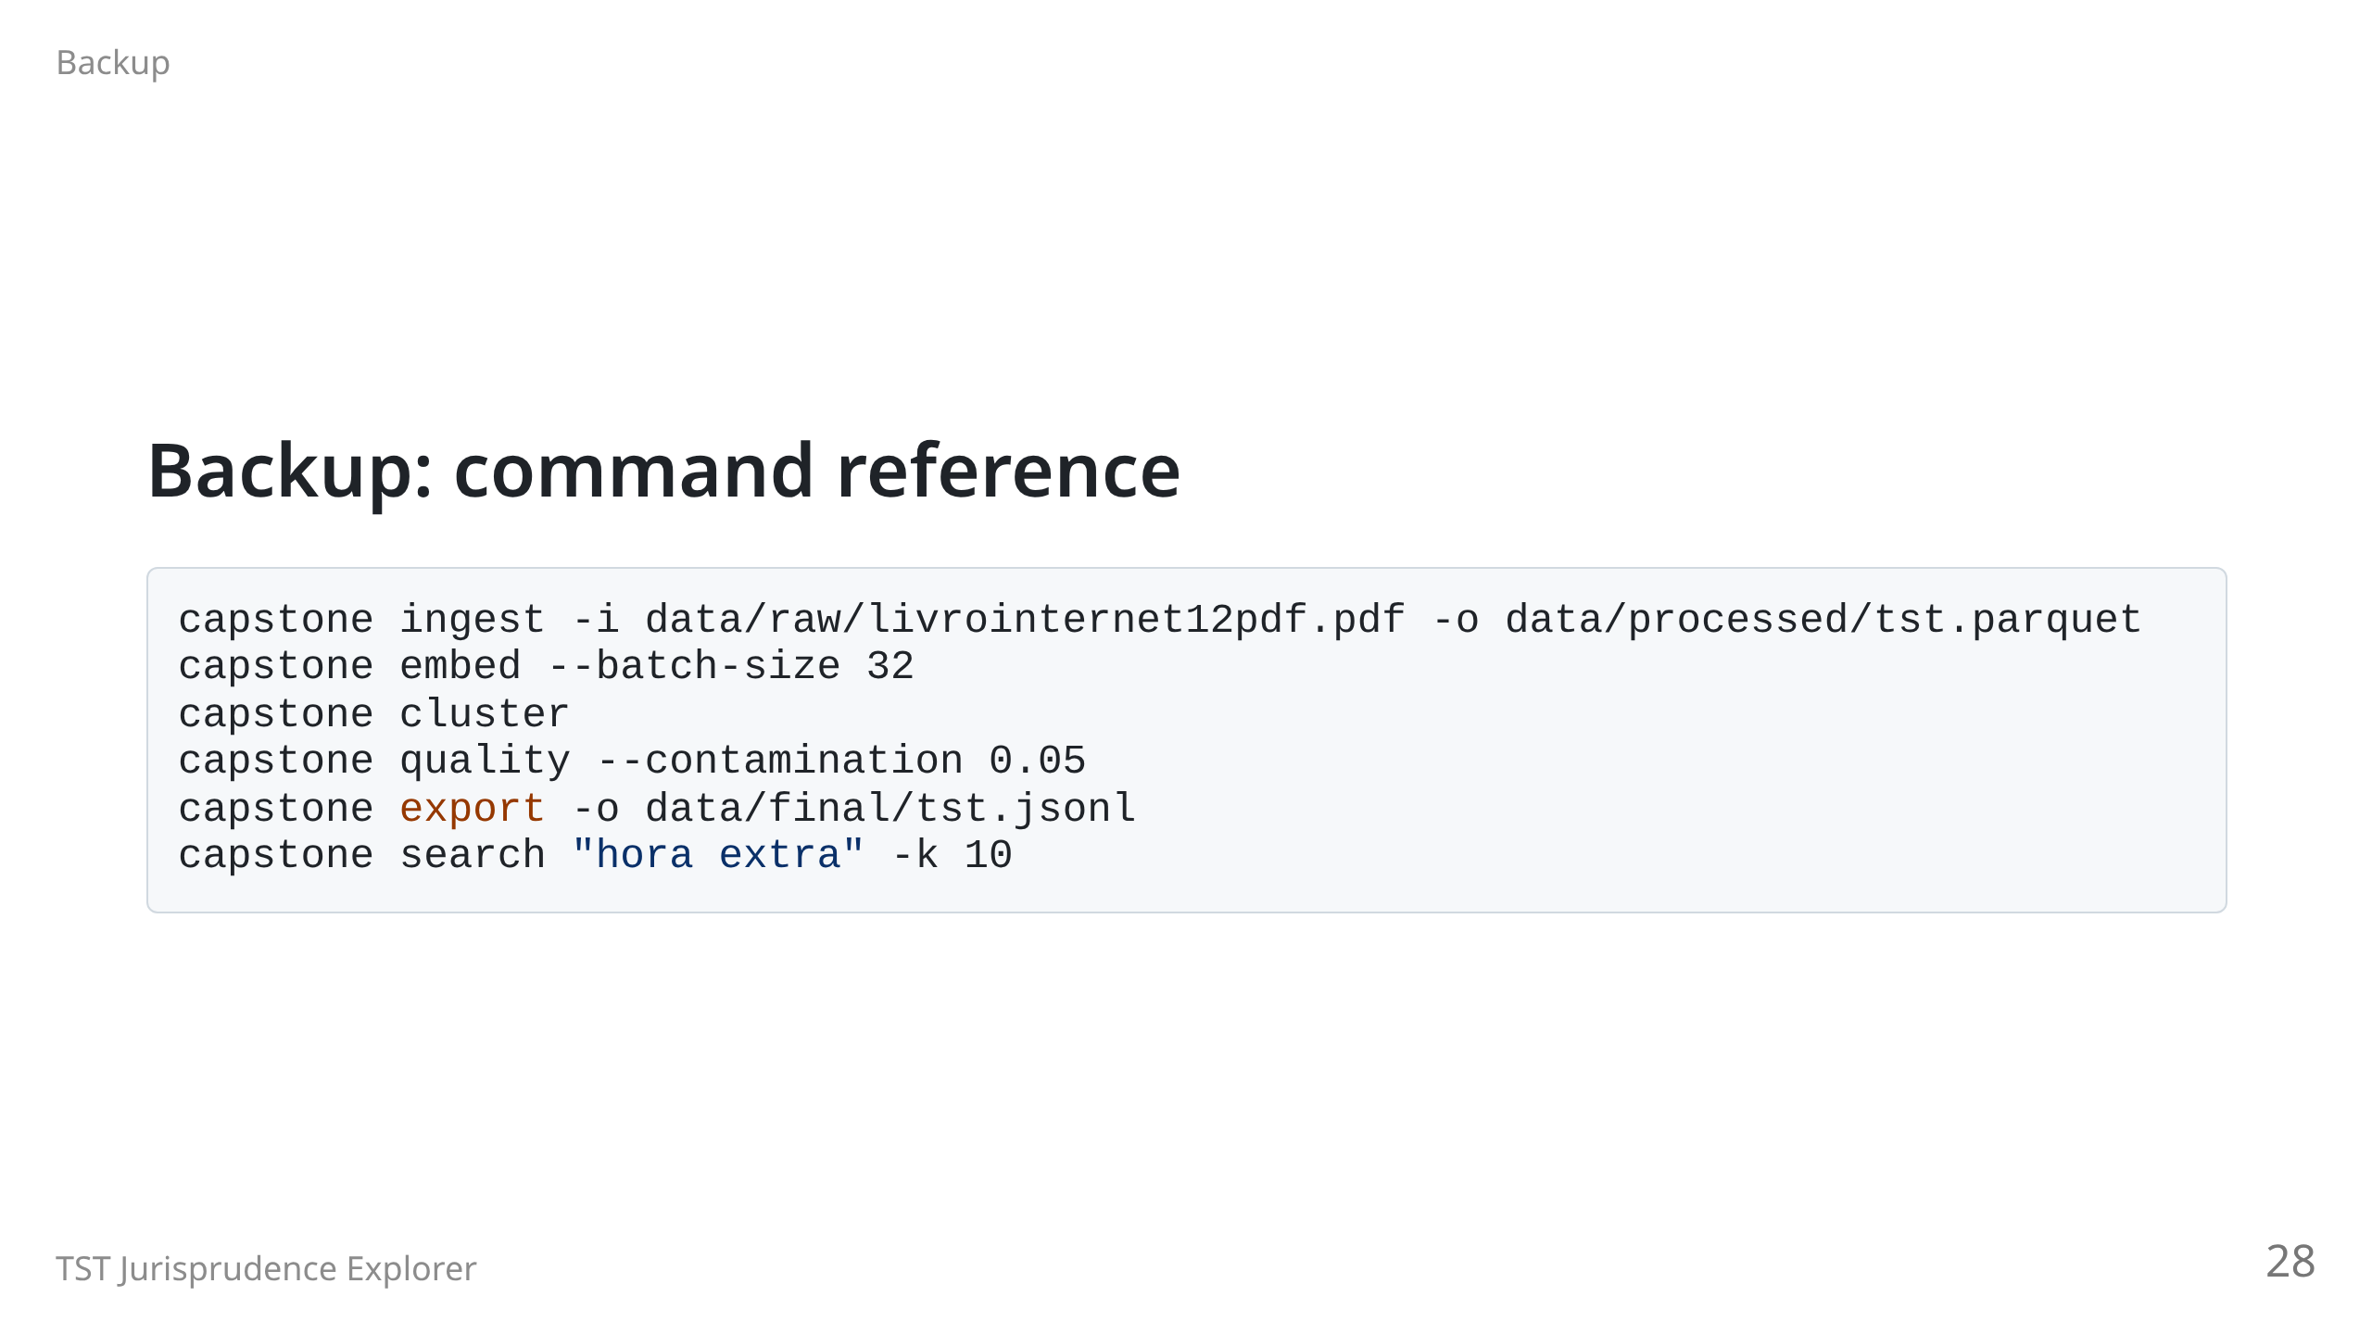

Slide 29
