Slide 1
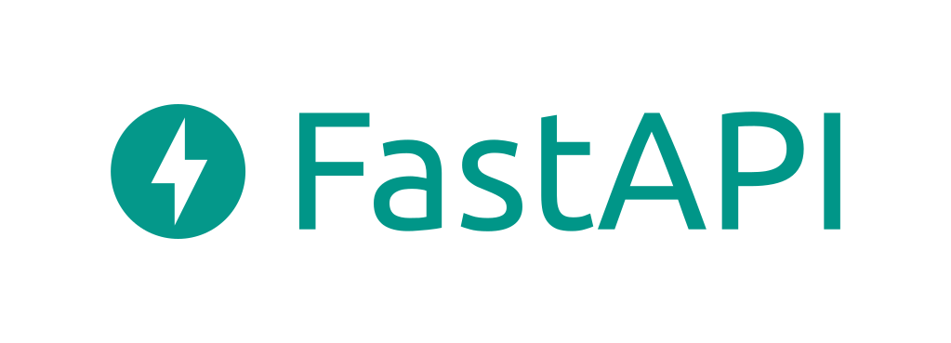
Introduction

Slide 2


General Architecture of WebApps
Gate Interface
App
Web Server
ASGI
or
WSGI
Web Application
Notes:
Modül adı sağ üst köşeye geçiyor.

Slide 3
WSGI and ASGI
Both have same functionality.
WSGI: Web Server Gateway Interface
ASGI: Asynchronous Server Gateway Interface
WSGI & ASGI Simplified
ASGI explained: The future of Python web development
Notes:
Modül adı sağ üst köşeye geçiyor.

Slide 4
WSGI
ASGI
Gateway interface
Wait while tea water is boiling
Responses requests sequentially.
Servers: Gunicorn, uWSGI, Apache
Frameworks: Flask, Django, Falcon
Gateway interface
Slice cheese while tea water is boiling
Concurrent responses.
Servers: Daphne, Uvicorn, Hypercorn
Application/Frameworks: Django/Channels, FastAPI, Quart, Sanic, Starlette
WSGI & ASGI Simplified
ASGI explained: The future of Python web development
https://wsgi.readthedocs.io/en/latest/servers.html
https://asgi.readthedocs.io/en/latest/implementations.html

Slide 5
What is FastAPI?
It is an open source python library for API development.
Features
It is fast and efficient.
It offers rapid development.
The error rate is low.
It is intuitive.
It is plain.
It is easy to learn and use.
It has automatic documentation (Swagger UI and ReDoc).
It works with Python 3.7+.
It is for API development only. It uses uvicorn to present.

Slide 6
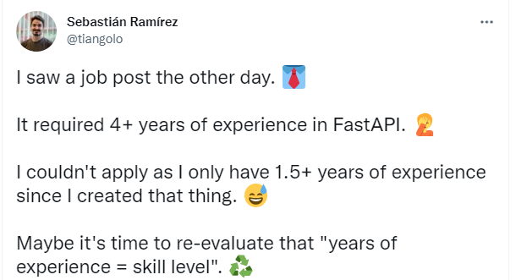
FastAPI creator
Developed on open source standards.
https://fastapi.tiangolo.com/
Notes:
Modül adı sağ üst köşeye geçiyor.

Slide 7

What is uvicorn?
It is an ASGI web server for Python.
ASGI (Asynchronous Server Gateway Interface)
provides a standard interface between async-capable Python web servers, frameworks, and applications.
In short, asynchronous http server.
Notes:
Modül adı sağ üst köşeye geçiyor.

Slide 8
Installation
pip install fastapi[all] uvicorn[standard]
Run
uvicorn --reload \
crud.index:app \
--host 0.0.0.0 \
--port 8000
Notes:
Modül adı sağ üst köşeye geçiyor.

Slide 9
Temel HTTP Commands
C | Create | POST
R | Read | GET
U | Update | PUT
D | Delete | DELETE
Status Codes: https://www.moesif.com/blog/technical/api-design/Which-HTTP-Status-Code-To-Use-For-Every-CRUD-App/
Notes:
Modül adı sağ üst köşeye geçiyor.

Slide 10




Example architecture
DB
Notes:
Modül adı sağ üst köşeye geçiyor.

Slide 11
Terminology
@app.get("/about") def about(): return {"data": "about page"}
Path(endpoint)
Operation
Path Operation Decorator
Path Operation Function
Notes:
Modül adı sağ üst köşeye geçiyor.

Slide 12
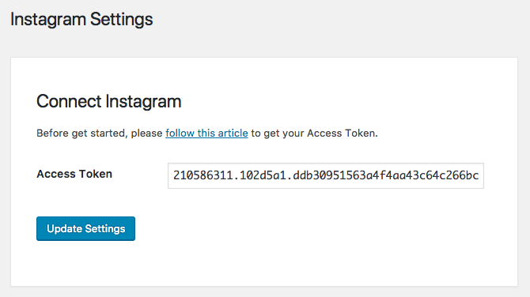
Authentication vs. Token
Token and authentication; are two concepts that limit/allow access to an API. The two are not the same thing. The token does not authenticate the user, it only allows access. Authentication authenticates the user.
Notes:
Modül adı sağ üst köşeye geçiyor.

Slide 13
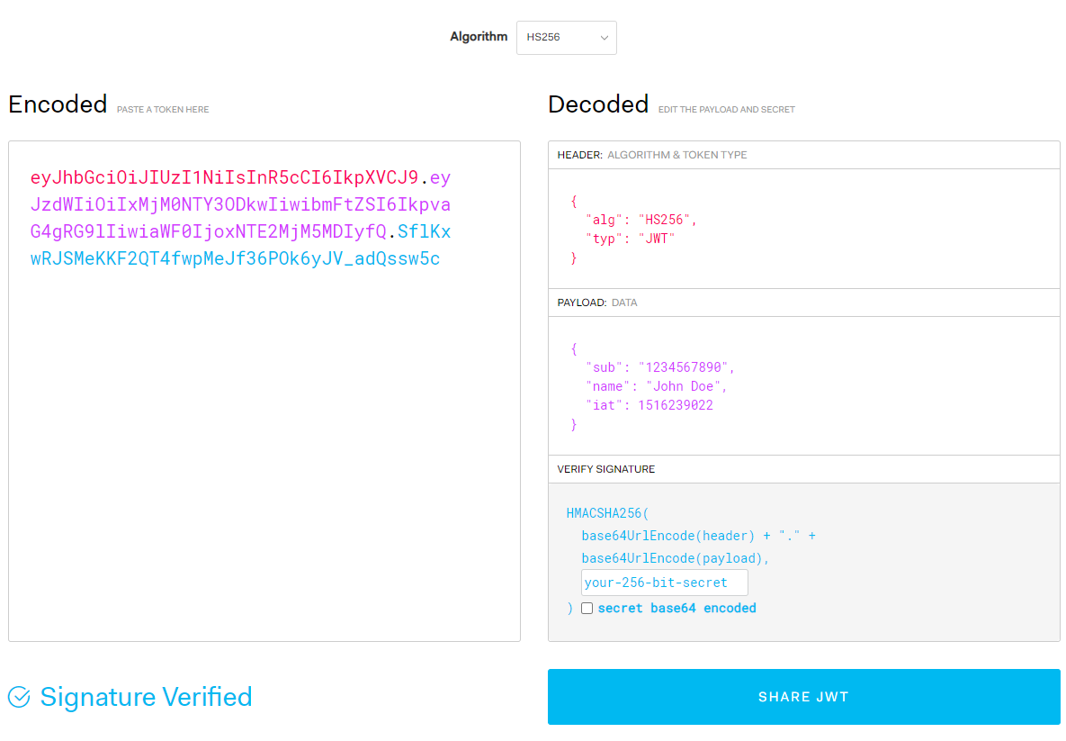
JWT
JSON Web Tokens are an open, industry standard RFC 7519 method for representing claims securely between two parties. JWT.IO allows you to decode, verify and generate JWT.

Slide 14

References
Notes:
Modül adı sağ üst köşeye geçiyor.

Slide 15
References
https://www.technoarchsoftwares.com/blog/asgi/
https://fastapi.tiangolo.com/
https://medium.com/analytics-vidhya/difference-between-wsgi-and-asgi-807158ed1d4c
https://asgi.readthedocs.io/en/latest/
https://wsgi.readthedocs.io/en/latest/
Notes:
Modül adı sağ üst köşeye geçiyor.

