Slide 1
MLOps
More than a Jupyter notebook…

Slide 2

Intro
Wonderful model.
Heights of mathematics, algebra and statistics.
Your success metric is great.
The presentation is very well.

Slide 3

Intro
The boss says: “Let's start right away."
How hard could it be?
Now the rest is non of my business, operations.

Slide 4
Intro
Only 22% of machine learning models
can be used successfully.
https://info.deeplearning.ai/the-batch-companies-slipping-on-ai-goals-self-training-for-better-vision-muppets-and-models-china-vs-us-only-the-best-examples-proliferating-patents

Slide 5
Intro
only 4% of companies have succeeded in deploying ML models to production environment.
https://www.datanami.com/2020/10/01/most-data-science-projects-fail-but-yours-doesnt-have-to/
https://dimensionalresearch.com/

Slide 6
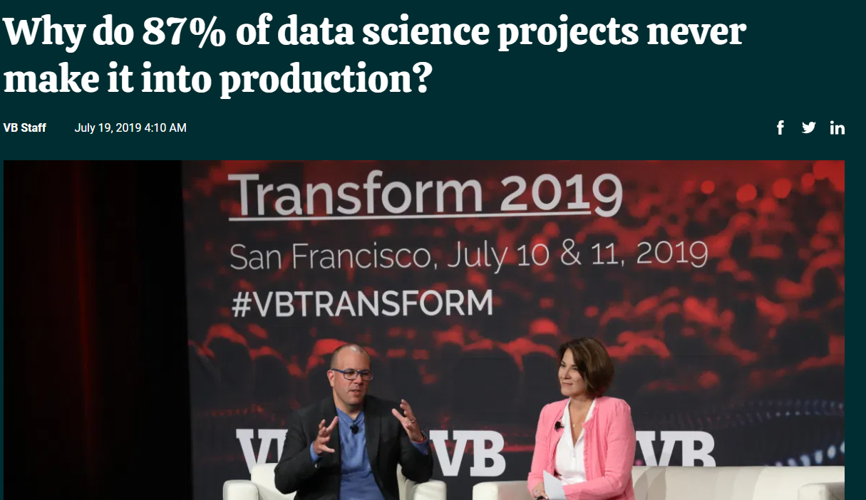
Intro
https://venturebeat.com/2019/07/19/why-do-87-of-data-science-projects-never-make-it-into-production/

Slide 7
Causes of fail
Not just technical
People
Organizational culture
Organizational structure
Consciousness and awareness level
The delusion that model deployment is the end.
. . .

Slide 8
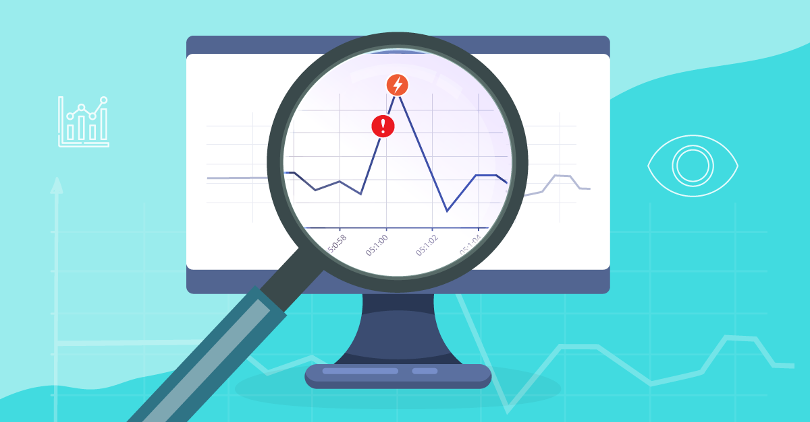
MLOps Intro
Who will monitor whether the model works?
Image source: https://360suite.io/blog/business-objects-monitoring-360live-360suite/

Slide 9

MLOps Intro
Will a monitoring system be installed? Who will look after the incoming alarms?

Slide 10

MLOps Intro
Is the model working correctly? How will it be checked?

Slide 11
MLOps Intro
With which data, in which periods will the model be trained again?

Slide 12
DevOps
Reflection of years of experience in the software world.
Standard
Secure
Automated
Fast

Slide 13

Why DevOps?
The government has issued a ministry circular regarding the pandemic.
You are expected to reflect this change in your software until morning.
You need standard, flexible and powerful automation
If you don't have a system, you can’t do it
even if you don't sleep until morning….
Image: https://www.artofliving.org/in-en/lifestyle/well-being/how-to-stop-feeling-tired-all-the-time

Slide 14
MLOps
Machine Learning + Operations
It doesn’t refer a tool or software.

Slide 15
MLOps
ML Ops is a set of practices that combines Machine Learning, DevOps and Data Engineering, which aims to
deploy and maintain ML systems in production reliably and efficiently.

Slide 16
MLOps
In addition to CI and CD, MLOps introduces two practices:
Continuous Training (CT) that aims to automatically retrain the model where needed.
Continuous Monitoring (CM) concerns with monitoring production
data and model performance metrics, which are bound to business
metrics.

Slide 17
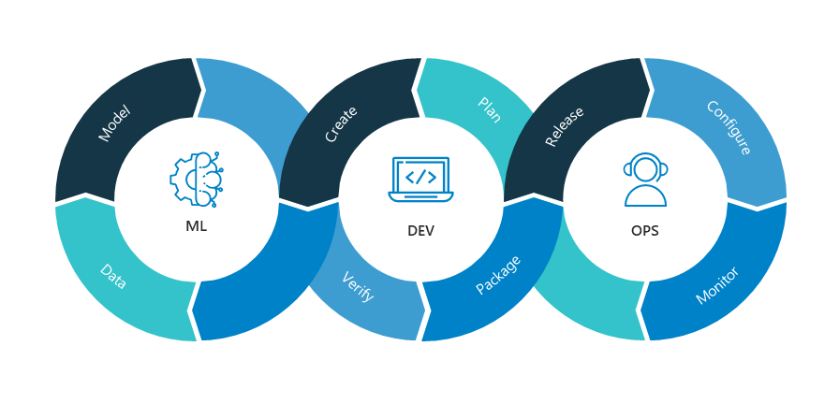
MLOps
Image: https://nealanalytics.com/expertise/mlops/

Slide 18
MLOps
The DevOps process between software development and operation is a DevOps-like process between ML models and operationalizing them.
MLOps is not exactly the same as the DevOps process, as ML model development has some differences from software development.

Slide 19
MLOps place in the ecosystem
Machine Learning
MLOps
Data Engineering
DevOps
Görsel Esinlenme: https://towardsdatascience.com/ml-ops-machine-learning-as-an-engineering-discipline-b86ca4874a3f

Slide 20
Who is responsible with MLOps?
Under normal circumstances, the data scientist alone is not expected to achieve the goal of MLOps.
However it depends on,
The expectations from the roles;
The size of the institution,
The size of data science team,
Level of awareness and maturity of datascience.

Slide 21
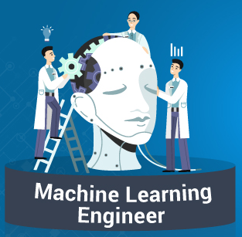
Then whose job MLOps is?
ML Engineer
Proficient in designing, building, testing and maintaining production software applications that integrate AI services and include data science models.
Experience of applying development patterns in relation to security, scalability and performance.
Working with our data engineers to ensure models run efficiently.
Summarizing complex concepts in a digestible way for stakeholders with less technical understanding.
Building scalable solutions and RESTful APIs to expose models as a service.
You will work closely with Data Scientists to frame business problems, analyzing and proposing innovative machine learning solutions. You will then build and productionize scalable machine learning models in GCP.
Image source: https://images.app.goo.gl/uygFkyHvWeuPNret6

Slide 22
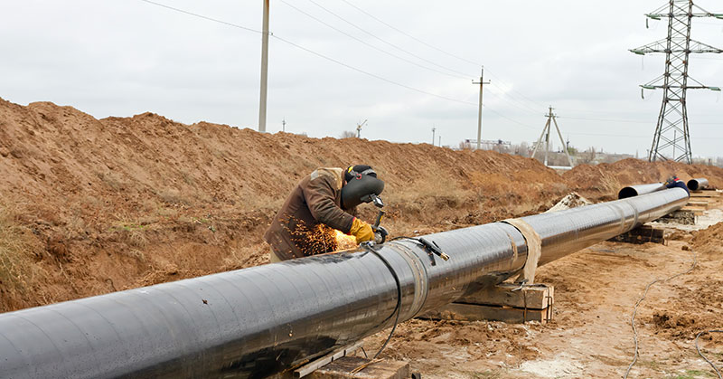
ML Pipelines
MLOps is pipeline oriented.
Deploy the pipeline, not the model.

Slide 23
ML Pipelines
CI (Continuous Integration): Validation of data, not just code and model
CD (Continuous Delivery): Delivery Part of the Delivery pipeline
CT (Continuous Training): Models automatically re-train and monitor

Slide 24
MLOps Maturity Model
The level of automation mainly determines the maturity level.
Level 0
Level 1
Level 2 (Full automation)
MLOps: Continuous delivery and automation pipelines in machine learning

Slide 25
MLOps Maturity Model
Level 0 (NoOps):
Datascientist hands over model as artifact
Static offline dataset usage, manual data collection
Manual model deployment or sometimes scripting
No frequent new releases
No CI/CD
There is only prediction service
No performance Monitoring, no testing
MLOps: Continuous delivery and automation pipelines in machine learning

Slide 26
MLOps Maturity Model
Level 1 (Automated Training):
There is a working pipeline for data collection
Datascientist doesn’t work isolated, a team member
Source code are modularized. No notebooks.
Level 2 (Full Automation):
CI, Pipeline CD
Data validation in progress
MLOps: Continuous delivery and automation pipelines in machine learning

Slide 27
Key roles in a data-driven organization
Data Engineer:
Builds data pipeline and prepares clean data
Decision maker:
Decides to invest in a data-driven opportunity.
Data Analyst:
Explores the data for insights and potential relationships that could be useful as features in a machine learning model.
Statisticians:
Helps data-inspired decisions become true data-driven decisions, with their added rigor.

Slide 28
Key roles in a data-driven organization
ML Engineer who have real-world experience building production machine learning models from the latest and best information and research by the researchers.
Data Scientist who have the mastery over analysis, statistics, and machine learning.
Researcher
Analytics manager
Social scientist

Slide 29
A common mistake that companies make is that they go out and hire 10 PhD machine learning scientists, and expect magic to happen.

Slide 30
References
https://ml-ops.org/
https://cloud.google.com/architecture/mlops-continuous-delivery-and-automation-pipelines-in-machine-learning#devops_versus_mlops
https://medium.com/slalom-data-analytics/mlops-part-1-assessing-machine-learning-maturity-88e9cb05eca9

