Slide 1
Introduction to ML Engineering

Slide 2
ML related roles
ML Engineer
Data Scientist
Data Engineer
Roles can overlap.
Can be merge into one person.
No matter who what to do value expectation does not change.

Slide 3
Value
What value do you create for your company, institution, boss?
Money
Productivity Increase
Saving
Operational improvement
Save time..

Slide 4
Who Does What: Data Scientist
One sentence: Builds models.
Business information
Field information
Understanding consumer/customer needs
Boss needs
Analysis
Modelling
...

Slide 5
Who Does What: Data Engineer
One sentence: Makes data available where, when and in the format it is needed.
Understanding the needs of data customers
Understanding the data
Create a pipeline
Pipeline maintenance (monitoring, maintenance, troubleshooting, remediation)
Data quality, reliability, scaling, access to systems

Slide 6
Who Does What: ML Engineer
One sentence: All things models to production.
Understanding the model and the value it produces
Model deployment
Model maintenance (monitoring, maintenance)
Retraining as needed
ML Pipelines, automation

Slide 7
Who Does What
Science
MLOps
Datascience
ML Engineering
DataOps
Data Engineering
Engineering

Slide 8
Building Team
Don't make a decision in the mode of turning OKEY in the Kiraathane.
I will do artificial intelligence, I need 3-5 data scientists
Everybody's taking it, we'll take it too
Data engineer if the product is data-heavy (simple model robust system)
If field knowledge is important, field expert, analyst (energy specialist)
Data scientist-heavy if model intensive (1% improvement $10 million)
Usually a mixed team is good.

Slide 9
ML Engineering in the real world
Don't overlook the value generation.
Don't spend months researching, reading articles and talking about the magnificence of new algorithms.
Make good use of your time.
Learn new things too, but don't forget to offer a business benefit.
Offer a benefit in a reasonable amount of time, satiate the appetite of the employer or customer.
Don't sell dreams, over-shine and raise expectations when there's nothing there.

Slide 10
ML Engineering in the real world
Must understand business logic.
Get the job done
Understand the customer: What are their needs, expectations and concerns?
Communicate.
Don't stop, don't wait, act.
Raise the flag when necessary.

Slide 11
ML Engineering in the real world
Is the problem really an ML problem?
Knowing fluctuations in energy demand?
Detecting energy losses and leaks?
Improving data quality in the ERP system?
Reducing and simplifying complexity in business reports?
Not every problem can be solved with ML.

Slide 12
What is an ML solution like?
Interface
Visualization
Model input
API
Box
Button
Storage
Computation
Training data
Models
Metadata
Model training
Data pre-processing
Prediction

Slide 13
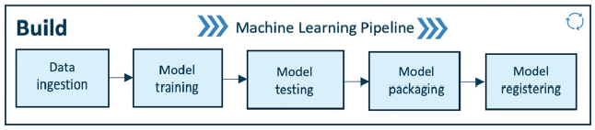
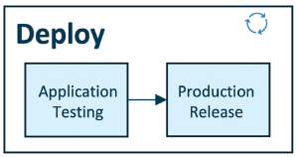
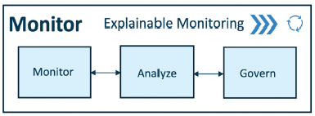
MLOps Flow
Engineering MLOps
Copyright © 2021 Packt Publishing

Slide 14
Deployment Types
Batch
Online
Realtime
High throughput, high latency
Low latency, low throughput
High throughput, low latency

