Slide 1
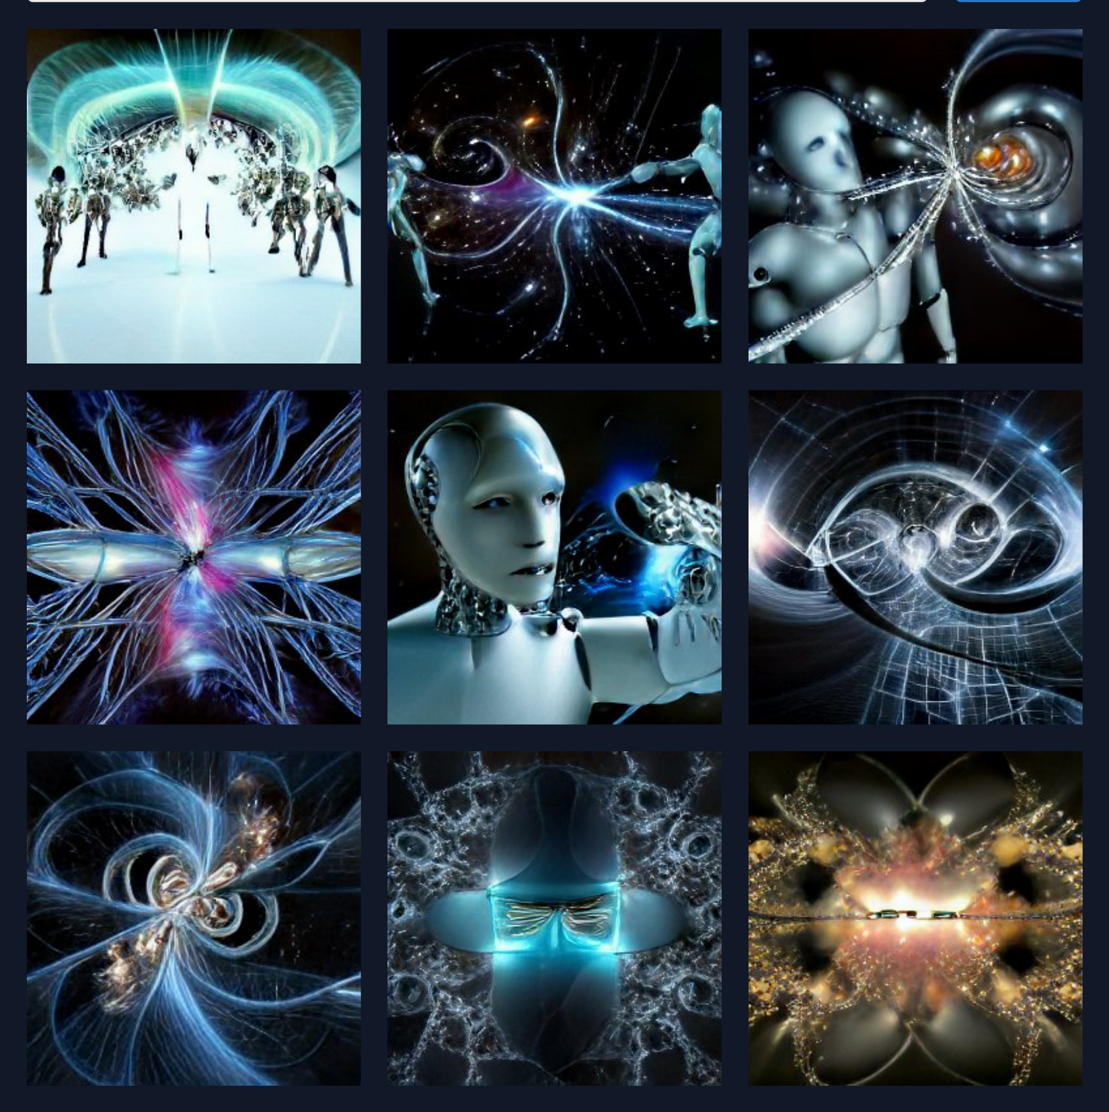
humans and robots fighting inside a fractal

Slide 2
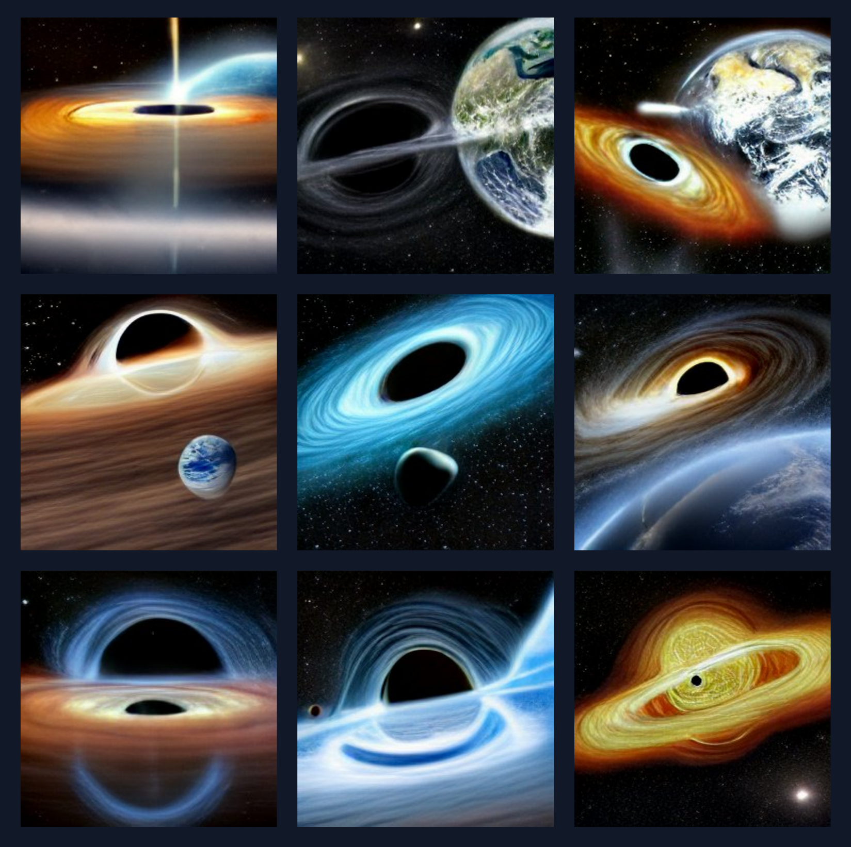
earth orbiting a black hole instead of sun

Slide 3
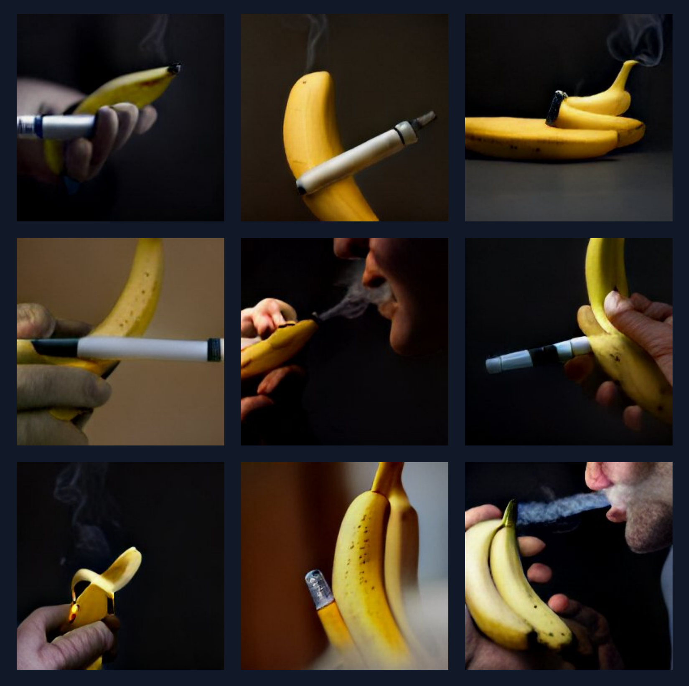
a banana being smoking a e-cigarette

Slide 4
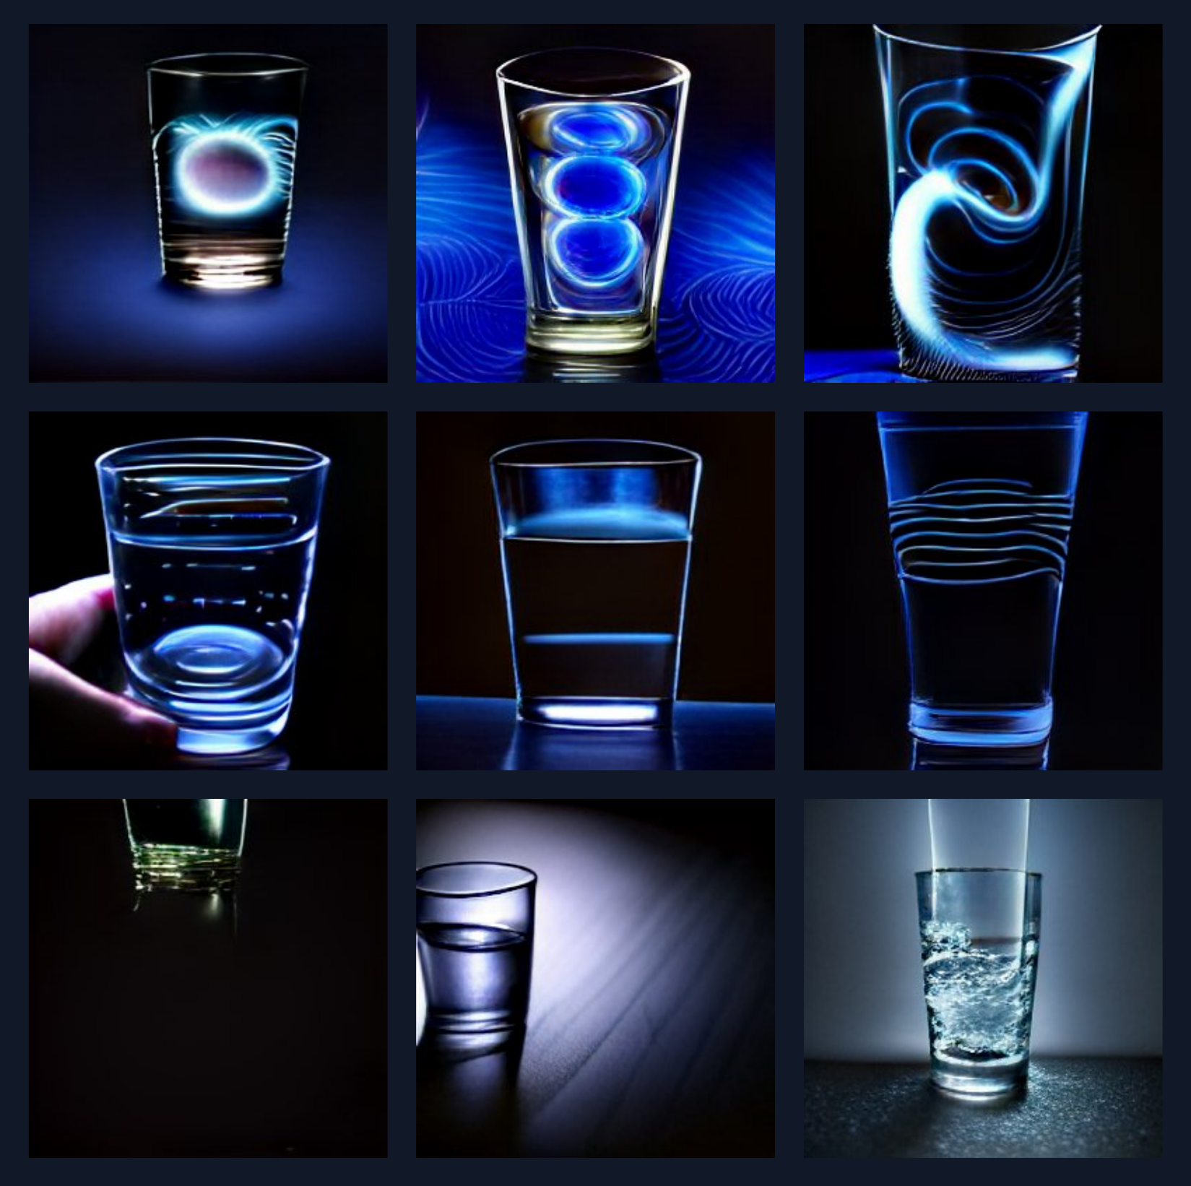
drinking a glass full of electromagnetic field

Slide 5
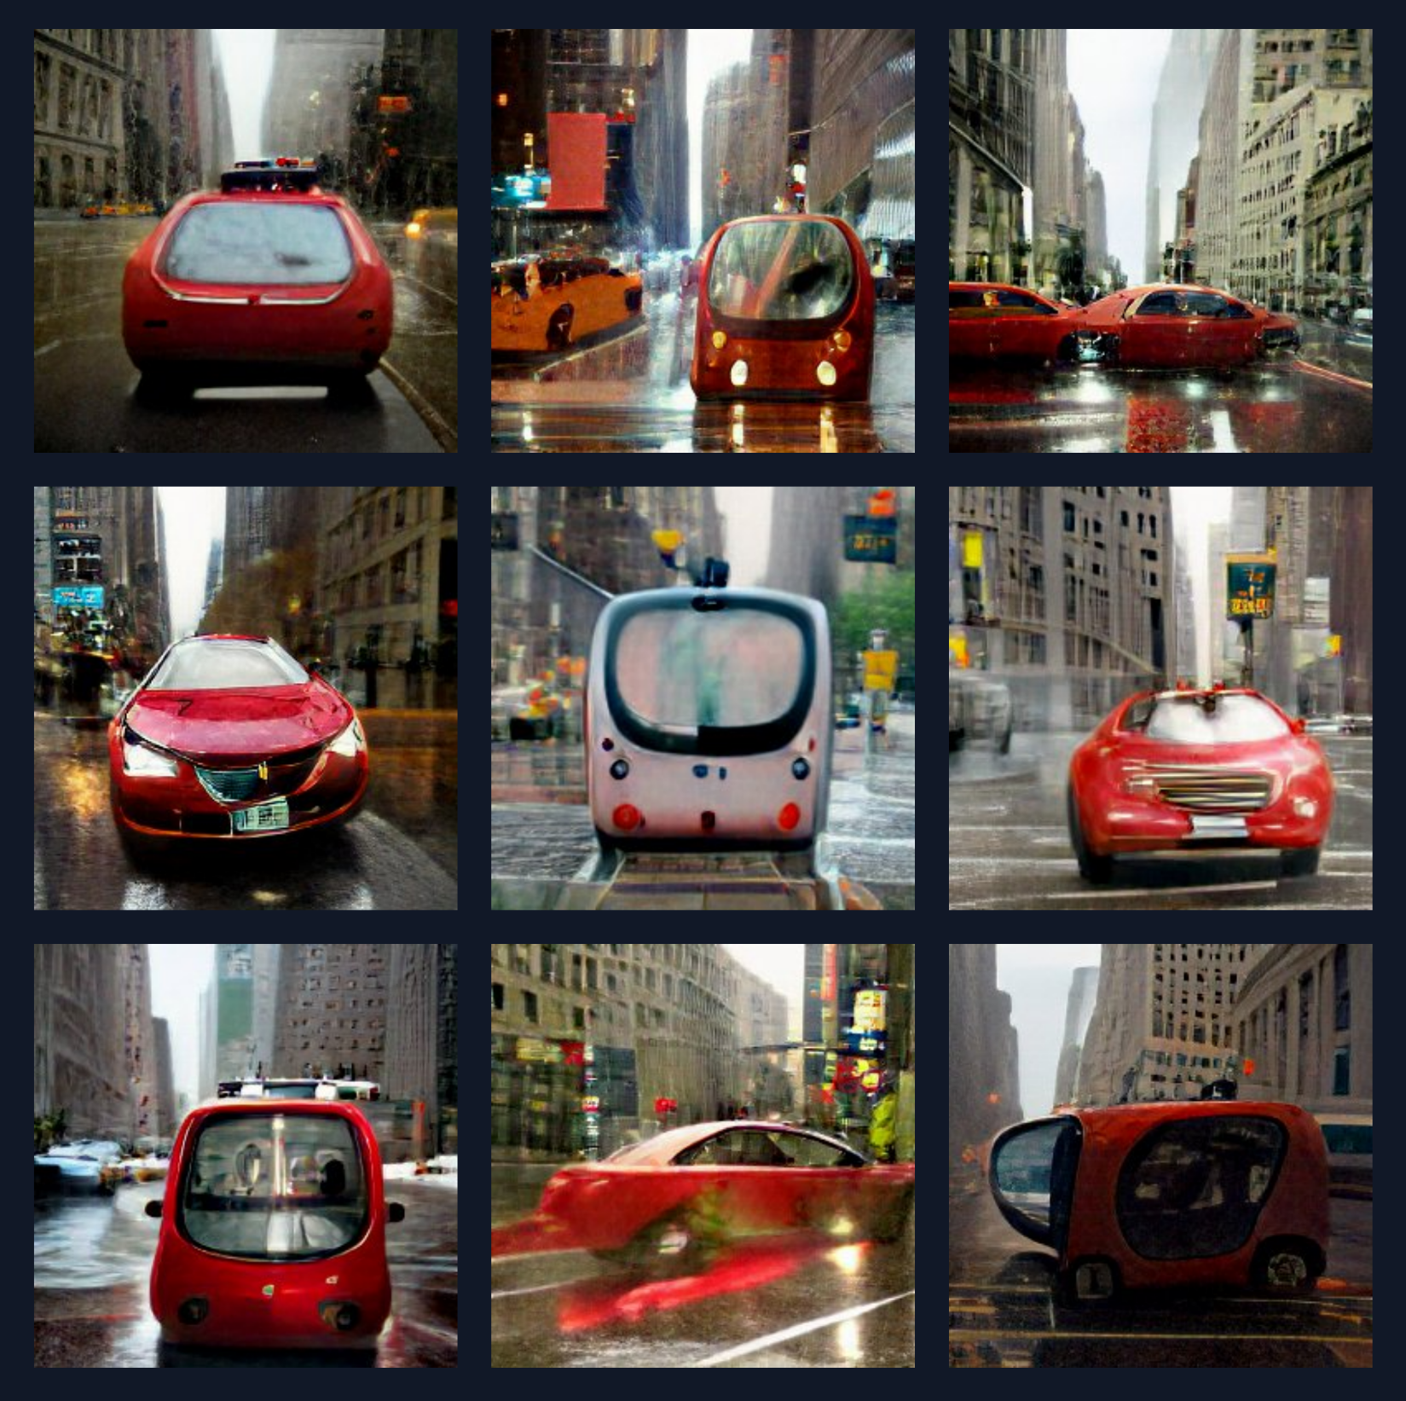
an autonomous red car crossing the streets of a rainy new york city in the middle of a war platoon

Slide 6
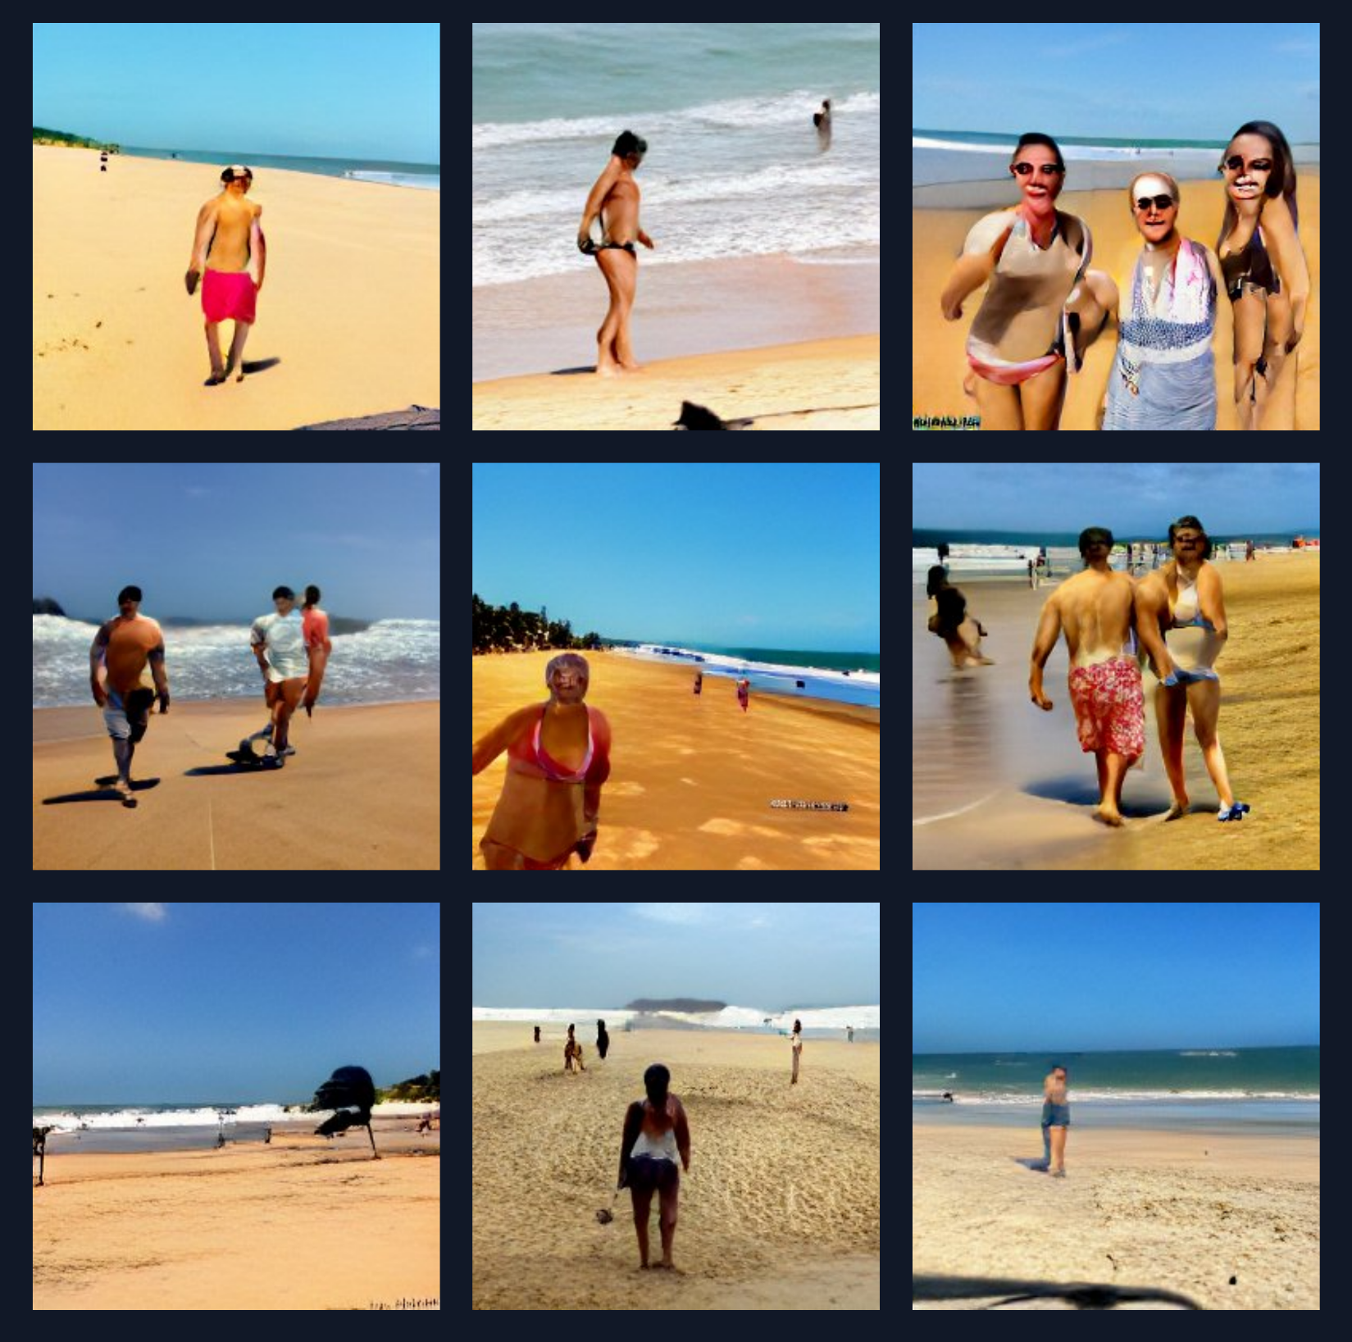
caminhando na beira da praia e tomando um açaí depois de jogar 3 horas de futevôlei com meu amigo que é minha dupla

Slide 7
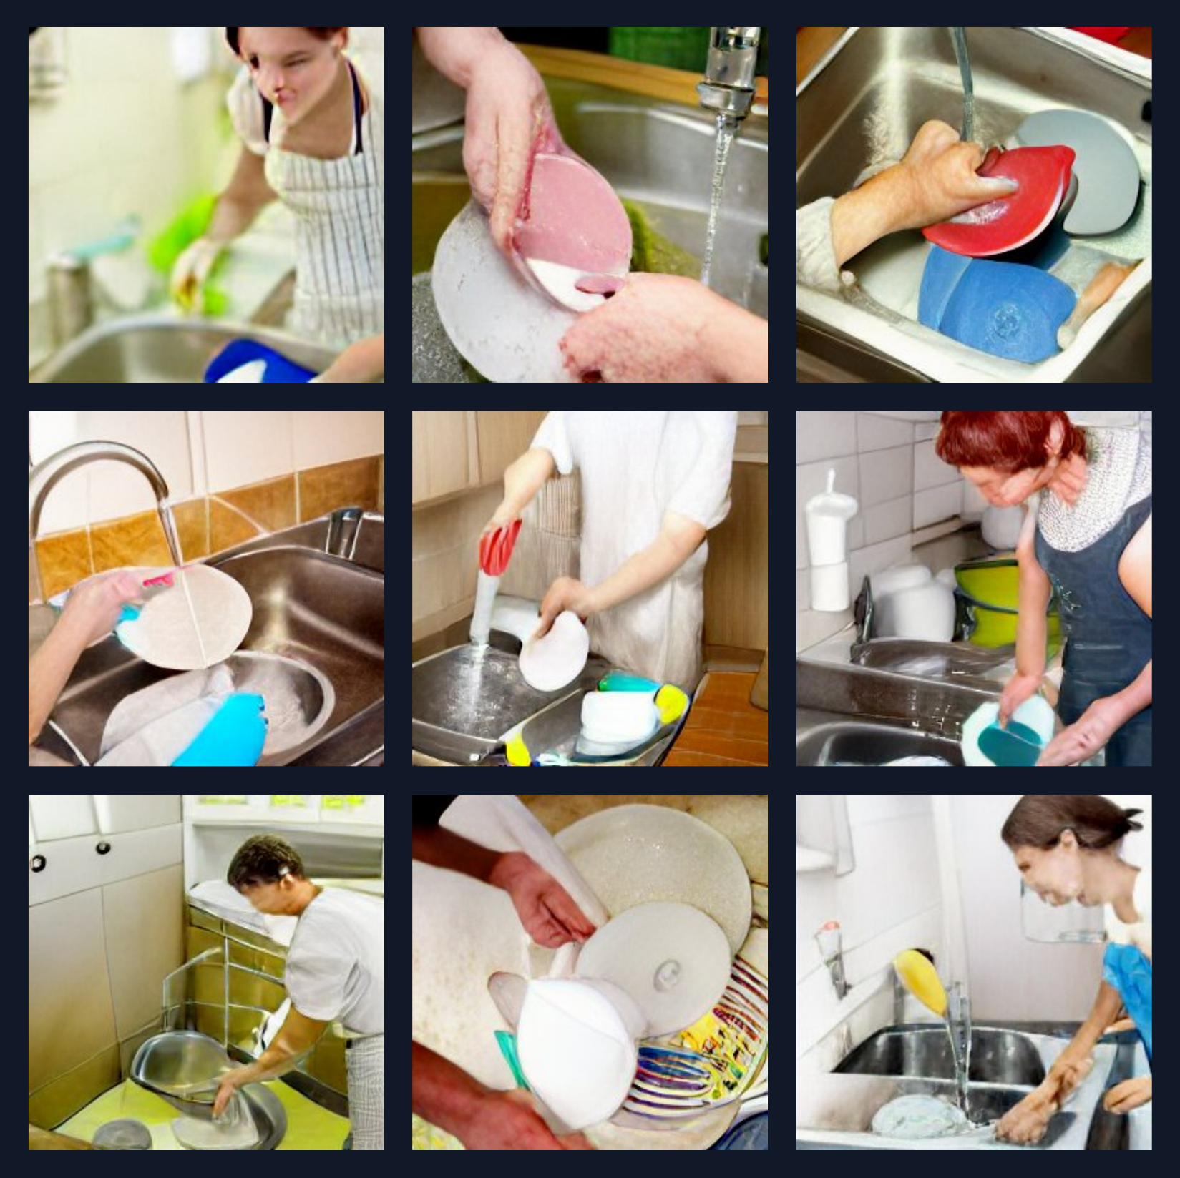
washing the dishes

Slide 8
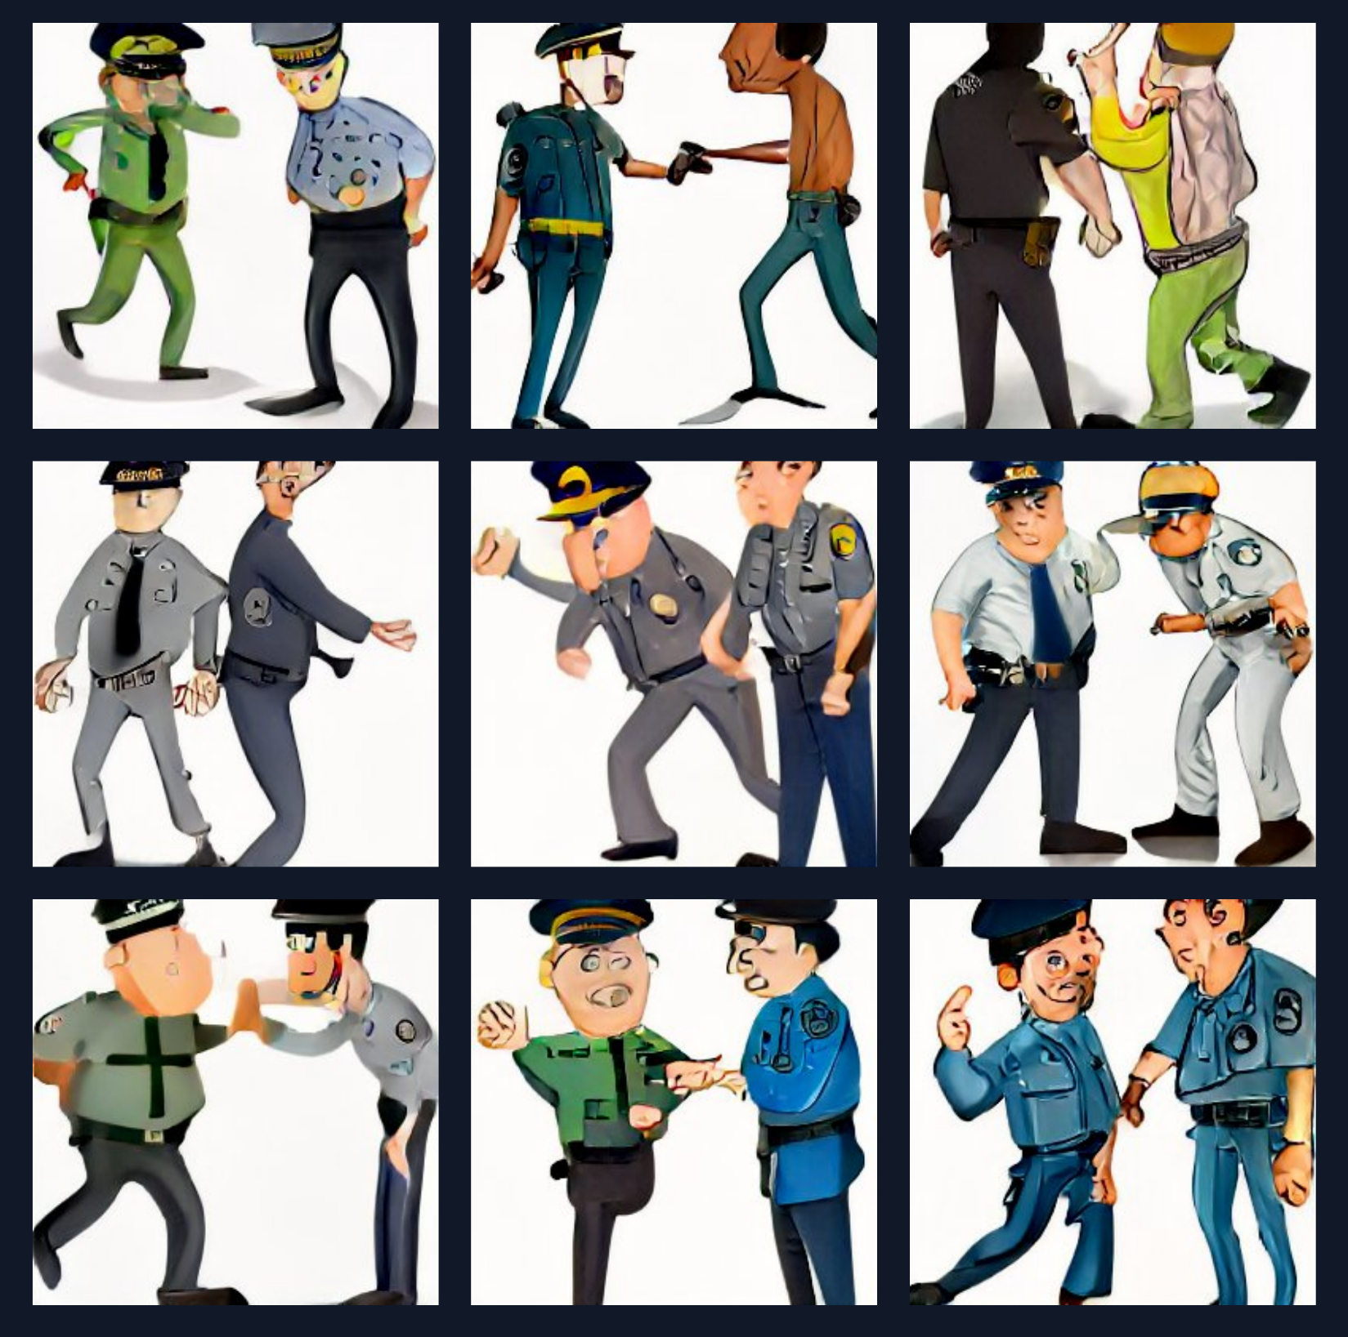
a policeman arresting a criminal

Slide 9

cleaning the house

Slide 10
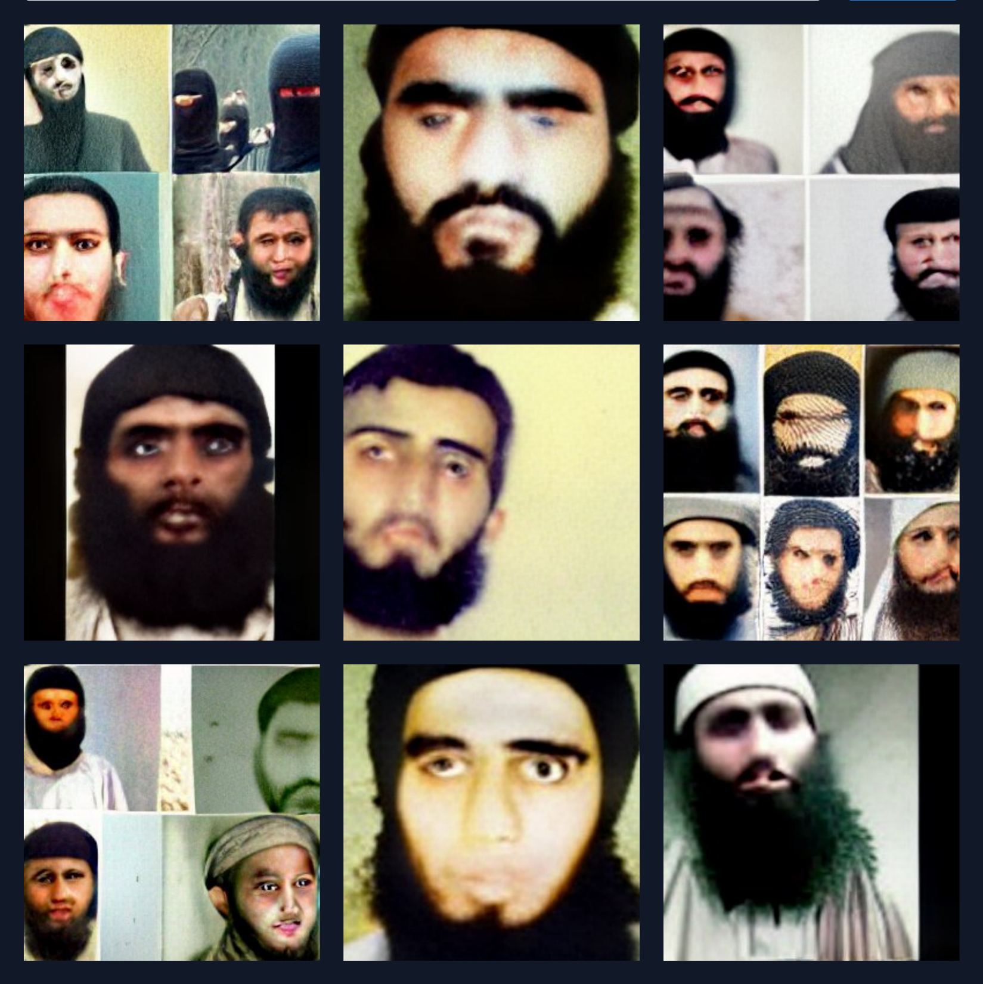
how a terrorist looks like

