Slide 1
Adapter Design Pattern
CECS 470
Fall 2017
Mimi Opkins

Slide 2
Adapter Pattern
Adapter is a structural design pattern, which allows incompatible objects to cooperate.
Adapter acts as a wrapper between two objects, It catches calls for one object and transforms them to format and interface recognizable by the second object.
In other words, how we put a square peg in a round hole.

Slide 3
Definition & Applicability
Adapters are used to enable objects with different interfaces to communicate with each other.
The Adapter pattern is used to convert the programming interface of one class into that of another.
We use adapters whenever we want unrelated classes to work together in a single program.
Adapters come in two flavors,
object adapters and
class adapters.
The concept of an adapter is thus pretty simple; we write a class that has the desired interface and then make it communicate with the class that has a different interface.
Adapters in Java can be implemented in two ways:
by inheritance, and
by object composition.

Slide 4
Object Adapters
Object adapters use a compositional technique to adapt one interface to another.
The adapter inherits the target interface that the client expects to see, while it holds an instance of the adaptee.
When the client calls the request() method on its target object (the adapter), the request is translated into the corresponding specific request on the adaptee.
Object adapters enable the client and the adaptee to be completely decoupled from each other. Only the adapter knows about both of them.

Slide 5
Example 1
/**
* The SquarePeg class.
* This is the Target class.
*/
public class SquarePeg {
public void insert(String str) {
System.out.println("SquarePeg insert(): " + str);}
}
/**
* The RoundPeg class.
* This is the Adaptee class.
*/
public class RoundPeg {
public void insertIntoHole(String msg) {
System.out.println("RoundPeg insertIntoHole(): " + msg);}
}

Slide 6
Example 1
If a client only understands the SquarePeg interface for inserting pegs using the insert() method, how can it insert round pegs, which are pegs, but that are inserted differently, using the insertIntoHole() method?

Slide 7
Example 2
Solution:
Design a RoundToSquarePeg adapter that enables to insertIntoHole() a RoundPeg object connected to the adapter to be inserted as a SquarePeg, using insert().

Slide 8
Example 2
/**
* The RoundToSquarePegAdapter class.
* This is the Adapter class.
* It adapts a RoundPeg to a SquarePeg.
* Its interface is that of a SquarePeg.
*/
public class RoundToSquarePegAdapter extends SquarePeg {
private RoundPeg roundPeg;
public RoundToSquarePegAdapter(RoundPeg peg) {
//the roundPeg is plugged into the adapter
this.roundPeg = peg;}
public void insert(String str) {
//the roundPeg can now be inserted in the same manner as a squarePeg!
roundPeg.insertIntoHole(str);}
}

Slide 9
Example 3
// Test program for Pegs.
public class TestPegs {
public static void main(String args[]) {
// Create some pegs.
RoundPeg roundPeg = new RoundPeg();
SquarePeg squarePeg = new SquarePeg();
// Do an insert using the square peg.
squarePeg.insert("Inserting square peg...");
// Now we'd like to do an insert using the round peg.
// But this client only understands the insert()
// method of pegs, not a insertIntoHole() method.
// The solution: create an adapter that adapts
// a square peg to a round peg!
RoundToSquarePegAdapter adapter = new RoundToSquarePegAdapter(roundPeg);
adapter.insert("Inserting round peg...");}
}

Slide 10
Example 3
Execution trace:
SquarePeg insert(): Inserting square peg...
RoundPeg insertIntoHole(): Inserting round peg...

Slide 11
Class Adapters
Class adapters use multiple interfaces to achieve their goals.
As in the object adapter, the class adapter inherits the interface of the client's target. However, it also inherits the interface of the adaptee as well.
Since Java does not support true multiple inheritance, this means that one of the interfaces must be inherited from a Java Interface type.
Both of the target or adaptee interfaces could be Java Interfaces.
The request to the target is simply rerouted to the specific request that was inherited from the adaptee interface.

Slide 12
Consequences of the Adapter Pattern
Class and object adapters have different trade-offs.
A class adapter:
adapts Adaptee to Target by committing to a concrete Adapter class;
lets Adapter override some of Adaptee's behavior, since Adapter is a subclass of Adaptee;
introduces only one object, and no additional indirection is needed to get to the adaptee.
An object adapter
Let’s a single Adapter work with many Adaptees - that is, the Adaptee itself and all of its subclasses (if any). The Adapter can also add functionality to all Adaptees at once.
Makes it harder to override Adaptee behavior. It will require subclassing Adaptee and making Adapter refer to the subclass rather than the Adaptee itself.

Slide 13
Adapter Pattern – Another Example
.
Adapter pattern works as a bridge between two incompatible interfaces. This type of design pattern comes under structural pattern as this pattern combines the capability of two independent interfaces.
This pattern involves a single class which is responsible to join functionalities of independent or incompatible interfaces. A real life example could be a case of card reader which acts as an adapter between memory card and a laptop. You plugin the memory card into card reader and card reader into the laptop so that memory card can be read via laptop.
We are demonstrating use of Adapter pattern via following example in which an audio player device can play mp3 files only and wants to use an advanced audio player capable of playing vlc and mp4 files.

Slide 14
Implementation
We have a MediaPlayer interface and a concrete class MP3 implementing the MediaPlayer interface. MP3 can play mp3 format audio files by default.
We are having another interface MediaPackage and concrete classes implementing the MediaPackage interface. These classes can play vlc and mp4 format files.
We want to make MP3 to play other formats as well. To attain this, we have created an adapter class FormatAdapter which implements the MediaPlayer interface and uses MediaPackage objects to play the required format.
MP3 uses the adapter class FormatAdapter passing it the desired audio type without knowing the actual class which can play the desired format. Main, our demo class will use MP3 class to play various formats.

Slide 15
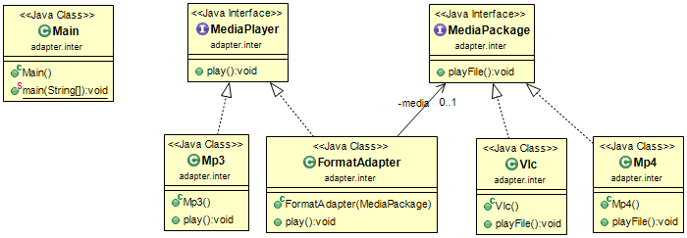

Slide 16
Step 1
public interface MediaPlayer { void play(String filename);}
void play(String filename);
Create interfaces for MediaPlayer and MediaPackage.
MediaPlayer.java
public interface MediaPlayer {
public void play(String fileName);
}
MediaPackage.java
public interface MediaPackage {
public void playFile(String fileName);
}

Slide 17
Step 2
Create concrete classes implementing the MediaPlayer interface
public class MP3 implements MediaPlayer {
@Override public void play(String filename) { System.out.println("Playing MP3 File " + filename); }
}

Slide 18
Step 3
Create concrete classes implementing the MediaPackage interface.
VlcPlayer.java
public class VlcPlayer implements MediaPackage{
@Override
public void playFile(String fileName) {
System.out.println("Playing vlc file. Name: "+ fileName);
}
}

Slide 19
Step 3
Mp4Player.java
public class Mp4Player implements MediaPackage {
@Override
public void playFile(String fileName) {
System.out.println("Playing mp4 file. Name: "+ fileName);
}
}

Slide 20
Step 4
Create adapter class implementing the MediaPlayer interface.
public class FormatAdapter implements MediaPlayer { private MediaPackage media;
public FormatAdapter(MediaPackage m) { media = m; }
@Override public void play(String filename) { System.out.print("Using Adapter --> "); media.playFile(filename); }
}

Slide 21
Step 5
Use the MediaPlayer to play different types of audio formats.
public class Main { public static void main(String[] args) { MediaPlayer player = new MP3(); player.play("file.mp3");
player = new FormatAdapter(new MP4()); player.play("file.mp4");
player = new FormatAdapter(new VLC()); player.play("file.avi"); }
}

Slide 22
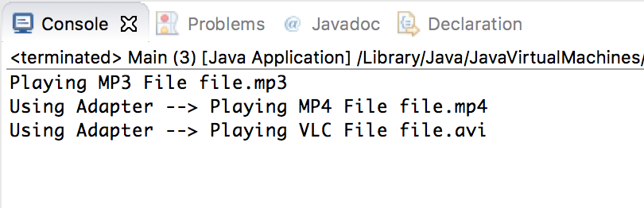
Step 6
Verify the output.

Slide 23
Summary
When you need to use an existing class and its interface is not the one you need, use an adapter: allows collaboration between classes with incompatible interfaces.
An adapter changes an interface into one a client expects.
Implementing an adapter may require little work or a great deal of work depending on the size and complexity of the target interface.
There are two forms of adapter patterns: object and class adapters.
Class adapters require multiple inheritance.

Slide 24
Credits
Java Design Patterns - DEPARTMENT OF COMPUTER SCIENCE AND SOFTWARE ENGINEERING CONCORDIA UNIVERSITY - Emil Vassev, Joey Paquet : 2006-2012
Tutorials Point Design Patterns – Adapter Pattern - https://www.tutorialspoint.com/design_pattern/adapter_pattern.htm
Implement the Adapter Design Pattern in Java
https://medium.com/@ssaurel/implement-the-adapter-design-pattern-in-java-f9adb6a8828f

