Slide 1
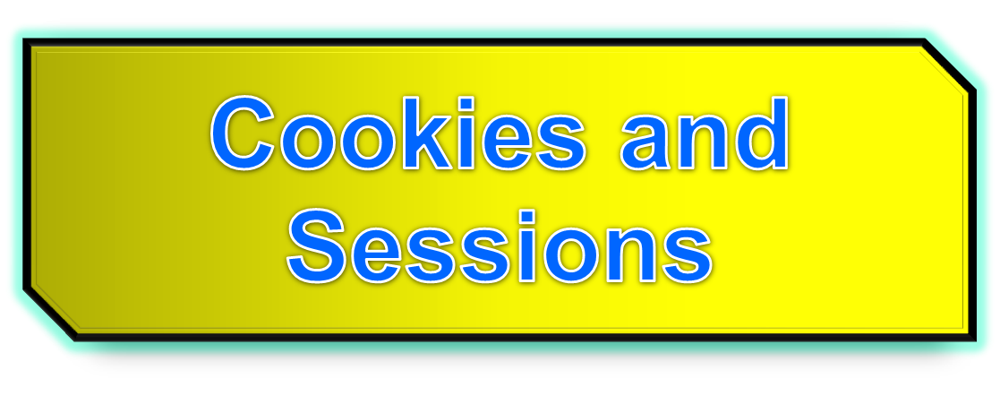

Slide 2
The need for persistence
Consider these examples
  Counting the number of “hits” on a website
  i.e. how many times does a client load your web page source
  The questionnaire on computing experience
Somehow your .php needs to remember previous instances of it being requested by a client

Slide 3
Persistence
Persistence is the ability of data to outlive the execution of the program that created them.
An obvious way of achieving persistence is to simply save the data in a file

Slide 4
Persistence and HTTP
Recall http is a stateless protocol. It remembers nothing about previous transfers
Two ways to achieve persistence:
PHP cookies
PHP sessions
HTTP
server
Client
Session
Cookie

Slide 5
HTTP Cookies
In internet programming, a cookie is a packet of information sent from the server to client, and then sent back to the server each time it is accessed by the client.
Introduces state into HTTP (remember: HTTP is stateless)
Cookies are transferred between server and client according to http.
PHP supports http cookies
Cookies can also be thought of as tickets used to identify clients and their orders

Slide 6
How Cookies are implemented
Cookies are sent from the server to the client via “Set-Cookie” headers
Set-Cookie: NAME=VALUE; expires=DATE; path=PATH; domain=DOMAIN_NAME; secure
The NAME value is a URL-encoded name that identifies the cookie.
The PATH and DOMAIN specify where the cookie applies

Slide 7
setcookie(name,value,expire,path,domain,secure)
Parameter | Description
name | (Required). Specifies the name of the cookie
value | (Required). Specifies the value of the cookie
expire | (Optional). Specifies when the cookie expires. e.g. time()+3600*24*30 will set the cookie to expire in 30 days. If this parameter is not set, the cookie will expire at the end of the session (when the browser closes).
path | (Optional). Specifies the server path of the cookie. If set to "/", the cookie will be available within the entire domain. If set to "/phptest/", the cookie will only be available within the test directory and all sub-directories of phptest. The default value is the current directory that the cookie is being set in.
domain | (Optional). Specifies the domain name of the cookie. To make the cookie available on all subdomains of example.com then you'd set it to ".example.com". Setting it to www.example.com will make the cookie only available in the www subdomain
secure | (Optional). Specifies whether or not the cookie should only be transmitted over a secure HTTPS connection. TRUE indicates that the cookie will only be set if a secure connection exists. Default is FALSE.

Slide 8
Cookies from HTTP
Client (e.g. Firefox)
it026945
GET /*.html HTTP/1.1
Host: it026954.domain
GET /*.html HTTP/1.1
Host: it026945.domain
Cookie: name=value
Accept: */*
HTTP/1.1 200 OK
Content-type: text/html
Set-Cookie: name=value
(content of page)

Slide 9
Creating PHP cookies
Cookies can be set by directly manipulating the HTTP header using the PHP header() function
<?php
header(“Set-Cookie: mycookie=myvalue; path=/; domain=.coggeshall.org”);
?>

Slide 10
Creating cookies with setcookie()
Use the PHP setcookie() function:
Setcookie (name,value,expire, path, domain, secure)
e.g.
<?php
setcookie("MyCookie", $value, time()+3600*24);
setcookie("AnotherCookie", $value, time()+3600);
?>
Name: name of the file
Value: data stored in the file
Expire: data string defining the life time
Path: subset of URLs in a domain where it is valid
Domain: domain for which the cookie is valid
Secure: set to '1' to transmit in HTTPS

Slide 11
Reading cookies
To access a cookie received from a client, use the PHP $_COOKIE superglobal array
<?php
foreach ($_COOKIE as $key=>$val) {
print $key . " => " . $val . "<br/>";
}
?>
Each key in the array represents a cookie - the key name is the cookie name.

Slide 12
Creating and using cookies example
<?php
setcookie("MyCookie", $value, time()+7200);
setcookie("AnotherCookie", $value, time()+7);
?>
<?php
foreach ($_COOKIE as $key=>$val) {
print $key . " => " . $val . "<br/>";
}
?>
Cookies only become visible on the next page load

Slide 13
Using headers (wrong approach!)
<!DOCTYPE html PUBLIC "=//W3C//DTD XHMTL 1.1//EN" "http://www.w3.org/TR/xhtml11/DTD/xhtml11.dtd">
<html xmlns="http://www.w3.org/1999/xhmtl" xml:lang="en">
<head><title>PHP Script using Cookies</title>
<meta http-equiv="Content-Type" content="text/html; chatset=ISO-8859-1" />
</head>
<body>
<?php
$strValue = "This is my first cookie";
setcookie ("mycookie", $strValue);
echo "Cookie set<br>";
?>
</body>
</html>
Gets an error!:
Warning: Cannot modify header information - headers already sent by (output started at /var/www/html/TESTandre/159339/PHP/cookie_with_headers.php:9) in /var/www/html/TESTandre/159339/PHP/cookie_with_headers.php on line 11
(adapted from Stobart & Parsons (2008))

Slide 14
Using headers
setcookie() did not run before information was sent to the browser...
Cookies have to be sent before the heading elements

Slide 15
Using headers (correct approach)
<?php
$strValue = "This is my first cookie";
setcookie ("mycookie", $strValue);
echo "Cookie set<br>";
?>
<!DOCTYPE html PUBLIC "=//W3C//DTD XHMTL 1.1//EN" "http://www.w3.org/TR/xhtml11/DTD/xhtml11.dtd">
<html xmlns="http://www.w3.org/1999/xhmtl" xml:lang="en">
<head><title>PHP Script using Cookies</title>
<meta http-equiv="Content-Type" content="text/html; charset=ISO-8859-1" />
</head>
<body>
<?php
echo “<p> A cookie has been set. </p>”;
?>
</body>
</html>
This is the correct approach!

Slide 16
Deleting a cookie
Set the cookie with its name only:
setcookie(“mycookie”);

Slide 17
Multiple data items
Use explode() e.g.
<?php
$strAddress = $_SERVER['REMOTE_ADDR'];
$strBrowser = $_SERVER['HTTP_USER_AGENT'];
$strOperatingSystem = $_ENV['OS'];
$strInfo = "$strAddress::$strBrowser::$strOperatingSystem";
setcookie ("somecookie4",$strInfo, time()+7200);
?>
<?php
$strReadCookie = $_COOKIE["somecookie4"];
$arrListOfStrings = explode ("::", $strReadCookie);
echo "<p>$strInfo</p>";
echo "<p>Your IP address is: $arrListOfStrings[0] </p>";
echo "<p>Client Browser is: $arrListOfStrings[1] </p>";
echo "<p>Your OS is: $arrListOfStrings[2] </p>";
?>

Slide 18
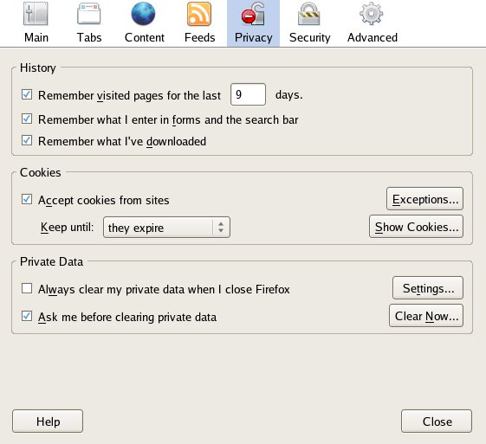
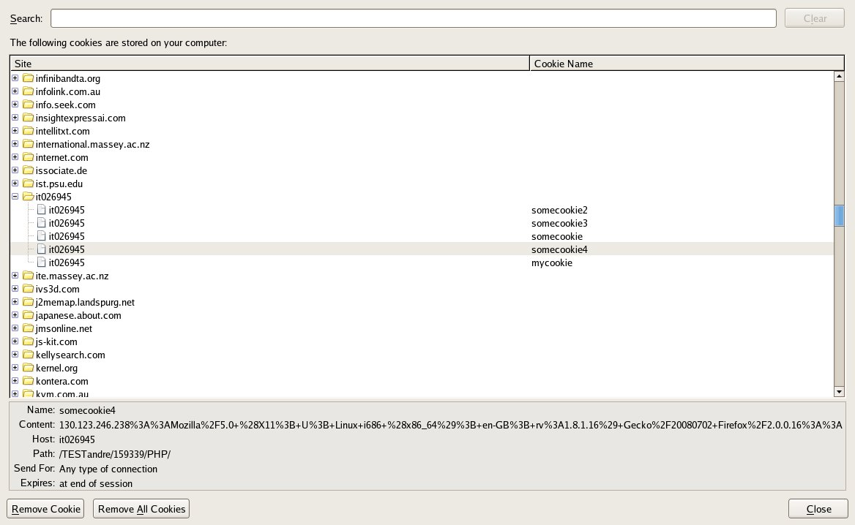
Where is the cookie stored?

Slide 19
Where is the cookie stored
Depends on the browser...
e.g., firefox/mozilla under /home/a________
  Look for cookies.txt in .mozilla directory
  Usually under:
    /home/a______/.mozilla/firefox/asdkfljy.default
  Cookie is stored only if there is an expiry date
  Otherwise it is deleted when leaving browser
  Persistent only if an expiry date is set

Slide 20


Slide 21
PHP Sessions
You can store user information (e.g. username, items selected, etc.) in the server side for later use using PHP session.
Sessions work by creating a unique id (UID) for each visitor and storing variables based on this UID.
The UID is either stored in a cookie or is propagated in the URL.

Slide 22
When should you use sessions?
Need for data to stored on the server
Unique session information for each user
Transient data, only relevant for short time
Data does not contain secret information
Similar to Cookies, but it is stored on the server
More secure, once established, no data is sent back and forth between the machines
Works even if cookies are disabled
Example: we want to count the number of “hits” on our web page.

Slide 23
Before you can store user information in your PHP session, you must first start up the session.
session_start() function must appear BEFORE the <html> tag.
<?php session_start(); ?>
<html>
<body>
</body>
</html>

Slide 24
PHP Sessions
Starting a PHP session:
    <?php
    session_start();
    ?>
This tells PHP that a session is requested.
A session ID is then allocated at the server end.
session ID looks like:
sess_f1234781237468123768asjkhfa7891234g

Slide 25
Session variables
$_SESSION
e.g., $_SESSION[“intVar”] = 10;
Testing if a session variable has been set:
session_start();
if(!$_SESSION['intVar']) {...} //intVar is set or not

Slide 26
Registering session variables
Instead of setting superglobals, one can register one’s own session variables
<?php
  $barney = “A big purple dinosaur.”;
  $myvar_name = “barney”;
  session_register($myvar_name);
?>
$barney can now be accessed “globally” from session to session
This only works if the register_globals directive is enabled in php.ini - nowadays this is turned off by default
Use of session_register() is deprecated!

Slide 27
Make your own session variables
With session_start() a default session variable is created - the name extracted from the page name
To create your own session variable just add a new key to the $_SESSION superglobal
$_SESSION[‘dug’] = “a talking dog.”;
Use of $_SESSION is preferred, as of PHP 4.1.0.

Slide 28
Session Example 1
<?php
    session_start();
    if (!isset($_SESSION["intVar"]) ){
    $_SESSION["intVar"] = 1;
    } else {
    $_SESSION["intVar"]++;
    }
    echo "<p>In this session you have accessed this page " . $_SESSION["intVar"] . "times.</p>";
?>

Slide 29
Session Example 2
<?php session_start();?>
<?php
$thisPage = $_SERVER['PHP_SELF'];
$pageNameArray = explode('/', $thisPage);
$pageName = $pageNameArray[count($pageNameArray) - 1];
print "The name of this page is: $pageName<br/>";
$nameItems = explode(‘.', $pageName);
$sessionName = $nameItems[0];
print "The session name is $sessionName<br/>";
if (!isset($_SESSION[$sessionName])) {
$_SESSION[$sessionName] = 0;
print "This is the first time you have visited this page<br/>";
}
else {
$_SESSION[$sessionName]++;
}
print "<h1>You have visited this page " . $_SESSION[$sessionName] .
" times</h1>";
?>

Slide 30
Ending sessions
unset($_SESSION[‘name’])
  Remove a session variable
session_destroy()
  Destroys all data registered to a session
  does not unset session global variables and cookies associated with the session
  Not normally done - leave to timeout

Slide 31
Destroying a session completely
<?php
// Initialize the session.
// If you are using session_name("something"), don't forget it now!
session_start();
// Unset all of the session variables.
$_SESSION = array();
// If it's desired to kill the session, also delete the session cookie.
// Note: This will destroy the session, and not just the session data!
if (ini_get("session.use_cookies")) { // Returns the value of the configuration option
$params = session_get_cookie_params();
setcookie(session_name(), '', time() - 42000,
$params["path"], $params["domain"],
$params["secure"], $params["httponly"]
);
}
// Finally, destroy the session.
session_destroy();
?>
returns the name of the current session
http://nz2.php.net/manual/en/function.session-destroy.php

Slide 32
Session Example 3
<?php
session_start();
if(!isset($_SESSION['strColourBg'])) $_SESSION['strColourBg'] = "red";
else echo "Currently Bg set to " . $_SESSION['strColourBg'] . "<br>";
if(!isset($_SESSION['strColourFg'])) $_SESSION['strColourFg'] = "yellow";
else echo "Currently Fg set to " . $_SESSION['strColourFg'];
if(isset($_POST["submit"]) ) {
$strColourBg = $_POST["strNewBg"];
$strColourFg = $_POST["strNewFg"];
$_SESSION['strColourBg'] = $strColourBg;
$_SESSION['strColourFg'] = $strColourFg;
echo "<br>New Settings";
}
else {
$strColourBg = $_SESSION['strColourBg'];
$strColourFg = $_SESSION['strColourFg'];
echo "<br>Keep old settings";
}
?>

Slide 33
Session Example 3 (cont.)
<head> <style type="text/css">
body {background-color: <?php echo $strColourBg ?>}
p {color: <?php echo $strColourFg?>}
h2 {color: <?php echo $strColourFg?>}
</style></head>
<body>
<h2>h2 colour</h2>
<form action = '<?php echo $SERVER["PHP_SELF"] ?>' method='post'>
<label for="strNewBg"> Background colour: </label>
<select name='strNewBg' id='strNewBg'>
<option>red</option> ... <option>grey</option>
</select>
<label for="strNewFg"> Text colour: </label>
<select name='strNewFg' id='strNewFg'>
<option>yellow</option> ... <option>grey</option>
</select>
<input type='submit' name='submit'/>
</form></body>
(adapted from Stobart & Parsons, 2008)

Slide 34
Examples
php_imagefields.php
php_retention.php
upload.html
upload.php
php_imagefields.php
php_imagecreation.php
php_truetypefonts.php
php_file_get_contents.php
php_cookie_multipledata.php
cookie1.php
cookie_with_headers.php
session1.php
session2.php
php_session_colours2.php
php_session_destroy.php

Slide 35
Summary
PHP sessions and cookies are mechanisms for introducing state into HTTP transactions.

