Slide 1
HOUSE PRICE PREDICTION
From property data to an actionable valuation estimate
Machine learning project presentation
Linear regression | 1,000 records | 7 predictive features

Slide 2
01 | BUSINESS CONTEXT
02
The question behind the model
Can property characteristics support a reliable first-pass estimate of selling price?
PROJECT OUTPUT
A reusable prediction pipeline
Support faster, more consistent property valuation
Translate mixed numeric and categorical data into one prediction
Clean data → explore patterns → train model → estimate price
Give users a simple interface for testing property scenarios
Desktop prediction app

Slide 3
02 | DATA UNDERSTANDING
03
Dataset at a glance
RECORDS
COLUMNS
DATA QUALITY
TEST SPLIT
1,000
9
0
80 / 20
observations
including target
missing / duplicate rows
random_state = 42
Predictors used
Square_Feet
Bedrooms
Bathrooms
Floors
Year_Built
Location
Condition
Target: Price
House_ID is retained for identification but excluded from training.

Slide 4
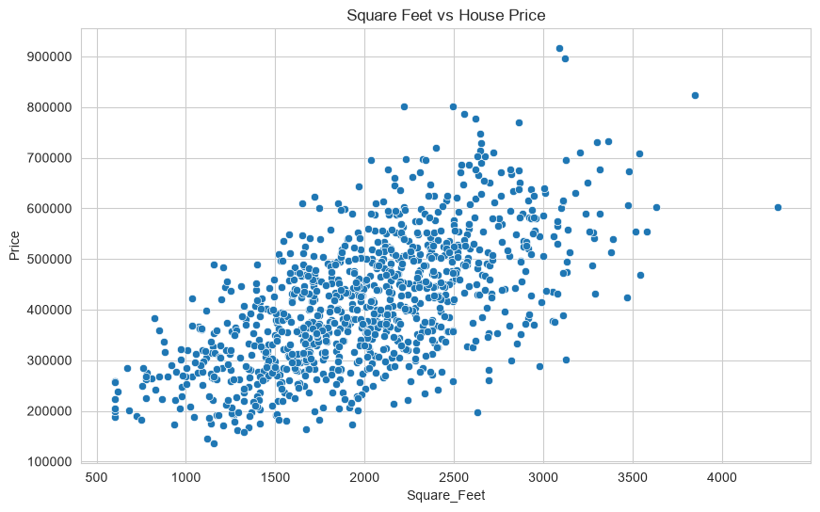
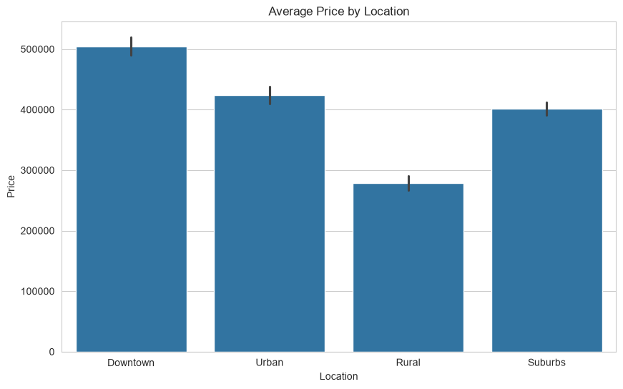
03 | EDA FINDINGS
04
What the exploratory analysis revealed
Larger homes generally command higher prices
Location adds meaningful context
The relationship is strong enough to make floor area a useful signal.
Categorical features are encoded so the model can learn group-level effects.

Slide 5
04 | MODELING WORKFLOW
05
From raw rows to a price estimate
01
02
03
04
05
Load
Prepare
Encode
Learn
Evaluate
Read source CSV
Impute + scale numeric data
One-hot encode categories
Fit linear regression
Score held-out data
The complete preprocessing and model pipeline is saved as a reusable Joblib artifact.
trained_house_price_model.joblib

Slide 6
05 | EVALUATION
06
Performance on unseen test data
Held-out results from a fixed 20% test split
R²
MAE
RMSE
0.9485
$23,575
$30,269
variance explained
average absolute error
penalizes larger errors
Interpretation
The model explains approximately 94.8% of price variation in this held-out split. The error metrics are dataset-specific and should be revalidated before real-world deployment.
Model: LinearRegression | random_state: 42

Slide 7
06 | APPLICATION
07
A usable path from input to insight
REAL ESTATE INTELLIGENCE
EXAMPLE OUTPUT
Property characteristics
$ 486,250
>
Square_Feet
Bedrooms
A simple desktop interface makes the trained pipeline accessible for scenario testing.
Bathrooms
Location
Estimate selling price

Slide 8
07 | CLOSE
08
What this project delivers
A complete, reproducible baseline for property price estimation
Documented business objective and data understanding
NEXT STEPS
EDA visuals for numeric and categorical relationships
Compare additional regression models
Reusable preprocessing + model pipeline
Use cross-validation for stability
Add richer location and market signals
Saved predictions and evaluation metrics
Monitor error on newer listings
Desktop interface for interactive estimates
Thank you
House Price Prediction | Final presentation

