Slide 1
Moundville Archeological Park Interactive Experience
Brian Connell
Matt Robbins
Darwin Witt
Dept. of Computer Science, The University of Alabama

Slide 2
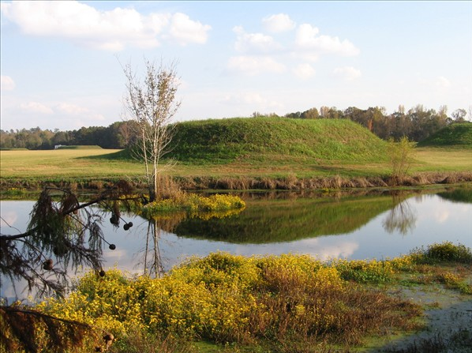
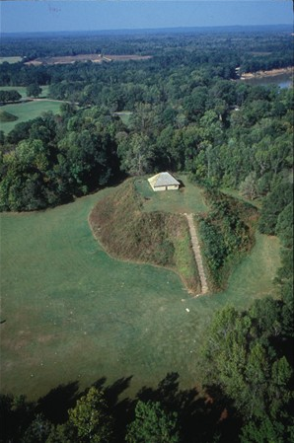
Moundville

Slide 3
A New Museum Experience
Maximize visitor access to park discoveries
Provide immersive educational experience
Centralize Moundville’s data

Slide 4
Proposed Solution
Mobile application for self-guided tours
Allow Users to lead their own discovery of the park and follow their interests
Centralized database to digitize and catalog Moundville records

Slide 5
System Overview
Android App
Museum Visitors
Experience-driven database viewer
Indoor and Outdoor experiences
Admin Web Portal
Museum Curators
Simple interface to database
Upload text, images & geo-tag articles

Slide 6
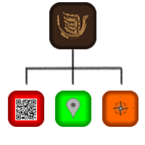
System Overview Cont.
QR Code Reader
Custom Google Map
Highlight artifacts & photos
“Near Me” Proximity Explorer
Allows Users to browse points of interest near by

Slide 7
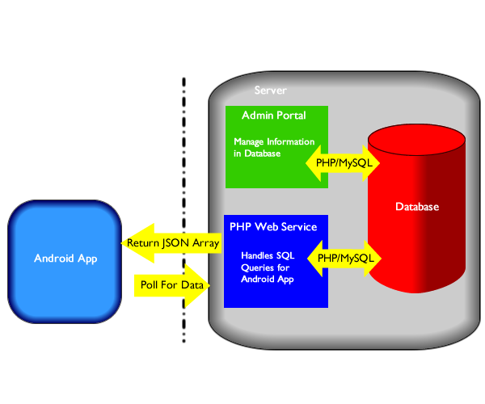
System Overview Cont.

Slide 8
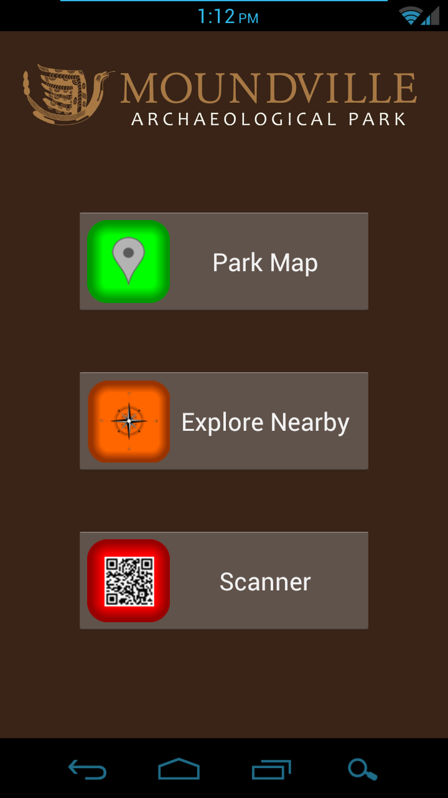
Screenshots

Slide 9
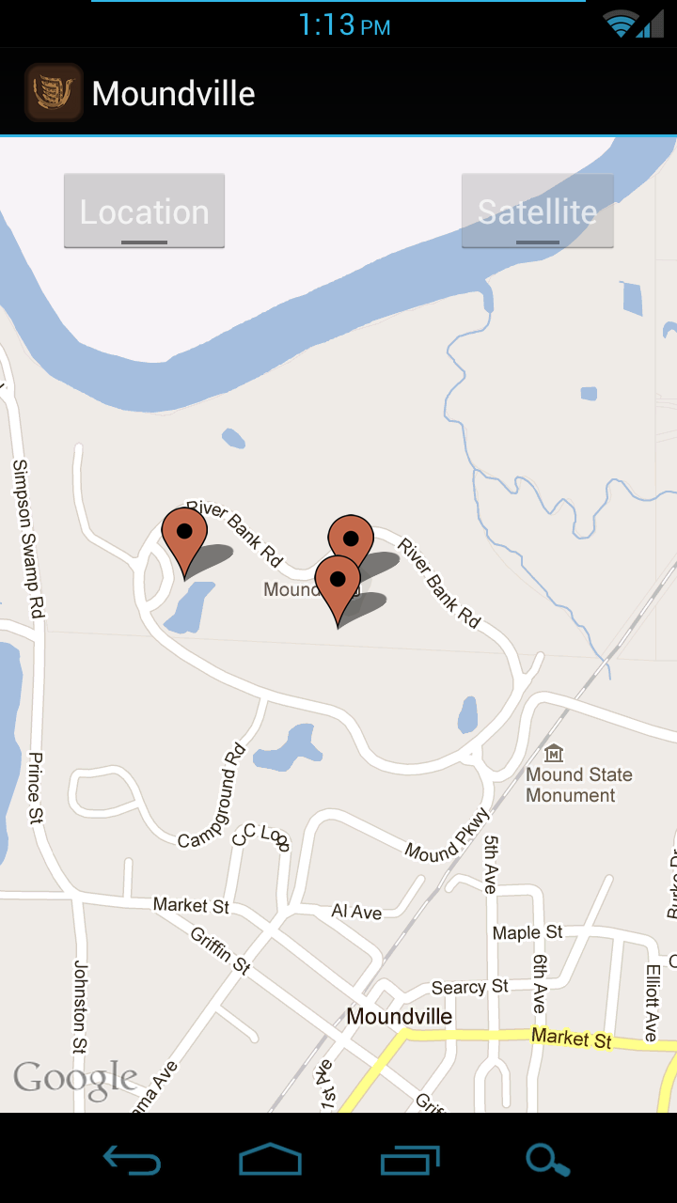
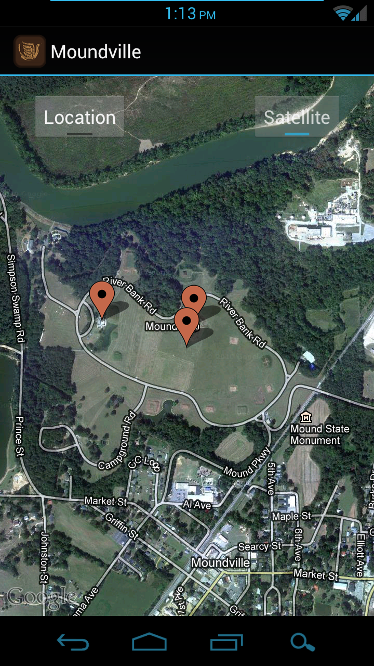
Screenshots: Park Map

