Slide 1
Data Mining (A8526)
Course Overview
This course provides the concepts and techniques in processing gathered data or information, which will be used in various applications.
Students will become acquainted with both the strengths and limitations of various data mining techniques like Association, Classification, Cluster and Outlier analysis.
Data mining tools predict future trends and behaviours, allowing businesses to make proactive, knowledge-driven decisions.
Data Mining: Concepts and Techniques

Slide 2
Course Pre/co-requisites
A8514- Data Base Management Systems.
Data Mining: Concepts and Techniques

Slide 3
Course Outcomes (COs)
After the completion of the course, the student will be able to:
Make use of pre-processing techniques on any given raw data.
Build data warehouse schemas for enterprise applications.
Perform market basket analysis using association rule mining.
Utilize classification techniques for analysis and interpretation of data.
Identify appropriate clustering and outlier detection techniques to handle complex data.
Data Mining A8526

Slide 4
Unit 2. Data Warehouse and OLAP
Data Warehouse and OLAP: DataWarehouse basic concepts, Differences between Operational Database Systems and Data Warehouses,
Multi-Tiered Architecture, Data Warehouse Models,
Schemas for Multidimensional Data Models,
Typical OLAP Operations, Data Ware house Design Process, OLAP Servers
Data Mining: Concepts and Techniques

Slide 5
Introduction
Data warehousing provides architectures and tools for business executives to systematically organize, understand, and use their data to make strategic decisions.
Data warehouse refers to a data repository that is maintained separately from an organization’s operational databases.
Data warehouse systems allow for integration of a variety of application systems.
They support information processing by providing a solid platform of consolidated historic data for analysis.
Data Mining (A8526)

Slide 6

Why Data Warehousing?
Which are our
lowest/highest margin
customers ?
Who are my customers
and what products
are they buying?
What is the most
effective distribution
channel?
Which customers
are most likely to go
to the competition ?
What impact will
new products/services
have on revenue
and margins?
Data Mining: Concepts and Techniques

Slide 7
Need for Data Warehousing
Industry has huge amount of operational data
Knowledge worker wants to turn this data into useful information.
This information is used by them to support strategic decision making.
It is a platform for consolidated historical data for analysis.
It stores data of good quality so that knowledge worker can make correct decisions.
From business perspective
-it is latest marketing weapon
-helps to keep customers by learning more about their needs.
-valuable tool in today’s competitive fast evolving world.
Data Mining: Concepts and Techniques

Slide 8
William H. Inmons’s definition
A data warehouse is
-Subject-oriented (Customer,Supplier,product,sales)
-Integrated (Relational databases,flatfiles,online trans),
-Time-variant (past 5-10 yrs),
-Nonvolatile (No operation needed)
collection of data in support of management’s decision making process.
Data Mining (A8526)

Slide 9
Definition
A datawarehouse is a subject-oriented, integrated, time-variant and non-volatile collection of data in support of managements decision making process.
It is the process whereby organizations extract value from their informational assets through use of special stores called data warehouses
Data Mining (A8526)

Slide 10
Integration
oracle
Client
Data preprocessing
Data
Warehouse
Data Source in bangalore
sybase
Clean
Transform
Integrate
Load
Query and
Analysis
Tools
Data Source in Mumbai
VSAM
Data Source in Delhi
Flat files
Client
Data Source in chennai
Data Mining (A8526)

Slide 11
Data Integrity Problems
Same person, different spellings
  Agarwal, Agrawal, Aggarwal etc...
Multiple ways to denote company name
  Persistent Systems, PSPL, Persistent Pvt. LTD.
Use of different names
  mumbai, bombay
Data Mining (A8526)

Slide 12
Nonvolatile
Data once recorded cannot be updated.
Data warehouse requires two operations in data accessing
  Initial loading of data
  Access of data
load
access
Data Mining (A8526)

Slide 13
OLTP:
U
S
E
R
Write
Read
Warehouse:
U
S
E
R
Read
Data Mining: Concepts and Techniques

Slide 14
Differences between Operational Database Systems and DataWarehouses
The major task of online operational database systems is to perform online transaction and query processing.
These systems are called online transaction processing (OLTP) systems.
They cover most of the day-to-day operations of an organization such as purchasing, inventory, manufacturing, banking, payroll, registration, and accounting.
Data warehouse systems, on the other hand, serve users or knowledge workers in the role of data analysis and decision making.
Such systems can organize and present data in various formats in order to accommodate the diverse needs of different users.
These systems are known as online analytical processing (OLAP) systems.
Data Mining (A8526)

Slide 15
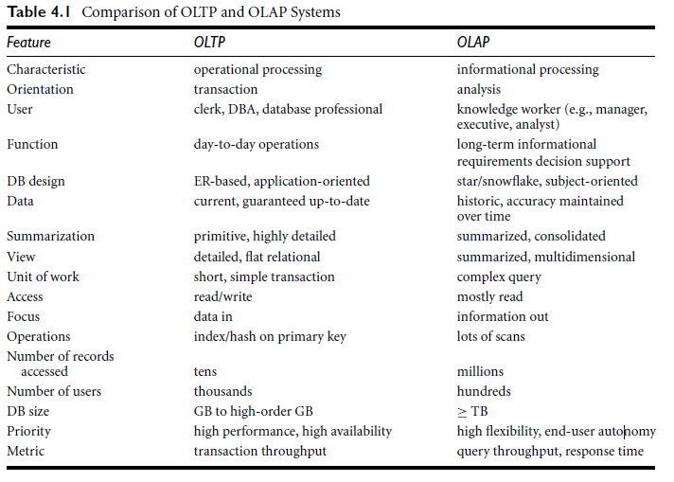
Contd..
Data Mining (A8526)

Slide 16
 | OLTP | OLAP
Users | clerk, IT professional | knowledge worker
Function | day to day operations | decision support
DB design | Application-oriented | Subject-oriented
Data | current, up to date | historical
Summarization | Primitive, detailed | summarized, consolidated
Focus | Data in | Information out
Access | read/write | Mostly read
Unit of work | short, simple transaction | complex query
# records accessed | tens | millions
# of users | thousands | hundreds
DB size | 100MB-GB | 100 GB -TB
Metric | Transaction throughput | Query throughput, response time
Data Mining: Concepts and Techniques

Slide 17
Why Separate Data Warehouse?
High performance for both systems
DBMS— tuned for OLTP: access methods, indexing, concurrency control, recovery
Warehouse—tuned for OLAP: complex OLAP queries, multidimensional view, consolidation.
Note: The separation of operational databases from data warehouses is based on the different structures, contents, and uses of the data in these two systems.
Data Mining: Concepts and Techniques

Slide 18
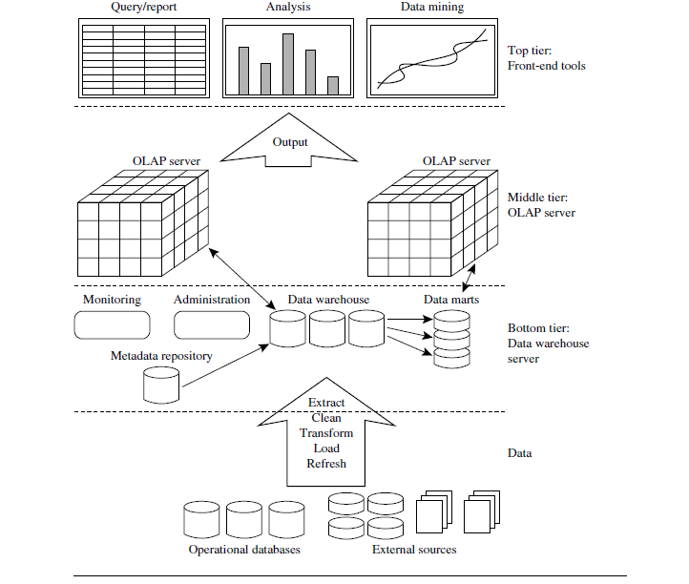
A three-tier data warehousing architecture.
Data Mining (A8526)

Slide 19
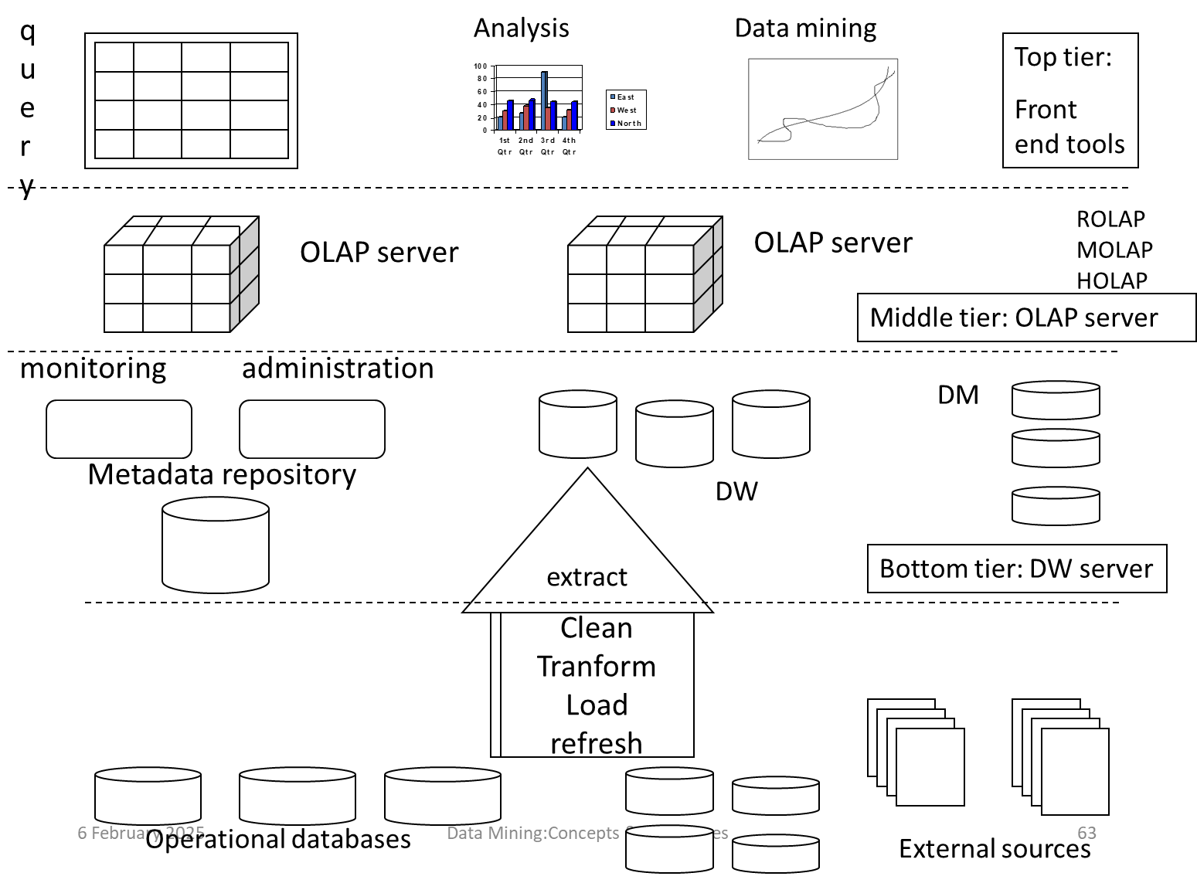

Slide 20
Contd..
The bottom tier is a warehouse database server that is almost always a relational database system.
Back-end tools and utilities are used to feed data into the bot tom tier from operational databases or other external sources (e.g., customer profile information provided by external consultants).
These tools and utilities perform data extraction, cleaning, and transformation (e.g., to merge similar data from different sources into a unified format), as well as load and refresh functions to update the data warehouse.
The data are extracted using application pro graminterfaces known as gateways.
Data Mining (A8526)

Slide 21
Contd..
The middle tier is an OLAP server that is typically implemented using either
A relational OLAP(ROLAP)model(i.e.,an extended relational DBMS that maps operations on multidimensional data to standard relational operations)
A multi dimensional OLAP (MOLAP) model (i.e., a special-purpose server that directly implements multidimensional data and operations)
The top tier is a front-end client layer, which contains query and reporting tools, analysis tools, and/or data mining tools (e.g., trend analysis, prediction, and so on).
Data Mining (A8526)

Slide 22
Data Warehouse Models:
From architecture point of view, there are three data warehouse models:
  Enterprise warehouse
  Data mart
  Virtual warehouse
Enterprise warehouse:
It collects all of the information about subjects spanning the entire organization.
Its size ranges from a few gigabytes to hundreds of gigabytes, terabytes or beyond.
It takes years to be designed & build.
Data Mining (A8526)

Slide 23
Data mart:
A data mart is defined as “A subset of a data warehouse for a single department or function”.
It can be build in weeks.
A data mart may have tens of gigabytes of data rather than hundreds of gigabytes for the entire enterprise.
Depending on source of data, DM may be:
Independent DM
Dependent DM
Data Mining (A8526)

Slide 24
Dependent DM
Data warehouse
Data marts
External sources
Data Mining (A8526)

Slide 25
Independent DM
.
Data warehouse
Data mart
External sources
Data Mining (A8526)

Slide 26
Virtual warehouse:
User given direct access to source database
Data is not moved from source databases
No target database-> no data warehouse
Benefits:
Preserves the investment in operational system hardware, software, packages and databases & skill set.
Risks:
Not a data warehouse
No historical data
Queries may disrupt operational system.
Data Mining (A8526)

Slide 27
Data Cube: A Multidimensional Data Model
A data cube allows data to be modeled and viewed in multiple dimensions. It is defined by dimensions and facts.
In general terms, dimensions are the perspectives or entities with respect to which an organization wants to keep records.
For example, AllElectronics may create a sales data warehouse in order to keep records of the store’s sales with respect to the dimensions time, item, branch, and location.
Data Mining (A8526)

Slide 28
Contd..
These dimensions allow the store to keep track of things like monthly sales of items and the branches and locations at which the items were sold.
Each dimension may have a table associated with it, called a dimension table
For example, a dimension table for item may contain the attributes item name, brand, and type.
A multidimensional data model is typically organized around a central theme, such as sales. This theme is represented by a fact table.
Facts are numeric measures. Think of them as the quantities by which we want to analyze relationships between dimensions.
Data Mining (A8526)

Slide 29
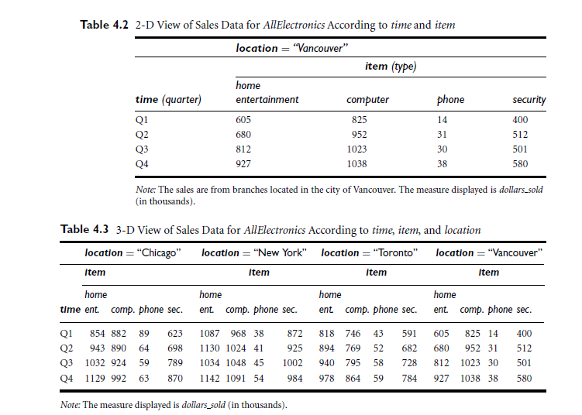
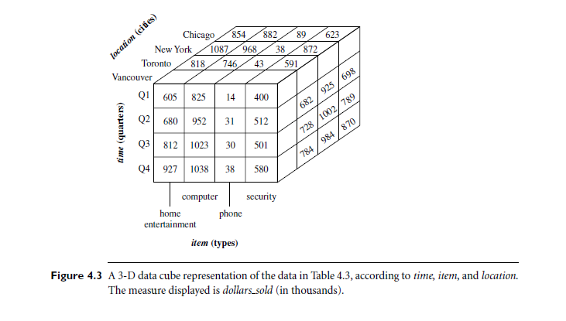
2D & 3D View of Data
Data Mining (A8526)

Slide 30
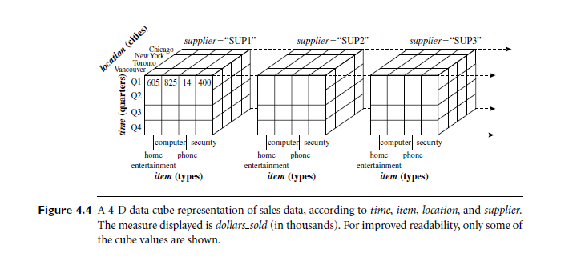
4D Data
Data Mining (A8526)

Slide 31
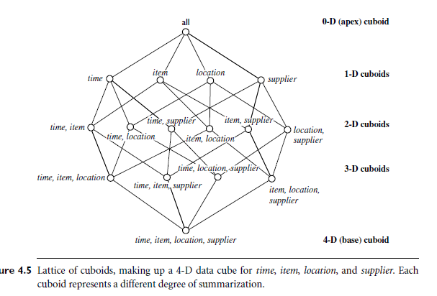
Lattice of cuboids
Data Mining (A8526)

Slide 32
Schemas for Multidimensional Data Models
Modeling data warehouses: dimensions & measures
  Star schema
  Snowflake schema
  Fact constellations
  Concept Hierarchy
Data Mining (A8526)

Slide 33
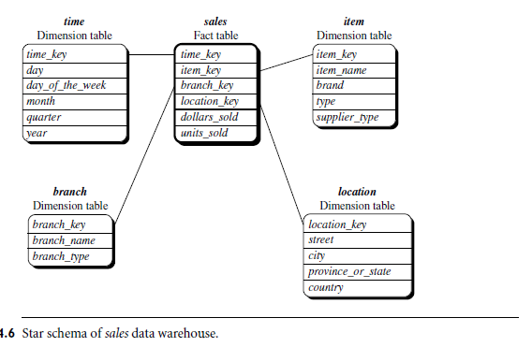
Star Schema
The most common modeling paradigm is the star schema, in which the data warehouse contains a large central table (fact table) containing the bulk of the data, with no redundancy, and a set of smaller attendant tables (dimension tables), one for each dimension.
Data Mining (A8526)

Slide 34
Star Schema
Key 1
Attribute
Attribute
…….
Attribute
Key 3
Attribute
Attribute
…….
Attribute
Fact table
Key 1
Key 2
Key 3
Key 4
measure1
……
measuren
Key 2
Attribute
Attribute
…….
Attribute
Key 4
Attribute
Attribute
…….
Attribute
Data Mining (A8526)

Slide 35
Example of Star Schema
time
item
time_key
day
day_of_the_week
month
quarter
year
item_key
item_name
brand
type
supplier_type
Sales Fact Table
time_key
item_key
branch_key
branch
location
location_key
branch_key
branch_name
branch_type
location_key
street
city
province_or_state
country
dollars_sold
units_sold
avg_sales
Measures
Data Mining (A8526)

Slide 36
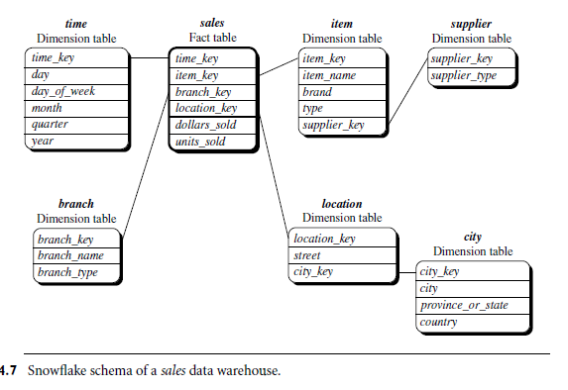
Snowflake schema
The snowflake schema is a variant of the star schema model, where some dimension tables are normalized, thereby further splitting the data into additional tables.
The resulting schema graph forms a shape similar to a snowflake.
Data Mining (A8526)

Slide 37
Example of Snowflake Schema
time
time_key
day
day_of_the_week
month
quarter
year
item
Sales Fact Table
item_key
item_name
brand
type
supplier_key
time_key
item_key
supplier
branch_key
location
supplier_key
supplier_type
branch
location_key
location_key
street
city_key
branch_key
branch_name
branch_type
units_sold
dollars_sold
city
avg_sales
city_key
City
state
country
Measures
Data Mining (A8526)

Slide 38
Difference B/w Snow Flake & Star
The major difference between the snowflake and star schema models is that the dimension tables of the snowflake model may be kept in normalized form to reduce redundancies.
Such a table is easy to maintain and saves storage space.
However, this space savings is negligible in comparison to the typical magnitude of the fact table.
Furthermore, the snowflake structure can reduce the effectiveness of browsing, since more joins will be needed to execute a query.
Consequently, the system performance may be adversely impacted.
Hence, although the snowflake schema reduces redundancy, it is not as popular as the star schema in data warehouse design.
Data Mining (A8526)

Slide 39
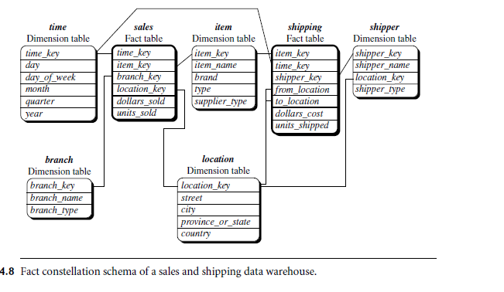
Fact constellation
Sophisticated applications may require multiple fact tables to share dimension tables.
This kind of schema can be viewed as a collection of stars, and hence is called a galaxy schema or a fact constellation.
Data Mining (A8526)

Slide 40
Example of Fact Constellation
time
time_key
day
day_of_the_week
month
quarter
year
time_key
item
Sales Fact Table
item_key
item_key
item_name
brand
type
supplier_type
time_key
shipper_key
item_key
from_location
branch_key
to_location
branch
branch_key
branch_name
branch_type
location_key
dollars_cost
units_sold
units_shipped
location
dollars_sold
location_key
street
city
province_or_street
country
shipper
avg_sales
shipper_key
shipper_name
location_key
shipper_type
Measures
Data Mining (A8526)

Slide 41
The Role of Concept Hierarchies
A concept hierarchy defines a sequence of mappings from a set of low-level concepts to higher-level, more general concepts.
Consider a concept hierarchy for the dimension location.
City values for location include Vancouver, Toronto, New York, and Chicago.
Each city, however, can be mapped to the province or state to which it belongs. For example, Vancouver can be mapped to British Columbia, and Chicago to Illinois.
The provinces and states can in turn be mapped to the country (e.g., Canada or the United States) to which they belong.
Data Mining (A8526)

Slide 42
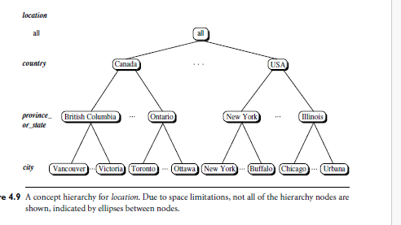
Concept Hierarchy Contd..
Data Mining (A8526)

Slide 43
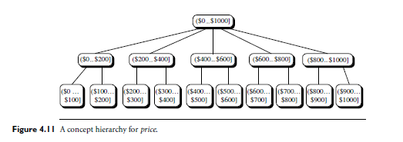
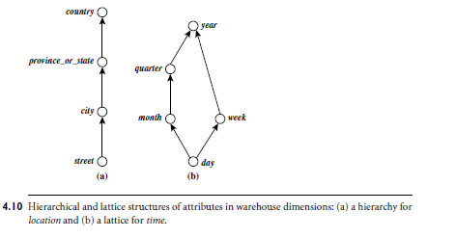
Concept Hierarchy contd..
Data Mining (A8526)

Slide 44
Contd…
A concept hierarchy that is a total or partial order among attributes in a database schema is called a schema hierarchy.
Concept hierarchies that are common to many applications (e.g., for time) may be predefined in the data mining system.
Data mining systems should provide users with the flexibility to tailor predefined hierarchies according to their particular needs.
For example, users may want to define a fiscal year starting on April 1 or an academic year starting on September 1.
Data Mining (A8526)

Slide 45
Contd…
Concept hierarchies may also be defined by discretizing or grouping values for a given dimension or attribute, resulting in a set-grouping hierarchy.
A total or partial order can be defined among groups of values. An example of a set-grouping hierarchy is shown for the dimension price, where an interval .$X : : :$Y] denotes the range from $X (exclusive) to $Y (inclusive).
Data Mining (A8526)

Slide 46
Contd…
There may be more than one concept hierarchy for a given attribute or dimension, based on different user viewpoints.
For instance, a user may prefer to organize price by defining ranges for inexpensive, moderately priced, and expensive.
Concept hierarchies may be provided manually by system users, domain experts, or knowledge engineers, or may be automatically generated based on statistical analysis of the data distribution.
Concept hierarchies allow data to be handled at varying levels of abstraction
Data Mining (A8526)

Slide 47
OLAP Operations
Roll-up
Drill-down
Slice and dice
Pivot (rotate)
Other OLAP operations
  Drill-across
  Drill-through
Data Mining (A8526)

Slide 48
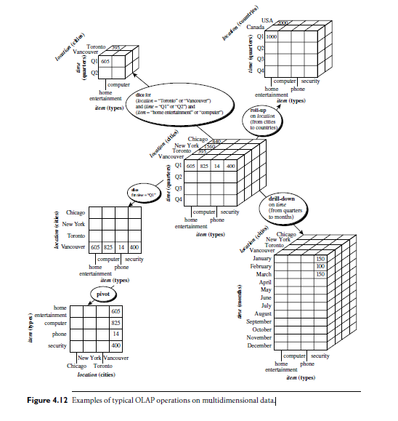
OLAP operations on multidimensional data
Data Mining (A8526)

Slide 49
Rollup
The roll-up operation (also called the drill-up operation by some vendors)performs aggregation on a data cube, either by climbing up a concept hierarchy for a dimension or by dimension reduction.
Ex: shows the result of a roll-up operation performed on the central cube by climbing up the concept hierarchy for location
Data Mining (A8526)

Slide 50
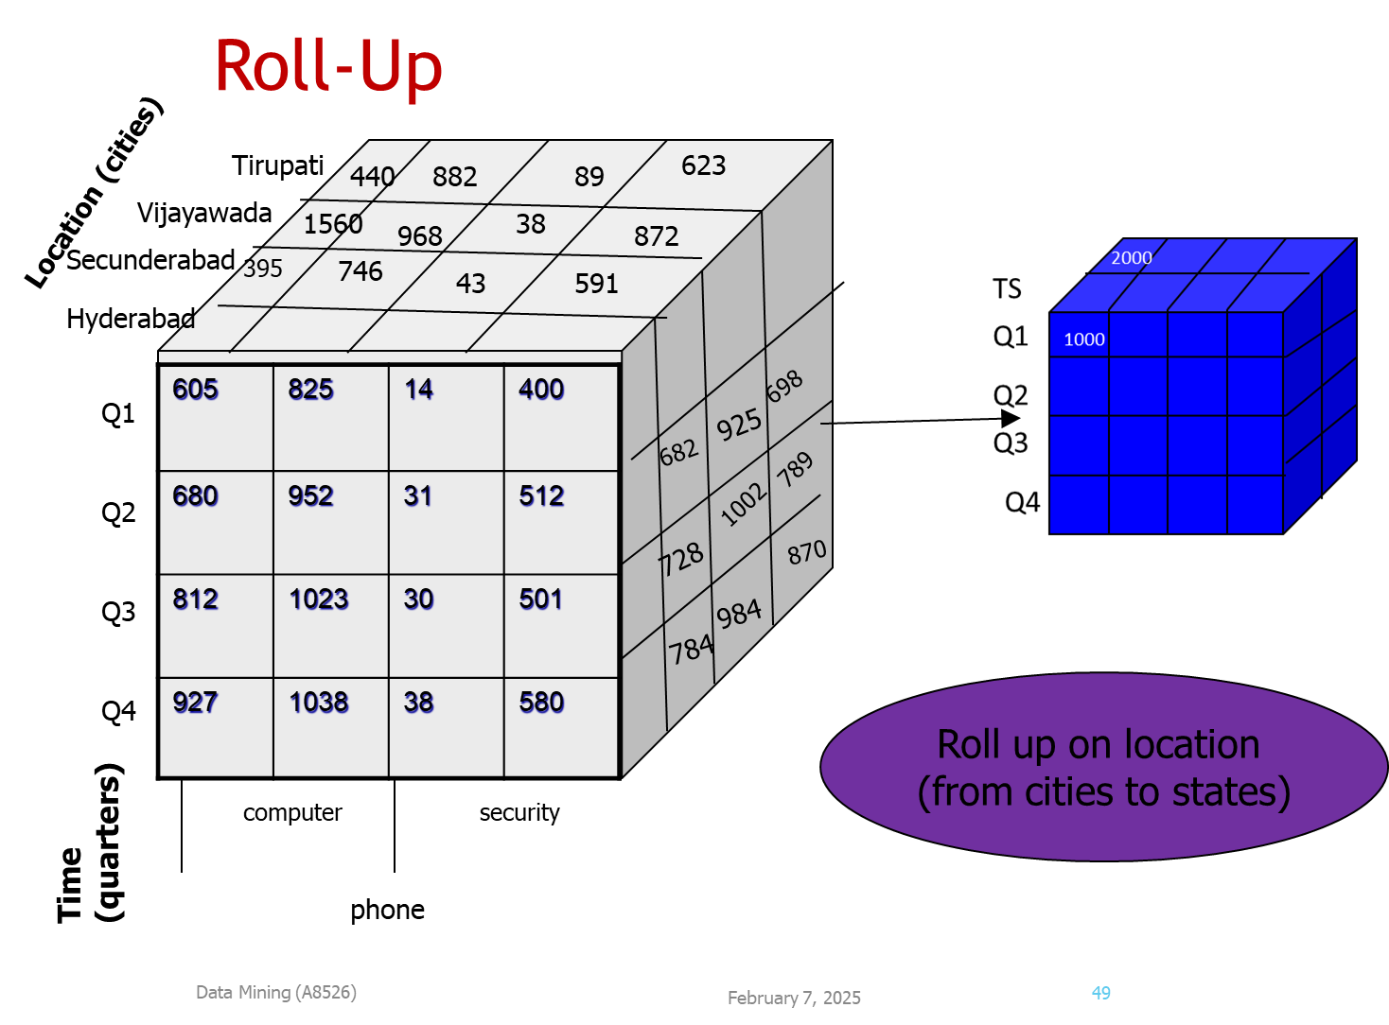

Slide 51
Drill-Down
It is reverse of roll-up.
It navigates from less detailed to more detailed data.
Drill-down can be realized by either stepping down a concept hierarchy for a dimension or introducing additional dim.
Data Mining (A8526)

Slide 52
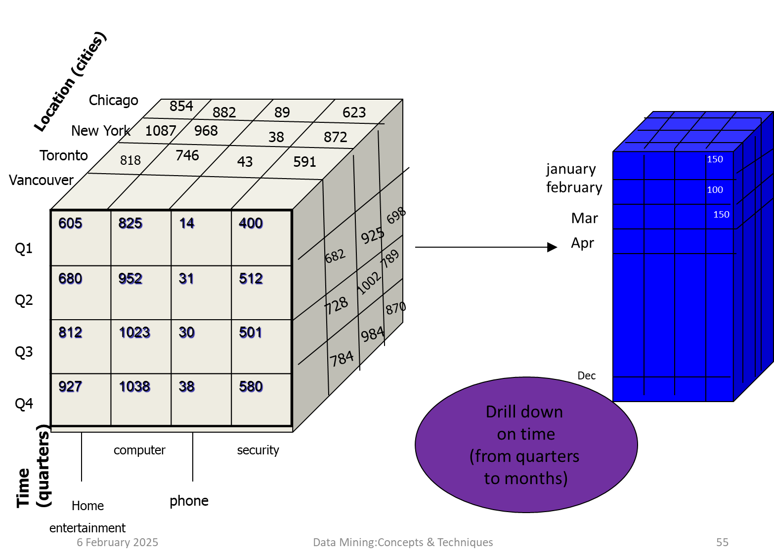
Drill-down

Slide 53
Dice
The dice operation extracts a sub cube by performing a selection on two or more dimensions.
Data Mining (A8526)

Slide 54
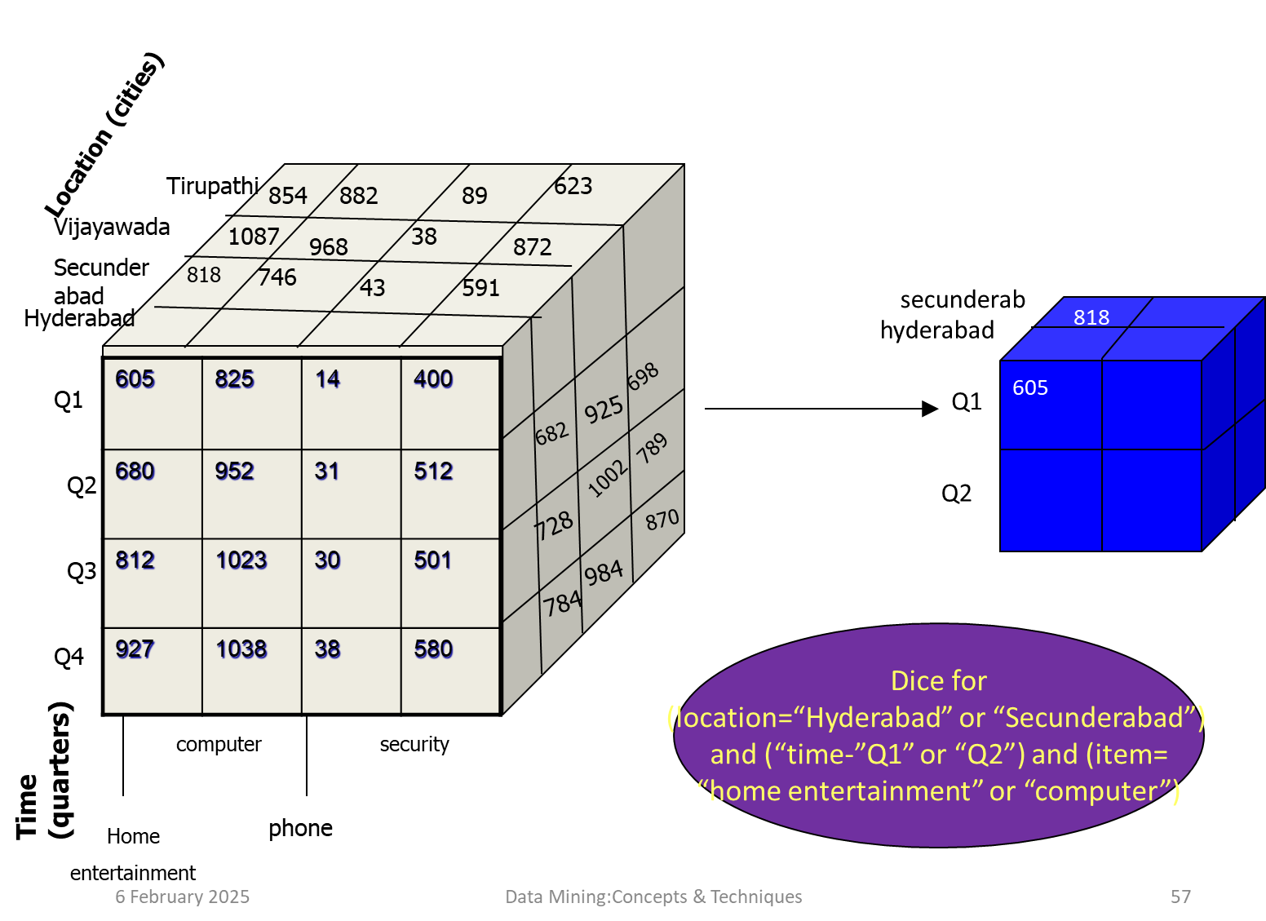
Dice

Slide 55
Slice
The slice operating performs a selection on one dimension of the given cube.
Data Mining (A8526)

Slide 56
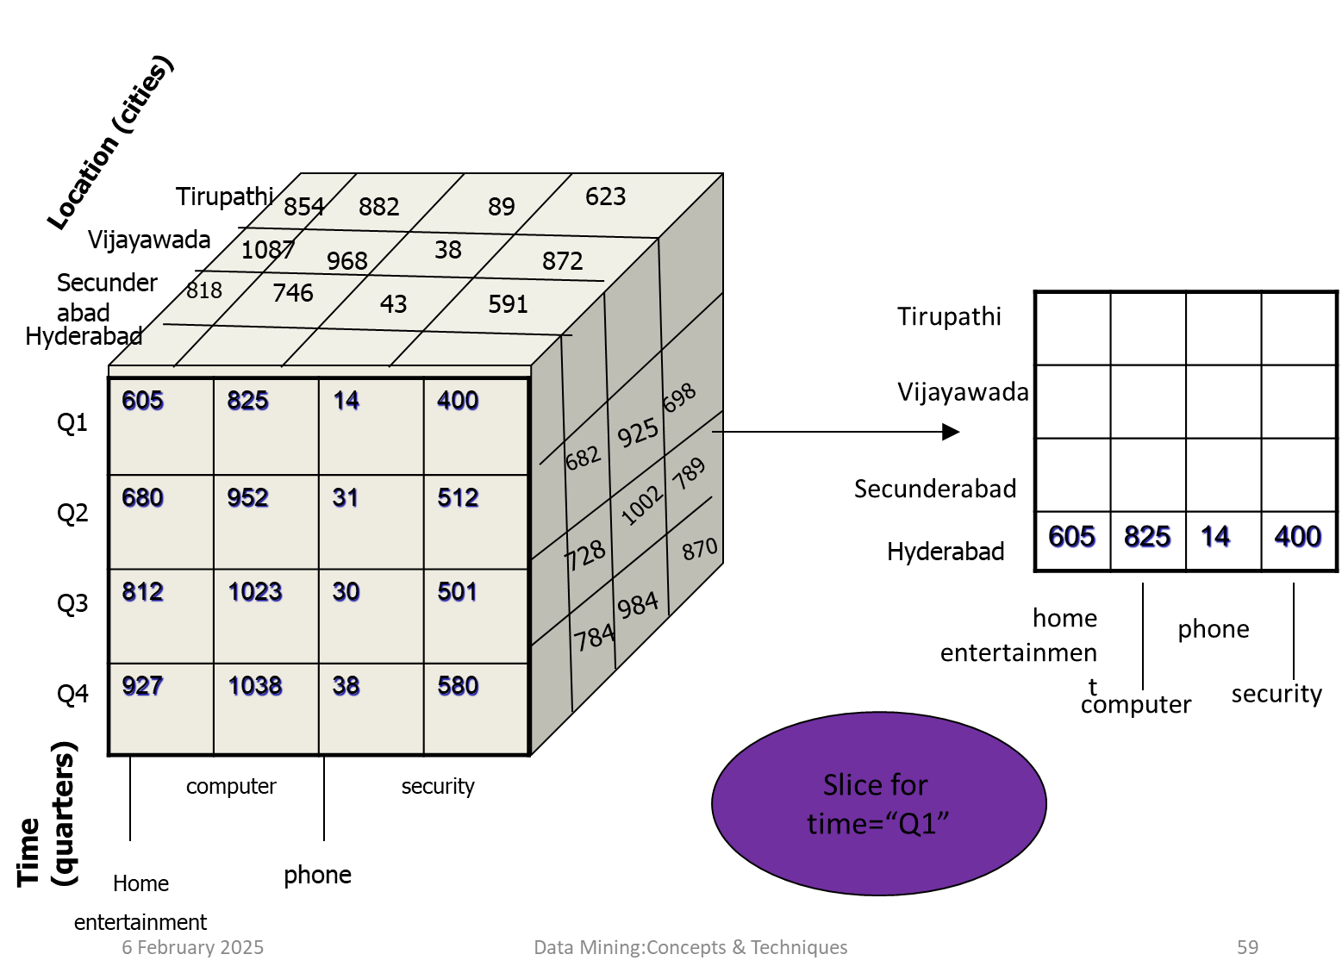
Slice

Slide 57
Pivote (Rotate):
It is a visualization operation.
It rotates the data axes to provide an alternate presentation of data.
Data Mining (A8526)

Slide 58
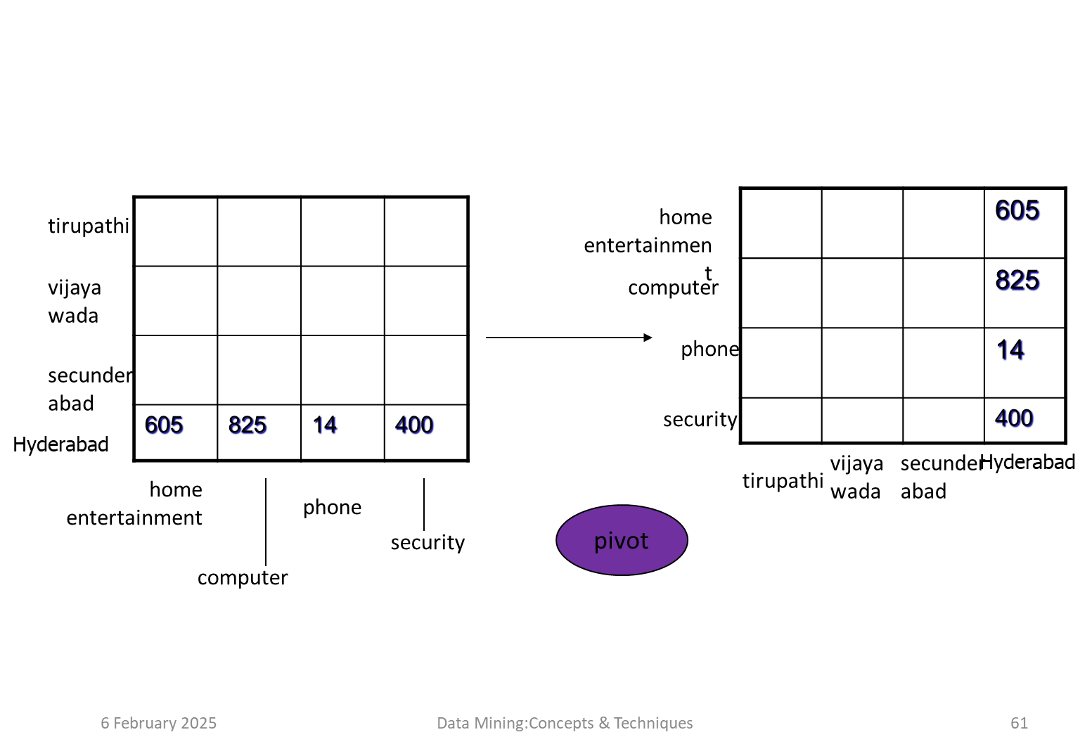
Pivote (Rotate):

