Slide 1
GPU-Accelerated Deep Learning-Based ECG Signal Classification
for Cardiac Abnormality Detection | Group 7
Rishabh Jha - 24/CSE/136
Rishi Raj - 24/CSE/137
Ritam Jana - 24/CSE/138
Rohan Adak - 24/CSE/143
Ronit Jana - 24/CSE/145
MIT-BIH Arrhythmia Database | 1D-CNN and CNN-LSTM

Slide 2
Problem and Objectives
ECG beats must be checked one by one, which is slow for long recordings.
Goal: classify each beat as Normal or Abnormal using deep learning.
Compare a 1D-CNN with a CNN-LSTM and measure the GPU speedup.
ECG data handling
Deep-learning classification
Model evaluation
CPU vs GPU comparison
Dataset
Preprocessing
1D-CNN / CNN-LSTM
Evaluation
CPU vs GPU
Demo

Slide 3
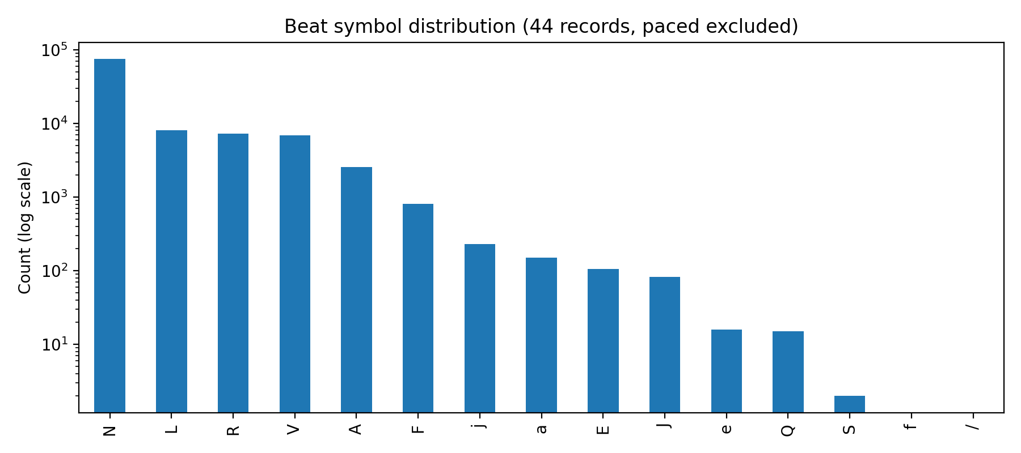
Dataset: MIT-BIH Arrhythmia
44
records used (of 48)
100,733
annotated beats
10.5%
360 Hz, lead MLII. Normal: N, L, R, e, j. Abnormal: A, a, J, S, V, E, F, /, f, Q. Four paced records excluded.
abnormal beats (10,608)

Slide 4
Preprocessing and Data Split
Bandpass 0.5-45 Hz
360-sample beat window
Z-score per beat
Normal / Abnormal label
Split | Records | Beats | Abnormal
Train | 30 | 68,386 | 8.2%
Validation | 7 | 16,399 | 11.3%
Test | 7 | 15,897 | 19.9%
Record-wise split: no record appears in two splits, so test results are not inflated by leakage.

Slide 5
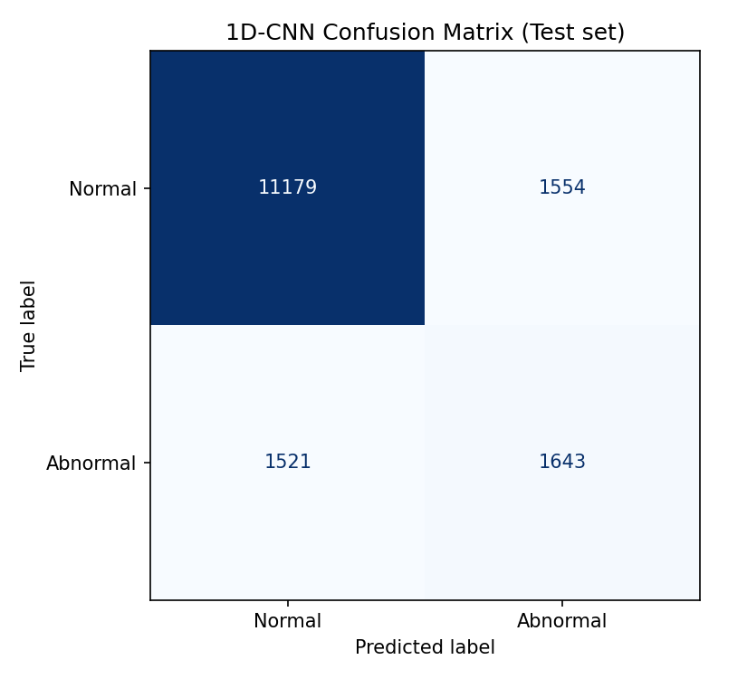
1D-CNN
Conv1D 32 + Pool
Conv1D 64 + Pool
Flatten
Dense 64 + Dropout
Sigmoid
0.8066
ROC-AUC 0.8448. Recall 0.5193, precision 0.5139. Best epoch 1 of 7, then overfitting.
accuracy
0.5166
F1 (abnormal)

Slide 6
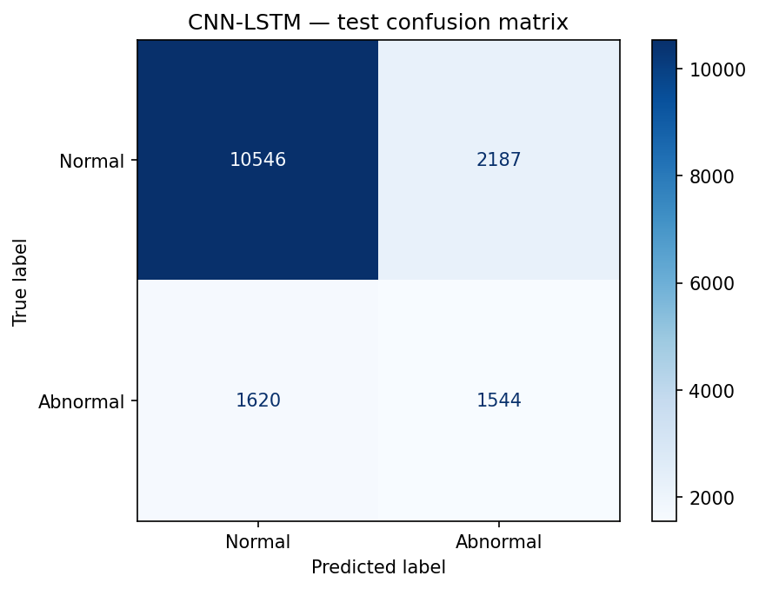
CNN-LSTM
3 x Conv1D + Pool
LSTM 64
Dense 32 + Dropout
Sigmoid
0.7605
ROC-AUC 0.7418. Recall 0.4880, precision 0.4138. Best epoch 9 of 13 (112.11 s on Tesla T4).
accuracy
0.4479
F1 (abnormal)

Slide 7
CPU vs GPU Performance
8.76x
9.75x
7.43x
training, 5 epochs
average epoch time
test-set inference
 | CPU | GPU
Training (5 epochs) | 297.20 s | 33.94 s
Inference (15,897 beats) | 3.563 s | 0.479 s
Google Colab, Tesla T4 GPU, TensorFlow 2.20.0. Same model, data, seed and batch size. Each timing run once.

Slide 8
Model Comparison
Test metric | 1D-CNN | CNN-LSTM
Accuracy | 0.8066 | 0.7605
Precision (abnormal) | 0.5139 | 0.4138
Recall (abnormal) | 0.5193 | 0.4880
F1 (abnormal) | 0.5166 | 0.4479
ROC-AUC | 0.8448 | 0.7418
The 1D-CNN wins on every metric.
Both models are weak on abnormal beats (F1 about 0.45 to 0.52).
Test: 7 unseen records, 15,897 beats.
Training times are not directly comparable: the 1D-CNN run had no GPU and different early-stopping settings.

Slide 9
Demo
1
2
3
4
Select or upload an ECG beat
>
Filter 0.5-45 Hz, 360 samples, z-score
>
1D-CNN and CNN-LSTM give P(abnormal)
>
Normal or Abnormal, plus results
Streamlit app. Threshold 0.5. The output is a classification result, not a clinical diagnosis.
Live demo: ecg-project-deeplearning-6383kyappwquwvbrmgodag6.streamlit.app

Slide 10
Limitations and Conclusion
Conclusion
One pipeline: data, preprocessing, two models, evaluation, CPU vs GPU, demo.
1D-CNN: F1 0.5166. CNN-LSTM: F1 0.4479.
GPU gave 7.4x to 9.8x speedup.
Limitations
Both models overfit the training records.
3 test records hold 2,791 of 3,164 abnormal beats.
Single timing runs; epoch limits differed.
Thank you

