Slide 1
Booking of hotel website
Zhumartov Marat

Slide 2
Project_description
The topic of a project is booking service for a hotel called Mountain Wind. The website consists of 5 webpages completed with html and css codes. There we have Information page; Home page; Catalog page; Registration page and Contact page;

Slide 3
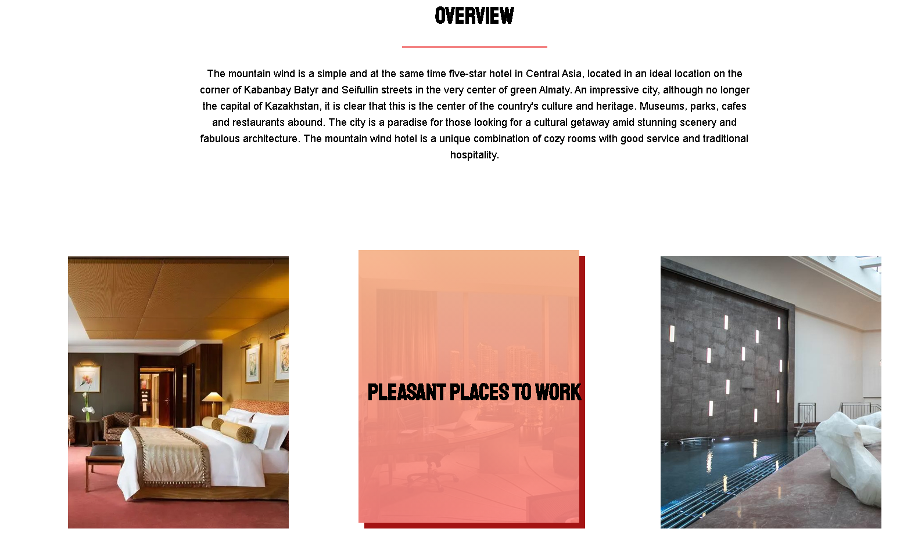
Home_page
The home page has an overview for a hotel, also short description of a hotel. Prices and reviews are present below it.

Slide 4
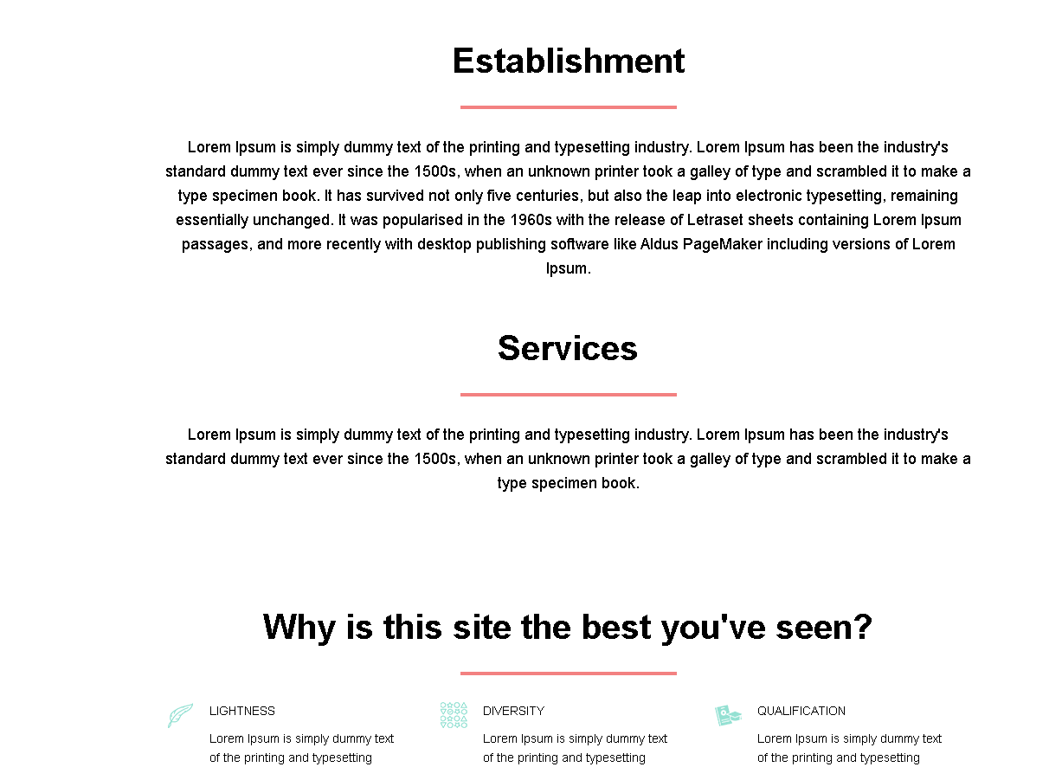
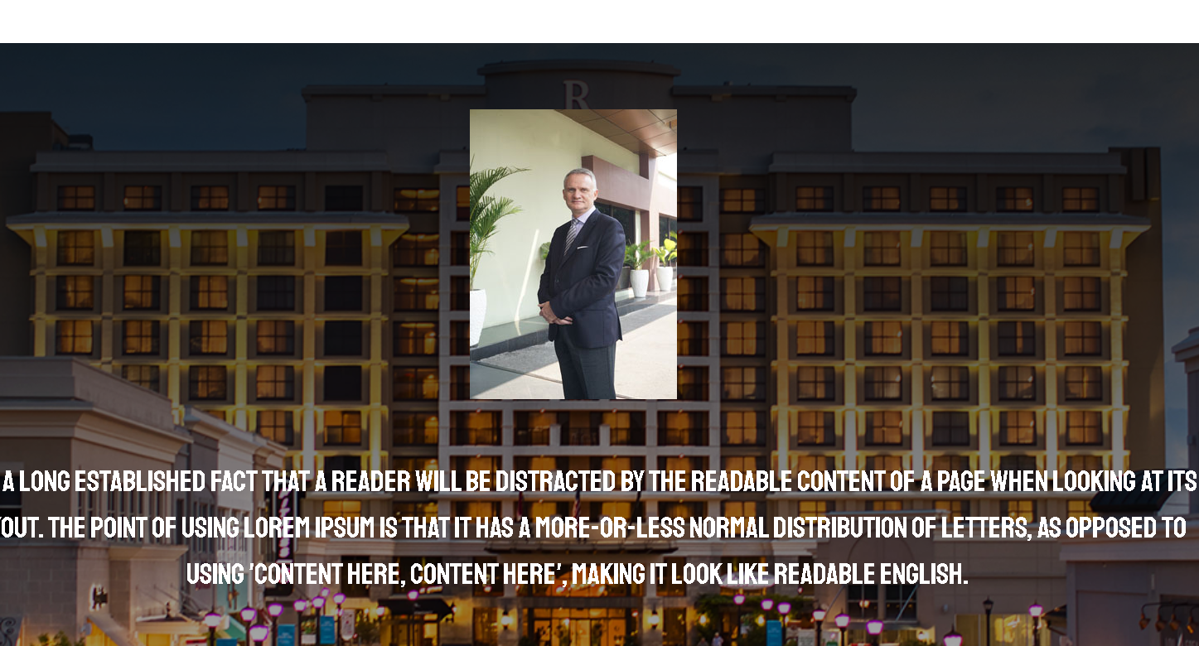
Info_page

Slide 5
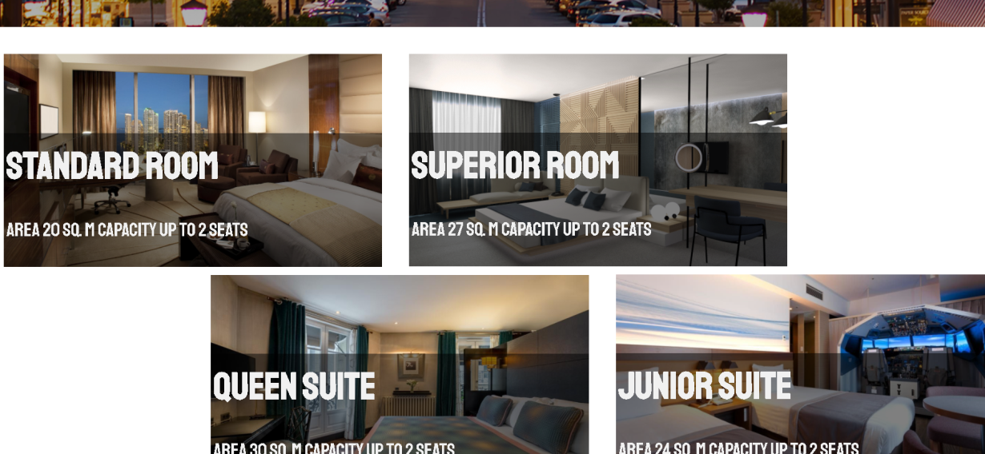
Catalog_page
On catalog page there we have room tours in our hotel.

Slide 6

Project_relevance
The project is a relevant one, because there are not so many qualitative websites for a hotel in Almaty, especially if everything is online now, so after quarantine people would relax from staying at home.

Slide 7

Responsibilites!
Marat Zhumartov is the only member of a team kakoijeparol; So everything was performed by me, as far as possible (Did not use bootstrap).

Slide 8
Project_features
The project provides only a front for a website.
User can clique onto reference pages, see comfortable color palette and pop-up blocks.

Slide 9
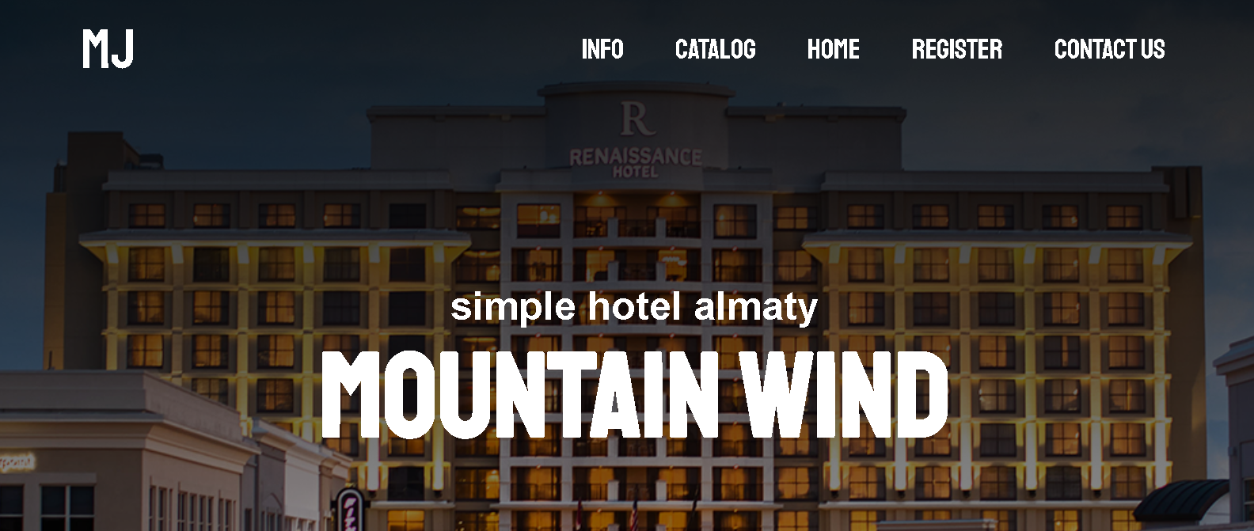
header

Slide 10
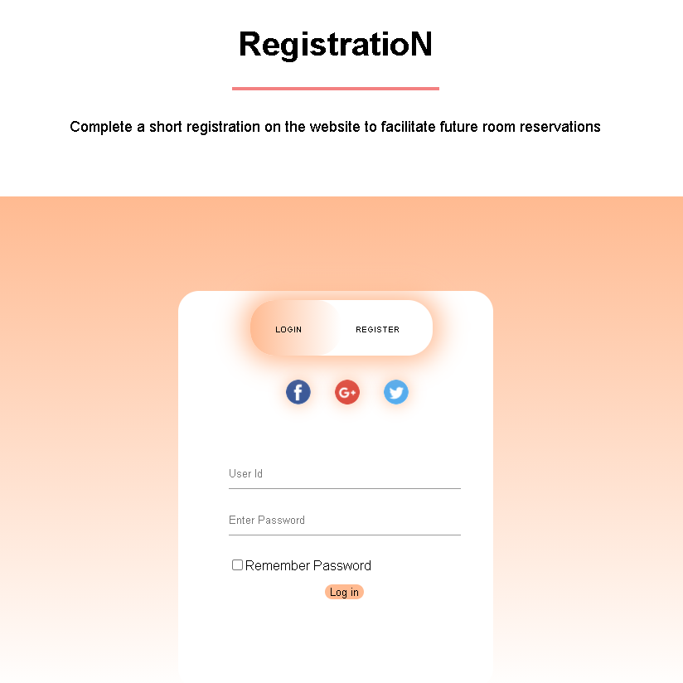
Reg_page

