Slide 1
JEOPARDY
Models of Exponential and Log Functions | Properties of Logarithms | Solving Exponential and Log Functions | Exponential Growth and Decay
100 | 100 | 100 | 100
200 | 200 | 200 | 200
300 | 300 | 300 | 300
400 | 400 | 400 | 400
500 | 500 | 500 | 500

Slide 2

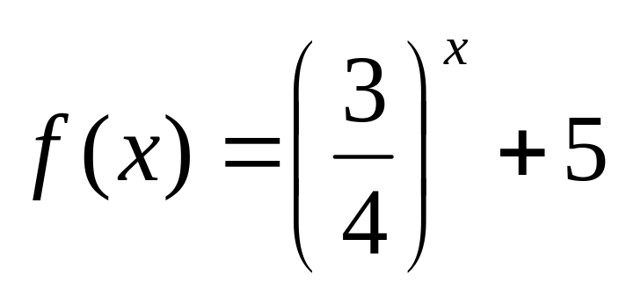
100
Identify the model represented by

Slide 3
100
Exponential Decay

Slide 4
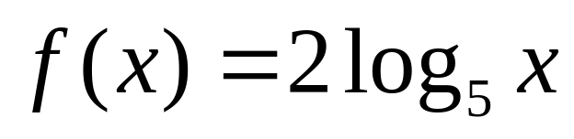
200
Identify the model represented by
a.

Slide 5
200
a. Logarithmic

Slide 6
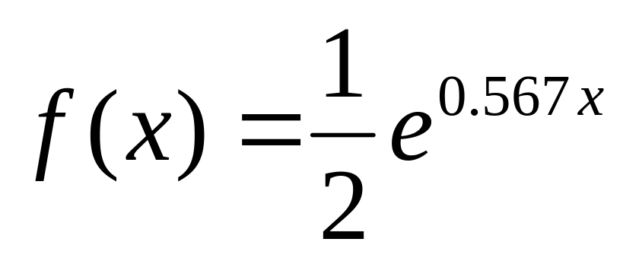
300
Identify the model represented by

Slide 7
300
Exponential Growth

Slide 8
400
In 1985, you bought a sculpture for $380. Each year, t, the value, v, of the sculpture increases by 8%. Write an exponential model that describes this situation?

Slide 9
400
v=380(1.08)^{t}
^{where t=0 represents 1985}

Slide 10
500
Record albums increased in popularity until about 1980. In 1980, 817 (million) record albums were sold. Each year after that, the number sold decreased by 27%. Write an exponential model which describes this situation.

Slide 11
500
y=817(0.73)^{x}
where x =0 represents 1980

Slide 12
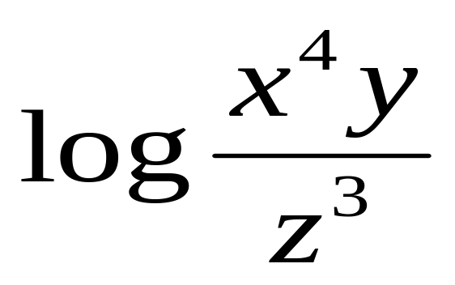
100
Expand the following logarithm

Slide 13
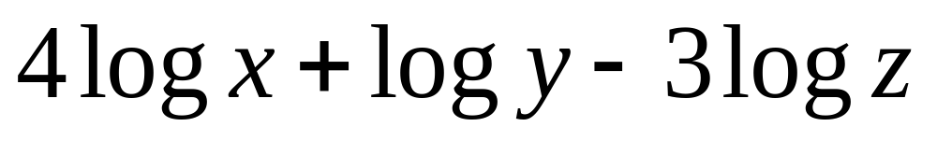
100

Slide 14
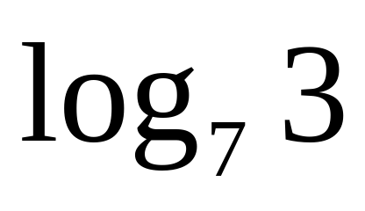
200
Use the change of base formula to solve the given logarithm:

Slide 15
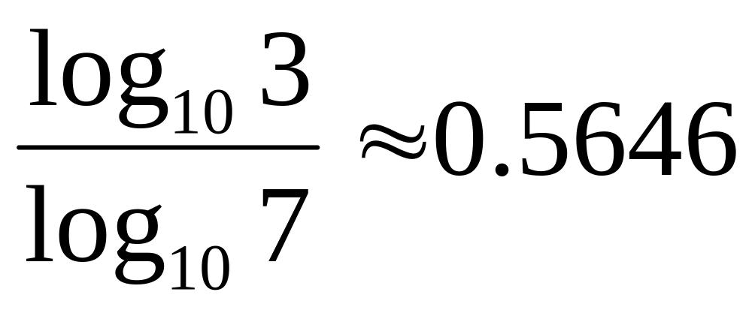
200

Slide 16
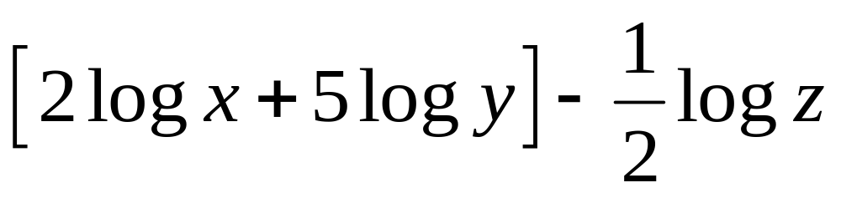
300
Condense the following logarithm

Slide 17
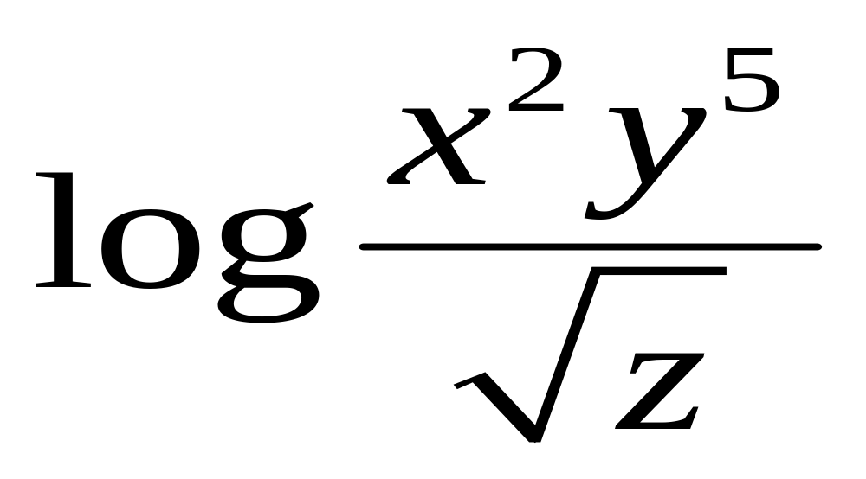
300

Slide 18
400
DAILY DOUBLE!!!!

Slide 19
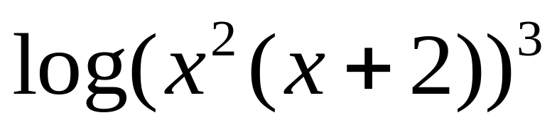
500
Use the properties of logarithms to expand the following logarithmic expression

Slide 20
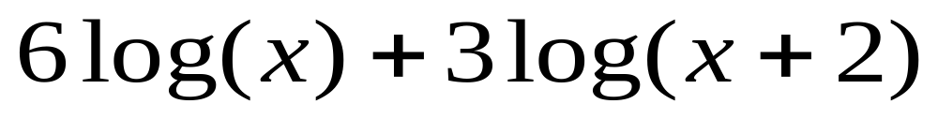
500

Slide 21
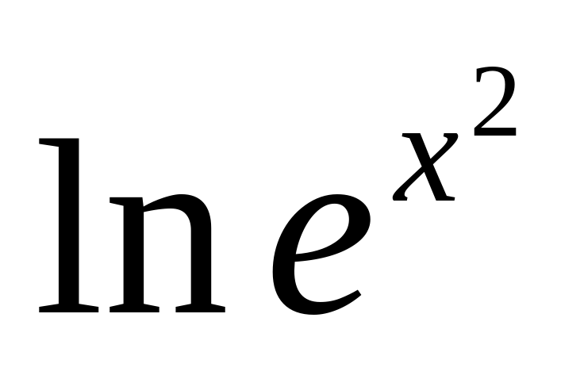
100
Simplify the expression:

Slide 22
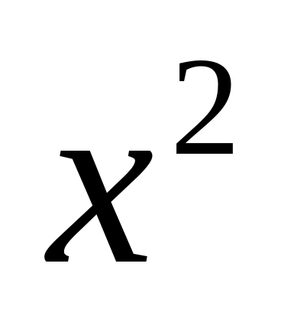
100

Slide 23
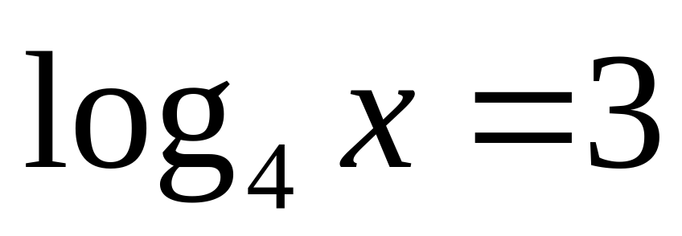
200
Solve for x:

Slide 24
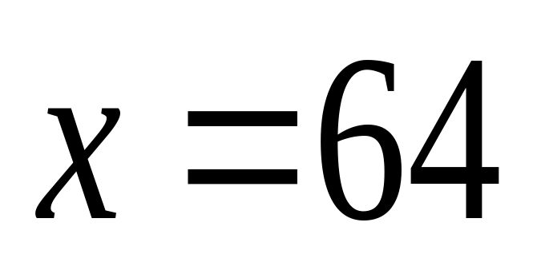
200

Slide 25
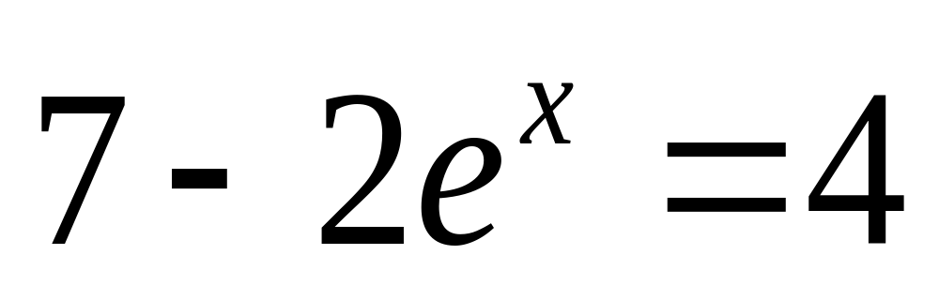
300
Solve the exponential equation algebraically:

Slide 26
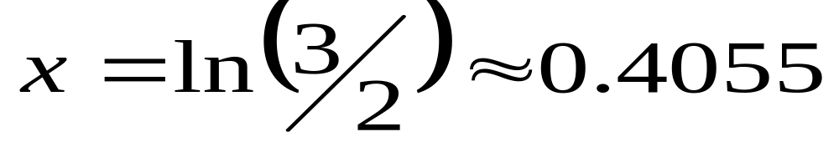
300

Slide 27
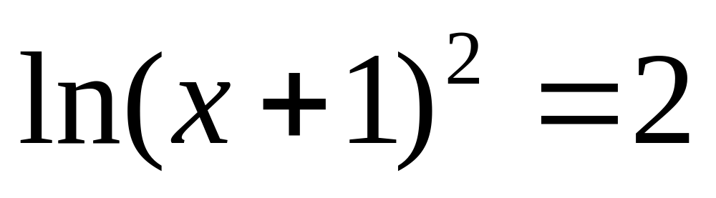
400
Solve the equation algebraically:

Slide 28
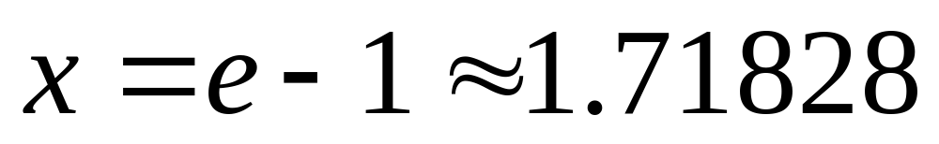
400

Slide 29
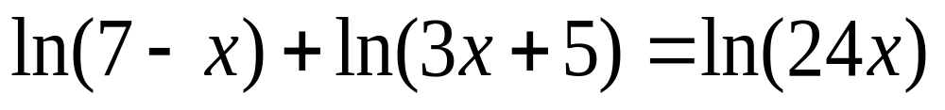
500
Solve for x:

Slide 30
500
X = 7/3

Slide 31
100
Find the number of years required for a $1000 investment to double at an 7% interest rate compounded continuously.

Slide 32
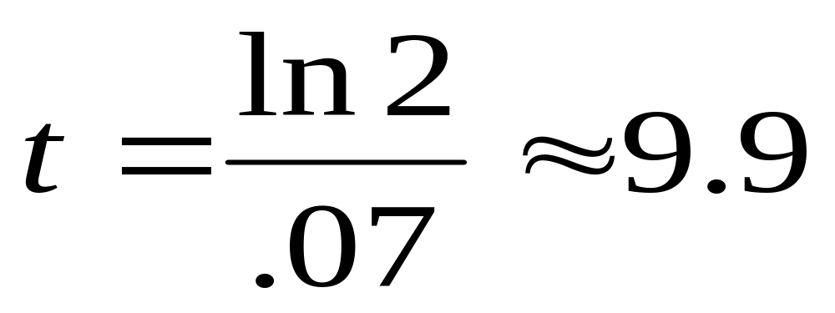
100

Slide 33
200
Determine the amount of money that should be invested at a rate of 6% compounded annually to produce a final balance of $2,000 in 5 years.

Slide 34
200
$1,494.52

Slide 35
300
An initial deposit of $2000 is made in a savings account for which the interest is compounded continuously. The balance will triple in 20 years. What is the annual rate of interest for this account?

Slide 36
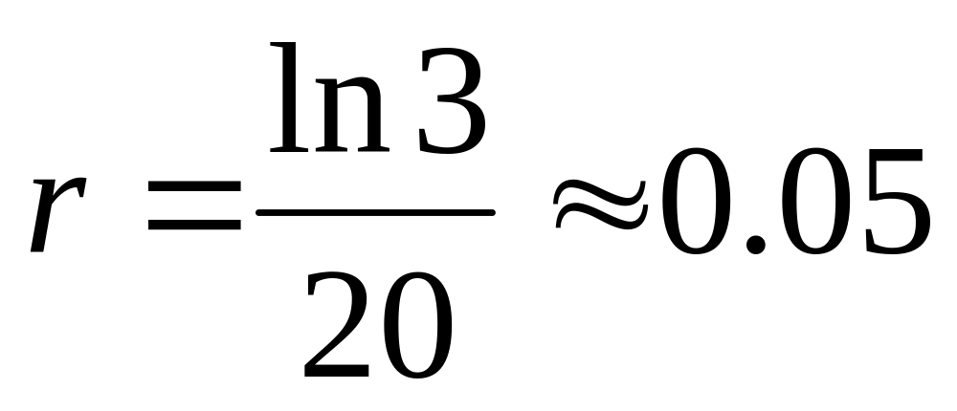
300

Slide 37
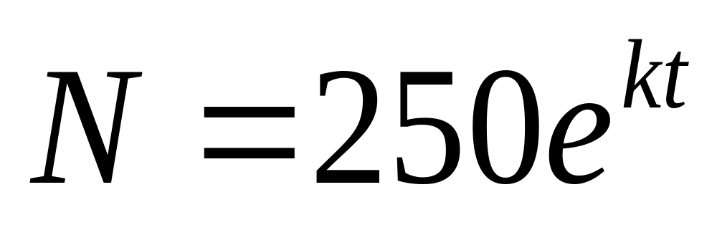
400
The number of bacteria N in a culture is given by the model below where t is the time in hours. If N = 280 when t = 10, estimate the time required for the population to double in size.

Slide 38
400
61.16 hours

Slide 39
500
The population P of a city is given by P=2500e^{kt} where t = 0 represents 1990. In 1945, the population was 1350. Find the value of k.

Slide 40
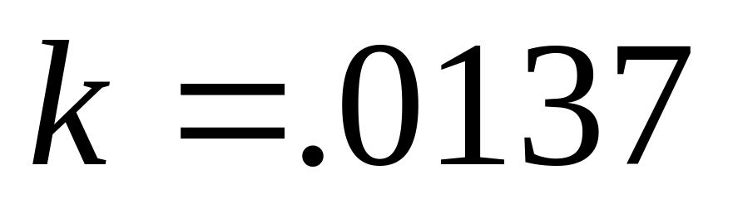
500

Slide 41
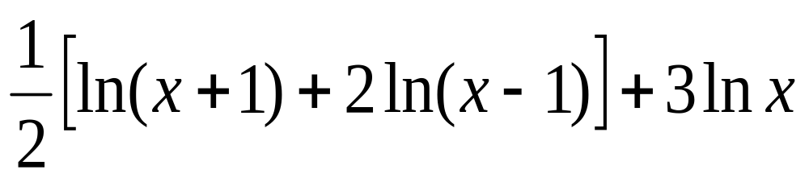
DAILY DOUBLE
Write the expression as the logarithm of a single quantity:

Slide 42
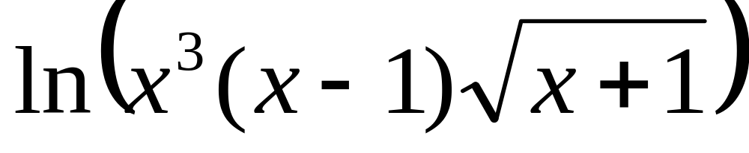
DAILY DOUBLE

