Slide 1
Use Inverse Functions
Section 6.4

Slide 2
Key Vocabulary
Inverse Relation – a relation that interchanges the input and output values of the original relation
Inverse Function – the original relation and its inverse relation whenever both relations are functions.

Slide 3
Inverse Relations in a Table
Original Relation
X | 0 | 1 | 2 | 3 | 4
Y | 6 | 4 | 2 | 0 | -2
What do you think happens in the inverse relations table?
Make a prediction.
Inverse Relation
X | 6 | 4 | 2 | 0 | -2
Y | 0 | 1 | 2 | 3 | 4
Write a sentence that describes what changed.
The x and y values switched in the inverse relation.

Slide 4


Example 1:
Step 1: Write the original equation.
Step 2: Switch x and y.
Step 3: Solve for y.
The inverse relation →

Slide 5
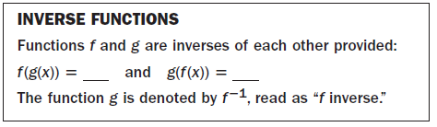

Example 2:
Step 1: Show that f(f(x)⁻¹) = x
Step 2: Show that f⁻¹(f(x)) = x

Slide 6



Example 2:
Step 1: Show that f(f(x)⁻¹) = x
Step 2: Show that f⁻¹(f(x)) = x

Slide 7


Example 3: find the inverse of a power function.
Step 1: Write the original equation.
Step 2: Replace f(x) with y.
Step 3: Switch x and y.
Step 4: Solve for y.
The inverse relation →

Slide 8
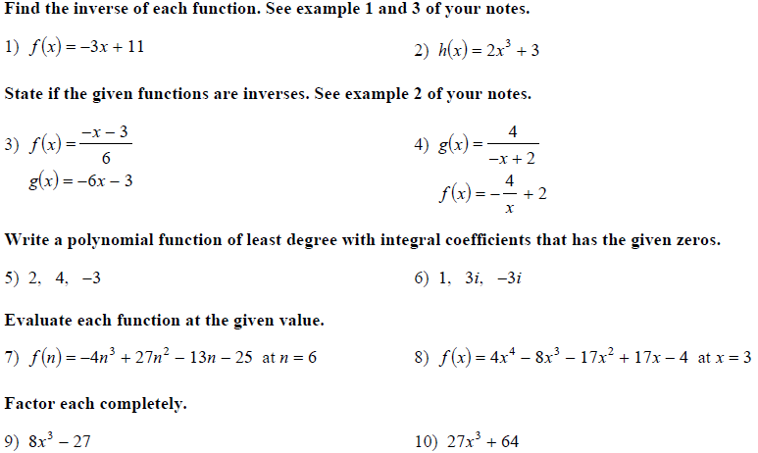
Class Practice: Take out a sheet of paper.

Slide 9
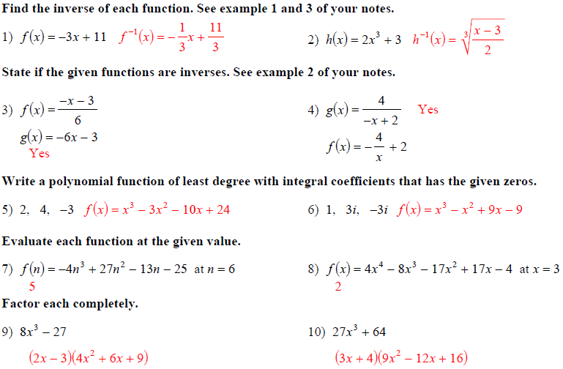
Class Practice: Take out a sheet of paper.

