Slide 1
Graphing Growth and Decay Part 1
Sections 7.1 + 7.2

Slide 2
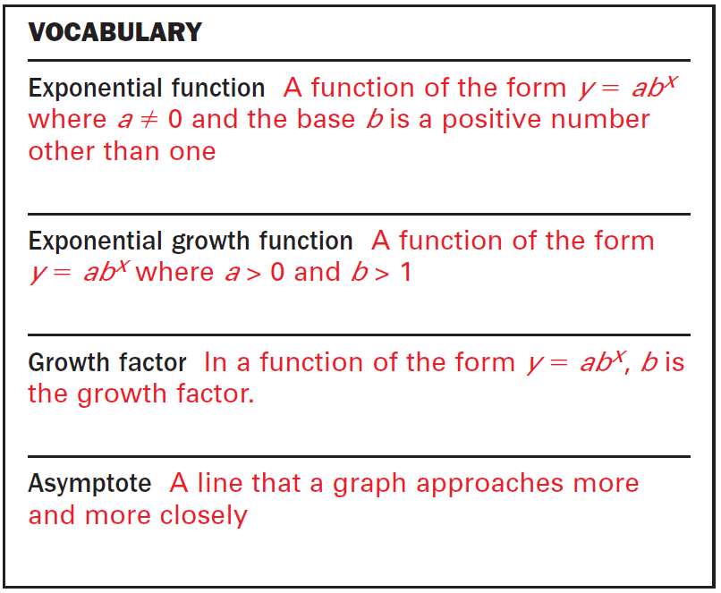

Slide 3
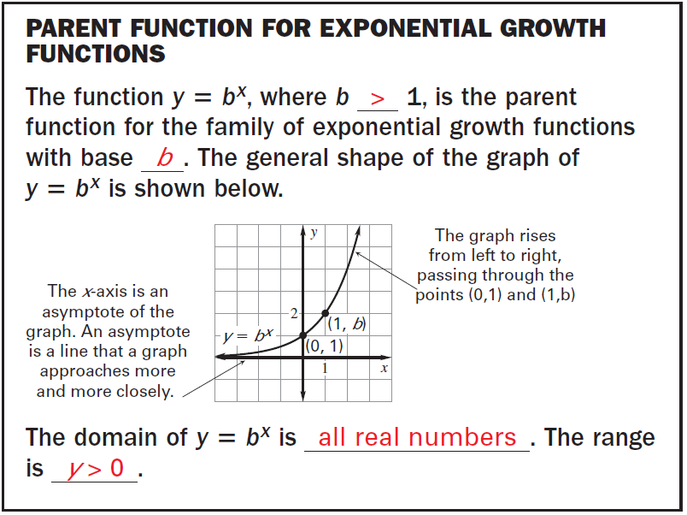

Slide 4


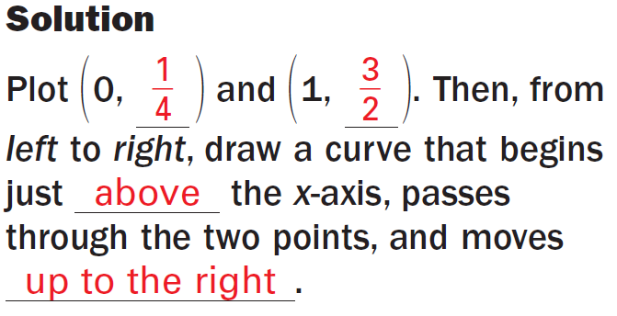
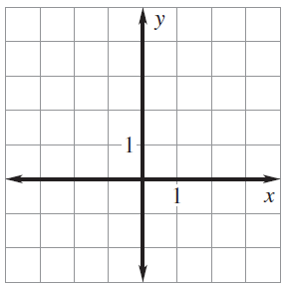
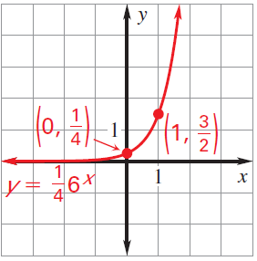
Example 1:
Step 1: Plug in 0 and 1 into the function to find the y-values.

Slide 5
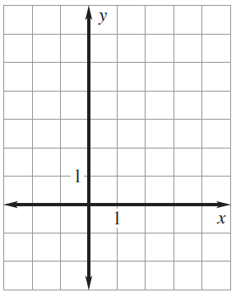
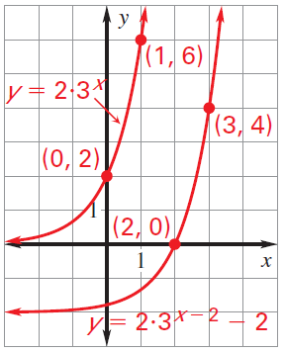
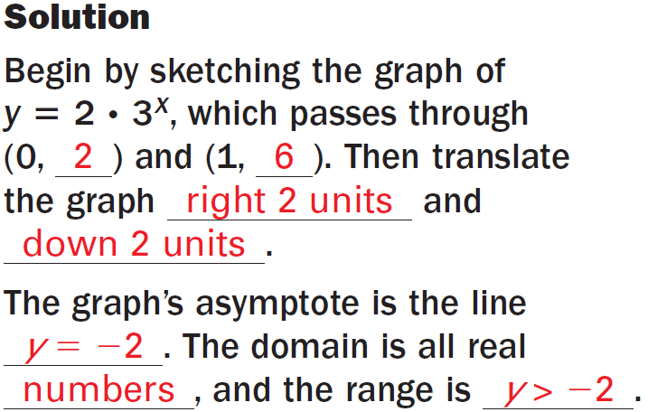
Example 2:
Step 1: Plug in 0 and 1 into the function to find the y-values.
Step 2: Determine the h (horizontal) and k (vertical) shift values. → Graph
Step 3: Determine the domain and the range.

Slide 6
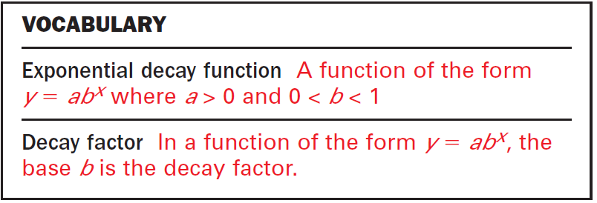

Slide 7
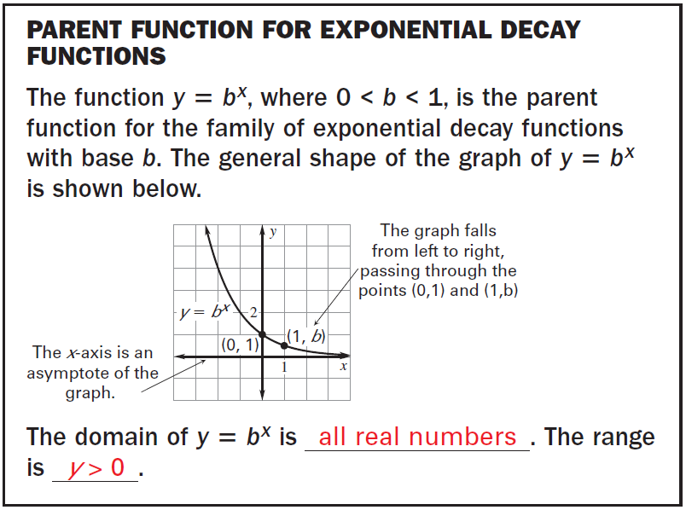

Slide 8

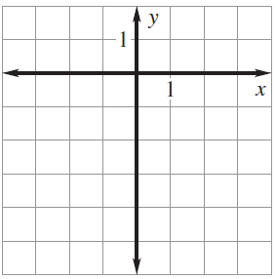
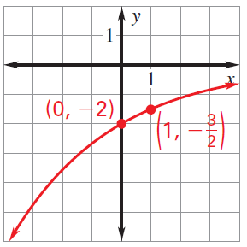
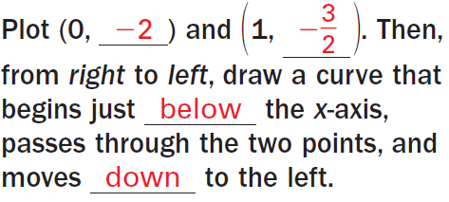
Example 1:
Step 1: Plug in 0 and 1 into the function to find the y-values.

Slide 9
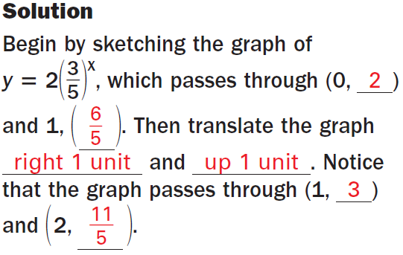
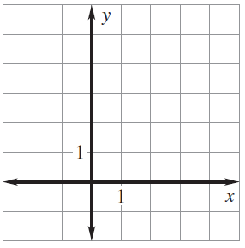
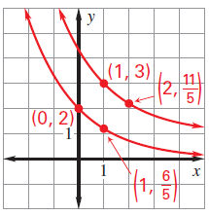
Example 2:
Step 1: Plug in 0 and 1 into the parent function to find the y-values.
Step 2: Determine the h (horizontal) and k (vertical) shift values. → Graph
Step 3: Determine the domain and the range.

Slide 10
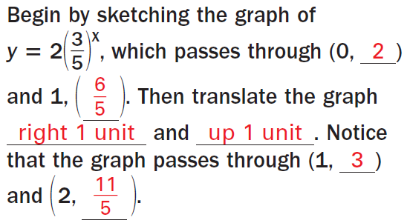
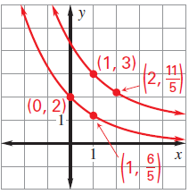


Slide 11
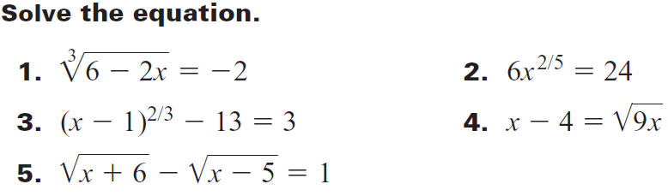
Class Practice: Complete these 5.

