Slide 1
Angles and Their Measure
Section 13-2

Slide 2
Angles
Terminal Side
Initial Side
Vertex

Slide 3
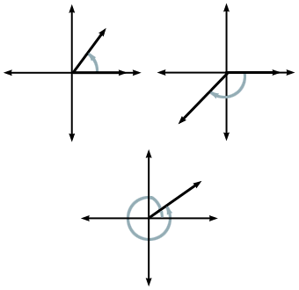
Standard Position: Initial side is on the positive x-axis with the vertex at the origin. Positive angles are measured counter-clockwise. Negative angles are measured clockwise.
Positive Angle
Negative Angle
Quadrantal Angle: Angle in standard position with terminal side on an axis

Slide 4
Measuring Angles
There are two ways to measure angles:
Radians (One Circle = 2 radians)
Radians are the commonly used angle measure for Trig
Degrees (One circle = 360º)

Slide 5
Ex: Draw each angle with the given measure in standard position
1. 215º 2.
3. -305º 4.

Slide 6
Converting
If 360º = 2 radians, then 180º =  rad
To convert degrees to rad, use the ratio
To convert rad to degrees, use the ratio
Ex: Convert
1. 45º to rad 2. to degrees

Slide 7
Coterminal Angles
Two angles in standard position that have the same terminal side
Ex: Find one positive angle and one negative angle that are coterminal with
To find coterminal angles, add or subtract any number of full circles:

Slide 8
HW: p.862 (3 – 31, 39 – 41)

