Slide 1
The Unit Circle
Section 13.3

Slide 2



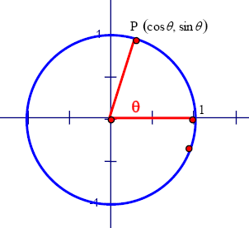



The Unit Circle
Circle with r = 1
If the terminal side of an angle in standard position intersects the unit circle at a point (x, y) then

Slide 3
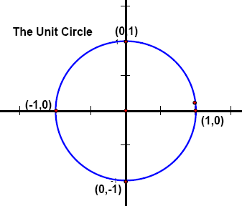

Labeling all points on the unit circle might be difficult, but four points are easy to figure out:
Ex: Use the diagram to calculate the following values:

Slide 4

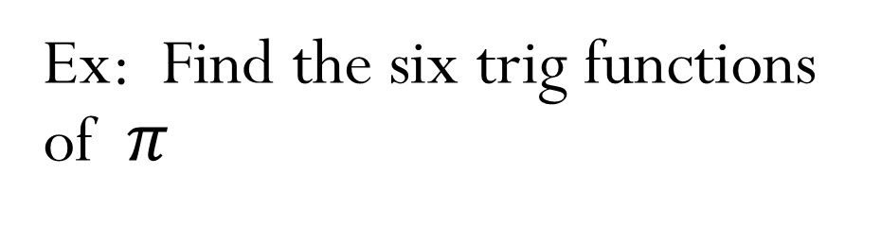
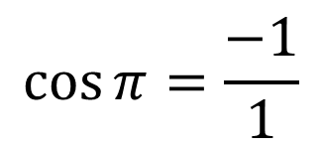
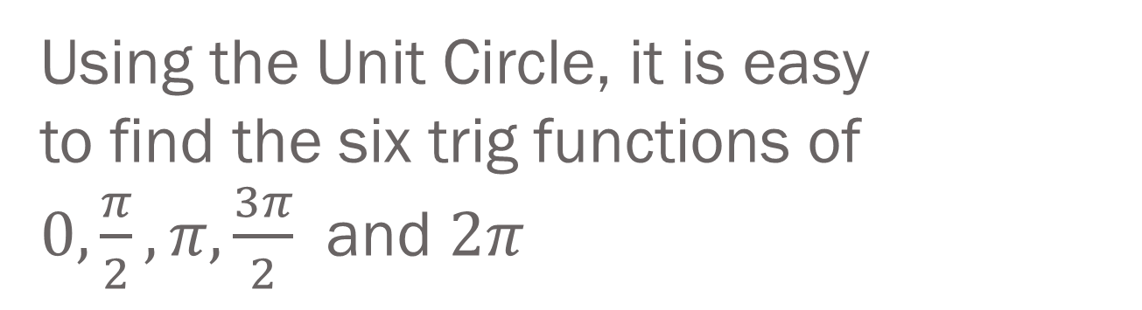

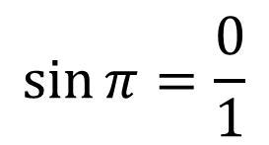
Using the Unit Circle, it is easy to find the six trig functions of $0, \frac{π}{2}, π, \frac{3π}{2}$ and $2π$
Ex: Find the six trig functions of $π$
Use the point (-1,0) and r = 1 to fill in the six trig ratios:
$$\sin{π}=\frac{0}{1}$$
$$=0$$
$$\cos{π}=\frac{−1}{1}$$
$$=−1$$

Slide 5
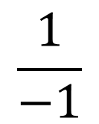





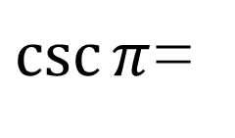



$$\frac{0}{1}$$
$$\tan{π}=$$
$$=0$$
$$\frac{1}{0}$$
$\csc{π}$=
= undefined
$$\frac{1}{−1}$$
$$\sec{π}=$$
$$=−1$$
$$\frac{1}{0}$$
$$\cot{π}=$$
= undefined

Slide 6
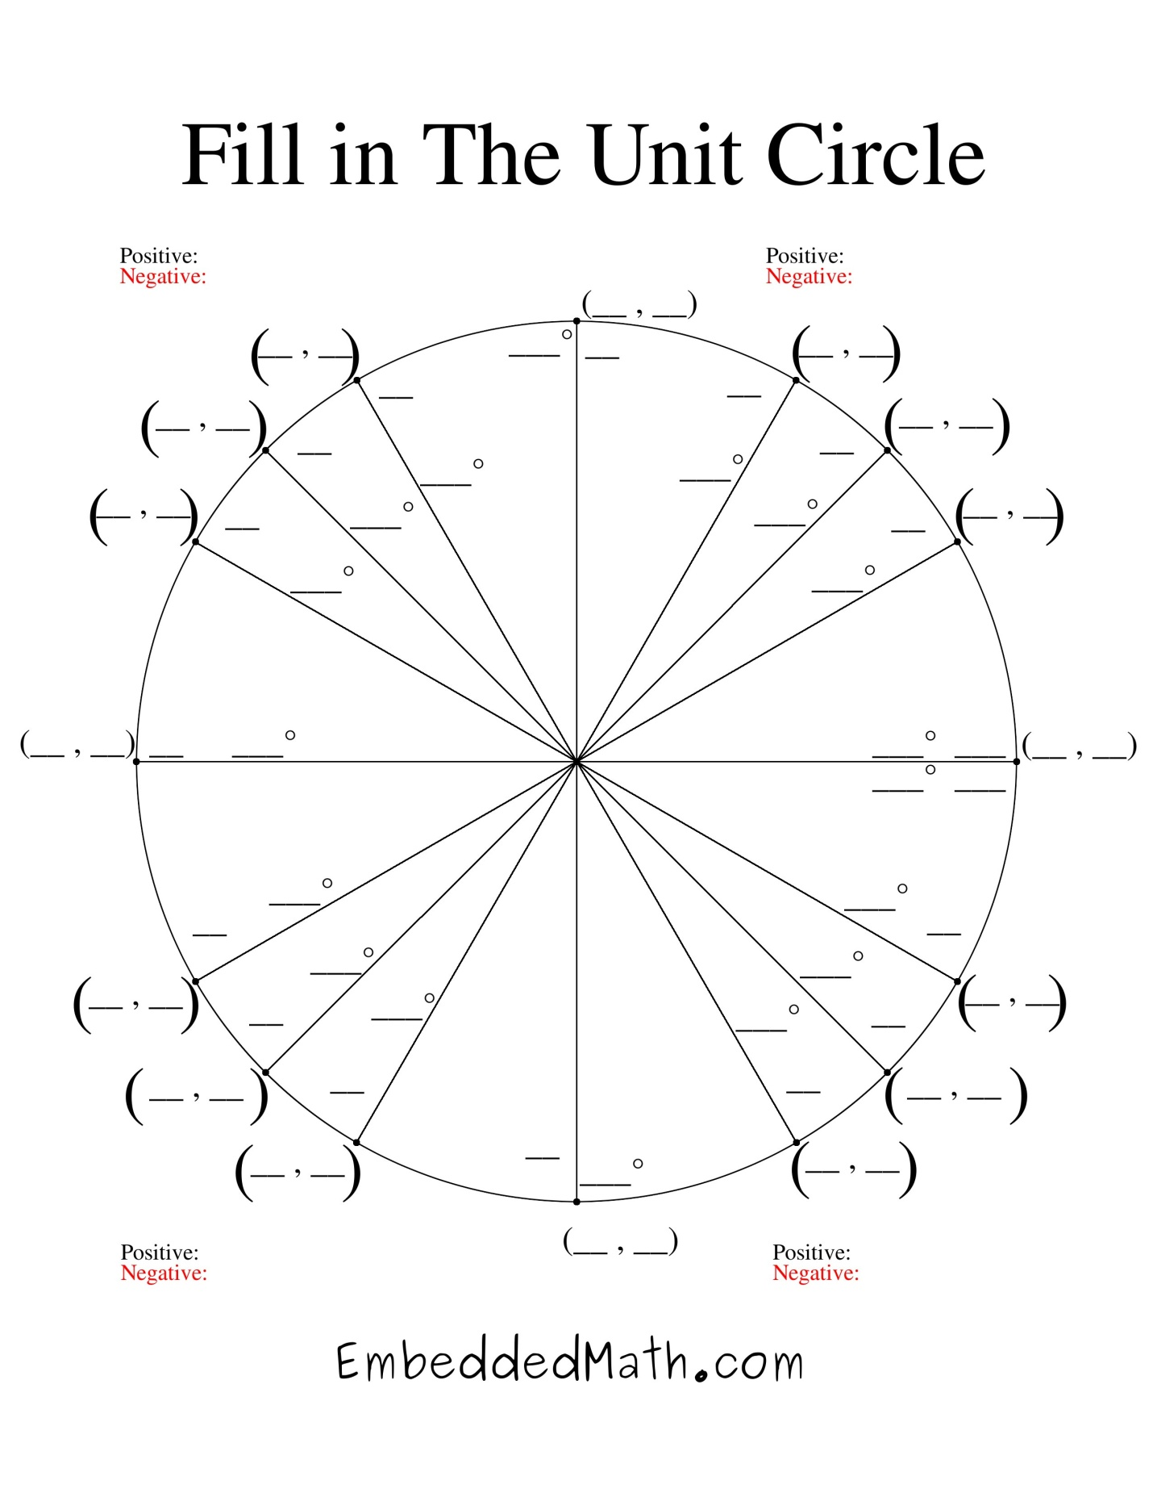
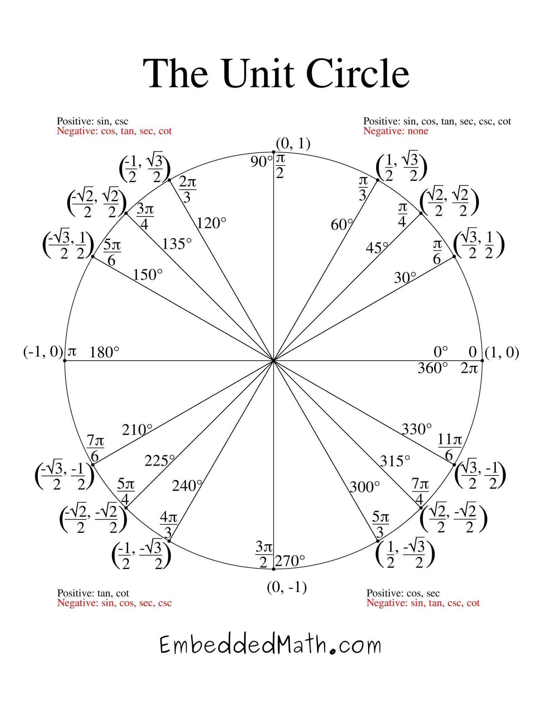
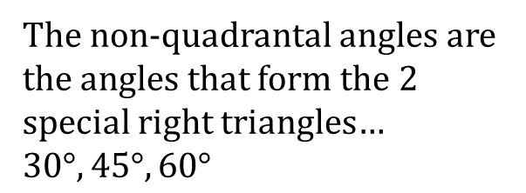
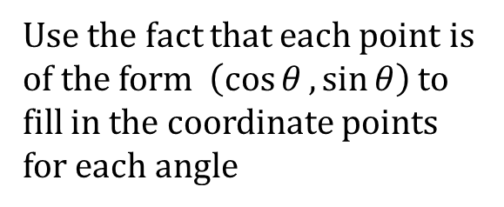
Quadrant I of the Unit Circle…
The non-quadrantal angles are the angles that form the 2 special right triangles… $30°, 45°, 60°$
Use the fact that each point is of the form $\left(\cos{θ}, \sin{θ}\right)$ to fill in the coordinate points for each angle
Fill in the degree and radian measure of the 3 interior angles

Slide 7
Fill in the angles in the remaining quadrants…

Slide 8
Use the symmetry of a circle to fill in the points in the remaining quadrants…

Slide 9
Determine which of the six trig functions are positive in each quadrant…
Sine
S
All
A
T
Tangent
Cosine
C

Slide 10
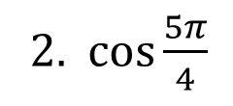
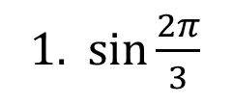
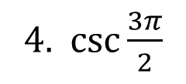
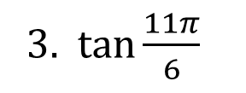
Ex: Use the unit circle to evaluate each
1. $\sin{\frac{2π}{3}}$
2. $\cos{\frac{5π}{4}}$
3. $\tan{\frac{11π}{6}}$
4. $\csc{\frac{3π}{2}}$
1. $\frac{\sqrt{3}}{2}$ 2. $−\frac{\sqrt{2}}{2}$ 3. $−\frac{\sqrt{3}}{3}$ 4. $−1$

Slide 11
HW: Worksheet

