Slide 1
Reference angles
Section 13.3

Slide 2
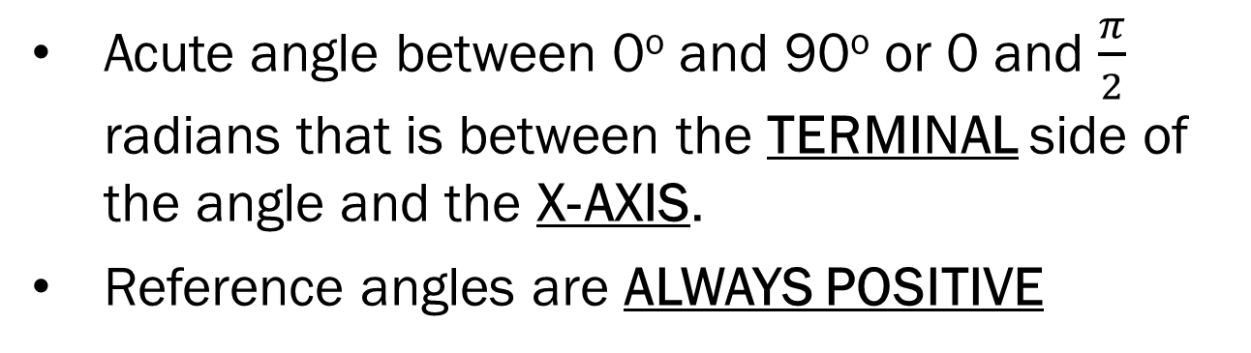
Reference angles…
Acute angle between 0º and 90º or 0 and $\frac{π}{2}$ radians that is between the TERMINAL side of the angle and the X-AXIS.
Reference angles are ALWAYS POSITIVE

Slide 3
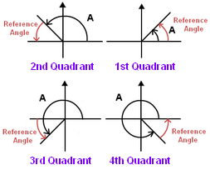

Slide 4

Ex: Draw an angle in standard position measuring 245º. Label the reference angle and find its measure.
Reference Angle = 245º – 180º
$$θ$$
= 65º

Slide 5

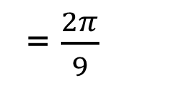


Ex: Draw an angle in standard position measuring $\frac{7π}{9}$. Label the reference angle and find its measure.
Reference Angle = $π−\frac{7π}{9}$
$$θ$$
= $\frac{2π}{9}$

Slide 6
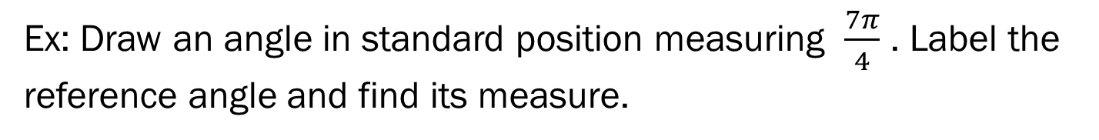
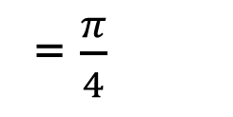

Ex: Draw an angle in standard position measuring $\frac{7π}{4}$ . Label the reference angle and find its measure.
Reference Angle = $2π−\frac{7π}{4}$
$$θ$$
= $\frac{π}{4}$

Slide 7


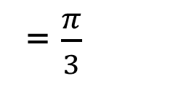
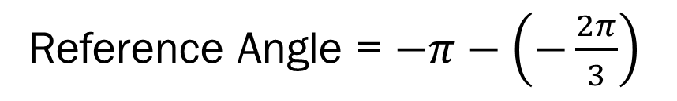
Ex: Draw an angle in standard position measuring $−\frac{2π}{3}$ . Label the reference angle and find its measure.
Reference Angle = $−π−\left(−\frac{2π}{3}\right)$
= $\frac{π}{3}$
$$θ$$

Slide 8

In general, the reference angle for any positive angle $θ$ in each quadrant may be found by…

Slide 9
HW: Worksheet

