Slide 1
Remainder Theorem
Section 5.5 Part 1

Slide 2
One method used to divide polynomials
similar to the way you divide numbers.
A method used to divide any polynomial
by divisor of the form x – k.

Slide 5
← Quotient
- ( )
← Remainder

Slide 6

Checkpoint:

Slide 8
Remainder Theorem
Section 5.5 Part 2

Slide 9
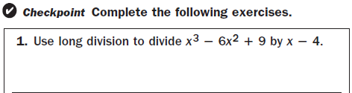


Slide 10







Slide 11




← Remainder

Slide 12
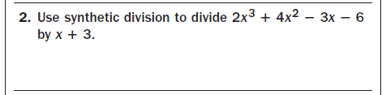

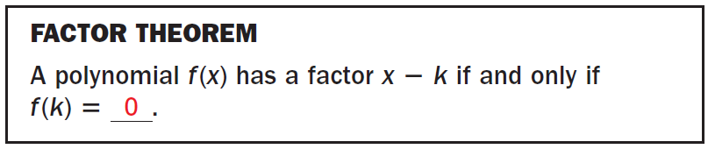

Slide 13
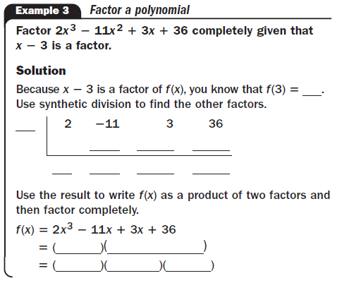
← Remainder
Note: When your remainder is 0,
You may need to factor more.

Slide 14

← Remainder
Note: When your remainder is 0,
you may need to factor more.

Slide 15
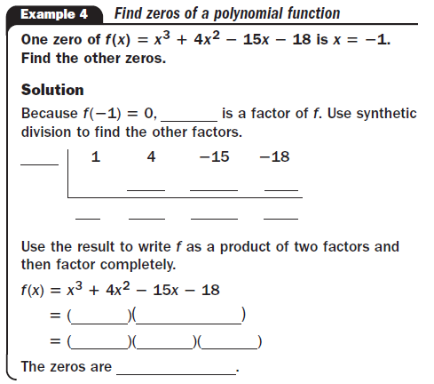


← Remainder
Note: When your remainder is 0,
you may need to factor more.

Slide 16
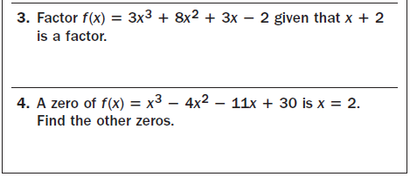



Slide 17
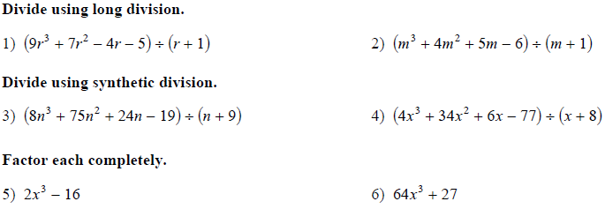
Class Practice

