Slide 1
Find the Rational Zeros
Section 5.6

Slide 2
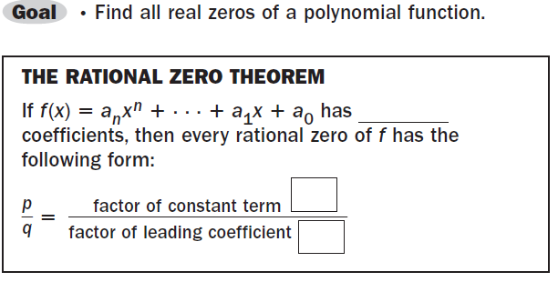

Slide 3
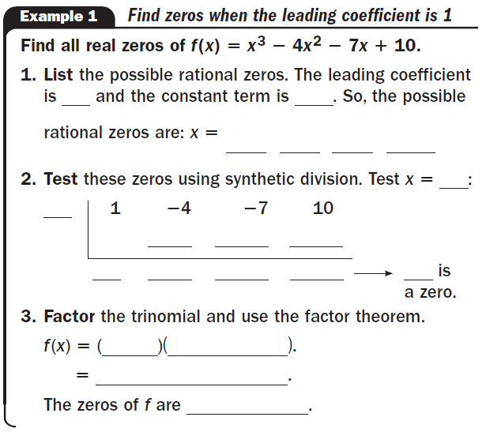





Slide 4



Slide 5
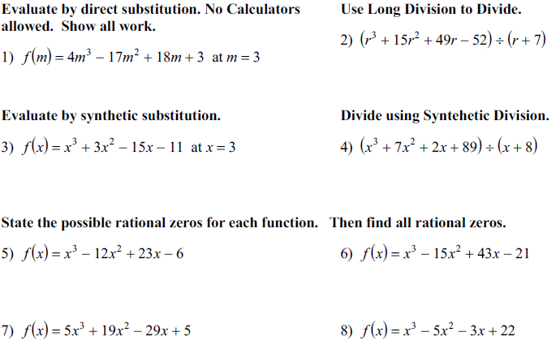

Slide 6
