Slide 1
Increasing, Decreasing, Maximum and Minimum
Notes: 9/9

Slide 2

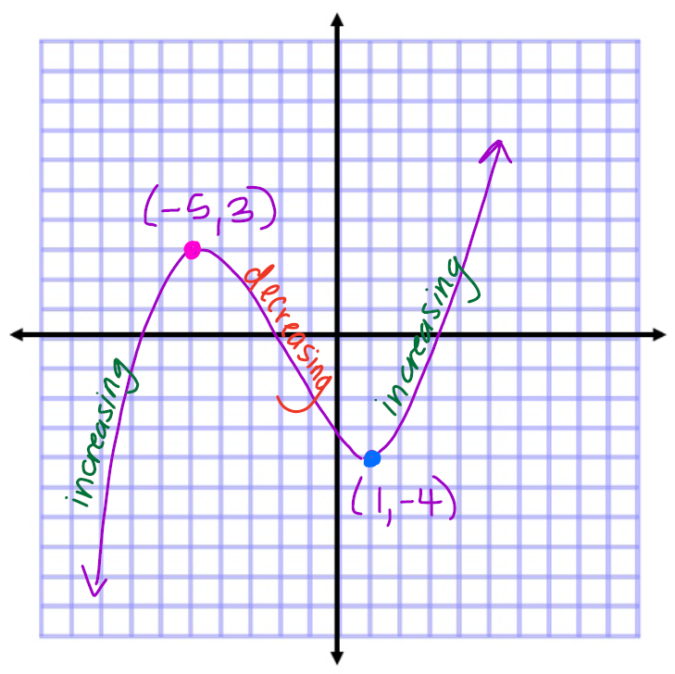









Sketch the following graph

Slide 3
Observations:
A function is increasing on an interval if it increases as x increases
A function is decreasing on an interval if it decreases as x increases
A maximum value is the highest point of a function or a
region of the function (there can be more than one or none).
A minimum value is the lowest point of a function or a
region of a function (there can be more than one or none).

