Slide 1


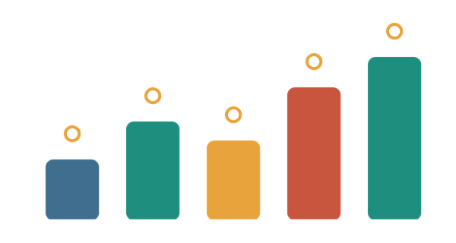
Resource Allocation Optimization System
A.D PATEL INSTITUTE OF TECHNOLOGY
(CVM UNIVERSITY)
Comparing Backtracking, Greedy, Dynamic Programming and Branch and Bound
Course: Design and Analysis of Algorithms | 5th Semester
Group No.: 12
Faculty: Yamini Dubey
Rana Rudra
Patel Yash
12402080601122
12402080601157
Kshatriya Sahil
Raj Yashpalsinh
12502080603017
12502080603020
Notes:
Introduce the group, the topic and the four algorithms compared.

Slide 2




Problem Statement
Problem
Input
Choose which funding requests a college should support so that the total benefit is as large as possible without crossing the limited budget (0/1 knapsack problem).
n funding requests, each with a cost (Rs. lakh) and a benefit score out of 100, plus a total budget W. Default data: 12 campus requests and W = 60.
Output and Constraints
Objective
Funded set, total benefit, cost used, operation count and run time. Constraints: total cost ≤ W, and each request is funded fully or not at all.
Maximise the total benefit and find which method (Backtracking, Greedy, Dynamic Programming, Branch and Bound) gives the best balance of quality and speed.
Expected: an optimal funding plan for any instance, plus a measured comparison of the four methods.
Notes:
Explain the knapsack model: limited budget, requests with cost and benefit.

Slide 3




Motivation and Real-World Application
Why it matters
Where it is used
Who benefits
Money, CPU time and man-hours are always limited. Funding the wrong mix of requests wastes benefit, and small gains add up across many requests.
College fund allocation, project selection, CPU and memory sharing, cargo loading, investment portfolios, cloud capacity and production planning.
College administrators and finance committees, IT and cloud operators, project managers, NGOs with limited funds, and students studying algorithm trade-offs.
Academic value: one problem solved with four design paradigms shows where Greedy is enough and where DP or Branch and Bound is needed.
Notes:
Real-world uses of the knapsack model.

Slide 4
Objectives
Model the problem as n funding requests, each with a cost and a benefit, and a total budget W (0/1 knapsack).
Implement Backtracking, Greedy, Dynamic Programming and Branch and Bound in one program.
1
2
Return the funded set, total benefit, cost used and operation count for any instance.
Test with n = 10, 15, 20, 50, 100 and 500 requests and record the average run time.
3
4
Check that the exact methods agree (14 tests) and measure how far Greedy falls below the optimum.
Derive best, average and worst time and space complexity and compare with measured operations.
5
6
Notes:
Six objectives, one per theme: model, implement, return, test, verify, analyse.

Slide 5




Existing Approach and Background
Manual / first-come funding
Limitation: Ignores benefit per rupee, so budget is spent on low-value requests while better ones are left out.
Fund requests in the order received
Backtracking only
Limitation: 2^n cases. Measured: 935 nodes at n = 10 grow to 620,701 at n = 20 (95.49 ms).
Try every include / exclude choice
Greedy only
Limitation: Fast, but a locally good pick can block a better mix: benefit 255 against the optimum 260 on campus data, and 160 against 220 on the textbook case.
Best benefit ÷ cost first
Need: a method that is optimal and fast, so DP and Branch and Bound are judged fairly against Backtracking and Greedy.
Notes:
Why existing approaches fall short; this motivates comparing four methods.

Slide 6

Proposed Approach (Solution Flow)
1
Problem Definition
2
Input / Data
3
Algorithm Selection
4
Algorithm Design
Fix requests, budget W and the goal: maximise total benefit.
12 campus requests (cost, benefit) and seeded random instances.
Backtracking, Greedy, Dynamic Programming, Branch and Bound.
Write pseudocode, the DP recurrence and the B&B bound.
8
Results and Conclusion
7
Performance Comparison
6
Testing
5
Implementation
Recommend a method for each situation.
Time, operations and benefit vs optimum, n = 10 to 500.
14 checks, including 200 random instances.
Python code, one function per method, shared test harness.
Notes:
Walk through steps 1 to 4 on the top row, then 5 to 8 on the bottom row (right to left).

Slide 7



Algorithms Used
Backtracking
Always optimal
Greedy
Not always optimal
Idea
Include or exclude each request; drop a branch when the budget is exceeded, then backtrack.
Idea
Sort by benefit ÷ cost (value for money) and fund every request that still fits.
Why chosen
Baseline that proves correctness on small inputs.
Why chosen
Very fast; a good quick estimate.
Data structure
Recursion stack and a best-so-far record.
Data structure
Index list sorted by ratio.
Dynamic Programming
Always optimal
Branch and Bound
Always optimal
Idea
T[i][w] = best benefit using the first i requests with budget w: skip or take request i.
Idea
Best-first search; an optimistic fractional bound prunes branches that cannot beat the best plan.
Why chosen
Guaranteed optimum in O(n·W) time.
Why chosen
Optimal with far fewer nodes than Backtracking.
Data structure
2-D table T and a trace-back to find the funded set.
Data structure
Max-heap (heapq) ordered by bound; bitmask for the chosen set.
Notes:
Idea, reason for choosing and data structure for each of the four algorithms.

Slide 8

Algorithm / Pseudocode
Backtracking
Time O(2^n) Space O(n)
Greedy (benefit / cost)
Time O(n log n) Space O(n)
explore(i, cost, value):
if i == n: update best; return
if cost + c[i] <= W: # include i
explore(i+1, cost+c[i], value+b[i])
undo # BACKTRACK
explore(i+1, cost, value) # exclude i
order = sort items by b[i]/c[i], high first
used = 0
for i in order:
if used + c[i] <= W:
fund item i
used = used + c[i]
return funded set
Dynamic Programming
Time O(n·W) Space O(n·W)
Branch and Bound
Worst O(2^n) Space O(2^n)
T[0][w] = 0 for all w
for i = 1 to n:
for w = 0 to W:
T[i][w] = T[i-1][w] # skip
if c[i] <= w: # take
T[i][w] = max(T[i][w],
T[i-1][w-c[i]] + b[i])
trace back from T[n][W] -> funded set
sort items by ratio; push root in max-heap
while heap not empty:
node = pop node with best bound
if bound(node) <= best: prune
child 1: include item (if it fits)
child 2: exclude item
push child if its bound > best
bound = fractional greedy on the rest
Notes:
Pseudocode for the four algorithms with their time and space complexity.

Slide 9







System Design / Architecture
User Input
Data Module
Algorithm Module
Performance Module
Output
Backtracking
Total budget W (default Rs. 60 lakh) and the choice of graphs to show.
Holds the 12 funding requests (cost, benefit) or builds seeded random instances.
Greedy
Timer, operation counter, total benefit, cost used and gap to optimum.
Allocation tables, live graphs and the final optimal allocation graph.
Dynamic Programming
Branch and Bound
Independent modules
Same input for all
Metrics logged
New algorithms can be added to the ALGORITHMS table without touching the rest.
Every algorithm runs on the identical instance, so the comparison is fair.
Each run returns (chosen set, operations) and run_all() adds time, benefit and cost.
Notes:
Data flows left to right: input, data, algorithms, performance measurement, output.

Slide 10


Implementation
Language and tools
Python 3 with heapq, random, sys and time.perf_counter; Matplotlib and NumPy for the live graph windows.
Data structures
List of (name, cost, benefit) tuples, 2-D DP table, max-heap (heapq), recursion stack and a bitmask for the chosen set.
Important functions
backtracking(), greedy(), dp_table(), dynamic_programming(), branch_and_bound(), fractional_greedy_value(), run_all(), benchmark(), run_tests().
Brief explanation
Each algorithm returns (chosen, ops). run_all() times them on one input; benchmark() averages repeated runs on seeded instances (n = 10 to 500); the --test flag runs 14 checks.
Notes:
Single-file Python program; each algorithm is one function with the same signature.

Slide 11
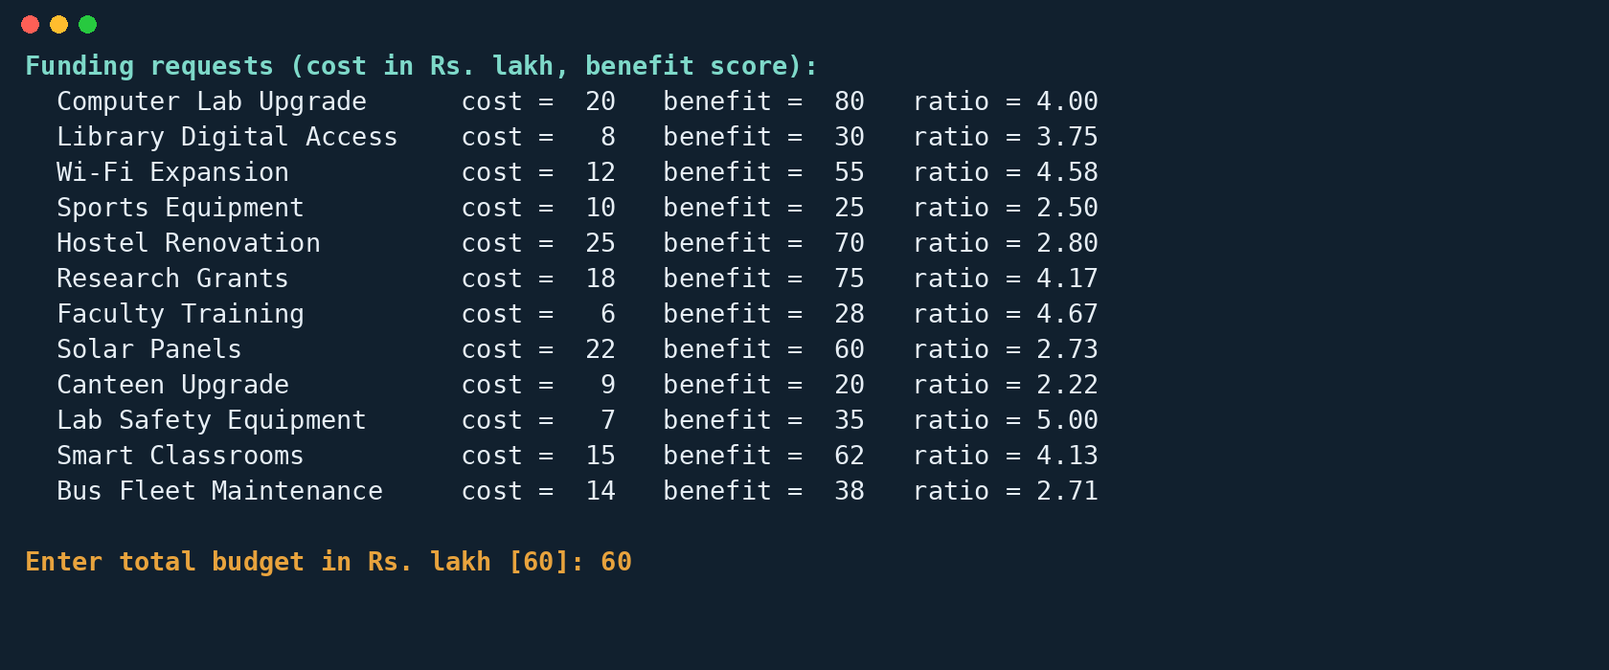
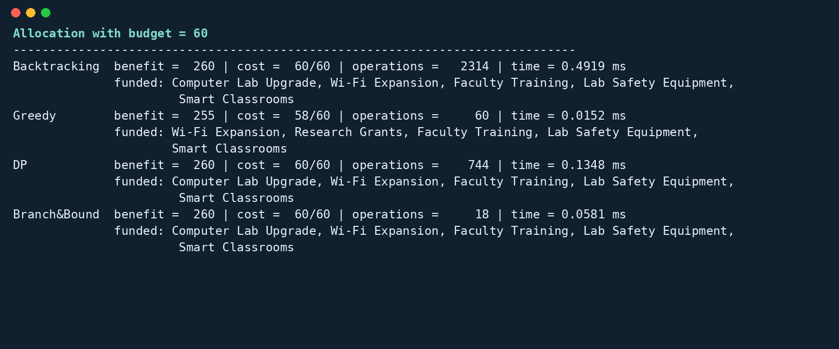
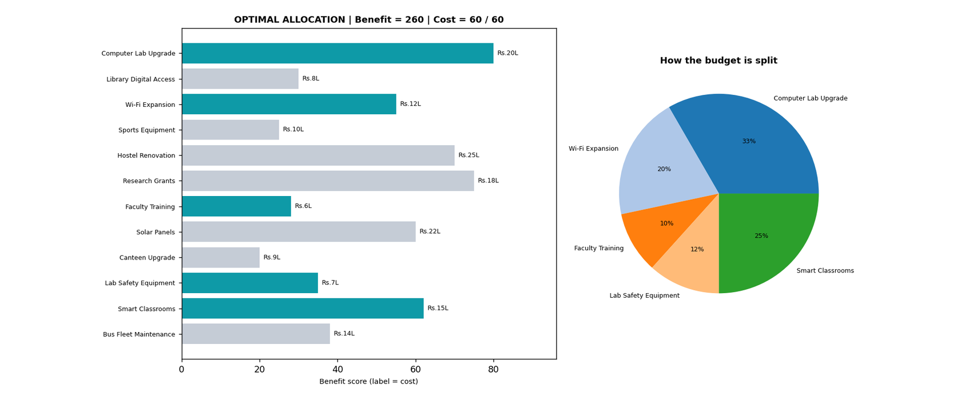
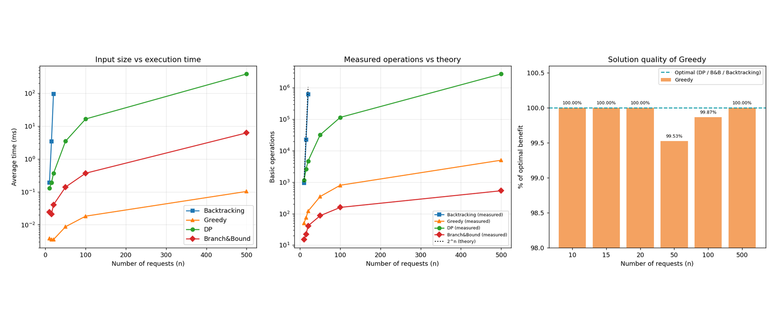
Project Screenshots
Input: 12 funding requests and a total budget of Rs. 60 lakh
Processing: all four algorithms on the same input
Output: optimal allocation, benefit 260 at cost 60 / 60
Performance: time, operations and Greedy quality vs input size
Notes:
Screenshots come from the real program run: console input, console results and two graph windows.

Slide 12
Results
n | Backtracking (ms) | Greedy (ms) | DP (ms) | B&B (ms) | Greedy % of optimal
10 | 0.192 | 0.0038 | 0.129 | 0.024 | 100.00%
15 | 3.43 | 0.0035 | 0.189 | 0.021 | 100.00%
20 | 95.49 | 0.0035 | 0.362 | 0.040 | 100.00%
50 | - | 0.0087 | 3.46 | 0.140 | 99.53%
100 | - | 0.018 | 16.41 | 0.368 | 99.87%
500 | - | 0.103 | 381.9 | 6.18 | 100.00%
Dataset: seeded random instances (cost 5 to 50, benefit 10 to 100, budget = 40% of total cost). Time is the average of repeated runs; Backtracking is skipped above n = 20 because 2^n is too large.
260
≈15,000×
≈62×
Optimal benefit on campus data (budget Rs. 60 lakh). Backtracking, DP and B&B agree; Greedy gets 255 (98%).
fewer operations for Branch and Bound than Backtracking at n = 20 (41 vs 620,701).
Branch and Bound is faster than DP at n = 500 (6.18 ms vs 381.9 ms); Greedy takes 0.103 ms.
Notes:
Timings were measured on the group machine and will vary with hardware; operation counts do not.

Slide 13

Complexity Analysis
Algorithm | Best Case | Average Case | Worst Case | Space
Backtracking | O(n) (nothing fits) | O(2^n) | O(2^n) | O(n)
Greedy | O(n log n) | O(n log n) | O(n log n) | O(n)
Dynamic Programming | O(n·W) | O(n·W) | O(n·W) | O(n·W)
Branch and Bound | O(n²) (one path) | Far below 2^n | O(2^n) | O(2^n)
Backtracking explodes
DP follows n × W
Greedy and B&B stay small
Nodes grow from 935 (n = 10) to 22,216 (n = 15) and 620,701 (n = 20): about ×24 to ×28 per 5 extra requests, in line with 2^n. Time: 0.192 ms to 95.49 ms.
Operations are n(W+1) + n: 1,170 at n = 10 and 2,745,500 at n = 500. Here W grows with n (40% of total cost), so cost rises faster than linearly.
Greedy needs n log n + n steps: 50 to 5,000. Branch and Bound expands only 15 to 534 nodes because pruning drops hopeless branches.
Notes:
Measured operation counts match the theory: 2^n for Backtracking, n times W for DP.

Slide 14



Advantages, Limitations and Future Scope
Advantages
Limitations
Future Scope
Backtracking, DP and B&B always return the optimal plan
Four methods compared on identical input
B&B is optimal with only 534 nodes at n = 500
Greedy answers in about 0.103 ms at n = 500
14 built-in tests pass, including 200 random instances
Live graphs and a final optimal allocation graph
Costs must be whole numbers (DP table index)
DP time and memory grow with the budget W
Greedy can miss the optimum (255 vs 260); about 81% in the worst random test
B&B worst case is still 2^n
Backtracking skipped above n = 20
Timings depend on hardware
Several resource types at once (multi-dimensional knapsack)
Partial funding of a request (fractional option)
Read requests from a CSV or Excel file
Web dashboard for administrators
Test on real college budget data
Notes:
Be honest about limitations: integer costs, DP memory, hardware-dependent timings.

Slide 15

Conclusion and References
Conclusion
References
Modelled resource allocation as a 0/1 knapsack (cost, benefit, budget W) and implemented Backtracking, Greedy, DP and Branch and Bound.
Key finding: the three exact methods always agree (benefit 260 at cost 60/60 on campus data, verified on 200 random instances). Greedy reached 255, about 98% of the optimum on average and as low as 81%.
Branch and Bound gives the best balance: optimal with 534 nodes at n = 500, about 62× faster than DP. Backtracking is impractical beyond about 20 requests.
Recommendation: use Branch and Bound or DP when the optimum is required; use Greedy for a very quick estimate.
Cormen, Leiserson, Rivest, Stein: Introduction to Algorithms (CLRS), MIT Press. Greedy and dynamic programming chapters.
Kleinberg and Tardos: Algorithm Design, Pearson.
Horowitz and Sahni: Fundamentals of Computer Algorithms (backtracking, branch and bound).
Python documentation: heapq, time, random.
Matplotlib and NumPy documentation.
Data: campus funding requests and seeded random instances from the project code.
Notes:
Close with the recommendation: exact method when the optimum matters, Greedy for speed.

