Slide 1
THE TALENT HACK • BUILD SPRINT
MERGEGATE
LIVE PRODUCT
Visual workflows
Deterministic proof
Human merge gate
Proof-Carrying Autonomy
for AI Coding Agents
An agent can propose.
Evidence decides. Humans merge.
merge-gate-beta.vercel.app
Notes:
[Sources]
- MergeGate product repository: https://github.com/mrsameer/merge-gate
- Live deployment: https://merge-gate-beta.vercel.app

Slide 2
THE TRUST GAP
02
AI coding is fast.
Trust is the bottleneck.
“The agent said it worked.”
A confident agent message does not answer the questions a reviewer needs to ask.
What changed?
MergeGate replaces that claim with a reviewable proof trail.
Inspect the diff, commands, workspace, and exact evidence.
Did it actually pass?
A separate deterministic validator decides—not the agent.
Can we replay the claim?
The durable ledger makes the decision inspectable.
MERGEGATE • PROOF-CARRYING AUTONOMY
Notes:
[Sources]
- Product positioning based on repository README and recorded demo: https://github.com/mrsameer/merge-gate

Slide 3
THE CONTROL PLANE
03
Proof sits between generation and merge.
A coding harness may propose changes—but it never chooses the verdict.
1
2
3
4
Freeze criteria
Run agent
Validate
Merge gate
Human-approved contract
Isolated Git worktree
LLM-free commands & policy
Human decides
MERGEGATE • PROOF-CARRYING AUTONOMY
Notes:
[Sources]
- Architecture description from https://github.com/mrsameer/merge-gate/blob/main/docs/architecture.md

Slide 4
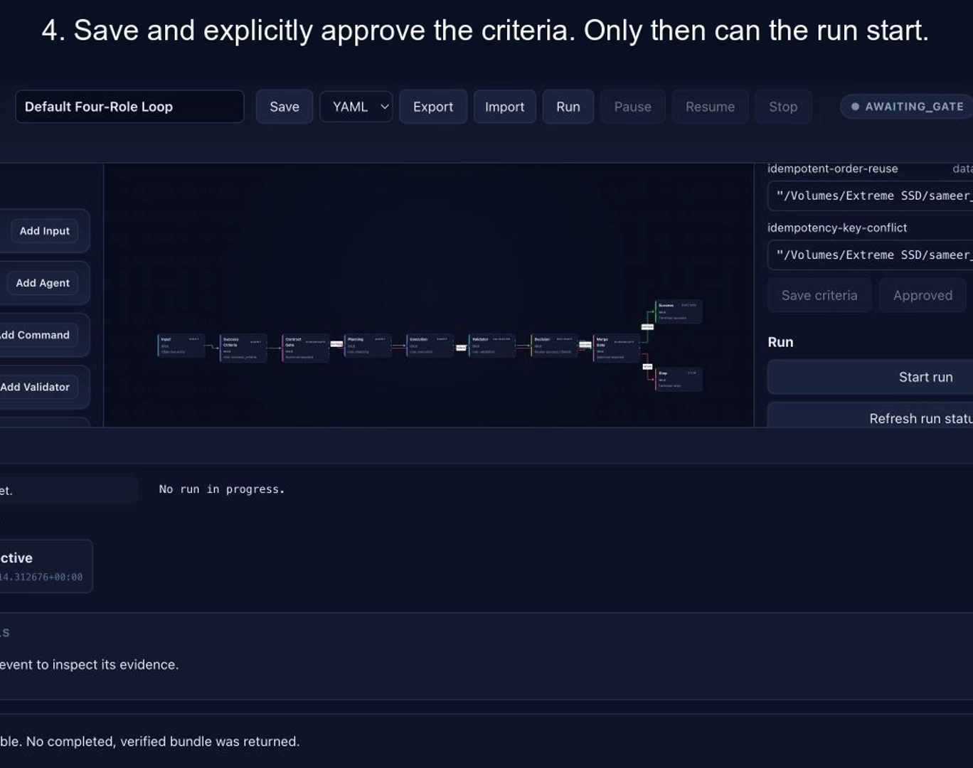
CONTRACT BEFORE CODE
04
Success criteria become a
frozen contract.
The team defines the objective, reviews generated criteria, and approves them before a coding provider can run.
Reusable workflow
Save or export the visual control flow.
Explicit approval
Criteria are editable until the contract is frozen.
Clear intent
The agent receives the objective and deterministic acceptance checks.
MERGEGATE • PROOF-CARRYING AUTONOMY
Notes:
[Sources]
- Recorded walkthrough frame from /docs/demo-videos/01-objective-criteria-workflow.mov
- Feature behavior documented in https://github.com/mrsameer/merge-gate

Slide 5
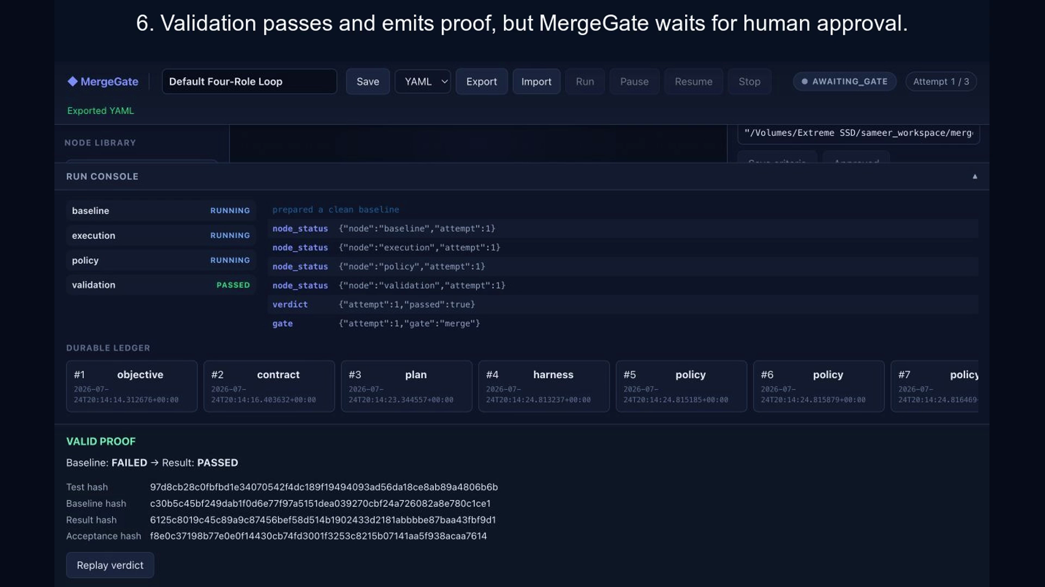
PROOF, NOT PROMISES
05
The validator produces evidence—not optimism.
MergeGate records baseline and result outcomes, acceptance hashes, command output, and a downloadable evidence bundle.
WHAT A REVIEWER GETS
• Frozen criteria
• Red/green proof
• Commands & exit codes
• Acceptance hash
• Replayable verdict
MERGEGATE • PROOF-CARRYING AUTONOMY
Notes:
[Sources]
- Recorded walkthrough frame from /docs/demo-videos/02-retry-evidence-inspection.mov
- Evidence behavior documented in https://github.com/mrsameer/merge-gate

Slide 6
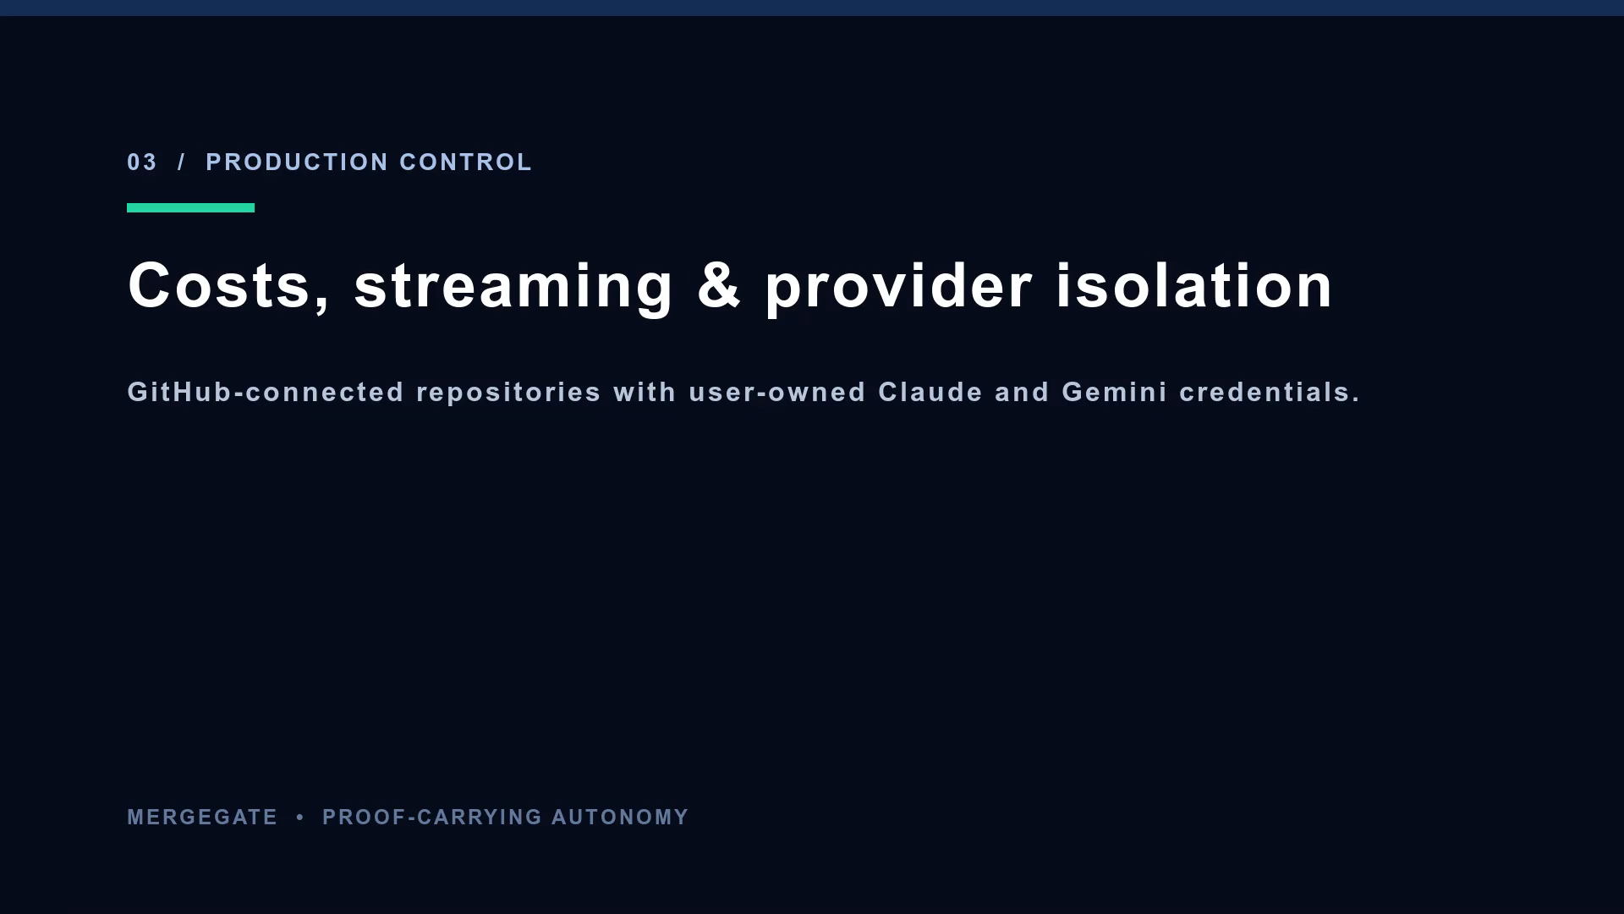
SAFE AUTONOMY
06
Failures become structured feedback, not hidden loops.
A failed criterion becomes the next attempt’s concrete input. Repeated non-progress or invalid proof ends safely.
Bounded by
• attempts
• wall clock
• model calls
NO_PROGRESS is an honest outcome—not a false success.
MERGEGATE • PROOF-CARRYING AUTONOMY
Notes:
[Sources]
- Recorded walkthrough frame from /docs/demo-videos/02-retry-evidence-inspection.mov
- Safe-stop behavior documented in https://github.com/mrsameer/merge-gate

Slide 7
LIVE PRODUCTION EXPERIENCE
07
The demo is now a live, user-owned workflow.
The deployed product adds GitHub sign-in, private repository attachment, encrypted provider connections, and live run telemetry.
GitHub OAuth
Attach a repository owned by the signed-in user.
TRY THE LIVE CONTROL PLANE
User-owned credentials
merge-gate-beta.
vercel.app
Encrypted Gemini API keys or Claude Code OAuth tokens.
Live operations
SSE stream, run console, cost receipts, evidence bundle.
MERGEGATE • PROOF-CARRYING AUTONOMY
Notes:
[Sources]
- Live deployment: https://merge-gate-beta.vercel.app
- Product credential and repository flow documented in repository README

Slide 8
WHAT JUDGES CAN VERIFY IN 90 SECONDS
Autonomy you can inspect
before you merge.
LIVE DEMO
merge-gate-beta.
vercel.app
1. Define and approve the contract
2. Watch the agent act in an isolated worktree
3. Inspect deterministic proof and the human merge gate
github.com/mrsameer/merge-gate
An agent can propose. Evidence decides. Humans merge.
Notes:
[Sources]
- Live deployment: https://merge-gate-beta.vercel.app
- Source repository: https://github.com/mrsameer/merge-gate
- Combined video: /docs/demo-videos/MergeGate-Competition-Demo.mp4

