Slide 1

Salary Prediction System
An intelligent platform leveraging machine learning and predictive analytics to estimate compensation ranges based on educational qualifications, technical skills, and professional experience.
ML-POWERED
HR TECHNOLOGY
CAREER INTELLIGENCE

Slide 2
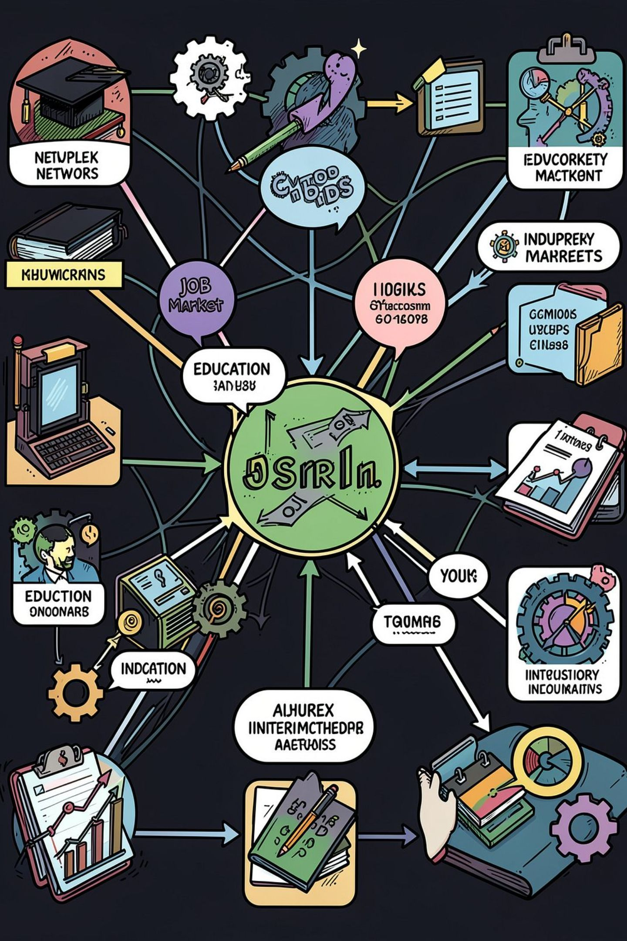
The Challenge of Modern Salary Estimation
Education & Certifications
Degrees, institutions, and certifications create wide salary variance across the same role.
Skills & Experience
Technical skill combinations and years of experience drive compensation beyond job titles.
Location & Industry
Geographic cost-of-living and sector demand cause significant regional salary gaps.
Market Dynamics
Rapidly evolving trends and talent shortages make historical benchmarks quickly outdated.

Slide 3
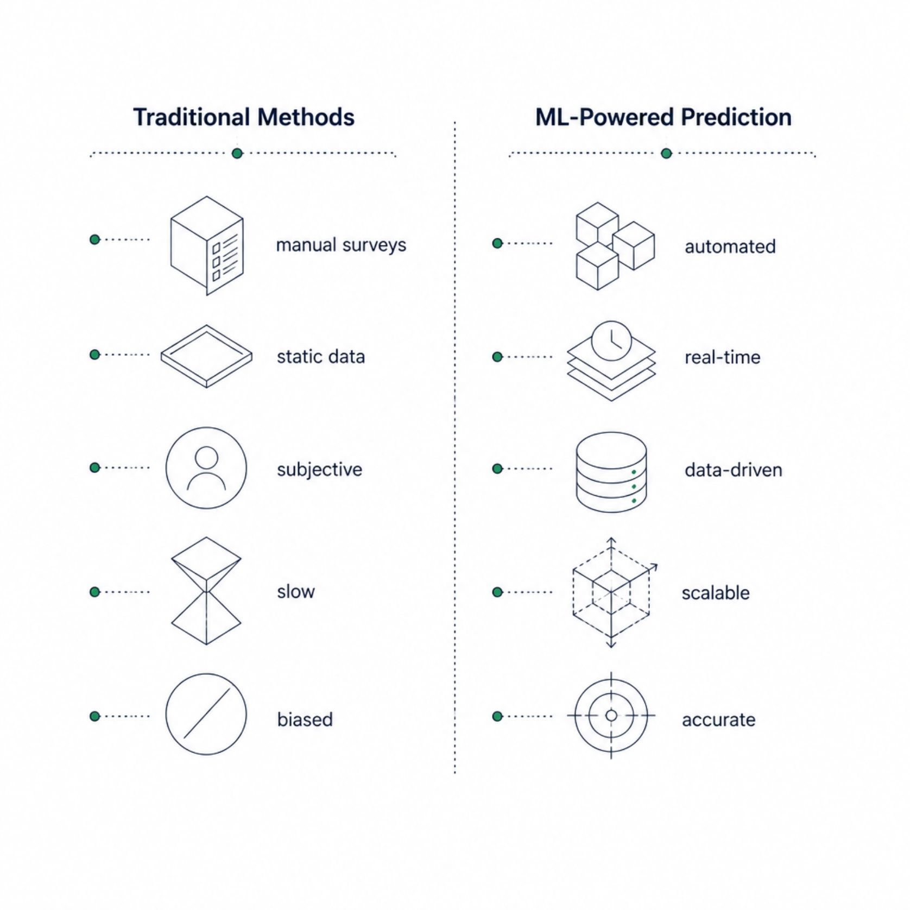

Why Traditional Methods Fall Short
Limitations of Manual Approaches
Reliance on outdated salary surveys and static benchmarks
Inability to process multi-variable professional profiles
Subjective judgment introduces bias and inconsistency
No real-time adaptation to market shifts
Limited scalability across industries and geographies
Organizations need intelligent predictive systems that learn from data and continuously improve.

Slide 4
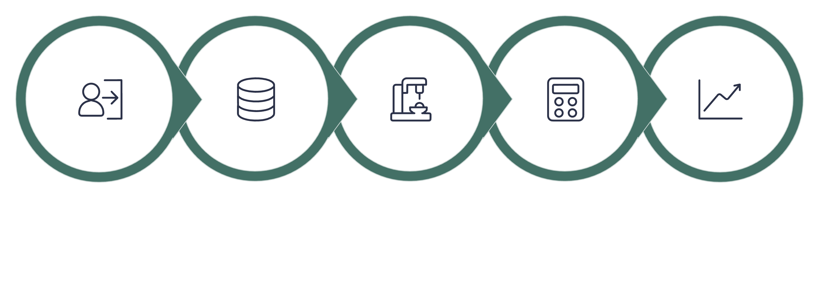
System Architecture Overview
The Salary Prediction System integrates six core modules into an end-to-end intelligent pipeline — from data ingestion to actionable compensation insights.
User Input
Preprocessing
ML Regression
Salary Engine
Analytics
Each module is designed for modularity, allowing independent updates to the ML model, data sources, or UI without disrupting the overall system.

Slide 5
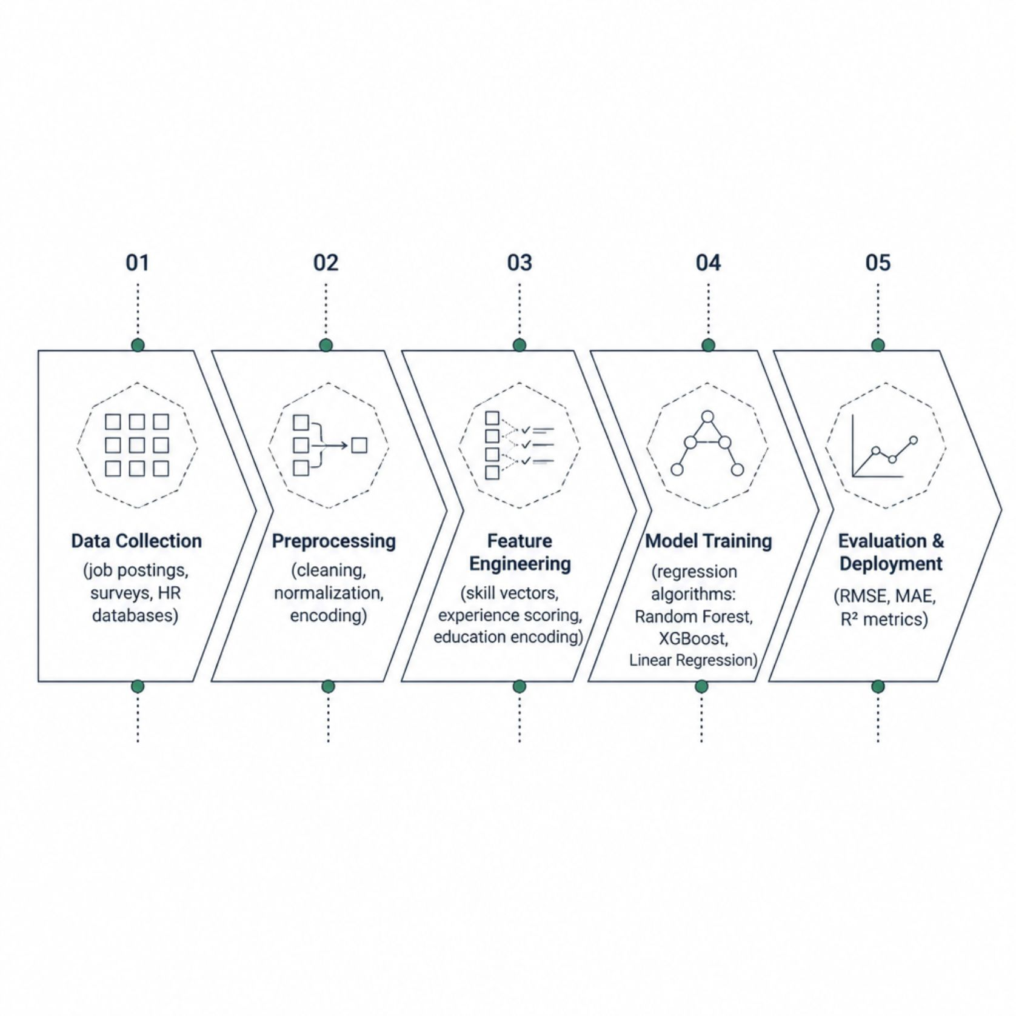
Machine Learning Pipeline
Core Algorithms
Random Forest Regression — handles non-linear feature interactions
XGBoost — gradient boosting for high predictive accuracy
Linear & Ridge Regression — interpretable baseline models
Neural Networks — for complex, high-dimensional profiles
Ensemble methods are used as the primary approach, combining multiple models for robust, generalizable predictions.

Slide 6






Input Features & Data Preprocessing
The system analyzes a comprehensive professional profile to generate accurate salary estimates.
Education
Technical Skills
Degree level, institution tier, and field of study.
Programming languages, tools, frameworks, and certifications.
Experience
Job Role & Industry
Years of experience, seniority level, and career trajectory.
Job title, function, and industry sector classification.
Location
Market Trends
City, region, and cost-of-living index for geographic adjustment.
Real-time labor market signals and demand indicators.

Slide 7






Features by User Role
Job Seekers
Enter profile details, receive predicted salary ranges, and identify skill gaps to improve market value.
Recruiters & HR
Benchmark offers, compare candidates, and build data-driven compensation strategies.
Career Counselors
Guide clients with salary trend comparisons across industries, roles, and locations.
Administrators
Manage users, monitor model performance, update datasets, and configure system parameters.

Slide 8

Implementation Methodology
Quality & Reliability Standards
Data Flow & Processing
Scalability — cloud-ready architecture supporting millions of predictions
Security — encrypted data storage, OAuth2 authentication, role-based access
Accuracy — evaluated via RMSE, MAE, and R² on held-out test sets
Interpretability — SHAP values explain feature contributions per prediction
Adaptability — periodic retraining to reflect evolving market conditions
Data Collection
Preprocessing
Feature Selection
Model Training

Slide 9

Benefits & Business Impact
35%
90%
Faster Hiring
Prediction Accuracy
Reduction in time-to-offer with data-backed salary benchmarks.
Target R² score on validated test datasets across major job categories.
3x
60%
Better Decisions
Cost Savings
Improvement in compensation decision confidence for HR teams.
Estimated reduction in over/under-hiring costs through accurate salary planning.
The system empowers job seekers, recruiters, and organizations with transparent, data-driven compensation intelligence.

Slide 10





The Road Ahead: Future Enhancements
Deep Learning
Transformer-based models for richer profile understanding and higher accuracy.
Real-Time Data
Live labor market API integration for up-to-the-minute salary signals.
Explainable AI
Transparent prediction reasoning to build user trust and regulatory compliance.
Mobile & Cloud
Native mobile apps and cloud deployment for global, on-the-go accessibility.
Future phases will also introduce personalized career recommendations, skill gap analysis, job matching integration, and continuous model learning to keep predictions aligned with a rapidly changing employment landscape.

