Slide 1

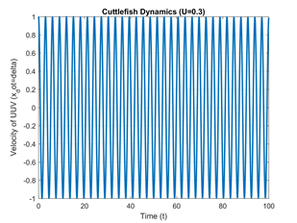
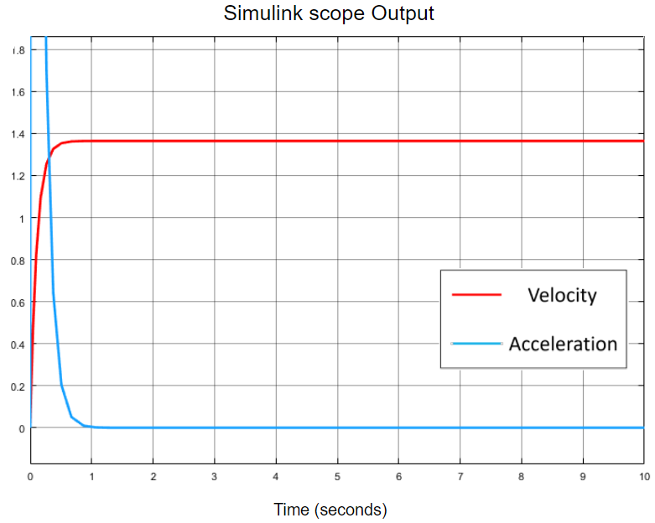
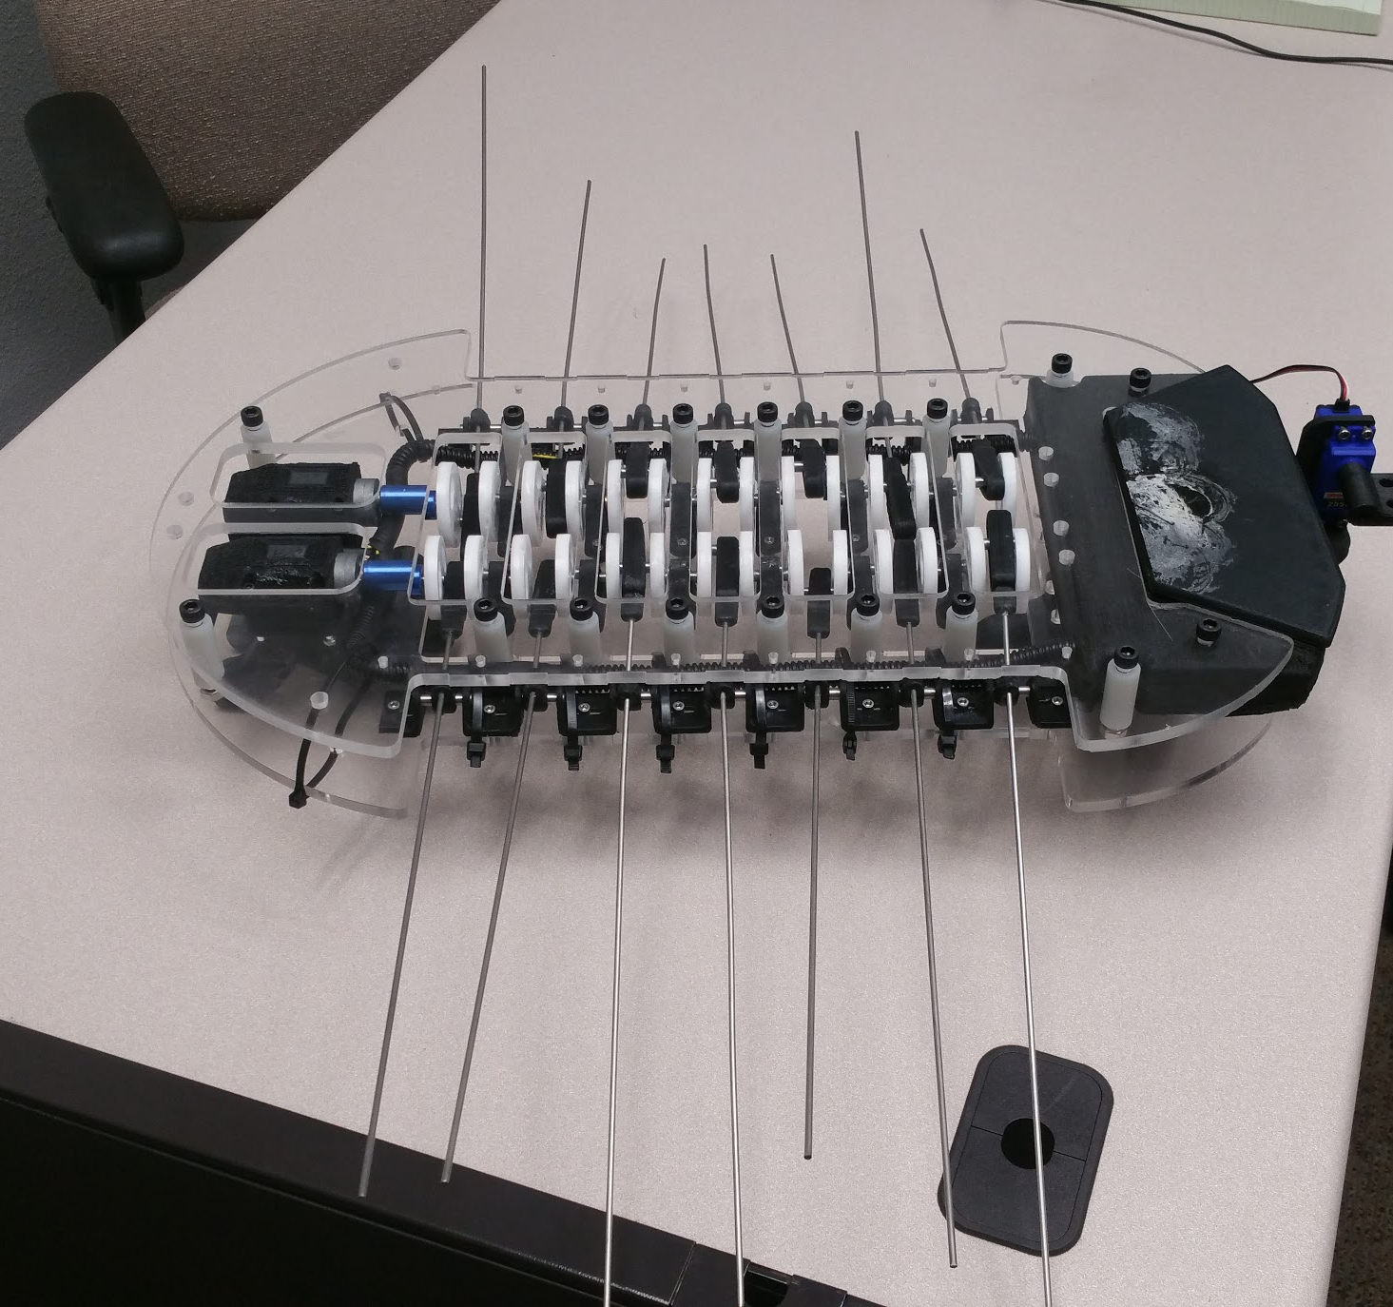
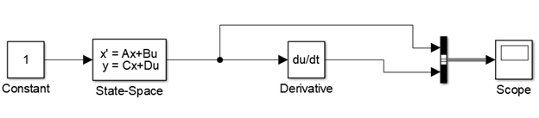


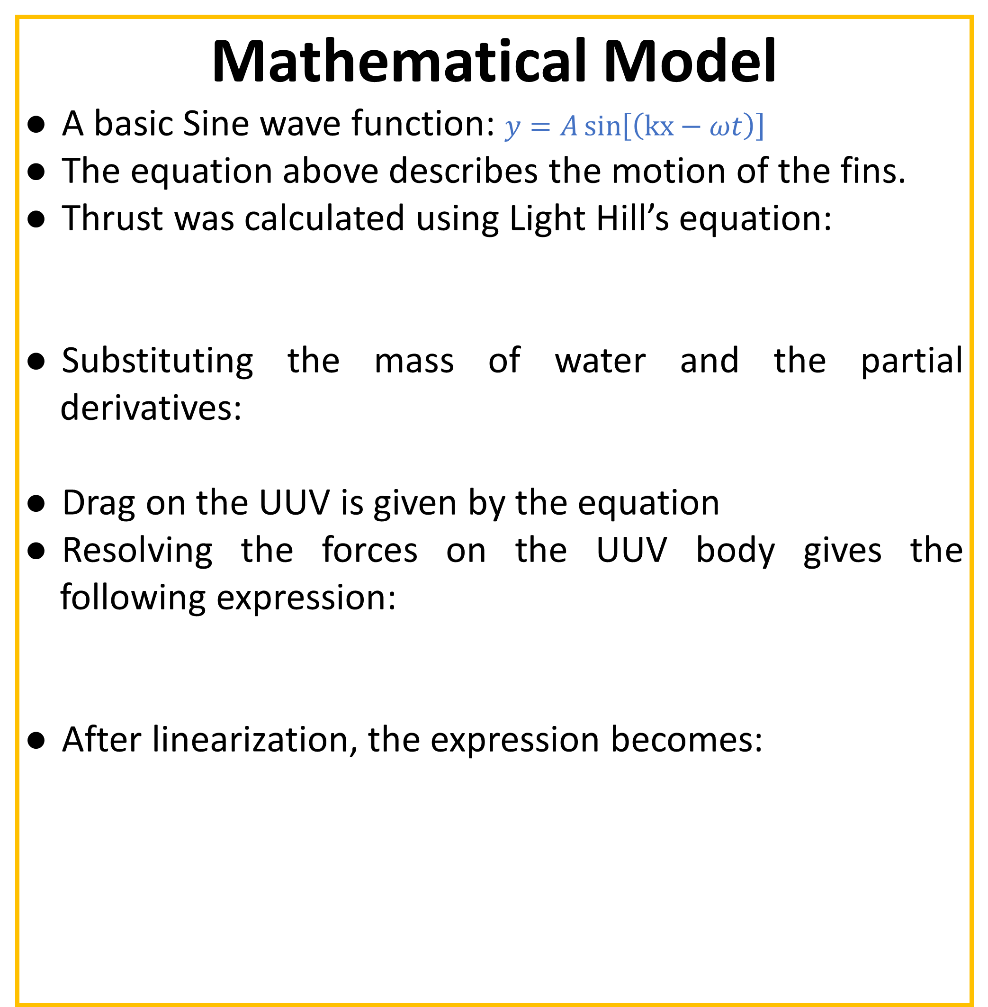
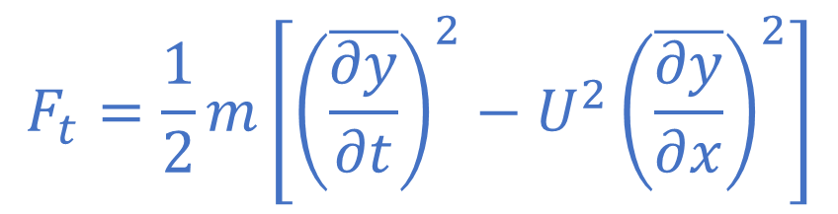
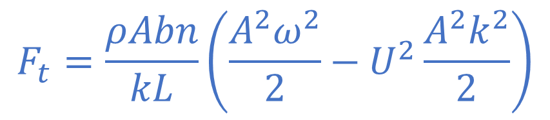

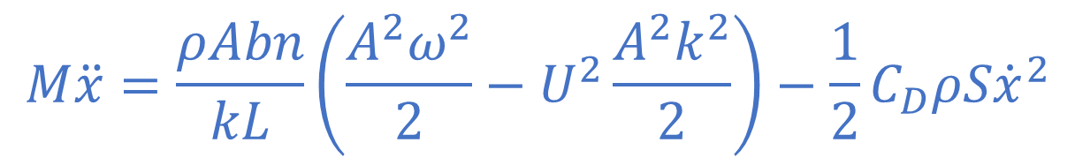
EGR598:
System Control
& Optimization
Design and Development of an Unmanned Underwater Vehicle (UUV) in the form of a Cuttlefish
Thao Le
Arizona State University
Jason Olson
Arizona State University
Sandesh Bhat
Arizona State University
Susheelkumar Cherangara
Arizona State University
Engineering perfection
Problem
The goal of the project is to design and simulate a bio-inspired UUV, in the form of a cuttlefish that has an improved energy efficiency and better control. Deliverables of the project include: a theoretical model that describe the kinematics and dynamics of the UUV; a CAD model of the fin mechanism; a control algorithm that will improve the energy efficiency of the UUV; and simulation model to verify the theoretical results.
Mathematical Model
A basic Sine wave function: $y=A\sin\left[\left(kx−ωt\right)\right]$
The equation above describes the motion of the fins.
Thrust was calculated using Light Hill’s equation:
Substituting the mass of water and the partial derivatives:
Drag on the UUV is given by the equation
Resolving the forces on the UUV body gives the following expression:
After linearization, the expression becomes:
Optimization & Simulation
To optimize the system, the values of ‘w’ and ‘A’ were tuned. It was observed that the optimum amplitude was 114 m. The system was stable on its own when the stream velocity was minimal. But as the stream velocity increased, the UUV’s thrust was counteracted by the drag. A simple proportional controller was enough to stabilize the system. The system was simulated in simulink and data was collected. The maximum speed attained by the UUV under ideal conditions was 1.3 m/s.
$$F_{t}=\frac{1}{2}m\left[{\left(\overline{\frac{∂y}{∂t}}\right)}^{2}−U^{2}{\left(\overline{\frac{∂y}{∂x}}\right)}^{2}\right]$$
$$F_{t}=\frac{ρAbn}{kL}\left(\frac{A^{2}ω^{2}}{2}−U^{2}\frac{A^{2}k^{2}}{2}\right)$$
$$D=\frac{1}{2}C_{D}ρS{\dot{x}}^{2}$$
$$M\ddot{x}=\frac{ρAbn}{kL}\left(\frac{A^{2}ω^{2}}{2}−U^{2}\frac{A^{2}k^{2}}{2}\right)−\frac{1}{2}C_{D}ρS{\dot{x}}^{2}$$
$$\left\{\begin{matrix}{\dot{x}}_{1}=δ+\sqrt{\frac{2ρAbn}{kLC_{D}ρS}\left(\frac{A^{2}ω^{2}}{2}−U^{2}\frac{A^{2}k^{2}}{2}\right)} \\ \dot{δ}=−\frac{2}{m}\sqrt{\frac{2ρAbnC_{D}ρS}{kL}\left(\frac{A^{2}ω^{2}}{2}−U^{2}\frac{A^{2}k^{2}}{2}\right)}δ\end{matrix}\right.$$
Conclusions
The UUV concept was proved via simulations and also the maximum throughput of the system was checked. Future work will include prototype testing and mathematical model validation by verification of the simulation data.

