Slide 1

Data Analytics Capstone
Part 1

Slide 2



OUTLINE
Executive Summary
Introduction
Methodology
Results
Visualization – Charts
Dashboard
Discussion
Findings & Implications
Conclusion
Appendix

Slide 3

EXECUTIVE SUMMARY
Staying competitive in the global IT sector requires adapting to evolving technologies. This report analyzes data from Stack Overflow, IBM, and GitHub job postings to identify trends in programming languages, databases, and tech workforce demographics.
Key findings:
SWIFT is the most paid programming with PYTHON being the close second
C dominates open positions globally, with JAVA dominating the US market
PostgreSQL is on top for DB technologies in both this year's and next year's trends

Slide 4

INTRODUCTION
The IT industry is rapidly evolving, requiring professionals to stay updated on emerging technologies and skills.
This analysis examines trends in programming languages, databases, and workforce demographics using data from Stack Overflow survey and IBM job postings data.
Python was used for data collection, cleaning, and exploratory data analysis to identify key insights.
The findings provide valuable insights into the current state and future direction of the tech industry.

Slide 5

METHODOLOGY
Job availability data for various technologies and locations was collected using the Stack Overflow API in Python.
The IBM dataset was scraped to obtain the names of the programming languages and their yearly wages. The dataset from a 2024 Stack Overflow developer survey was downloaded and saved.
Python was used for data cleaning and analysis. Exploratory data analysis (EDA) was conducted to examine data distribution, detect outliers, and assess correlations between columns.

Slide 6
RESULTS

Slide 7
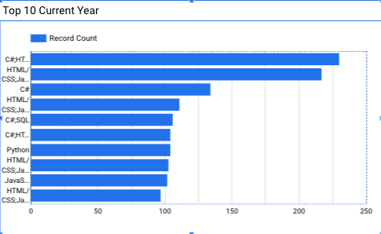
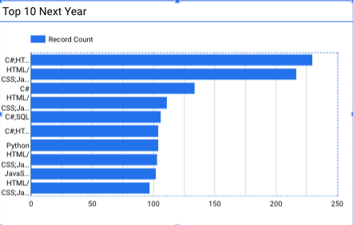
PROGRAMMING LANGUAGE TRENDS
Current Year
Next Year

Slide 8
PROGRAMMING LANGUAGE TRENDS - FINDINGS & IMPLICATIONS
Findings
Web Development stack with C# is the most popular stack
Same stack is trending to be the most popular next year
Web stacks are the top 10 technology in the current year
Implications
Web is dominating development interest for this and upcoming year
C# and JAVA are the most popular backend languages for web development
There is no correlation between popularity and pay scale for the technology stack

Slide 9
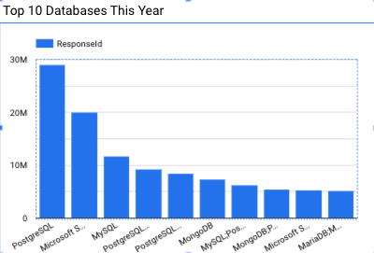
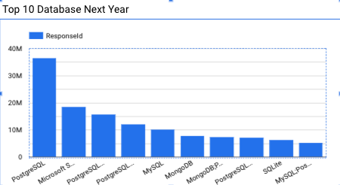
DATABASE TRENDS
Current Year
Next Year

Slide 10
DATABASE TRENDS - FINDINGS & IMPLICATIONS
Findings
PostgreSQL dominates this and next year trends
MS SQL moved MySQL from the top position
NoSQL MongoDB is still a top 5 used technology
Implications
Open Source database technology is more popular than proprietary
NoSQL approach is getting traction
Oracle is nowhere to be seen

Slide 11

DASHBOARD
https://github.com/mrscrum/dataanalytics/blob/main/lab26.pdf

Slide 12
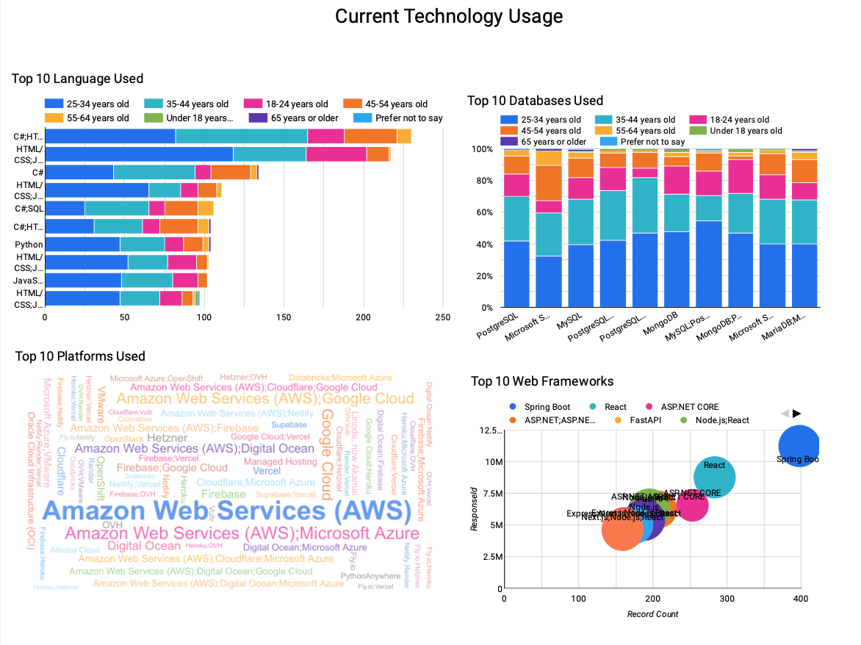
DASHBOARD TAB 1

Slide 13
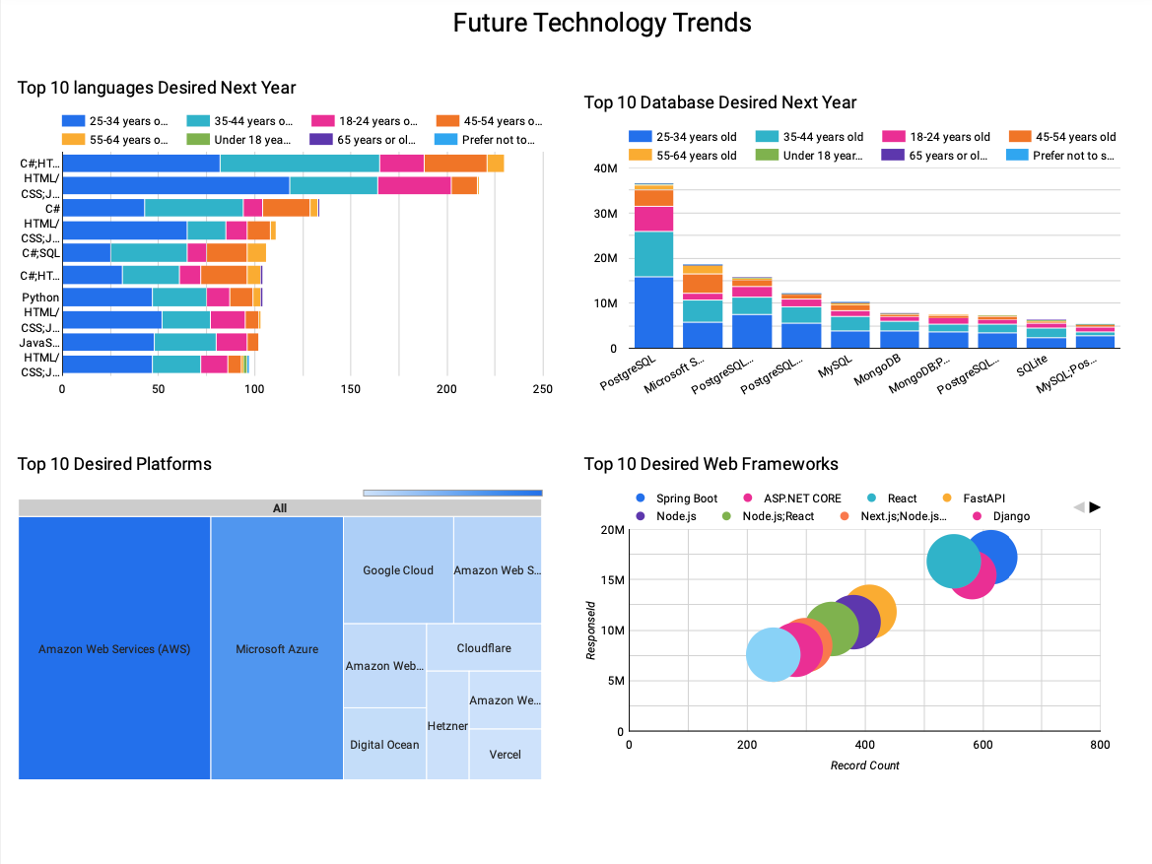
DASHBOARD TAB 2

Slide 14
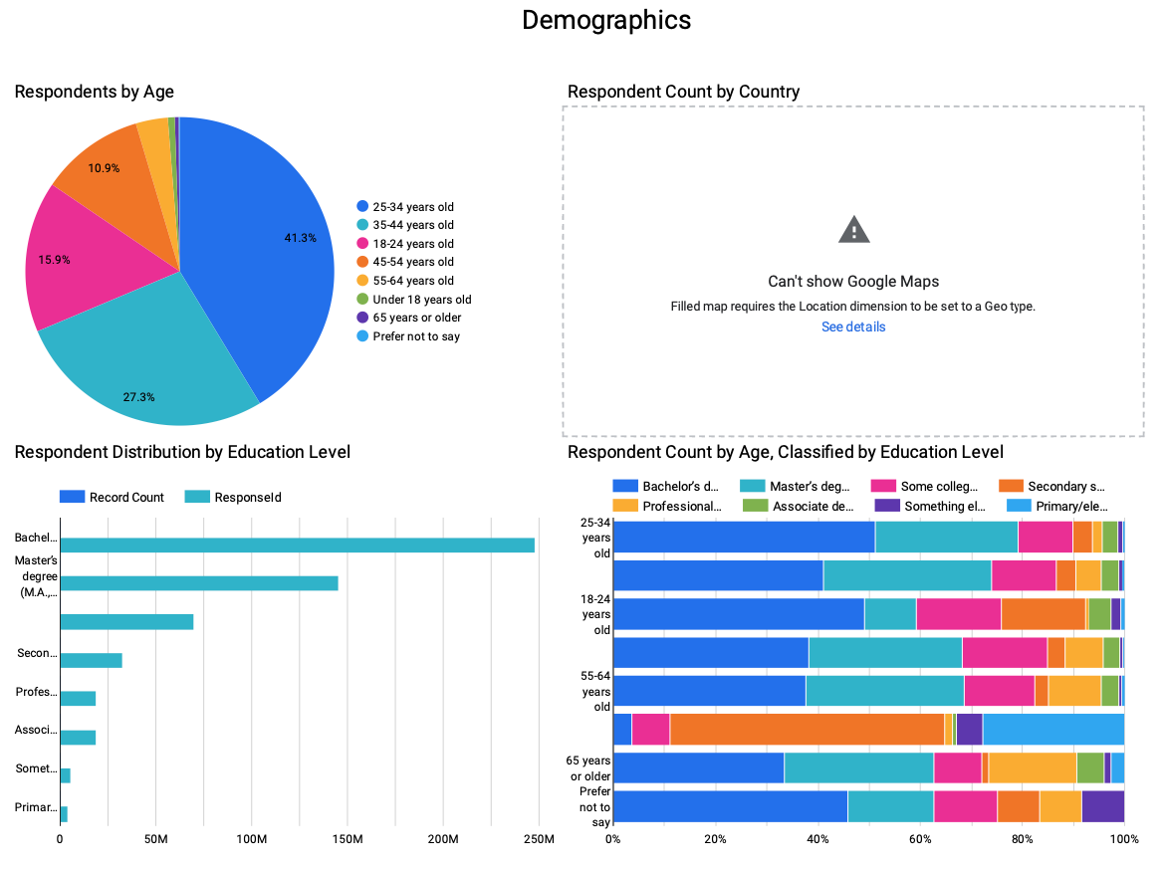
DASHBOARD TAB 3

Slide 15
DISCUSSION

Slide 16
OVERALL FINDINGS & IMPLICATIONS
Findings
Most IT professionals hold a bachelor's degree.
Web development languages are currently the most popular and in-demand.
The tech sector is predominantly composed of individuals under 40.
Implications
A degree boosts IT job prospects.
Web development skills require constant updating.
Tech favors young, adaptable professionals.

Slide 17

CONCLUSION
Swift and Python are the most popular programming languages, and PostgreSQL is expected to grow in demand.
Most IT professionals are male, from the USA, around 28 years old, and hold a bachelor's degree.
The tech industry is driven by web development and predominantly consists of young professionals under 40.

Slide 18
JOB POSTINGS

Slide 19
POPULAR LANGUAGES

