Slide 1

Cricbuzz LiveStats
Real-Time Cricket Insights & SQL-Based Analytics
Domain: Sports Analytics
Prepared By: Deepika Sunil

Slide 2
Problem Statement
Objective:
Build a comprehensive cricket analytics dashboard integrating live data from the Cricbuzz API with a SQL database.
Deliverables:
Real-time match updates.
Detailed player statistics.
SQL-driven analytics and full CRUD operations

Slide 3
Problem Statement
Problem Statement:
Bridging the gap between live match updates and historical SQL-driven analytics through a unified web application.
Business Use Cases:
Sports Media: Real-time updates and historical trends for commentary teams.
Fantasy Platforms: Player form analysis and head-to-head statistics for team selection.
Analytics Firms: Advanced statistical modeling and performance evaluation.

Slide 4
Problem Flow
CRICBUZZ LIVE STATS
Rapid API
Python
Postgre SQL
Stream lit

Slide 5
Technical Architecture
Frontend: Multi-page web application developed using Streamlit.
Backend: Python utilizing the requests library for REST API integration and pandas for data manipulation.
Database: SQL Integration (PostgreSQL/MySQL/SQLite) for persistent storage and optimized querying.
API: Cricbuzz Cricket API via RapidAPI for live match data and player stats.

Slide 6
Database Design & Schema
Centralized Logic: Database-agnostic design with connection handling centralized in utils/db_connection.py.
Optimization: Implementation of proper indexing for frequently queried columns to enhance performance.

Slide 7
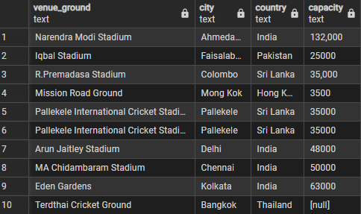
SQL Analytics – Level 1: Foundational Insights
Q1: National Representation: Identification of players representing India with specific roles and styles. (public.q1_players_india)
Q2: Recent Match Tracking: Temporal analysis of matches played in recent days, sorted by recency. (public.q2_recent_matches)
Q3: ODI Hall of Fame: Ranking top 10 run-scorers by average and centuries. (public.top10_odi)
Q4: Venue Infrastructure: Capacity-based analysis of global cricket grounds. (q4_venu)

Slide 8
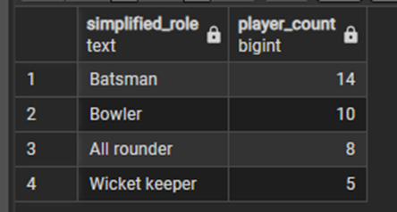
Level 1: Foundational Insights
Q5: Team Dominance: Win-count aggregation across all formats. (public.q5_most_wins)
Q6: Squad Composition: Distribution analysis of player roles (Batsmen vs. Bowlers). (public.q6_player_roles)
Q7 & Q8: Format & Time Series: Tracking highest scores by format and 2024 series planning. (q8_match_2024)

Slide 9
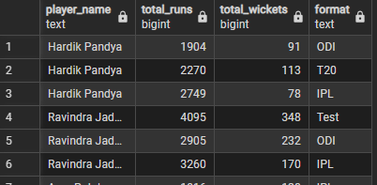
Level 2: Performance Metrics
Q9: The All-Rounder Elite: Multi-condition filtering for players with >1000 runs and >50 wickets. (public.q9_allround_rank)
Q10: Match History: Deep dive into the last 20 completed matches including victory margins. (public.q10_last20matches)
Q11: Multi-Format Performance: Cross-joining formats to compare player averages in Test, ODI, and T20I. (play_diff_match)

Slide 10
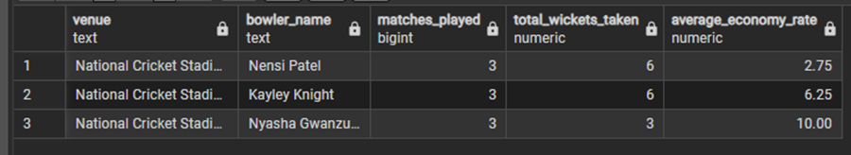
Level 2: Performance Metrics
Q12: Home vs. Away Advantage: Logic-driven analysis of win percentages based on venue country. (q12_count_of_wins)
Q14: Venue-Specific Bowling: Calculating economy rates and wickets for bowlers at specific grounds. (public.q14_bowler_perf)
Q17: The Toss Factor: Statistical investigation into whether "Win Toss = Win Match" holds true. (q17_toss)
Q19: Consistency Scoring: Utilizing Standard Deviation to find the most reliable batsmen since 2022. (q19_stddevi_2022)

Slide 11
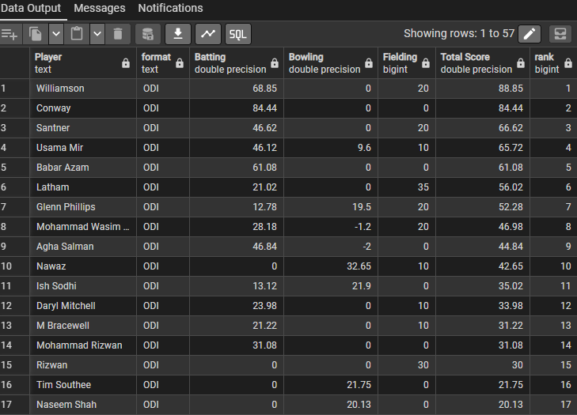
Level 3: Advanced Modeling
Q21: Weighted Ranking System: A custom algorithm combining batting (avg/SR), bowling (wickets/econ), and fielding (catches/stumpings) into a single score. (q21_players_ranking)
Q22: Head-to-Head Predictor: Analyzing pair-wise team performance and victory margins over 3 years. (q22_final)

Slide 12
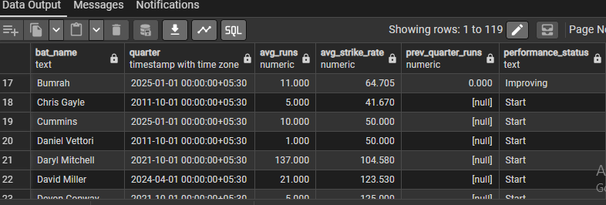
Level 3: Advanced Modeling
Q23: Form Momentum Categorization: Classifying players as "Excellent" or "Poor" form based on their last 10 innings. (public.q23)
Q24: Partnership Synergy: (The Core Study) Identifying the most successful batting combinations using a success rate percentage. (public.q24_batting_partner)
Q25: Career Trajectory (Time-Series): Quarterly performance analysis to categorize players as "Ascending," "Stable," or "Declining." (q25_performance_trend)

Slide 13
Technical Implementation
Data Staging: All these queries run against the tables populated by the Python-to-SQL pipeline.
Query Efficiency: Advanced queries utilize Common Table Expressions (CTEs) and Window Functions (like RANK() and STDDEV()) for professional-grade reporting.
Advanced Query Engineering: To ensure professional-grade reporting, the system utilizes high-performance SQL features:
Common Table Expressions (CTEs): Used for modular and readable query logic.
Window Functions: Implemented RANK() for player leaderboards and STDDEV() for consistency analysis (Q19).
Complex Joins: Correlating match details with player statistics across multiple formats.

Slide 14

Front-end implementaion
Streamlit design

Slide 15
Stream lit
Home page
Live match page
Player stats
SQL query analysis
CRUD operations
Web Page Implementation
Page1
Home
Page2
Live matches
Page3
Player stats
Page4
SQL analytics
Page5
CRUD

Slide 16

Live Match Page
Real-Time Data: Users can view ongoing matches directly from the Cricbuzz API.
Dynamic Scorecards: Displays detailed information on batsmen, bowlers, match status, and venue details in real-time.
Automation: Automatic parsing of JSON API responses into readable dataframes using the q2024 staging variable.

Slide 17
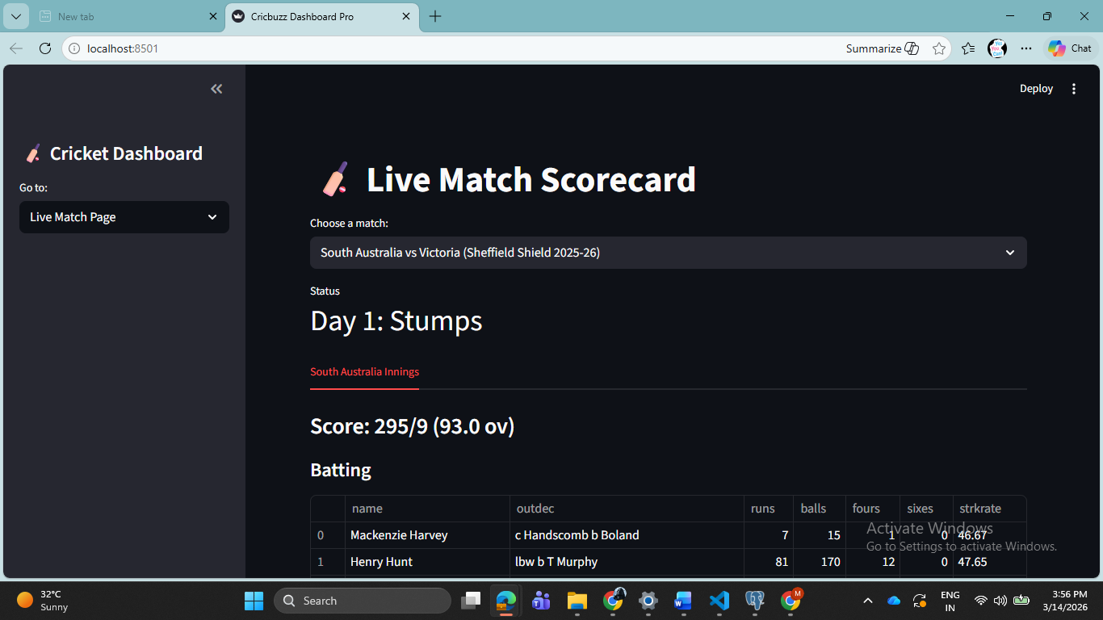
Live match score card
Real-time validation of API responses using Python to ensure zero data loss during the transfer from the Cricbuzz API to the cricbuzz database.

Slide 18
Player stats
Live API Integration: Displays real-time player rankings and career statistics fetched directly from the Cricbuzz RapidAPI.
Dynamic Data Staging: Utilizes the q2024 DataFrame to temporarily store and process JSON responses for immediate display.
Multi-Format Analysis: Features interactive toggles to switch between personal info, batting and bowling data for comprehensive performance reviews.
Real-Time Interactivity: Enables instant sorting and searching of player metrics, such as batting averages and strike rates, without page reloads.
Data Persistence Bridge: Acts as the primary interface for capturing live stats before they are committed to the cricbuzz database on the Deeps server.

Slide 19
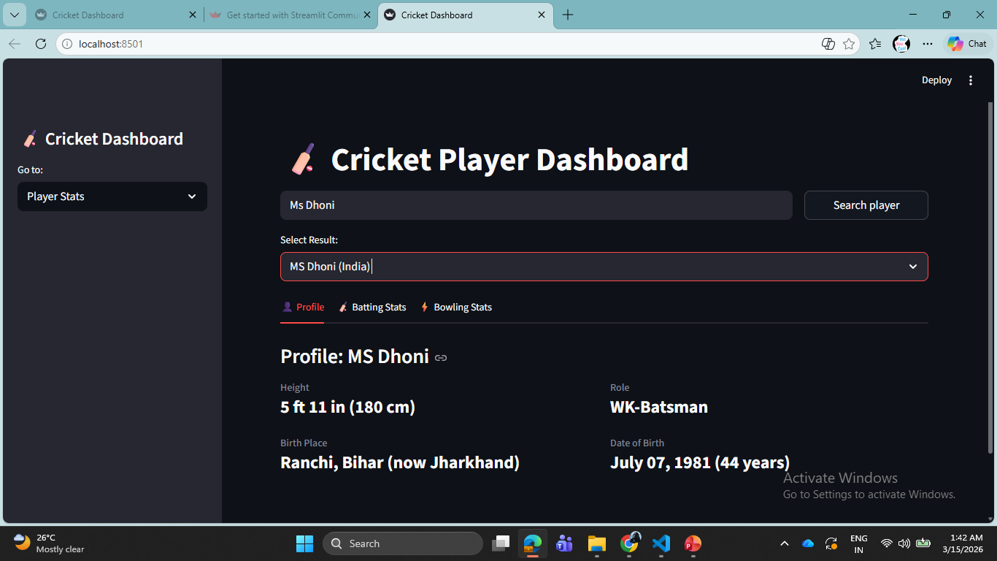

Slide 20
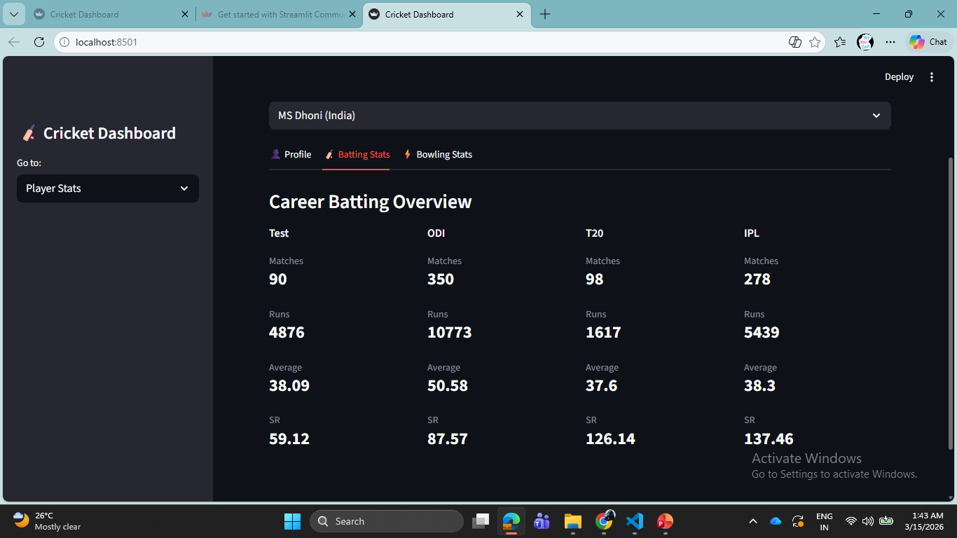

Slide 21
SQL Analytics
Centralized Query Interface: A unified "on-screen" dashboard where all 25 analytical questions are accessible via a single dynamic dropdown menu.
Live Database Execution:
Upon selection, the system triggers a targeted SQL query to the cricbuzz database on the Deeps server.
Results are fetched and displayed instantly in the same view using st.dataframe, ensuring a seamless user experience.
Analytical Diversity:
Displays everything from foundational player filters (Q1) to advanced weighted ranking systems (Q21) and time-series trends (Q25).

Slide 22
SQL Analytics
Technical Integration:
Built using SQLAlchemy to handle the connection between the user's selection and the database engine.
Utilizes Pandas to bridge the gap between raw SQL result sets and the visual UI tables.
Backend Staging: While the Live Stats use the q2024 staging variable, this page demonstrates the power of persistent storage by analyzing data already committed to the database.
Reliability: "This proves the stability of the connection to the Deeps server. We are fetching complex analytical results—like the partnership success rates from Question 24—in milliseconds."

Slide 23
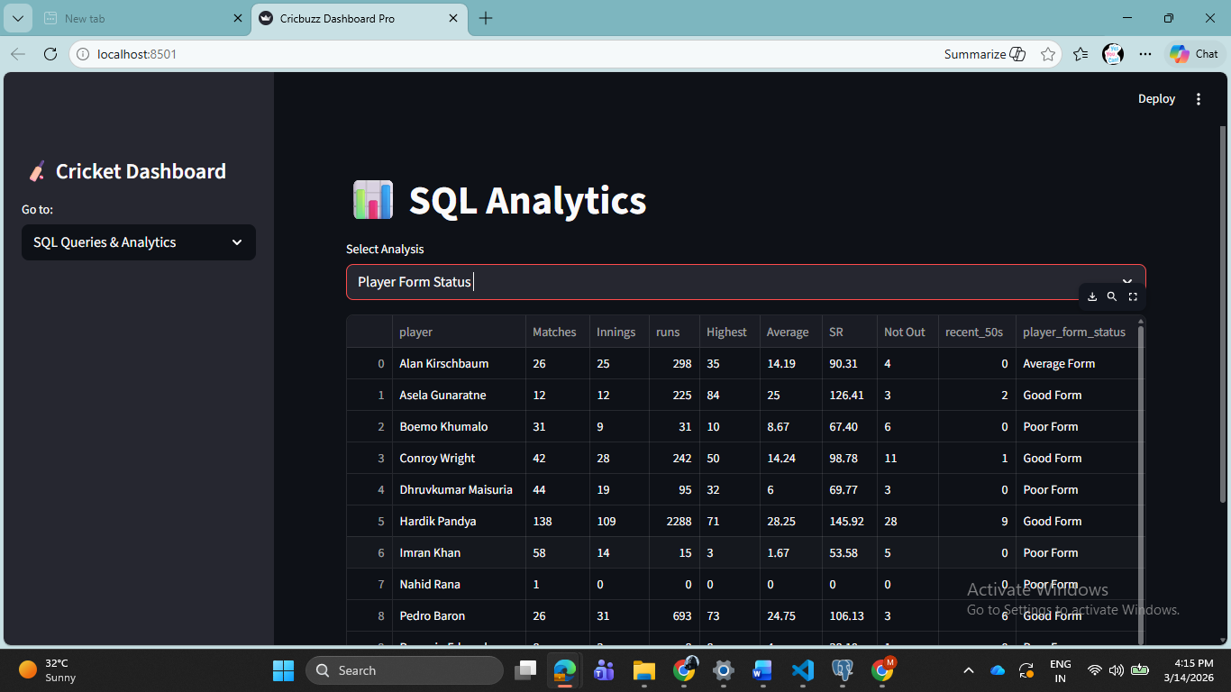

Slide 24
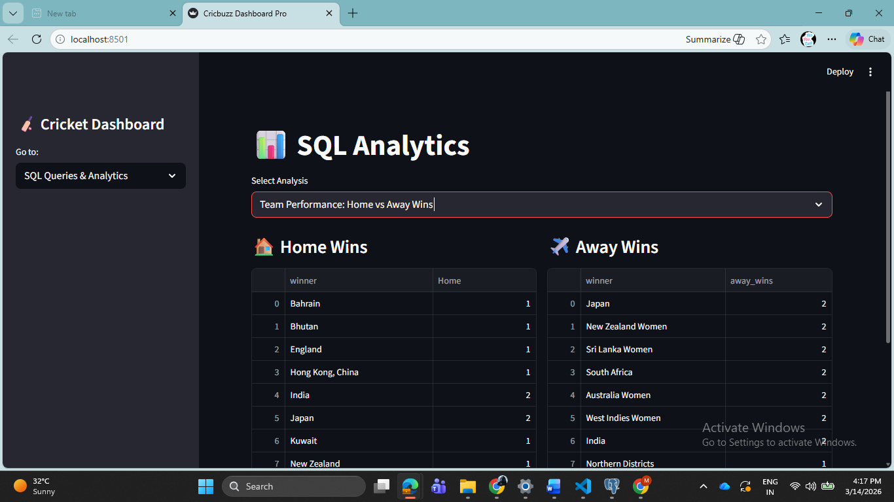

Slide 25
CRUD Operations
Administrative Data Management: Provides a dedicated interface for full Create, Read, Update, and Delete control over the project database.
Direct Database Interaction: Facilitates real-time modifications to the cricbuzz database hosted on the Deeps server.
Streamlined Player Records: Allows for the manual addition of new player profiles or the updating of existing statistics that may not be available via live API feeds.
User-Friendly UI Design: Built with Streamlit forms and buttons, making complex database manipulations accessible without writing raw SQL code during the demo.

Slide 26
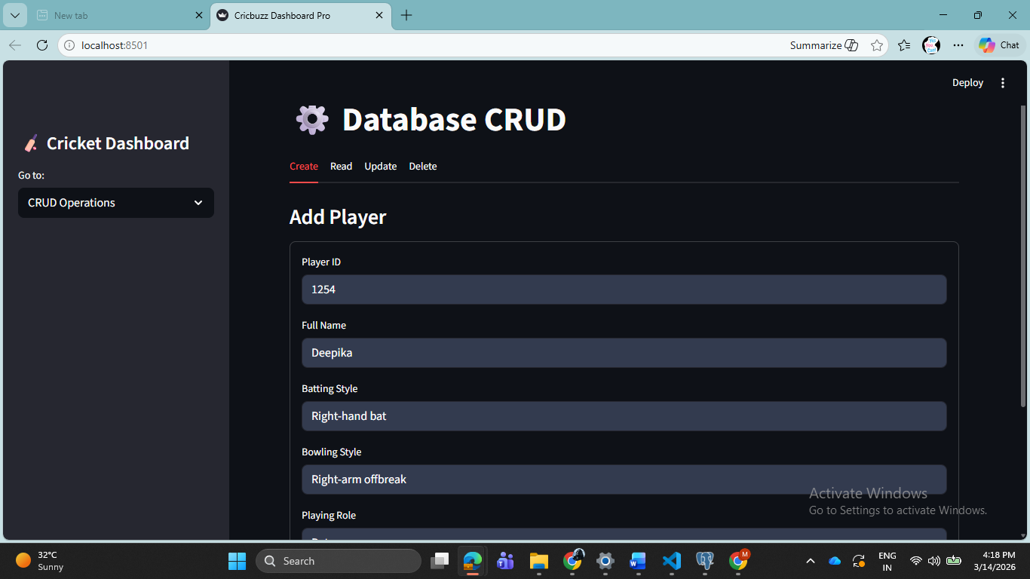

Slide 27

Project Pages Overview

Slide 28
Project Pages Overview
Live Match Dashboard: Integrates real-time data from the Cricbuzz API into the staging area for instant score updates and match tracking.
Player Statistics Hub: Provides dynamic, format-specific career metrics (Test, ODI, T20I) with high-speed sorting and searching capabilities.
SQL Analytics Engine: Executes 25 complex queries on the cricbuzz database (Server: Deeps) via a single-screen, interactive dropdown interface.
Administrative CRUD Page: Enables direct data management on the SQL server to ensure data integrity, allowing for manual entry updates and record maintenance.

Slide 29
Thank you

