Slide 1
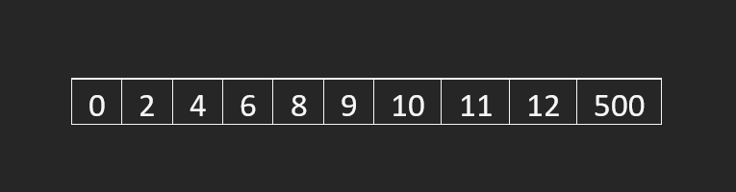

Slide 2
Min
Q1
Median
Q3
Max
25%
25%
25%
25%

Slide 3
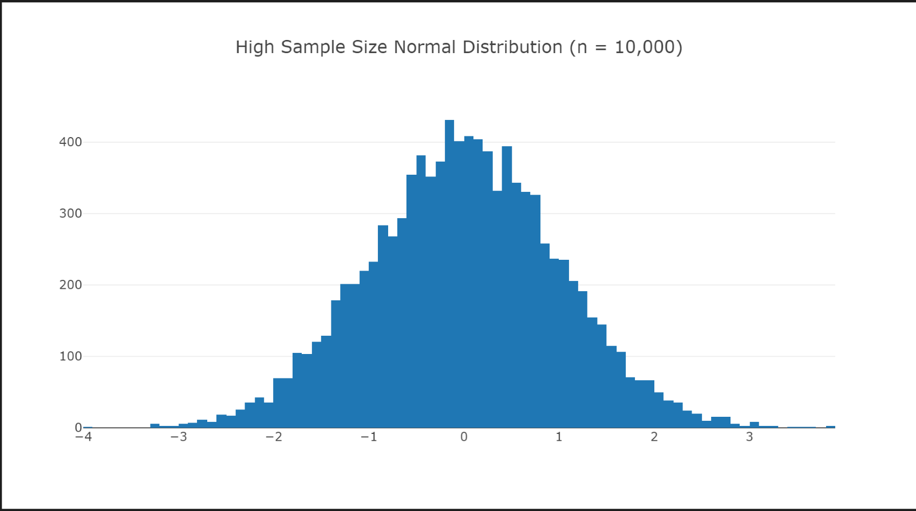
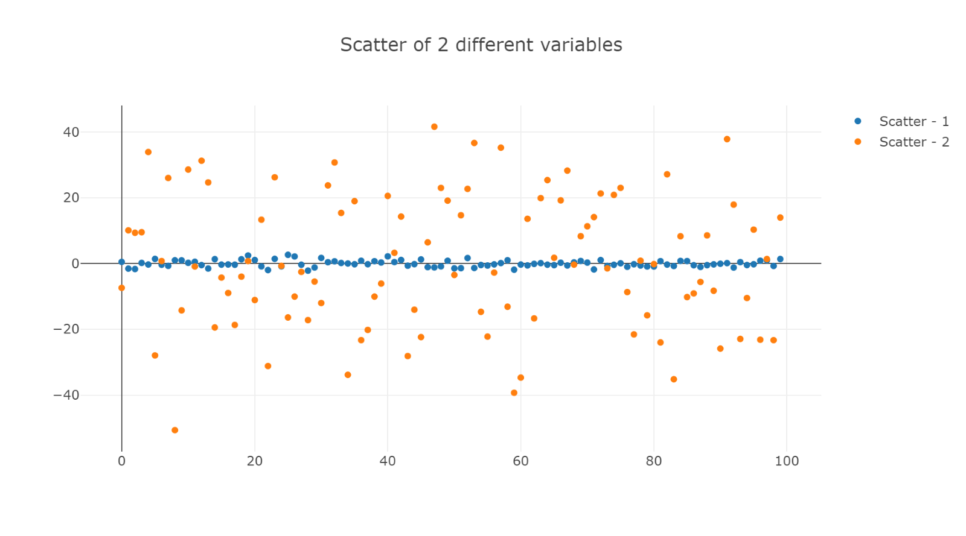
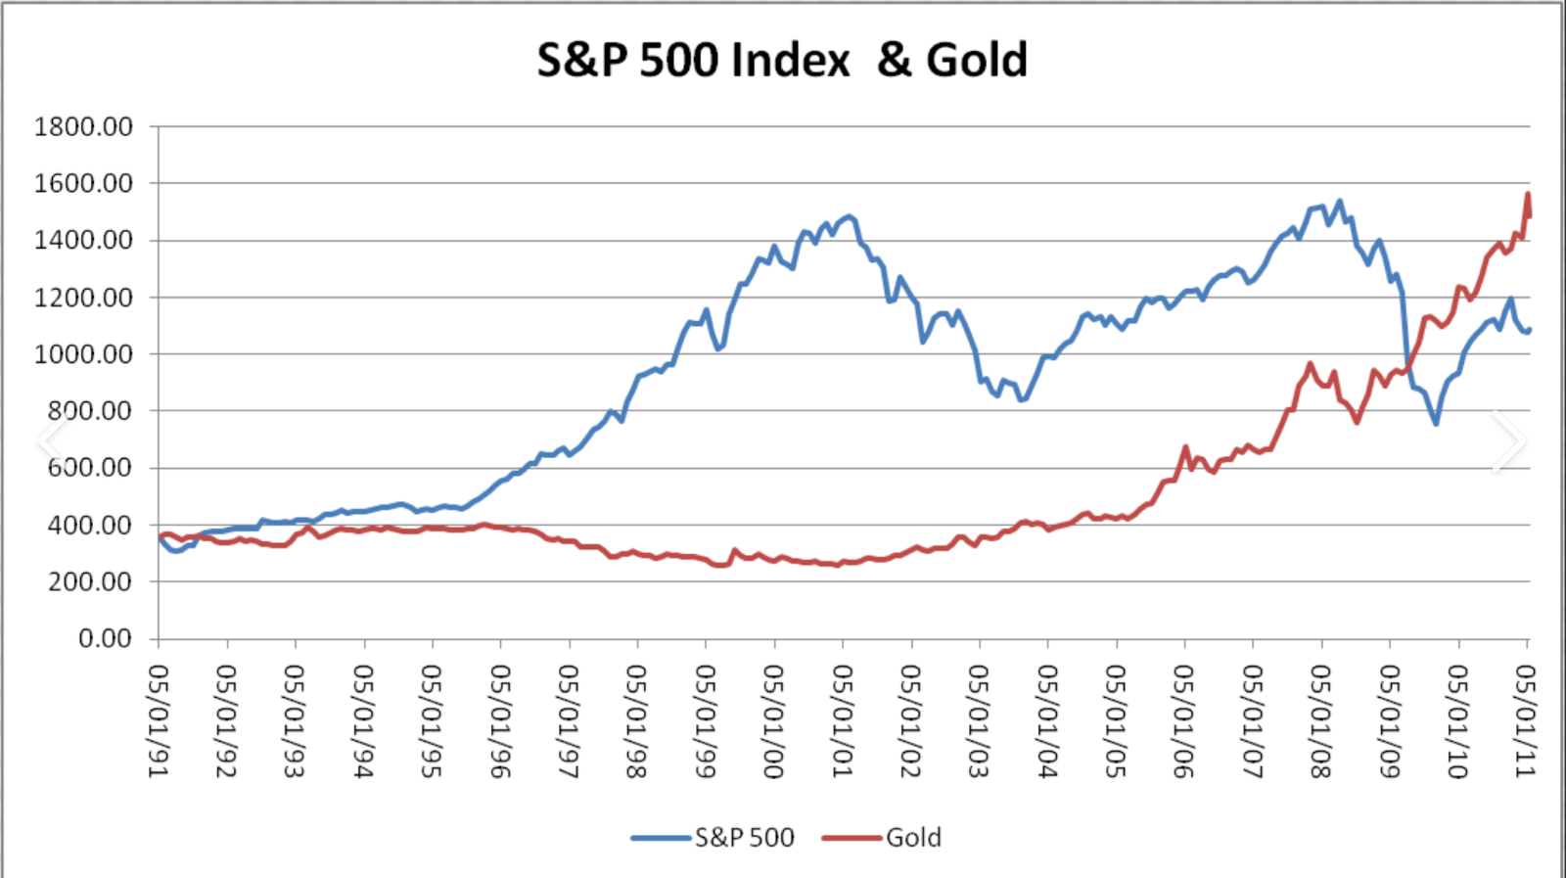
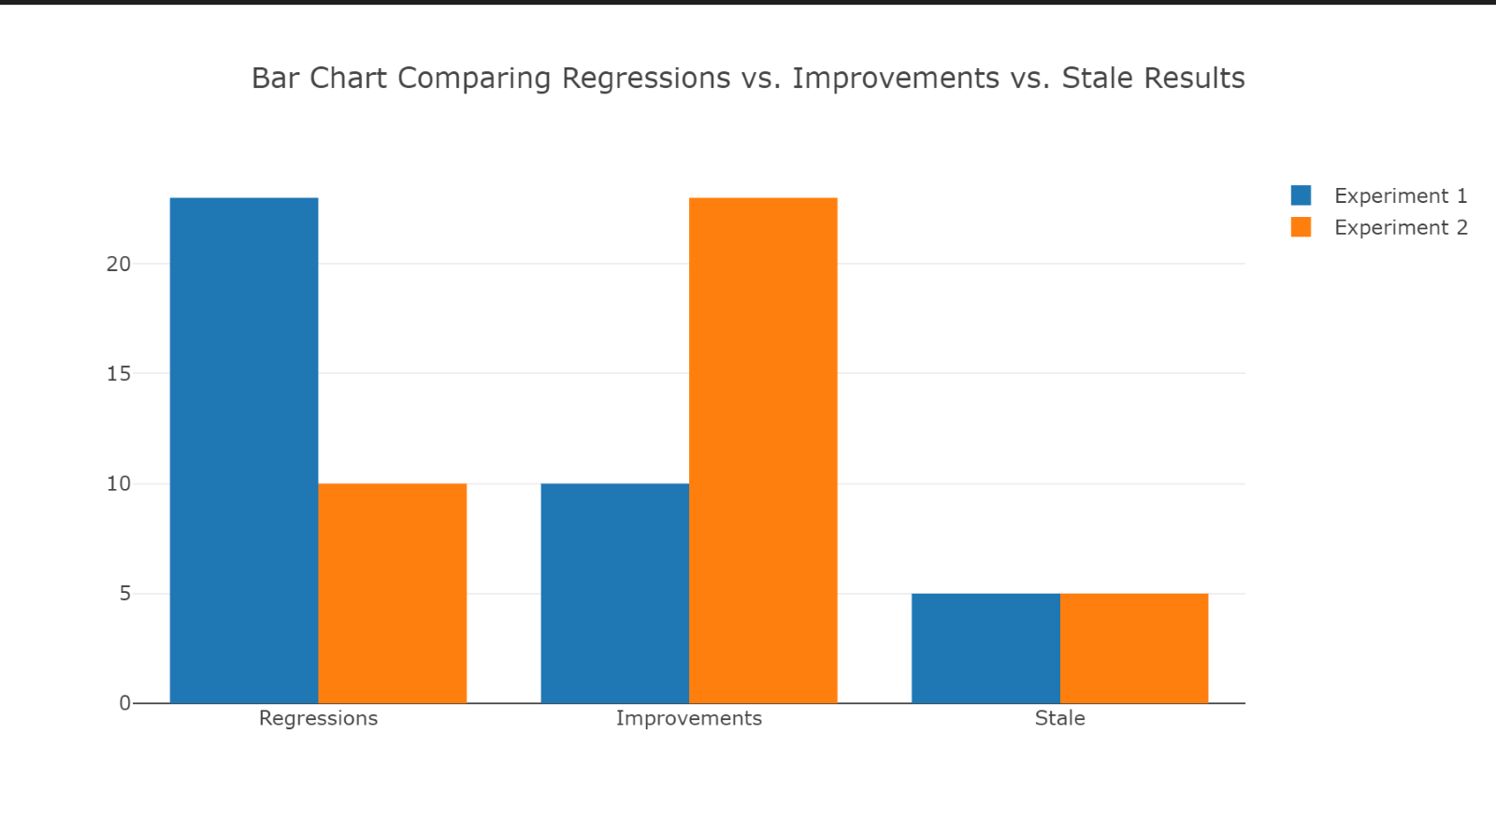
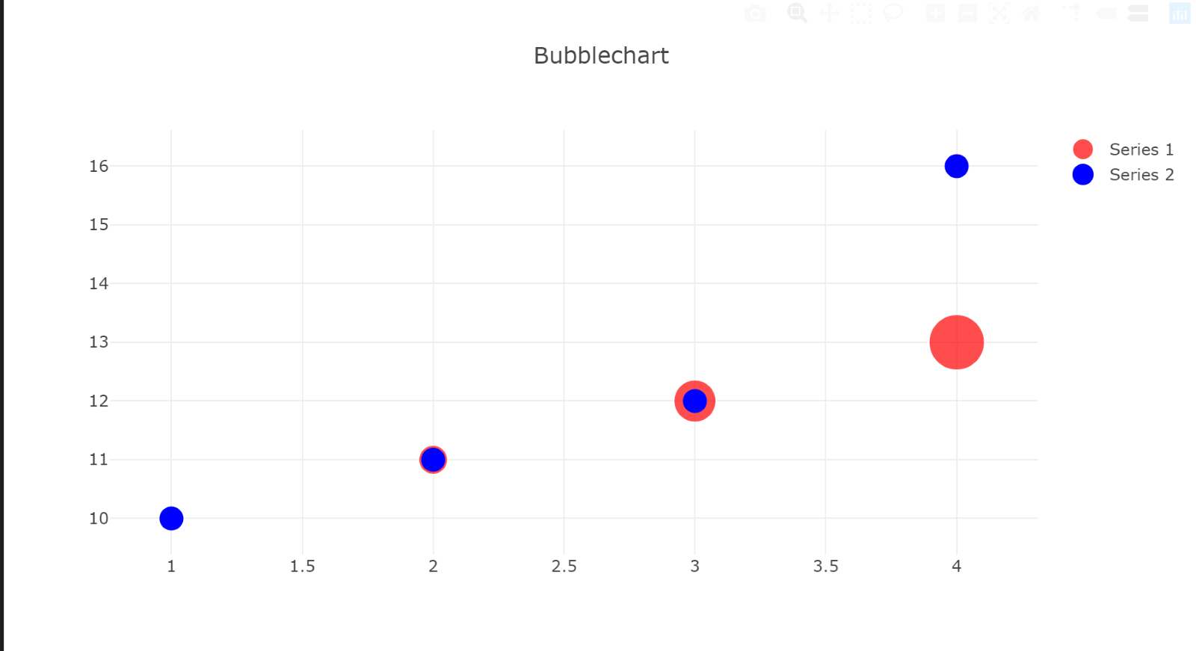
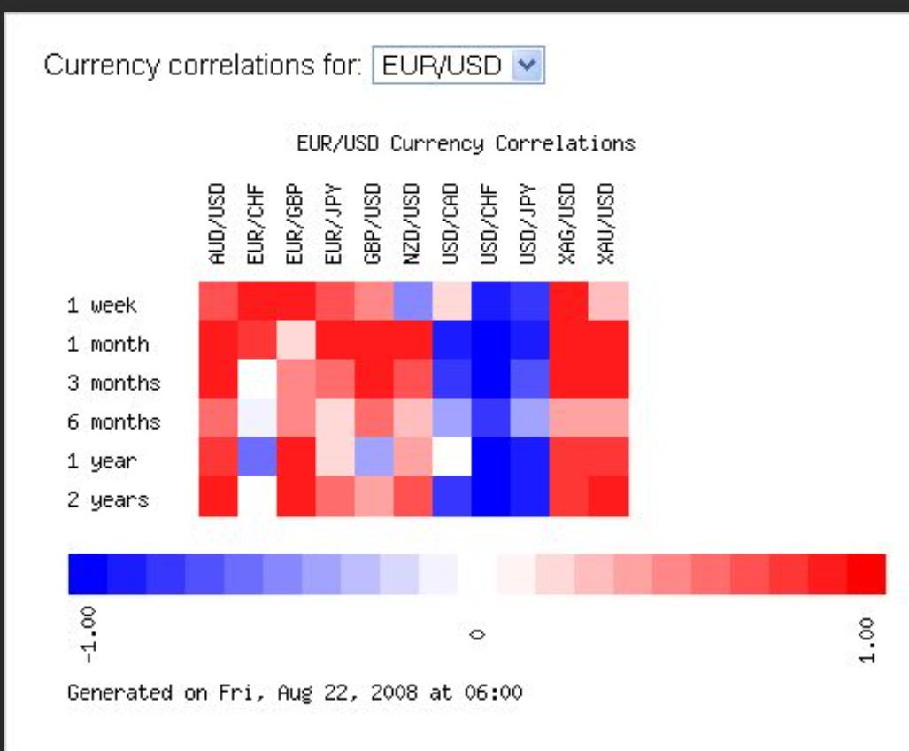
What Idea Are You Trying to Convey?
Describing a Distribution
Do we want to look at distributions with just one variable?
Do we want to look at distributions of more than one variable?
A Histogram
A Scatter of 2 different variables
A Relationship
A Comparison
Are we dealing with 2 variables?
Are we dealing with 3 variables?
Are we dealing with 4 variables?
Are the data time-series based?
Are the data categorical?
Comparative Line Chart or
Area Chart
Comparative Line Chart or
Area Chart
Scatter Plot
Bubble Chart
Heat Map

