Slide 1
Chat Box Application
Linux Shared Memory studies

Slide 2
Group Member
Nguyen Tuan Dung - 20194427
Nguyen Huy Hoang - 20194433
Nguyen Van Thanh Tung - 20190090
Tran Duc Duy - 20205181

Slide 3
Table Of Contents
Introduction
Shared Memory
Semaphore
Chat Box Application - Components
Scenario
Shared Memory Area
Semaphore Lock
Messages & Display
Chat Box Application - Combination & Proof
Combination
Proof
Conclusion

Slide 4
Introduction

Slide 5
Shared Memory

Slide 6
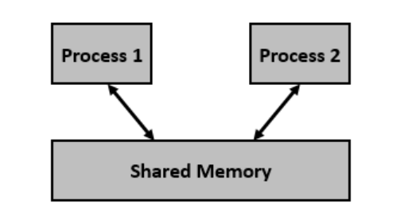
Shared Memory
A technique used for IPC
A memory management technique in the Linux operating system
Allow multiple processes to share, access a portion of memory
Allows for the creation of a common data region that can be accessed by multiple process

Slide 7
Shared Memory - Linux System calls
shmget() | Create a new shared memory segment or to access an existing shared memory segment
shmat() | Attach a shared memory segment to a process's address space
shmdt() | Detach a shared memory segment from a process's address space
shmctl() | Control the shared memory segment

Slide 8
Shared Memory
A memory management technique in the Linux operating system
Allow multiple processes to share, access a portion of memory
Allows for the creation of a common data region that can be accessed by multiple process
How to synchronize the accesses?
Need a synchronization mechanism!!!

Slide 9
Semaphore

Slide 10
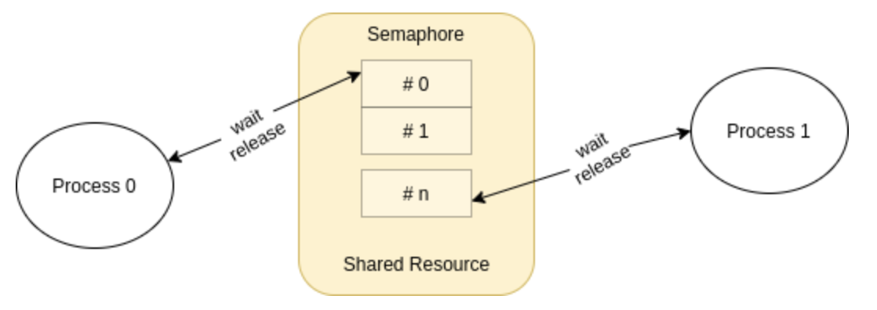
Semaphore
Synchronization object
Used to control access to shared resource in multi-threaded/process environment

Slide 11
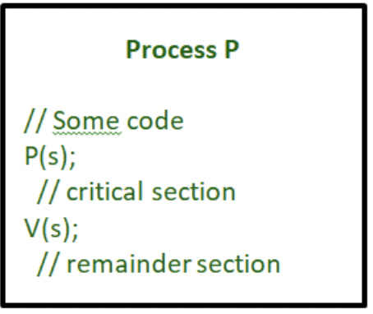
Semaphore
Typically has two operation:
wait() - P()
signal() - V()
Semaphore value > 0: it decrements the value and continues the critical section
Semaphore value = 0: the process is blocked until other process finished with the resource, signals the semaphore value, wake up the blocked process
→ Semaphore can be used to synchronize Shared Memory Area

Slide 12
Chat Box Application
Components

Slide 13
Scenario

Slide 14

Chat Box - Scenario
The chat box is where the user can chat with other users
Each user have a unique name
Each user can send message to the chat box, display received messages on the screen

Slide 15
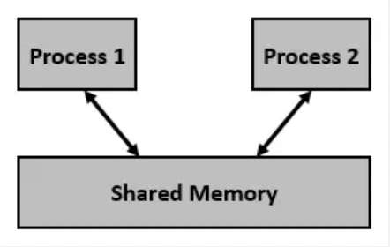
Chat Box - Scenario
The chat box is where the user can chat with other users
Each user have a unique name
Each user can send message to the chat box, display received messages on the screen
→ Basically,
The chat box is a shared memory area
Each user can create a separate process to join the chat box

Slide 16
Shared Memory Area

Slide 17
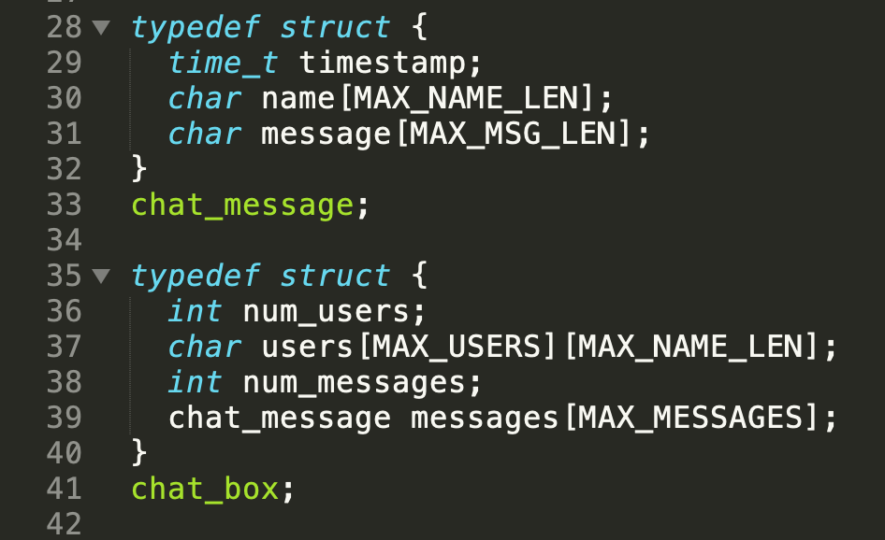
Chat Box - Shared Memory Area
We declared the chat box with users and messages
The chat box has been pre-allocated an amount of memory by the size of these constant:
MAX_USERS
MAX_NAME_LEN
MAX_MESSAGES
Messages are identified by the time of sending, the sender, and the content of the message

Slide 18
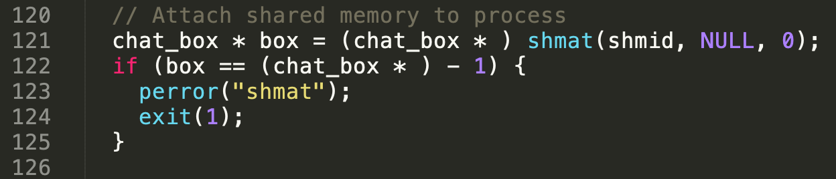
Chat Box - Shared Memory Area
When a user wanna join the box chat: attach the shared memory area which declared the chat_box to the user’s chat process

Slide 19
Chat Box - Shared Memory Area
When a user wanna join the box chat: attach the shared memory area which declared the chat_box to the user’s chat process
And detach when exit from the chat box: `shmdt(box)`

Slide 20
Semaphore Lock

Slide 21
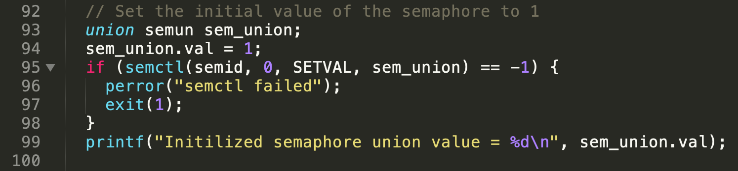
Semaphore Lock
Messages and users data saved in shared memory area
JUST 1 PROCESS CAN MODIFY IT AT ONE TIME
We use binary semaphore to lock the access of processes to the shared memory area
0 <= sem_union.val <= 1

Slide 22
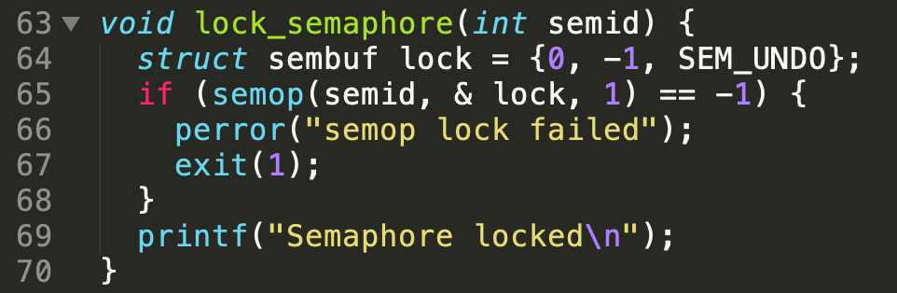
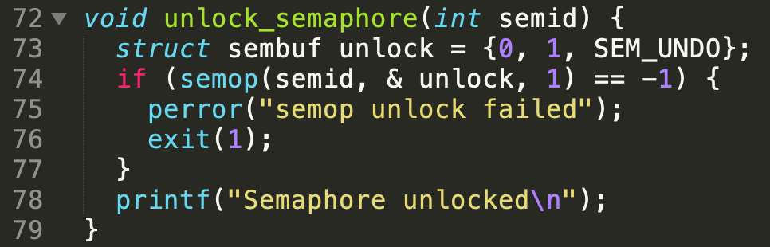
Semaphore Lock - Unlock
We also provide lock and unlock function for the purpose of easy to use in processes
When ever process access to shared memory area:
Add a user
Save a message
We will lock then unlock after the modification done successfully

Slide 23
Messages & Display

Slide 24
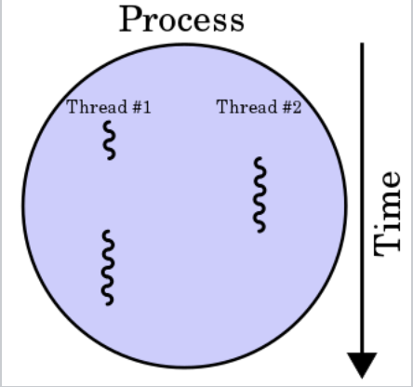
Chat Box - Messages & Display
As each user represented by one process and each process have 1 main thread, we create another thread:
The main thread for the purposes of sending message
The sub thread for the purposes of display received message
→ Allow multi-tasking

Slide 25
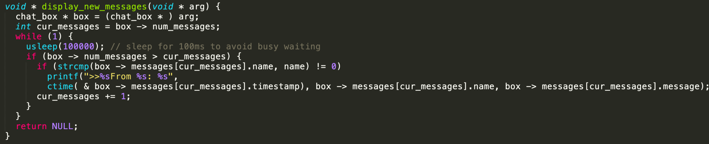
Chat Box - Display Thread
Store a pointer point to the latest messages displayed
Not display the message of owner

Slide 26
Chat Box Application
Combination & Proof

Slide 27
Final Products - Combination

Slide 28
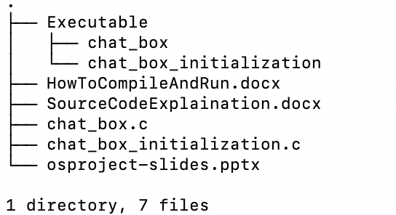
Final Products
Combine above components, we executed, extract 2 executable files in the executable folder
The `chat_box_initialzization`: for the main purpose of create new chat box or delete existing chat box and create new one
The `chat_box`: user can run this file to access the chat box

Slide 29
Proof

Slide 30
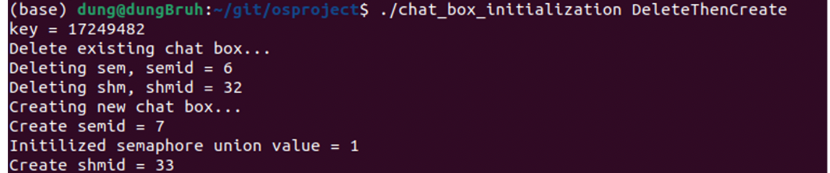
Proof - Chat Box Initialization
We deleted existing chat_box…
Then create new one with new `semid`, `shmid`

Slide 31
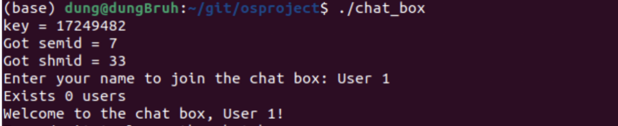
Proof - User Join
User join the chat box by key, with the same `semid`, `shmid` as initialized
User name = `User 1`

Slide 32
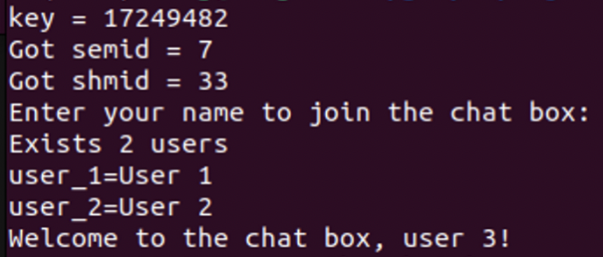
Proof - Users Join
More users join the chat box by key, with the same `semid`, `shmid` as initialized
User name = `user 3`
Exists 2 users: `User 1`, `User 2`

Slide 33
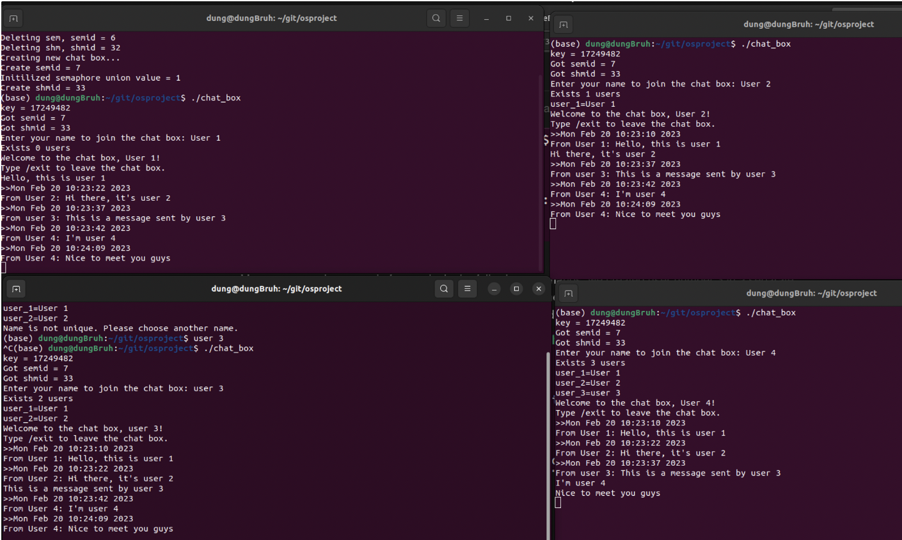
Proof - Chat Box

Slide 34
Conclusion

Slide 35
Conclusion
In conclusion, our group had have a deeper understanding about Shared Memory in Linux operating system
Shared memory provides a fast and efficient mechanism for inter-process communication by allowing multiple processes to share the same region of memory
However, it is important to note that shared memory is a low-level mechanism and requires careful management to ensure that it is used correctly and efficiently
In addition, we implemented a simulated program that allows two process to exchange messages with inter-process synchronization technique included.

Slide 36
Conclusion - Future Work
The chat box application still have some aspects to extends:
Add some GUI to the application for user - friendly interface
Add the feature of sending file through the chat box
Maybe, we will implement this for the purpose of deploy product in the future?
Maybe …

Slide 37
Thank you for listening!!!

