Slide 1
Section 3: Processes

Slide 2
Chapter 3: Processes
Process Concept
Process Scheduling
Operations on Processes
Interprocess Communication
Examples of IPC Systems
Communication in Client-Server Systems

Slide 3
Objectives
To introduce the notion of a process -- a program in execution, which forms the basis of all computation
To describe the various features of processes, including scheduling, creation and termination, and communication

Slide 4
Process/Program
A process is a program in execution
What’s a program: source code (init.c)
int mybigarray[50000] = {1,2,3,4};
int main (void) {
mybigarray[0] = 3;
return 0;
}
Once compiled we get an object file (init.o) which has among several sections the following two:
  Code segment: the executable code
  Data segment: initialized static variables
See the output of deassembling init.o using objdump –d and then –s –d

Slide 5
Part of disassembling init.o
Disassembly of section .text:
00000000000004f0 <_start>:
4f0: 31 ed xor %ebp,%ebp
4f2: 49 89 d1 mov %rdx,%r9
4f5: 5e pop %rsi
4f6: 48 89 e2 mov %rsp,%rdx
4f9: 48 83 e4 f0 and $0xfffffffffffffff0,%rsp
4fd: 50 push %rax
4fe: 54 push %rsp

Slide 6
Process/Program
Notice what happens with this second program not-init.c:
int mybigarray[50000];
int main (void) {
mybigarray[0] = 3;
return 0;
}
The size of the object file not-init.o is 8216 bytes while init.o is 208216 bytes.
The array mybigarray is not initialized in not-init.c, therefore the memory space is not allocated in the data section of the object file not-init.o
Only once not-init.o is loaded in main memory will the array be initialized with all 0’s

Slide 7
Object file
So the code (text section) and the static data (data section) are separated in the object file.
How about local variables, function parameters and variables allocated dynamically?
int Sum(int n);
int main(){
int num = 2;
Sum(num);
return 0;
}
int Sum(int n){
int s = 0;
while( n > 0 ) {
s += n; n--;
}
return s;
}

Slide 8
Dynamic data
No storage is allocated for local variables and function parameters in the object code (binary)
  Only the name of these variables exist in the text segment
If a variable is assigned a value in the program, the value is only represented as text, i.e. as ASCII characters
Data for local and function parameters are stored in the process memory addresses called “run time stack”
Finally, variables for which storage is allocated dynamically at run time, such as those allocated using an instruction like “malloc” in C, their storage come from the process memory addresses called “heap”
Copyright © 2007 Addison-Wesley. All rights reserved.
1-<number>

Slide 9

Compiled code representation
Static Data
int big-array[5000]; has memory reserved
for it if initialized in the text segment
Code, i.e. text, ascii characters
even int i = 6; float j[26]; is all text, no
memory is created to store these variables

Slide 10

From program to process
The object file of a program is stored permanently on the file system
In order to execute it must first be copied in the main memory.
As the program executes, it generates data, so part of the main memory must be allocated for storing these data
  The run time stack
  The heap
It is impossible to know before execution how much memory is needed for the stack and the heap
  A fix amount of main memory is allocated to a program to grow stack and heap

Slide 11
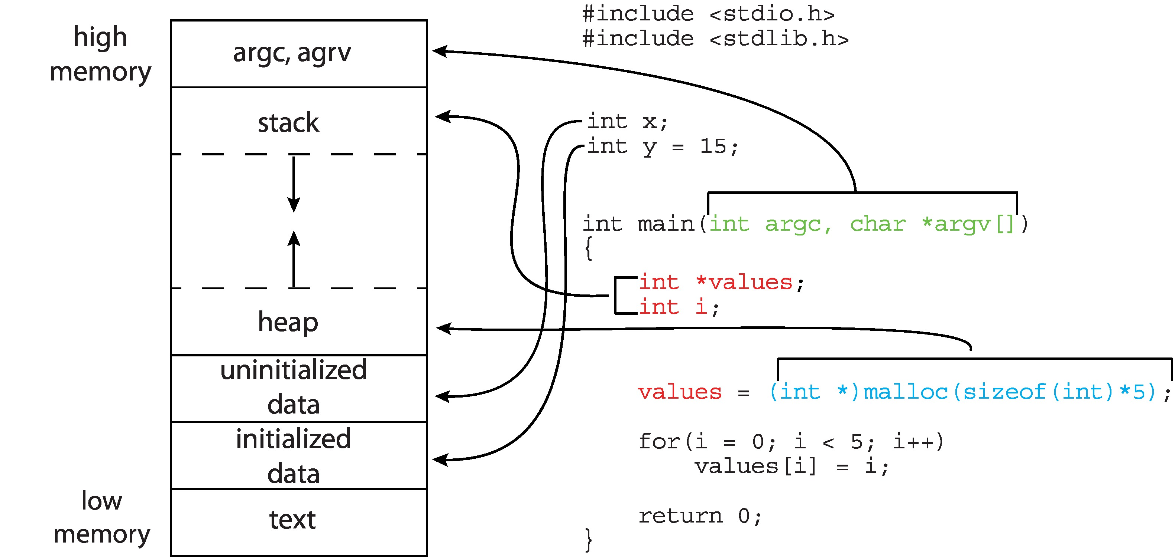
Process memory layout of a C Program

Slide 12
Process ID
Each process has a Process ID (PID), which is associated to a process at its creation
The following program output the PID of the process running that program and its parent process ID. See code PID1.c
#include <stdio.h>
#include <unistd.h>
int main (void) {
printf("I am process %ld\n", (long)getpid());
printf("My parent is %ld\n", (long)getppid());
return 0;
}

Slide 13
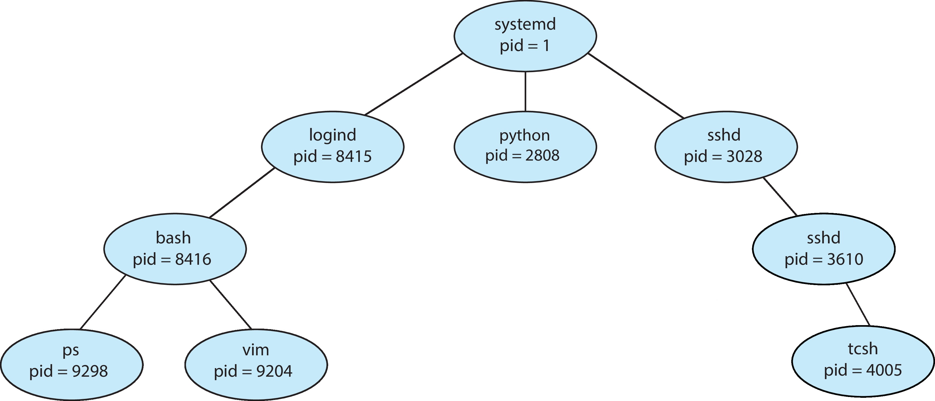
Unix process creation
All processes are created by other processes except for the first one (process 0) which is created when the system boots.
Except process 0, all the other processes have a parent process, i.e. the process that has created them
Most processes have also child processes, i.e. processes they have created
All together processes form a tree which can be displayed using the command pstree -p

Slide 14
Unix process creation
In Unix OSs, a process can create a new process by executing the command fork().
The fork() command creates a child process, the process calling fork() becomes the parent. See fork1 and ps –f
#include <stdio.h> #include <unistd.h> #include <sys/types.h>
int main(void) {
pid_t childpid;
childpid = fork();
if (childpid == 0) /* child code */
printf("I am child %ld\n", (long)getpid());
else /* parent code */
printf("I am parent %ld\n", (long)getpid());
return 0;
}

Slide 15
Implementation of process creation
As we can see, the function fork() has no argument, how can it knows from which program it fills the text and data sections of the child process???
Answer: it is filled with the text and data section of the parent process
Actually, the OS copies the parent's memory image in the child process, the child process is a copy of its parent.
#include <stdio.h> #include <unistd.h> #include <sys/types.h>
int main(void) {
pid_t childpid;
childpid = fork();
if (childpid == 0) /* child code */
printf("I am child %ld\n", (long)getpid());
else /* parent code */
printf("I am parent %ld\n", (long)getpid());
return 0;
}

Slide 16
Implementation of process creation
After a fork() there are two completely identical processes (except for the PID)
Both processes continue execution at the instruction after the fork() statement
However, parent and child can tell each other apart because fork() returns two different values dependent on whether a process is the parent or the child
fork() returns 0 to the child process and return the PID of the child process to the parent process: (see code fork2.c)
pid_t childpid; pid_t mypid; mypid = getpid();
childpid = fork();
if (childpid == 0) /* child code */
printf("I am child with PID = %ld, My parent PID is = %ld\n", (long)getpid(), (long)mypid);
else /* parent code */
printf("I am parent with PID = %ld, My child PID is = %ld\n", (long)getpid(), (long)childpid);
return 0;

Slide 17
Parent’s address space copied in child
This example illustrates the fact that the fork() creates a child process that has the memory space of its parent process. The child starts execution after the fork()
The variable mypid is initialized by the parent process. When the child print the value of mypid it is the same as for the parent. The child get a copy of all the parent variables (see fork3-memory)
#include <stdio.h> #include <unistd.h> #include <sys/types.h>
int main(void) {
pid_t childpid;
pid_t mypid;
mypid = getpid();
childpid = fork();
if (childpid == 0) /* child code */
printf("I am child %ld, ID = %ld\n", (long)getpid(), (long)mypid);
else /* parent code */
printf("I am parent %ld, ID = %ld\n", (long)getpid(), (long)mypid);
return 0;
}

Slide 18
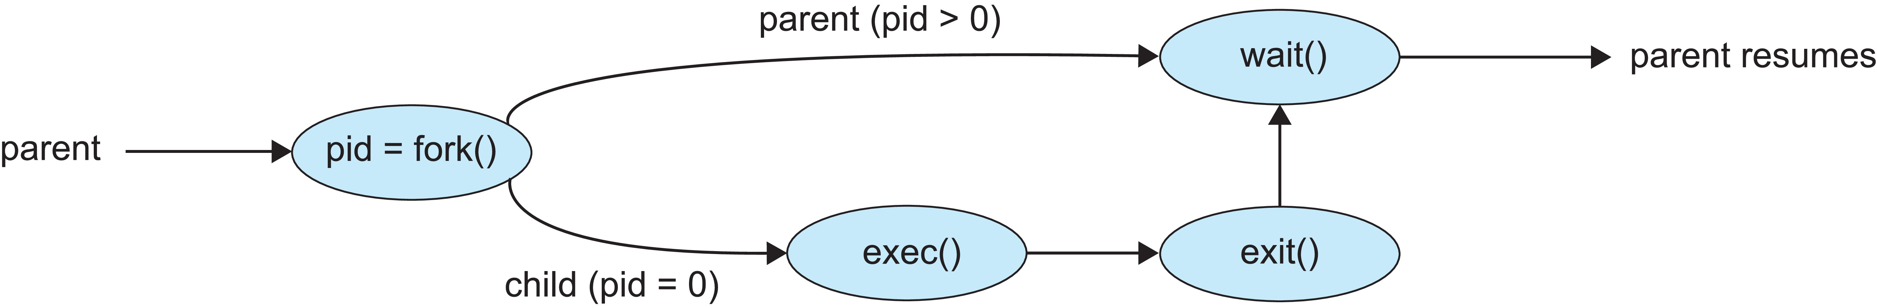
Making child and parent different
Creation of two completely identical processes is not very useful
There are two ways we can have parent and child execute different codes
  One is to have code written for the child in the parent process and require that only the child execute it (like in the previous example)
  The second one is as in the figure below, the child process executes the function exec() after the fork() which load a new binary in the child process.
Parent process calls wait()waiting for the child to terminate

Slide 19
Parent and child: same computation
In this example, before the fork(), one instance of this program is running (is a process) which executes x = 0.
After the fork() there are two instances of this program running, the parent and child processes, both execute the assigment x = 1. (See fork-same.c)
#include <stdio.h>
#include <unistd.h>
int main(void) {
int x = 0;
fork();
x = 1;
printf("I am process %ld and my x is %d\n", (long)getpid(), x);
return 0;
}

Slide 20
Parent and child: different computation
In this example, parent and child processes choose which part of the code to execute base on the value returned by fork() (see fork-different.c)
#include <stdio.h> #include <unistd.h> #include <sys/types.h>
int main(void) {
pid_t childpid;
childpid = fork();
if (childpid == 0) /* child code */
printf("I am child %ld\n", (long)getpid());
else /* parent code */
printf("I am parent %ld\n", (long)getpid());
return 0;
}

Slide 21
Different parent-child using exec()
This code shows how to use exec() such that the child process loads a different program to execute it (See fork-exec.c)
The child executes the linux command “ls -l”
#include <stdio.h> #include <stdlib.h> #include <unistd.h> #include <sys/wait.h>
int main(void) {
pid_t childpid;
childpid = fork();
if (childpid == 0) { /* child code */
execl("/bin/ls", "ls", "-l", NULL);
perror("Child failed to exec ls");
return 1;
}
if (childpid != wait(NULL)) { /* parent code */
perror("Parent failed to wait due to signal or error");
return 1;
}
return 0;
}

Slide 22
Different parent-child using exec()
In this code, the child first execute the code it has inherited from his parent. Then replace the code of his parent by another one. The code after exec(), printf(), is not executed as it is no longer the code of the child
#include <stdio.h> #include <stdlib.h> #include <unistd.h> #include <sys/wait.h>
int main(void) {
pid_t childpid; pid_t mypid = getpid();
printf("I am parent with PID = %ld\n", (long)mypid);
childpid = fork();
if (childpid == 0) { /* child code */
printf("I am child with PID = %ld\n", (long)getpid());
execl("/bin/ls", "../ls","..", NULL);
printf("I am child with PID = %ld, my parent PID is = %ld\n", (long)getpid(),(long)mypid);
}
if (childpid != wait(NULL)) { /* parent code */
perror("Parent failed to wait due to signal or error");
return 1;
}
return 0;
}

Slide 23
The exec() command
The exec family of functions provides a facility to replace the executable of the parent process by a new code
There are six variations of the exec function execl, execlp, execle, execv, execvp and execve which differ in the way command-line arguments are passed.
int execl(const char *path, const char *arg0, ... /*, char *(0) */);
  The first parameter is the path to the binary which is to be executed
  The other parameters are pointers to the arguments of the program to execute
For example in execl("/bin/ls", "ls", "-l", NULL); "/bin/ls", is the path, “ls” is the command, “-l” is an argument of the command “ls”,
excel() commands always terminates with NULL

Slide 24
Chain of processes
Each process terminates after the execution of one iteration of the loop
Each child process continues the loop with i equal to the increment i++ from the parent process (See fork-chain.c)
#include <stdio.h> #include <stdlib.h> #include <unistd.h>#include<sys/wait.h>
int main (int argc, char *argv[]) {
pid_t childpid = 0;
int i, n;
n = atoi(argv[1]);
for (i = 1; i < n; i++)
if (childpid = fork())
break;
fprintf(stderr, "i:%d process ID:%ld parent ID:%ld child ID:%ld\n",
i, (long)getpid(), (long)childpid, (long)getppid());
wait(NULL);
return 0;
}

Slide 25
One level tree of processes
In this example, child processes exit the loop immediately after creation.
Only the parent process executes all the iterations of the loop calling fork(). This creates a tree of processes with parent as the root and the children as leaves (See fork-fan.c)
#include <stdio.h> #include <stdlib.h> #include <unistd.h>
int main (int argc, char *argv[]) {
pid_t childpid = 0;
int i, n;
n = atoi(argv[1]);
for (i = 1; i < n; i++)
if ((childpid = fork()) <= 0)
break;
fprintf(stderr, "i:%d process ID:%ld parent ID:%ld child ID:%ld\n",
i, (long)getpid(), (long)childpid, (long)getppid());
return 0;
}
Notes:
Here the parent process executes the print once it exit the fr loop, i.e. when the value of i = n

Slide 26
Multilevel tree of processes
The following program creates a multilevel tree of processes. Using the PID of the processes created you can construct the tree relationship of parent versus child processes (See fork-multilevel.c)
#include <stdio.h> #include <stdlib.h> #include <unistd.h>
int main (int argc, char *argv[]) {
pid_t childpid = 0;
int i,j, n;
n = atoi(argv[1]);
for (i = 1; i < n; i++){
childpid = fork();
if (childpid != 0)fprintf(stderr, "i:%d process ID:%ld parent ID:%ld child ID:%ld\n", i, (long)getpid(), (long)getppid(), (long)childpid);
}
sleep(15);
return 0;
}

Slide 27
Multilevel tree of processes
The root process p0-0 forks n-1 processes p0-1, p0-2, .., p0-n-1
Process p0-1 forks n-2 processes p1-2, p1-3, .., p1-n-1
Process p0-2 forks n-3 processes p2-3, p2-4, .., p2-n-1
Process p1-2 forks n-3 processes p2-3, p2-4, .., p2-n-1
#include <stdio.h> #include <stdlib.h> #include <unistd.h>
int main (int argc, char *argv[]) {
pid_t childpid = 0;
int i,j, n;
n = atoi(argv[1]);
for (i = 1; i < n; i++){
childpid = fork();
if (childpid != 0)fprintf(stderr, "i:%d process ID:%ld parent ID:%ld child ID:%ld\n", i, (long)getpid(), (long)getppid(), (long)childpid);
}
sleep(15);
return 0;
}

Slide 28
Tree of processes in a Linux version
Notes:
The system process (which always has a pid of 1) serves as the root parent process for all user processes, and is the first user process created when the system boots. Once the system has booted, the systemd process creates processes which provide additional services such as a web or print server, an ssh server, and
the like.

Slide 29
wait() command
The wait() command executed by a parent process causes the caller to block until a child finishes.
The wait(&status) function causes the caller to suspend execution until a child's status becomes available or until the caller receives a signal
  for example, the child executes exit(), which returns a signal to the parent, the signal is captured by wait())
wait() returns the pid of the process that interrupt the wait. If something else causes the wait to end it returns -1
wait(NULL) means wait for any changes in the status of the child process
The waitpid() command causes the parent to wait for a specific child, waitpid(pid,&status,options)
See wait4.c for wait() and fork-wait.c for waitpid()

Slide 30
wait() example
#include <stdio.h> #include <unistd.h> #include <sys/types.h>
#include <sys/wait.h>
int main (void) {
pid_t childpid;
childpid = fork();
if (childpid == 0)
fprintf(stderr, "I am child %ld\n", (long)getpid());
else if (wait(NULL) != childpid)
fprintf(stderr, "A signal must have interrupted the wait!\n");
else
fprintf(stderr, "I am parent %ld with child %ld\n", (long)getpid(),
(long)childpid);
return 0;
}

Slide 31
Process Termination: exit() command
A called process executes last statement and then asks the operating system to delete it using the exit(exit_statut) system call (See exit1.c)
Returns status = 0 from child to parent (via wait()) when exit success
Process’ resources are deallocated by operating system
Child process may also exit by executing return 0, where 0 means exit normally

Slide 32
Exit() command example
#include <stdio.h>#include <stdlib.h>#include <unistd.h>#include <sys/wait.h>
#include <sys/types.h>
int main(void) {
pid_t childpid, thechild;
childpid = fork();
if (childpid == 0){ /* child code */
printf("I am child, I wait 5 seconds %ld\n", (long)getpid());
sleep(5);
exit(0);
}
else {/* parent code */
printf("I am parent I will wait for child to exit %ld\n", (long)getpid());
thechild = wait(NULL);
printf("Child exit %ld\n",(long) thechild);
return 0;
}
}

Slide 33
Process Termination: kill() command
Parent may terminate the execution of children processes using the kill(pid,signal) system call (see kill1.c).
Signal is usually SIGKILL

Slide 34
Example of kill() command
#include <stdio.h>#include <unistd.h>#include <sys/types.h>#include
#include <stdlib.h>#include <signal.h>
int i = 0;
int main(void) {
pid_t childpid, mypid;mypid = getpid();
childpid = fork();
if (childpid == 0){ /* child code */
while (i++ <10){
printf("I am child with PID = %ld, loop index is = %d\n", (long)getpid(), i);
sleep(1);}
}
else {/* parent code */
printf("I am parent with PID = %ld, My child PID is = %ld\n", (long)getpid(), (long)childpid);
while (i++ < 7) {
printf("I am parent in the loop PID = %ld, My loop index is is = %d\n", (long)getpid(), i);
sleep(1);}
kill(childpid,SIGKILL);
printf("I am parent with PID = %ld, My child PID is = %ld, I have killed my child process\n", (long)getpid(), (long)childpid);
}return 0;
}

Slide 35
Other components of a process
Memory allocated to a process is the most visible part.
Also, in the kernel of the OS, there is a data structure called process table that hold quite a bit of information needed to manage processes.
Further, associated to each process, is the process control block (PCB) which contains detailed information about its process

Slide 36
Process table
Information includes in the process table about each process:
  PID process id
  UID process owner
  PRI process priority
  ST current process state (s = sleep)
  PPID the parent process
  PGRP process group
PROC TABLE SIZE = 47
SLOT ST PID PPID PGRP UID PRI CPU NAME
0 s 0 0 0 0 95 0 sched
1 s 1 0 0 0 66 1 init
2 s 2 0 0 0 95 0 vhand
3 s 3 0 0 0 81 0 bdflush
4 s 4 1 1 0 95 0 kmadaemon
5 s 5 1 11 0 95 0 htepi_daemon
6 s 6 1 16 0 95 22 strd
7 s 289 1 289 0 73 0 ksh

Slide 37
Windows and Linux process tables
PID 0 is a special process that is created when the system boots
The table on the previous slide and the table displayed on Ubuntu using the command ps –ef are process tables of unix like OSs (ps displays information about processes associated with the user. The -a option displays information for processes associated with terminals. The -A option displays information for all processes)
In this class our laptops have two OSs, Ubuntu and Windows, therefore there are two process tables
To display the process table of Windows, go to the Windows command line and enter the command tasklist
Tasklist displays the Windows processes, they are a different set of processes compared to the one displays in Ubuntu

Slide 38
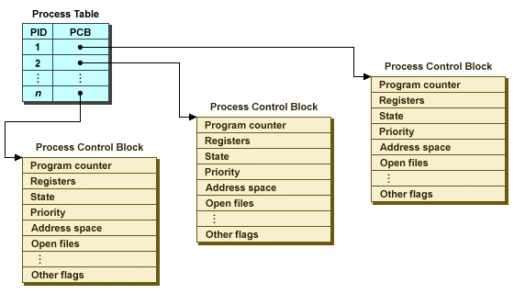
Process table and Process Control Block
Each process is associated with a Process Control Block (PCB)
There is one process table in the OS but there is one PCB for each process

Slide 39
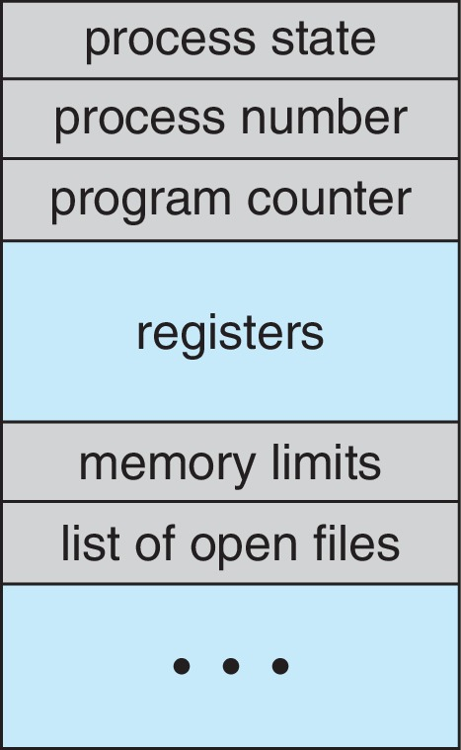
Process Control Block (PCB)
The PCB contains the following information about its process:
Process state – running, waiting, etc.
Program counter – location of instruction to be executed next
CPU registers – contents of all process-centric registers
CPU scheduling information- priorities, scheduling queue pointers
Memory-management information – memory allocated to the process
Accounting information – CPU used, clock time elapsed since start, time limits
I/O status information – I/O devices allocated to process, list of open files

Slide 40
Process State
The state of a process indicates its status at a particular time.
As a process executes, it changes state
  New: The process is being created
  Running: Instructions are being executed
  Waiting: The process is waiting for some event to occur
  Ready: The process is waiting to be assigned to a processor
  Terminated: The process has finished execution

Slide 41

Diagram of Process State
A state diagram is a graphical representation of the allowed
states of a process and the allowed transitions between states
The nodes of the graph in the diagram represent the possible states, and the edges represent possible transitions
The labels on the arcs specify the conditions that cause the transitions between states to occur

Slide 42
Process states explained
While a program is on the way to be transformed into an active process, it is said to be in the new state.
Once the transformation is completed, the OS puts the process in a queue of processes that are ready to run. The process is then in the ready or runnable state.
Eventually the component of the OS called the process scheduler selects a process to run. The process is in the running state when it is actually executing on the CPU
A process is in a blocked state if waiting for an event and is then not eligible to be picked for execution. Typically a process moves to the blocked state when it performs an I/O request

Slide 43
Steps in a Process Creation
Allocate a slot in the process table for the new process.
Assign a unique process ID to the child process.
Copy of process image of the parent, with the exception of any shared memory.
Increment the counters for any files owned by the parent, to reflect that an additional process now also owns those files.
Assign the child process to the Ready to Run state.
Because both processes (parent and child) may perform different tasks, we should be able to identify them. The return value is:
  Child’s process ID (in parent process)
  Zero (in the child process)
Child and parent processes execute different parts of the same program or the child process execute another program

Slide 44
Zombie processes
When a child exits, the parent process must wait() on it to get its exit code.
That exit code is stored in the process table until the parent execute wait()
Between the time a child exits and wait() is executed, the child is called a zombie
A zombie process has been erased from the main memory, it does not occupied space and does not used cpu
However, a zombie process has still his entry in the process table where its exit status is kept
(see zombie.c)

Slide 45
Example of zombie process
#include <stdio.h>#include <stdlib.h> #include <sys/types.h>
#include <unistd.h>#include <sys/wait.h>
/*the child will become a zombie*/
int main()
{
pid_t child_pid = fork();
if (child_pid > 0) {
printf("I am parent, will execute wait in 20 seconds, my pid is %ld\n", (long) getpid());
sleep(20);
wait(NULL);
printf("I am parent exiting \n");
}
else // Child process
if (child_pid == 0) {
printf("I am child, will exit in 5 seconds, my pid is %ld \n", (long) getpid());
sleep(5);
printf("I am child exiting \n");
exit(0);
}
return 0;
}

Slide 46
Orphan processes
If a parent process exits when its children are still running (and doesn't kill its children), those children are orphans.
Orphan processes are immediately adopted by another process, in our case it is the bash process
An orphan is a normal process, when it exit the adopting parent will take care that it does not become a zombie
(see orphan.c)

Slide 47
Example of orphan process
#include <stdio.h>#include <stdlib.h> #include <sys/types.h>
#include <unistd.h>
/*the child will become an orphan*/
int main()
{
pid_t child_pid = fork();
if (child_pid > 0) {
printf("I am parent, will finish execution in 5 seconds, before my child %ld\n", (long) getpid());
sleep(5);
}
else // Child process
if (child_pid == 0) {
printf("I am child, will sleep 15 seconds, before exiting %ld \n", (long) getpid());
sleep(15);
printf("I am child exiting \n");
}
return 0;
}

Slide 48
Process Scheduling
There are always a lot of processes active in same time but only one or few CPUs
The action of assigning a process to a CPU (moving from ready state to running state) is called scheduling
The process scheduler selects among available processes for next execution on CPU core
Goal -- Maximize CPU use, quickly switch processes onto CPU core
Maintains scheduling queues of processes
  Ready queue – set of all processes residing in main memory, ready and waiting to execute
  Wait queues – set of processes waiting for an event (i.e., I/O)
  Device queues – set of processes waiting for an I/O device
  Processes migrate among the various queues

Slide 49
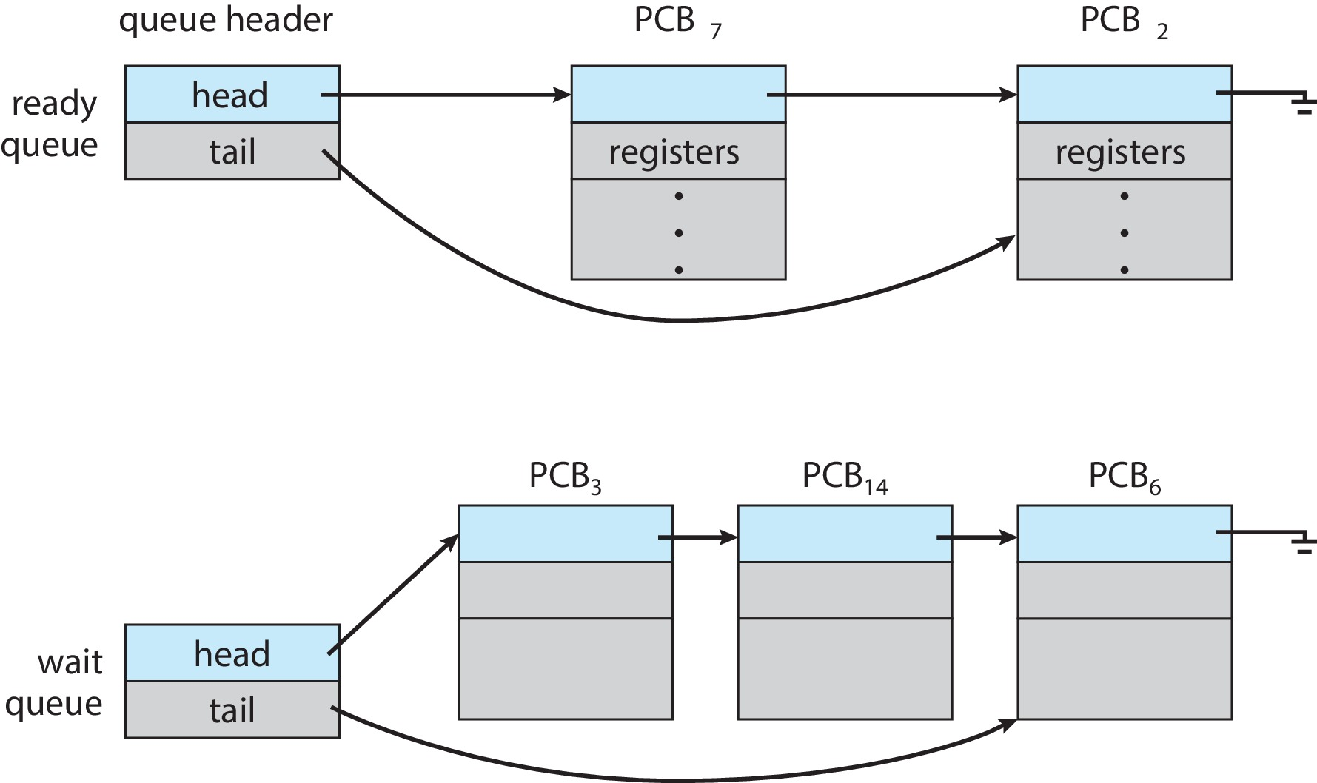
Ready and Wait Queues

Slide 50
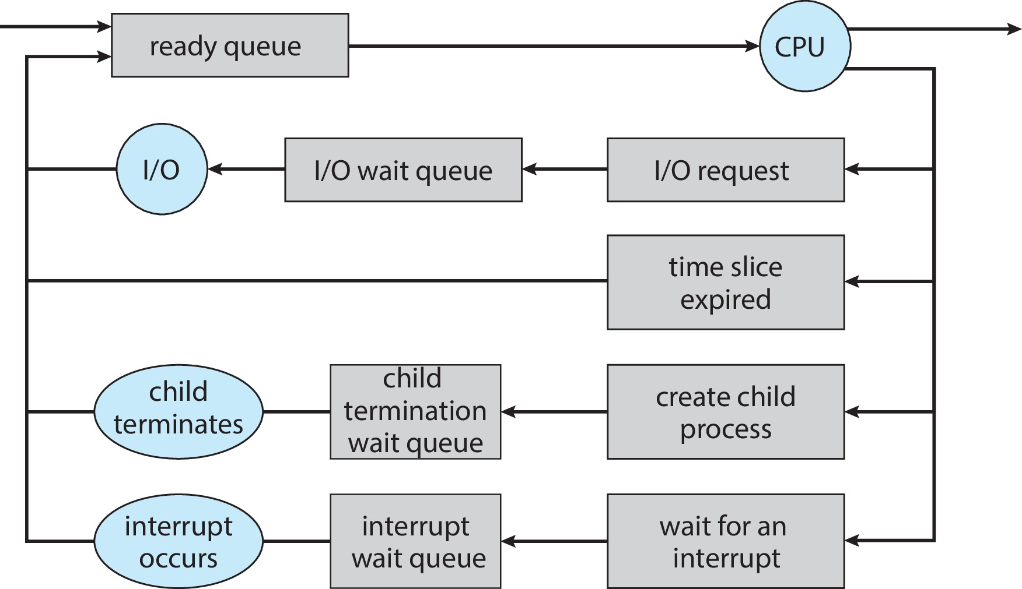
Representation of Process Scheduling

Slide 51
Process context
A context switch is the act of removing one process from the running state and replacing it by another.
The process context is the information that the operating systems needs about the process to restart it after a context switch.
For example, when a process is interrupted
  the current value of the program counter and processor registers (context data) need to be saved
  the state of the process is changed to “blocked” or “ready”
This information is stored in the process control block (PCB).

Slide 52
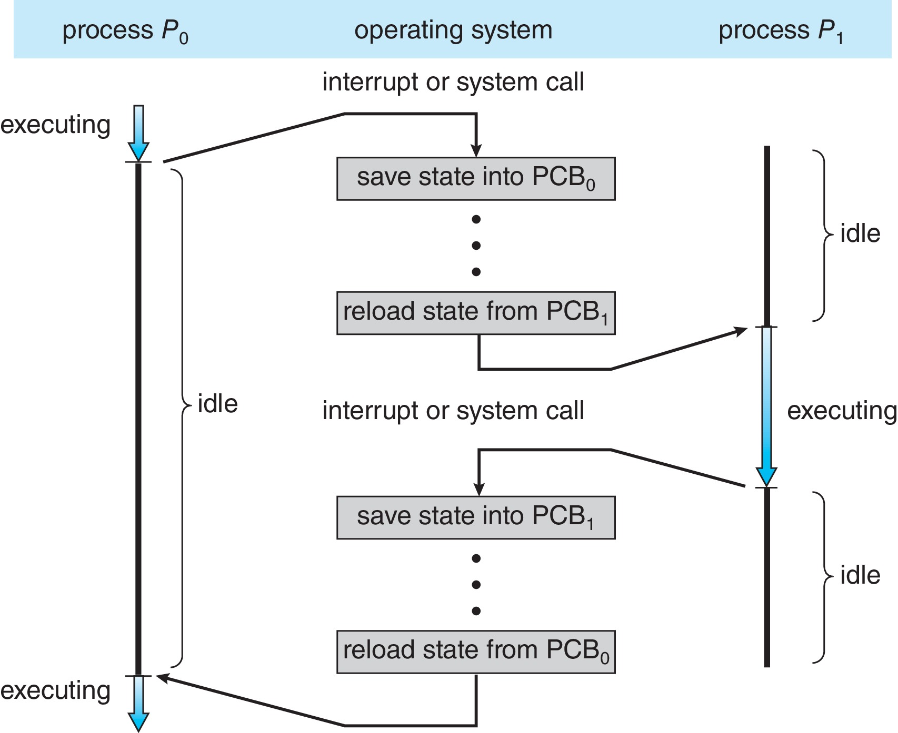
Context Switch from Process to Process
A context switch occurs when the scheduler removes a process from CPU to replace it by another process.
System save the state of the old process into its PCB and load the saved state of the new process from its PCB.

Slide 53
Steps in a Context Switch
The steps in a context switch are:
  Save context of processor including program counter and other registers
  Update the process control block of the process that is currently in the Running state
  Move process control block to appropriate queue – ready; blocked; ready/suspend
  Select another process for execution
  Update the process control block of the process selected
  Update memory-management data structures
  Restore context of the selected process
Notes:
If the currently running process is to be moved to another state (Ready, Blocked, etc.), then the OS must make substantial changes in its environment.
The steps involved in a full process switch are as follows:
1. Save the context of the processor, including program counter and other registers.
2. Update the process control block of the process that is currently in the Running state.
This includes changing the state of the process to one of the other states (Ready; Blocked; Ready/Suspend; or Exit). Other relevant fields must also be updated, including the reason for leaving the Running state and accounting information.
3. Move the process control block of this process to the appropriate queue (Ready;Blocked on Eventi; Ready/Suspend).
More next slide

Slide 54
Context Switch
Context-switch time is pure overhead; the system does no useful work while switching
  The more complex the OS and the PCB ➔ the longer the context switch
Time dependent on hardware support
  Some hardware provides multiple sets of registers per CPU ➔ multiple contexts loaded at once

Slide 55
End chapter 3

