Slide 1
Section 4: Threads

Slide 2
Outline
Overview
Multithreading Models
Thread Libraries
Threading Issues
Multicore Programming
Operating System Examples

Slide 3
Objectives
Identify the basic components of a thread, and contrast threads and processes
Describe the benefits and challenges of designing multithreaded applications
Describe how the Windows and Linux operating systems represent threads

Slide 4
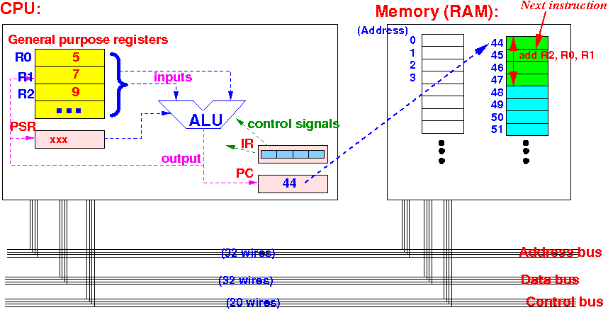
Instruction Execution Cycle

Slide 5
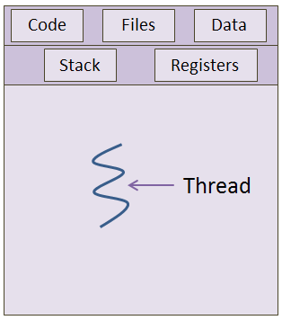
Threads
When a program executes, the CPU uses the program counter to determine which instruction to execute next.
The resulting stream of instructions is called the program's thread of execution
The stream of instructions can be represented by the sequence of addresses assigned to the program counter during the execution of the program's code.
A process may execute statements 245, 246 and 247 in a loop. Its thread of execution can be represented as 245, 246, 247, 245, 246, 247, 245, 246, 247 . . . ,
Each process executes a sequence of instructions which appears to the process as an uninterrupted stream of addresses

Slide 6

Multi-threaded processes
Multi-threading means to have multiple threads within the same process.
This is achieved by dividing the single thread into different sequences of addresses
Each thread has its own execution stack, program counter value, register set and state.

Slide 7
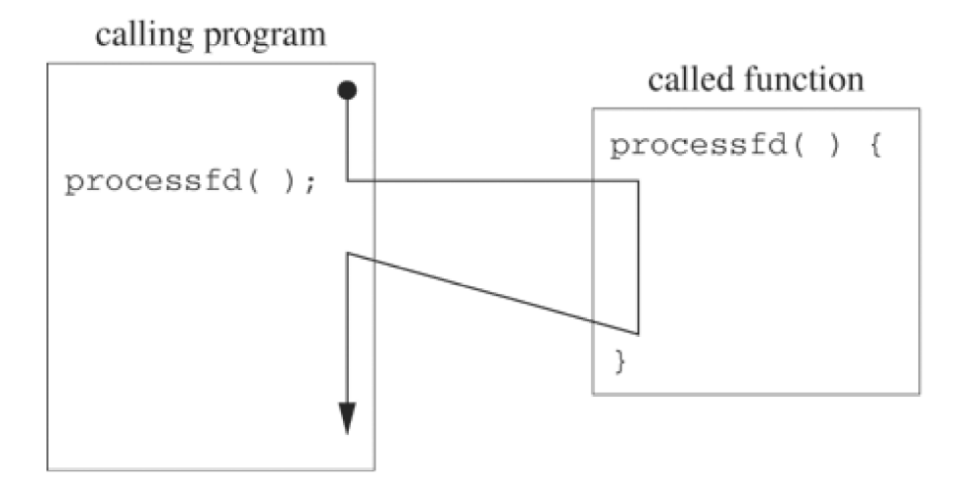
One thread execution
The figure below illustrates a call to a function (processfd) within the same thread of execution.
The calling mechanism creates an activation record on the stack
The thread of execution jumps to processfd when the calling mechanism writes the starting address in the processor's program counter.
The return statement copies the return address that is stored in the activation record into the program counter, causing the thread of execution to jump back to the calling program.

Slide 8
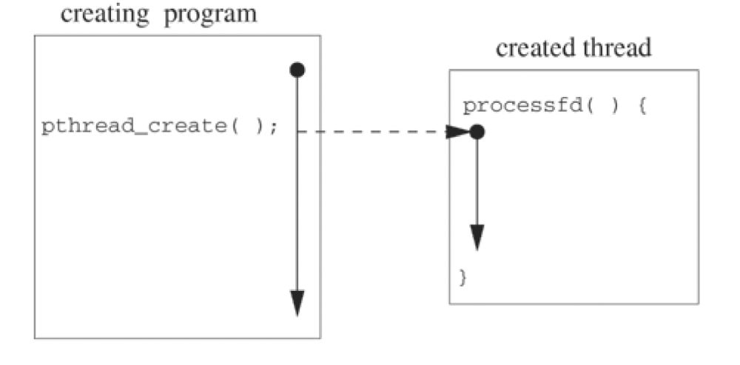
Two threads for the same program
Next figure illustrates the creation of a separate thread to execute the processfd function. The pthread_create call creates a new thread with its own value of the program counter, its own stack and its own scheduling parameters.
The thread executes an independent stream of instructions, never returning to the point of the call.
The calling program continues to execute concurrently. In contrast, when processfd is called as an ordinary function, the caller's thread of execution moves through the function code and returns to the point of the call, generating a single thread of execution rather than two separate

Slide 9
Threads package
Instructions for the management of threads are contained in a “thread package” (thread library)
Thread operations include:
  thread creation,
  termination,
  synchronization (joins,blocking),
  scheduling,
  data management
There are 3 main thread libraries:
  POSIX threads (are called pthreads because all the thread functions start with pthread)
  Win32 threads: Library for Windows
  Java threads

Slide 10
Some POSIX threads functions
pthread_create create a thread
pthread_join wait for a thread
pthread_exit exit a thread without exiting process
pthread_self find out own thread ID
Calling pthread_create
int pthread_create(pthread_t *thread, const pthread_attr_t *attr,
void *(*start_routine) (void *), void *arg);
first argument receives the thread id (tid), second are the attributes of the thread (such as scheduling priority), the third is the name of the function to execute by this thread, and last are the parameters of the function

Slide 11
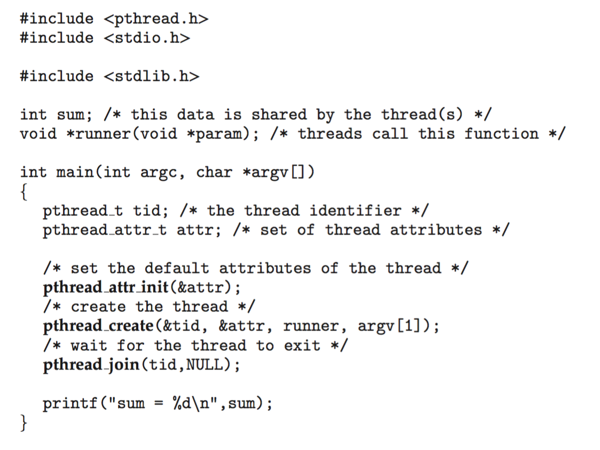
Pthreads Example

Slide 12
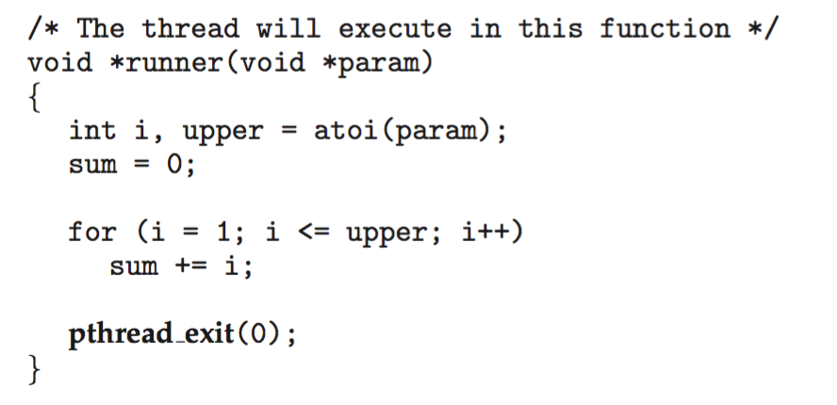
Pthreads Example (Cont.)

Slide 13
Pthreads Example (Cont.)
The program above takes an input parameter n and adds the sequence of numbers from 0 to n.
It has two threads: the initial (or parent) thread in main() and the summation (or child) thread performing the summation operation in the runner() function. (see Linux thread1.c)
Pthreads programs must include the pthread.h header file.
The statement pthread_t tid declares the variable that will hold the id of the thread to be created.
The summation thread “runner” has local variables that can only used by that thread
  It has also a global variable “sum” which is shared by all the threads: Static (global) variables are shared by all threads
The summation thread terminates when it calls the function pthread_exit(0).
Once the summation thread has returned, the parent thread will output the value of the shared static variable sum.
ps –T to see all the threads that are running, SPID are the threads ID
To compile with threads: gcc thread.c -o thread –lpthread

Slide 14
Pthread example (cont.)
This program follows the thread create/join strategy, whereby after creating the summation thread, the parent thread wait for it to terminate by calling the pthread join() function.
Each thread has a set of attributes, including stack size and scheduling information.
  The declaration pthread attr_t attr defines the storage for the attributes of the thread.
  Because the attributes are not explicitly set, the default attributes are passed using the function call pthread_attr_init(&attr).

Slide 15
Waiting for a thread: pthread_join
The pthread_join function causes the caller to wait for the specified thread to exit, similar to waitpid at the process level.
int pthread_join(pthread_t thread, void **value_ptr);
where first parameter is the thread id and the second one provides a location for a pointer to the return status that the target thread passes to
pthread_exit or return. If value_ptr is NULL, the caller does not retrieve the target thread return status.
if (error = pthread_join(tid, &exitcodep))
fprintf(stderr, "Failed to join thread: %s\n", strerror(error));
else
fprintf(stderr, "The exit code was %d\n", *exitcodep);

Slide 16
Thread termination after exit
When a thread exits, by calling pthread_exit(), it does not release its resources. The command pthread_exit() only signal the parent thread that the child thread has finished
It is only when the parent executes pthread_join() that the resources of child thread are released (such as memory for the run time stack)
However, as shown in the texit1.c, the thread ID is removed from the process table immediately after the thread has exited
Child threads that have exited but for which the join has not yet been executed by the parent thread have similar status as a zombie process except they are no longer in the process table
If parent threads never execute join, then we have memory leak, it may come to a point where threads can no longer be created
Do ps –T to get the thread id in linux

Slide 17
texit1.c
int sum;void *runner(void *param);
int main(int argc, char *argv[]) {
pthread_t tid;
pthread_create(&tid, &attr, runner, argv[1]);
sleep(10); /*wait for child thread*/
pthread_join(tid,NULL);
}
void *runner(void *param){
pthread_t tid2 = syscall(SYS_gettid);
int i, upper = atoi(param); sum = 0;
for (i = 1; i <= upper; i++)
sum += i;
pthread_exit(0);
}
Ps -T
PID SPID CMD
4222 pts/0 00:00:00 texit1
4222 4223 pts/0 00:00:00 texit1
4224 4224 pts/0 00:00:00 ps
Child thread exit, ID is 4223
ps -T
PID SPID CMD
4222 pts/0 00:00:00 texit1
4225 4225 pts/0 00:00:00 ps

Slide 18
Terminating thread: pthread_detach
The pthread_detach function sets a thread's internal options to specify that storage for the thread can be reclaimed when the thread exits.
int pthread_detach(pthread_t thread);
pthread_detach(pthread_self());
pthread_exit();
Here the thread detach itself. Here is another example
pthread_create(&tid, NULL, processfd, &fd);
pthread_detach(tid);
Essentially, threads that are detached release all their resources once they exit.
To prevent memory leaks, long-running programs should eventually call either pthread_detach or pthread_join for every thread.

Slide 19
Terminating process
A process can terminate by calling exit directly, by executing return from main, or by having one of the other process threads call exit. (see texit2.c)
In any of these cases, all threads terminate. If the main thread has no work to do after creating other threads, it should either block until all threads have completed or call pthread_exit(NULL).
A call to exit causes the entire process to terminate; a call to pthread_exit causes only the calling thread to terminate
A process will exit if its last thread calls pthread_exit.

Slide 20
texit2.c
int sum;void *runner(void *param);
int main(int argc, char *argv[]) {
pthread_t tid;
pthread_create(&tid, &attr, runner, argv[1]);
sleep(10); /*wait for child thread*/
pthread_join(tid,NULL);
pthread_exit(0);
}
void *runner(void *param){
pthread_t tid2 = syscall(SYS_gettid);
int i, upper = atoi(param); sum = 0;
for (i = 1; i <= upper; i++)
sum += i;
exit(0);
}
ps-T
PID SPID CMD
4402 4402 pts/0 00:00:00 texit2
4402 4403 pts/0 00:00:00 texit2
4404 4404 pts/0 00:00:00 ps
Child thread exit with exit(0), ID is 4403
ps -T
PID SPID CMD
4405 4405 pts/0 00:00:00 ps

Slide 21
Killing a thread
Threads can force other threads to return through the cancellation mechanism.
A thread calls pthread_cancel to request that another thread be canceled.
The single parameter of pthread_cancel is the thread ID of the target thread to be canceled.
The pthread_cancel function does not cause the caller to block while the cancellation completes. Rather, pthread_cancel returns after making the cancellation request.
(see texit3.c)

Slide 22
texit3.c
int sum; void *runner(void *param);
int main(int argc, char *argv[]){
pthread_t tid;
pthread_create(&tid, &attr, runner, argv[1]);
sleep(4);
pthread_cancel(tid);
pthread_join(tid,NULL);
printf("Parent thread has canceled the child thread \n");
pthread_exit(0);}
}
void *runner(void *param){
int i, upper = atoi(param);
sleep(10);
pthread_exit(0);
}
ps-T
PID SPID CMD
4478 4478 pts/0 00:00:00 texit3
4478 4479 pts/0 00:00:00 texit3
4480 4480 pts/0 00:00:00 ps
Parent thread has canceled the child thread
ps -T
PID SPID CMD
4478 4478 pts/0 00:00:00 texit3
4481 4481 pts/0 00:00:00 ps

Slide 23
Same thread program for Windows
#include <Windows.h> #include <stdio.h>
DWORD Sum;
DWORD WINAPI Summation(LPVOID Param){
DWORD Upper = *(DWORD*)Param;
for (DWORD i = 0; i <= Upper; i++)
Sum += i;
return 0;
}
int main(int argc, char *argv[] ){
DWORD ThreadId;
HANDLE ThreadHandle;
int Param;
Param = atoi(argv[1]);
ThreadHandle = CreateThread(NULL,0,Summation,&Param,0,&ThreadId) ;
if(ThreadHandle != NULL){
WaitForSingleObject(ThreadHandle, INFINITE);
CloseHandle(ThreadHandle);
printf("sum= %d\n", Sum);
}
}
(see C:Teaching/HUST/Operating Systems/Exercises/TW)

Slide 24
Two other examples
See pdf files PthreadEx1 and PthreadEx2 also the C code for these example in thread2.c and thread3.c
PthreadEx1 has 3 threads, the main and 2 others.
  The two threads execute the same function
  Two data structures are declared and initialized in main, one is passed as argument to thread1 and the other to thread2.
  Each thread print the content of the received data structure.
PthreadEx2 defines an array of 1000000 double.
  The program adds number from 1 to 1000000, this addition is parallelize using some number of threads.
  Each thread adds a different sub-sequence of 1000000/4 numbers.
  Once a thread has completed the addition of its sub-sequence of numbers it write the value into a global variable sum.
  To avoid that two threads write in same time in the global variable, a synchronization primitive is used to guarantee exclusive access to the global variable.

Slide 25
thread2.c
void *message_function ( void *ptr );
typedef struct str_thdata{
int thread_no; char message[100];
} thdata; /* structs to be passed to threads */
int main(){
pthread_t thread1, thread2;
thdata data1, data2;
data1.thread_no = 1;
strcpy(data1.message, "Hi prof!");
data2.thread_no = 2;
strcpy(data2.message, "Hi Students!");
pthread_create (&thread1, NULL, message_function, (void *) &data1);
pthread_create (&thread2, NULL, message_function, (void *) &data2);
pthread_join(thread2, NULL);
pthread_join(thread1, NULL);
pthread_exit(0);
}
void *message_function ( void *ptr ){
thdata *data;
data = (thdata *) ptr;
printf("Thread %d with thread id %ld says %s \n", data->thread_no, tid1, data->message);
sleep(5);
pthread_exit(0);
}

Slide 26
thread3.c: child thread
#define NTHREADS 4
#define ARRAYSIZE 1000000
#define ITERATIONS ARRAYSIZE / NTHREADS
double sum=0.0, a[ARRAYSIZE];
pthread_mutex_t sum_mutex;
void *do_work(void *tid) {
int i, start, *mytid, end;
double mysum=0.0;
mytid = (int *) tid;
start = (*mytid * ITERATIONS);
end = start + ITERATIONS;
for (i=start; i < end ; i++) {a[i] = i * 1.0; mysum = mysum + a[i]; }
pthread_mutex_lock (&sum_mutex);
sum = sum + mysum;
pthread_mutex_unlock (&sum_mutex);
sleep(15); pthread_exit(NULL);
}

Slide 27
thread3.c
#define NTHREADS 4
#define ARRAYSIZE 1000000
#define ITERATIONS ARRAYSIZE / NTHREADS
double sum=0.0, a[ARRAYSIZE];
pthread_mutex_t sum_mutex;
int main(int argc, char *argv[]){
int i, start, tids[NTHREADS];
pthread_t threads[NTHREADS];
pthread_mutex_init(&sum_mutex, NULL);
for (i=0; i<NTHREADS; i++) {
tids[i] = i;
pthread_create(&threads[i], &attr, do_work, (void *) &tids[i]);
}
/* Wait for all threads to complete then print global sum */
for (i=0; i<NTHREADS; i++)
pthread_join(threads[i], NULL);
printf ("Done. Sum= %e \n", sum);
sum=0.0;
for (i=0;i<ARRAYSIZE;i++){
a[i] = i*1.0; sum = sum + a[i]; }
printf("Check Sum= %e\n",sum); /* Clean up and exit */
pthread_mutex_destroy(&sum_mutex);
pthread_exit (NULL);
}

Slide 28
Why use threads
There are four major categories of benefits to multi-threading:
  Responsiveness:
    One thread may provide rapid response while other threads are blocked or slowed down doing intensive calculations.
  Resource sharing:
    By default threads share common code, data, and other resources, which allows multiple tasks to be performed simultaneously in a single address space.
  Economy:
    Creating and managing threads ( and context switches between them ) is much faster than performing the same for processes.
  Parallelism, i.e. utilization of multiprocessor architectures:
    A single threaded process can only run on one CPU, whereas the execution of a multi-threaded application may be split amongst available processors.

Slide 29
Parallelism vs concurrency
Parallelism
    implies a system can perform more than one task simultaneously
Concurrency
  supports more than one task making progress

Slide 30
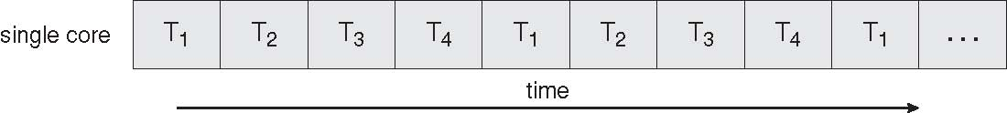
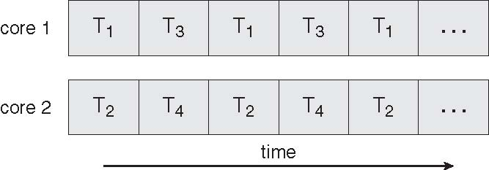
Single/Multicore systems
In a single core, multithreading only implement concurrency where thread interleave over time but only one thread is executed at a time
Multiple computing cores on a single cheap
Multithreading helps to efficiently used multiple core architectures, threads may run in parallel

Slide 31
Multicore Programming
Types of parallelism
  Data parallelism – distributes subsets of the same data across multiple cores, same operation on each
  Task parallelism – distributing threads across cores, each thread performing unique operation

Slide 32
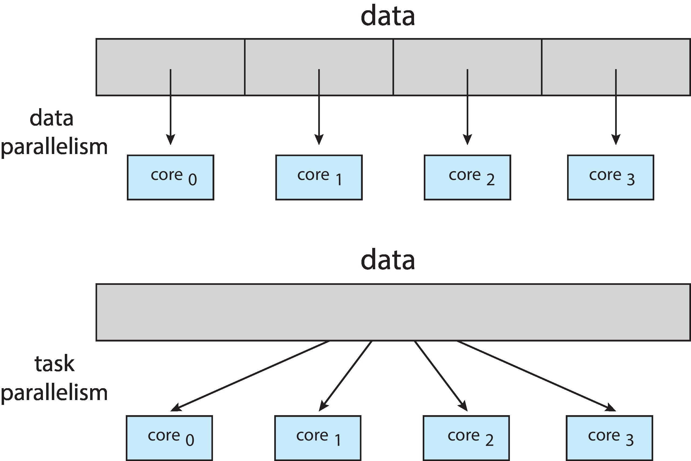
Data and Task Parallelism

Slide 33
Threads attributes: State
pthread_attr_t attr; /* set of thread attributes */
pthread_attr_init(&attr);
pthread_create(&tid, &attr, runner, argv[1]);
When a thread is created, it is passed a set of attributes which are used to run the thread.
Settable properties of thread attributes are state, stack, scheduling.
The pthread_attr_init function initializes a thread attribute with default values. This is the case with the example above.
Thread state: The possible values of the thread state are PTHREAD_CREATE_JOINABLE and PTHREAD_CREATE_DETACHED.
By default, threads are joinable. You can detach a thread by calling the pthread_detach function after creating the thread. Alternatively, you can create a thread in the detached state by using an attribute object with thread state PTHREAD_CREATE_DETACHED

Slide 34
Threads attributes: Stack
A thread has a stack whose location and size are user-settable. To define the placement and size of the stack for a thread, you must first create the stack attributes using pthread_attr_setstack function which sets the stack parameters
First the function pthread_attr_getstack must be called to examine the stack parameters

Slide 35
Threads attributes: Scheduling
The contention scope controls whether the thread competes within the process or at the system level for scheduling resources.
The pthread_attr_getscope examines the contention scope, and the pthread_attr_setscope sets the contention scope of the thread
The following code segment creates a thread that contends for kernel resources:
pthread_attr_t tattr;
pthread_t tid;
pthread_attr_init(&tattr);
pthread_attr_setscope(&tattr, PTHREAD_SCOPE_SYSTEM);
pthread_create(&tid, &tattr, processfd, &fd);

Slide 36
Threads attributes: Scheduling
Thread scheduling also specifies the priority of the thread
The sched_priority field holds an int priority value, with larger priority values corresponding to higher priorities. Implementations must support at least 32 priorities
The following code segment creates a dothis thread with the default attributes, except that the priority is HIGHPRIORITY.
int fd;
pthread_attr_t tattr;
pthread_t tid;
struct sched_param tparam;
tattr = makepriority(HIGHPRIORITY);
pthread_create(&tid, tattr, dothis, &fd);
Threads of the same priority compete for processor resources as specified by their scheduling policy. The sched.h header file defines SCHED_FIFO for first-in-first-out scheduling, SCHED_RR for round-robin scheduling and SCHED_OTHER for some other policy

Slide 37
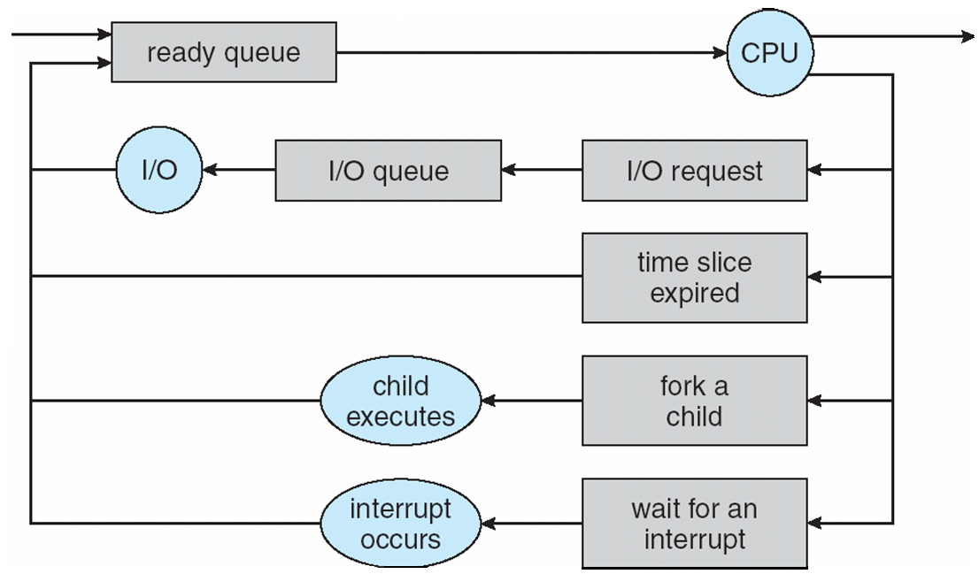
Scheduling
When processes support multi-threading the scheduling and execution is done at the thread level

Slide 38
Thread control block (TCB)
Very similar to Process Control Block (PCB) which represents processes, Thread Control Blocks (TCBs) represents threads generated in the system
The TCB includes:
  Thread Identifier: Unique id (tid) is assigned to every new thread
  Stack pointer: Points to thread's stack in the process
  Program counter: Points to the current program instruction of the thread
  State of the thread: (running, ready, waiting, start, done)
  Thread’s register values:
  Pointer to the process control block (PCB) of the process that the thread lives on

Slide 39
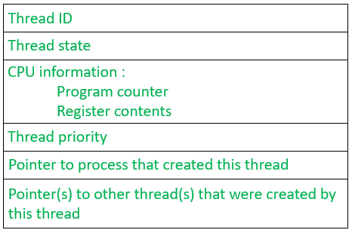
Thread control block

Slide 40
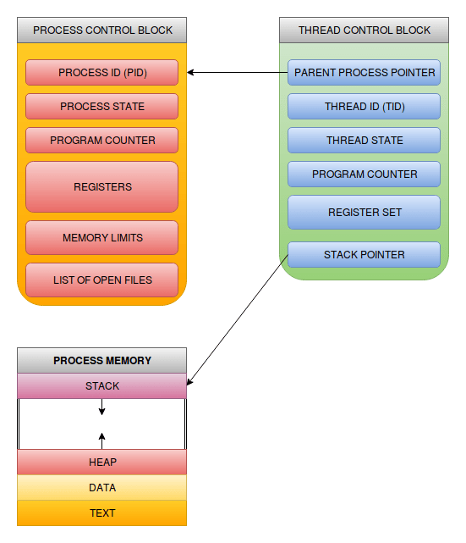
Process vs thread control blocks

Slide 41
Process Context Switch
The steps in a process context switch are:
  Save context of processor including program counter and other registers
  Update the process control block of the process that is currently in the Running state
  Move process control block to appropriate queue – ready; blocked; ready/suspend
  Select another process for execution
  Update the process control block of the process selected
  Update memory-management data structures
  Restore context of the selected process
vmstat 1 3 The first line gives the average number of context switches over 1 second since the system booted, and the next two lines give the number of context switches over two 1-second intervals
cat /proc/2166/status number of context switches for a given process
Notes:
If the currently running process is to be moved to another state (Ready, Blocked, etc.), then the OS must make substantial changes in its environment.
The steps involved in a full process switch are as follows:
1. Save the context of the processor, including program counter and other registers.
2. Update the process control block of the process that is currently in the Running state.
This includes changing the state of the process to one of the other states (Ready; Blocked; Ready/Suspend; or Exit). Other relevant fields must also be updated, including the reason for leaving the Running state and accounting information.
3. Move the process control block of this process to the appropriate queue (Ready;Blocked on Eventi; Ready/Suspend).
More next slide

Slide 42
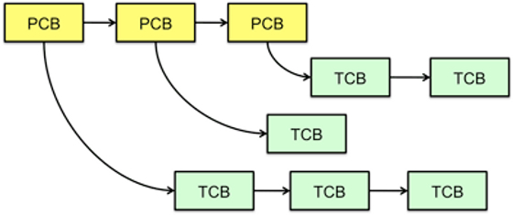
Thread context switch
  A thread context switch can be understood as a context switch inside a process:
    1-Save context of processor including program counter and other registers in TCB
    2-Update the thread control block of the thread that is currently in the Running state
    3- Move thread control block to appropriate queue – ready; blocked; ready/suspend
    4- Select another thread for execution
    5- Update the thread control block of the thread selected

Slide 43
Threads context switch within different processes
Process and thread context switch are the same up to this point:
  6- the kernel checks if the scheduled and unscheduled threads belong to the same process.
  7- If not ("process" rather than "thread" switch), the kernel resets the current address space by pointing the MMU (Memory Management Unit) to the page table of the scheduled process.
  8- The TLB (Translation Lookaside Buffer), which is a cache containing recent virtual to physical address translations, is also flushed to prevent erroneous address translation.
Note that these are the only steps in the entire set of context switch actions that cares about processes!

Slide 44
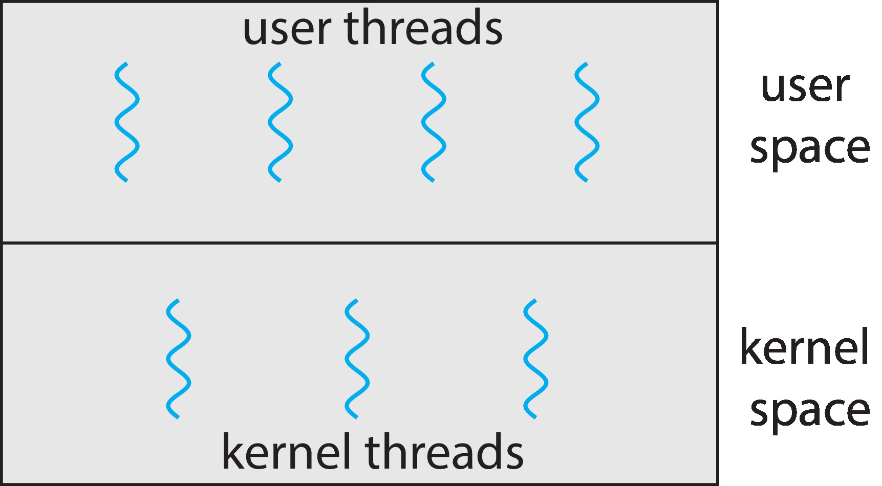
User and Kernel Threads
Support for threads may be provided either at the user level, for user threads, or by the kernel, for kernel threads.
User threads are supported above the kernel and are managed without kernel support, whereas kernel threads are supported and managed directly by the operating system.
However there must be a relationship between user threads and kernel threads

Slide 45
User level Threads
For user level threads, the thread library is implemented entirely in user space with no kernel support.
All code and data structures for the library exist in user space. This means that invoking a function in the library results in a local function call in user space and not a system call.
User-level threads have low overhead, but they have the disadvantages of running as a single thread at the kernel level, therefore no parallel execution is possible among the user threads of a same process.

Slide 46
Kernel Threads (KLT)
For kernel threads, the thread library is implemented at the kernel-level library and supported directly by the operating system.
In this case, code and data structures for the library exist in kernel space.
Invoking a function in the API for the library typically results in a system call to the kernel, for example creating a thread results in a system call
Virtually all general -purpose operating systems support kernel threads, including:
  Windows, Linux, Mac OS X, iOS, Android
Kernel-level threads have more overhead (can be almost as expensive as the scheduling of processes themselves) but kernel level threads of a same process can execute in parallel

Slide 47
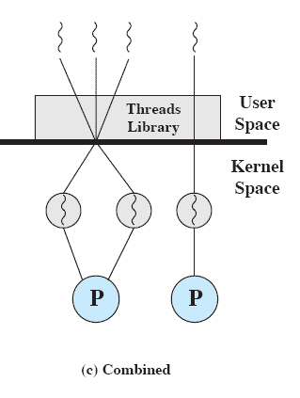
Mapping user threads to kernel threads
The user writes the program in terms of user-level threads and then specifies how many kernel-schedulable entities are associated with the process.
The user-level threads are mapped into the kernel-schedulable entities at runtime to achieve parallelism.
Linux and Windows OS’s map each user level thread to a kernel thread, mappings is one-to-one

Slide 48
POSIX threads mapping
POSIX uses thread-scheduling contention scope, which gives the programmer some control over how user level threads are mapped to kernel threads.
A thread can have a contentionscope attribute of either PTHREAD_SCOPE_PROCESS or PTHREAD_SCOPE_SYSTEM.
Threads with the PTHREAD_SCOPE_PROCESS attribute contend for processor resources with the other threads in their process.
Threads with the PTHREAD_SCOPE_SYSTEM attribute contend systemwide for processor resources, much like kernel-level threads.
POSIX leaves the mapping between PTHREAD_SCOPE_SYSTEM threads and kernel entities up to the implementation, but the obvious mapping is to bind such a thread directly to a kernel entity.

Slide 49
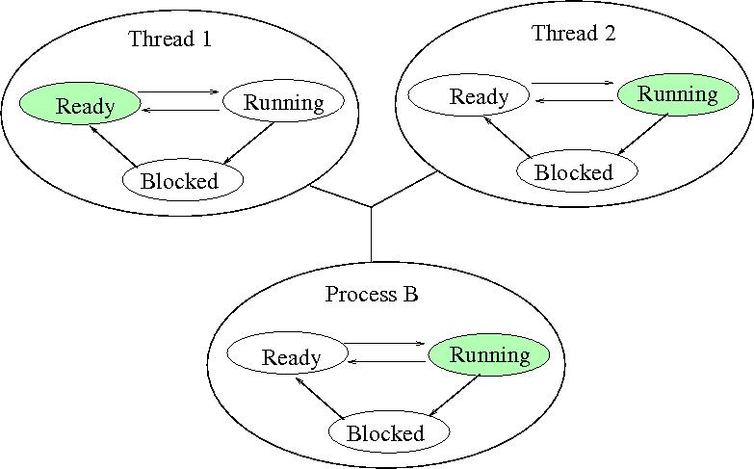
Many-to-one: many ULTs to one KLT
Process B is running
Thread one is ready
Thread 2 is running

Slide 50
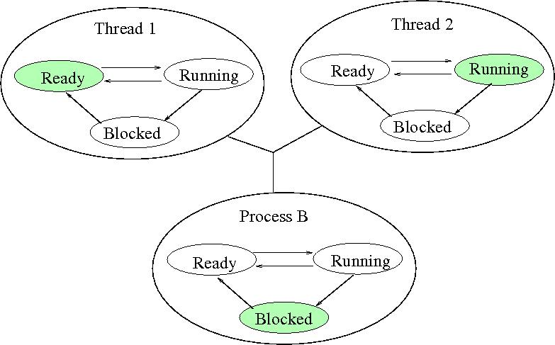
Many ULTs versus one KLT (2)
Thread 2 made a system call
Which blocks process B

Slide 51
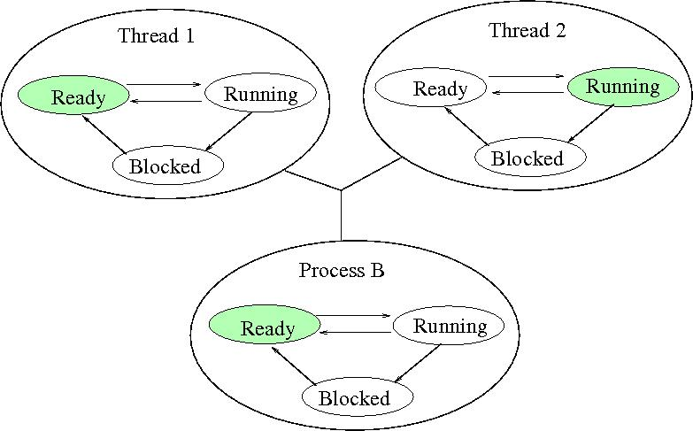
Many ULTs versus one KLT (3)
Once the system call has been served, OS place process B in the Ready queue
According to data structure of the user level threads library, thread 2 still running

Slide 52
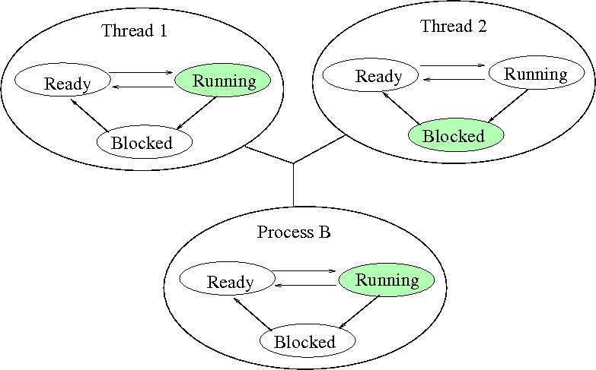
Many ULTs versus one KLT (4)
Process B moves into the running state
Thread 2 needs actions performed by thread 1
Thread 2 enters in a blocked state
Thread 1 transits from Ready to Running

Slide 53
Threading Issues
Semantics of fork() and exec() system calls
Thread execution
Thread cancellation of target thread

Slide 54
Semantics of fork() and exec()
Does fork() duplicate only the calling thread or all threads?
  Some Unix (Solaris) have two versions of fork():
    One duplicate all threads: forkall()
    One duplicate only the thread invoking fork1()
The execution of exec() destroy completely the calling program, including all the threads belonging to the corresponding process
  Should not use the fork that duplicate all threads if exec() is called

Slide 55
Relations Threads/Processes
Actions that affect all of the threads in a process:
  The OS must manage these at the process level
Examples:
  Suspending a process (swapping the process out of the main memory) involves suspending all threads of the process
  Termination of a process, terminates all threads within the process

Slide 56
Thread Execution States
Key thread states are Running, Ready and Waiting
No suspend states as it is a per-process concept
  If a process is swapped out, so all the threads since they shared the same address space with the swapped process

Slide 57
Thread Execution States (cont)
A thread is blocked when waiting for an event (saving its registers, program counter and stack pointers)
The occurrence of the event on which the thread was blocked triggers the thread to be placed in the ready queue
A thread within the process may spawn other threads
May synchronize with other threads
  Similar to processes

Slide 58
Operating System Examples
Linux Threads

Slide 59
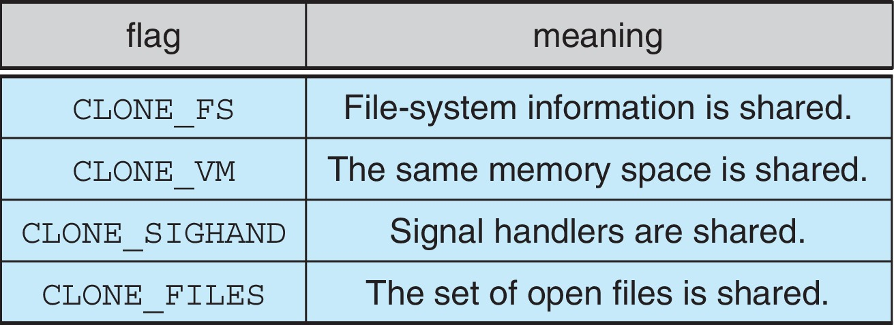
Linux Process/Thread Model
Linux does not recognize a distinction between processes and threads
  it uses the more generic term "tasks".
Linux has a single command to create processes or threads, it is clone()
clone( ) allows for varying degrees of sharing between the parent and child tasks, controlled by flags such as those shown in the following table:
Calling clone( ) with no flags set is equivalent to fork( ).
Calling clone( ) with CLONE_FS, CLONE_VM, CLONE_SIGHAND, and CLONE_FILES is equivalent to creating a thread, as all of these data structures will be shared.

Slide 60
Clone(): example
The flag CLONE_VFORK means the execution of the calling process is suspended until the child exit
The flag CLONE_VM has been defined, if not used, the two tasks are in different memory spaces, the parent task is copied in the child task, any changes by the child task will not be visible to the parent
#define _GNU_SOURCE #include <stdio.h> #include <unistd.h> #include <stdlib.h>
#include <sched.h> #include <signal.h>
#define FIBER_STACK 8192
void * stack; int b = 0;
int do_something(){
while (b<10){
printf("pid : %d, b = %d\n", getpid(), b++);
}
exit(0);
}
int main() {
void * stack;
stack = malloc(FIBER_STACK);
int a = 0;
if (a == 0)
clone(&do_something, (char *)stack + FIBER_STACK, CLONE_VM|CLONE_VFORK, 0);
//clone(&do_something, (char *)stack + FIBER_STACK, CLONE_VFORK, 0);
while (a<10){
printf("pid : %d, a = %d, b = %d\n", getpid(), a++,b);
}
free(stack);
exit(0);
}

Slide 61
End of Section 4

