Slide 1
Section 6: Synchronization Tools

Slide 2
Processes/Threads Synchronization
Synchronization problems such as the Critical-Section Problem
Synchronization solutions:
  Hardware instructions
  Mutex locks
  Binary semaphores
  Counting semaphores
Synchronization Examples

Slide 3
The data consistency problem
int sum = 0;
thread(k..l){
int local-sum = 0;
int temp;
int i;
for (i=k;i<= l;i++)
local-sum = local-sum + i;
temp = sum;
--------------------------
sum = temp + local-sum;
}
main(){
makethread1(thread(1..5));
makethread2(thread(6..10));
}
memory
thread1
thread2
The value of sum depends on the schedule order of the two threads!

Slide 4
Objectives
Introduce the critical-section problem, whose solutions can be used to ensure the consistency of shared data
Present software and hardware synchronization primitives
Describe different synchronization problems and solution approaches using synchronization primitives

Slide 5
Motivation
When a parent process executes fork():
  The parent page table is updated to be copy on write
  The parent page table is copied to become the child page table
  A process control block is created for the child process
  A new row is added in the process table to store info about the new child process
All these operations are done on behalf of the parent process
At any time the parent process can be de-scheduled
  The first 3 data structures are not shared among processes
  However the fourth one is shared among all the processes and threads
If the parent process is de-scheduled in the middle of updating the process table
  ps –ef may return the entry for the child process with missing info (no big deal)
  Or the same row is used to enter the info of 2 different processes (BIG DEAL)

Slide 6
Motivation
One solution to the above problem is to make the kernel non-preemptive, i.e. processes running kernel code cannot be de-scheduled until kernel code is completed
The Linux kernel is fully preemptive, unlike many other Unix like OSs
In this case, the synchronization tools describe in this section are used to make sure shared data structure are updated in a consistent manner
Preemptive kernels are much more complicated to design and program but they improve response time of user oriented processes as well as of high priority real time and system processes

Slide 7
Background/Motivation
Cooperating processes have concurrent access to shared data:
  Threads: data section
  Processes: shared memory segment
This sharing may result in data inconsistency (variables get values which cannot have occurred according to the algorithm)
Maintaining data consistency requires mechanisms to ensure the orderly execution of cooperating processes

Slide 8
Example: thread
#define NTHREADS 4
#define ARRAYSIZE 1000000
#define ITERATIONS ARRAYSIZE / NTHREADS
double sum=0.0, a[ARRAYSIZE];
pthread_mutex_t sum_mutex;
void *do_work(void *tid) {
int i, start, *mytid, end;
double mysum=0.0;
mytid = (int *) tid;
start = (*mytid * ITERATIONS);
end = start + ITERATIONS;
for (i=start; i < end ; i++) {a[i] = i * 1.0; mysum = mysum + a[i]; }
pthread_mutex_lock (&sum_mutex);
sum = sum + mysum;
pthread_mutex_unlock (&sum_mutex);
sleep(15); pthread_exit(NULL);
}
The threads that execute the function “do_work” share the double “sum”
Threads cannot be allowed to execute the instruction “sum = sum + mysum” is same time, otherwise the value of sum may be inconsistent
The “mutex” synchronization primitive allows only one thread at a time to update sum

Slide 9
Producer-consumer problem
This a prototypal example of the problems we address in this section:
  A producer thread write data in an array “buffer[]” and a consumer thread read the data from an entry of “buffer[]”
  Producer and consumer must synchronize, so for example the consumer does not try to consume an item when the buffer is empty
  We can synchronize by having the two threads to share a synchronization variable, count.
  Thus, count is incremented every time a new item is added in buffer and is decremented every time one item is removed from buffer
while (true) { /*Consumer*/
while (count == 0);
// do nothing, buffer empty
Item = buffer[out];
out = (out + 1) % buffer_size;
count--;
consume the item Item;
}
while (true) { /*Producer*/
produce an item Item;
while (count == buffer_size);
//do nothing, buffer full
buffer [in] = Item;
in = (in + 1) % buffer_size;
count++;
}

Slide 10
Problems with the shared var “count”
The variable count “must be” a static/global variable shared by both threads
Problems arise when the two threads try in same time to increase and decrease the value of count:
  Suppose that the value of the variable count = 5
  The producer and consumer execute the non-atomic statements count++ and count-- concurrently.
  Then the new value of count could be 4, 5, or 6!
while (true) { /*Consumer*/
while (count == 0);
// do nothing, buffer empty
Item = buffer[out];
out = (out + 1) % buffer_size;
count--;
consume the item Item;
}
while (true) { /*Producer*/
produce an item Item;
while (count == buffer_size);
//do nothing, buffer full
buffer [in] = Item;
in = (in + 1) % buffer_size;
count++;
}

Slide 11
Imlementation of “count” update
Instructions count++ and count– can be implemented in machine instructions such as:
  count++
  register1 = count
  register1 = register1 + 1
  count = register1
  count--
  register2 = count
  register2 = register2 - 1
  count = register2

Slide 12
Count update (cont)
  The sequence of the concurrent executions of these instructions could be as below:
  S0: producer execute register1 = count {register1 = 5}
  S1: producer execute register1 = register1 + 1 {register1 = 6}
  S2: consumer execute register2 = count {register2 = 5}
  S3: consumer execute register2 = register2 - 1 {register2 = 4}
  S4: producer execute count = register1 {count = 6 }
  S5: consumer execute count = register2 {count = 4}
register1 = count
register1 = register1 + 1
count = register1
register2 = count
register2 = register2 – 1
count = register2

Slide 13
Race Condition
Variations in the outcome of the computation are caused by the scheduler which determines in which order threads modify the variable count
This is called race condition because processes are seen as racing to access the shared variable
  S0: producer execute register1 = count {register1 = 5}
  S1: producer execute register1 = register1 + 1 {register1 = 6}
  S2: consumer execute register2 = count {register2 = 5}
  S3: consumer execute register2 = register2 - 1 {register2 = 4}
  S4: producer execute count = register1 {count = 6 }
  S5: consumer execute count = register2 {count = 4}

Slide 14
Critical section
Several threads access and manipulate the same data concurrently.
  The outcome of the execution depends on the particular order in which the access is granted to sharing threads
To guard against the race condition, we need to ensure that:
  Only one thread at a time can access and modify shared variables
This section of the code that can be executed by only one thread at a time is called a “critical section”
  .

Slide 15
Critical section
The critical sections in the producer-consumer problem above are the code sections where the shared variable “count” is updated
while (true) { /*Consumer*/
while (count == 0);
// do nothing
Item = buffer[out];
out = (out + 1) % buffer_size;
count--; //critical section
consume the item Item;
}
while (true) { /*Producer*/
produce an item Item;
while (count == buffer_size);
//do nothing
buffer [in] = Item;
in = (in + 1) % buffer_size;
count++; //critical section
}
Note that although these two threads execute different functions, they still compete with each other to update the variable count
The section of these functions that update count must not be executed in same time

Slide 16
Example: thread
#define NTHREADS 4
#define ARRAYSIZE 1000000
#define ITERATIONS ARRAYSIZE / NTHREADS
double sum=0.0, a[ARRAYSIZE];
pthread_mutex_t sum_mutex;
void *do_work(void *tid) {
int i, start, *mytid, end;
double mysum=0.0;
mytid = (int *) tid;
start = (*mytid * ITERATIONS);
end = start + ITERATIONS;
for (i=start; i < end ; i++) {a[i] = i * 1.0; mysum = mysum + a[i]; }
pthread_mutex_lock (&sum_mutex);
sum = sum + mysum;
pthread_mutex_unlock (&sum_mutex);
sleep(15); pthread_exit(NULL);
}
In the above code example, the critical section is sum = sum + mysum;
Entry in this critical section is controlled by the mutex synchronization primitive pthread_mutex_lock (&sum_mutex); that a thread must acquire in order to execute the code in the critical section

Slide 17
Critical section
Critical section:
  Segments of code that updates shared variables
Given n threads sharing same variables:
  The code that access shared data in each thread is a critical section
  When one process is executing in its critical section, no other process is allowed to execute in its critical section
do {
critical section
remainder section
} while (TRUE);
entry section
Process requests permission to enter its critical section (in the entry section)
Critical section may have an exit section
Remainder of the code is the remainder section
exit section

Slide 18
Critical-Section Solution
A good solution to the critical section problem requires fairness as well as exclusive access.
Mutual Exclusion - If process P_{i} is executing in its critical section, then no other processes can be executing in their critical sections
Progress - If no process is executing in its critical section and there exist some processes that wish to enter their critical section, then the selection of the process that will enter the critical section next cannot be postponed indefinitely
Bounded Waiting - A bound must exist on the number of times that other processes are allowed to enter their critical sections after a process has made a request to enter its critical section and before that request is granted

Slide 19
Hardware instructions
Access control to critical sections can be implemented using machine code
Computer systems provide different special hardware instructions that:
  test and modify the content of a variable
  or swap the contents of two variables
atomically, i.e. the execution of these hardware instructions cannot be interrupted
We look at two hardware instructions:
  Test&Set instruction: test-and-modify the content of a word
  Compare&Swap instruction: swap the contents of two words atomically (uninterruptedly)

Slide 20
Test&set()
The test&set instruction can be defined as follows
Fetch lock from main memory.
Return the value of lock
Store true into the memory address for lock
While a test&set instruction is running, if another process/thread or CPU runs test&set, it will be served a hardware interrupt
boolean test&set (boolean *lock){
boolean rv = *lock; /* test */
*lock = true; /* set */
return rv:
}

Slide 21
Test&set(): application
There is a global (shared) variable lock, a Boolean initialized to false
The function below is executed by several threads
Each thread try to get the lock, only one thread at a time is successful at capturing the lock
do {
while (test&set(&lock))
; /* do nothing */
Execute critical section
lock = false; /*release lock*/
}
--------------------------------------------------
boolean test&set (boolean *lock){
boolean rv = *lock;
*lock = true;
return rv:
}

Slide 22
Compare&swap (cas): definition
Definition
int cas(int *value, int expected, int new_value){
int temp = *value;
if (*value == expected)
*value = new_value;
return temp;
}
Interpretation:
  Value is the state of the lock
  (if value == expected) means “the lock is free (lock == 0)” then the calling process captures the lock by making value = 1
    i.e. changing the state of the lock from free to not free
All these steps occur without interruption, i.e. once cas() starts it will complete without been de-scheduled

Slide 23
cas(): application
There is a global (shared) variable lock, an integer initialized to 0
The function below is executed by several threads
Each thread try to get the lock, only one thread at a time is successful at capturing the lock
while (cas(&lock, 0, 1) != 0)
; /* do nothing */
Execute critical section
lock = 0; /* release the lock */
Always return the state of lock
Compare lock with 0, if equal set the lock to 1
-----------------------------------------------------
int cas(int *value, int expected, int new_value){
int temp = *value;
if (*value == expected)
*value = new_value;
return temp;
}

Slide 24
Example: Atomic Adder
Application to obtain an atomic adder:
function add(int *p, int a) {
value ← *p
while (cas(p,value,value+a) != value)
value ← *p
}
}
int cas(int *value, int expected, int new_value){
int temp = *value;
if (*value == expected)
*value = new_value;
return temp;
}

Slide 25
Example: Atomic Adder
Application to obtain an atomic adder:
function add(int *p, int a) {
value ← *p
while (cas(p,value,value+a) != value)
value ← *p
}
return value;
}
int cas(int *value, int expected, int new_value){
int temp = *value;
if (*value == expected)
*value = new_value;
return temp;
}

Slide 26
Hardware Synchronization
Solutions to the critical-section problem based on the atomic instructions test_and_set() and compare-and-swap() satisfy the mutual-exclusion condition
Do not satisfy the bound-waiting condition
Another test_and_set() instruction satisfies the conditions:
  The method requires two data items to be shared between n processes:
  Boolean waiting[n];
  Boolean lock;
  All initialized to false.

Slide 27
Bounded-waiting Mutual Exclusion with test_and_set()
do {
waiting[i] = TRUE;
key = TRUE;
while (waiting[i] && key)
key = TestAndSet(&lock);
waiting[i] = FALSE;
critical section
j = (i + 1) % n;
while ((j != i) && !waiting[j])
j = (j + 1) % n;
if (j == i)
lock = FALSE;
else
waiting[j] = FALSE;
remainder section } while (TRUE);
Process Pi execute this code
Pi enters its critical section only if either waiting[i] == false or key == false
The first process to execute the TestAndSet() will find key == false. All others must wait.

Slide 28
Bounded-waiting Mutual Exclusion with test_and_set()
do {
waiting[i] = TRUE;
key = TRUE;
while (waiting[i] && key)
key = TestAndSet(&lock);
waiting[i] = FALSE;
critical section
j = (i + 1) % n;
while ((j != i) && !waiting[j])
j = (j + 1) % n;
if (j == i)
lock = FALSE;
else
waiting[j] = FALSE;
remainder section } while (TRUE);
Process Pi find the next waiting process if any
If no waiting process, release the lock
Otherwise hold the lock, and Pj is granted to enter its critical section

Slide 29
Bounded-waiting Mutual Exclusion with TestAndSet()
Mutual-exclusion condition:
  When a process leaves its critical section, only one waiting[ j ] is set to false.
Progress condition:
  A process exiting the critical section either sets lock to false or sets waiting[ j ] to false
  Both allow a process that is waiting to enter its critical section to proceed.
Bounded-waiting condition:
  When a process leaves its critical section, it scans the array waiting in the cyclic ordering waiting
  Any waiting process will thus do so within n-1 turns.

Slide 30
Software: Mutex Lock
The hardware-based solutions are complicated and often not accessible to application programmers.
Instead, operating systems provide higher-level software
Tools to solve the critical-section problem such as mutex lock and semaphore.
The simplest of these tools is the mutex lock

Slide 31
Mutex lock
Threads must explicitly acquire the lock and then explicitly release the lock when exiting the critical section:
  First acquire() a lock
  Then release() the lock
Calls to acquire() and release() must be atomic
  Usually, these two functions are implemented via hardware atomic instructions such as compare&swap.
do {
acquire lock
critical section
release lock
}

Slide 32
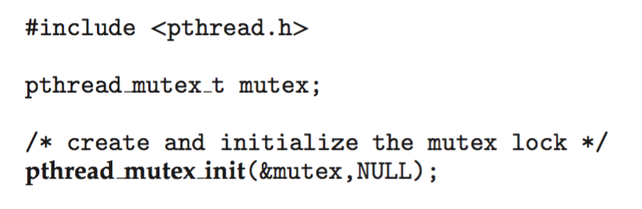
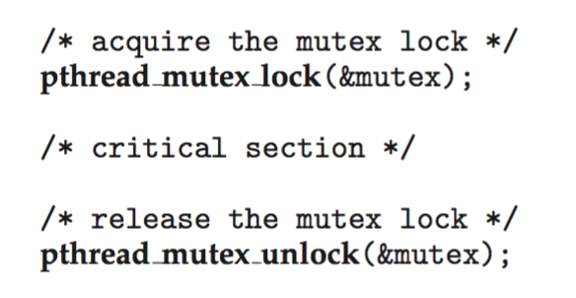
POSIX Mutex Locks
A mutex lock is a Boolean variable. It can only be modified and used by specific functions
Creating and initializing the lock
Acquiring and releasing the lock

Slide 33
Inconvenient of mutex lock
The main disadvantage of mutex lock is that it requires, while a process is in its critical section, that any other process that tries to enter its critical section to loop continuously in calling for the lock
This is called busy waiting, and a mutex lock is called a spinlock because the threads “spins” while waiting for the lock to become available.
Busy waiting from spinning threads wastes CPU cycles that some other threads/process might be able to use productively.
Spinlocks do have an advantage, however, no context switch is required when a process must wait on a lock, a context switch may take considerable time

Slide 34
Semaphores
Semaphore is another tool to synchronize access to critical sections
A semaphore S – is a special type of integer where, apart from initialization, only two other operations can modify the value of a variable of type semaphore: wait() and signal()
wait() decrement by 1 the value of a semaphore
signal() does the opposite, it increments by 1 the value of a semaphore
Modifications to the integer variable in wait() and signal() are atomic operations
Definitions of wait() and signal() are as followed:
  wait (S) {
  while S <= 0;
  // no-op
  S--;
  }
  signal (S) {
  S++;
  }

Slide 35
Types of semaphores
Two types of semaphores:
  Binary semaphore – integer value can range only between 0 and 1. Same as a mutex lock
  Counting semaphore – integer value can range over an unrestricted domain

Slide 36
Binary Semaphore: Mutex
Integer value can range only between 0 and 1;
The code below can be executed by several threads
  semaphore mutex; // initialized to 1
  do {
  wait(mutex);
  Execute critical section
  signal(mutex);
  }
When mutex = 0, the thread trying to execute this code will block as the value of a mutex cannot be negative

Slide 37
Usage of binary semaphore
Synchronization using a binary semaphore:
  Assume process P₁ with a statement S₁ and process P₂ with a statement S₂
  It is required that S₂ is executed only after S₁ has completed
  Using binary semaphore sync, initialized to 0,
    when P₁ is ready it will execute S₁
    P₂ will execute its statement S₂ only after P₁ has invoked signal(sync)
P₁ P₂
S₁;
signal(sync);
wait(sync);
S₂;

Slide 38
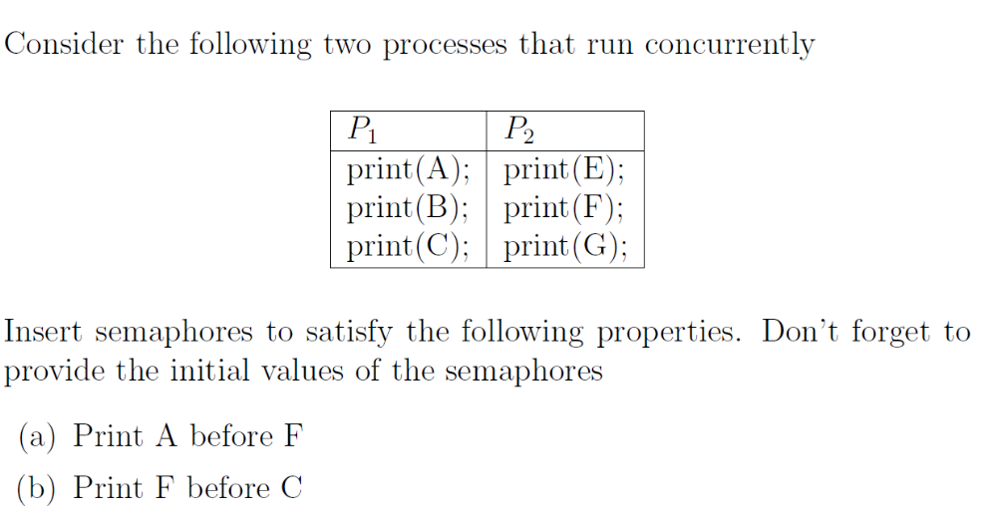
Exercise with bin semaphores

Slide 39
Sem1 = 0; sem2 = 0
T1 T2
Print(A) print(E)
Signal(sem1) wait(sem1)
Print(B) Print(F)
Wait(sem2) signal(sem2)
Print(C) Print(G)

Slide 40
Counting Semaphore
Integer value can range over an unrestricted domain.
Examples of counting semaphore declarations in Windows and Java:
  Windows:
CreateSemaphore(
NULL, // default security attributes
INIT_COUNT, // initial value of the semaphore, 0 <= INIT_COUNT <= MAX_COUNT
MAX_COUNT, // maximum value of the semaphore
SEM_NAME); // name of the semaphore
  Java:
  Semaphore sem = new Semaphore(8); //8 is the max value of the semaphore

Slide 41
Usage of counting semaphores
Counting semaphores are used to manage computer resources or to allow more than one process/thread in same time in a critical section
Managing resources:
  The OS may put limits on the number of open files a process may have. This policy can be implement using a counting semaphore cs initialized to the number of allowed open files
    Each time the process open a file, cs is decremented
    Once cs = 0, the process is not allowed to open more files
    Once the process close a file, cs is incremented
  The OS may put limit on the number of frames a process may have in physical memory.
    Each time a page fault occur, the counting semaphore cs is decremented
    If a page fault occurs and cs = 0, then a replacement page has to be found among the page the process currently hold in main memory

Slide 42
Semaphore Implementation
The basic implementation of semaphores we have just seen is also a busy waiting:
  When wait(S) is called, the instruction busy wait until S > 0.
  wait (S) {
  while S <= 0; // no-op
  S--;}

Slide 43
Semaphore Implementation without busy waiting
With each semaphore there is an associated waiting queue
Each entry in a waiting queue has two data items:
  Value (of type integer)
  Pointer to next record in the list
typedef struct {
int value;
struct process *list;
} semaphore;

Slide 44
Implementation with no busy waiting
Two operations:
  block – place the process invoking the operation on the appropriate waiting queue
  wakeup – remove one of the processes in the waiting queue and place it in the ready queue
wait(semaphore *S) {
S->value--;
if (S->value < 0) {
add this process to S->list;
block();
}
}
signal(semaphore *S) {
S->value++;
if (S->value <= 0) {
remove a process P from
S->list;
wakeup(P);
}
}

Slide 45
Blocking Semaphores
In busy waiting semaphore implementations, the value of a semaphore cannot be negative
In the waiting queue implementation, semaphore values can be negative:
  indicate the number of processes waiting on that semaphore
List of waiting processes can be implemented as FIFO queue

Slide 46
Two applications of semaphores
We look at two synchronization problems with solutions based on semaphores
  Bounded-Buffer (producer-consumer) Problem
  Readers and Writers Problem

Slide 47
Producer-consumer problem
while (true) { /*Consumer*/
while (count == 0);
// do nothing, buffer empty
Item = buffer[out];
out = (out + 1) % buffer_size;
count--;
consume the item Item;
}
while (true) { /*Producer*/
produce an item Item;
while (count == buffer_size);
//do nothing, buffer full
buffer [in] = Item;
in = (in + 1) % buffer_size;
count++;
}

Slide 48
Bounded-Buffer Problem
Same problem as the producer-consumer problem beginning of this section. Called bounded-buffer because the buffer is of finite size
The previous solution used a variable “count”, however this variable could have been updated incorrectly by competing threads
Here introduce a solution with semaphores, no “count” variable, it is an example of how counting semaphores can be used
The producer and consumer threads share the following data structures
  A buffer of size n
  Binary semaphore mutex initialized to the value 1
  Counting semaphore full initialized to the value 0
  Counting semaphore empty initialized to the value n
Updating the buffer (adding or removing an item) is now a critical section protected by the mutex binary semaphore, mutex is initialized to the 1.

Slide 49
Bounded Buffer Problem (Cont.)
Code for the producer thread:
while (true) {
produce an item
wait(empty);
wait(mutex);
add item in the buffer /*critical section */
signal(mutex);
signal(full);
}
Semaphore empty initialized to n count the number of available entries in the buffer. If empty = 0, the producer thread is blocked.
Semaphore mutex, initialized to 1, controls access to the critical section. If mutex = 0, the producer thread is blocked.
Semaphore full initialized to 0 count the number of items in the buffer. signal(full) increments this semaphore, indicating one more item has been added in the buffer

Slide 50
Bounded Buffer Problem (Cont.)
Code for the consumer thread:
while (true) {
wait(full);
wait(mutex);
remove an item from the buffer /* critical section */
signal(mutex);
signal(empty);
}
If there is no item in the buffer, the counting semaphore full = 0, thus the consumer thread block.
If mutex = 0, meaning the producer is adding an item in the buffer, the consumer thread block.
signal(empty) decrements the value of the counting semaphore empty, indicating there is one less item in the buffer

Slide 51
Running the threads
while (true) { /*producer*/
produce an item
wait(empty);
wait(mutex);
add item in the buffer
signal(mutex);
signal(full);
}
while (true) {/*consumer*/
wait(full);
wait(mutex);
remove an item from
the buffer
signal(mutex);
signal(empty);
}

Slide 52
Readers-Writers Problem
A database is to be shared among several concurrent processes.
Some processes only read the database (readers), others seek to update (read and write) the database (writers)
There is no problems for two or more readers accessing the database simultaneously
If a writer update the database while other processes access it (readers or writers), the requests may return incoherent results
To avoid incoherence, it is required that writers have exclusive access to the database
This synchronization problem is referred to as the readers–writers problem. It has been used to test nearly every new synchronization primitive.
Here we solve this synchronization problem using semaphores

Slide 53
Readers-Writers Problem
A database is shared among a number of concurrent processes
  Readers – only read the data set; they do not perform any updates
  Writers – can both read and write
Problem – allow multiple readers to read at the same time
  Only one single writer can access the shared data at the same time

Slide 54
Readers-Writers Problem (Cont.)
Shared Data
  Database
  Binary semaphore rw_mutex initialized to 1
  Binary semaphore mutex initialized to 1
  int read_count initialized to 0
  Counting semaphore readers initialized to n
mutex and rw_mutex are binary semaphores while read_count is an integer variable
The read_count variable record the number of reader processes currently accessing the database

Slide 55
Readers-Writers Problem (Cont.)
A reader process
while (true){
wait(mutex);
read_count++;
if (read_count == 1)
/* first reader */
wait(rw_mutex);
signal(mutex);
...
/* reading is performed */
...
wait(mutex);
read count--;
if (read_count == 0)
/* last reader */
signal(rw_mutex);
signal(mutex);
}
A writer process
while (true) {
wait(rw_mutex);
...
/* writing is performed */
...
signal(rw_mutex);
}
While(true) {
Wait(readers);

Slide 56
Semaphores Ubuntu
#include etc
sem_t mutex; //semaphore declaration
sem_wait(&mutex);
//critical section
sem_post(&mutex); //equivalent to signal
}
int main()
{
sem_init(&mutex, 0, 1);
sem_init(sem_t *sem, int pshared, unsigned int value);

Slide 57
Semaphores: Potential Problems
Semaphores are effective, but they can be used incorrectly by a programmer which will result in synchronization errors difficult to detect.
These errors happen only when some specific execution sequences take place
  Here is a normal sequence of execution
  Suppose a programmer swaps signal() and wait()
  wait(mutex);
  critical section
  signal(mutex);
  remainder
  signal(mutex);
  critical section
  wait(mutex);
  remainder

Slide 58
Deadlock
Deadlock – two or more processes are waiting indefinitely for an event that can be caused by only one of the waiting processes
Could happen in semaphores with the waiting queue
Let S and Q be two semaphores initialized to 1
P₀ P₁
wait (S); wait (Q);
wait (Q); wait (S);
. .
. .
. .
signal (S); signal (Q);
signal (Q); signal (S);

Slide 59
Deadlock again
Suppose a programmer replaces signal() with wait()
A deadlock will occur even when there is a single process as process will not be freed from the wait() operation
  wait (mutex);
  critical section
  wait (mutex);
  remainder

Slide 60
Monitors
A monitor is a class in an object-oriented language
A class of type monitor is such that a thread that execute a method in the class has exclusive access to the data in the class
A monitor has also condition variables that can de-schedule a thread inside a monitor until conditions are satisfied.
Only one thread is active inside a monitor at a time
Note that C++ and Python don’t have monitors, Java does

Slide 61
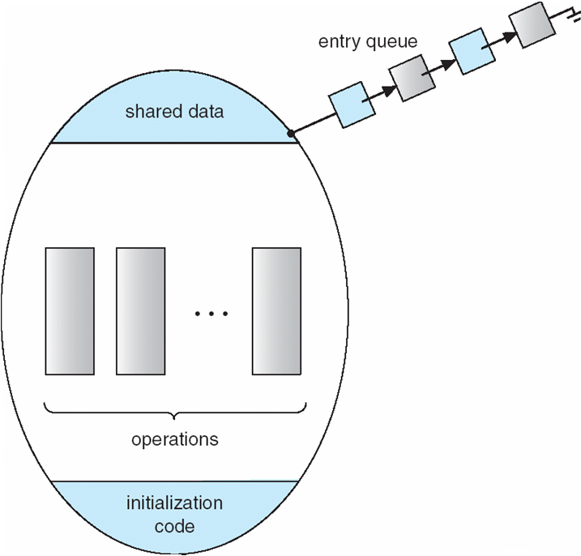
Schematic view of a Monitor
    monitor monitor-name
    {
    // shared variable declarations
    method M1 (…) { …. }
    …
    method Mn (…) {……}
    Initialization code ( ….) { … }
    }
    The entry queue is a list of threads seeking to execute a method in the monitor

Slide 62
Monitor Implementation Using Semaphores
Monitors can be implemented using semaphores
Each method M is replaced by
wait(mutex);
…
body of M;
…
signal(mutex);
Mutual exclusion within a monitor is ensured

Slide 63
Definition of a monitor class
monitor class Account {
private int balance = 0;
public method boolean withdraw(int amount)
if balance < amount return false;
else
balance := balance – amount; return true;
public method deposit(int amount)
balance := balance + amount;

Slide 64
Implementation of account
class Account {
private lock myLock; private int balance = 0;
public method boolean withdraw(int amount)
myLock.acquire()
try {
if balance < amount {
return false
} else {
balance := balance - amount
return true
}
} finally {
myLock.release()
}
public method deposit(int amount)
myLock.acquire()
try {
balance := balance + amount
} finally {
myLock.release()
}
}

Slide 65
Mutual Exclusion with Monitors
If a thread calls a monitor method, it must acquire the lock
Success to acquire the lock happen only if no other thread is active in the monitor
If a thread is active in the monitor, the calling thread will be suspended until the currently executing thread releases the lock and exits the monitor
Monitors reduce the risk caused by programmer mistakes

Slide 66
Condition Variables
Monitors provide an easy way to achieve mutual exclusion, but this is not enough
Also need a way for threads already in a monitor to block (give up exclusive access of the monitor) when they cannot proceed
Blocking is implemented using condition variables

Slide 67
Condition Variables
Programmers defines one or more condition variables.
condition x, y;
Only two operations can be executed on a condition variable:
  x.wait () – a thread invoking the operation is suspended.
  x.signal () – resumes one of the threads (if any) that has invoked x.wait ()

Slide 68

Monitor with Condition Variables

Slide 69
Condition Variables: Example
condition full;
  full.wait () – thread that invokes the operation is suspended.
  full.signal () – resumes one of threads (if any) that invoked full.wait ()

Slide 70
Full Implementation of Monitors
Variables
semaphore mutex; // (binary, initially = 1)
semaphore next; // (binary, initially = 0)
int next_count = 0; // number of processes waiting
inside the monitor
Each method P will be replaced by
wait(mutex);
…
body of P;
…
if (next_count > 0)
signal(next)
else
signal(mutex);
Mutual exclusion within a monitor is ensured

Slide 71
Implementation – Condition Variables
For each condition variable x, we have:
semaphore x_sem; //(binary, initially = 0)
int x_count = 0;//# of threads blocked on condition variable x
The operation x.wait() can be implemented as:
x_count++;
if (next_count > 0)
signal(next);//thread in sem exec
else
signal(mutex);// a new thread in sem exec
wait(x_sem); //thread block on x
x_count--;

Slide 72
Implementation (Cont.)
The operation x.signal() can be implemented as:
if (x_count > 0) {
next_count++;
signal(x_sem);
wait(next); //thread block itself because 2 threads cannot execute in same time
next_count--;
}

Slide 73
Condition Variables: Example
For instance, in the producer-consumer problem, we should block a producer thread when the buffer is full or the consumer thread when the buffer is empty
  When the producer finds the buffer full, it does a wait() on condition variable “full”
    This action causes the calling thread to block, and allows another thread that had been previously prohibited from entering the monitor to enter now
  When the consumer finds the buffer empty, it does a wait() on condition variable “empty”
    This action causes a thread that was blocked in the monitor to resume activity

Slide 74
Monitor class for producer/consumer
monitor ProducerConsumer
condition full, empty;
int count = 0;
method add();
if (count == N) wait(full); // if buffer is full, block
put_item(item); // put item in buffer
count = count + 1; // increment count of full slots
if (count == 1) signal(empty); // if buffer was empty, wake consumer
method remove();
if (count == 0) wait(empty); // if buffer is empty, block
remove_item(item); // remove item from buffer
count = count - 1; // decrement count of full slots
if (count == N-1) signal(full); // if buffer was full, wake producer
end monitor;

Slide 75
Threads for producer/consumer
Thread 1
Producer();
while (TRUE)
{
make_item(item); // make a new item
ProducerConsumer.add; // call add method in monitor
}
Thread 2
Consumer();
while (TRUE)
{
ProducerConsumer.remove; // call method remove in monitor
consume_item; // consume an item
}

Slide 76
End of Section 6

