Slide 1
Section 8: Deadlocks

Slide 2
Chapter 7: Deadlocks
A set of System and Resource Assumptions
Deadlock Characterization
Deadlock Avoidance
Deadlock Detection
Recovery from Deadlock

Slide 3
Chapter Objectives
Illustrate how deadlock can occur when mutex locks are used
Define the four necessary conditions that characterize deadlock
Identify a deadlock situation in a resource allocation graph
Evaluate the four different approaches for preventing deadlocks
Apply the banker’s algorithm for deadlock avoidance
Apply the deadlock detection algorithm
Evaluate approaches for recovering from deadlock

Slide 4
System Model
System consists of resources
Resource types R₁, R₂, . . ., R_{m}
  Synchronization primitives, CPU cycles, memory space, I/O devices
Each resource type R_{i} has W_{i} instances.
Each process utilizes a resource as follows:
  request
  use
  release

Slide 5
requests/releases
The request and release of resources done through system calls:
  open() (request for file) and close() (release of a file)
  allocate() and free() of memory
  wait() and signal() for semaphores
  acquisition and release for mutex locks

Slide 6
What is a Deadlock?
A set of processes is in a deadlock state when
  Every process in the set is waiting for an event that can be caused only by another process in the set
  The event in question is a resource acquisition or release

Slide 7
Deadlock
Deadlock – two or more processes are waiting indefinitely for an event that can be caused by only one of the waiting processes
Could happen with semaphores
S and Q are two semaphores initialized to 1
P₀ P₁
wait (S); wait (Q);
wait (Q); wait (S);
. .
. .
. .
signal (S); signal (Q);
signal (Q); signal (S);

Slide 8
Process deadlock itself
A deadlock can occur even when there is a single process
Suppose a programmer replaces signal() with wait(), then the process deadlock itself
  wait (mutex);
  critical section
  wait (mutex);
  remainder

Slide 9
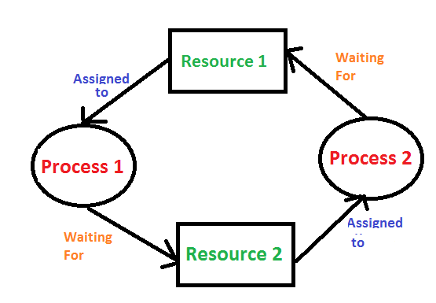
Deadlock in graphic

Slide 10
Deadlock with Semaphores
Data:
  A semaphore s1 initialized to 1
  A semaphore s2 initialized to 1
Two threads T1 and T2
T1:
wait(s1) success
wait(s2) blocked
T2:
wait(s2) success
wait(s1) blocked
s1
hold s1
request s1
T1
T2
request s2
s2
hold s2

Slide 11
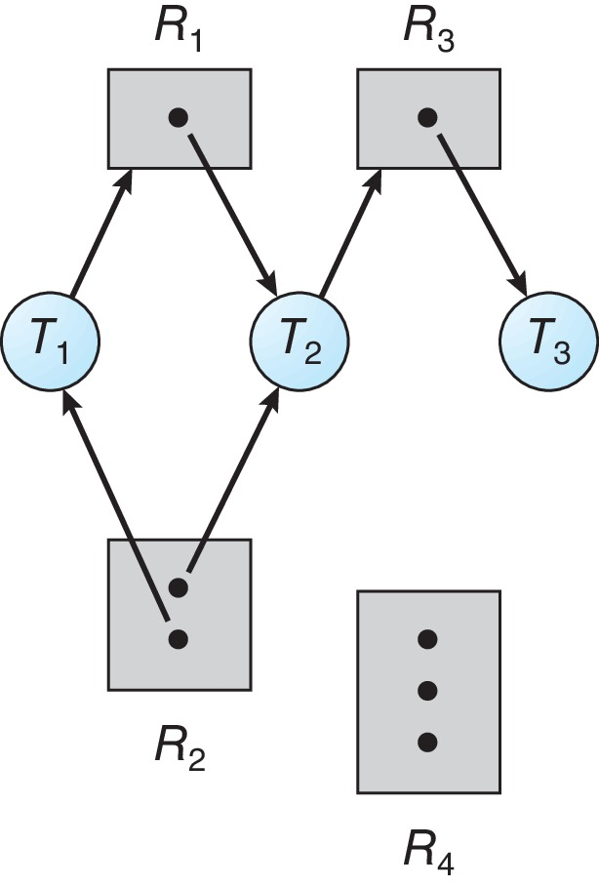
Resource-Allocation Graph
The resource-allocation graph G = (V,E) describes the relationship among the processes and resources in a system in terms of a directed graph
V is partitioned into two types:
  T = {T₁, T₂, …, T_{n}}, the set consisting of all the threads in the system
  R = {R₁, R₂, …, R_{m}}, the set consisting of all resource types in the system
Edges are either
  request edge – directed edge T_{i} → R_{j}
  assignment edge – directed edge R_{j} → T_{i}

Slide 12
Resource Allocation Graph Example
The number of dots inside a resource type is the number of occurrence of the corresponding resource:
  One instance of R1
  Two instances of R2
  One instance of R3
  Three instance of R4
Edges meaning:
  T1 holds one instance of R2 and is waiting for an instance of R1
  T2 holds one instance of R1, one instance of R2, and is waiting for an instance of R3
  T3 is holds one instance of R3

Slide 13

Resource Allocation Graph: Deadlock
Deadlocked may occur when there are cycles in a resource-allocation graph
This resource-allocation graph has two cycles:
  P₁ R₁ P₂ R₃ P₃ R₂ P₁
  P₂ R₃ P₃ R₂ P₂
In the cycle P₁ R₁ P₂ R₃ P₃ R₂ P₁
  P₁ is waiting for the resource R₁ which is held by P₂
  P₂ is waiting for resource R₃ which is held by P₃
  P₃ is waiting for R₂ which is held by P₁
  The three processes are deadlocked

Slide 14

Graph With a Cycle: No Deadlock
Resource allocation graph is a picture in time of the state of the resource allocation, this graph keeps changing during the computation
If the resource allocation graph contains no cycles ⇒ no deadlock
If the resource allocation graph contains a cycle:
  only one instance per resource type, then deadlock
  several instances per resource type, then possibility of deadlock

Slide 15
Deadlock Characterization
Deadlock can arise if four conditions hold simultaneously:
Mutual exclusion: only one process at a time can use a resource
Hold and wait: a process holding at least one resource is waiting to acquire additional resources held by other processes
No preemption: a resource can be released only voluntarily by the process holding it, after that process has completed its task
Circular wait: there exists a set {P₀, P₁, …, P_{n}} of waiting processes such that
  P₀ is waiting for a resource that is held by P₁,
  P₁ is waiting for a resource that is held by P₂,
  …, P_{n–1} is waiting for a resource that is held by P_{n},
  and P_{n} is waiting for a resource that is held by P₀.

Slide 16
Example
  Here all the four necessary conditions for deadlock exist: mutual exclusion, hold and wait, no preemption, circular wait

Slide 17
Methods for Handling Deadlocks
We can deal with the deadlock problem in one of three ways:
  Use protocols to avoid deadlocks, ensuring that the system will never enter a deadlock state: deadlock prevention and deadlock avoidance
  Allow the system to enter a deadlock state, detect it, and then recover
  Ignore the problem and pretend that deadlocks never occur in the system

Slide 18
Deadlock Prevention
Invalidate one of the four necessary conditions for deadlock:
Mutual Exclusion – not required for sharable resources; must hold for non-sharable resources
  A printer is a non-sharable resource, cannot be accessed simultaneously by several processes
  A sharable resource like read-only files can be accessed by several processes
    As processes don’t need to wait for sharable resources, they cannot be deadlocked
Hold and Wait – must guarantee that whenever a process requests a resource, it does not hold any other resources
  1- require process to request and be allocated all its resources before it begins execution, or 2- allow process to request resources only when the process has none allocated to it.
  Low resource utilization; starvation possible

Slide 19
Deadlock Prevention
Hold and Wait (continue)– must guarantee that whenever a process requests a resource, it does not hold any other resources
Ex: a process copies data from a DVD drive to a file on disk, sorts the file and then prints the results to a printer
First protocol:
  Require process to request and be allocated all its resources before it begins execution
  Process initially request the DVD drive, disk file and printer
  Printer is held for the whole execution though used only at the end
Second protocol:
  Processes request resources only when they have none
  A process may request some resources and use them
  If additional resources needed, must release all resource currently held
  Once process has copied from DVD drive to disk, release both resources, then again request disk file and printer to copy disk file to the printer

Slide 20
Hold & Wait Protocols
Disadvantages for both protocols:
  Low resource utilization:
    Resources may be allocated but unused for a long period (first protocol)
  Starvation is possible:
    A process that needs several popular resources may have to wait indefinitely (second protocol)
    If at least one of the resources that it needs is always allocated to some other process

Slide 21
Deadlock Prevention (Cont.)
No Preemption:
  If a process that is holding some resources requests another resource that cannot be immediately allocated to it, then all resources currently being held are released
  Released resources are added to the list of resources for which the process is waiting
  Process will be restarted only when it can regain its old resources, as well as the new ones that it is requesting
Circular Wait:
  Impose a total ordering of all resource types, and require that each process requests resources in an increasing order of enumeration

Slide 22
Circular Wait: Example
Impose a total ordering F of all resource types:
  F(tape drive) = 1
  F(disk drive) = 5
  F(printer) = 12
Require that each process requests resources in an increasing order of enumeration
  Usually tape drive is needed before the printer, so makes sense to define F(tape drive) < F(printer)
=> P_{k} cannot request a resource R_{i} when holding resource R_{j} for j > i.
Therefore, circular waiting impossible for it will implies that:
  F(R_{n}) < F(R₀) < F(R₁) < F(R_{n-1}) < F(R_{n} )
Deadlock will be avoided on slide 10 if mutex variables are ordered after the first thread acquires a lock:
  If thread one acquires first mutex, then order is one, two. Second thread must follow this order

Slide 23
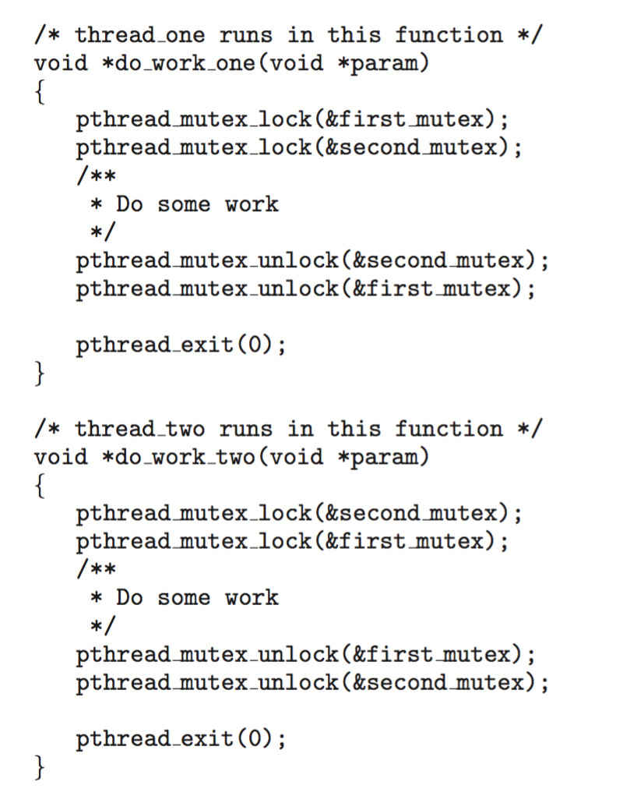
Circular Wait
Invalidating the circular wait condition is most common.
Simply assign each resource (i.e., mutex locks) a unique number.
Resources must be acquired in order.
If:
first_mutex = 1
second_mutex = 5
code for thread_two could not be
written as follows:

Slide 24
Deadlock Avoidance
Requires that the system has some additional a priori information
available
Simplest and most useful model requires that each process declare the maximum number of resources of each type that it may need
The deadlock-avoidance algorithm dynamically examines the resource-allocation state to ensure that there can never be a circular-wait condition
Resource-allocation state is defined by the number of available and allocated resources, and the maximum demands of the processes

Slide 25
Resource Allocation State
Resource-allocation state is the number of available and allocated resources, and the maximum demand by each process for these resources
This state (represented in a table) is dynamically updated
Deadlock-avoidance algorithms examines the resource-allocation state to ensure that there can never be a circular-wait condition
12 resources, 3 available
 | Max Needs | Current Needs (hold)
P₀ | 10 | 5
P₁ | 4 | 2
P₂ | 9 | 2

Slide 26
Safe State
When a process requests an available resource, system must decide if immediate allocation leaves the system in a safe state
A state is safe if the system can allocate resources to each process in some sequence and avoid deadlock
Formally, the system is in safe state if there exists a sequence <P₁, P₂, …, P_{n}> of all the processes such that for each P_{i}, the resources that P_{i} can still request can be satisfied by currently available resources + resources held by all the P_{j}, with j < i
That is:
  If P_{i} resource needs are not immediately available, then P_{i} can wait until all P_{j} have finished
  When P_{j} is finished, P_{i} can obtain needed resources, execute, return allocated resources, and terminate
  When P_{i} terminates, P_{i +1} can obtain its needed resources, and so on
If no such sequence exists, then the system is said to be unsafe

Slide 27
Deadlock Avoidance
Example: a system with 12 magnetic tape drivers and three processes: P₀, P₁, and P₂.
  At time t₀: Additional information
  Is the system in a safe state?
  The sequence <P₁, P₀, P₂> satisfies the safety condition.
 | Max Needs | Current Needs (hold)
P₀ | 10
P₁ | 4
P₂ | 9
available:
5
3
0
10
4
0
2
9
0
2
YES!!

Slide 28
Deadlock Avoidance
A system can go from a safe state to an unsafe state: at time t₁:
  Process P₂ requests and is allocated one more tape drive.
    Can we find a safe sequence?
    We cannot , P₁ is safe, but not the two other processes
    The mistake was in granting the request from P₂ for one more tape drive.
 | Max Needs | Current Needs (hold)
P₀ | 10
P₁ | 4
P₂ | 9
5
available:
2
2
3

Slide 29

Safe, Unsafe, Deadlock State
If a system is in safe state ⇒ no deadlocks
If a system is in unsafe state ⇒ possibility of deadlock
Avoidance ⇒ ensure that a system will never enter an unsafe state.

Slide 30
Avoidance algorithms
Avoidance algorithms ensure that the system will always remain in a safe state
Initially the system is in a safe state
Whenever a process requests a resource that is currently available, the system must decide
  whether the resource can be allocated or
  whether the process must wait

Slide 31
Avoidance algorithms
Single instance of a resource type
  Use the resource-allocation graph algorithm
  In addition to the request and assignment edges, we introduce a new type of edge, called a claim edge
Multiple instances of a resource type
  Use the banker’s algorithm

Slide 32
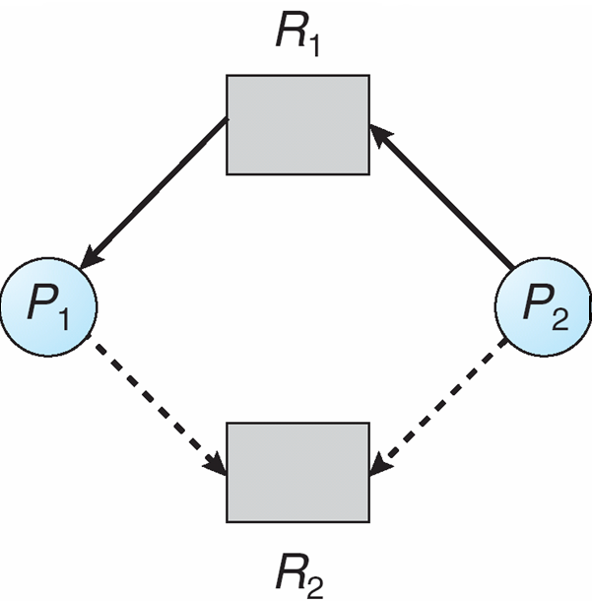
Resource-Allocation Graph Algo
Claim edge
  represented by a dashed edge P_{i} → R_{j}
  indicates that process P_{j} may request resource R_{j}
Resources must be claimed a priori in the system
  Before process P_{i} starts executing, all its claim edges must already appear in the resource-allocation graph

Slide 33
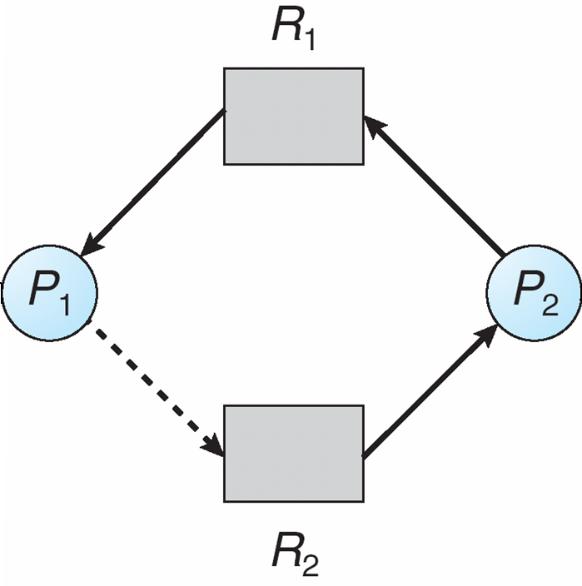
Resource-Allocation Graph Algo
Claim edge converts to assignment edge when a process requests a resource
Request granted only if the edge conversion does not result in a cycle in the graph
P₂ requests R₂

Slide 34
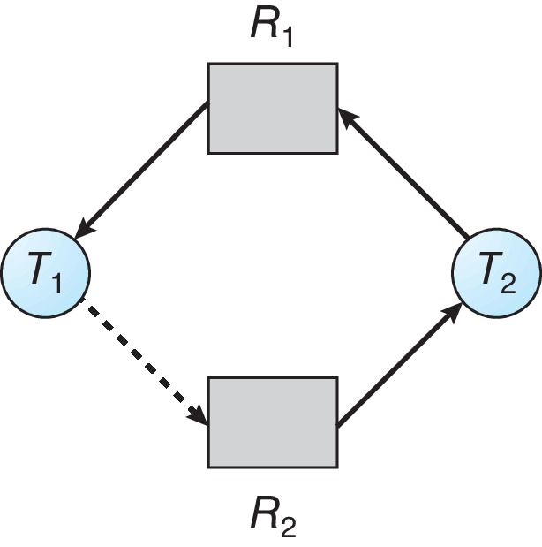
Unsafe State In Resource-Allocation Graph
The request can be granted only if converting the request edge to an assignment edge does not result in the formation of a cycle in the resource allocation graph

Slide 35
Banker’s Algorithm
Multiple instances of each resource
When a process enters the system, must declare the maximum number of instances of each resource it may need
System must determine whether the allocation of the resources requested by a process will leave the system in a safe state

Slide 36
Data Structures for the Banker’s Algorithm
Let n = number of processes, and m = number of resources types.
Available: Vector of length m. If available [j] = k, there are k instances of resource type R_{j} available
Max: n x m matrix. If Max [i,j] = k, then process P_{i} may request at most k instances of resource type R_{j}
Allocation: n x m matrix. If Allocation[i,j] = k then P_{i} is currently allocated k instances of R_{j}
Need: n x m matrix. If Need[i,j] = k, then P_{i} may need k more instances of R_{j} to complete its task
    Need [i,j] = Max[i,j] – Allocation [i,j]

Slide 37
Safety Algorithm
1. Let Work and Finish be vectors of length m and n, respectively. Initialize:
      Work = Available
      Finish [i] = false for i = 0, 1, …, n- 1
2. Find an i such that both: (a) Finish[i] = false and
  (b) Need_{i} ≤ Work. If no such i exists, go to step 4
3. Work = Work + Allocation_{i}
Finish[i] = true
go to step 2
4. If Finish[i] == true for all i, then the system is in a safe state

Slide 38
Resource-Request Algorithm for Process P_{i}
Request = request vector for process P_{i}.
  If Request_{i} [j] = k then process P_{i} wants k instances of resource type R_{j}
  If Request_{i} ≤ Need_{i} go to step 2.
  Otherwise, raise error condition, since process has exceeded its maximum claim
  If Request_{i} ≤ Available, go to step 3.
  Otherwise P_{i} must wait, since resources are not available
  3. Pretend to allocate requested resources to P_{i} by modifying the state as follows:
      Available = Available – Request;
      Allocation_{i} = Allocation_{i} + Request_{i};
      Need_{i} = Need_{i} – Request_{i};
    if safe ⇒ the resources are allocated to P_{i}
    If unsafe ⇒ P_{i} must wait, and the old resource-allocation state is restored

Slide 39
Example of Banker’s Algorithm
Given:
  5 processes P₀ through P₄;
  3 resource types: A (10 instances), B (5 instances), and C (7 instances)
  Snapshot at time T₀:
Allocation Max Available
A B C A B C A B C
P₀ 0 1 0 7 5 3 3 3 2
P₁ 2 0 0 3 2 2
P₂ 3 0 2 9 0 2
P₃ 2 1 1 2 2 2
P₄ 0 0 2 4 3 3

Slide 40
The matrix need
Compute the matrix Need defined as Max – Allocation
Max
A B C
7 5 3
3 2 2
9 0 2
2 2 2
4 3 3
Allocated
A B C
0 1 0
2 0 0
3 0 2
2 1 1
0 0 2
Need
A B C
7 4 3
1 2 2
6 0 0
0 1 1
4 3 1
Available
A B C
3 3 2
P₀
P₁
P₂
P₃
P₄

Slide 41
System is in a safe state
Max
A B C
7 5 3
3 2 2
9 0 2
2 2 2
4 3 3
Allocated
A B C
0 1 0
2 0 0
3 0 2
2 1 1
0 0 2
Need
A B C
7 4 3
1 2 2
6 0 0
0 1 1
4 3 1
Available
A B C
3 3 2
P₀
P₁
P₂
P₃
P₄
The need from P₁ can be satisfied from the available resources. Once P₁ exits, its allocated resources become available, A = 5, B = 3, C = 2.
Next need from P₃ can be satisfied, available becomes A = 7, B = 4, C = 3
Similarly, for P₄
Thus, the system is in a safe state since the sequence <P_{3 ,}P₁, P₄, P₂, P₀> satisfies safety criteria

Slide 42
P₁ makes request (1,0,2)
Check that request ≤ need (that is, (1,0,2) ≤ (1,2,2) ⇒ true
Check that request ≤ Available (that is, (1,0,2) ≤ (3,2,2) ⇒ true
Pretend the request is allocated to P₁ , i.e., allocation changes from 2, 0, 0 to 3, 0, 2, (thus available become 2, 3, 0) and check if system in a safe state
Allocation Need Available
A B C A B C A B C
P₀ 0 1 0 7 4 3 2 3 0
P₁ 3 0 2 0 2 0
P₂ 3 0 2 6 0 0
P₃ 2 1 1 0 1 1
P₄ 0 0 2 4 3 1
Executing safety algorithm shows that sequence < P₁, P₃, P₄, P₀, P₂> satisfies safety requirement
Can request for (3,3,0) by P₄ be granted?
Can request for (0,2,0) by P₀ be granted?

Slide 43
Exercises
2 processes P₀ ,P₁;
4 resource types of one instance each
Snapshot at time T₀:
Allocation Max Available
A B C D A B C D A B C D
P₀ 1 1 0 0 1 1 0 1 0 0 0 1
P₁ 0 0 1 0 0 1 1 1
Draw the resource-allocation graph for this system
Assume a request is made by P₀ to obtain resource D, draw the resource-allocation graph after this request has been made
Can this request be granted? Explain your answer briefly

Slide 44
Exercises
Consider the following snapshot of a system of four processes and four resource types:
Allocation Max Available
A B C D A B C D A B C D
P₀ 0 1 0 0 0 1 0 1 0 0 0 1
P₁ 0 0 1 0 0 0 1 1
P₂ 1 0 0 0 1 1 1 1
P₃ 0 0 0 0 0 0 0 1
Draw the matrix Need?
Is the system in safe state? If you answer yes, prove it by exhibiting a safe sequence. If you answer no, show a scenario where the safety algorithm fails to complete a safe sequence.
Given the current allocation of resources, if a request from process P₂ arrives for (0,1,0,0), can the request be granted immediately? Explain your answer.

Slide 45
Deadlock Detection
No effort is made to detect whether the system is in a safe state
Rather allow the system to perform without constraints
Periodically detect whether the system is in a deadlock state using a detection algorithm
Apply some recovery scheme

Slide 46
Single Instance of each Resource Type
Maintain a wait-for graph
  Nodes are processes
  P_{i} → P_{j} if P_{i} is waiting for P_{j}
Periodically invoke an algorithm that searches for a cycle in the wait-for graph. If there is a cycle, then there exists a deadlock
An algorithm to detect a cycle in a graph requires an order of n² operations, where n is the number of vertices in the graph

Slide 47
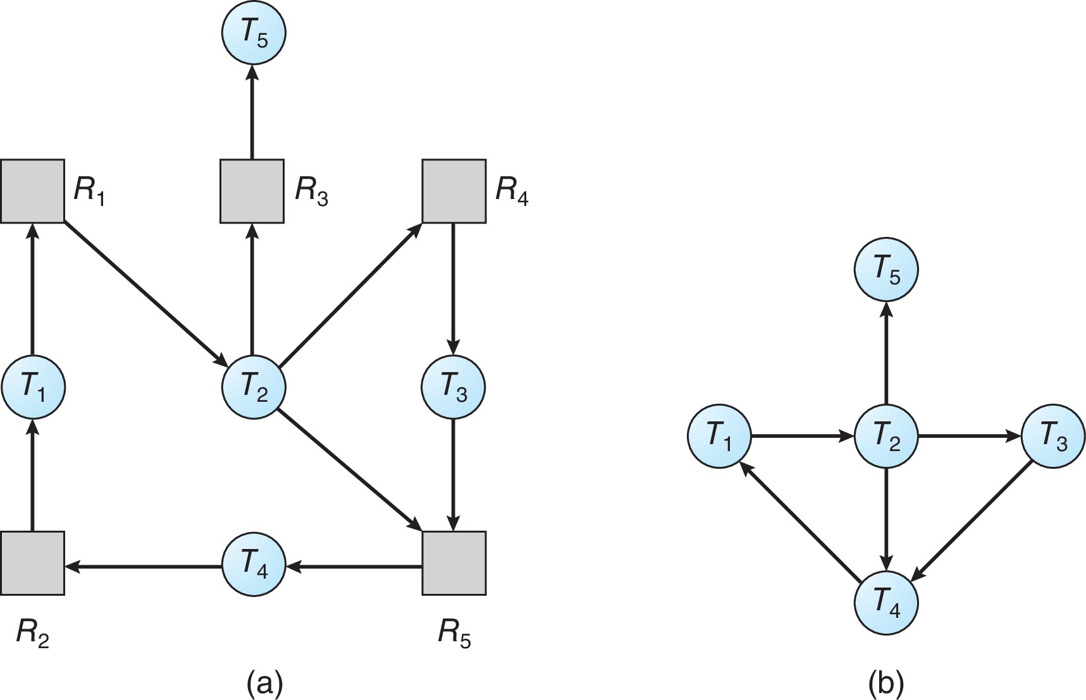
Resource-Allocation Graph and Wait-for Graph
Resource-Allocation Graph
Corresponding wait-for graph

Slide 48
Several Instances of a Resource Type
Available: A vector of length m indicates the number of available resources of each type
Allocation: An n x m matrix defines the number of resources of each type currently allocated to each process
Request: An n x m matrix indicates the current request of each process. If Request [i][j] = k, then process P_{i} is requesting k more instances of resource type R_{j}.

Slide 49
Detection Algorithm
Let Work and Finish be vectors of length m and n, respectively Initialize:
  Work = Available
  For i = 1,2, …, n, if Allocation_{i} ≠ 0, then
  Finish[i] = false; otherwise, Finish[i] = true
Find an index i such that both:
  Finish[i] == false
  Request_{i} ≤ Work
  If no such i exists, go to step 4
Work = Work + Allocation_{i}
Finish[i] = true
go to step 2
If Finish[i] == false, for some i, 1 ≤ i ≤ n, then the system is in deadlock state. Moreover, if Finish[i] == false, then P_{i} is deadlocked

Slide 50
Example of Detection Algorithm
Five processes P₀ through P₄; three resource types A (7 instances), B (2 instances), and C (6 instances)
Allocation is what is currently allocated to a process, while Request are the resources a process currently wait-for given none is available
In this current config, the detection algo is run to see whether there is a deadlock
Allocation Request Available
A B C A B C A B C
P₀ 0 1 0 0 0 0 0 0 0
P₁ 2 0 0 2 0 2
P₂ 3 0 3 0 0 0
P₃ 2 1 1 1 0 0
P₄ 0 0 2 0 0 2
Here the system is not in deadlock state as once processes P₀, P₂ exit, they will release enough resource to allow the other processes to complete
Sequence <P₀, P₂, P₃, P₁, P₄> will result in Finish[i] = true for all i

Slide 51
Example (Cont.)
Here P₂ make an additional request for an instance of type C
Request
A B C
P₀ 0 0 0
P₁ 2 0 2
P₂ 0 0 1
P₃ 1 0 0
P₄ 0 0 2
State of system?
  Can reclaim resources held by process P₀, but insufficient resources to fulfill other processes requests
  Deadlock exists, consisting of processes P₁, P₂, P₃, and P₄
Allocation Request Available
A B C A B C A B C
P₀ 0 1 0 0 0 0 0 0 0
P₁ 2 0 0 2 0 2
P₂ 3 0 3 0 0 0
P₃ 2 1 1 1 0 0
P₄ 0 0 2 0 0 2

Slide 52
Exercises
Five processes P₀ through P₄; three resource types
A (5 instances), B (6 instances), and C (3 instances)
Snapshot at time T₀:
Allocation Request Available
A B C A B C A B C
P₀ 1 0 0 1 0 1 1 2 0
P₁ 1 0 1 2 1 1
P₂ 0 2 0 1 3 0
P₃ 1 0 1 1 0 0
P₄ 1 2 1 3 2 2
Is this system in a deadlock state? Prove your answer by listing an execution sequence of the processes or by pointing to a deadlocked process

Slide 53
Exercise
Here P₁ make an additional request for an instance of type C
Request
A B C
P₀ 1 0 0
P₁ 2 1 2
P₂ 1 3 0
P₃ 1 0 0
P₄ 3 2 2
State of system?
  Give an executable process sequence with this new request if one exists
  Otherwise, point to the deadlock in which the system will be with this request
Allocation Request Available
A B C A B C A B C
P₀ 1 0 0 1 0 1 1 2 0
P₁ 1 0 1 2 1 2
P₂ 0 2 0 1 3 0
P₃ 1 0 1 1 0 0
P₄ 1 2 1 3 2 2

Slide 54
Detection-Algorithm Usage
When, and how often, to invoke depends on:
  How often a deadlock is likely to occur?
  How many processes will need to be rolled back?
    one for each disjoint cycle
If detection algorithm is invoked arbitrarily, there may be many cycles in the resource graph and so we would not be able to tell which of the many deadlocked processes “caused” the deadlock.

Slide 55
Recovery from Deadlock: Process Termination
Abort all deadlocked processes
Abort one process at a time until the deadlock cycle is eliminated
In which order should we choose to abort?
  Priority of the process
  How long process has computed, and how much longer to completion
  Resources the process has used
  Resources process needs to complete
  How many processes will need to be terminated
  Is process interactive or batch?

Slide 56
Recovery from Deadlock: Resource Preemption
Selecting a victim – minimize cost
Rollback – return to some safe state, restart process for that state
Starvation – same process may always be picked as victim, include number of rollback in cost factor

Slide 57
End of Section 8

