Slide 1

Sliding CUSUM and its Solutions to Anomaly Detection problems in the field of
Digital Currency
Dang Thanh Lam - 20194442
Nguyen Vu Thien Trang - 20194459
Nguyen Van Thanh Tung - 20190090
Notes:
1. Table of contents
2. Introduction
3. Our company
4. Our team
5. Problem
6. Them vs. us
7. Solution
8. SWOT analysis
9. Product overview
10. Our plans
11. Product demo
12. Traction
13. Case study
14. Reviews
15. Awards
16. Market size
17. Target
18. Competitors
19. Business model
20. Timing
21. Predicted growth
22. Investment

Slide 2
Table of Contents
01
02
03
04
Problem
Basis Algorithms
Statement on the challenges of anomaly detection
A brief explanation of basis knowledge
Sliding CUSUM
Experiments
Our proposed algorithm
Application of SCUSUM on real Bitcoin price data

Slide 3
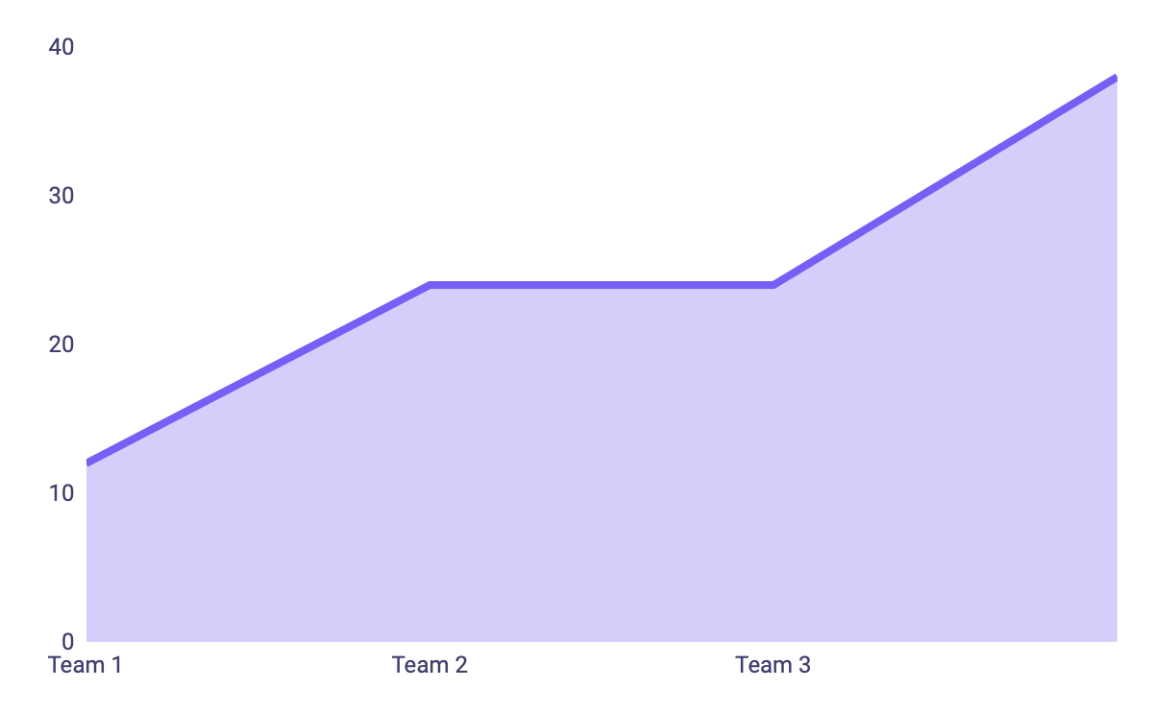
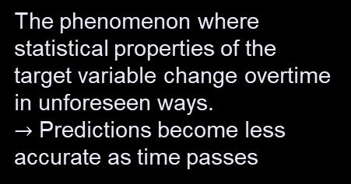
Problem Statement
Concept Drift
The phenomenon where statistical properties of the target variable change overtime in unforeseen ways.
$→$ Predictions become less accurate as time passes
Sliding CUSUM

Slide 4
Basis Knowledge | Sliding Window
Sliding Window
Split an unbounded stream of data (events) into finite sets.
Observes the most recent data points measurements and moves by a fixed step size along the time axis as new ones arrive.
x1 x2 x3 x4 x5 x6 x7 x8 x9 x10 …

Slide 5

Basis Knowledge | CUSUM
One-sided CUmulative SUM
$$So=0$$
$S_{n+1}=max⁡(0,S_{n}+X_{n}−μ−k)$
$$for n=1, 2, …N$$
μ | The expected mean
σ | The expected standard deviation
k | The size of the shift to be detected
H | The control limit

Slide 6

Basis Knowledge | CUSUM
Two-sided CUmulative SUM
μ | The expected mean
σ | The expected standard deviation
k | The size of the shift to be detected
H | The control limit
$$S_{{n+1}^{+}}=max (0,S_{n}+X_{n}−μ−k)$$
$$S_{{n+1}^{−}}=min (0,S_{n}+X_{n}−μ+k)$$

Slide 7
Sliding Window
CUSUM
$$S_{{n+1}^{+}}=max (0,S_{n}+X_{n}−μ−k)$$
$$S_{{n+1}^{−}}=min (0,S_{n}+X_{n}−μ+k)$$
x1 x2 x3 x4 x5 x6 …
Sliding CUSUM

Slide 8
Sliding CUSUM | Main Idea
01
03
Mean of current window
CUSUM(windows’ mean)
Data Stream
Label
02
04
Average and Standard Deviation of windows’ mean
Check for upper and lower threshold

Slide 9
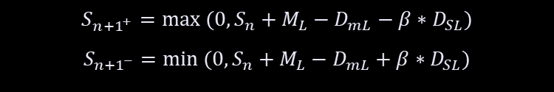

Sliding CUSUM | Notations and Formulas
L_{W} | Length of the windows
β | The output rate
M_{L} | The mean of the latest window
D_{mL} | The mean of windows’ mean values
D_{SL} | The mean of the windows’ standard deviation
S_{n+1}⁺ | The upper cumulative sum
S_{n+1}⁻ | The lower cumulative sum
$$S_{{n+1}^{+}}=max (0,S_{n}+M_{L}−D_{mL}−β∗D_{SL})$$
$$S_{{n+1}^{−}}=min (0,S_{n}+M_{L}−D_{mL}+β∗D_{SL})$$
$$H^{+}= D_{SL}$$
$${ H}^{−}= {−D}_{SL}$$

Slide 10


Sliding CUSUM | Notations and Formulas
$$S_{{n+1}^{+}}=max (0,S_{n}+M_{L}−D_{mL}−β∗D_{SL})$$
$$S_{{n+1}^{−}}=min (0,S_{n}+M_{L}−D_{mL}+β∗D_{SL})$$
Dynamic
$$H^{+}= D_{SL}$$
$${ H}^{−}= {−D}_{SL}$$

Slide 11
Sliding CUSUM

Slide 12
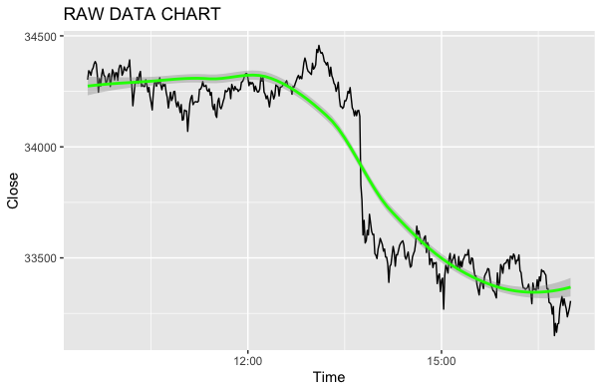
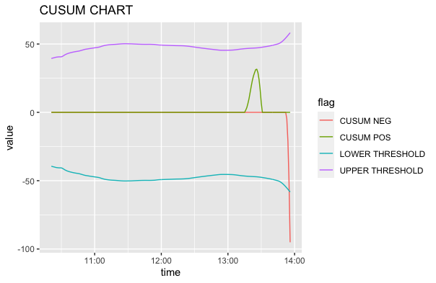
Experiments
Figure 7. Data analysis diagram
Figure 8. SCUSUM

Slide 13
THANK YOU Do you have any question?
lam.dt194442@sis.hust.edu.vn
trang.nvt194459@sis.hust.edu.vn
tung.nvt0090@sis.hust.edu.vn
Notes:
1. Table of contents
2. Introduction
3. Our company
4. Our team
5. Problem
6. Them vs. us
7. Solution
8. SWOT analysis
9. Product overview
10. Our plans
11. Product demo
12. Traction
13. Case study
14. Reviews
15. Awards
16. Market size
17. Target
18. Competitors
19. Business model
20. Timing
21. Predicted growth
22. Investment

