Slide 1
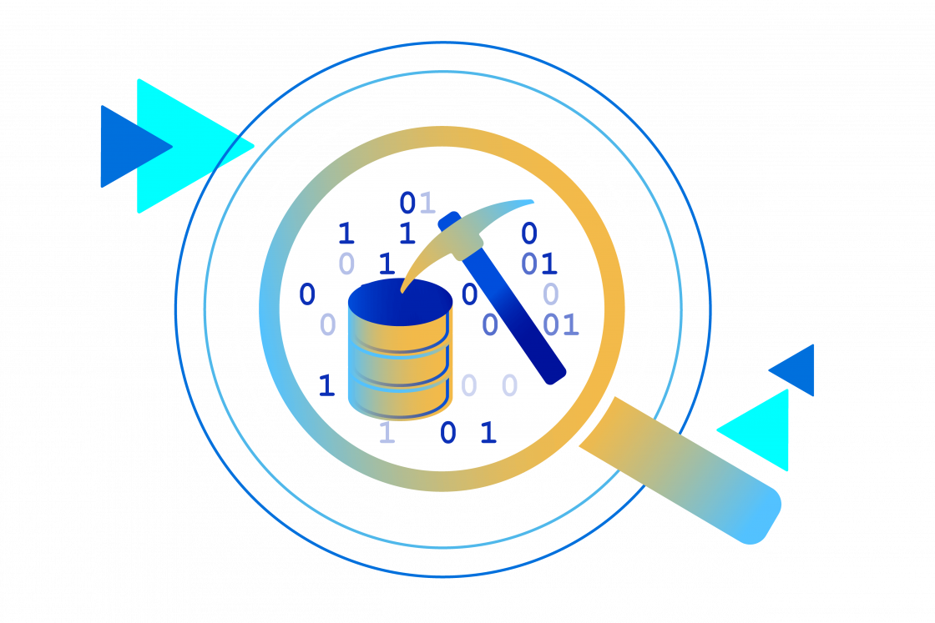
BAG OF WORDS DOCUMENT CLASSIFICATION USING FEED FORWARD NEURAL NETWORK AND RECURRENT NEURAL NETWORK
Group 9:
Ali Shokri
Sahar Kadkhoda Masoum Ali
Yemisi Teju Olasoji

Slide 2
IntroduCtion
AIMS OF THE PROJECT: The goal is to train a simple feed-forward neural network and Recurrent Neural Network for document classification, focusing on various configurations of bags-of words features(count vectorizer and TF-IDF) with Pytorch as the machine learning framework.
BACKGROUND KNOWLEDGE
Dataset: Consists of two text columns, "Abstract" and "Field“ of scientific articles in English, containing the article abstracts and the field of the research (10 subcategories of computer science, physics, and math are considered)
Data Cleaning and Preprocessing: Due cleaning were performed to make it ready for feeding into a machine learning algorithm. This includes Tokenization, Removal of stop words, Lemmatization etc
Feature extraction: Training a classifier to forecast a paper's field based on its abstract by converting abstracts into feature vectors using the bags-of-words representation technique i.e.
• CountVectorizer • TF-IDF
Neural Network Architecture: Experiments were carried out using the FFNN and RNN with varying hyperparameters like different number of layers and activation functions
• Number of layers • Activation functions

Slide 3
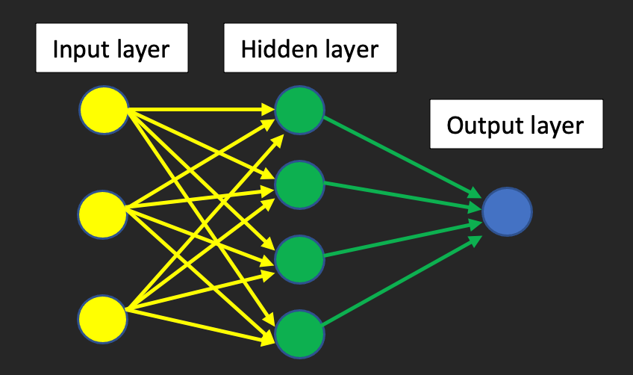
Feed Forward Neural Network
Model Architecture
Input Layer
Hidden Layers
Out put Layers
Evaluation of the model by:
Number of layers
Activation function
Batch size
Regularization

Slide 4
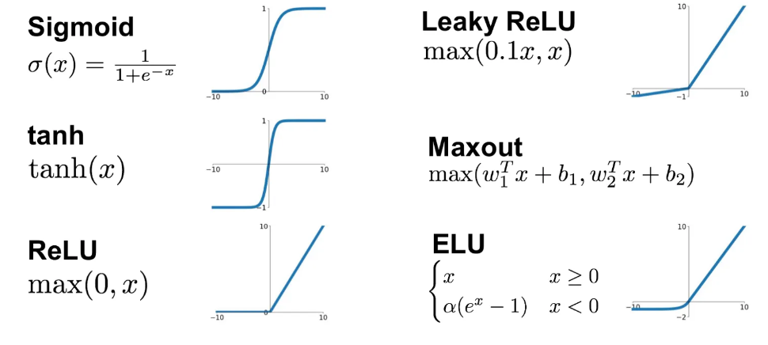



Evaluation of the FFNN Algorithm
Number of layers: [1,2,3] Count vectorizer: 2-layers , Tf_IDF: 1-Layer
Activation Function:
Algorithm
Count Vectorizer | Sigmoid | Leaky RELU | ELU
TF-IDF | ELU | Softmax | Leaky RELU
Batch Size: [32,68,128,256]
Count vectorizer: 256 , Tf_IDF: 32
Regularization (Drop out)
For Both method of feature detection improvement of the accuracy are so little.

Slide 5
RNN EXPERIMENTATION ALI!

Slide 6
RNN RESULT AND VISUALISATION

Slide 7
CONCLUSION& REFERENCES ALI
COPY REFERENCE FROM REPORT HERE
GITHUB LINK

