Slide 1

BAG OF WORDS DOCUMENT CLASSIFICATION USING FEED FORWARD NEURAL NETWORK AND RECURRENT NEURAL NETWORK
Group 9:
Ali Shokri
Sahar Kadkhoda Masoum Ali
Yemisi Teju Olasoji

Slide 2
Introduction
AIMS OF THE PROJECT: The goal is to train a simple feed-forward neural network and Recurrent Neural Network for document classification, focusing on various configurations of bags-of words features(count vectorizer and TF-IDF) with Pytorch as the machine learning framework.
BACKGROUND KNOWLEDGE
Dataset: Consists of two text columns, "Abstract" and "Field“ of scientific articles in English, containing the article abstracts and the field of the research (10 subcategories of computer science, physics, and math are considered)
Data Cleaning and Preprocessing: Due cleaning were performed to make it ready for feeding into a machine learning algorithm. This includes Tokenization, Removal of stop words, Lemmatization etc
Feature extraction: Training a classifier to forecast a paper's field based on its abstract by converting abstracts into feature vectors using the bags-of-words representation technique i.e.
• CountVectorizer • TF-IDF
Neural Network Architecture: Experiments were carried out using the FFNN and RNN with varying hyperparameters like different number of layers and activation functions
• Number of layers • Activation functions

Slide 3
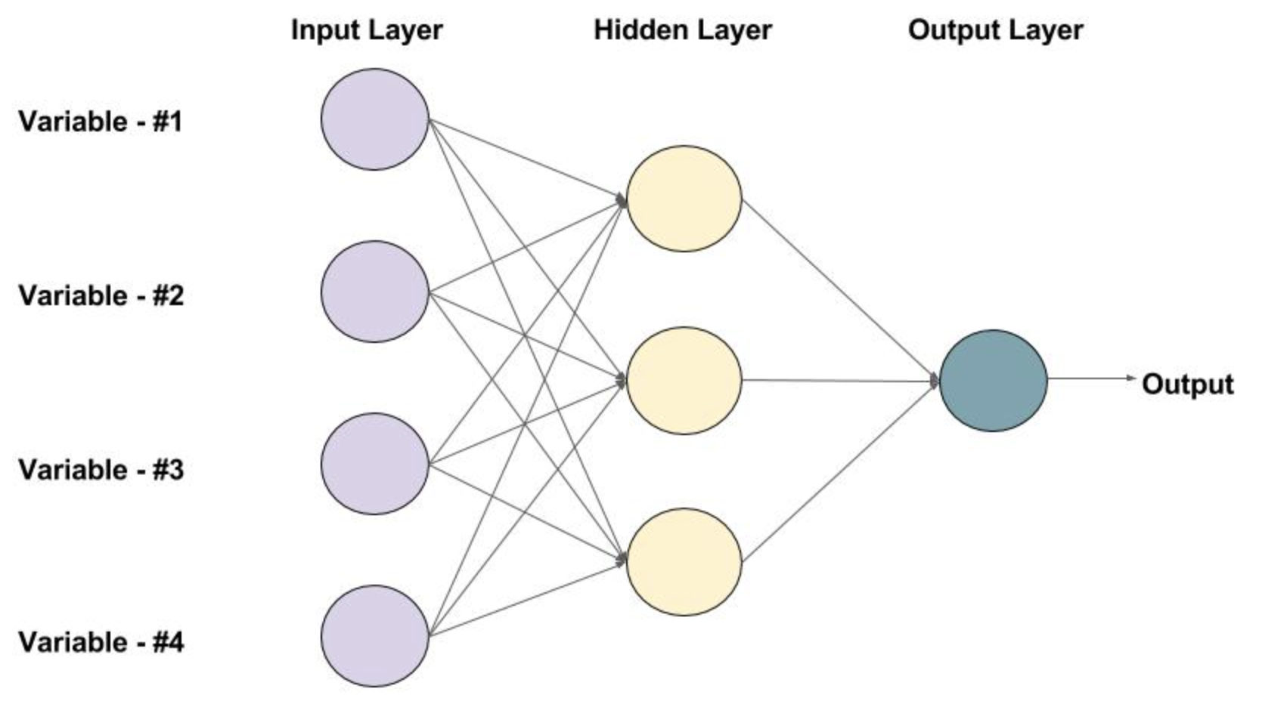
Feed Forward Neural Network
Model Architecture
Input Layer
Hidden Layers
Output Layers
Evaluation of the model by:
Number of layers
Activation function
Batch size
Regularization

Slide 4
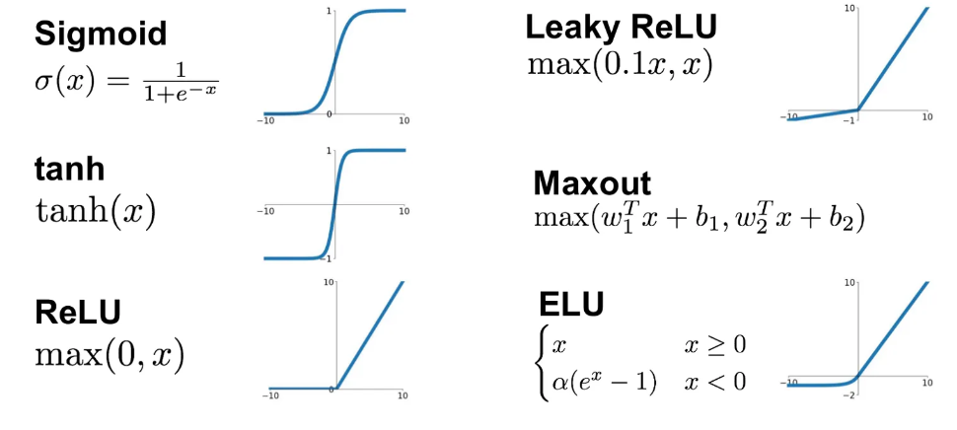



Evaluation of the FFNN Algorithm
Number of layers: [1,2,3] For both methods of feature detection 1-layer has the highest accuracy.
Activation Functions:
Algorithm
Count Vectorizer | Sigmoid | Leaky RELU | ELU
TF-IDF | ELU | Leaky RELU | Softmax
Batch Size: [32,68,128,256]
Count vectorizer: 256 , Tf_IDF: 32
Regularization (Drop out)
For Both method of feature detection has more than 1% improvement in accuracy.

Slide 5
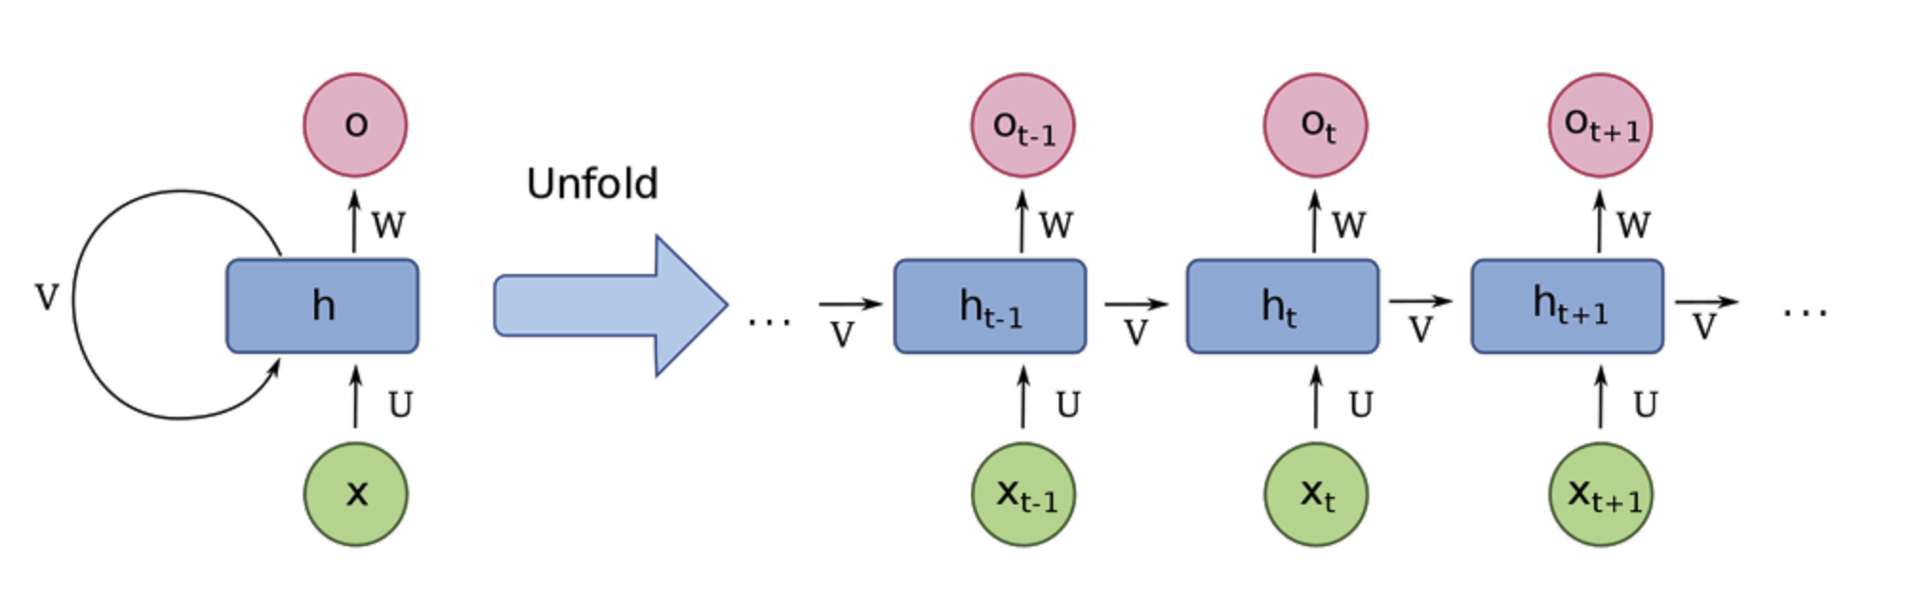
Recurrent Neural Network (RNN)
- RNN:
Well-suited for sequential data analysis
Effective in handling the sequences inherent in textual data
- Architecture:
Input Layer
Recurrent Layers
Hidden Layers
Output Layer

Slide 6
Optimal RNN Model Configurations
Two layers
Sigmoid activation function
Smaller batch sizes
TF-IDF
Dropout regularization improved results

Slide 7
Comparative Analysis of FFNN and RNN
Performance Metrics:
FFNN: Achieved the highest overall accuracy of 81% using the Count-Vectorizer method.
RNN: Excelled in environments where sequence and context of data are significant, such as with the TF-IDF method
Optimal Feature Extraction:
FFNN: Best results were observed with Count-Vectorizer
RNN: Showed a preference for TF-IDF, benefiting from the method’s emphasis on contextual importance
Activation Functions and Layers:
FFNN: Found optimal performance with fewer layers
RNN: Demonstrated robustness with increasing layers
Conclusion and Recommendation:
The study suggests RNN might be more adaptable to complex patterns and contexts within text data, making it a potentially more suitable choice for future text classification tasks given its performance stability across various configurations.

Slide 8
QA
Thanks for your time
Project on Github

