Slide 1

HORSE POWERED READING · CLASS #4
Two Practice Sessions, Feet and Hooves on the Ground
Stacie · Tribal Cowboy LLC · Athol, Idaho
HPR Facilitator Course · August 2026
www.tribalcowboy.com
info@tribalcowboy.com
Notes:
Open with one line about why you signed up for HPR — your ponies, your Clydesdales, and kids who need a different way into reading. Keep it under 30 seconds, then go straight to the sessions.

Slide 2
SESSIONS AT A GLANCE
Two Sessions, Two Lessons
SESSION 1
SESSION 2
Lesson
Word Racer: CVC words & Magic E
Reader(s)
Charlie, age 6
Horse
Charlie the Fjord
When & where
Friday, August 21 · the ranch
Lesson
Pony Express Mailbox: letter + 3D discs
Reader(s)
Charlie, age 6
Horse
Charlie the Fjord
When & where
Friday, August 21 · the trailer
www.tribalcowboy.com
info@tribalcowboy.com
Notes:
Fill each card from your session journals. If you worked with the same child both times, say so here — it sets up the “building on session 1” story.

Slide 3
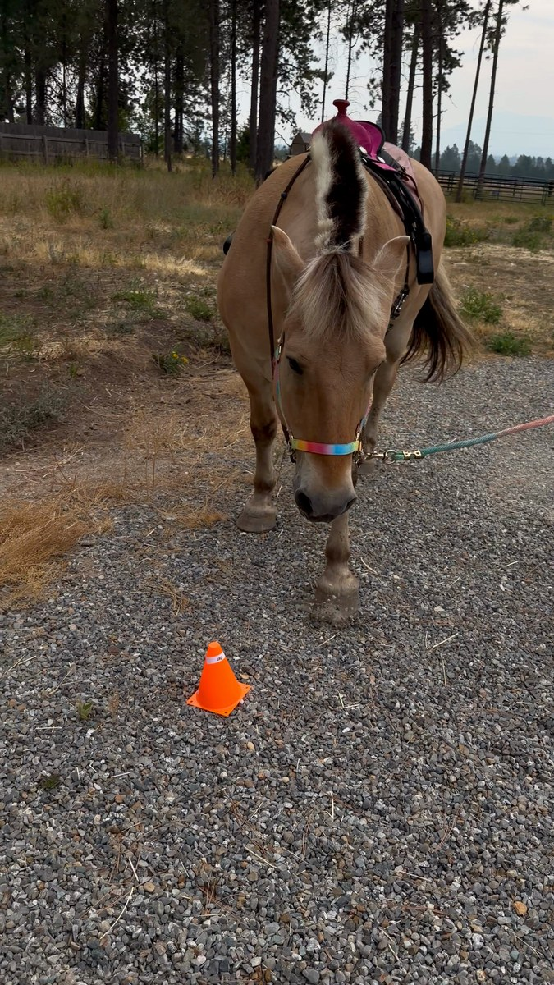
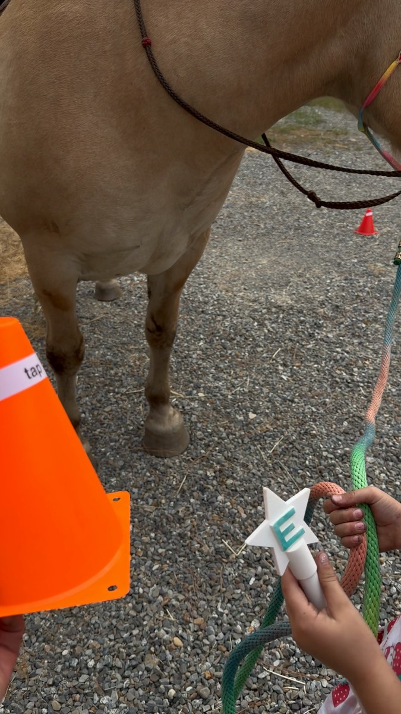
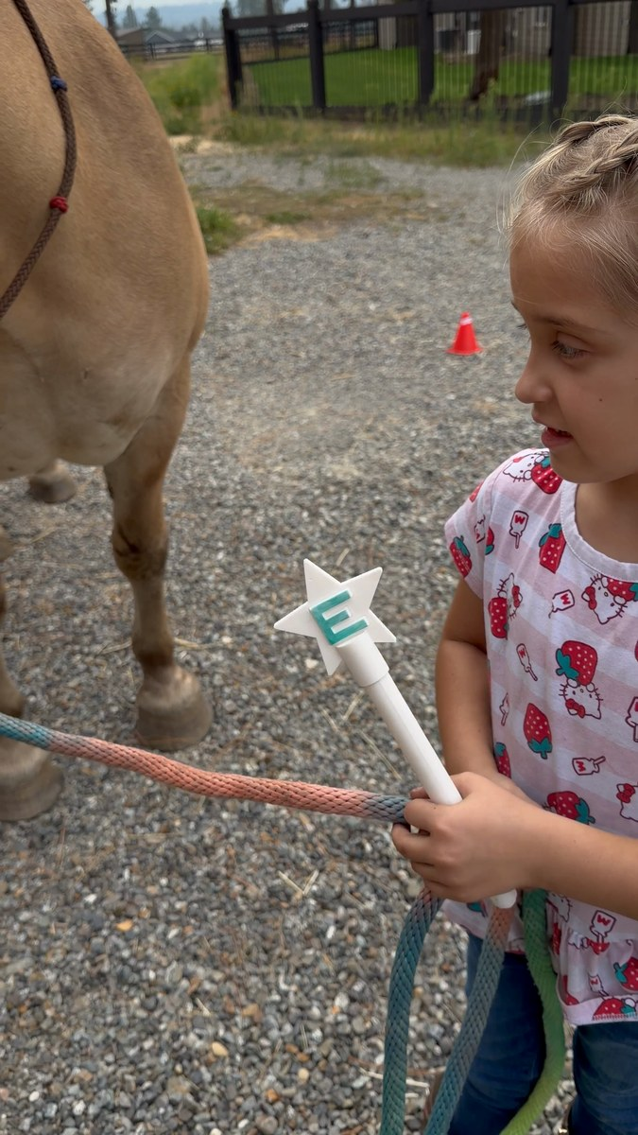
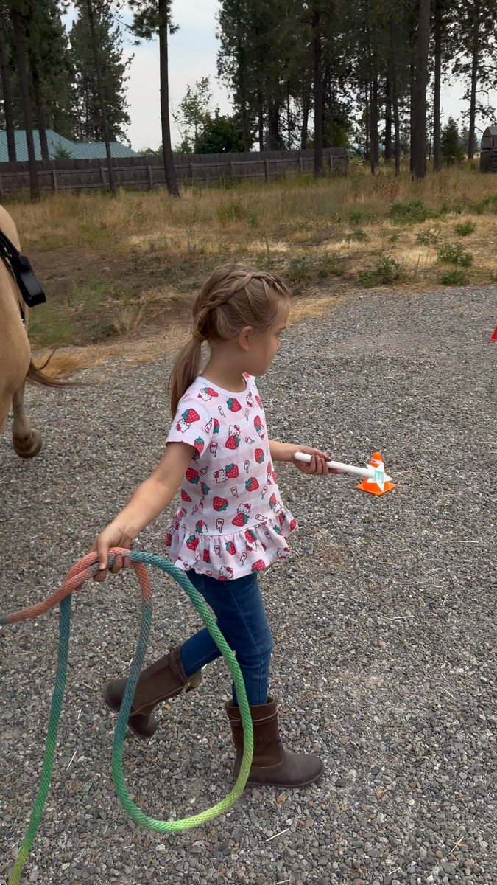
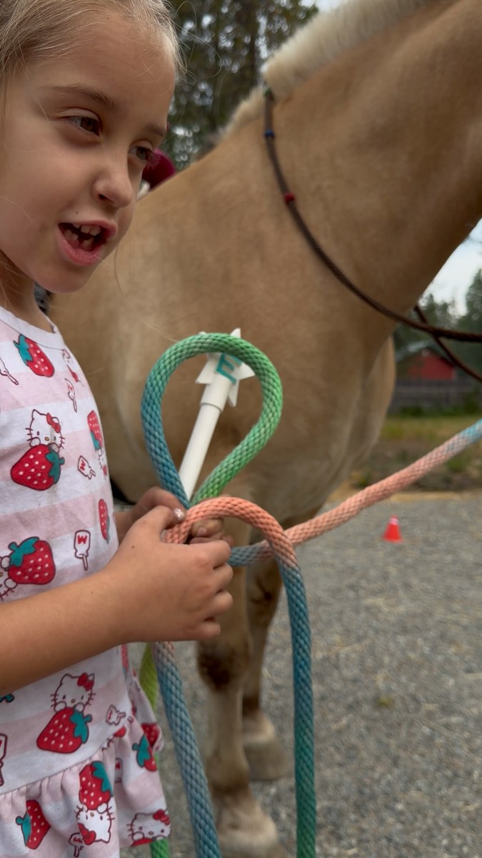
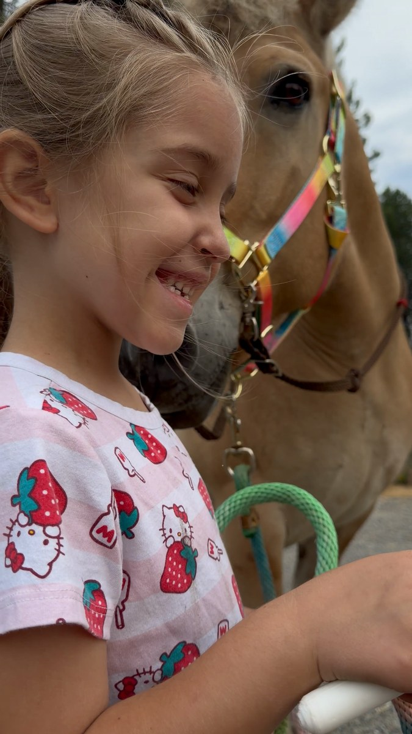
SESSION 1 · WHAT WE DID
Session 1: Word Racer
Word cards taped to the cones. Charlie the Fjord walked the line and stopped where he wanted. Whatever cone he picked, that was her word.
Charlie read the short word out loud, then tapped the card with the Magic E wand I 3D printed. Pew. Tap turned into tape, kit turned into kite.
She started with no clue what the silent E does. Two cards later she was telling me: it goes quiet and the vowel says its name.
THE CONCEPT
Magic E is silent, but it makes the vowel say its name: tap becomes tape.
www.tribalcowboy.com
info@tribalcowboy.com
Notes:
Walk the class through Word Racer in about a minute: word cards taped to the cones and the Magic E wand I 3D printed. Charlie the Fjord walked the line and stopped to pick each card. Charlie read the short vowel word, tapped it with the wand, and read the new word: tap to tape, kit to kite. He set the pace, which kept her from rushing. About 45 seconds here, then the reflections carry the weight.

Slide 4
SESSION 1 · REFLECTIONS
Session 1: What Stood Out
THE AH-HA MOMENT
I asked what the Magic E does and got a flat no. Two cards later she was telling me: the E goes silent and the vowel says its name. Kit became kite, and she read it like she owned it.
WHAT I LEARNED
Let the pony deal the cards. When Charlie the Fjord stopped and chose the next word, the drill became his game and she wanted a turn in it. My job was one question at a time, then wait.
THE HORSE'S PART
He stood dead quiet while she worked out K, I, T with his lead in one hand and the wand in the other. I told her you can hold it, he will stay. He did. That gave her the time to finish the word.
www.tribalcowboy.com
info@tribalcowboy.com
Notes:
These three boxes answer Ruth's prompts directly: the ah-ha moment, what you learned, and the horse holding space / giving feedback. One or two sentences each — a specific detail (what the horse did with its body, the exact words the child used) lands better than a summary.

Slide 5
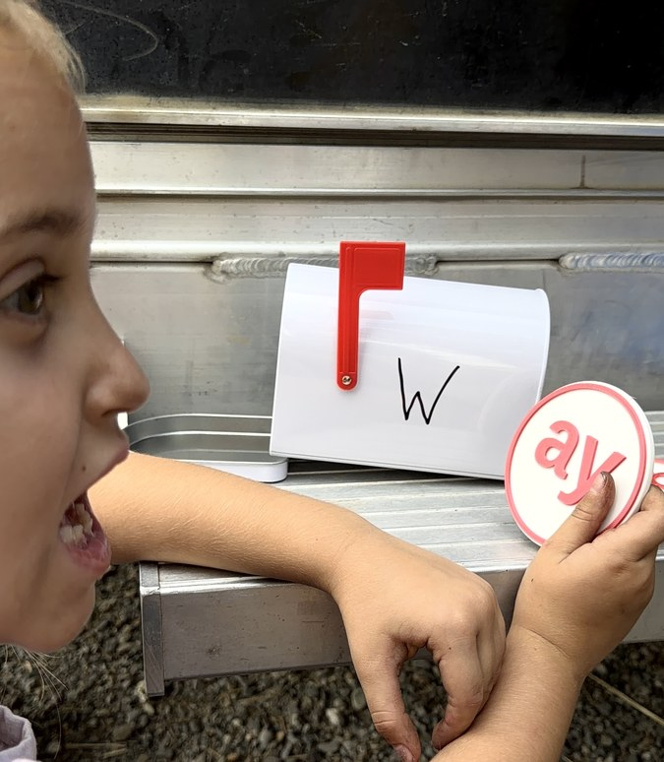
SESSION 2 · WHAT WE DID
Session 2: Pony Express Mailbox
I wrote a big W on the mailbox and set it on the trailer fender with a stack of 3D printed phonogram discs: ash, ay, ame, oke, ow.
Charlie held each disc up to the letter and sounded out the pair. Real words like wash and way went in the mailbox. Sillies like wame got tossed, with giggles.
Every disc she got in the mailbox earned a point. One read as nonsense until she flipped it and found wow. She counted her points to the end.
THE CONCEPT
One letter plus the right disc builds a real word: W + ash = wash.
www.tribalcowboy.com
info@tribalcowboy.com
Notes:
Walk the class through the Pony Express Mailbox in about a minute: I wrote a W on the mailbox and 3D printed the phonogram discs. Charlie tested each disc against the letter, sounded out the pair, and called it real or silly. Real words went in the mailbox for a point each: wash, way, wow. Sillies got tossed, and wame drew the biggest laugh. One disc sat upside down until she flipped it and found wow. Points counted to the end.

Slide 6
SESSION 2 · REFLECTIONS
Session 2: What Stood Out
THE AH-HA MOMENT
The upside down disc. She read woo, frowned, got one hint, flipped it, and got wow. Then said it four more times because she earned it.
WHAT I LEARNED
The no answers teach as much as the yes answers. Sounding out wame and ruling it not a word works the same muscle as reading wash. Points turned real versus silly into a game instead of a test.
THE HORSE'S PART
His work came first. The session with Charlie the Fjord built the calm she carried straight to the mailbox, halters at her feet and the trailer fender for a desk.
www.tribalcowboy.com
info@tribalcowboy.com
Notes:
These three boxes answer Ruth's prompts directly: the ah-ha moment, what you learned, and the horse holding space / giving feedback. One or two sentences each — a specific detail (what the horse did with its body, the exact words the child used) lands better than a summary.

Slide 7
ONE METAPHOR FROM THE ARENA
“
She read the disc upside down and got nonsense. She turned it, and it said wow.
That is a struggling reader in one disc. The letters were never wrong. She held the word the wrong way up, and nobody grabbed it out of her hands. My job, and the pony's, is to stand quiet and give her room to turn it.
www.tribalcowboy.com
info@tribalcowboy.com
Notes:
Ruth asked for one metaphor from your sessions, described. Pick the one that gave you goosebumps. Say the metaphor, pause, then explain it — don't rush this slide, it's the emotional center of your presentation.

Slide 8
GLOW & GROW
Glow & Grow
GLOW
GROW
Me
One question at a time, then wait. The quiet did more teaching than I did.
I handed her the Magic E answer instead of letting her guess first. Next time I ask twice before I tell.
The Reader
Spelled every word out loud before saying it, and called real or silly on her own by the end.
Short vowel sounds still wobble, ah versus A. The wand gave her the why. Now she needs the reps.
The Horse
He picked word cards like he was dealt into the game, then stood like a stone while she read.
Walking a cone line past loose hay without a snack stop is still a lesson in progress.
www.tribalcowboy.com
info@tribalcowboy.com
Notes:
This is the GLOW / GROW self-reflection another participant shared. Fill it across both sessions — you don't need one per session. Be honest in the “Me · Grow” box; that's the one the class learns most from.

Slide 9
PLANTING HPR ROOTS IN NORTH IDAHO
Where This Goes From Here
Horse Powered Reading folds into Tribal Cowboy's Pony Express Program: reading sessions at the ranch and school visits across Kootenai and Bonner counties, starting with the kids reading below grade level.
Thank you — and thank you to the horses.
www.tribalcowboy.com
info@tribalcowboy.com
Notes:
Close with where you want to take HPR: your own herd, your own community, Tribal Cowboy's school programs. This is also your invitation to the class — you're building this in North Idaho and open to brainstorming at the live class.

