Slide 1
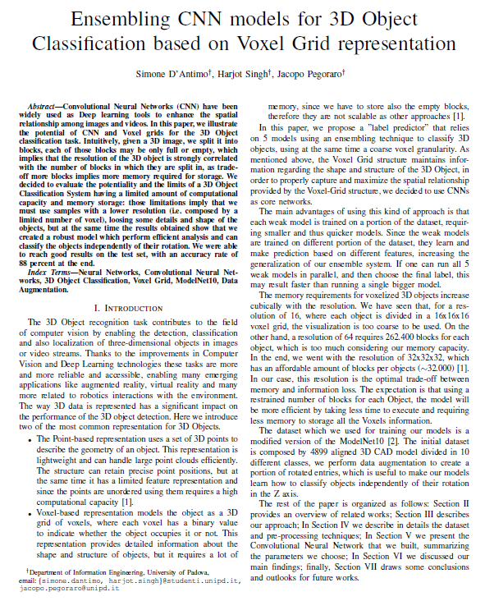
NNDL@UNIPD
Ensembling CNN models for 3D Object
Classification based on Voxel Grid representation
Authors
D’Antimo Simone¹
Singh Harjot¹
simone.dantimo@studenti.unipd.it
harjot.singh@studenti.unipd.it
¹The University of Padua

Slide 2
Table of Contents
The Challenge
03
Our Approach
05
Data preparation
07
Model
13
Training & Experimental results
15
Conclusions and Future work
20

Slide 3
THE Challenge

Slide 4
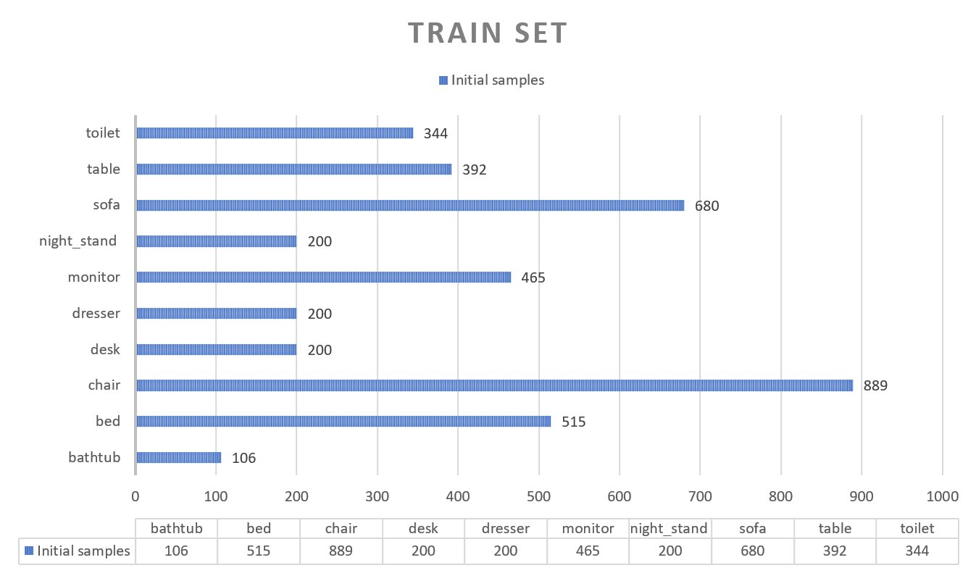
THE CHALLENGE
Our goal: Classifying 3D Object independently their rotation using CNN and Voxel Grid representation
Our data: ModelNet10,
• 4899 3D CAD divided into 10 classes
• 80/20* = train/test* splitting
• orientation aligned
- CAD models
- Non i.i.d.
- Desired partition 80-10-10

Slide 5
Our Approach

Slide 6
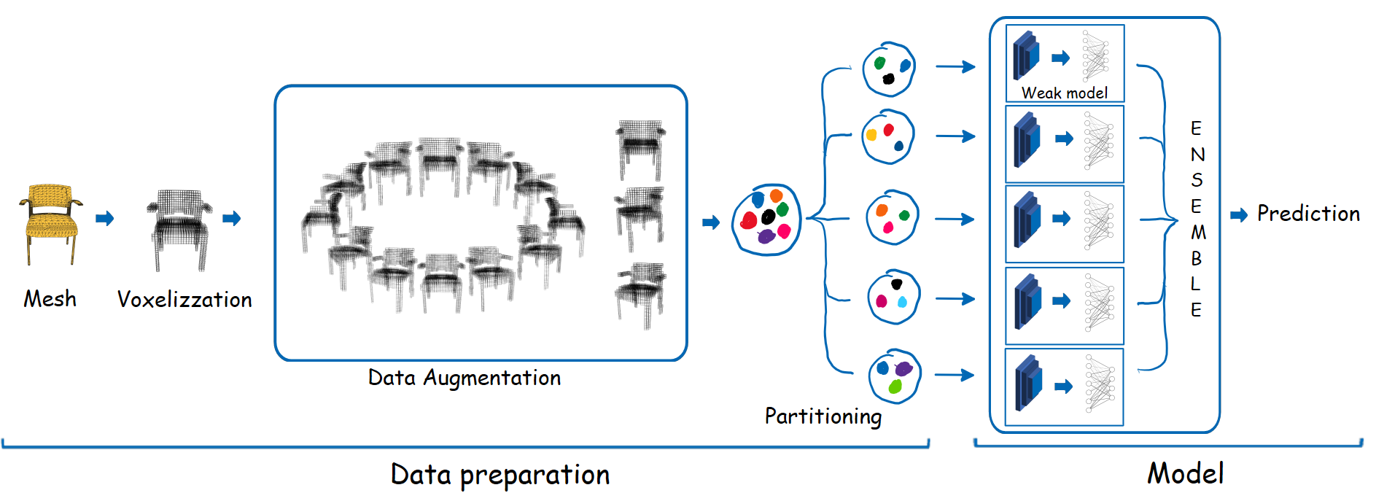
Processing pipeline

Slide 7
Data Preparation

Slide 8
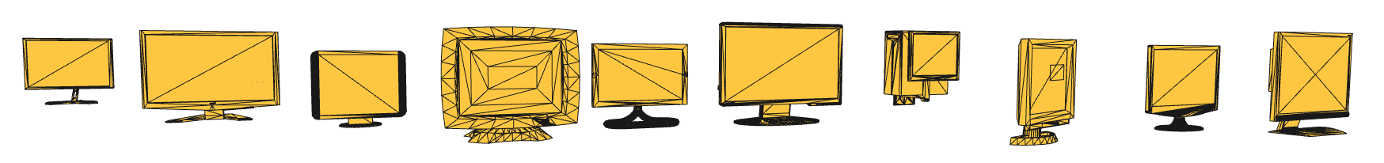
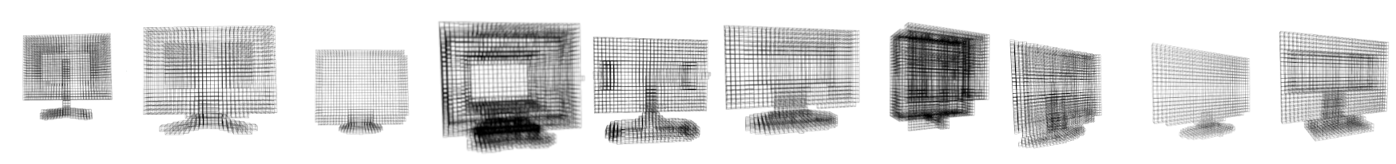
Data preparation
VOXELIZATION
1
ModelNet10
3D Cad Models
Voxel Grids

Slide 9
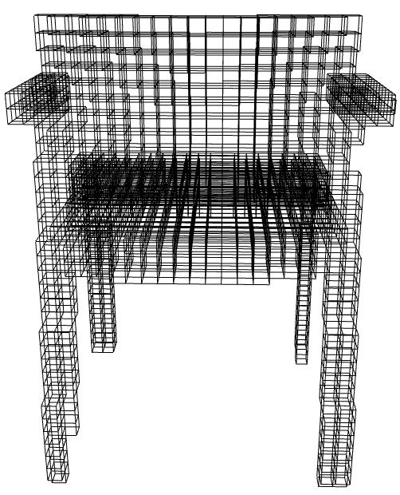
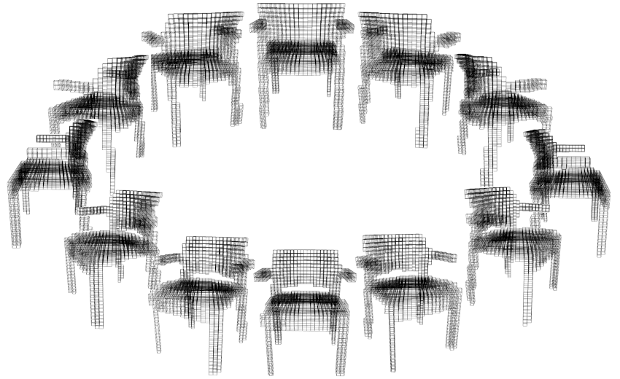
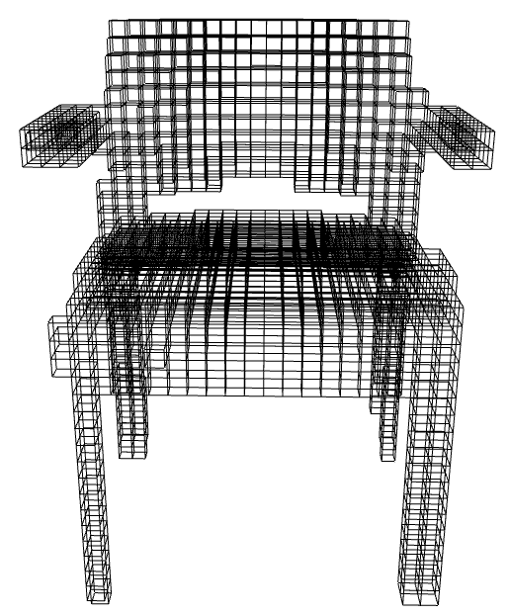
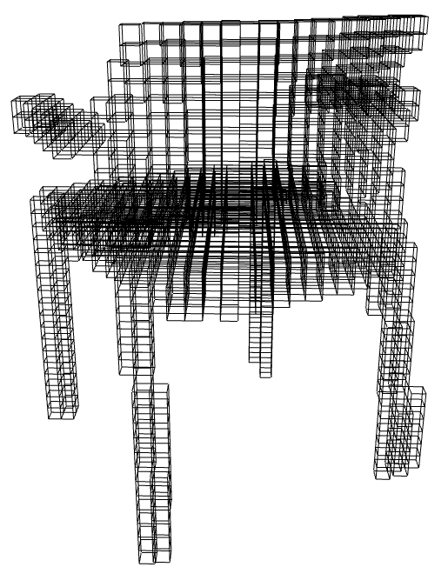
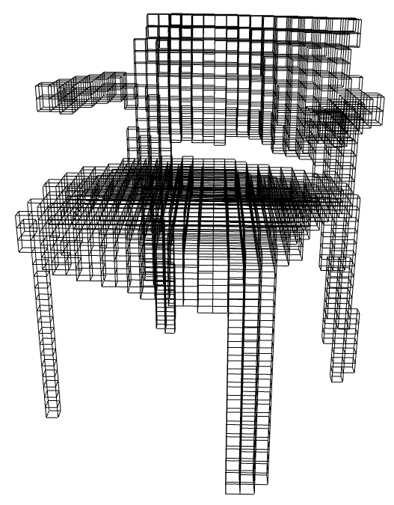
Data preparation
VOXELIZATION
>
AUGMENTATION
>
1
Focus on making the dataset IID
2
N Rotations, depending on their initial distribution
Rotations | Classes
2 | bed, chair, monitor, sofa
3 | table, toilet
5 | desk, dresser, night_stand
8 | bathtub

Slide 10
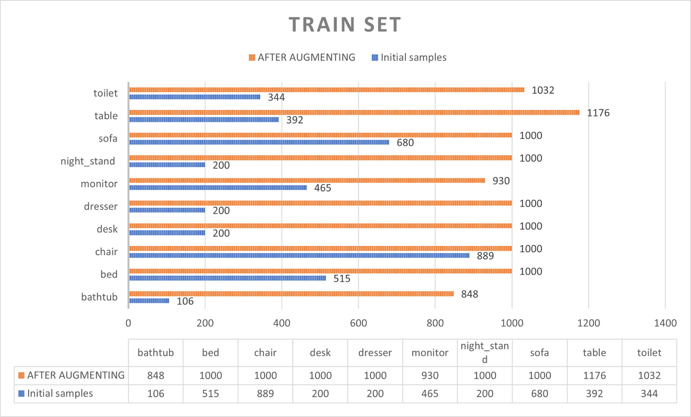
Data preparation
VOXELIZATION
>
AUGMENTATION
>
1
Focus on making the dataset IID
2
N Rotations, depending on their initial distribution
Rotations | Classes
2 | bed, chair, monitor, sofa
3 | table, toilet
5 | desk, dresser, night_stand
8 | bathtub

Slide 11
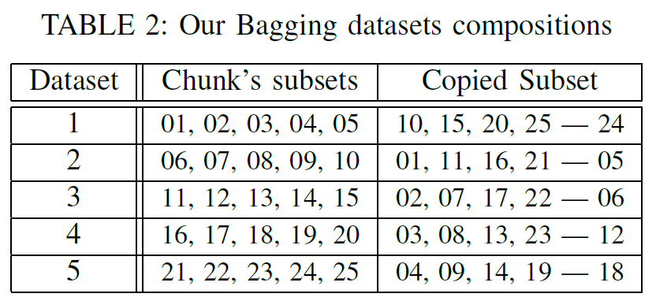
Data preparation
VOXELIZATION
>
AUGMENTATION
>
PARTITIONING
1
Focus on making the dataset ready for the ENSEMBLE models
2
Each weak model should learn
well on their part of the dataset
some information on data of other models.

Slide 12
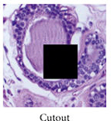
Data preparation
VOXELIZATION
>
AUGMENTATION
>
PARTITIONING
>
CUTOUT
1
Masking Out a random portion of the input data
Improve robustness
Improve generalization
Reference: Research Gate
Notes:
Form of data augmentation
randomly masking out regions of the input data during training.
improve the robustness and generalization ability of the network.
prevent the network from relying too heavily on specific local features

Slide 13
Model

Slide 14
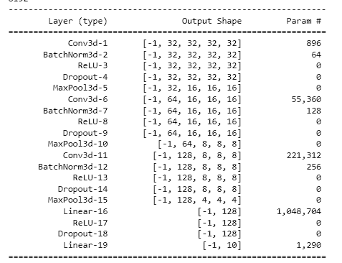
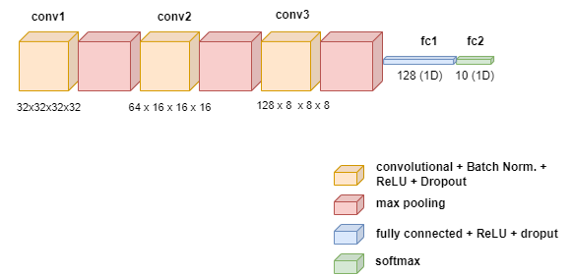
THE weak MODELs STRUCTURE
!! Represent in 3D for model flow, but 3DConv layer has 4 dimension

Slide 15
Training & Experimental results

Slide 16
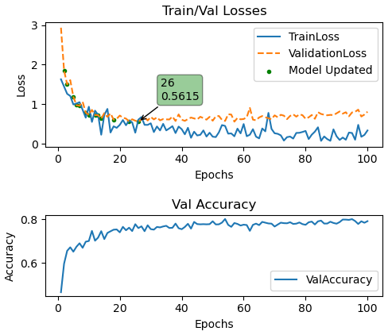
training weak models
Epochs per model:100
Converge quickly <50 Epochs
Learning rate: 1e-3
Optimizer: ADAM
Loss: Cross Entropy
Max Pooling Kernel: 2x2x2
Max Pooling Stride: 2x2x2

Slide 17
RESULTS on validation set
CLASS
M0
M1
M2
M3
M4
EN
0
bathtub
0.98 | 0.98 | 0.94 | 0.97 | 0.93 | 0.98
0.92 | 0.90 | 0.92 | 0.96 | 0.94 | 0.94
0.96 | 0.91 | 0.98 | 0.94 | 0.96 | 0.97
0.62 | 0.67 | 0.80 | 0.75 | 0.65 | 0.78
0.74 | 0.73 | 0.71 | 0.83 | 0.74 | 0.77
0.94 | 0.97 | 0.97 | 0.96 | 0.97 | 0.96
0.71 | 0.75 | 0.75 | 0.81 | 0.67 | 0.75
0.88 | 0.76 | 0.81 | 0.87 | 0.90 | 0.88
0.67 | 0.77 | 0.81 | 0.87 | 0.90 | 0.88
0.99 | 0.90 | 0.95 | 0.91 | 0.98 | 0.97
1
bed
2
chair
3
desk
4
dresser
5
monitor
6
night_stand
7
sofa
8
table
9
toilet
Notes:
Results are good, as we mentioned above the fact that we trained each model in a different part of the dataset show us how each model learn different features and we created a more generalized model

Slide 18
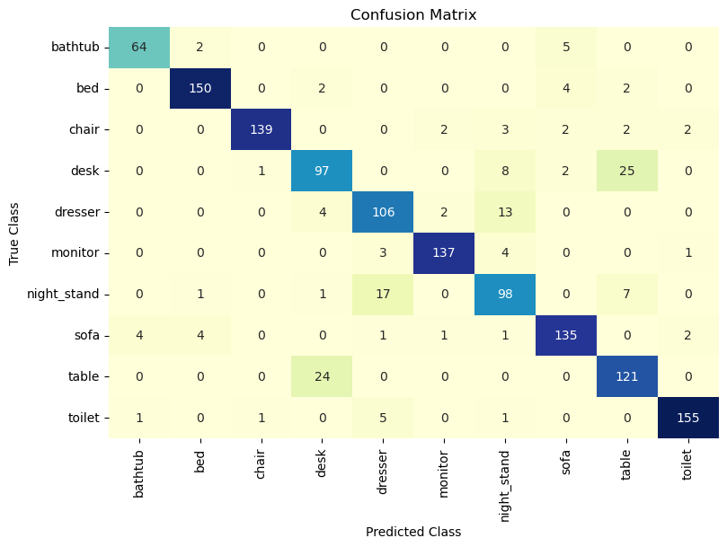
RESULTS on test set
Ensembled model results:
Good diagonal Confusion matrix
Errors are “Symmetric”
Confusion matrix of the ensemble model
Notes:
Symmetric conf. Matrix suggest that the model is making accurate predictions for each class without any significant bias towards a particular category.

Slide 19
RESULTS on Test set
ACCURACY
1
M0
0.83
0.83
0.85
0.87
0.86
0.88
BASELINE ACCURACY: 0.90
2
M1
3
M2
ShapeNet: 0.83
DeepPano 0.85
VoxNet 0.92
Orion 0.938
4
M3
5
M4
6
EN

Slide 20
Conclusions and Future work

Slide 21
Conclusions
Model has good accuracy
Dynamic, can be adapted on the computer in which is run
future work
Adding more data and Models
Implements a way to capture long-range context information
Notes:
Model run in parallel, 2 at a time on kaggle GPUs (SPEED/PERFORMANCE)

Slide 22
END Thank You

Slide 23
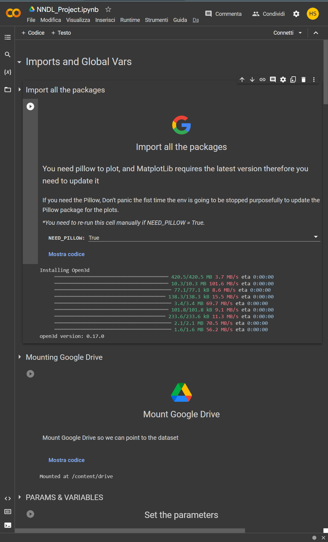
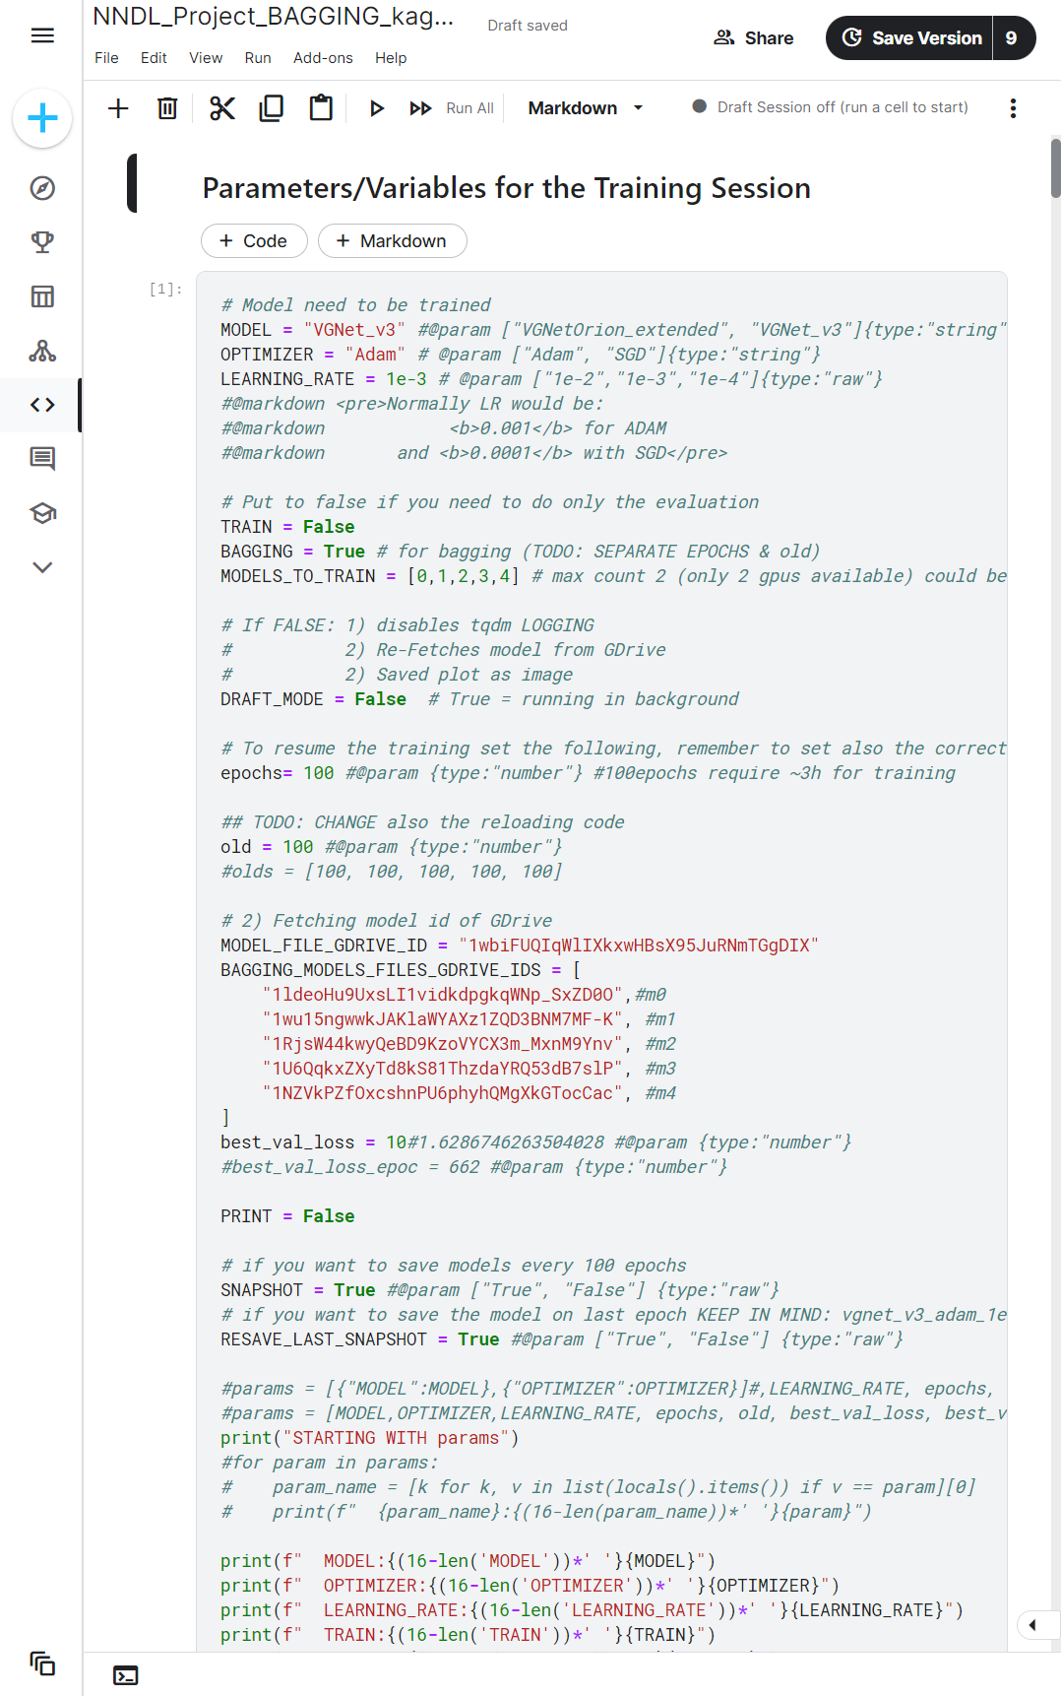
NOTEBOOK demo

