Slide 1









EMAIL CLASSIFICATION SYSTEM

Slide 2
Group membeRS:
ASHIKA JAIN (AP23110010618)
UJJWAL PANDEY (AP23110011121)
SAURABH KUMAR(AP23110010438)
MUKUL KUMAR (AP23110010700)
SAUBHAGYA KASHYAP (AP23110010439)

Slide 3





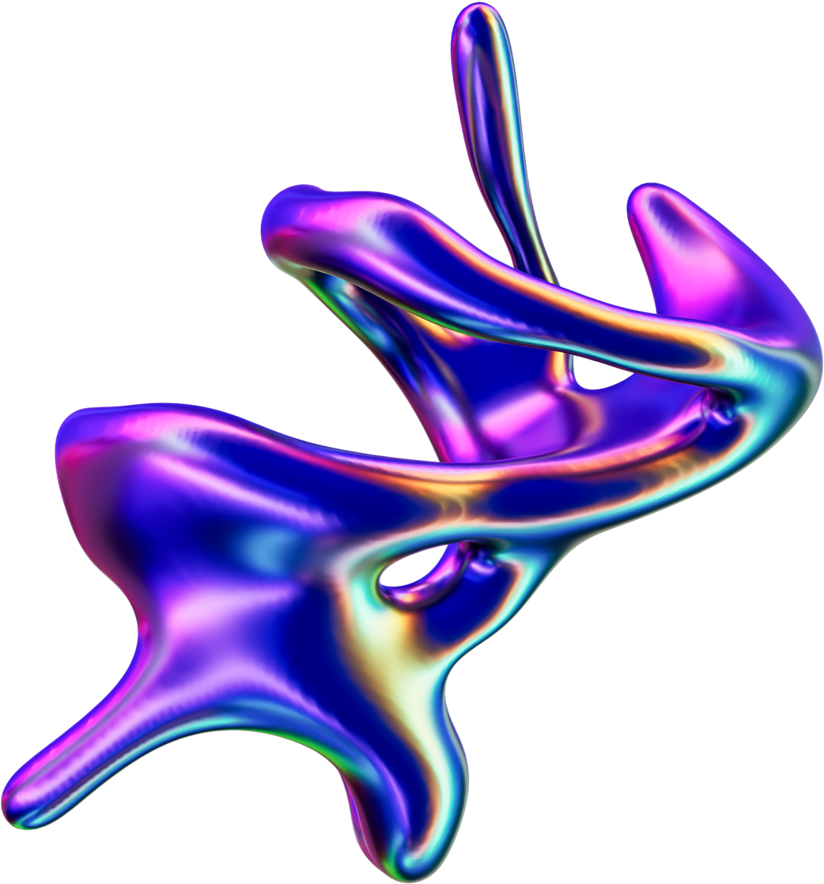

PROBLEM STATEMENT & OBJECTIVES
Problem Statement:
Organizations receive hundreds of emails daily.
Manually sorting them results in:
Missed important emails
Overloaded inbox
Low productivity
Existing spam filters provide only basic classification (spam vs non-spam), not organizational categories.
Objectives:
Build an AI-based system to automatically classify emails
Categories: Financial, General, HR, Urgent
Improve workplace productivity and response time
Provide a web interface to view categorized emails easily

Slide 4

PROPOSED SOLUTION & WORKFLOW
Proposed Solution:
A machine learning system that analyses email subject + body and classifies them into predefined categories using NLP + ML.
workflow:
01
02
03
04
Email Retrieval
Preprocessing and Feature Extraction
Model Prediction
Storage & Display
Cleaning text, removing HTML, stopword removal, tokenization and Convert text to numeric vectors using TF-IDF
Fetch emails using IMAP (Gmail integration)
ML classifier predicts suitable category
MongoDB stores user emails
Frontend (React + 3D UI) displays categorized emails

Slide 5
DATASET & METHODOLOGY
Dataset
Methodology
Source: Enron Email Corpus (~500,000 emails)
Contains real corporate emails from employees
Labeled subset used for training: Important, General, Promotion, Spam
Data cleaning & preprocessing
TF-IDF vectorization
Multiclass classification
Train-test split (70% train, 30% test)
Model saved and integrated with backend API

Slide 6
TECHNOLOGIES USED
01
02
03
Frontend
Backend
Machine Learning
React.js
Three.js + React Three Fiber (3D UI)
Axios for API calls
Python
FastAPI
IMAP for email fetching
MongoDB
Uvicorn server
Scikit-Learn
TF-IDF Vectorizer
Logistic Regression

Slide 7
RESULTS & FINDINGS
Model Performance:
Category | Precision | Recall | F1-Score
Urgent | 1.00 | 0.94 | 0.97
General | 0.90 | 0.98 | 0.93
PromotionHR | 0.90 | 0.89 | 0.90
Financial | 0.90 | 0.98 | 0.84
Findings:
AI accurately separates organizational emails
Drastically reduces inbox clutter
Helps prioritize urgent/important messages
Smooth integration with Gmail
Overall Accuracy: ~94%

Slide 8
CONCLUSION & FUTURE SCOPE
Conclusion
Future Scope
Use Transformer models (BERT) for more accurate classification
Addsentiment/emotion detection in emails
Mobile app version
Real-time continuous email syncing
Integration with Outlook, Slack, MS Teams
Successfully built a complete end-to-end ML system
Automates email organization inside workplace
Provides a modern, interactive 3D dashboard
Achieves high accuracy with classical NLP methods

Slide 9



