Slide 1

Lending Case Study
IIIT Bangalore – AI/ML – batch 63
Submitted By
Sunitha Saraf
Sivananda Reddy Mylarapu

Slide 2
Agenda
The primary objective of the Lending Club case study is to mitigate the credit loss while approving or denying the loans to their customers. This challenge arises from two potential scenarios
Rejecting the loans to the applicants who has the capability to repay the loans will result in a loss of business to the company
Approving the loans to the customers who are likely to default may lead to financial loss for the company
The objective is to determine the applicants at risk of defaulting on loans, enabling a reduction in credit losses. This case study aims to achieve this goal through Exploratory Data Analysis (EDA) using the provided dataset.

Slide 3
Case Study Approach
Data Cleansing
Data Standardization
Data Analysis
Conclusion
Remove null value columns
Remove unique value columns
Remove unused columns
Apply outlier filters
Impute column values
Remove unused datasets
Univariate Analysis
Bivariate Analysis
Multivariant Analysis
Correlation Analysis
Observations from Data Analysis
Loan Status: The key Attribute for the case study(loan_status). This column contains three distinct values:
Fully-Paid: Signifies customers who have successfully repaid their loans.
Charged-Off: Indicates customers who have been labeled as "Charged-Off" or have defaulted on their loans.
Current: Represents customers whose loan process is in progress and cannot provide conclusive evidence regarding. For the case study all these records will be excluded

Slide 4
DATA CLEANSING

Slide 5
Data Cleansing
Load data set
There are total 39717 rows with 111 columns available in the data set
Remove Null value columns
Total 54 records were removed out of 111 as these columns carry all null values. Only 57 columns has valid data.
Remove Unique value Columns
9 Columns are removed from the remaining 57 columns as these columns carry unique value which will not be helpful for the data analysis. Remaining 48 columns has distinct data.
Remove unused columns
21 columns out of 48 columns are removed as these columns are no helpful for our analysis.
Remove records which has duplicate data set
3 columns (mths_since_last_delinq, mths_since_last_record, next_pymnt_d) are removed as these carry 60% of duplicate data.
At the end of data cleansing activity the dataset contains totally 24 columns

Slide 6
DATA STANDARDIZATION

Slide 7
Data Standardization
Dropped the 1140 records whose loan status is ‘Current’ as the loan in-progress will not provide any insights for the analysis
Dropped 697 records as pub_rec_bankruptcies values are null and they cannot be imputed.
Imputed emp_length column with the mode of the same and converted in to Integer data type.
Converted interest rate column into float data type
Converted term column into Integer data type
Derived new columns Issued_month and Issued_year from issue_d column

Slide 8
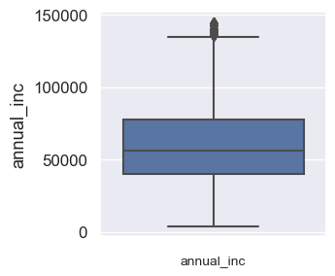
Data Standardization(Cont.)
Outlier Filtering:
Calculated Inter-Quartile Range based on the annual income and filtered the records outside the lower and upper bound range.
The loan amount of most of the loan applicants is in between 5000 and 15000 USD.
The interest rate on the loan is between 8.5% - 14.5%
EMI amount on the loan is between 180 - 420
The debt to income ratio is between 8 - 18
Data standardization process has filtered 3623 rows with the final data set contains 36094 records.

Slide 9
DATA ANALYSIS

Slide 10
Data Analysis
The following approaches are followed to analyze the lending club dataset.
Univariant Analysis
Univariant Segmented Analysis
Bivariant Analysis
Bivariant Segmented Analysis
Correlation Analysis

Slide 11
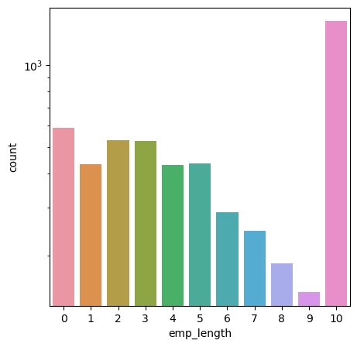
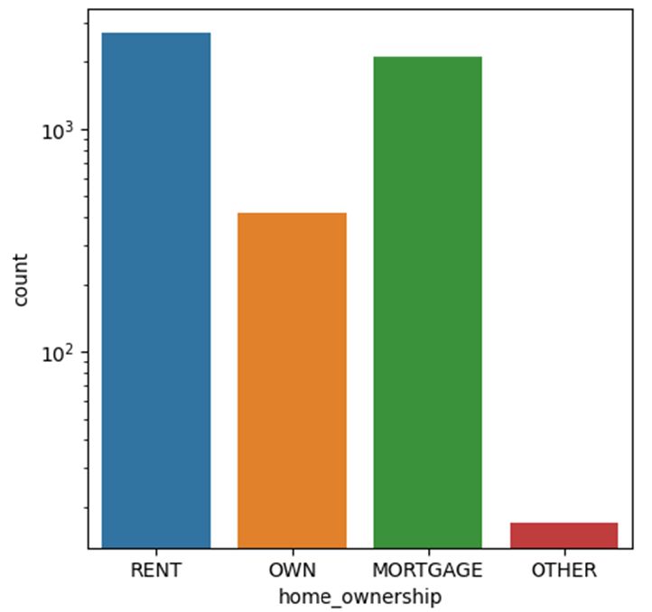
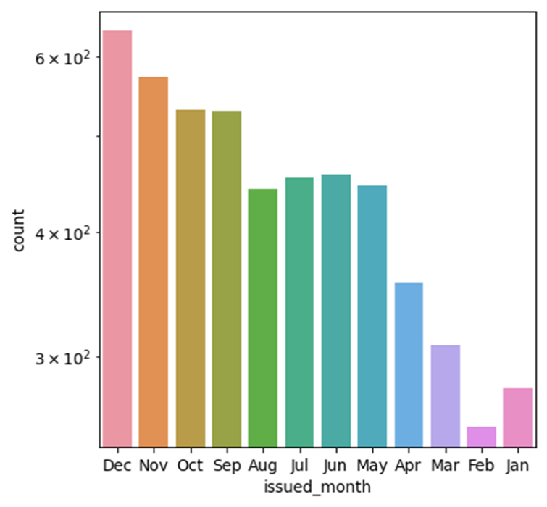
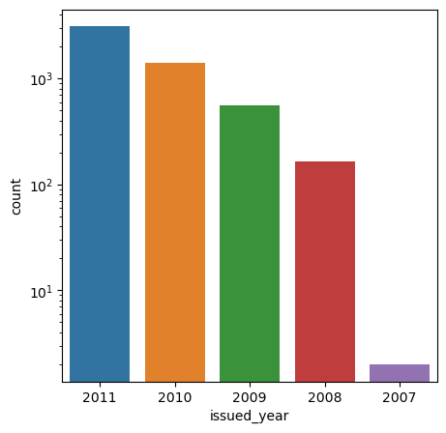
Univariant Analysis
Employment Length and Home Ownership Vs “Charged Off” Loans
Loan Issued Month and Year Vs “Charged Off” Loans

Slide 12
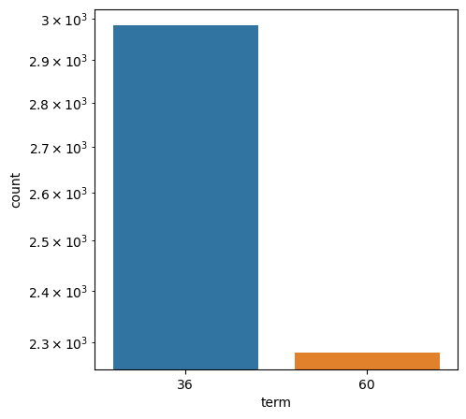
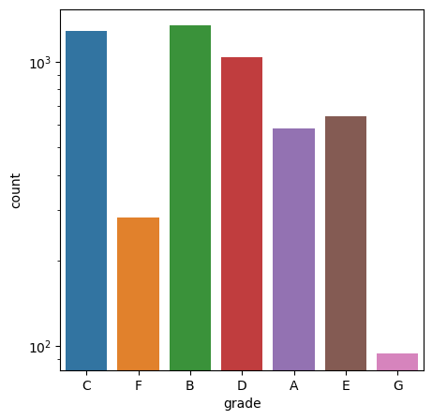
Univariant Analysis
Loan term and Grade Vs “Charged Off” Loans

Slide 13
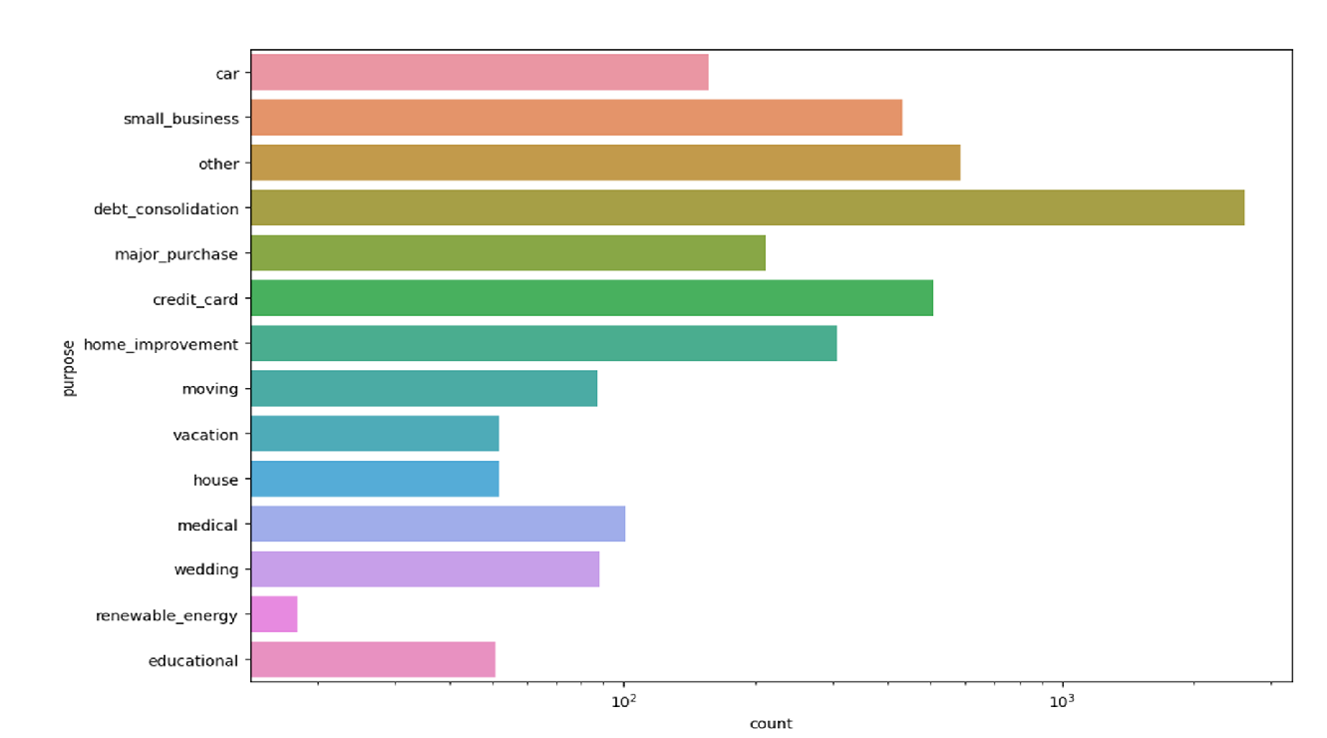
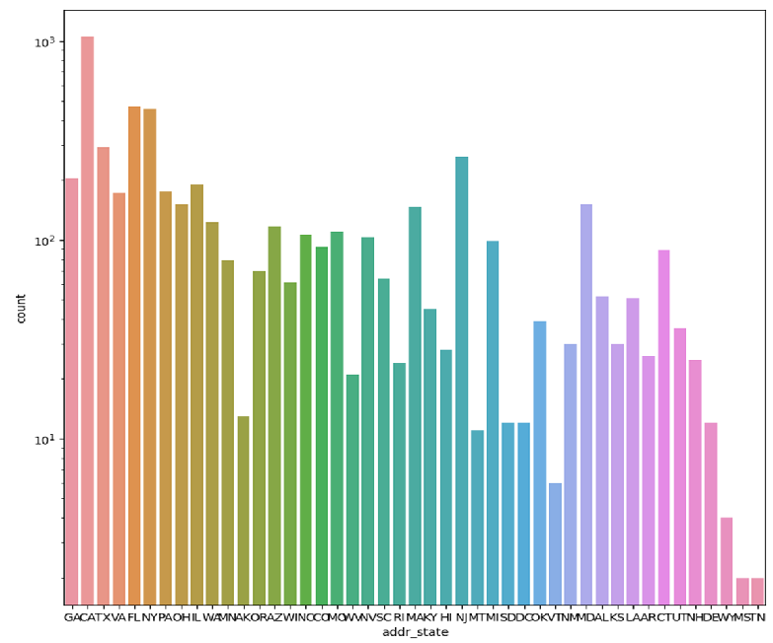
Univariant Analysis
Purpose of the Loan and applicants address state Vs “Charged Off” Loans

Slide 14
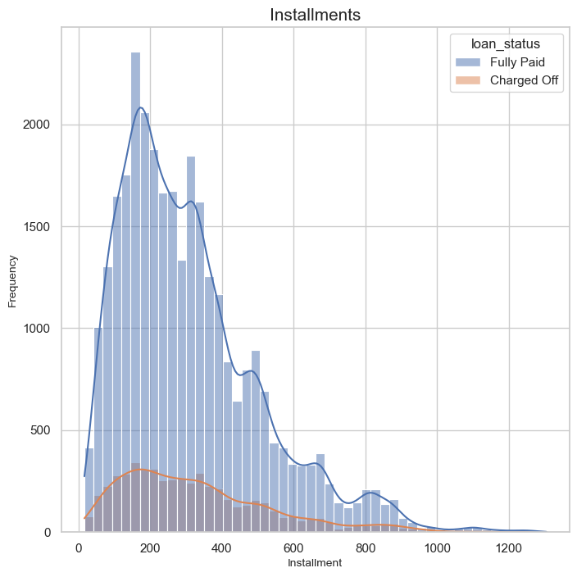
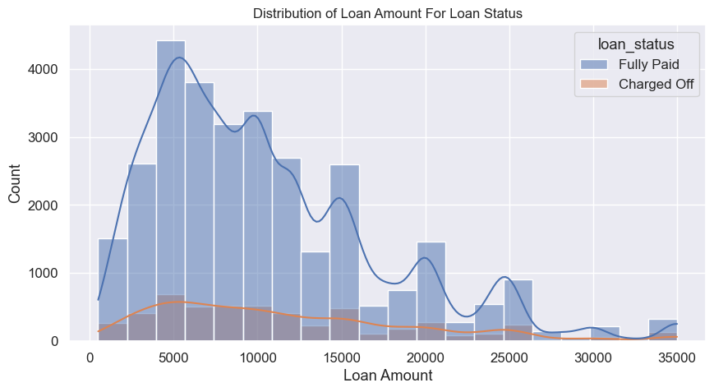
Univariant Analysis
Installment Amount and Loan Amount Vs Loan status Histogram graph representation

Slide 15
Univariant Analysis – Observations
Applicants who are employed for more than 10 years a for are accountable for the highest number of "Charged off" loans.
The majority of defaulted loan members are individuals, living in rented houses.
"Charged off" loans are mostly that are taken during the 4th quarter(December, November and October) primarily in December. This might be the reason for loan application during the holiday season.
The trend says, the Charged Off loans are increasing year by year.
Most of the Charged off loans are due to Debt Consolidation.
California state had the highest number of Charged off loan applicants.
Short term loans with a duration of 3 years or 36 months are popular among Charged Off loan applicants.

Slide 16
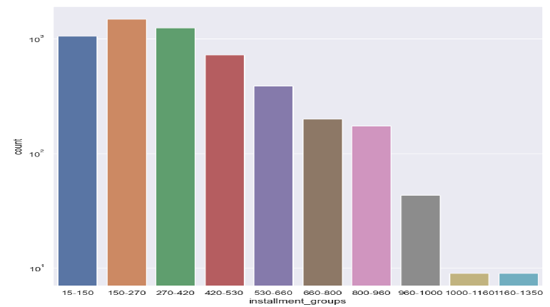
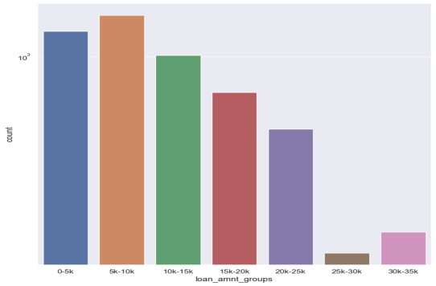
Univariant Segmented Analysis
Installment Groups and Loan Amount Groups Vs “Charged Off” Loans

Slide 17
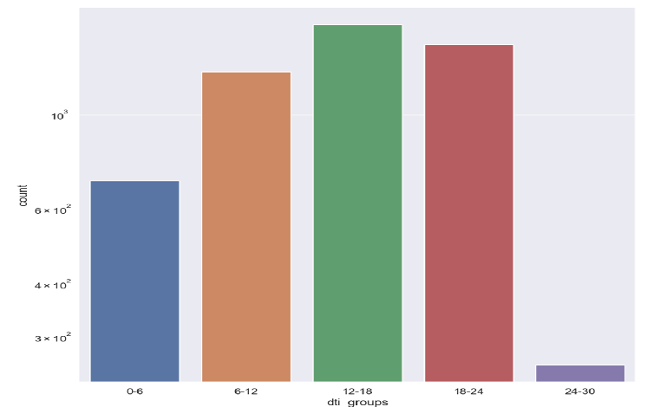
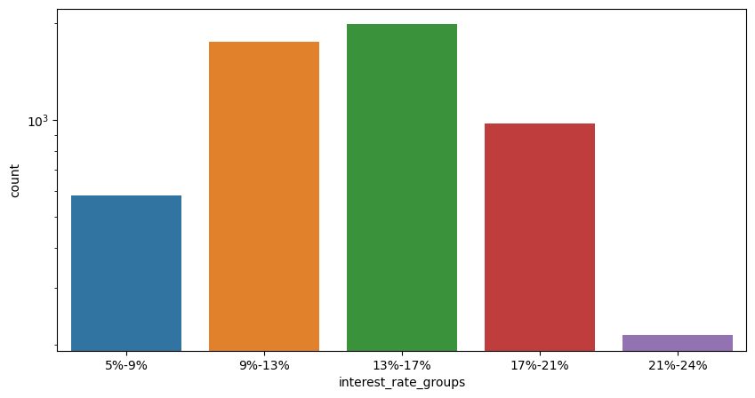
Univariant Segmented Analysis
Debt to Income Ratio and Interest Rate Groups Vs “Charged Off” Loans

Slide 18
Univariant Segmented Analysis – Observations
The following combinations are some of the reasons for Charged Off loans
Loan amounts between 5k to 10k
installment amount between 150$ to 270$
Interest rate between 13% to 17%
Debt to Payments ratio between 12 to 24.

Slide 19
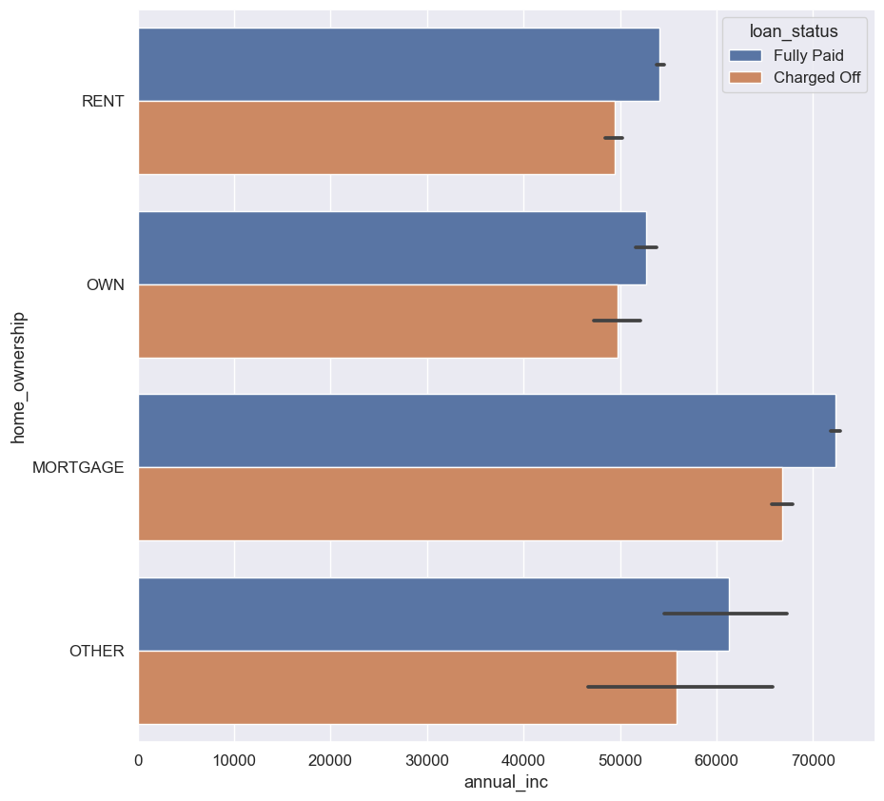
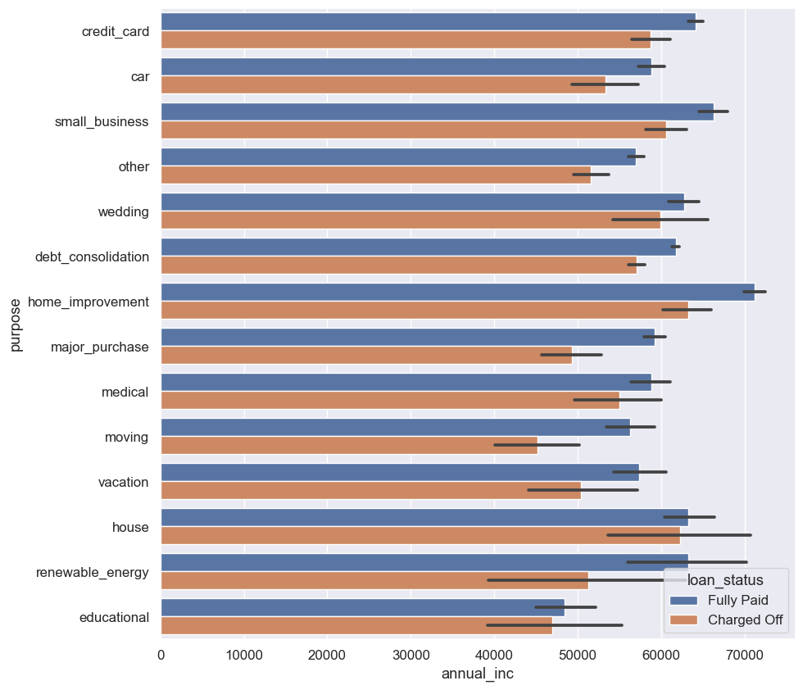
Bivariant Analysis – Annual Income
Home Ownership and purpose with Annual income combination

Slide 20
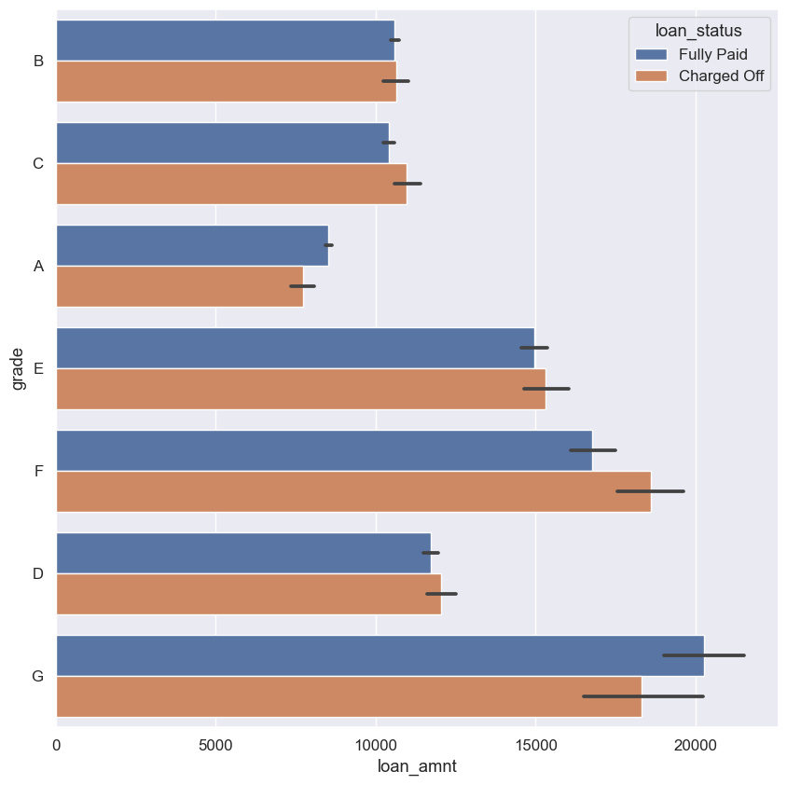
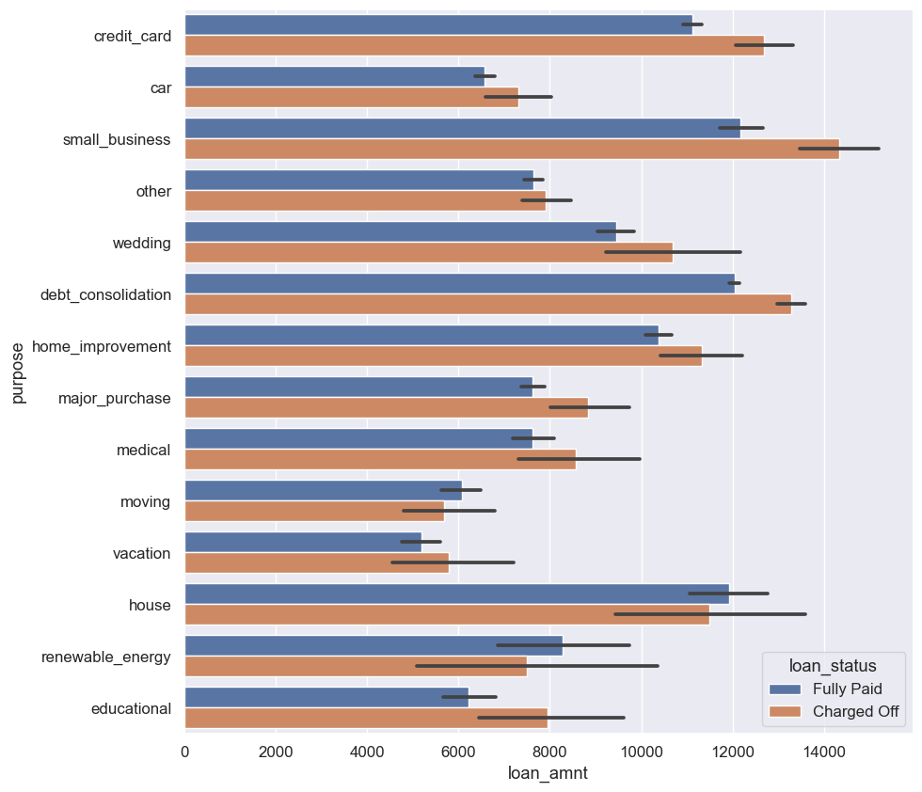
Bivariant Analysis – Loan Amount
Home Ownership and purpose with Loan Amount combination

Slide 21
Bivariant Analysis – Observations
Applicants with annual income more than 60k and applying for either home or home improvement or small business has higher chances of defaulting.
Applicants with Grade E, F, G and applying for 15k or more loan amount
Applicants applying for over 12k loan amount for the purpose of credit card, debt consolidation or house are prone to default

Slide 22
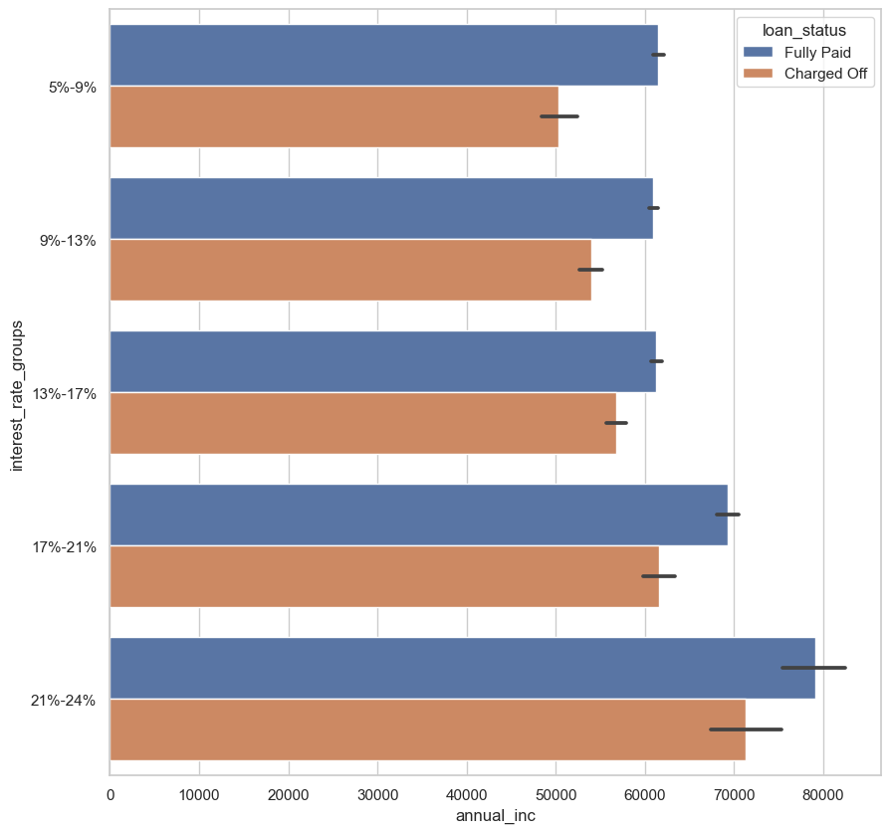
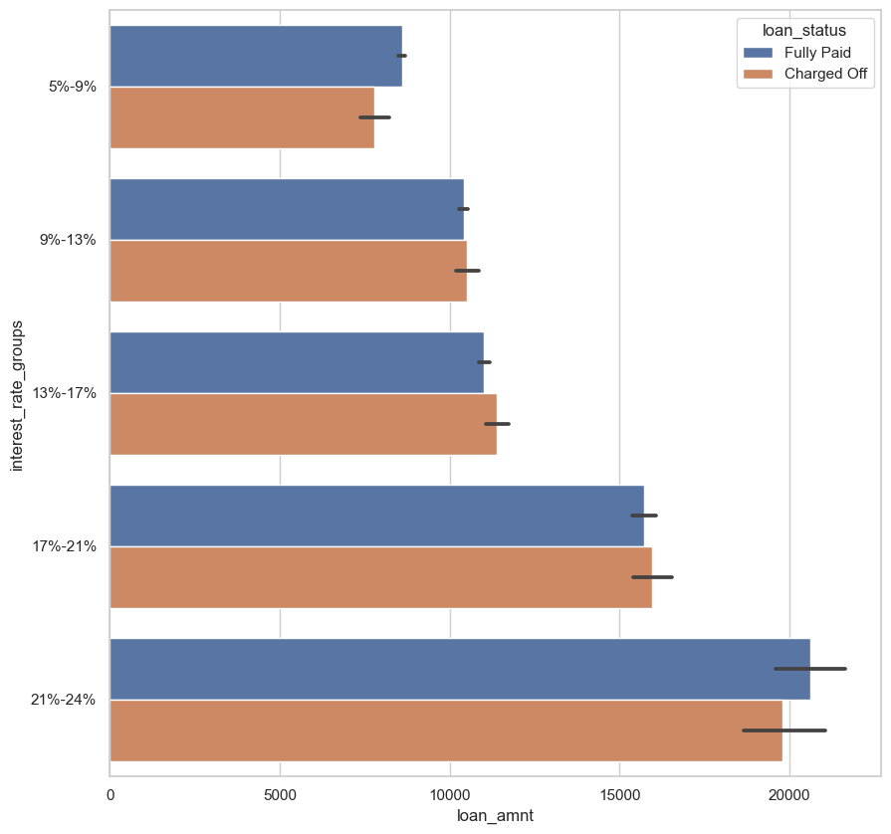
Bivariant Segmented Analysis
Annual Income and Loan Amount with Interest rate groups combination

Slide 23
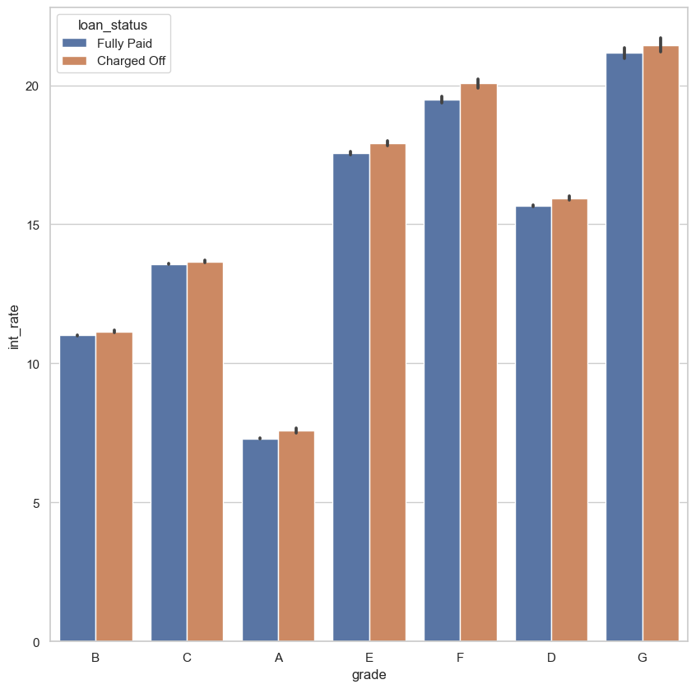
Bivariant Segmented Analysis
“Charged Off” loans are likely to happen if the applicants annual income is over 70k and interest rate is between 21-24%
“Charged Off” loans are likely to happen if the Loan amount is over 15k and interest rate is between 21-24%
“Charged Off” loans are likely to happen with F & G grades if the interest rate is over 20%
Grade and Interest rate combination

Slide 24
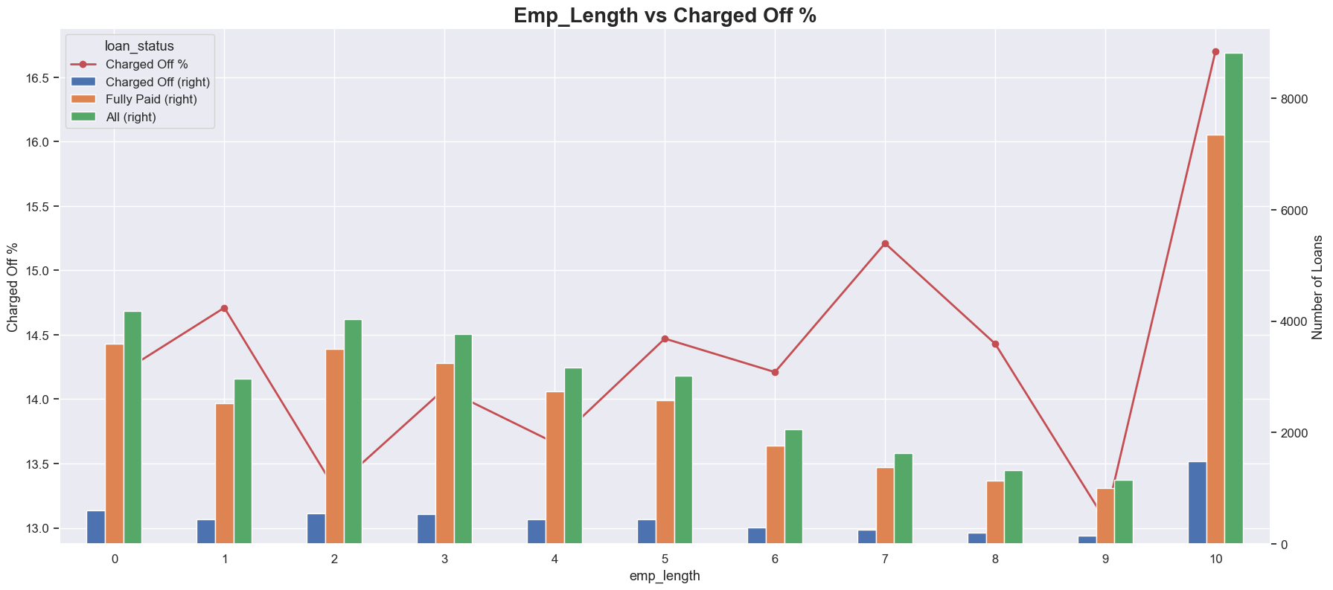
Multivariant Analysis

Slide 25
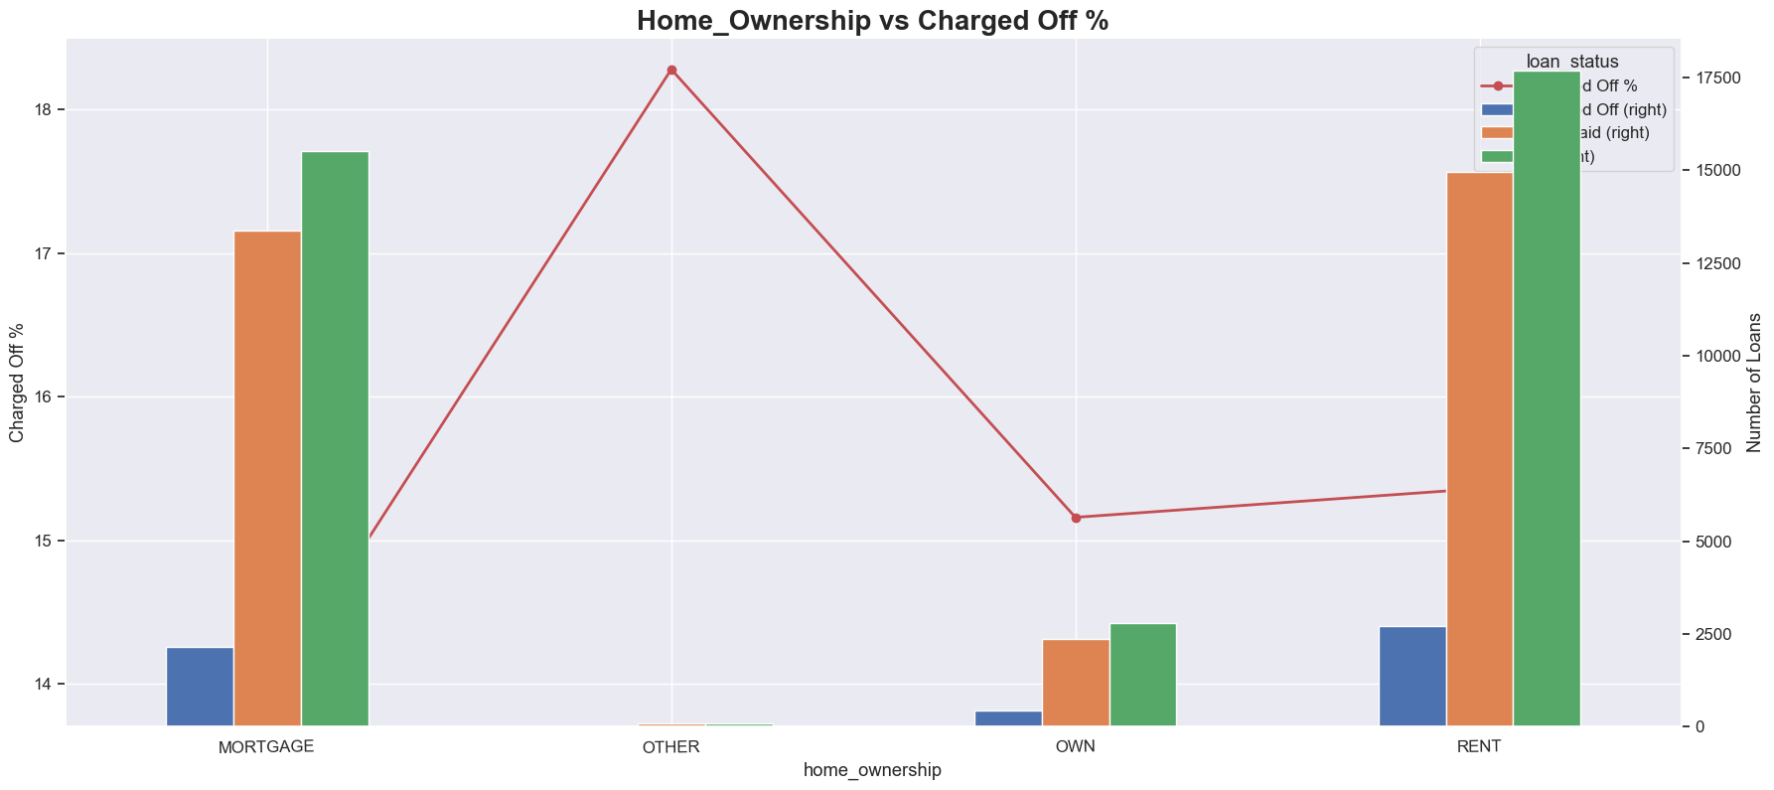
Multivariant Segmented Analysis

Slide 26
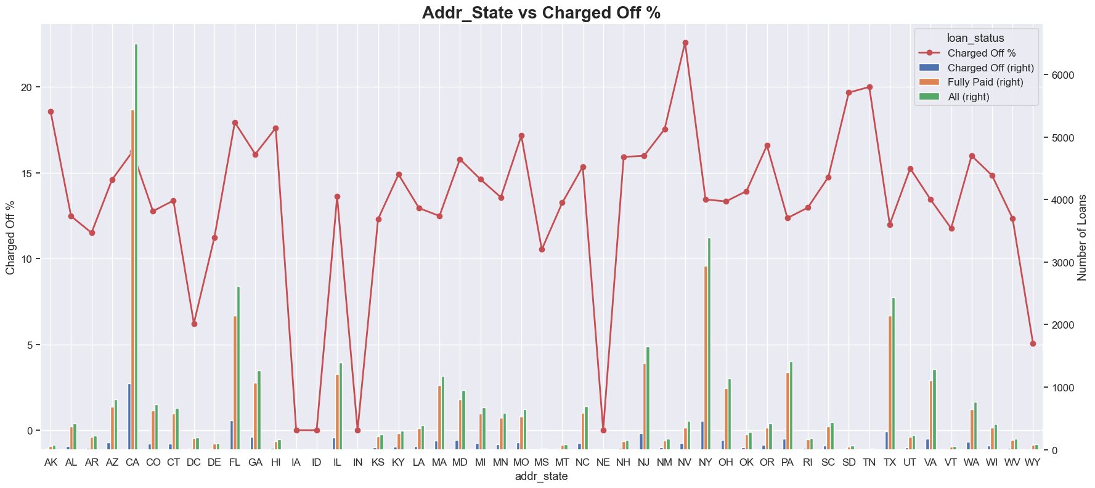
Multivariant Segmented Analysis

Slide 27
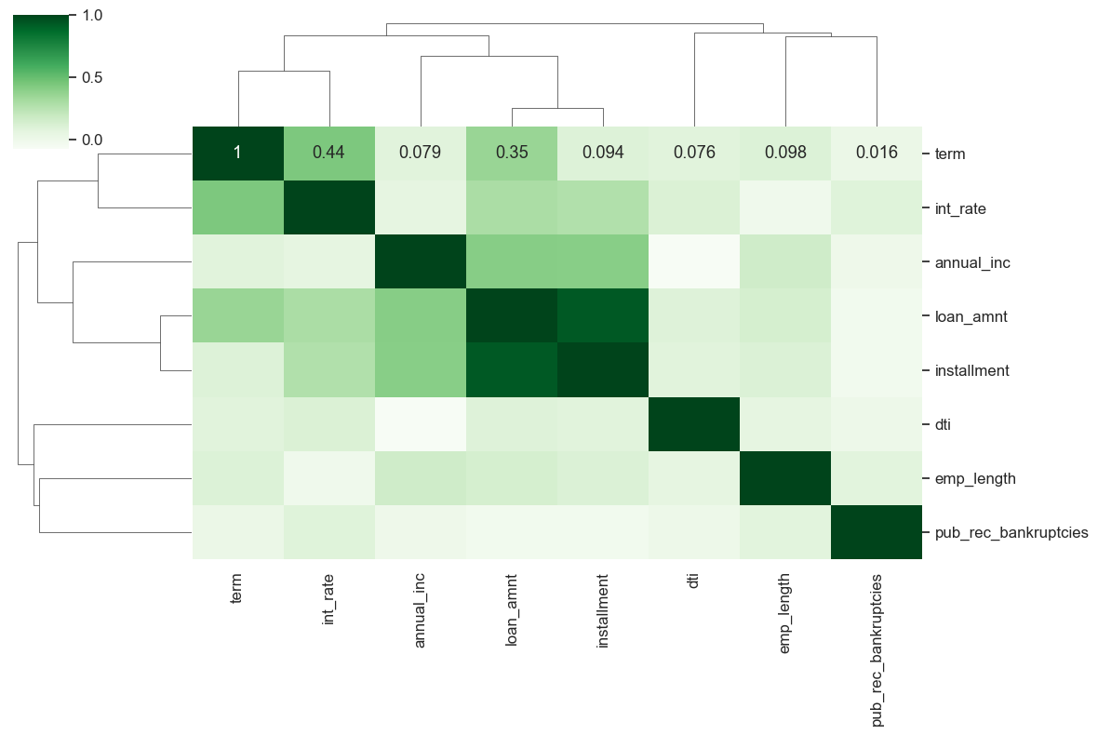
Correlation Analysis
Installment and loan amount has a strong correlation
Term and interest rate has strong correlation
Annual income and loan amount has a strong correlation
dti has weak correlation with other fields
emp_length has weak correlation with other fields
pub_rec_bankrupticies has weak correlation with every field
dti and annual income has negative correlation
Correlation Matrix with variables term, int_rate, annual_inc, loan_amnt, installment, pub_rec_bankrupticies,, emp_length

Slide 28
Conclusion
Limit short term Loans: Evaluate the risk associated with short term loans. Review the process to limit the short term or adjusting interest rates for longer-term loans to decrease the “Charged Off loans”
Anticipate Peak Periods: Assess the loan applications during peak periods like December and Q4. Ensure efficient processing to meet customer demands during these busy seasons.
Evaluation for Debt Consolidation Loans: Strict evaluations required for applicants seeking debt consolidation, house loans, considering potential interest rate adjustments to manage the associated risks.
Housing Stability: Consider housing status into account during the assessment process to assess housing stability and applicant's ability to repay the loan.
Assessment for High Loan Amounts: Conduct more thorough assessments for loan amounts of $15,000 or higher. Consider capping loan amounts for higher-risk applicants to mitigate potential defaults.
Adjust Interest Rates Based on DTI Ratios: Review the interest rate determination process and consider adjusting rates based on Debt-to-Income (DTI) ratios to align with the borrower's ability to repay.
Income Levels: Consider setting the maximum loan amounts based on annual incomes below $40,000 to ensure loan affordability for borrowers.

Slide 29
References
Technology/Library | Version | Reference Link
Python | 3.11.7 | https://www.python.org/
Pandas | 2.1.4 | https://pandas.pydata.org/
NumPy | 1.26.4 | https://numpy.org/
Matplotlib | 3.8.0 | https://matplotlib.org/
Seaborn | 0.12.2 | https://seaborn.pydata.org/
Git Hub Link: mrsivanandareddy/lending-club-case-study: Lending Club case study using EDA (github.com)

Slide 30
Thank you

