Slide 1

WEDNESDAY 19 AUGUST 2026
Modern Logging Platform
with Machine Learning
for HPC
ep
gr
$ tail -f /dev/cosmos
PRESENTED BY
SUPERVISORS
01 / 16
Marko Sladojevic
Lubos Krcal
Federico Ronchetti

Slide 2
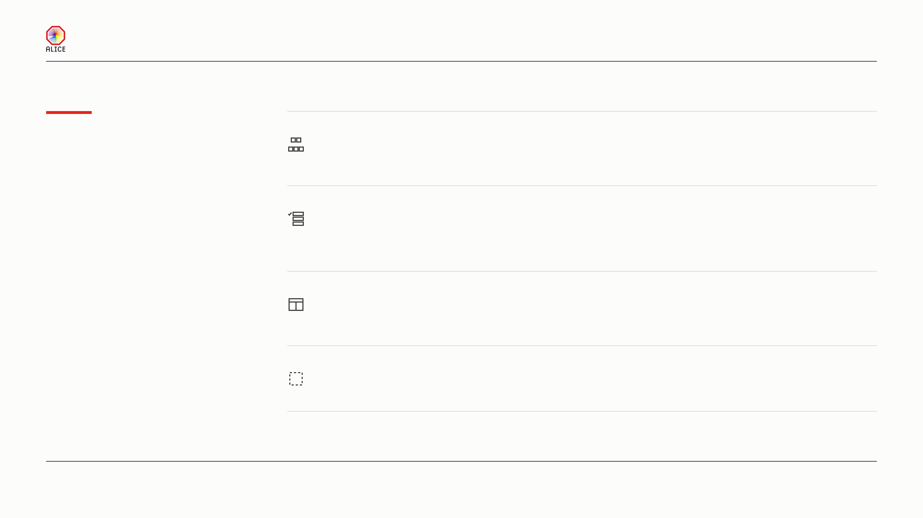
MODERN LOGGING PLATFORM WITH MACHINE LEARNING FOR HPC
Outline
03–06
The problem, and the design
Logging today · What we want to build · Our
suggested architecture · Federated search
What logging looks like today, what we suggest
instead, and what is still missing.
07–11
Choosing the tech
Why Fluent Bit · Why OpenSearch · Inside the
collector · How we use OpenSearch · Deployment
with Ansible
12–14
What people see, and what watches it
The interface · Log anomaly detection · Anomaly
detection on metrics
15
Coming soon
What is coming soon
ALICE COLLABORATION BOARD
02 / 16

Slide 3
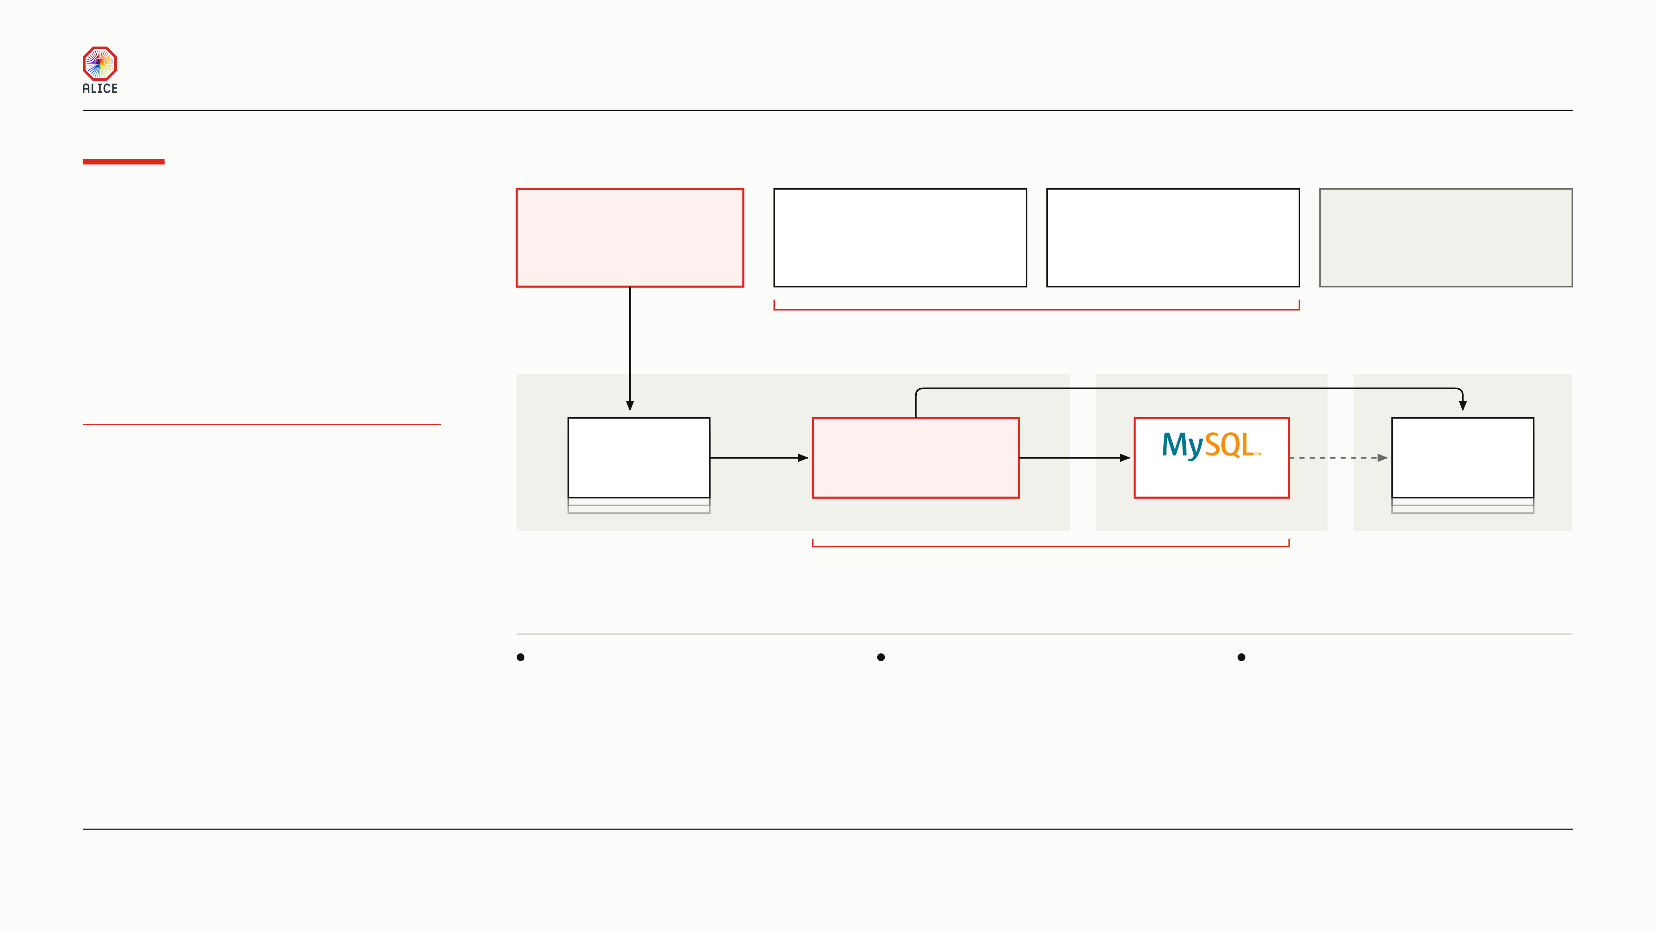
MODERN LOGGING PLATFORM WITH MACHINE LEARNING FOR HPC
Logging
01
WHAT A NODE WRITES
InfoLogger carries what a process sends it, and nothing else.
today
Application messages
Log files on disk
The machine’s journal
Host metrics
through libInfoLogger
process stdout, and ten
systemd, every service
processor, memory, disk
or stdout piped in
named O2 process logs
on the node
from the machine itself
monitoring already collects these
InfoLogger moves the messages a process
Neither of these reaches InfoLogger
sends it. That is one road. Most of what a node
local socket
writes never takes it.
02
COLLECT
03
STORE
04
DISPLAY
live push, tcp 6102
SHIFTERS READ THE LOGS BY HAND
infoLoggerD
tcp 6006
infoLoggerServer
tcp 3306
query
infoBrowser
one per node
one, central
one table
desktop GUI
One process and one table for the whole farm
05
THE LIMITS TODAY
ONE SQL TABLE
NO AGGREGATION
ONE POLICY, ONE COPY
Every message in the farm lands
infoBrowser lists single lines.
One retention rule covers every
in one messages table.
It draws no counts over time.
message. Nothing is replicated.
ALICE COLLABORATION BOARD
03 / 16

Slide 4
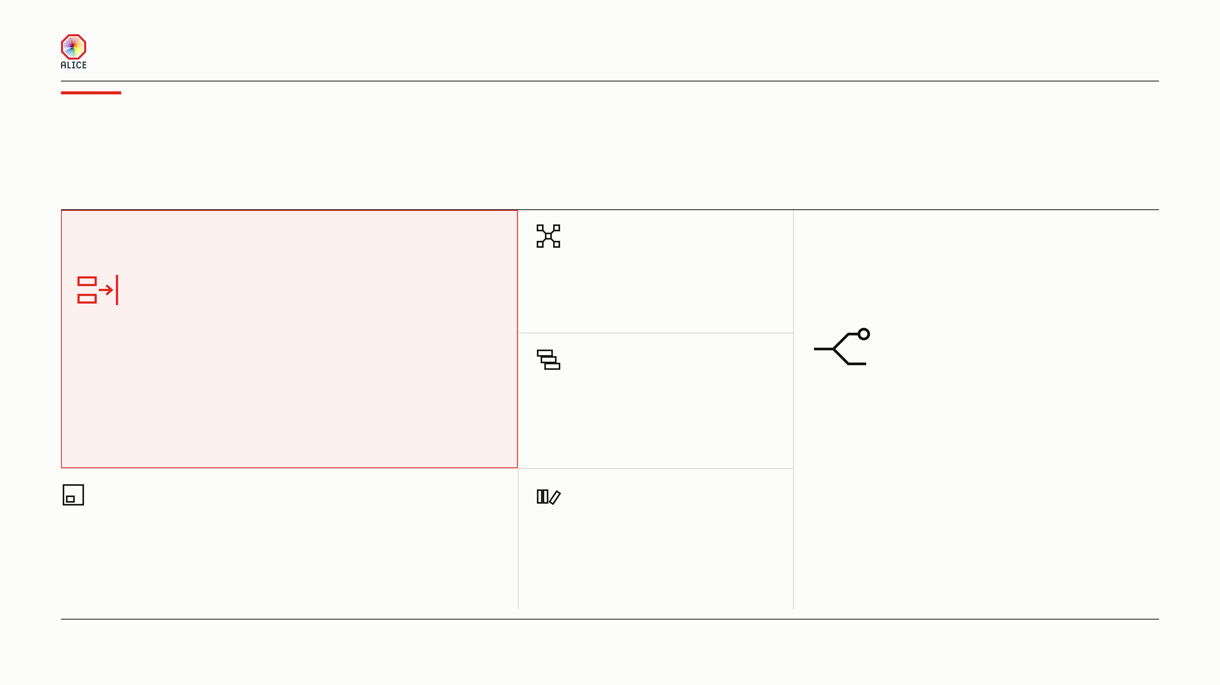
MODERN LOGGING PLATFORM WITH MACHINE LEARNING FOR HPC
What we
want to build
Six objectives shape the design that follows. Each one names a property the
platform must have. Together they keep the volume where it is made, and the
value where it is safe.
DISTRIBUTED
Five machines share the work as one cluster. Together
they handle more throughput than any one machine
could.
NO BULK OVER THE WIRE
Application logs at info severity are most of the
volume. Each worker indexes its own on its own
DURABLE
disk. They don’t cross the network.
Some logs matter more than others. We need a storage
SPLIT BY SEVERITY
tier that can ensure higher replication and retention
We split some log families by severity, not by source.
policies for them.
That puts the volume on one side and the value on the
other. Each kind of log then gets its own keep time
and its own number of copies.
WORKERS STAY CHEAP
FAULT TOLERANT
A worker indexes its own logs and answers a query now
Two of the three storage machines are enough to keep
and then. It never manages the cluster. It takes four of the
going. One can die and we lose nothing. In production
128 cores an EPN has, and little memory. We must not
the tier is bigger, so more can die. Lose a worker and
disturb the expensive timeframe reconstruction.
we lose only its local logs.
ALICE COLLABORATION BOARD
04 / 16

Slide 5
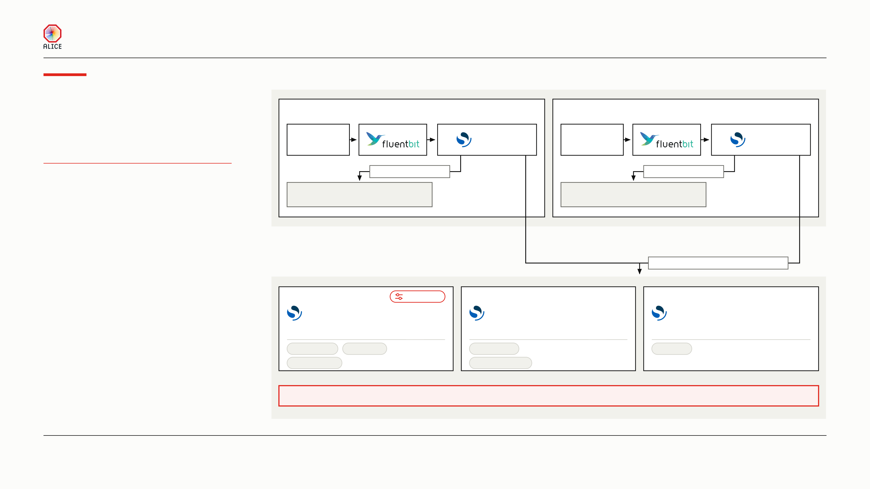
MODERN LOGGING PLATFORM WITH MACHINE LEARNING FOR HPC
Our suggested
01
WORKER TIER
architecture
alice-ingest-1
role = worker
alice-ingest-2
role = worker
alice-replay
node-01
alice-replay
node-02
real EPN logs
data, ingest
real EPN logs
data, ingest
5 VMS — 2 WORKER, 3 STORAGE
application-local
application-local
ONE OPENSEARCH CLUSTER
application-logs-local-node-01
application-logs-local-node-02
NATIVE SYSTEMD, NO DOCKER
1 shard, 0 replicas, never leaves
1 shard, 0 replicas, never leaves
02
STORAGE TIER
infologger + application-central
alice-ingest-3
Control
alice-ingest-4
alice-ingest-5
node-03
node-04
node-05
cluster_manager, data, ingest
cluster_manager, data, ingest
cluster_manager, data, ingest
role = storage
role = storage
role = storage
Dashboards
nginx TLS
Trend rollup
Live lane
Alertmanager
Signal projector
infologger + application-logs-central
1 shard, 2 replicas, one copy on every storage node
ALICE COLLABORATION BOARD
05 / 16

Slide 6
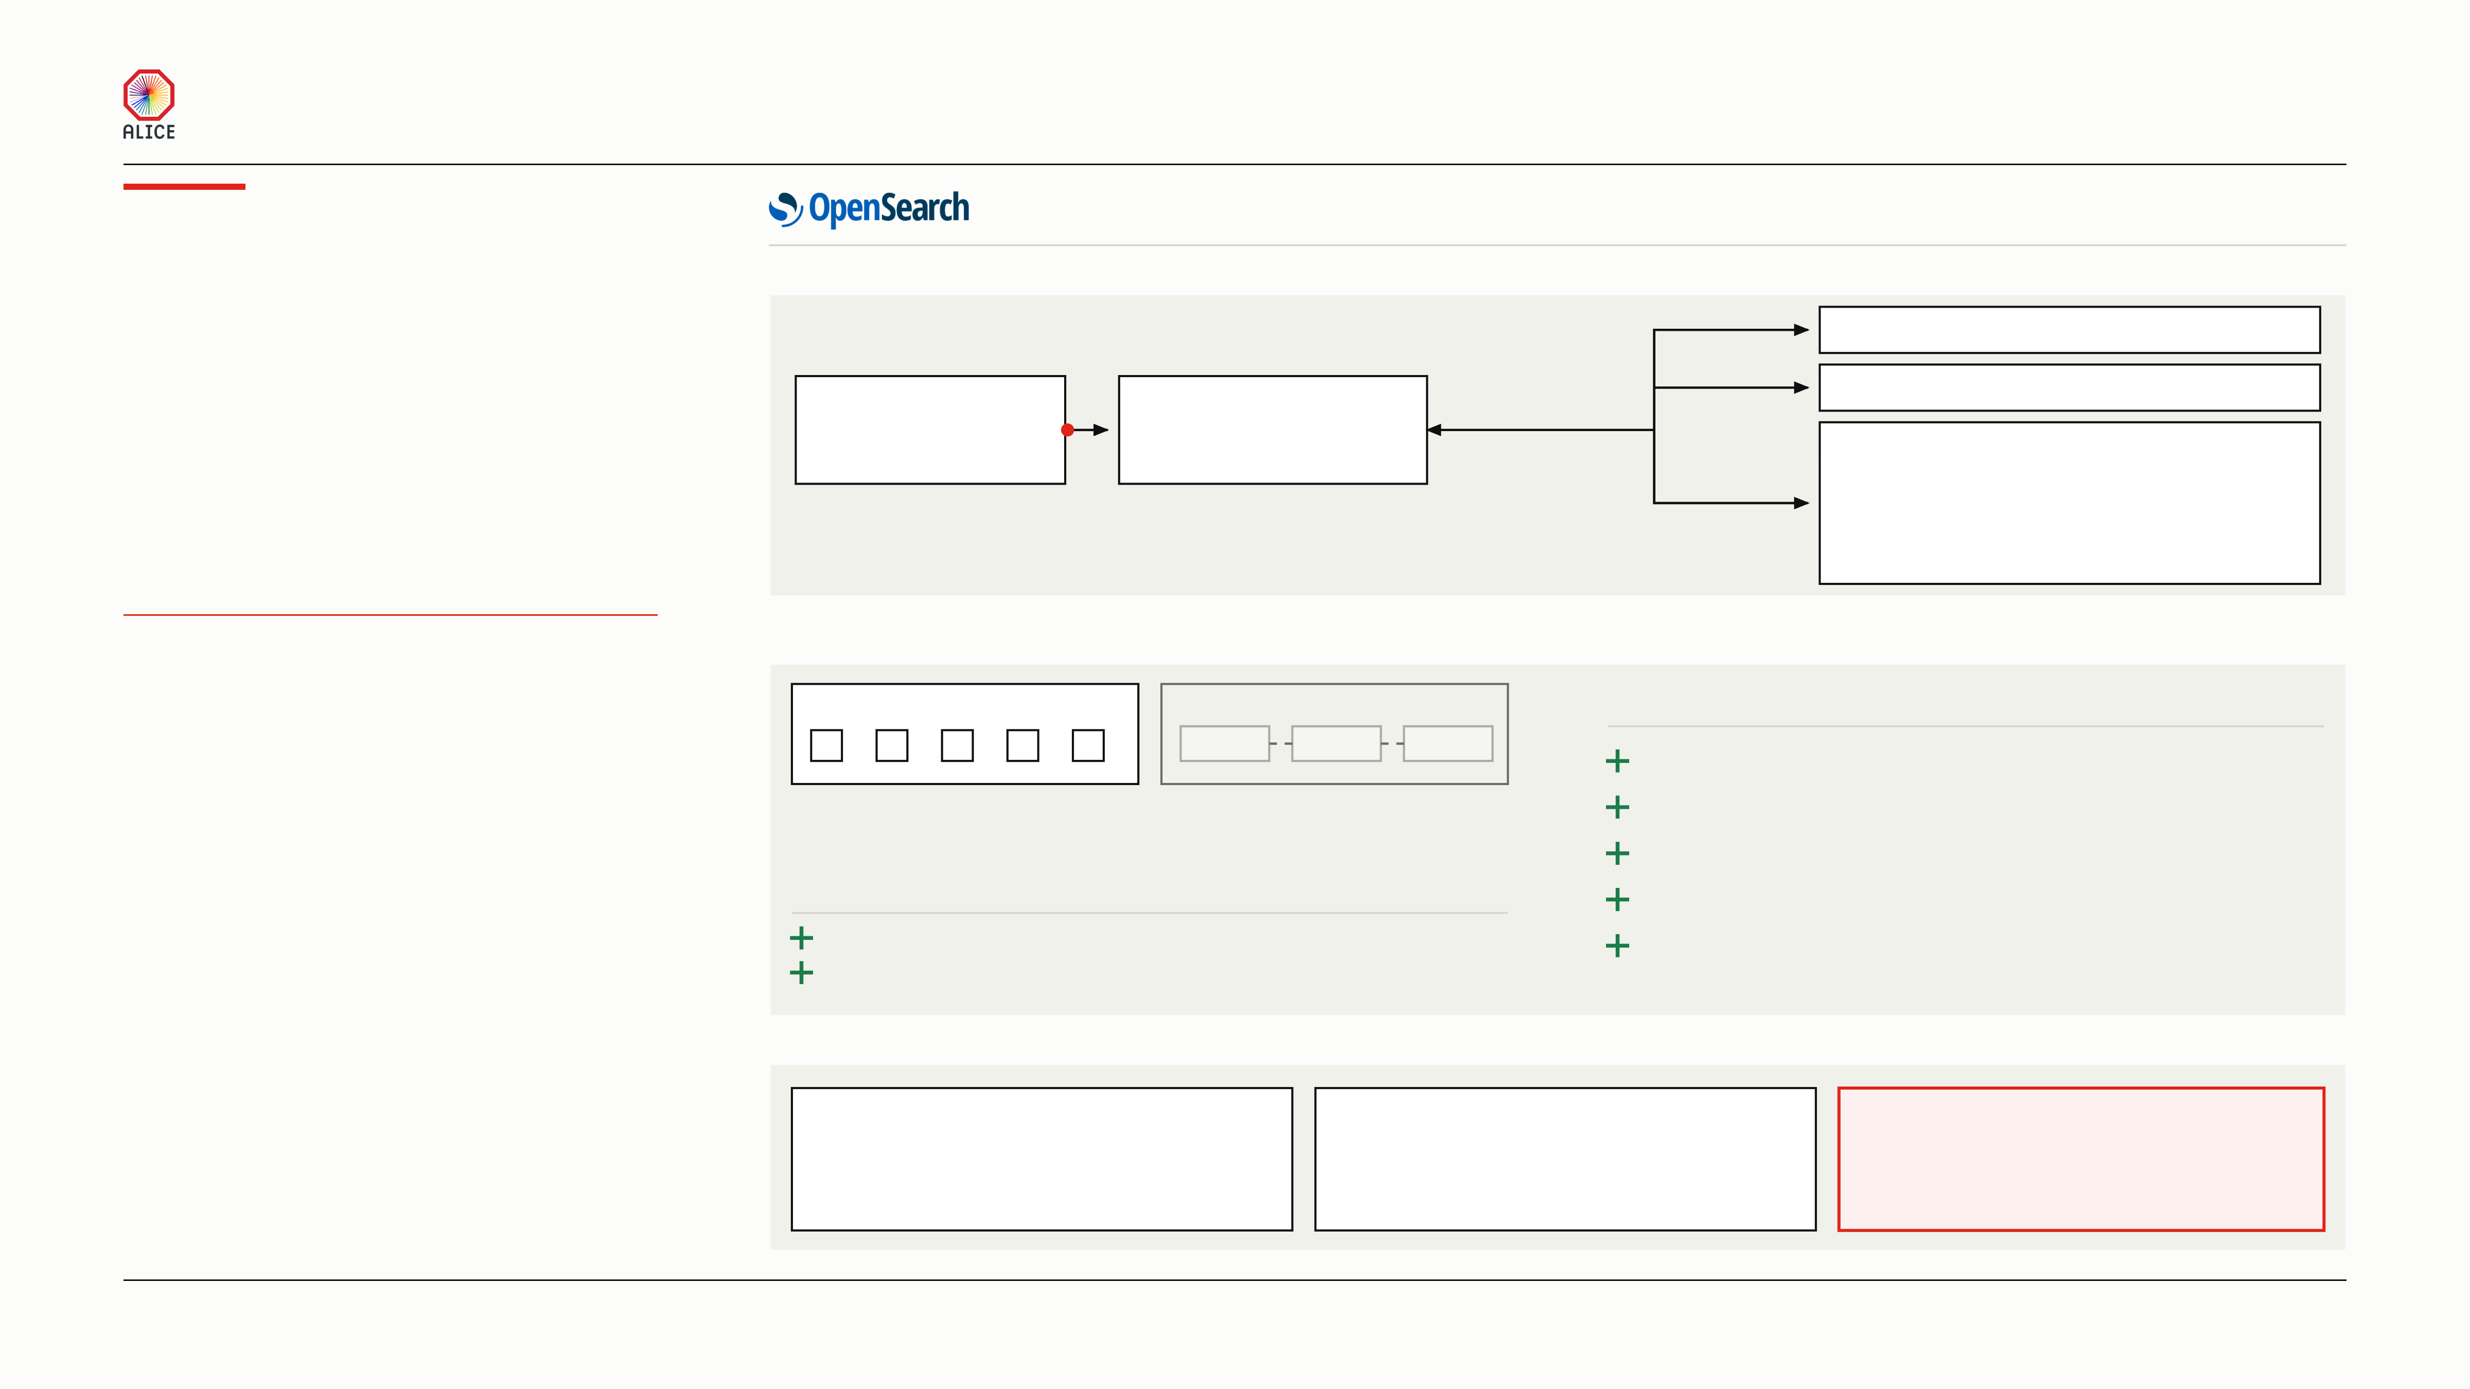
MODERN LOGGING PLATFORM WITH MACHINE LEARNING FOR HPC
Federated
one query, every machine
search
01
ASK ONCE — EVERY NODE ANSWERS
node-01
local logs
One query
Storage machine
node-02
local logs
Every machine writes its own logs and keeps
(one saved pattern)
collects the answers
them. So the real question is how one person
node-03
storage part
searches all of them at once. Our answer: make
node-04
of the cluster
the machines one cluster, and ask it once.
Dashboards sends the query to a storage machine.
node-05
That machine asks the others and merges the answers.
ONE CLUSTER, FIVE MACHINES
02
ONE CLUSTER, NOT MANY
ONE UPGRADE WINDOW FOR ALL
ONE CLUSTER
MANY CLUSTERS
PROS OF ONE CLUSTER
PUSH UP, NEVER POLL DOWN
cross-cluster search
Built-in cross-cluster search does not scale to 100 machines.
We run one cluster. The other way is many clusters,
The cluster places shards and replicas itself, across all machines.
joined together by cross-cluster search.
One set of users, roles and saved searches.
PROS OF MANY CLUSTERS
Detection and alerting streamlined.
One bad query cannot slow the other clusters.
No federation layer of our own to write and keep alive.
Each cluster upgrades on its own schedule.
04
FANOUT — NOT EVERYTHING IS PERFECT
Every machine pays
Reconstruction comes first
So we ask only when we must
One search asks all of them, so all of
Those same machines reconstruct
The live lane covers watching. But
them spend processor time on it. It is
events. That is their real job, and log
“which machines saw this error in
as slow as the slowest machine.
search must not compete with it.
run 561234?” has to ask all of them.
ALICE COLLABORATION BOARD
06 / 16

Slide 7
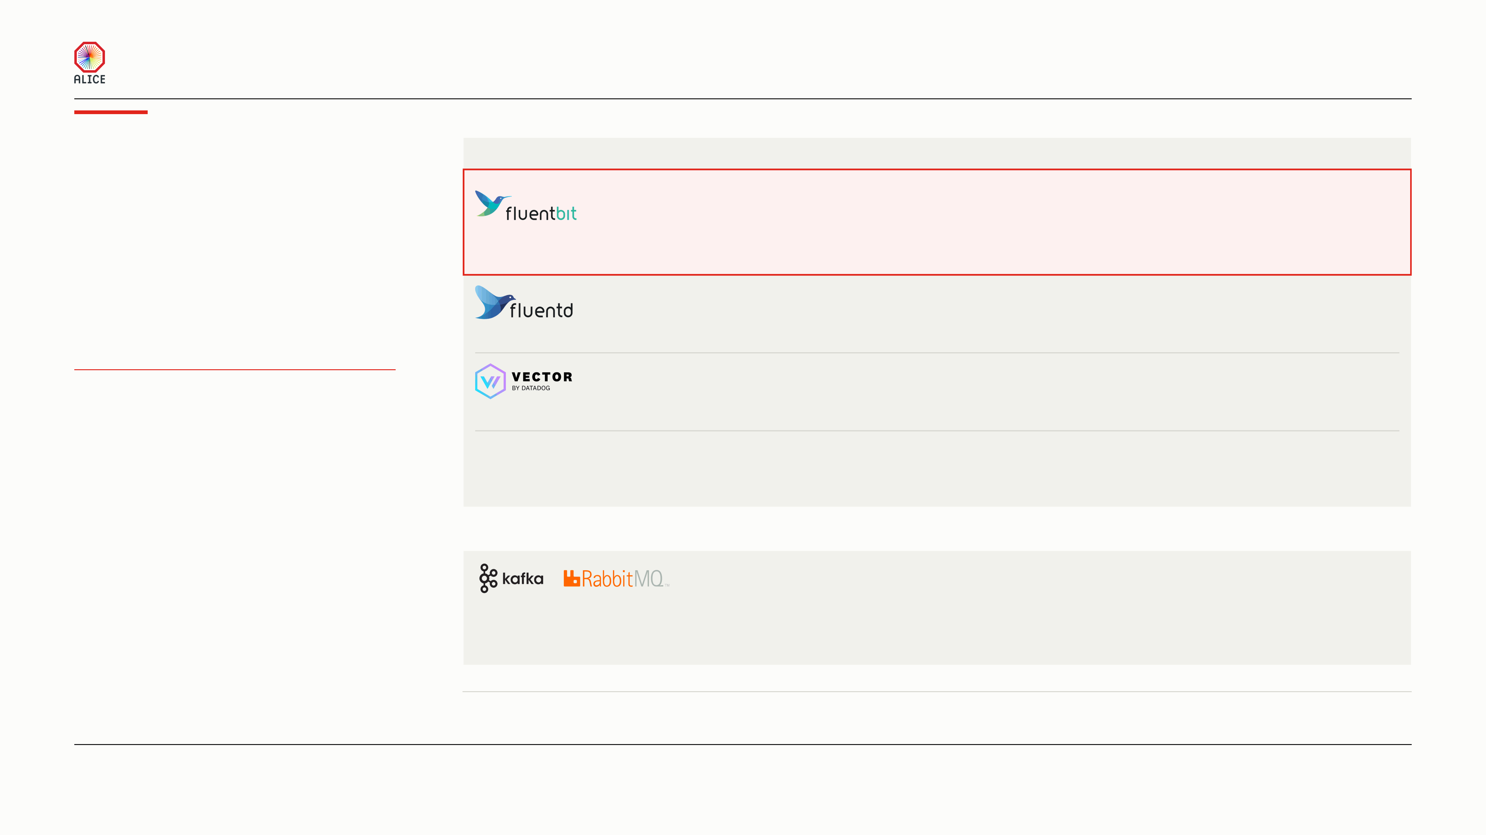
MODERN LOGGING PLATFORM WITH MACHINE LEARNING FOR HPC
Why
01
THE CANDIDATES
Three are Apache 2.0, Telegraf is MIT. Job and governance are what differ.
Fluent Bit
LANGUAGE
VENDOR’S MEMORY FIGURE
WHO GOVERNS IT
C
about 450 KB
CNCF*, graduated
CHOSEN
Where the community has converged. Its own project page counts fifteen billion deployments, and it has
A lightweight forwarder runs on the edge beside
been in production for a decade. CNCF* graduated: the roadmap sits in a foundation, not in one company.
the program that writes the logs. It reads each
line, decides where the line belongs and sends it
C and Ruby
over 60 MB
CNCF, graduated
on. It stores nothing.
The same project one size up, and the older of the two. A Ruby package tree on every worker is what we did not want.
4 CANDIDATES WEIGHED
Rust
no vendor figure
Datadog
MATURITY AND SIZE DECIDED IT
Small and fast, and the benchmarks disagree on which of the two is smaller. One company decides its future.
A QUEUE IS A DIFFERENT JOB
Telegraf
Go
no vendor figure
InfluxData
A DIFFERENT JOB
InfluxData
A metrics agent, and a good one. ALICE O2 already runs Telegraf to gather machine and service metrics.
It emits measurements in line protocol: a name, tags, numbers, a clock. That shape is a metric, not a log line.
02
WHY NOT A MESSAGE QUEUE
Neither can tail a file, parse a line or stamp a clock.
A broker moves records. It does not make them.
A forwarder still runs in front of the queue.
The queue itself costs three more machines and a quorum.
* CNCF is the Cloud Native Computing Foundation, the Linux Foundation body that also holds Kubernetes and Prometheus. Graduated is its highest maturity level. The 450 KB is the
vendor’s figure for an idle pipeline; ours peaked between 133 and 228 MB under load, measured on the collector slide.
ALICE COLLABORATION BOARD
07 / 16

Slide 8
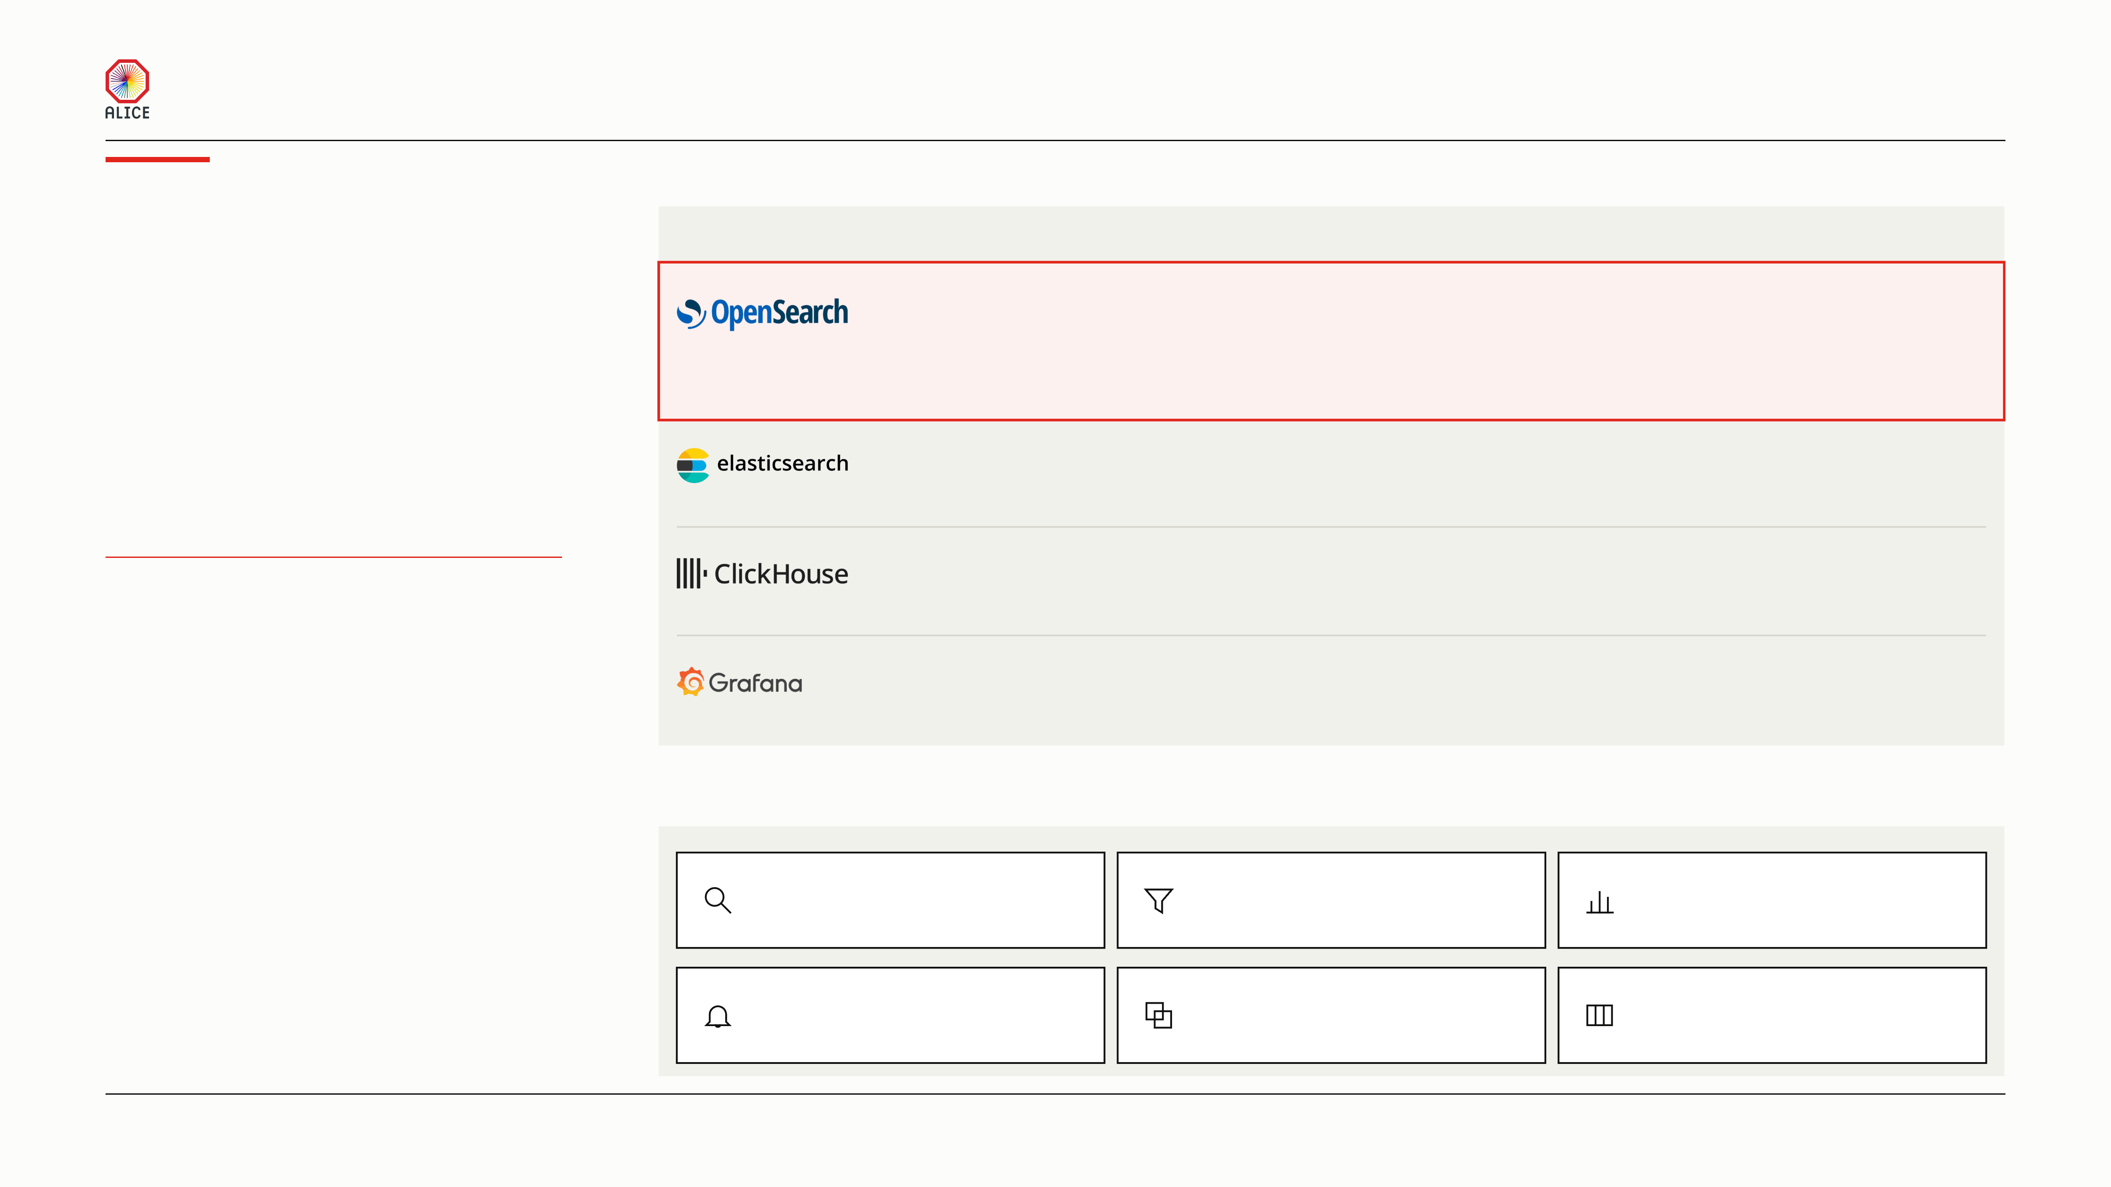
MODERN LOGGING PLATFORM WITH MACHINE LEARNING FOR HPC
Why
01
THE CANDIDATES
OpenSearch
LICENCE AND GOVERNANCE
WHAT IT CAN ANSWER
WHAT IT COSTS US TO RUN
Apache 2.0, Linux Foundation
Every field and the message
Detection included, free
CHOSEN
We need a search engine that indexes every field
The only candidate that is fully open, indexes the message body, and brings anomaly detection and alerting in the box.
and the message body, counts them over time,
The detection slides that follow run on it. CERN IT’s own monitoring service runs it too, so this is not a novel bet.
and brings anomaly detection with it. Four
candidates were weighed. Only one does all
Three licences, one company
Every field and the message
Detection is a paid tier
three.
Anomaly detection and alerting sit in Elastic’s paid tiers, so the detection half of this deck becomes a purchase.
4 CANDIDATES WEIGHED
Apache 2.0, one company
Every field and the message
We build the detection
AN OPEN LICENCE WAS THE FLOOR
It wins on disk and loses on machinery. Choosing it means we run 17 detectors and 28 alerting rules ourselves.
DETECTION DECIDED IT
Loki
AGPLv3, one company
Labels only, not the message
No detection to host
It indexes labels, not the text, so counting errors per host is a scan. Its guidance forbids 211 hostnames as labels.
02
WHAT WE GET THAT WE DO NOT HAVE TODAY
Search the text
Filter any mapped field
Count over time
any word, over a bunch of logs
host, detector, run, partition
errors per host, per minute
Detect and alert
Replicate every record
Shard the index
included, and already running
three copies, so a machine may die
writes spread, so throughput grows
ALICE COLLABORATION BOARD
08 / 16

Slide 9
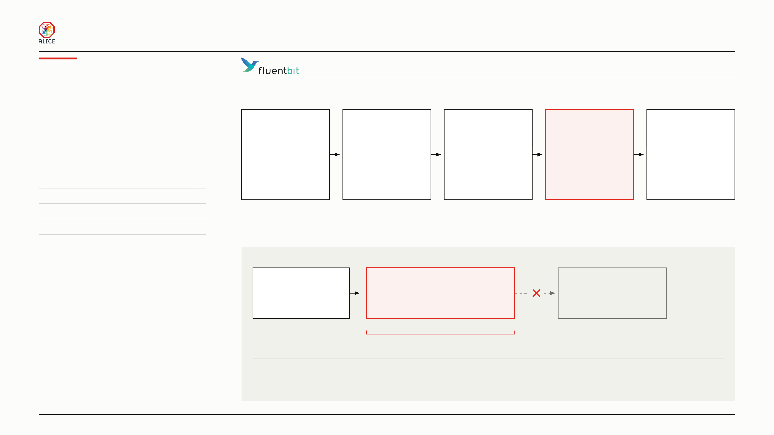
MODERN LOGGING PLATFORM WITH MACHINE LEARNING FOR HPC
Inside the
one process on every worker VM
4 inputs · 4 tags · 5 outputs
collector
01
WHAT IT DOES TO A LINE
One process on every worker. Every line takes
INPUT
TAG
FILTER
RETAG
OUTPUT
the same five steps, and the whole job is
Read each line
Give it a name
Parse and stamp
Sort by severity
Send it on
decided before it leaves the machine.
MEMORY ENVELOPE
from a file,
dds, stdout,
fields out of text,
info,
to the OpenSearch
a socket, a script
infologger, health
and the clock
or everything else
node on this VM
64 chunks in memory
128 MB
Documented worst case
307 MB
Measured, steady load
133–228 MB
Measured, sink outage
404 MB
02
WHAT THE DISK BUFFER REALLY IS
The collector
256 MB on disk
OpenSearch
still reading lines
one buffer for each lane, 10 retries
not answering
holds 50 seconds to 109 minutes
After that the record is gone.
There is no second destination.
A hiccup safety layer, not durability.
Every input writes to this local disk buffer first. It survives a restart of Fluent Bit and a short network outage.
It does not survive losing the node, and those records are gone. Real durability is a replicated queue, and Kafka is on the roadmap.
ALICE COLLABORATION BOARD
09 / 16

Slide 10
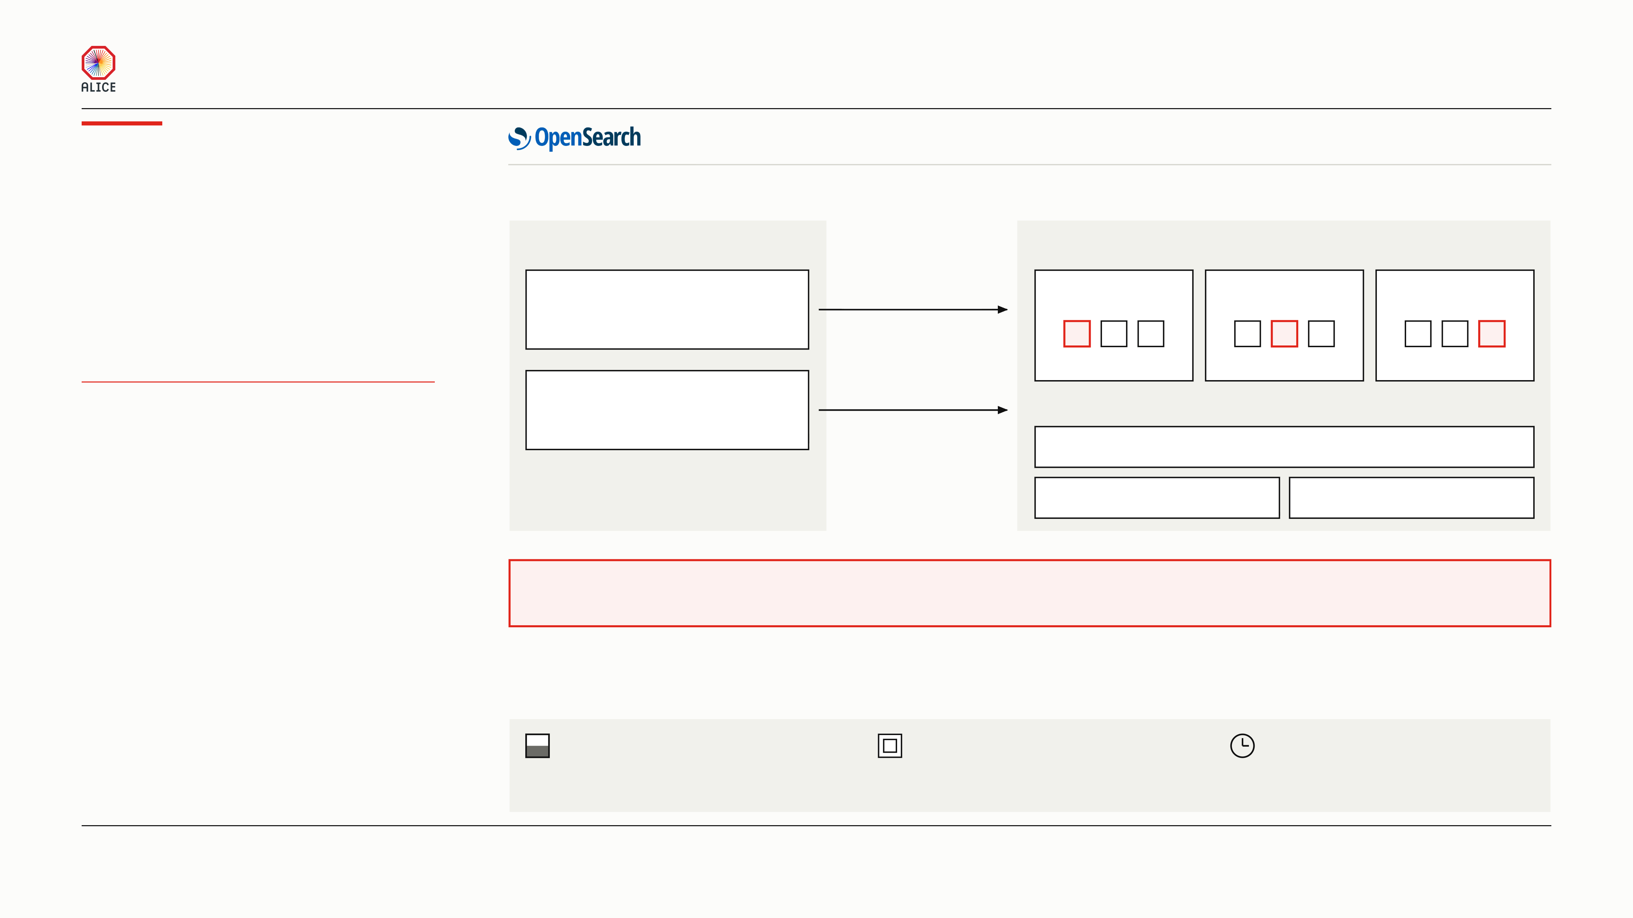
MODERN LOGGING PLATFORM WITH MACHINE LEARNING FOR HPC
How we use
one cluster, five machines, two halves
All five machines hold data. The three storage machines run the cluster.
OpenSearch
01
THE SPLIT, AND WHY IT IS A SPLIT
LOCAL — ON THE MACHINE
REPLICATED — THREE MACHINES
One cluster, split in two. The bulk of the logs
Worker machine
Storage machine
Storage machine
Storage machine
never leaves the machine that wrote them. The
its own info index, one copy
rest is copied onto three machines.
Everything above info
crosses the wire
Worker machine
+ all of InfoLogger
each machine writes one slice and holds two copies
ONE CLUSTER, FIVE MACHINES
its own info index, one copy
THREE COPIES OF THE VALUABLE HALF
These machines are ours alone
ZERO COPIES OF THE CHEAP HALF
No reconstruction here, so we can afford expensive work.
Routine info logs are the bulk.
Sharding
Replication
They never cross the wire.
Split three ways, more throughput.
Copied twice, a machine can die.
One storage machine may die and we lose nothing.
Every record is on all three. The cluster needs two of the three to agree, so it keeps running.
The local half is one copy on purpose. If a worker dies you lose that machine’s routine logs, which is the cheap half.
02
THREE THINGS TO WATCH
JVM heap
Memory outside the heap
ISM — Index State Management
The memory the Java process may hold. Every
The search index and the file cache use it. We lock the
Indices roll on a clock, old ones are deleted.
index costs heap, so we cap how many exist.
memory down, so a node can never swap.
Routine logs 8 days, others 35, InfoLogger 56.
ALICE COLLABORATION BOARD
10 / 16

Slide 11
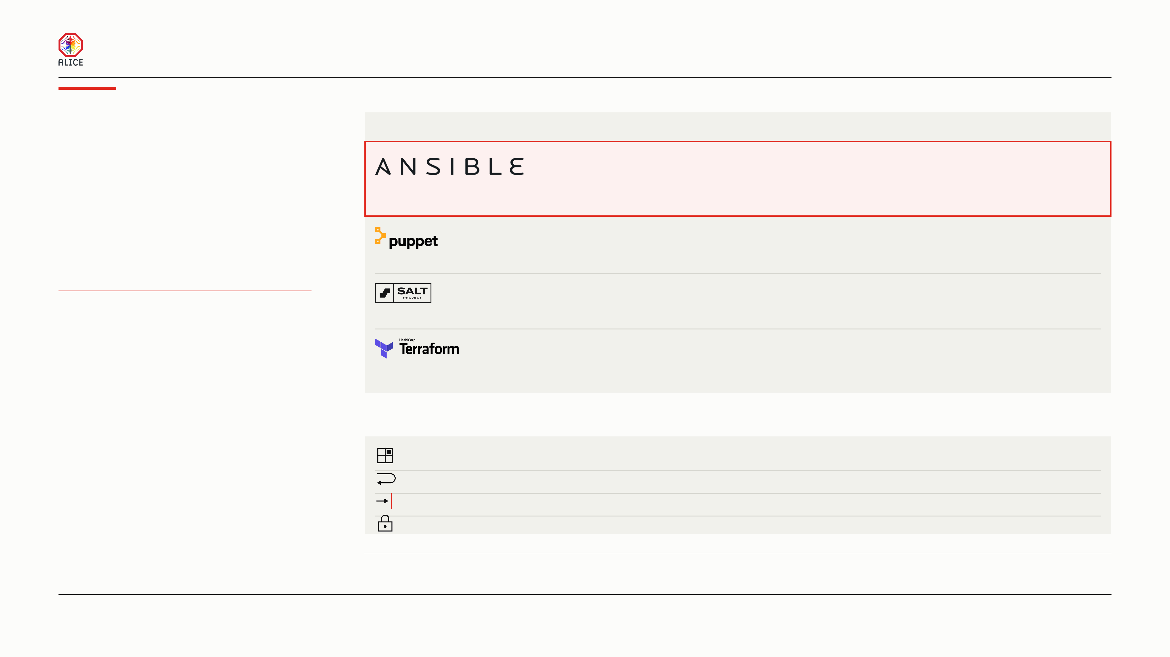
MODERN LOGGING PLATFORM WITH MACHINE LEARNING FOR HPC
Deployment
01
THE CANDIDATES
An agent is a program the tool installs and leaves running on every machine.
with Ansible
AGENT ON EVERY MACHINE
WHEN IT RUNS
CREATES THE MACHINES
None, over SSH
When we run it
Yes, same tool
CHOSEN
Ansible won because it leaves nothing running
A push over SSH puts nothing new on a CERN host. One tool creates the five machines and configures them.
on the five machines. It acts only when a person
starts it. The same tool also creates the
with Foreman
Agent and certificate
On a timer
Yes, with Foreman
machines.
The CERN standard, and it repairs drift by itself. It wants an agent and a signed certificate on every node.
and Chef
Agent and a server
On demand or a timer
No
4 TOOLS WEIGHED
Salt fans out fastest, but only at farm scale. Chef needs a second language. Both put an agent on every node.
THE AGENT DECIDED IT
PLACEMENT IS DATA, NOT CODE
None
When we run it
Yes, and nothing else
It builds machines well, and its vendor calls configuring them a separate job. That is two tools, not one.
02
OUR DESIGN DECISIONS
17 roles · 7 inventory groups · 5 machines
Placement is data
One inventory file says where each service runs. Moving one service to another machine changed no code.
Every step converges
A failed run is simply run again. Machines, monitors and detectors are created by name, never twice.
Gates stop the run
12 checks fail the deploy rather than report success. The last proves 28 monitors and 17 detectors exist.
Secrets stay encrypted
Every secret lives in one encrypted file in the repository. The cloud credential never touches disk.
ALICE build machines already run Puppet under the CERN Foreman setup. Puppet is likely right for the farm; it is wrong for five machines that one person deploys by hand. Shell
scripts were never a candidate, because a script does a thing but never checks the thing.
ALICE COLLABORATION BOARD
11 / 16

Slide 12
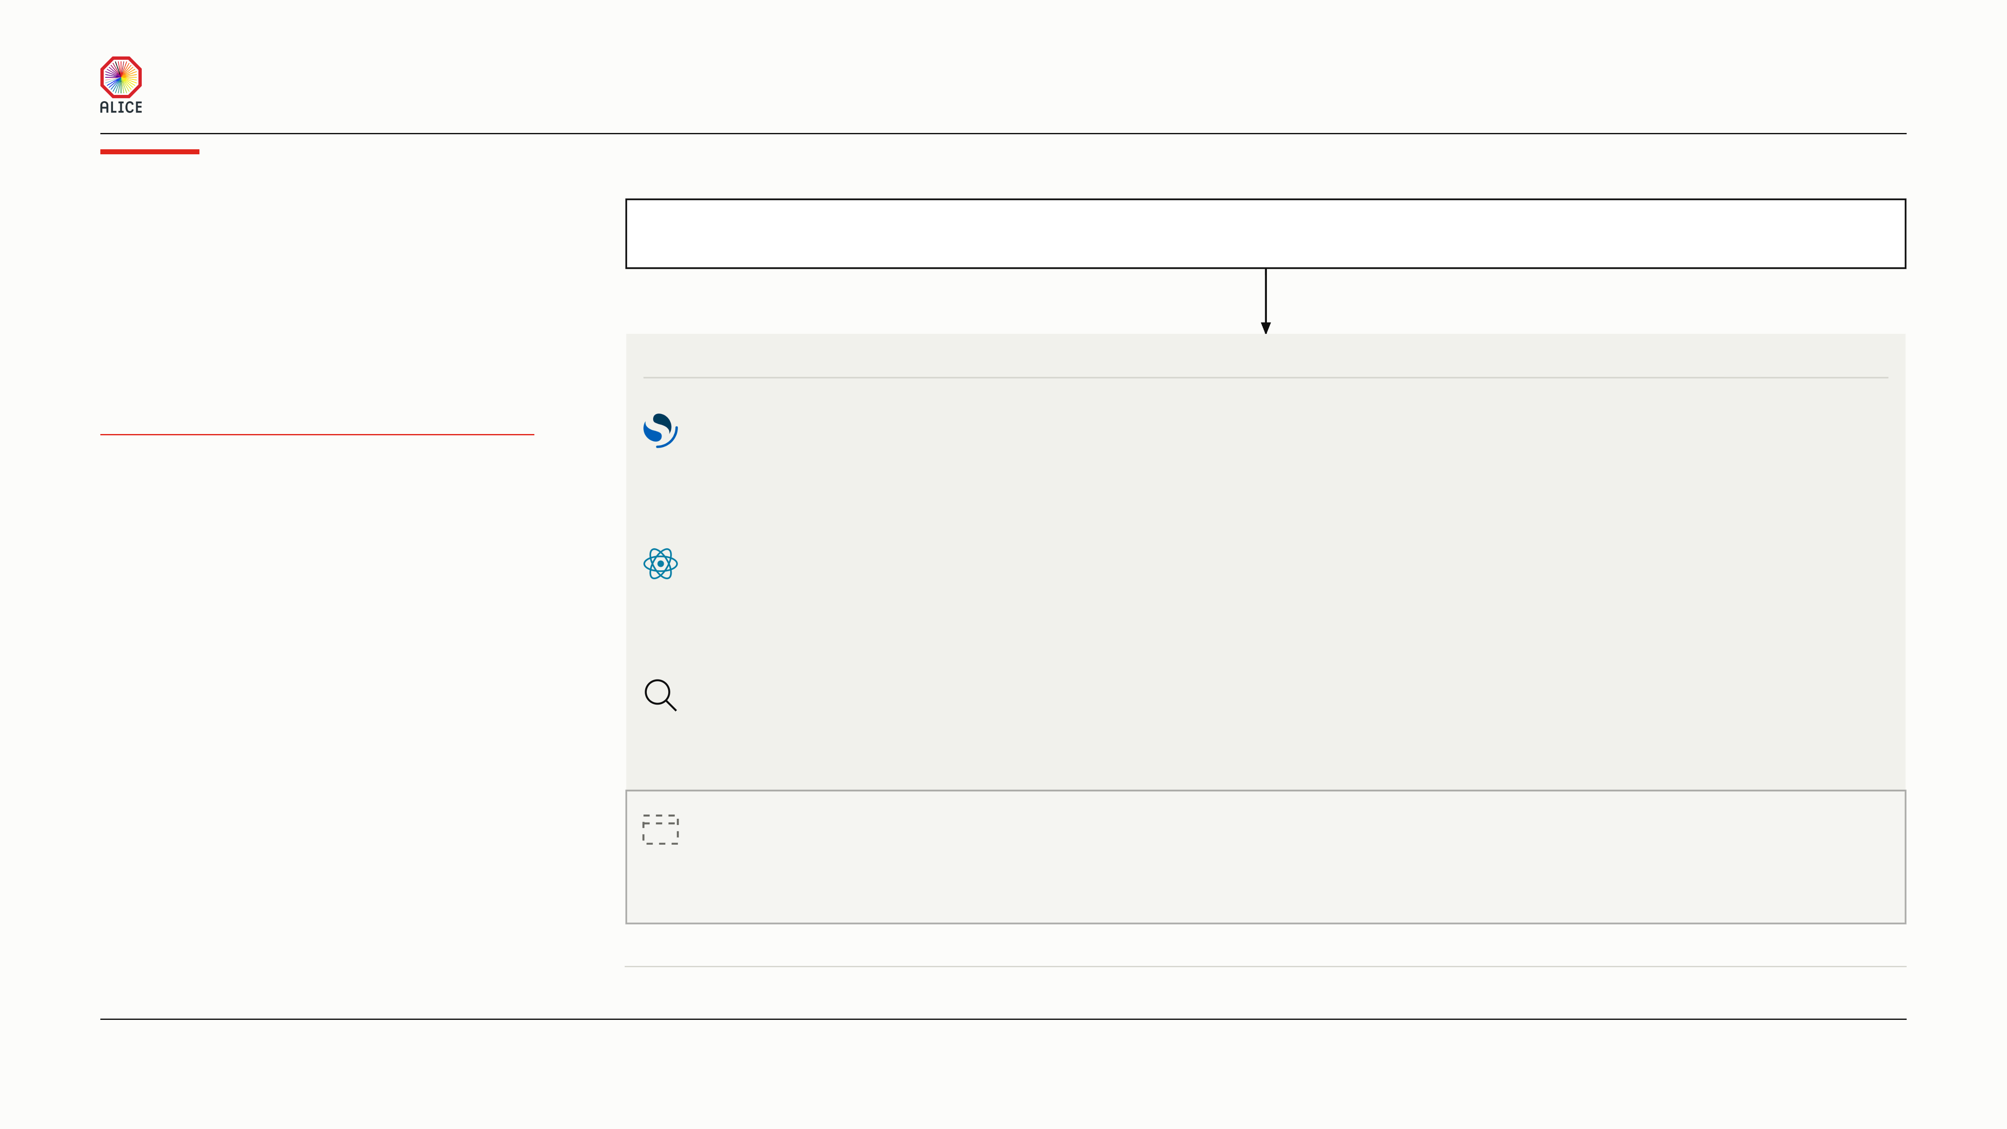
MODERN LOGGING PLATFORM WITH MACHINE LEARNING FOR HPC
The interface
00
ONE DOOR
Nobody signs in twice.
One address, on the control host
Encrypted, one account, and it leads to all four surfaces
Four surfaces sit behind one address. Each one
answers a different question, for a different
01
FOUR SURFACES
person. Three of them run today. The shifter’s
SURFACE
WHAT IT ANSWERS
WHO OPENS IT
own view is not built.
Maintainer cockpit
Is the pipeline healthy?
The people who maintain the platform
ONE DOOR, ONE ACCOUNT
IN USE
Charts and counters over the whole cluster.
THREE BUILT, ONE PLANNED
A shifter never asks this question.
THE LIVE LANE NEEDS NO CLUSTER
The live lane
What is arriving right now?
Anyone, and it holds when the cluster is down
IN USE
A small React page, fed by the collectors.
It asks the cluster nothing and survives an outage.
Discover
Anything in the archive, with filters
A physicist with a real question
IN USE
The free-form search page of the dashboards.
One box searches every source at once.
The shifter view
What is the experiment saying?
Shifters, who already know InfoLogger
COMING SOON
It should feel close to the InfoLogger view.
Familiarity is the point: nothing new to learn.
The shifter view will be served through the same door. The dashboards carry two clocks: ingest time for the health panels, the archive’s own event time for the logs.
ALICE COLLABORATION BOARD
12 / 16

Slide 13
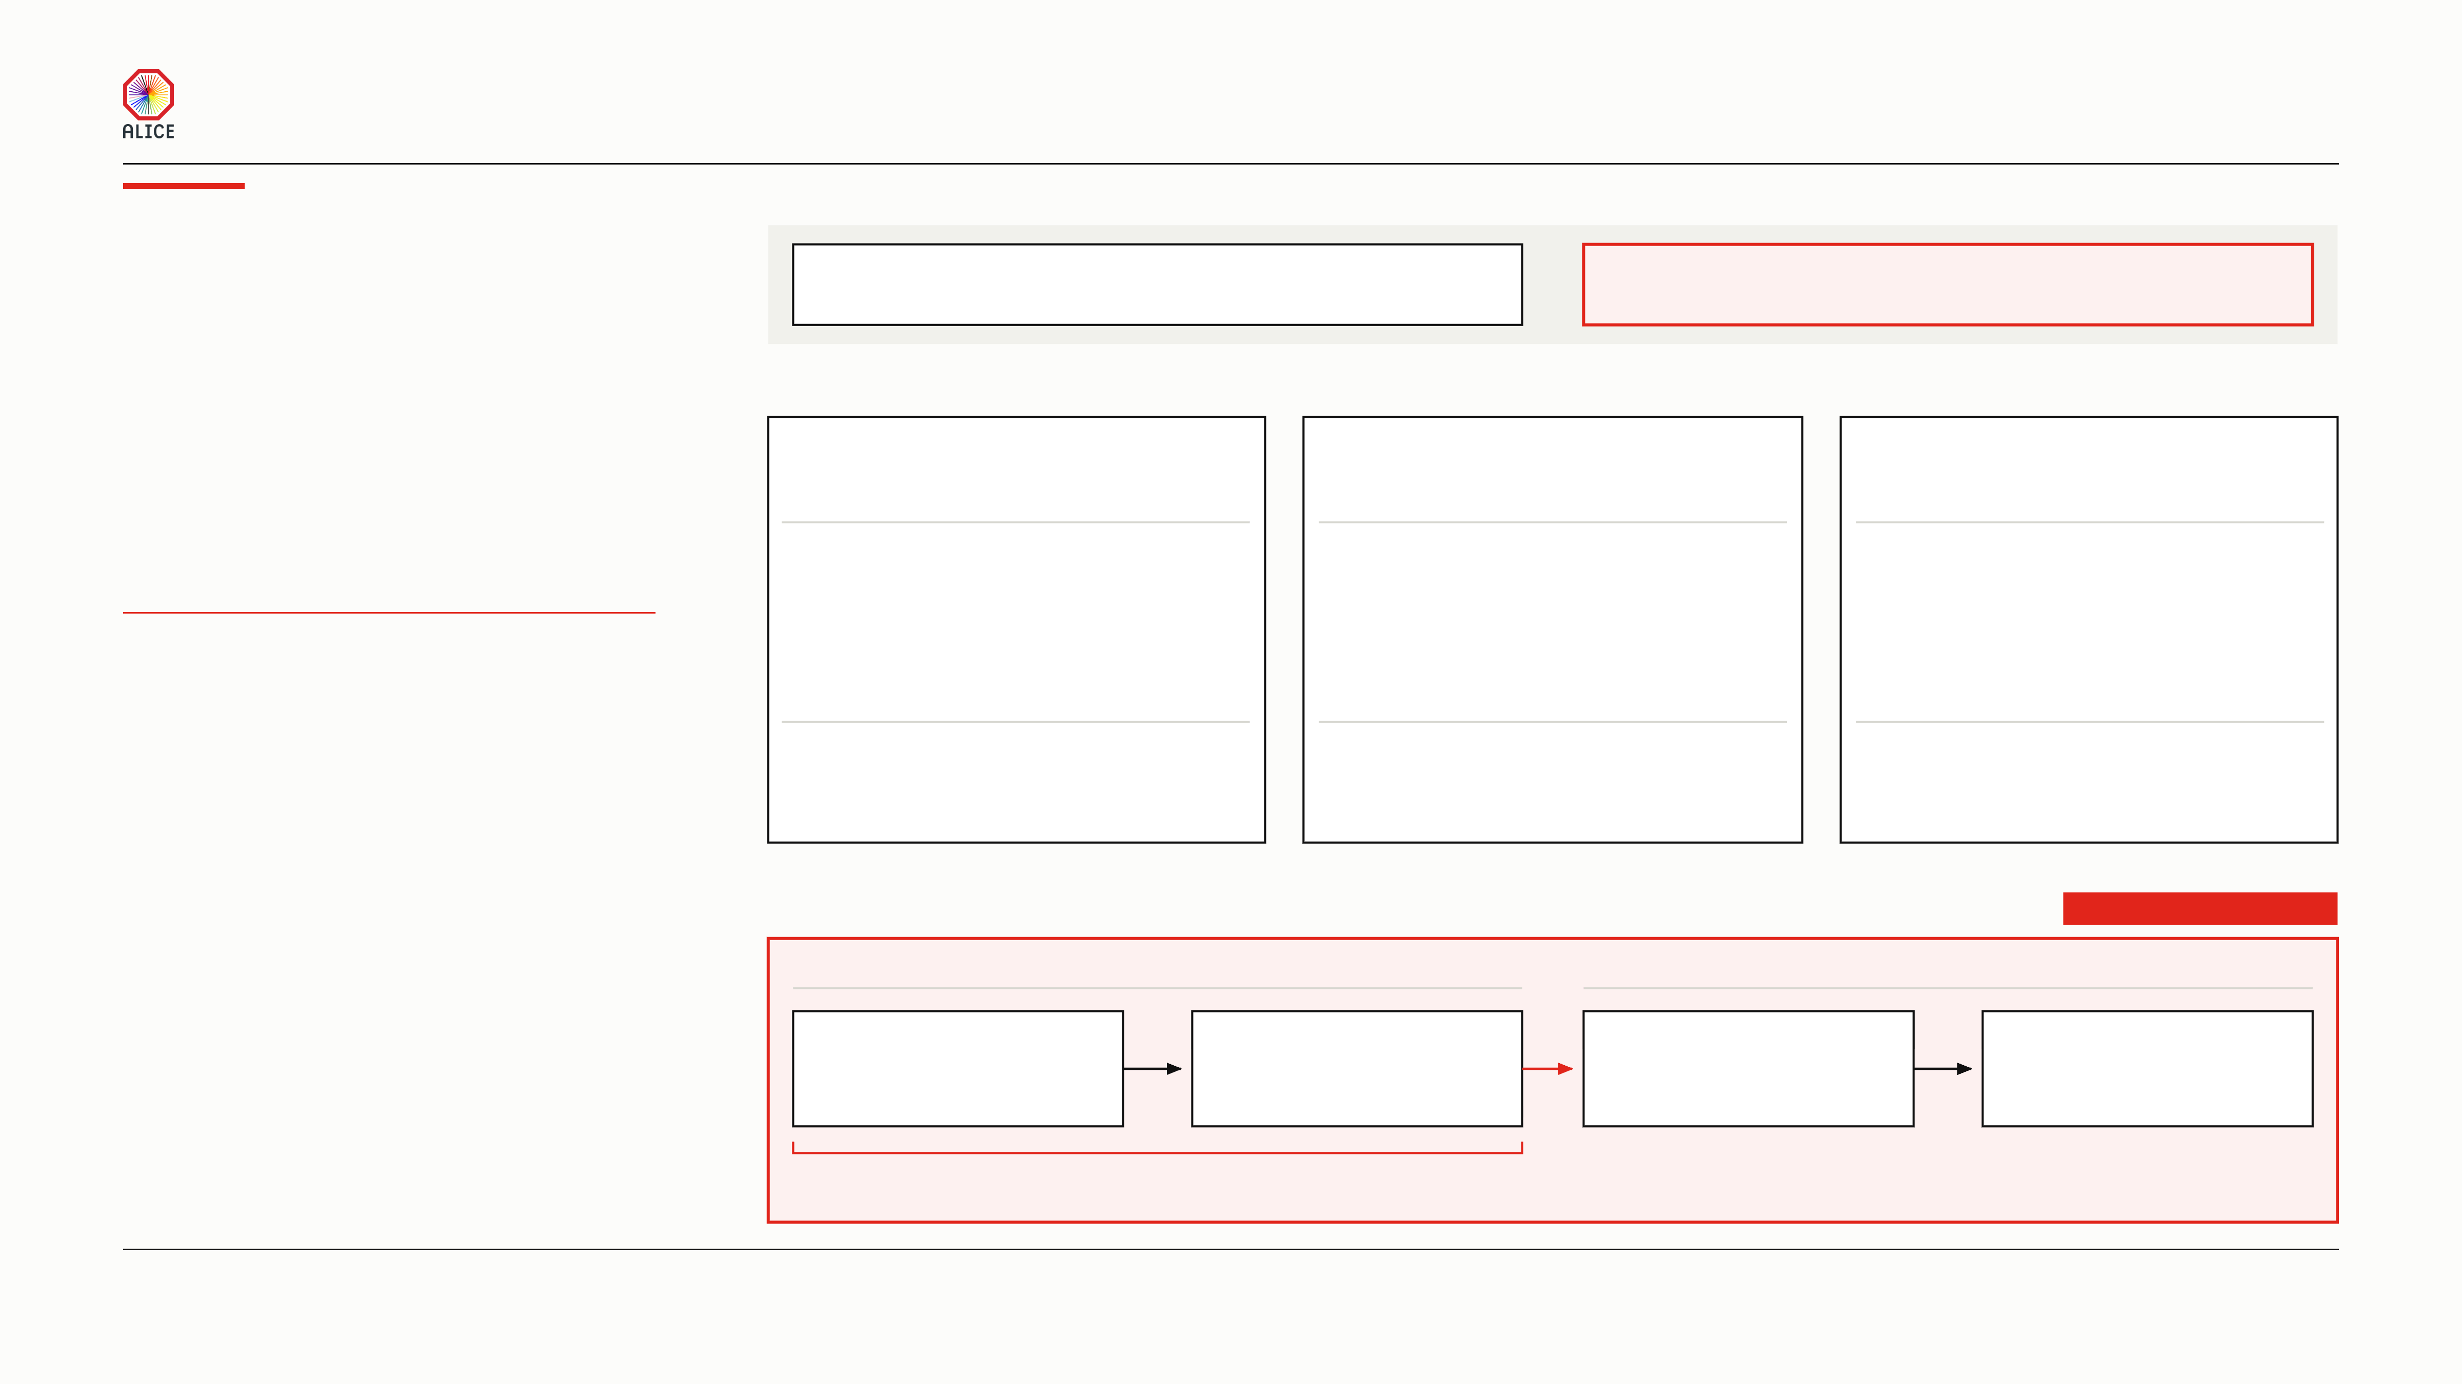
MODERN LOGGING PLATFORM WITH MACHINE LEARNING FOR HPC
Log anomaly
01
WHAT IS WATCHED TODAY
One of the project’s next focuses.
detection
Numbers about the logs
The log text itself
counts, error rates, lag — built and running
the words in the line — nothing reads them
02
THREE WAYS TO READ THE TEXT
None is chosen. All three are open.
Everything we run today watches numbers about
TEMPLATING ALONE
k-NN ALONE
TEMPLATES, THEN k-NN
the logs. It counts lines, errors and lag. Nothing
Collapse a line to its skeleton
Nearest-neighbour distance on lines
The two ideas, fused
yet reads the words in the line. That work is next,
and the method is not chosen.
Processing timeslice:41
k-NN: k nearest neighbours.
Templates, then distance.
Processing timeslice:<N>
Distance is the score.
A few thousand vectors.
Millions of lines become
Turn each line into a vector.
Extract the skeletons first.
NOTHING HERE IS BUILT
a few thousand templates.
Score a new line by how far
Then run the distance test
THREE WAYS, NONE CHOSEN
A template never seen
it is from the nearest line
on the templates, and
before is a free signal.
already seen.
not on the lines.
PUSH UP, SCORE IN STORAGE
TRADE-OFF
TRADE-OFF
TRADE-OFF
The signal runs out. Software prints
Rejected on cost. Every line runs
It fixes the cost. It inherits some of
only the messages in its source. Once
through a model at ingest. Millions of
the saturation. Our own document
every template is seen, it stops firing.
vectors sit in memory already rationed.
names this one as still open.
03
THE PROPOSED PIPELINE
COMING SOON
ON THE WORKER
IN THE STORAGE TIER
Extract the template
Count each template
push
The template vocabulary
The scoring
no model, string work
one counter per template
every template seen so far
one of the three ways above
cheap on the worker
one small table
held once, not per worker
on the storage tier only
Some work here, but not much
The worker pushes its template counts upward,
and any template it has never seen before.
Nothing polls the worker. No model runs on it.
ALICE COLLABORATION BOARD
13 / 16

Slide 14
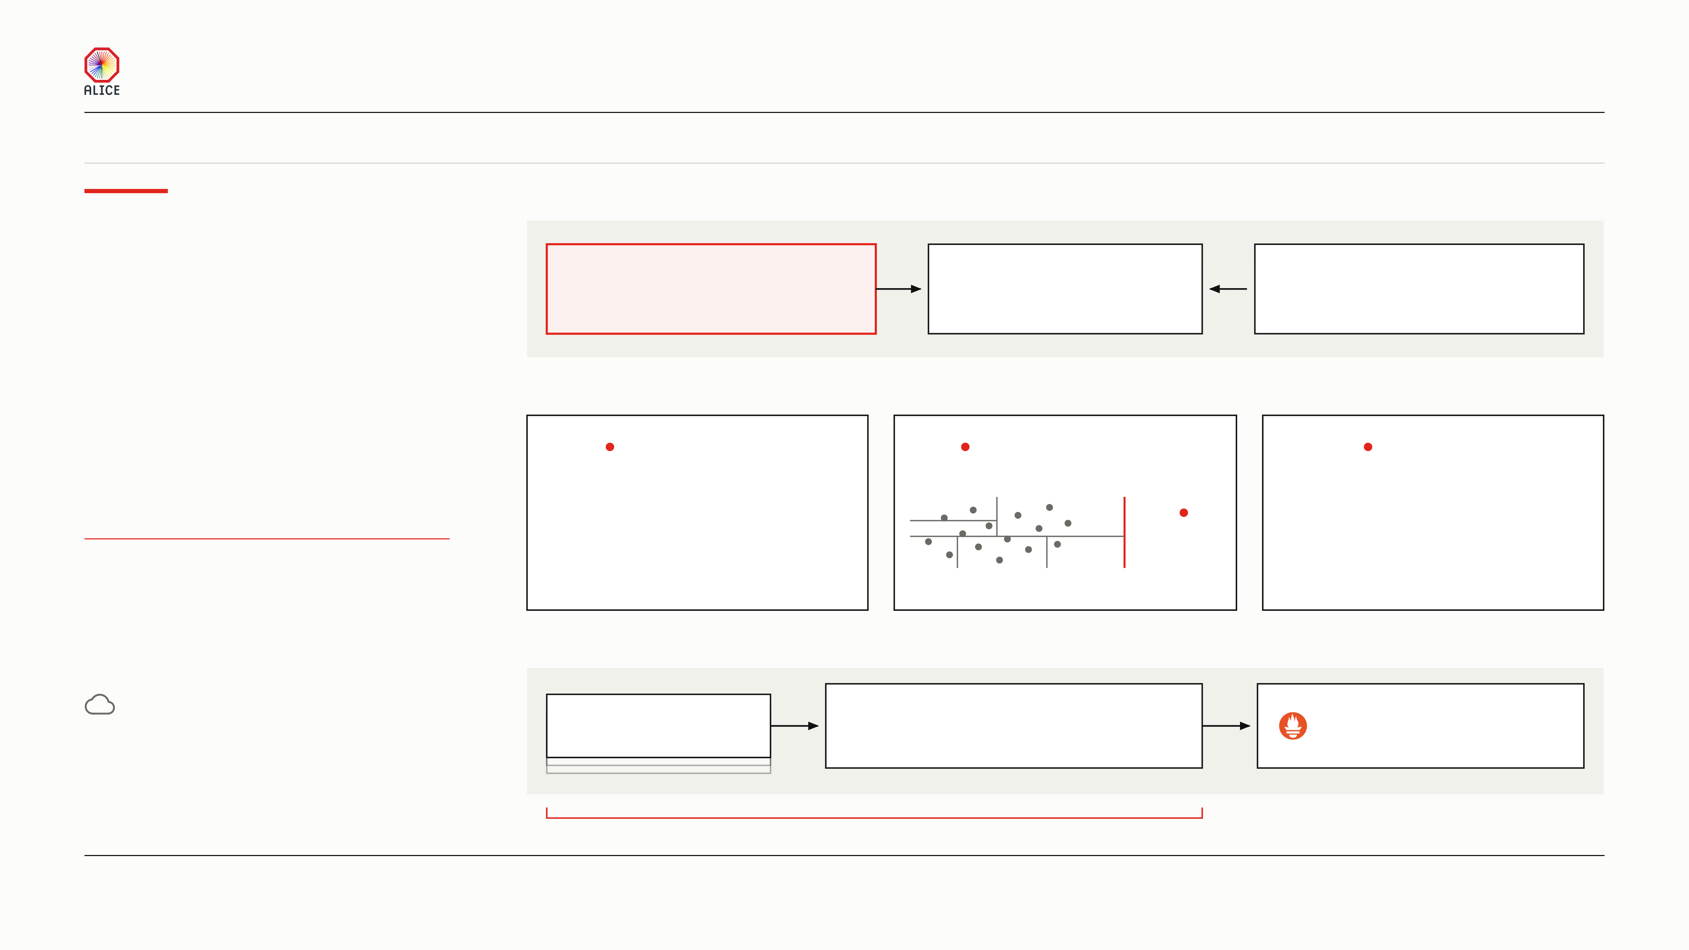
MODERN LOGGING PLATFORM WITH MACHINE LEARNING FOR HPC
SCOPE
This lane watches the numbers about the logs: counts, error rates and lag. It does not read the log text. The log text has its own lane, on the page before.
Anomaly
01
WHERE THE NUMBERS COME FROM
Nothing reaches into a worker to scrape it.
detection
Every worker
push
The numbers
poll
One poller
on metrics
pushes its own counters
one row per machine
asks the cluster and the dashboard
records in, out, retried, dropped
every thirty seconds
and who has gone quiet
02
THREE LANES READ THOSE NUMBERS
28 saved rules and 17 detectors, all inside the cluster.
Every worker pushes its own numbers up, and
nothing goes out to ask. Three lanes read those
THRESHOLD RULES
RANDOM CUT FOREST
TREND RULES
numbers. Many hits about one machine fold into
The cliffs we already know
How surprising is this minute?
Slow drift, over days
one alert.
a disk over 92 percent full,
what the forest would
a collector silent two minutes
one cut
otherwise learn as normal
WORKERS PUSH, NOTHING SCRAPES
A plain rule.
Random Cut Forest, one model
A frozen seven-day baseline.
THREE LANES, ONE SET OF NUMBERS
Nothing is trained.
per machine. No threshold.
Nine rules, every ten minutes.
ONE MACHINE, ONE ALERT
03
FROM HITS TO ONE ALERT
Feature engineering was the work.
Many hits
One episode
Alertmanager
The detectors, the forest and the alerting all ship
the same rule, again
one machine, one trouble
decides when a person is told
with OpenSearch. Choosing what to measure
opened at the first hit, closed when quiet
and how often it repeats
did not.
One broken machine is one alert, however many times the rule fires
ALICE COLLABORATION BOARD
14 / 16

Slide 15
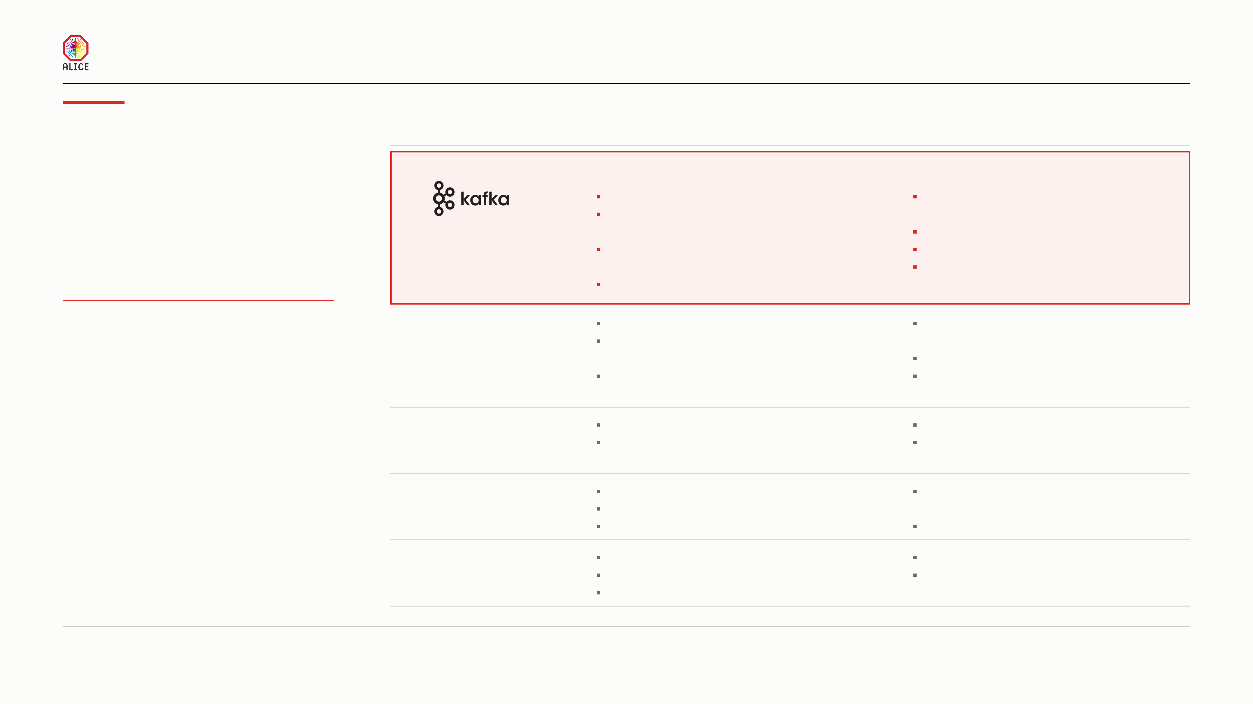
MODERN LOGGING PLATFORM WITH MACHINE LEARNING FOR HPC
Coming
NOT BUILT YET
In the order we would build them. Each line names what holds it, and what it costs.
soon
ITEM
WHAT IT WOULD DO
WHY IT WAITS, AND WHAT IT COSTS
01
A durable queue between collector and store
NEXT
Three brokers, on the three storage machines
Nothing needs it yet: two readers today, served
Five things are missing. Each one has a reason
KRaft: Kafka keeps its own cluster state, with no
by two collector outputs
for waiting and a price we can name. They are
for durability
separate coordination service beside it
A third reader is the trigger
listed in the order we would build them.
It decouples a slow reader from a fast writer
Costs three brokers and a second system to run
Fluent Bit writes fast, OpenSearch reads at its own pace
Memory these five machines do not have
A slow or dead store then stops costing records
KAFKA WAITS FOR A THIRD READER
02
More log
Today: DDS, stdout, InfoLogger, collector health
The archive we replay holds neither source,
SYSTEM LOGS NEED A REAL MACHINE
types
Missing: the machine’s system journal, and the ten
so this one needs a real machine
THE SHIFTER’S VIEW NEEDS EPN ACCESS
per-device process logs that slide 3 names
The parsers need real message shapes to test
Then parse numbers out of the message body:
Costs one input and one parser per machine
timeframe processing time, frame size, tracks
03
Anomaly detection
Today we watch numbers about the logs, not the text
The choice between the routes is not made
on the log text
Slide 13 gives that gap a full page, with the three
Nothing here is built
routes we are choosing between
04
The shifter’s
The cockpit says whether the pipeline is healthy
It needs access to the EPN machines: we must
own view
A shifter asks what the experiment is saying now
read the running interface first
A second view, close to the InfoLogger one
No data work; the fields are already mapped
05
Authentication
One password guards the web page
Fine on five machines we own, not on the farm
inside the cluster
Behind it, no port asks who you are
Costs a certificate on every machine, an account
A firewall rule is the whole boundary
for every job, and authentication on every call
ALICE COLLABORATION BOARD
15 / 16

Slide 16
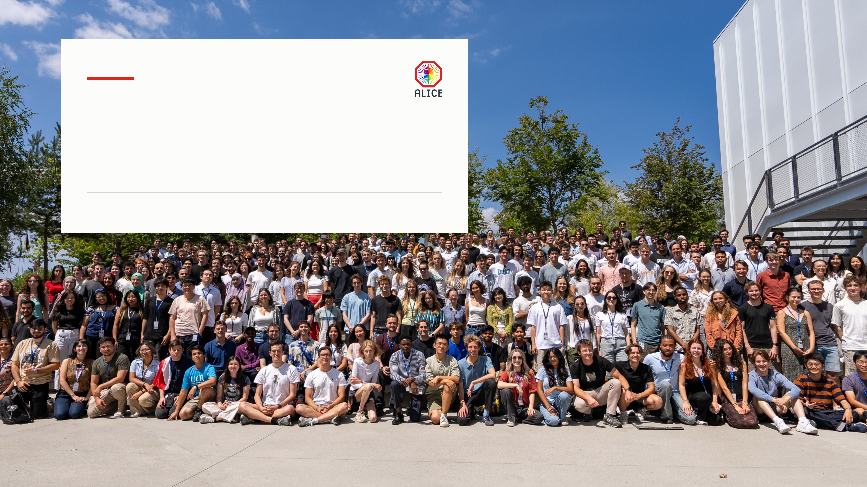
Thank you
for your attention
MODERN LOGGING PLATFORM WITH MACHINE LEARNING FOR HPC
MARKO SLADOJEVIC · CERN SUMMER STUDENT 2026
PHOTO — CERN, SUMMER STUDENTS 2026
16 / 16

